Slide 1

Templates Advanced
template inheritance, template and custom filters
SoftUni Team
Technical Trainers
Software University
https://softuni.org

Slide 2
Table of Contents
Template Inheritance
blocks
extends
Template Filters
built-in filters
custom filters
Template Tags
built-in tags
custom tags
2
Notes:
2

Slide 3
Have a Question?
sli.do
#python-web
Notes:
3

Slide 4

Template Inheritance
block, endblock, extends

Slide 5
Template Inheritance
Template inheritance allows us to build a base skeleton template
The base template contains all the common elements and defines blocks that child templates can override
Typically header, footer etc. remain the same in the whole app
Using template inheritance, we can reuse the common parts of our app

Slide 6
Example: Template Inheritance
base.html
<!DOCTYPE html>
<html lang="en">
<head>
<link rel="stylesheet" href="style.css">
<title>My amazing site</title>
</head>
<body>
{% block content%}
{% endblock %}
</body>
</html>
blogs.html
{% extends "base.html" %}
{% block content %}
{% for entry in blog_entries %}
<h2>{{ entry.title }}</h2>
<p>{{ entry.body }}</p>
{% endfor %}
{% endblock %}

Slide 7
Using include in templates
We can also use the include tag to include an existing template
blogs.html
{% extends "base.html" %}
{% block content %}
{% for entry in blog_entries %}
{% include "blog_header.html" %}
<h2>{{ entry.title }}</h2>
<p>{{ entry.body }}</p>
{% endfor %}
{% endblock %}

Slide 8

Demo
Live Template Inheritance Example

Slide 9

Built-in Filters

Slide 10
What is a Template Filter?
Filters allow us to modify variables before displaying them in the browser
For example {{ name|lower }} displays the value of name variable after being filtered through the lower filter
We use a pipe "|" to apply a filter

Slide 11

Chained Filters
Filters can also be "chained"
The output of one filter is applied to the next
Escaping text contents and converting line breaks to <p>
{{ text|escape|linebreaks }}

Slide 12

Filters with Arguments
Some filters require arguments
We use colon ":" to mark arguments
Will display the first 30 chars of the description variable
{{ description|truncatewords:30 }}

Slide 13
Some Built-in Filters
{{ my_date|date:"Y-m-d" }}
# formats date according to format
{{ value|default:"empty" }}
# uses the given default if a value is False
{{ value|join:", " }}
# joins a list with a string (like str.join(list) in python)
{{ value|length }}
# returns the length of the value
More built-in filters: https://docs.djangoproject.com/en/3.0/ref/templates/builtins/

Slide 14
Demo
Live Built-in Filters Example

Slide 15

Custom Filters

Slide 16
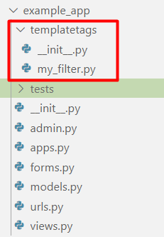
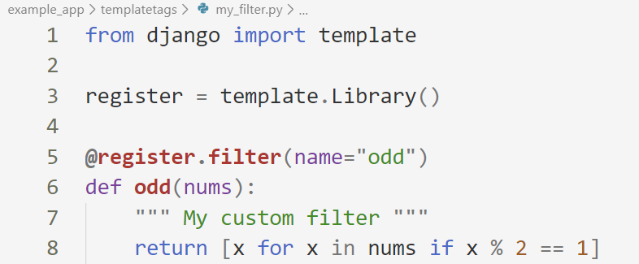
Create templatestags Folder
In your application create a templatestag module with your custom filter file
Write your own filter function

Slide 17
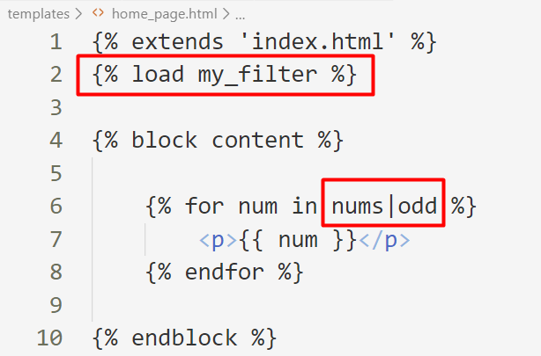
Use Your Custom Filter
Load the filter in your template and use it
Use the name of your file

Slide 18
Template Tags
{% my_tag %}

Slide 19
What is a Template Tag?
A template tag is a function which accepts one or more arguments, processes those values and returns a value to be displayed
We already know some of the built-in template tags
for
if/else
{% if user %}
<h1> Welcome User! </h1>
{% else %}
<h1> Please, login! </h1>
{% endif %}

Slide 20
Template Tags Helper Functions
Django provides us with helper functions that allow us to create our custom template tags
simple_tag - processes the data and returns a string
inclusion_tag - processes the data and returns a rendered template
assignment_tag - processes the data and sets a variable in the context

Slide 21
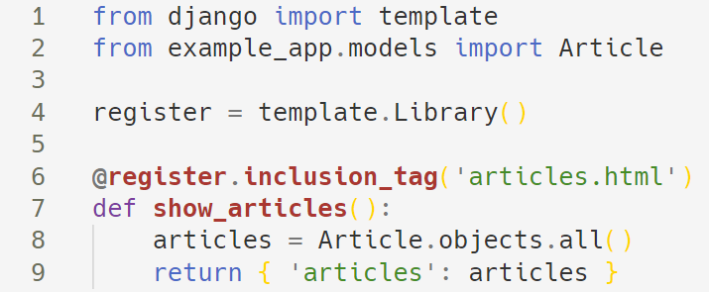
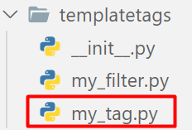
Creating Custom Template Tags
To create a custom template tag, we need again create a templatetags package
Here is an example of an inclusion custom tag

Slide 22
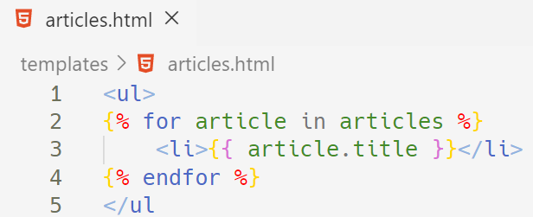
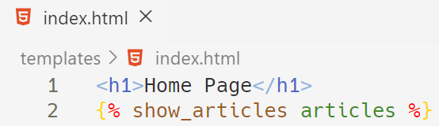
Using the Template Tag
Create the 'article.html' template and make a loop through the articles
After that, use your tag in your main template

Slide 23
Demo
Live Custom Filters and Tags Example

Slide 24

Summary
Template inheritance allows us to build a base skeleton template
Using template inheritance, we can reuse the common parts of our app
Filters allow us to modify variables before displaying them in the browser
Notes:
24

Slide 25
Questions?
Notes:
25

Slide 26












SoftUni Diamond Partners
Notes:
26

Slide 27




SoftUni Organizational Partners
Notes:
27

Slide 28

License
This course (slides, examples, demos, exercises, homework, documents, videos and other assets) is copyrighted content
Unauthorized copy, reproduction or use is illegal
© SoftUni – https://softuni.org
© Software University – https://softuni.bg
Notes:
28

Slide 29
Trainings @ Software University (SoftUni)
Software University – High-Quality Education, Profession and Job for Software Developers
softuni.bg, softuni.org
Software University Foundation
softuni.foundation
Software University @ Facebook
facebook.com/SoftwareUniversity
Software University Forums
forum.softuni.bg
Notes:
29

