Slide 1
Ch 7. Isolation Concepts
Jongbaeg Lee
hundredbag@gmail.com

Slide 2
Overview

Slide 3
Introduction of Isolation
Invariants
The system state consists of objects related in certain ways
ex) ''The checksum field of each page, P, must be CHECKSUM(P).“
"For each element, x, in a doubly linked ring, prev(next(x))= x“
"Account balances must be positive.“
Consistency
The system state is consistent if it satisfies all these invariants

Slide 4
Introduction of Isolation
First Law of Concurrency Control
Concurrent execution should not cause application programs to malfunction.
Each TX looks like running in isolation
Second Law of Concurrency Control
Concurrent execution should not have lower throughput or much higher response times than serial execution.
The second law favors simple algorithm
Transaction systems provide automatic locking and locking algorithm

Slide 5

The Dependency Model of Isolation
The simplest way to understand isolation results
A transaction is a sequence of read and write actions on objects
Only write-related interactions between two concurrent transactions can create inconsistency
No concurrency anomalies when
( O_{i} : a set of objects written by T_{i}
I_{i} : a set of objects read by T_{i})

Slide 6
Static vs. Dynamic Allocation
Static allocation
Each TX declare its Input-Output set
TX scheduler do computation to find conflicts
However, it is difficult to compute the inputs and outputs of a TX before it runs
Dynamic allocation
Each TX is viewed as a sequence of actions
Objects are dynamically allocated to the TX

Slide 7
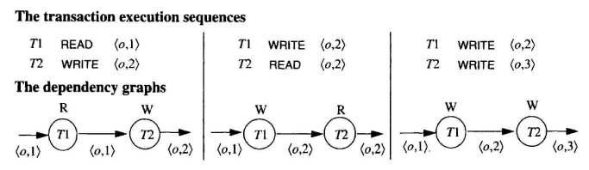
Transaction Dependencies
In dynamic allocation model, TXs are sequences of actions
Read action
Write action
Objects go through a sequence of versions
Each time an object is written, it gets a new version
Three possible execution sequences by two TXs

Slide 8
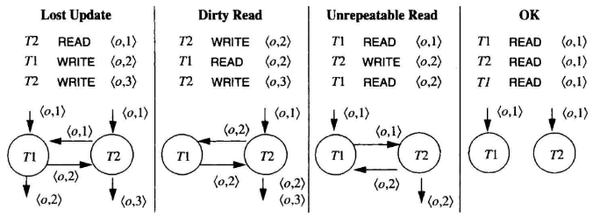
Three Bad Dependencies
Lost Update
READ → WRITE →WRITE
One of updates will be lost
Dirty Read
T1 reads an uncommitted data of an object written by T2
Unrepeatable Read
T1 read an object twice. Once before T2 updates and once after T2 updates.
The two read operations return different values

Slide 9
Isolation: The Application Programmer's View
Isolation: user’s definition 1
transactions may run in parallel, but it behaves as if it has run transactions in sequence.
Isolation: user’s definition 2
0. T does not overwrite dirty data of other transactions.
1. T's writes are neither read nor written by other transactions until COMMIT WORK.
2. T does not read dirty data from other transactions
3. Other transactions do not write (dirty) any data read by T before T completes.

Slide 10
Isolation Theorems
More formal presentation of isolation theorems are needed
Used notations
Sequences of elements : S = <a, b, c>
Concatenation : S || S`
ith element of S : S[i]
A subsequence S` of sequence S : S`= <S[i] | predicate (S[i])>

Slide 11
Actions and Transactions
The system supported actions
READ
WRITE
XLOCK
SLOCK
UNLOCK
Generic actions
BEGIN
COMMIT
ROLLBACK

Slide 12
Actions and Transactions
Transactions are represented by a sequence
<<T, Ai, Oi> | i = 1, ..., n>
ith step of transaction T performed action Ai on object Oi
Simple TX is composed of READ, WRITE, XLOCK, SLOCK, UNLOCK
(1) Discard the BEGIN action.
(2) Replace COMMIT to the following sequence of UNLOCKS: <UNLOCK A I if SLOCK A or XLOCK A appears in T for any object A>
(3) Replace ROLLBACK to the following sequence of UNLOCKS:
<WRITE A I if WRITE A appears in T for any object A> ||
<UNLOCK A I if SLOCK A or XLOCK A Appears in T for any object A>

Slide 13
Well-Formed and Two-Phased Transactions
Well-Formed Transaction
All its READ, WRITE, and UNLOCK actions are covered by locks
Two-Phase Transaction
All its LOCK actions precede all its UNLOCK actions

Slide 14
Transaction Histories
History for the set of transactions {Tj} is a sequence, each containing transaction Tj as a subsequence and containing nothing else.

