Slide 1
Ch 7. Isolation Concepts
Jongbaeg Lee
hundredbag@gmail.com

Slide 2
Overview
Introduction of Isolation
The Dependency Model of Isolation
Isolation Theorems
Degrees of Isolation
Phantoms and Predicate Locks
Granular Locks
Locking Heuristics
Scheduling and Deadlock
Exotics

Slide 3
Introduction of Isolation
Invariants
The system state consists of objects related in certain ways
ex) ''The checksum field of each page, P, must be CHECKSUM(P).“
"For each element, x, in a doubly linked ring, prev(next(x))= x“
"Account balances must be positive.“
Consistency
The system state is consistent if it satisfies all these invariants

Slide 4
Introduction of Isolation
First Law of Concurrency Control
Concurrent execution should not cause application programs to malfunction.
Each TX looks like running in isolation
Second Law of Concurrency Control
Concurrent execution should not have lower throughput or much higher response times than serial execution.
The second law favors simple algorithm
Contribution of Transaction systems
Automatic locking and locking algorithm with undo/redo

Slide 5

The Dependency Model of Isolation
The simplest way to understand isolation results
A transaction is a sequence of read and write actions on objects
Only write-related interactions between two concurrent transactions can create inconsistency
No concurrency anomalies when
( O_{i} : a set of objects written by T_{i}
I_{i} : a set of objects read by T_{i})

Slide 6
Static vs. Dynamic Allocation
Static allocation
Each TX declare its Input-Output set
TX scheduler do computation to find conflicts
However, it is difficult to compute the inputs and outputs of a TX before it runs
Dynamic allocation
Each TX is viewed as a sequence of actions
Objects are dynamically allocated to the TX

Slide 7
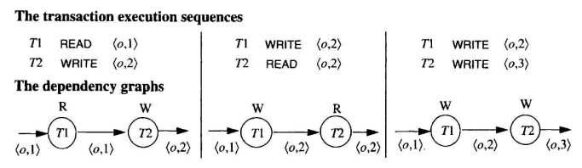
Transaction Dependencies
In dynamic allocation model, TXs are sequences of actions
Read action
Write action
Objects go through a sequence of versions
Each time an object is written, it gets a new version
Three possible execution sequences by two TXs

Slide 8
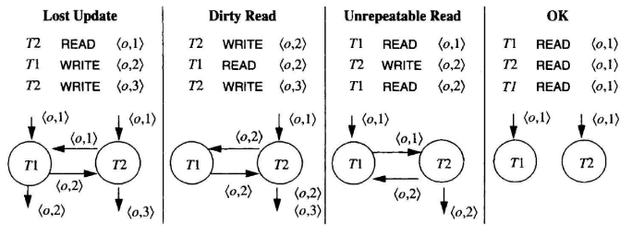
Three Bad Dependencies
Lost Update
READ → WRITE →WRITE
One of updates will be lost
Dirty Read
T1 reads an uncommitted data of an object written by T2
Unrepeatable Read
T1 read an object twice. Once before T2 updates and once after T2 updates.
The two read operations return different values

Slide 9
Isolation: The Application Programmer's View
Isolation: user’s definition 1
transactions may run in parallel, but it behaves as if it has run transactions in sequence.
Isolation: user’s definition 2
T does not overwrite dirty data of other transactions.
T's writes are neither read nor written by other transactions until COMMIT WORK.
T does not read dirty data from other transactions
Other transactions do not write (dirty) any data read by T before T completes.

Slide 10
Isolation Theorems
More formal presentation of isolation theorems are needed
Used notations
Sequences of elements : S = <a, b, c>
Concatenation : S || S`
ith element of S : S[i]
A subsequence S` of sequence S : S`= <S[i] | predicate (S[i])>

Slide 11
Actions and Transactions
The system supported actions on the objects
READ
WRITE
XLOCK
SLOCK
UNLOCK
Generic actions
BEGIN
COMMIT
ROLLBACK

Slide 12
Actions and Transactions
Transactions are represented by a sequence
<<T, Ai, Oi> | i = 1, ..., n>
ith step of transaction T performed action Ai on object Oi
Simple TX is composed of READ, WRITE, XLOCK, SLOCK, UNLOCK
(1) Discard the BEGIN action.
(2) Replace COMMIT to the following sequence of UNLOCKS: <UNLOCK A I if SLOCK A or XLOCK A appears in T for any object A>
(3) Replace ROLLBACK to the following sequence of UNLOCKS:
<WRITE A I if WRITE A appears in T for any object A> ||
<UNLOCK A I if SLOCK A or XLOCK A Appears in T for any object A>

Slide 13
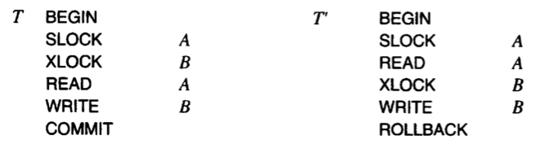
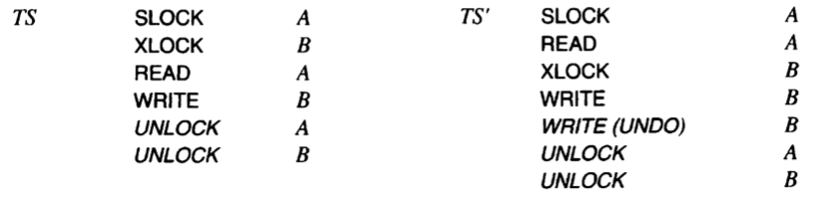
Actions and Transactions
Example

Slide 14
Well-Formed and Two-Phased Transactions
Well-Formed Transaction
All its READ, WRITE, and UNLOCK actions are covered by locks
Two-Phase Transaction
All its LOCK actions precede all its UNLOCK actions

Slide 15
Transaction Histories
History
Actions of a set of TXs merged into a single sequence
Serial history : One-TX-at-a-time history

Slide 16
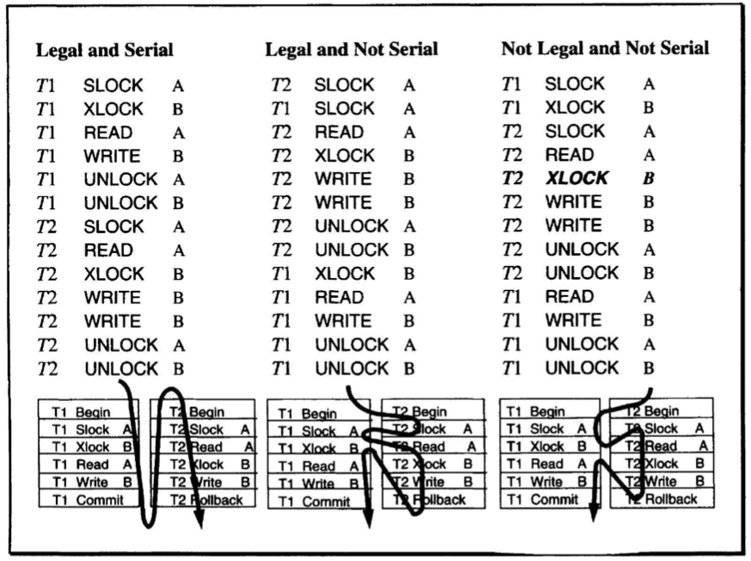
Legal Histories and Lock Compatibility
Legal History
History that obey the locking constraints

Slide 17
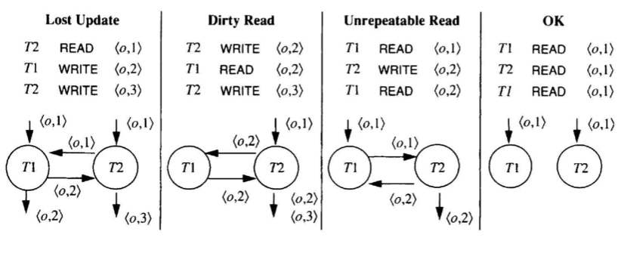
Versions, Dependencies, and Dependency Graph
T1 depends on T2
If T1 reads or writes data previously written by T2 in the history
or T1 writes an object previously read by T2
Two history have the same dependencies → Equivalent
Dependency Graph

Slide 18
Equivalent and Isolated Histories
Equivalent Histories
Two TXs have the same dependency relation ( DEP(H) = DEP(H’) )
Isolated History
A history is equivalent to a serial history

Slide 19
Wormholes
Wormhole transaction
BEFORE(T) : a set of TXs that run before T
AFTER(T) : a set of TXs that run after T
T’ ∈ BEFORE(T) ∩ AFTER(T)
Wormholes are not Isolated
Serial histories don't have wormholes
That is, isolated histories have no wormholes

Slide 20
Proof
Skip …

Slide 21
Degree of Isolation
Degree of Isolation
Degree 0 (anarchy)
No overwrite another TX’s dirty data
Well-formed writes
Degree 1 (browse)
No lost updates
Two-phase exclusive locks, Well-formed writes
Degree 2 (cursor stability)
No lost updates & No dirty reads
Two-phase exclusive locks, Well-formed
Degree 3 (isolated, serializable, or repeatable reads)
No lost updates and repeatable reads
Two-phase, Well-formed

Slide 22
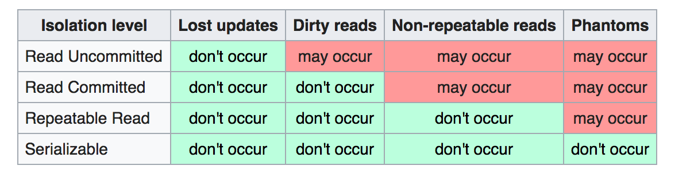
SQL and Degrees of Isolation
Four isolation levels
READ UNCOMMITTED
READ COMMITTED
REPEATABLE READ
SERIALIZABLE

Slide 23
Read through, read past, notify

Slide 24
Phantoms and Predicate Locks
Phantom records
Records that either appear or disappear from sets
No pure record-locking solution for phantoms
Predicate Locks
Solution for phantoms
Lock request specify a subset of the database
Format : < t, [slock | xlock], predicate >

Slide 25
Phantoms and Predicate Locks
Two Predicate Locks are Compatible if:
T = T` , or
Both modes are SHARE, or
The predicate (P AND P`) is FALSE
Example
< t, slock, emp.eyes = "blue" and emp.hair = "red” >
< t , xlock, emp.eyes = "blue" > : Compatible
< t', slock, emp.eyes = "blue" > : Compatible
< t’, xlock, emp.eyes = "blue" > : Incompatible
System always compares the lock request with the other granted and waiting locks

Slide 26
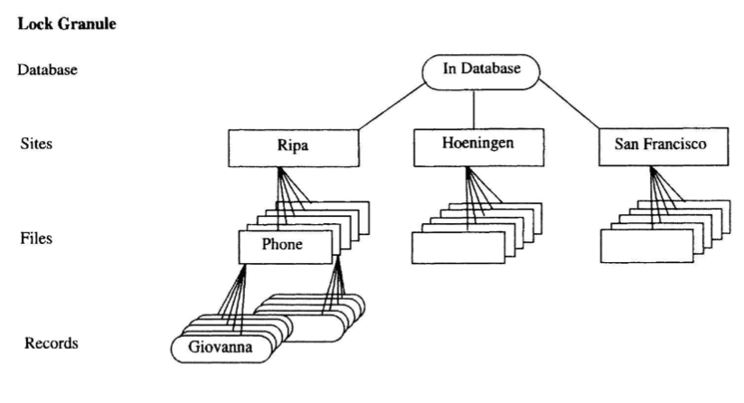
Granular Locks
Granular Locks
Pick a fixed set of predicates (precompute the predicate locks)
Ex)
SITE = "RIPA" AND FILE ="PHONE" AND RECORD ="GIOVANNA"
SITE = "RIPA"

Slide 27
Tree Locking and Intent Lock Modes
Locking a node implicitly locks child nodes with same mode
Intent lock mode
Prevent other TXs from setting coarse granularity on that node
Example
LOCK "IN DATABASE" IN INTENT MODE
LOCK NODE="RIPA" IN INTENT MODE
LOCK FILE= "PHONE" IN INTENT MODE
LOCK NAME = "GIOVANNA" IN SHARED MODE.

Slide 28
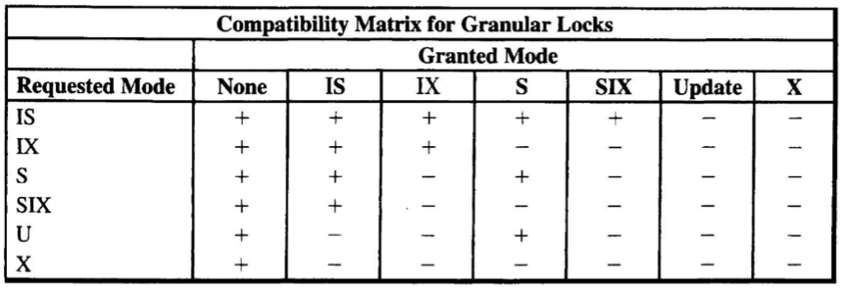
Tree Locking and Intent Lock Modes
Refined intent mode locks
IX : Intent to set shared or exclusive locks at finer granularity.
IS : Intent to set shared locks at finer granularity.
SIX : A coarse-granularity shared lock with intent to set finer-granularity exclusive locks -- essentially the union of S and IX.

Slide 29
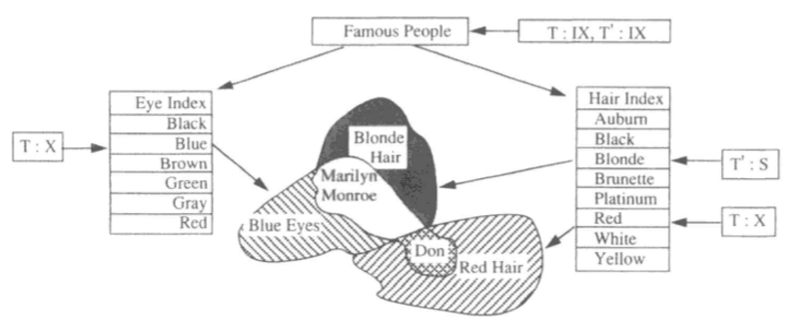
Key-Range Locking
Key-range lock
A lock on the key range ( locking set is logical )
Key-Range Locks Need DAG Locking
Locking on a Tree → Locking on a Directed acyclic graph

Slide 30
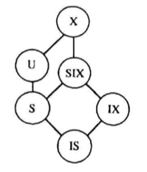
Locking Heuristics
Lock Conversion
Lock Escalation
Convert fine-granularity locks to coarse locks

Slide 31
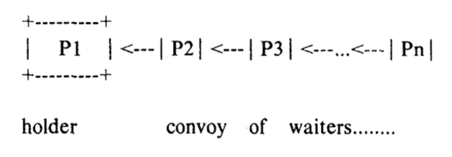
Scheduling and Deadlock
Scheduling
Problem of Convoy
Solution
Do not schedule hotspot locks on a FIFO basis
Spin (busy wait) on a lock for a few hundred instructions
Do not allow processes holding hotspot locks to be preempted

Slide 32
Deadlock
Deadlock Avoidance
Linearly order the resources and acquire them only in that order (deadlock requires a waits-for cycle)
Deadlock Detect
Timeout

Slide 33
Wait-for Graph and Deadlock Detector
Wait-for graph
T is waiting for a resource held by T`, or
T will eventually wait for a resource to be granted to T`
A cycle in the wait-for graph is deadlock
Waiting list and Granted list are used to build wait-for graph
T' is in the granted list or is ahead of T in the wait list, and
modes m and m' are incompatible

Slide 34
Exotics
Field Call
A field call consists of two parts:
A predicate; for example, quantity_on_hand> 100 and
A transform; for example, quantity_on_hand = quantity_on_hand -100
If the predicate is true, the predicate and the transform required are recorded in the redo log. Otherwise, the field call aborts.
The record locked in the shared mode is immediately unlocked;
At commit phase 1, the redo log is examined and the predicate of the transaction is again tested
If the result is false, TX is aborted
Else, shared lock on the predicate record, exclusive lock on the records
After all the transforms are performed, all the locks are immediately released

Slide 35
Optimistic and Timestamp Locking
Optimistic Locking
The predicate is {field = old-value}.
The transform is {field =new-value}.
Timestamp Locking
Add timestamp field that is read as part of the predicate check

