Slide 1
Chapter 4 Transaction Models - Emerging Hardware Trends in Large-Scale Transaction Processing - Transaction Basics and Distributed Transactions
Jongbaeg Lee
hundredbag@gmail.com

Slide 2
Emerging Hardware Trends
OLTP databases for emerging hardware
Non-volatile memory (NVM)
Many-Core CPU Architecture

Slide 3
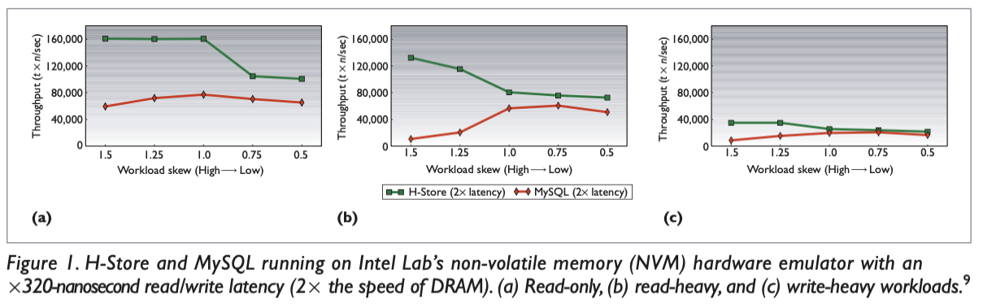
In Case of Non-Volatile Memory
Experiments testing MySQL and H-Store
Use NVM emulator
2 times slower than DRAM
YCSB benchmark with 3 workloads

Slide 4
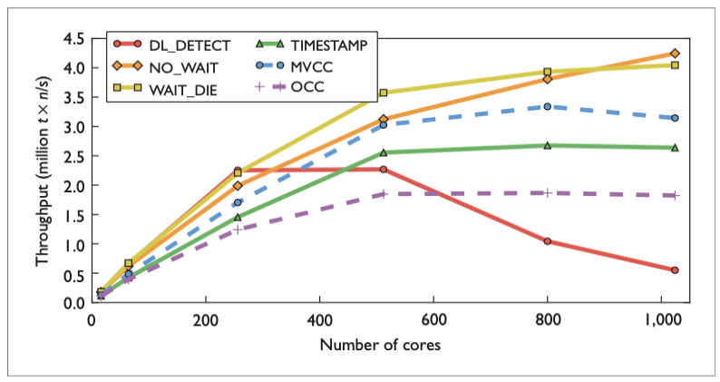
In Case of Multi-Core CPUs
DBx1000 DBMS with CPU simulator
Comparison of the concurrency control schemes

Slide 5
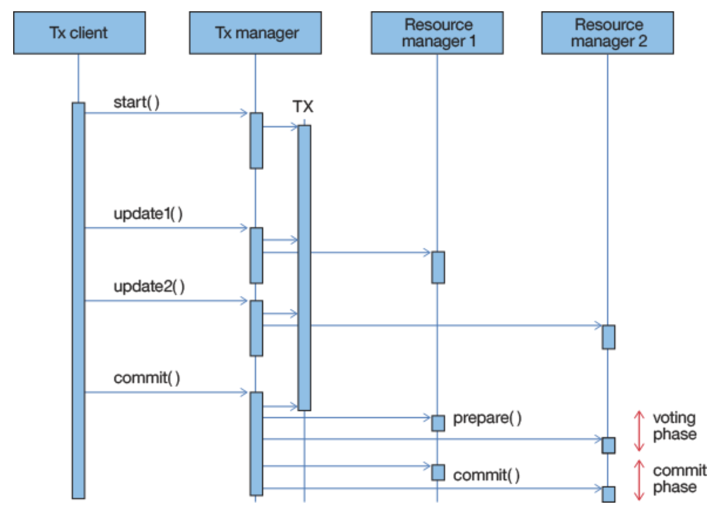
Distributed Transactions in a Cluster
Distributed Transactions with Two-Phase Commit

Slide 6
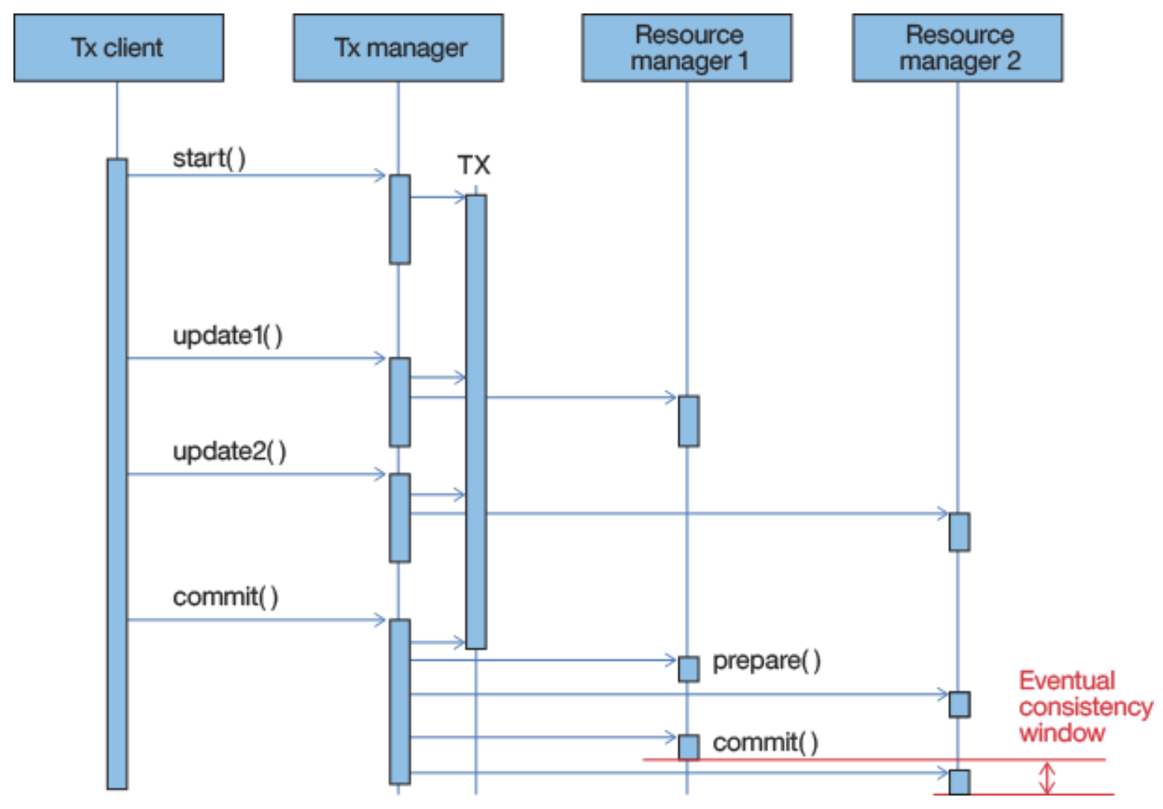
Distributed Transaction in a Cluster
In a real-world example
Window of inconsistency
TX Manager outages

Slide 7
Reference & To-read List
Reference
Pavlo, Andrew. "Emerging hardware trends in large-scale transaction processing." IEEE Internet Computing 19.3 (2015): 68-71.
To-read list
Arulraj, Joy, Andrew Pavlo, and Subramanya R. Dulloor. "Let's talk about storage & recovery methods for non-volatile memory database systems." Proceedings of the 2015 ACM SIGMOD International Conference on Management of Data. 2015.
DeBrabant, Justin, et al. "Anti-caching: A new approach to database management system architecture." Proceedings of the VLDB Endowment 6.14 (2013): 1942-1953.
Yu, Xiangyao, et al. "Staring into the abyss: An evaluation of concurrency control with one thousand cores." (2014).

