Slide 1

Foundations of NLP
Introduction
CS3126
Course Instructor : Nidhi Goyal​

Slide 2

Who am I?
Research interests
NLP, Knowledge Graphs, Graph Neural Networks, Computational Neuroscience, Computer Vision, Brain Computer Interfaces, Generative AI and solving real-world problems
Experience (Research and Teaching)
Applied researcher in NLP, Knowledge Graphs, Graph Neural Networks ~ 6 years [Research scholar -IIIT-Delhi and Naukri.com]
Taught NLP last semester (CS3216/AI5203) at Mahindra University
Former Assistant Professor, GGSIPU, New Delhi
Former Assistant Professor, DCE, Gurgaon
TA for many courses- COA, Privacy and security on Online social media @IIIT, NPTEL, NLP course PGDSAAI@IIIT-Delhi
Nidhi Goyal
(Assistant Professor, Ecole School of Engineering)

Slide 3
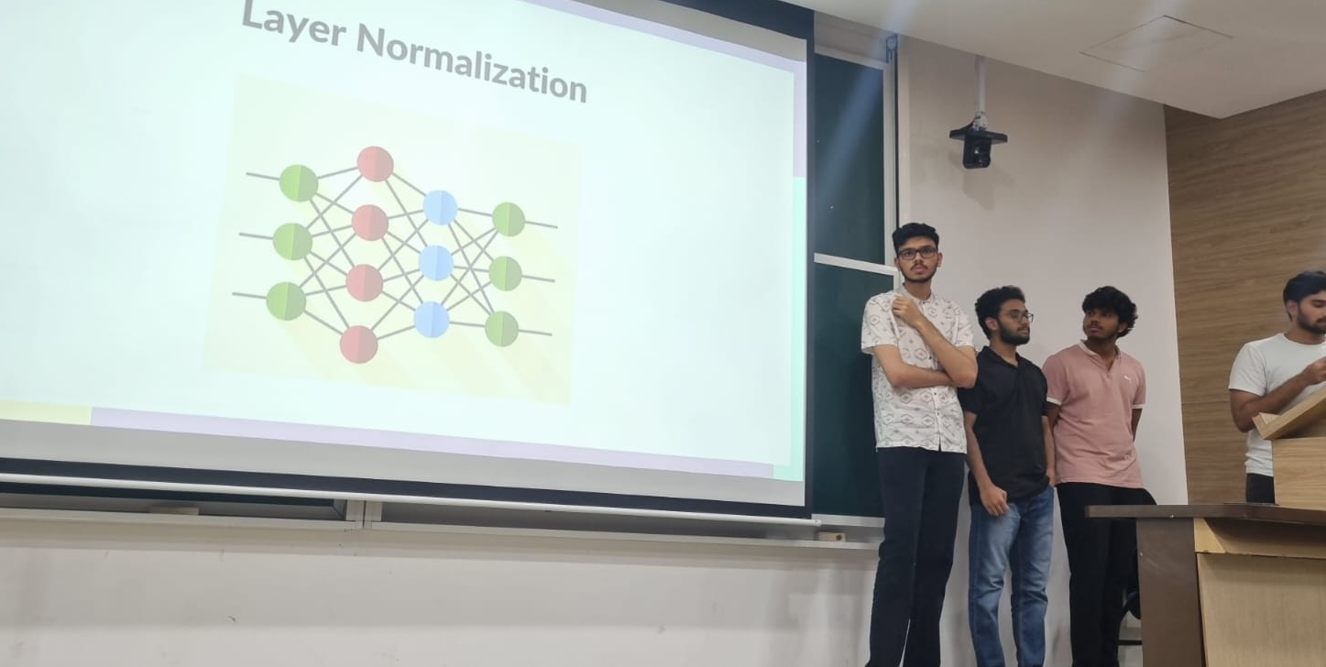
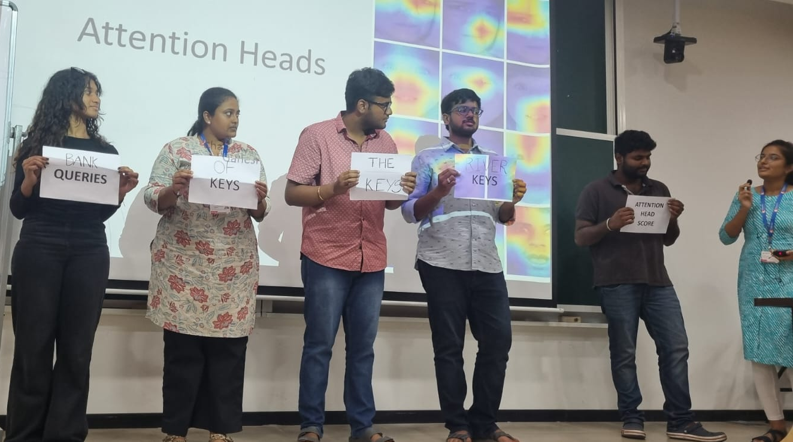
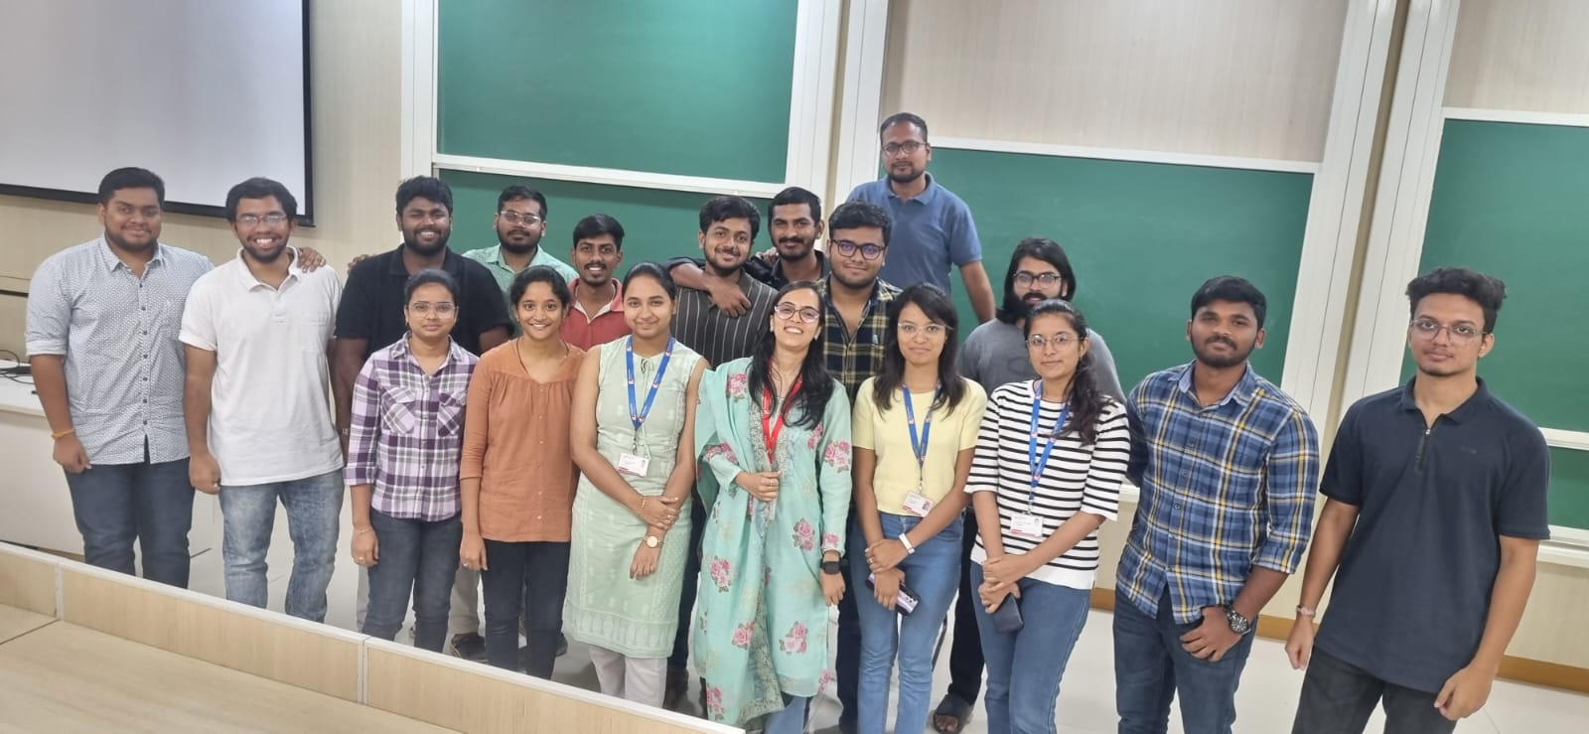
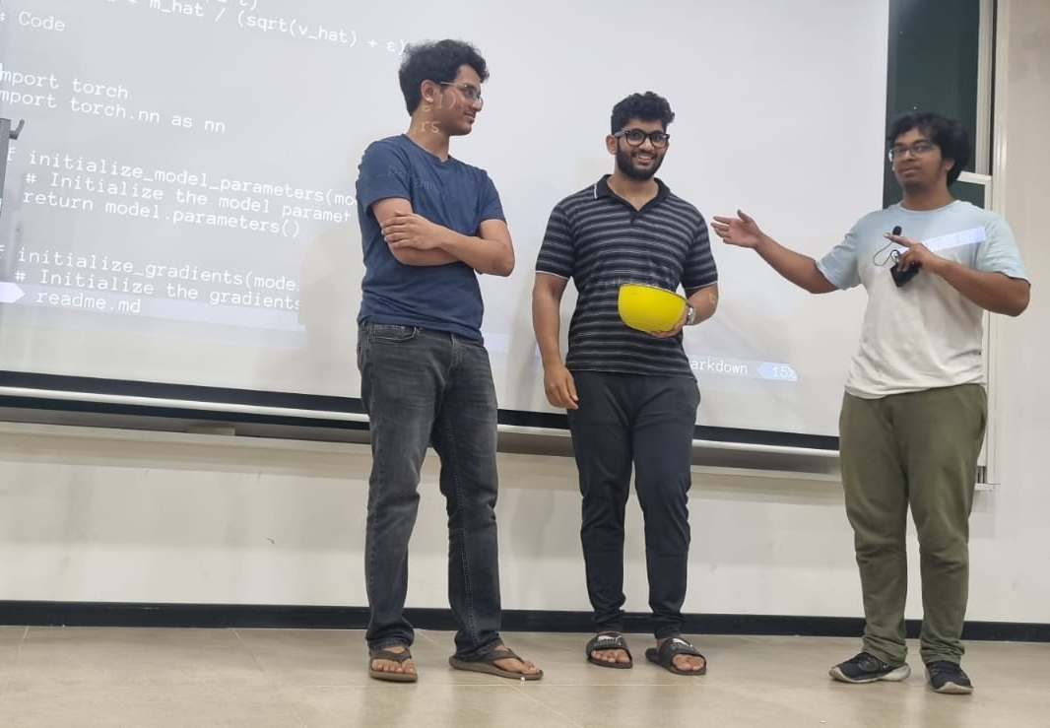
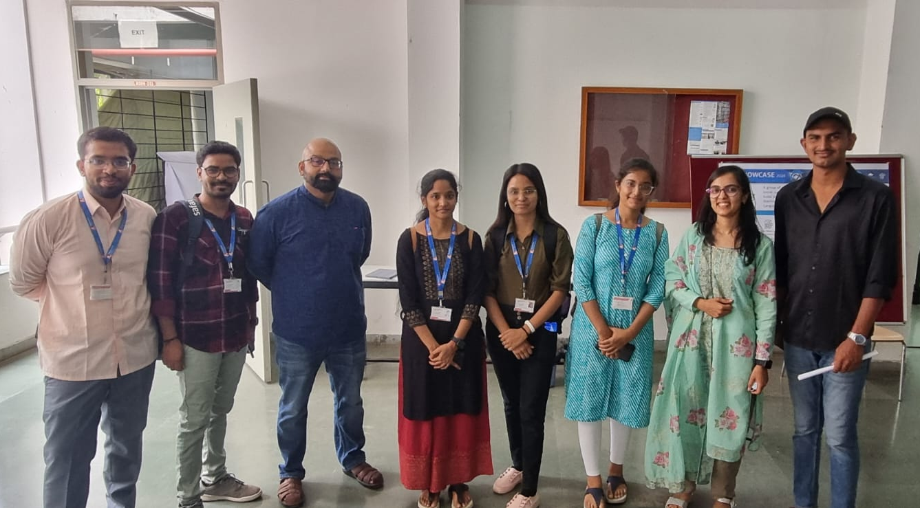
Previous Course Offerings (NLP) /CS3216/AI5203

Slide 4
Lecture Plan
Course Logistics
Course Outcomes
Content/Syllabus
Grading Policy
Why should you learn NLP?
What is Natural Language Processing?
Applications
Resources

Slide 5
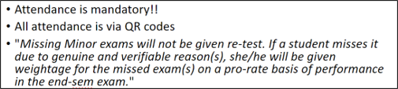
Course Logistics
Lecture Timings: Mondays, Wednesdays & Thursdays- 10:35–11:30 AM
(Strictly adhere to class timings)
Slack, help sessions/office hours (for all course questions/discussion)
Slack for assignments, doubts, course announcements, deadlines, etc.
Office hours start Monday and Wednesday (4:00-5:00 pm), Location- IT2 block, 180-seater lab, my cabin
For any queries: nidhi.goyal@mahindrauniversity.edu.in
Use email judiciously for important/urgent communication
Follow Course page for resources, materials, etc. We’ve put a lot of other important information on the class webpage (Link to be published soon).
Slide PDFs and other resources shall be uploaded before each lecture.

Slide 6
Smooth functioning of Course
Slack for assignments, doubts, course announcements, deadlines, etc.
Create your account on slack with Your Roll number as username.
Get yourself added to below channels by your instructor or TAs
nlp-announcements
Be active to check slack notifications for course related information!!
First communication point for doubts on slack (#doubts channel).
Healthy discussions among peers lead to effective learning.

Slide 7
Course Outcomes
After the successful completion of this course , the students will be able to:
CO1: Understand the fundamental concepts in Natural Language Processing, algorithms, methods, and strategies.
CO2: Analyze and evaluate the strengths and weaknesses of various NLP techniques.
CO3: Apply NLP tools and libraries, gaining hands-on experience with existing natural language processing and machine learning frameworks.
CO4: Implement and adapt cutting-edge frameworks in NLP for practical applications.

Slide 8
Course Content/Syllabus
Module-1: Introduction
Module-2: Syntax, Regular Expressions & Text Normalization
Module-3: Text Pre-processing and Sequence labeling
Module-4: Probabilistic Language Modeling
Module-5: Semantics & Word embeddings
Module-6: Neural & RNN-based Language Modeling
Module-7: Advanced Topics/Large Language Models and NLP Applications
Details are found here: Syllabus-NLP

Slide 9
Grading Policy
Type of Evaluation | % Contribution in Grade
Minor 1 and Minor 2 | 30 (15+15)
Majors | 25
In class activity/quiz | 10
Assignments | 10
Project | 25

Slide 10
Exams and quizzes are to be completed individually. Verbal collaboration on homework assignments is acceptable, but
you must not share any code or other written material,
Everything you submit must be your own work, and
you must note the names of anyone you collaborated with on each problem (the only exceptions are the instructors and TAs), and the nature of the collaboration (e.g., “X helped me,” “I helped X,” “X and I worked it out together.”).
If you find material in published literature (e.g., on the Web) that is helpful in solving a problem, you must cite it and explain the answer in your own words.
The project is to be completed by a team; you are not permitted to discuss any aspect of your project with anyone other than your team members, the instructor, and the TAs.
You are encouraged to use existing NLP components in your project; you must acknowledge these appropriately in the documentation.
Cheating Policy https://www.mahindrauniversity.edu.in/sites/default/files/2022/Annexure-XVI-Unfair-Means.pdf

Slide 11




Lecture Ethics

Slide 12

What do you see here?
Notes:
Humans use languages to express their thoughts, feelings, and actions, and to understand those of others.

Slide 13
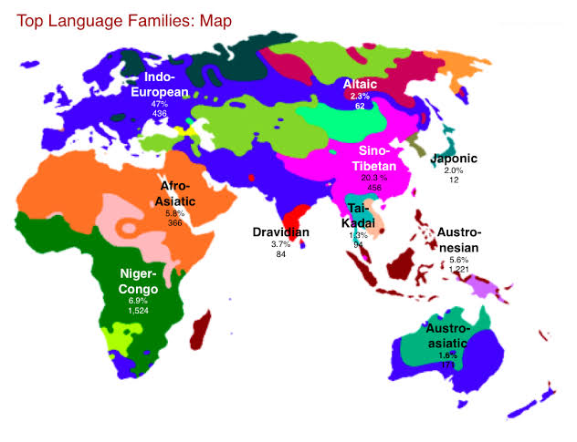
Diversity of languages in this world
Image source: https://triangulations.wordpress.com/2013/11/22/language-families/

Slide 14
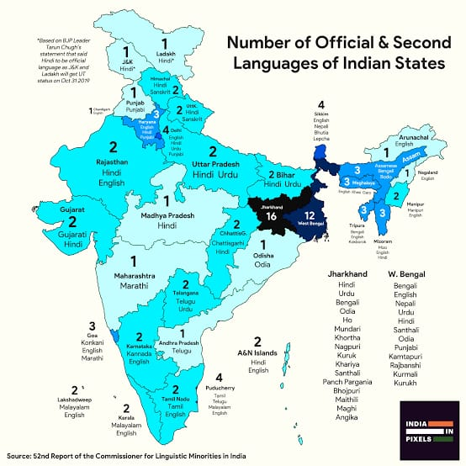
Variations across Indian languages
Source: https://twitter.com/indiainpixels/status/1299284220687167488
Notes:
India is second largest country with diversity of languages.

Slide 15
Natural language
In neuropsychology, linguistics, and philosophy of language,
a natural language is any language that occurs naturally in a human community by a process of use, repetition, and change without conscious planning or premeditation.

Slide 16
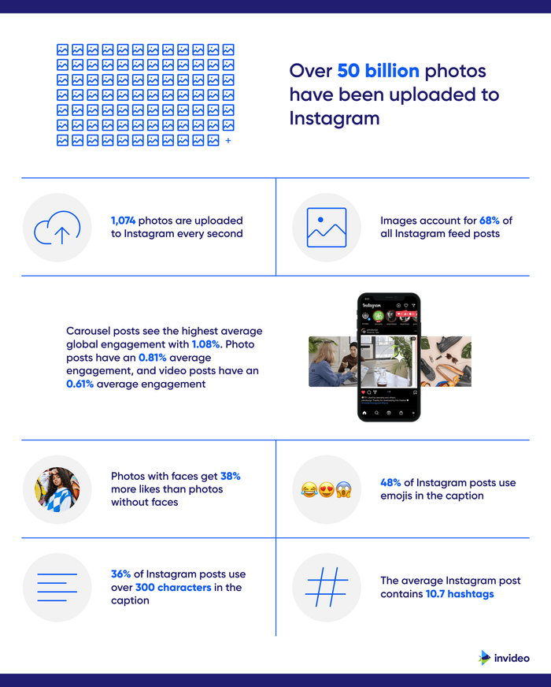
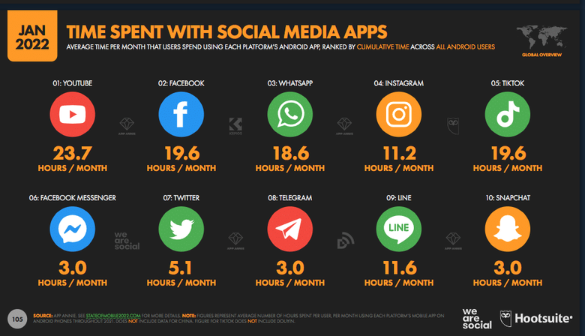
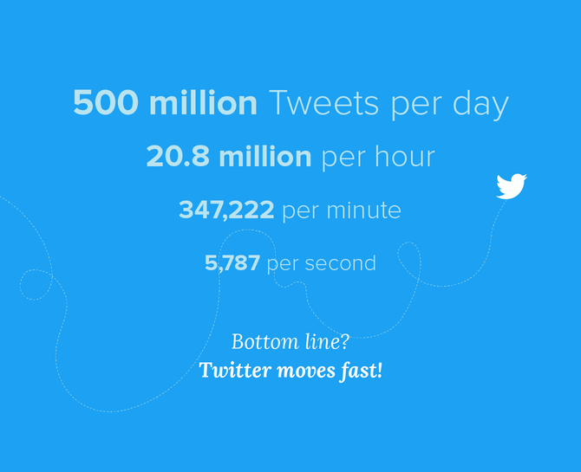
Data Data everywhere!!!!

Slide 17

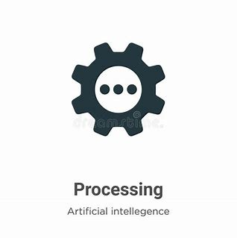




Natural language processing?
Natural language understanding
Natural language generation

Slide 18
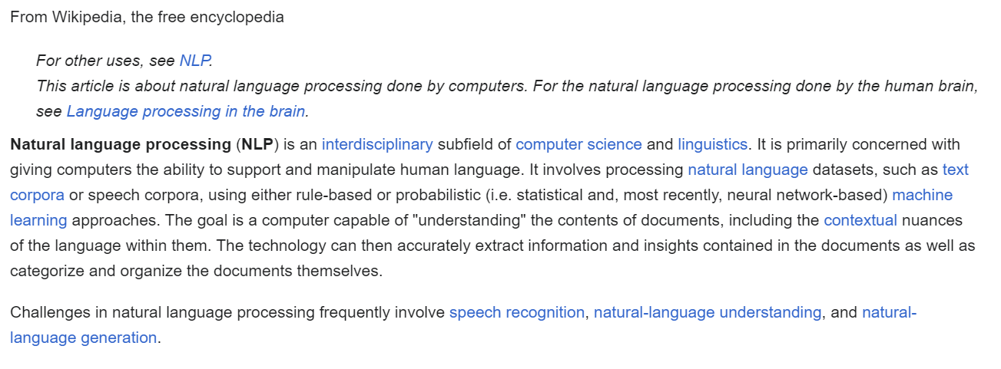
Natural language processing
https://en.wikipedia.org/wiki/Natural_language_processing

Slide 19
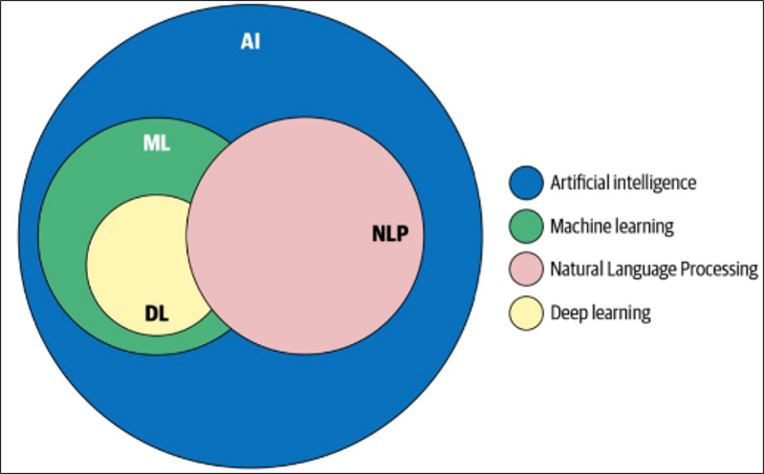
https://www.oreilly.com/library/view/practical-natural-language/9781492054047/

Slide 20
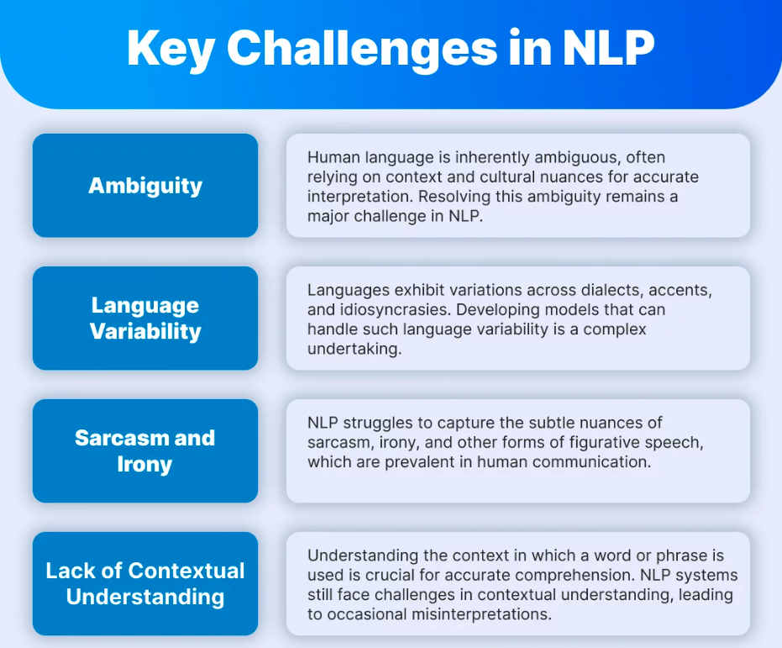
Challenges

Slide 21
Ambiguity in NLP
Lexical Ambiguity: This type of ambiguity represents words that can have multiple assertions. For instance, in English, the word “back” can be a noun ( back stage), an adjective (back door) or an adverb (back away).
Syntactic Ambiguity: This type of ambiguity represents sentences that can be parsed in multiple syntactical forms. Take the following sentence: “ I heard his cell phone ring in my office”. The propositional phrase “in my office” can be parsed in a way that modifies the noun or on another way that modifies the verb.
Semantic Ambiguity: This type of ambiguity is typically related to the interpretation of sentence. For instance, the previous sentence used in the previous point can be interpreted as if I was physically present in the office or as if the cell phone was in the office.
Metonymy: Arguably, the most difficult type of ambiguity, metonymy deals with phrases in which the literal meaning is different from the figurative assertion. For instance, when we say “Samsung us screaming for new management”, we don’t really mean that the company is literally screaming (although you never know with Samsung these days ;) ).

Slide 22
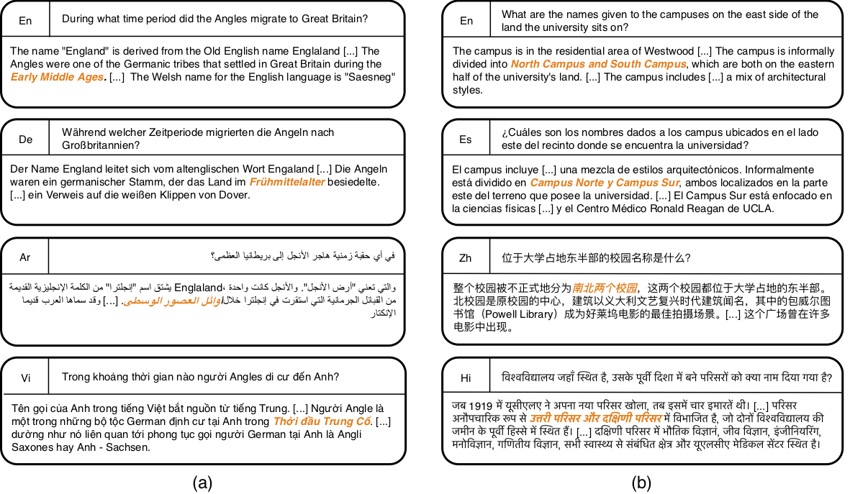
Multilingual

Slide 23
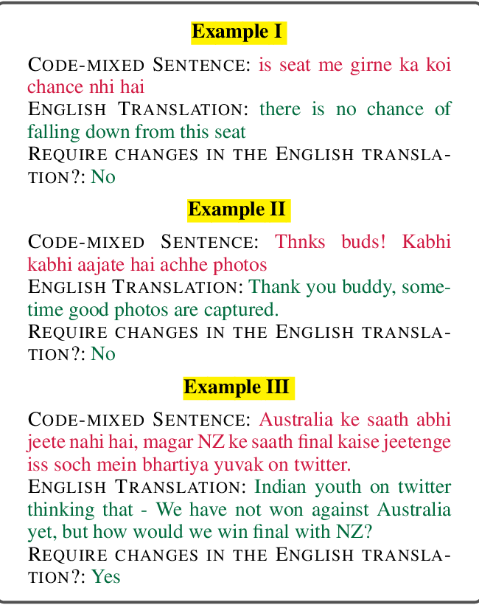
Code-mixed data

Slide 24
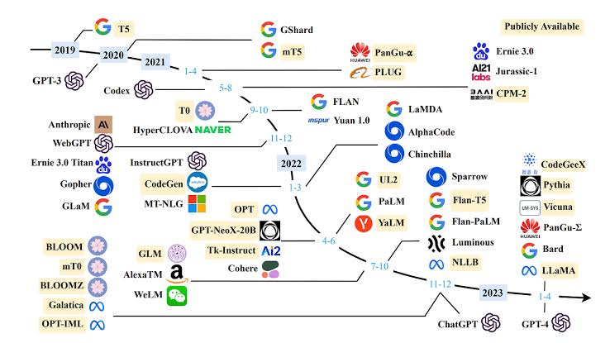
NLP research and advanced topics

Slide 25
Real-world impact
Industrial applications of language technologies
Google research
IBM
Meta/Facebook
OpenAI
AllenAI
Many more......

Slide 26
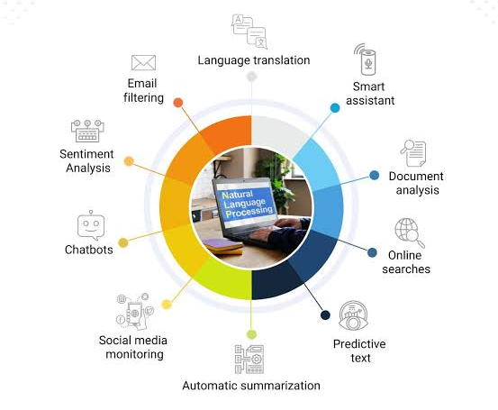
NLP Applications

Slide 27

https://www.youtube.com/watch?v=lj0bFX9HXeE&t=3s
Notes:
https://www.youtube.com/watch?v=lj0bFX9HXeE

Slide 28
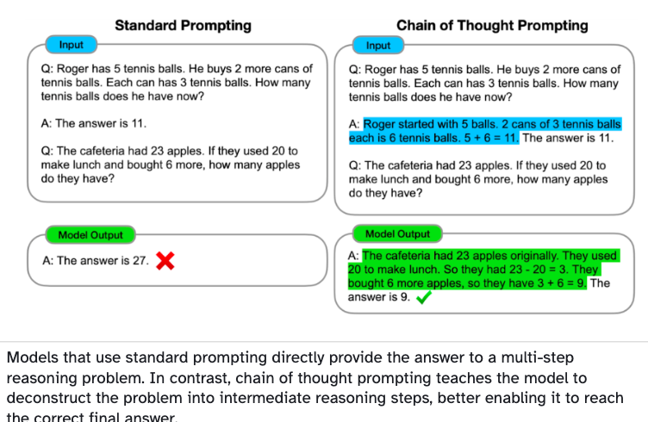
Applications!
https://blog.research.google/2023/01/google-research-2022-beyond-language.html

Slide 29
References
https://research.google/research-areas/
https://research.ibm.com/topics/natural-language-processing
https://openai.com/research/better-language-models

Slide 30



Resources
(A) Speech and Language Processing by Daniel Jurafsky and James H. Martin (3rd edition)
(B) Natural Language Processing with Python. (updated edition based on Python 3 and NLTK 3) Steven Bird et al. O’Reilly Media
https://vlanc-lab.github.io/mu-nlp-course/teachings/fall2024-books.html

