Slide 1
The sspm R package
spatial surplus production models for the management of northern shrimp fisheries Valentin Lucet (Msc) & Eric Pedersen (PhD)

Slide 2

Slide Title

Slide 3
How much fish are there?
Fisheries Economics & Policy: A Closer Look at Fisheries, Conservation Strategy Fund
Notes:
I’d like to start with a timeless question in fisheries management: how much fish is there in a given stock, and how much is it safe to harvest? How does one go about counting fish?

Slide 4
How much fish are there?
Fisheries Economics & Policy: A Closer Look at Fisheries, Conservation Strategy Fund
Notes:
Borrowing from an example by Jesse Agar from the CSF, let’s imagine counting the amount of trees in a forest.
The first step would be to define what a tree is for the sake of the survey, making sure you wont count saplings for example.
Once you’ve decided what counts as a tree, you would likely set up sampling areas across the forest.

Slide 5
How much fish are there?
Fisheries Economics & Policy: A Closer Look at Fisheries, Conservation Strategy Fund
Notes:
You would then use the resulting samples to infer the amount of tree in the forest, with a given amount of associated uncertainty. You might use some kind of model to make the most of the information contained in the samples.

Slide 6
How much fish are there?
Fisheries Economics & Policy: A Closer Look at Fisheries, Conservation Strategy Fund
–>
Notes:
Now imagine that your trees move and aggregate, are predated upon at different rates depending on where they are, and are harvested by multiple actors at different time periods. This is all just to take measure of the spatio-temporal variability inherent to fish populations.
This variability greatly complexifies the task of estimating fish stock sizes.

Slide 7
Non-stationarity
Models increasingly acknowledge the non-stationary nature of wild populations
Yet, stock models that explicitly incorporate spatio-temporal dynamics are still rare in fisheries science
Notes:
Early population models assumed that the conditions governing parameters affecting rate of change (growth rate, carrying capacity) stay constant
Models increasingly acknowledge the non-stationary nature of wild populations. Data is said to be non-stationary if its means, variance, and covariance change over time.
Population models designed to answer applied resource management questions, such as fisheries stock models, increasingly address how the dynamics of stocks vary across space and time.
We know that Treating spatially structured stocks as single unstructured stocks can lead to biased estimates YET stock models that explicitly incorporate spatio-temporal dynamics are still rare in fisheries science

Slide 8
Modelling approaches
process-based: often rely on differential equations and are based on replicating the underlying processes (predation, recruitment, dispersal) driving population dynamics
statistical: fit a regression model to time series of population abundances, abundance indices, or productivities, with some assumed error distribution for variation around predictions
Notes:
There would be two families of approaches for dealing with non-stationarity
[READ]
Statistical models allow for estimation of parameter uncertainty and ranges of model predictions, and for flexibly incorporating potential ecosystem drivers into models
Statistical models also allow for straight-forward estimation of spatial variation in population parameters such as maximum productivity or density dependence from data, in the absence of theory predicting how these parameters should vary.

Slide 9
Surplus Production Models
Surplus production models (SPMs) are based on modelling changes in the total biomass of a stock over time (i.e. surplus production) as a function of stock abundance and fishing pressure:
$$B_{t}=B_{t−1}+P_{t−1}−C_{t−1}$$
Where $B_{t}$ is the biomass, $P_{t}$ is productivity and $C_{t}$ is harvest (i.e. catch)
SPMs are useful in data-poor contexts, for example in the absence of population structure data
Notes:
One example of well used statistical model are Surplus production models (SPMs)
SPMs are one of the classic models used in fisheries, and are based on modelling changes in the total biomass of a stock in a given location over time (i.e. surplus production) as a function of current stock abundance and fishing pressure:
(DESCRIBE EQUATION)
SPMs are useful in data-poor contexts, for example in the absence of population structure data

Slide 10
Limitations of SPMs
Spatially constant productivity
Stock productivity is affected only by stock abundance and fishing.
Classically, single unstructured stocks with purely logistic dynamics
Notes:
[READ]
These assumptions ignore the effect of global changes that are affecting fisheries, such as climate change, that affect the growth rates of stocks independently of fishing pressure.

Slide 11
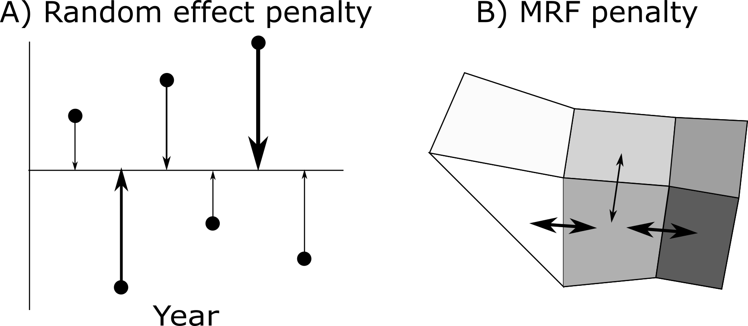
An approach: Spatial SPMs
To address these limitations, We use a statistical approach to fitting SPMs using Generalized Additive Models (GAMS)
We apply this approach to the population of Northern Shrimp of the Newfoundland and Labrador Shelves, leveraging the smoothing properties of GAMs to account for varying productivity across time and space. The resulting model is a spatial SPM (SSPM)
Notes:
To address these limitations, we use a statistical approach to fitting SPMs using Generalized Additive Models (GAMS), estimated using the mgcv R package as the backend.
We apply this approach to the population of Northern Shrimp of the Newfoundland and Labrador Shelves, leveraging the smoothing properties of GAMs to account for varying productivity across time and space.
The two main smoothing properties we use is random effects with penalty in time, as well as a Markov Random Field smoother across space
The resulting model is a spatial SPM (SSPM), implemented via our R package.

Slide 12
Implications for fisheries management
Fisheries managers are:
Becoming increasingly interested in how variation in ecosystem factors impact the variability of population parameters such as productivity.
Pushing for more ecosystem-based management methods
Notes:
These models have important implications for fisheries management because…
[READ]
We are moving away from single-species model and toward a more accurate picture of the ecosystem factors that impact stocks.

Slide 13
The Northern Shrimp
The Northern Shrimp (Pandalus borealis) in the Newfoundland and Labrador Shelves, has undergone several periods of large-scale biomass change in the last two decades, despite a relatively constant harvest regime.

Slide 14
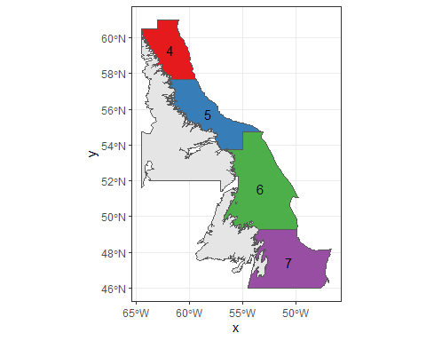
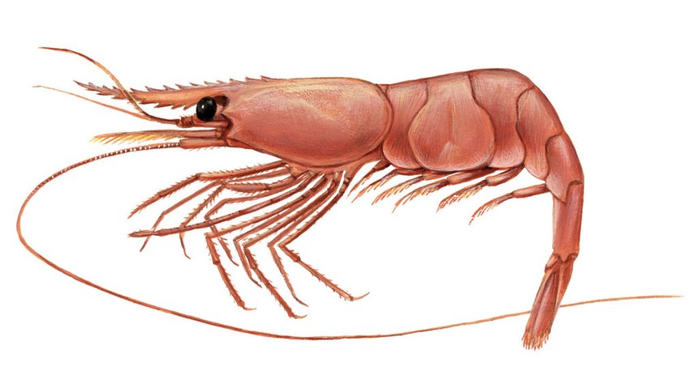
Notes:
The Northern Shrimp (Pandalus borealis) in the Newfoundland and Labrador Shelves, has undergone several periods of large-scale biomass change in the last two decades, despite a relatively constant harvest regime.
These stocks currently lack a population model to understand the drivers of this change, and to predict how fishing pressure and changing environmental conditions may affect future abundance in the region.
In the context of climate change and shifting ranges, fisheries productivity is likely to be a moving target and managers need better methods that account for varying productivity.

Slide 15
The need for sspm
Fisheries productivity models rarely integrate important spatially-structured ecosystem drivers
Northern Shrimp populations the Newfoundland and Labrador Shelves currently lacks a robust model
Current SPM models are rarely spatially explicit and usually cannot account for relevant ecosystem drivers
Fisheries managers lack user-friendly, flexible tools to implement and apply spatial SPMs
Notes:
[READ]

Slide 16
The sspm workflow
Ingestion of variables (biomass, predictors, catch…)
borealis_dataset <- spm_as_dataset(data = borealis, name = "borealis", time = "year_f", coords = c('lon_dec','lat_dec'), density = "weight_per_km2", uniqueID = "trawl_id") predator_dataset <- spm_as_dataset(data = predator, name = "predator", time = "year_f", uniqueID = "record_id", density = c("cod", "redfish", "turbot"), coords = c("lon_dec", "lat_dec"), boundaries = bounds)
Notes:
Let’s now look at at the package workflow.
The first step in the SSPM package is to ingest the datasets relevant to the management of the stock: the biomass of the stock, as well as predictors, such as the biomass of predators.
The package keeps track of the time variable and later uses it to apply penalties and smoothers properly.
It also keeps track of which variables represent actual biomass densities within the dataset.

Slide 17
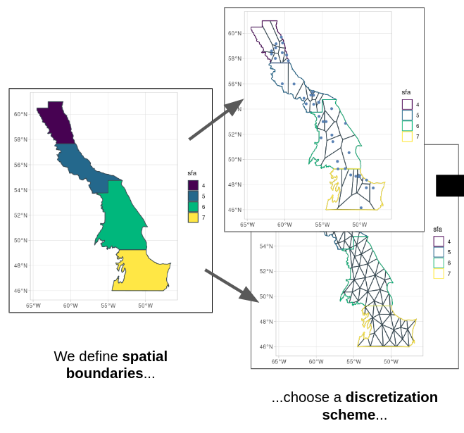
The sspm workflow
Ingestion and discretization of spatial boundaries into patches.
Notes:
The second step consists in ingesting the sptial boundaries of our model area, and discretizing that space into patches.
The package allows users to easily discretize their study areas along different discretization schemes.

Slide 18
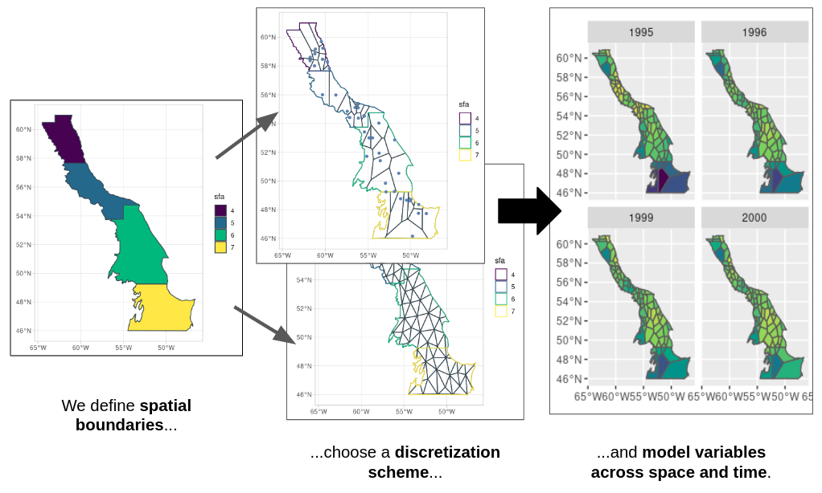
The sspm workflow
Smoothing data using spatio-temporal GAMs smoothers.
Notes:
Once discretized, biomass and predictors are smoothed to produce an estimate for each patch.

Slide 19
The sspm workflow
Smoothing data using spatio-temporal GAMs smoothers.
borealis_dataset_fitted <- borealis_dataset %>% spm_smooth(weight_per_km2 ~ sfa + smooth_time(by = sfa) + smooth_space() + smooth_space_time(k = c(NA,30)), boundaries = bounds, keep_fit = TRUE)
Notes:
The smoothing process is highly flexible as it allows for any type of GAM specifications, but the package supports special smoothing terms to improve usability and simplify the modelling process for managers.
The smooth_time() terms adds a random effect for time, where as the Markov Random Field smoother term smooth_space() adds a spatial smoothers to model the interactions between adjacent patches.

Slide 20
The sspm workflow
Computation of productivity values taking into account harvest information.
borealis_dataset_with_catch <- spm_aggregate_catch(biomass = borealis_dataset_fitted, catch = catch_data, biomass_variable = "weight_per_km2", catch_variable = "catch", corrections = landings_corrections, fill = mean)
Notes:
The next step consists in using the harvest data to compute productivities within each patch. These productivities will be the main response variable for the subsequent model.

Slide 21
The sspm workflow
Combining data and preparing to model
sspm_model <- sspm(biomass = borealis_dataset_with_catch, predictors = predator_dataset_fitted) sspm_model_split <- sspm_model %>% spm_split(year_f %in% year_train) %>% spm_lag(c("log_productivity", "weight_per_km2", "NAO", "cod", "other_predator" ), 1, default = NA)
Notes:
Before running the model, the package allows users to combine data, split the data into training and testing sets, as well as lagging relevant model variables.

Slide 22
The sspm workflow
Fitting of SSPMs to smoothed data with GAMs.
sspm_fit <- sspm_model_split %>% spm(log_productivity ~ cod_lag_1 + other_predator_lag_1 + smooth_space() + smooth_space(by = weight_per_km2_lag_1), select = TRUE, family = scat, method="REML")
Notes:
Finally, we run the model, specifying once again a formula using the package-specific smooth terms.

Slide 23
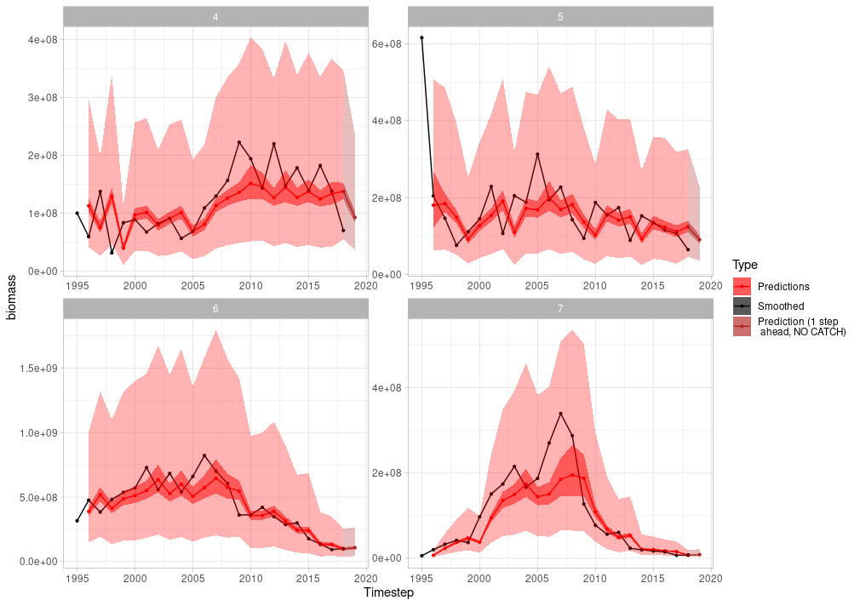
The sspm workflow
Visualization of results, including confidence and prediction intervals, and One step ahead prediction of biomass.
Notes:
The results from the model can be plotted. Here, the results are faceted by spatial boundaries (the 4 different shrimp fishing areas)

Slide 24
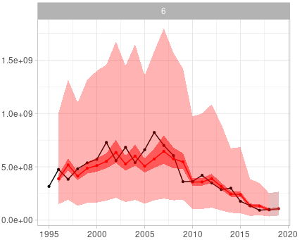

The sspm workflow
Notes:
By default, the package plots the smoothed biomass (in black, the smoothed observations), along with the predictions (in red, the predicted biomass computed from the predicted productivity).
In addition, users can plot the confidence (darker shade) and prediction intervals (lighter shade).

Slide 25
Generalizing the SSPM approach
The R package sspm is designed to make spatially-explicit surplus production models (SSPM) simpler to estimate and apply to any spatially structured stock.
In summary:
The package uses GAMs to estimate spatiotemporally varying biomass, and to estimate SSPMs based on changes in fitted biomass, observed catch, and spatially structured environmental predictors.
Notes:
While the initial application of this model was modelling Newfoundland and Labrador Northern Shrimp stocks, the R package sspm is designed to make spatially-explicit surplus production models (SSPM) simpler to estimate and apply to any spatially structured stock.
The package uses GAMs to estimate spatiotemporally varying biomass, and to estimate SSPMs based on changes in fitted biomass, observed catch, and spatially structured environmental predictors.

Slide 26
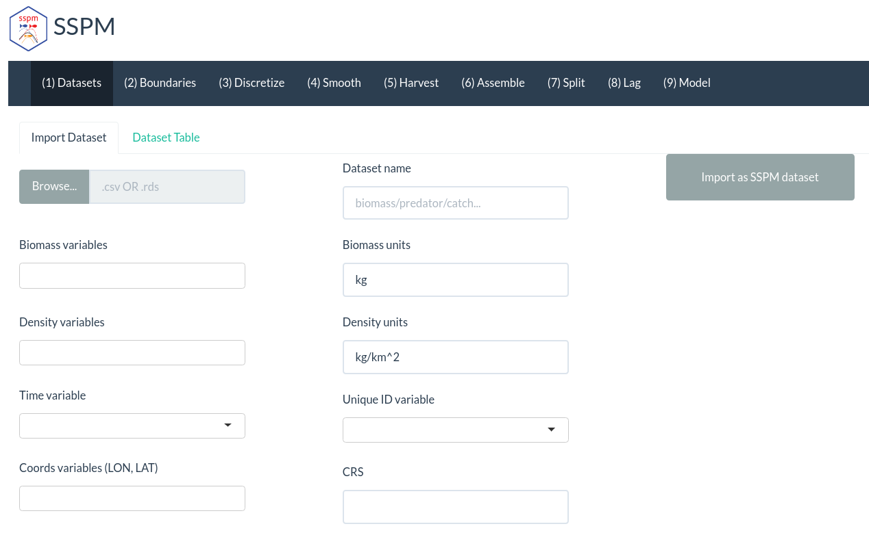
A future tool for managers
A sspm shiny app is in development and will increase the usability of the package

Slide 27
Thank you!
Twitter, Github: @vlucet
With the support of:

Slide 28



Slide 29


Slide 30
Thanks to the members of the Quantitative Fisheries Lab at Concordia University:
Eric Pedersen, Fonya Irvine, John-Philip Williams, Kyle Krumsick, Danielle Mac Rae, Alienor Stahl
Notes:
Thank you for listening, I’m happy to answer any questions. I’d like to thank our funders as well as all the member of the Quantitative Fisheries Lab at Concordia University

