Slide 1
EXECUTIVE PRESENTATION | PREPARED FOR ICE/SEVP LEADERSHIP
SEVP Innovation Lab + Knowledge Management AI MVP
Building federal AI capability that compounds — from one MVP to an enduring institutional advantage
Prepared for: ICE / SEVP Executive Leadership
Prepared by: Varun Malhotra, President — Changeis, Inc.
In partnership with: Perplexity Computer
Date: April 2026
01

Slide 2
A focused 12-week MVP can convert SEVP institutional knowledge into a compounding AI capability — at $450–650K and FedRAMP-High by design
Three columns: where SEVP is today, what we propose, and what the agency gets in 90 days.
WHERE WE ARE
WHAT WE'RE PROPOSING
WHAT IT DELIVERS
The current state
12-week MVP
Outcomes by Week 12
Mission-critical knowledge spread across SharePoint, Confluence, JIRA, Study-in-the-State, and email
Stand up an SEVP Innovation Lab on AWS GovCloud + Bedrock (Claude Sonnet 4.5)
25–40% time saved on document search & synthesis for pilot users
Workforce attrition risks loss of decades of policy and case-handling tacit knowledge
Deliver three live KM AI use cases: institutional Q&A, policy/SOP synthesis, case-officer copilot
~30% faster onboarding ramp for new SEVP staff via institutional Q&A
New SEVP staff face long ramp curves; SMEs spend hours on repeat questions
FedRAMP High / IL4-5 boundary; CAC/PIV identity; full audit logging from day one
3 production-ready use cases with measured accuracy and adoption
Existing SharePoint search returns documents, not answers — and no audit trail
Eval-first development with golden datasets and human-in-the-loop guardrails
Reusable Innovation Lab playbook — the flywheel for every future AI use case
No internal lab to safely test FedRAMP-grade AI before production
Mid-point Go/No-Go gate at Week 6; Demo Day + scale plan at Week 12
Clear path to ATO and Year-1 production scale (~$1.5–2.0M est.)
12 weeks — MVP duration
$450–650K — Labor ROM
3 use cases — Live by Week 12
FedRAMP High — Security boundary
Source: Changeis SEVP Innovation Lab MVP proposal (2026-04-23); Anthropic FedRAMP High program (2025); GSA OneGov Anthropic deal (2025).
Changeis Confidential — Executive Presentation — April 2026
2

Slide 3
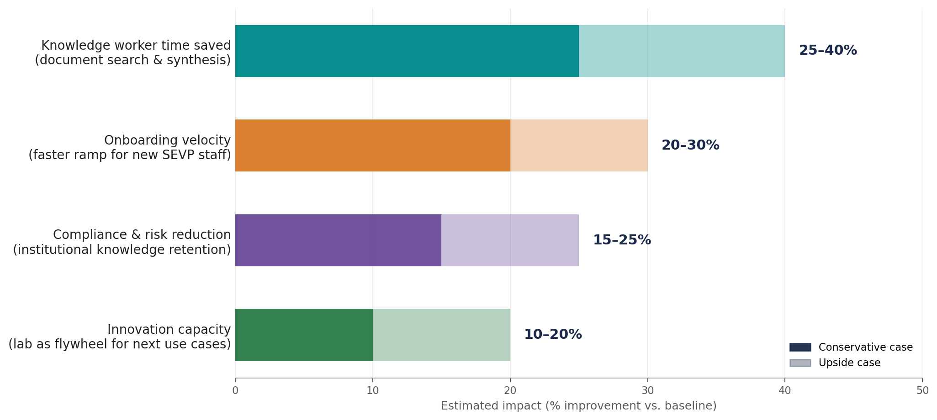
Quantified value: 25–40% knowledge-worker time back, 30% faster onboarding, and a reusable lab that compounds across SEVP
Conservative-to-upside ranges based on McKinsey, Gartner and GAO benchmarks for federal generative-AI deployments.
WHY IT MATTERS
Knowledge workers spend ~20% of their week searching for or synthesizing information.
McKinsey Global Institute
Federal generative-AI use cases grew 9× in one year (32 → 282 across 11 agencies).
GAO 2025
Gartner: by 2029, 60% of agencies will use AI agents for >50% of citizen transactions.
Gartner Public Sector AI
Anthropic Claude is FedRAMP-High authorized and offered to all federal agencies via GSA OneGov.
Anthropic / GSA 2025
ROUGH SIZING (illustrative) If 200 SEVP knowledge-workers save 25% of ~6 hrs/week on search & synthesis at a $90/hr loaded rate, that is ≈ $1.4M/year in recovered capacity — before onboarding, retention, and risk-reduction value.
Source: McKinsey State of AI 2025 (mckinsey.com/quantumblack); McKinsey Global Institute / Economic Potential of Generative AI; GAO-25-107653 Generative AI Use & Management at Federal Agencies (Jul 2025); Gartner Public Sector AI (Sep 2025); Anthropic + GSA OneGov announcement (Aug 2025); Changeis analysis.
Changeis Confidential — Executive Presentation — April 2026
3

Slide 4
Federal and enterprise precedents have already proven this model — SEVP can move with high confidence, not from a standing start
Five reference deployments across federal innovation labs, applied AI sprints, and enterprise knowledge management.
FEDERAL INNOVATION LAB
FEDERAL APPLIED AI
FEDERAL AGENTIC AI STACK
GSA TTS — Centers of Excellence (AI CoE)
VA AI Tech Sprint + Innovation Ecosystem
DoD CDAO (formerly JAIC) + Anthropic
What they built
What they built
What they built
Stood up the federal IT-modernization CoE inside GSA/TTS to accelerate AI adoption across agencies and centralize re-usable patterns.
Cohort-based 12-week tech sprints to apply AI to specific clinician workflows (notes, documentation, burnout reduction).
CDAO selected Anthropic's Claude under a $200M ceiling agreement to support national-security AI workflows on FedRAMP-High infrastructure.
Outcome
Outcome
Outcome
Reusable AI playbooks, vendor-neutral methodology, and an active practice partnering with DoL, DHS and others.
$1M prize pool drove industry partnerships; produced winners now scaling inside VHA — a direct analog for SEVP cohort cadence.
Validates the exact reference architecture (Claude on FedRAMP High) we are proposing for SEVP.
MOST DIRECTLY ANALOGOUS
ENTERPRISE KM REFERENCE
Anthropic + GSA OneGov ($1 deal)
JPMorgan COIN — Enterprise KM precedent
What they built
What they built
Claude for Government (FedRAMP High) and Claude for Enterprise made available to all three branches of government for $1 for one year (Aug 2025).
Contract-intelligence platform applies NLP to interpret complex legal documents in seconds rather than hours.
Outcome
Outcome
Removes acquisition friction; SEVP can pilot the same model class we propose without bespoke procurement risk.
≈ 360,000 hours of manual lawyer review saved per year — the canonical ROI case for KM-AI on dense regulatory text.
Source: GSA TTS Centers of Excellence (coe.gsa.gov); VA AI Tech Sprint (news.va.gov); CRS DoD CDAO realignment (Sep 2025); Anthropic OneGov + Claude for Government (Aug 2025); JPMorgan COIN public reporting; Changeis analysis.
Changeis Confidential — Executive Presentation — April 2026
4

Slide 5
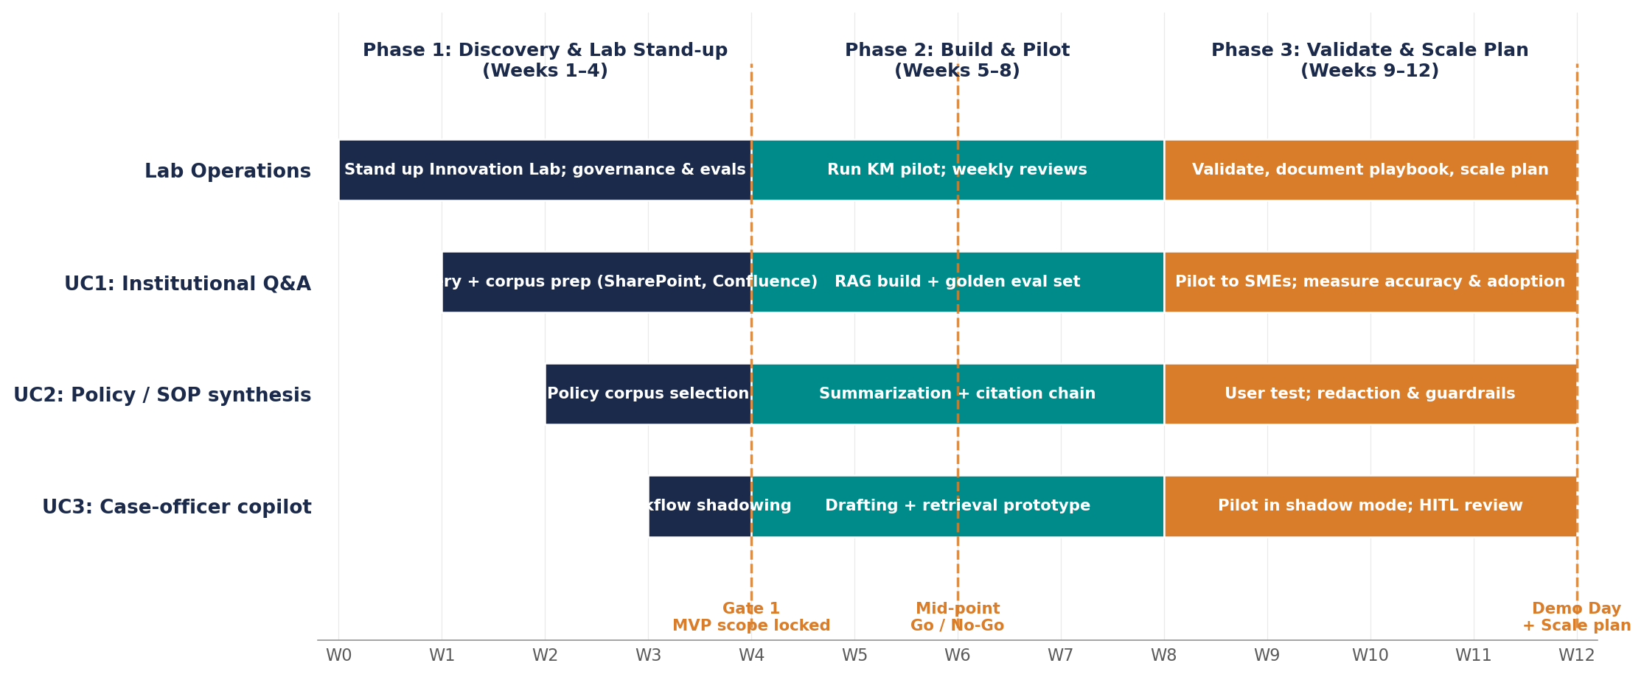
The MVP is delivered in three 4-week phases with parallel use-case tracks, gated reviews, and a Demo Day at Week 12
Discovery & Lab stand-up → Build & Pilot → Validate & Scale; mid-point Go/No-Go at Week 6.
Stakeholder rhythm
Weekly check-ins with SEVP sponsor + SMEs; bi-weekly steering committee.
Eval gates
Golden datasets, retrieval accuracy, factuality, and adoption metrics tracked at Weeks 4, 6, 8, 12.
Risk burn-down
ATO artifacts, PII redaction, role-based retrieval and audit logging delivered alongside features.
Source: Changeis SEVP Innovation Lab MVP proposal (2026-04-23); NIST AI RMF (Govern–Map–Measure–Manage); Changeis delivery methodology.
Changeis Confidential — Executive Presentation — April 2026
5

Slide 6
The reference architecture is FedRAMP-High by design: AWS GovCloud + Bedrock (Claude Sonnet 4.5) + RAG + CAC/PIV identity + audit
One page, no surprises — every component already has a federal precedent and an ATO path.
FedRAMP HIGH BOUNDARY | AWS GovCloud (US)
COMPLIANCE PILLAR
USER & IDENTITY
Built-in, not bolted-on
SEVP staff (CAC/PIV)
SAML SSO via agency IdP
Role-based access control
FedRAMP High
APPLICATION & ORCHESTRATION
Anthropic Claude for Government already authorized.
Institutional Q&A
Policy / SOP Synthesis
Case-Officer Copilot
DoD IL4 / IL5
Question answering over SharePoint / Confluence
Summarize + cite policy chains
Drafting + retrieval (human-in-the-loop)
AWS GovCloud regions support IL4–IL5 workloads.
ATO path
AI MODELS, RAG & DATA
DoD/DHS-aligned package; reciprocity targeted.
Amazon Bedrock
Claude Sonnet 4.5
Bedrock KB / OpenSearch
Source data
Section 508
Managed inference on FedRAMP High
Frontier model via Claude for Government
Vector + keyword retrieval (RAG)
SharePoint, Confluence, JIRA, Study-in-the-State
Accessibility tested on every UI surface.
OMB M-25-21 / M-25-22
Aligned to acceleration + responsible-acquisition memos.
CROSS-CUTTING
• Audit & logging (CloudTrail / Bedrock)
• PII redaction & DLP
• Eval harness + golden datasets
• KMS encryption (FIPS 140-2)
NIST AI RMF
Govern–Map–Measure–Manage applied throughout.
Source: Anthropic Claude for Government (FedRAMP High); AWS GovCloud documentation (IL4/IL5); OMB M-25-21 (Apr 2025); OMB M-25-22 (Apr 2025); NIST AI RMF 1.0 (NIST.gov).
Changeis Confidential — Executive Presentation — April 2026
6

Slide 7
Six discipline-grade practices we will apply on day one — drawn from NIST AI RMF, OMB guidance, and Changeis delivery experience
Each practice is observable, measurable, and tied to a specific deliverable.
1
Human-in-the-loop by default
2
Eval-first development
3
Privacy-by-design
Every high-impact output is reviewed by an authorized SEVP user before action; no autonomous decisions on rights-impacting workflows.
Golden datasets and acceptance thresholds (factuality, retrieval accuracy, citation fidelity) are written before any code ships.
Automated PII detection & redaction; role-based retrieval; data-loss prevention controls inside the FedRAMP boundary.
Anchor: OMB M-25-21 (high-impact AI)
Anchor: NIST AI RMF: Measure
Anchor: OMB M-25-22 (privacy & IP)
4
Reuse-or-buy posture
5
Continuous ATO via DevSecOps
6
Outcome metrics from day 1
No NIH: leverage Bedrock primitives, GSA OneGov Claude pricing, and existing agency IdP rather than rebuilding.
Security artifacts, SBOMs, and control evidence generated by the pipeline — not assembled by hand at the end.
Time saved, accuracy, adoption, and SME satisfaction are instrumented before launch and reviewed weekly.
Anchor: OMB M-25-22 (acquisition)
Anchor: DHS / DoD reciprocity guidance
Anchor: McKinsey State of AI 2025
Source: NIST AI RMF 1.0 (NIST); OMB M-25-21 & M-25-22 (Apr 2025) replacing M-24-10/M-24-18; McKinsey State of AI 2025; Changeis delivery practice.
Changeis Confidential — Executive Presentation — April 2026
7

Slide 8
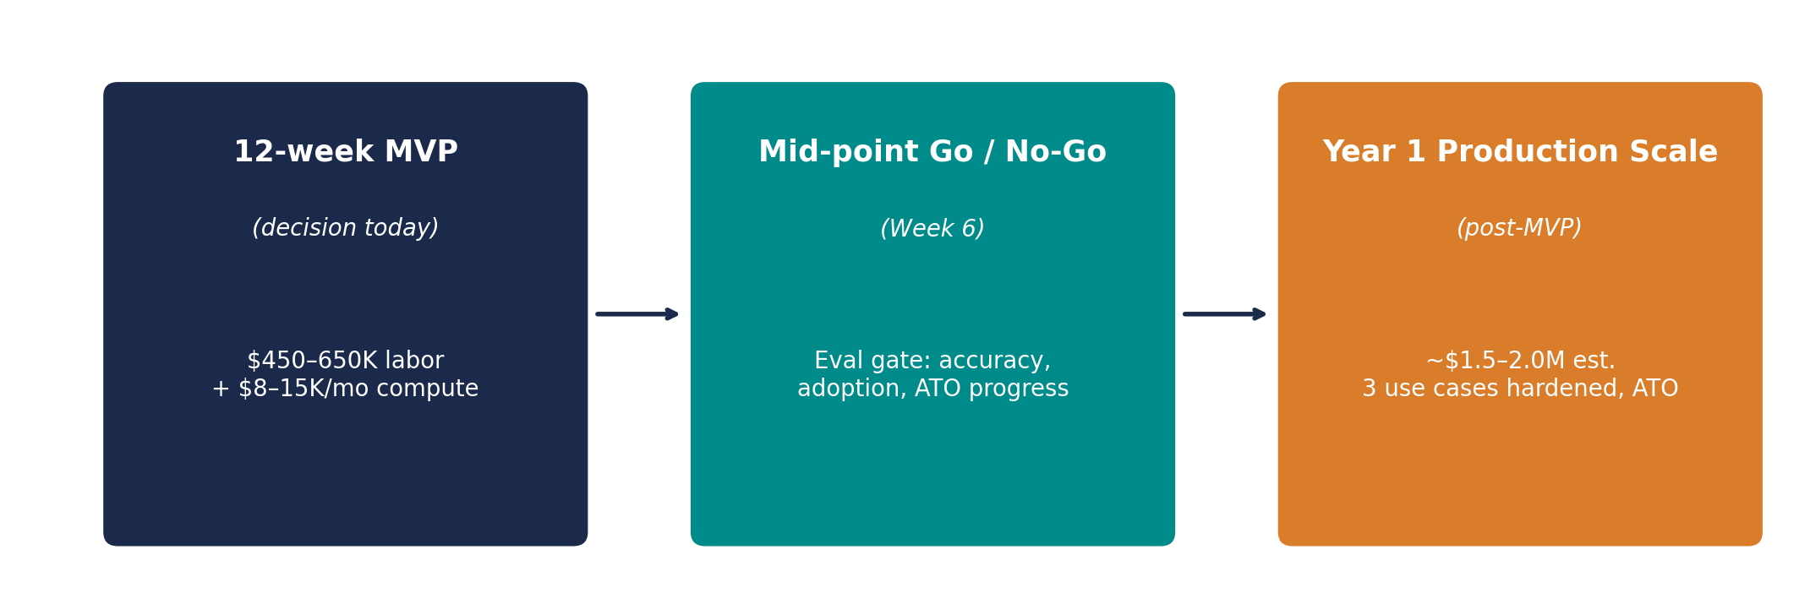
Greenlight the 12-week MVP today — Week-6 Go/No-Go protects the investment, and Year-1 production scale follows on demonstrated value
Three concrete asks to begin within the next two weeks.
THE ASK — three decisions to start within two weeks
Sponsor designated
Knowledge SMEs identified
Initial use case selected
1
Identify the SEVP executive sponsor accountable for outcomes and unblocking access to source systems.
2
Name 4–6 SEVP SMEs (policy, case-handling, IT) for SME interviews, golden-dataset curation, and pilot evaluation.
3
Confirm Use Case 1 priority (institutional Q&A vs. policy synthesis vs. case-officer copilot) for Week-1 kickoff.
Contact: Varun Malhotra, President — Changeis, Inc. varun@changeis.com • www.changeis.com
Source: Changeis SEVP Innovation Lab MVP proposal (2026-04-23); McKinsey State of AI 2025; Anthropic + GSA OneGov (2025); Changeis ROM model.
Changeis Confidential — Executive Presentation — April 2026
8

