Slide 1
Simplex results, explained
Five single-cell EMT datasets · three gene sets · pooled and within each unit
What is checked: (1) is there a significant simplex, and do its corners correspond to tasks, when the fit uses A. the entire gene set, B. the KS EMT genes, C. the Hallmark EMT genes; (2) how many hybrid cells are generalists, and how many generalists are hybrid, under three rules.
Thesis project, IISc · 22 October 2026

Slide 2
Key ideas in five lines
Read this once; every later slide uses these words
Simplex. If cells must trade off k tasks, they fill a shape (a line, triangle, tetrahedron...) whose k corners are cells specialised in one task each. We fit that shape to the leading PCA axes of the gene-expression data.
Significant simplex. The fitted shape is compared with the same data after shuffling each PCA axis independently, 100 to 200 times. If the real shape is more triangle-like than nearly all shuffles (p ≤ 0.05), it is not just a random cloud. A small p alone does not prove a trade-off: samples that differ from each other can also give a significant shape.
Corner = task? The 5% of cells nearest each corner are scored on the 50 MSigDB Hallmark gene sets (effect in SD versus all other cells). The top set names the programme (e.g. E2F Targets = cycling). Cell-cycle phase, EMT-state mix, dominant sample and marker genes support the name. A corner that is almost all one sample (≥ 70%) is an identity corner, not a task.
Hybrid cells. The middle EMT states (Early-Hybrid, Hybrid, Late-Hybrid). Cook has no state labels, so hybrids are the middle two quartiles of the KS EMT score.
Specialist vs generalist. A cell claimed by one corner is a specialist; every other cell is a generalist, an interior mixture. The key comparison: what % of hybrid cells are generalists, versus what % of all other cells are generalists. Same % = hybrids are not special.

Slide 3
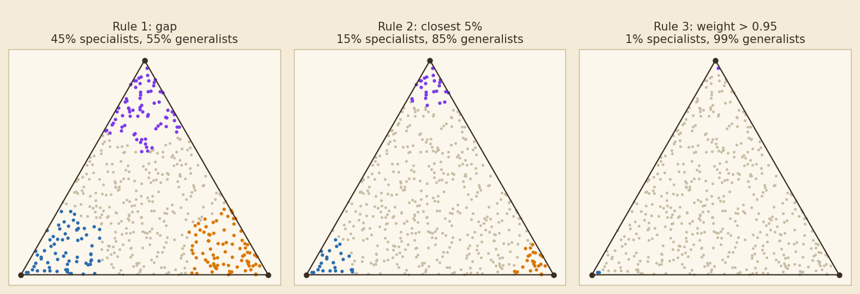
The three specialist rules on a toy triangle
500 simulated cells mixing three corners; the same rules are applied to the real fits
Rule 1, gap (Pal work): a cell is a specialist if its largest corner weight exceeds the second largest by at least 0.35.
Rule 2, closest 5% (Groves 2022): for each corner, the 5% of cells nearest to it are its specialists; everything else is a generalist. Caps specialists at about 15% for a triangle.
Rule 3, weight > 0.95 (Groves 2022, methods): specialist only if one weight exceeds 0.95. Because the fitted corners lie inside the cloud (delta = 0), almost no cell qualifies, so about 100% are generalists. It is the strictest and least informative.

Slide 4
How the numbers on each slide were produced
Everything is read from saved fits; no result is refitted for the rules
1. Fit. Each fit = PCA on the unit's cells (genes centred, not scaled) then archetypal analysis on the first k−1 PCs (15 starts); the permutation test shuffles each PC and refits (200 shuffles; 100 for the new Hallmark, cleaned-pooled and SCC scRNA-only / six-tumour pooled fits, marked in tables).
2. Best simplex. For each dataset × unit × gene set × arm the saved k values are compared; best = lowest p, ties go to the smaller k; pooled fits ignore k beyond the ESV elbow. On each slide the arm shown is the one with the lowest p (ties: cleaned arm).
3. Weights and rules. Each cell's barycentric weights on the k corners give the three rules (previous slide). Statistics use all cells of the fit; the plots draw at most 4,000 random cells. Within-unit fits are capped at 4,000 cells.
4. Corner names. 5% nearest each corner → Hallmark scores (mean log-expression per set; effect = difference in SD) + S/G2M share + state mix + dominant sample + top genes. For Hallmark-EMT fits the EMT set is excluded from naming (circular).
5. Arms. Light QC = standard cell QC; cleaned = at least 10,000 UMI (plus dataset-specific technical-gene / contamination filters). SCC has no cleaned arm. For k ≥ 4 the simplex is drawn by projecting the corners on PC1/PC2 and joining their convex hull.

Slide 5
Which fit is shown on each slide
One main fit per unit and gene set, so nothing is picked for having the lowest p
Mouse SCC. Main = the pooled fit on scRNA cells only, and the eight scRNA tumours. The four multiome tumours (MU3, MU4, MU7, MU8) were sequenced as nuclei, a different technology: mixing them in creates a technical corner, and inside a multiome tumour the signal is nuclear RNA. The all-cells pooled fit and the multiome tumours are kept in the appendix.
Cook, PDAC, 4T1, GSE114687. Main = the cleaned arm: cells with at least 10,000 UMI, plus each dataset's technical filter (Cook: mitochondrial fraction ≤ 0.07 and MALAT1 / NEAT1 / haemoglobin genes dropped; PDAC: liver ambient-RNA and haemoglobin genes dropped; 4T1: immune / stromal contamination removed; GSE114687: MALAT1 / NEAT1 / haemoglobin dropped). 4T1 clone E has only 142 cells after cleaning, so its light-QC fit is shown.
Why. Light QC and cleaning disagree on whether a simplex is significant in many units (Cook 2 of 12 unit × gene-set pairs, PDAC 8 of 27, 4T1 7 of 15, GSE114687 8 of 18). Picking whichever arm has the lower p would inflate significance. The light-QC p is printed on every slide as a comparison and tabulated in the appendix.
Counting. All summary numbers below count units (one main fit each), not fits.

Slide 6
At a glance: where is a simplex significant?
Main fits. Pooled: k and p. Within: number of units with a significant simplex
dataset | A. pooled | A. within | B. pooled | B. within | C. pooled | C. within
Mouse SCC | k=3, p=0.00498 * | 4 of 8 | k=5, p=0.0099 * | 3 of 8 | k=3, p=0.0495 * | 3 of 8
Cook | k=3, p=0.0099 * | 1 of 4 | k=4, p=0.0099 * | 1 of 4 | k=4, p=0.0099 * | 3 of 4
Mouse PDAC | k=4, p=0.0396 * | 9 of 9 | k=4, p=0.931 | 3 of 9 | k=3, p=0.208 | 4 of 9
4T1 clones | k=3, p=0.00995 * | 1 of 6 | k=4, p=0.0299 * | 1 of 6 | k=4, p=0.119 | 1 of 6
MCF10A/HuMEC | k=4, p=0.0099 * | 6 of 6 | k=3, p=0.0099 * | 4 of 6 | k=3, p=0.0099 * | 5 of 6
* significant (p ≤ 0.05). Units: SCC 8 scRNA tumours, Cook 4 lines, PDAC 9 (7 libraries, mouse 1, mouse 2), 4T1 6 clones, GSE114687 6 samples.
A. Entire gene set: 26 of 38 main fits significant (pooled 5 of 5, within 21 of 33 units).
B. KS EMT genes: 16 of 38 main fits significant (pooled 4 of 5, within 12 of 33 units).
C. Hallmark EMT genes: 19 of 38 main fits significant (pooled 3 of 5, within 16 of 33 units).

Slide 7
Mouse SCC
What the dataset is, and what to keep in mind when reading its slides
What the dataset means
Mouse skin squamous cell carcinoma: 12 real tumours (4 multiome, 8 scRNA), 23,959 cells, with the authors' four EMT states. Tumour, assay and EMT state are tangled.
Units in the main analysis
SC15, SC32, SC46, SC33, SC2b1, SC2b3, SC35, SC43
Gene sets
A. all genes (11,000 to 14,500); B. KS EMT genes (Tan 2014; about 160 to 190 present); C. Hallmark Epithelial-Mesenchymal-Transition set (200 genes, those present in the data).
Keep in mind
• Hybrids = Early-Hybrid + Hybrid (the authors' labels); Late-EMT is not counted as hybrid.
• The four multiome tumours (MU3, MU4, MU7, MU8) were read as nuclei, not whole cells: a corner dominated by them is a technical axis, not biology.
• Within-tumour fits were run for all 12 tumours; most tumours contain one or two EMT states only.
This dataset in numbers (main fits)
• Entire gene set: 5 of 9 fits significant; hybrids 53% / 87% / 100% generalist (median, rules 1/2/3).
• KS EMT genes: 4 of 9 fits significant; hybrids 64% / 80% / 100% generalist (median, rules 1/2/3).
• Hallmark EMT genes: 4 of 9 fits significant; hybrids 57% / 87% / 100% generalist (median, rules 1/2/3).
Question 1 slides come first, then the Question 2 slides for this dataset.

Slide 8
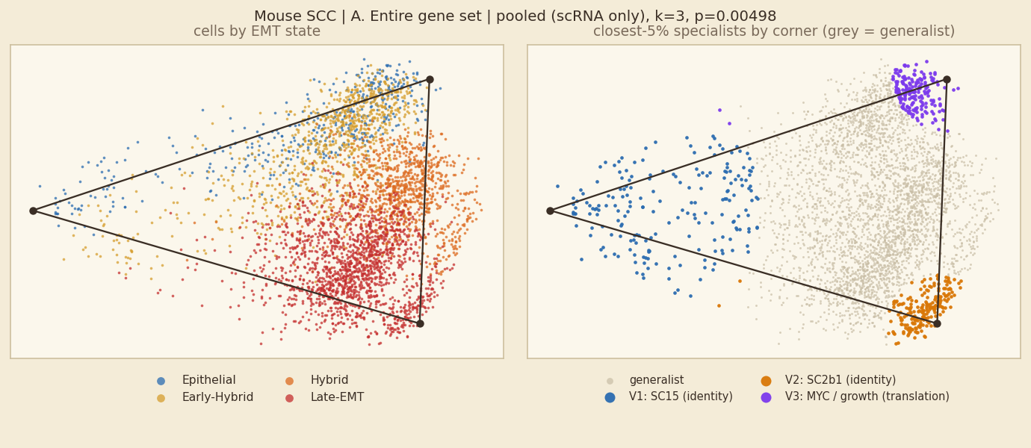
Mouse SCC: A. Entire gene set, pooled fit
Fit shown: scRNA only · k = 3 · p = 0.00498 · 14,059 cells · 200 shuffles | comparison, light QC: k=3, p=0.00498
SIGNIFICANT permutation test, p ≤ 0.05
In plain words
A significant simplex (k=3, p=0.00498), but 2 of 3 corners are almost entirely one sample (SC15, SC2b1). It separates samples; it is not a shared EMT trade-off.
Each corner is essentially one tumour. The programme names (Hallmark) only describe what distinguishes that tumour, and the EMT-state colours follow the tumours. These corners are not tasks.
Hybrid vs other cells: 61% of hybrid cells and 35% of other cells are generalists (rule 1; rule 2: 89% vs 81%), so hybrids are clearly more often generalists.
Corners and their tasks
V1 identity corner: SC15 (programme: cycling) — Mitotic Spindle +1.8 SD; 34% S/G2M; 44% Early-Hybrid; 82% SC15; Adgrl3 Ext1 Atxn1
V2 identity corner: SC2b1 (programme: coagulation / matrix-like) — Coagulation +1.04 SD; 11% S/G2M; 99% Late-EMT; 92% SC2b1; Postn Col1a1 Col3a1
V3 MYC / growth (translation) — Myc Targets V1 +1.57 SD; 80% S/G2M; 57% Early-Hybrid; Krt14 Krt5 Krt6a
Left: cells coloured by EMT state (blue epithelial → red mesenchymal; hybrids are the two middle colours). Right: the 5% of cells nearest each corner coloured by corner, all other cells grey = generalists.
rule | % of hybrid cells that are generalists | % of other cells that are generalists
1 gap (top weight − second ≥ 0.35) | 61% | 35%
2 closest 5% of cells to each corner | 89% | 81%
3 weight > 0.95 on one corner | 100% | 99%
Hybrids are 49% of all cells here; 77% of cells lie inside the simplex.

Slide 9
Mouse SCC: A. Entire gene set, all units at a glance
Main fit of each unit: 4 of 8 units have a significant simplex
unit | fit shown | k | p | light-QC p | hybrid % of cells | hybrids→generalist (1/2/3) | generalists→hybrid (1/2/3)
SC15 | light QC | 3 | 0.00498 * | – | 58% | 53 / 87 / 100% | 57 / 59 / 58%
SC32 | light QC | 3 | 0.0149 * | – | 57% | 66 / 93 / 100% | 68 / 62 / 58%
SC46 | light QC | 4 | 0.0796 | – | 50% | 61 / 84 / 100% | 65 / 53 / 50%
SC33 | light QC | 4 | 0.318 | – | 79% | 70 / 83 / 100% | 85 / 82 / 79%
SC2b1 | light QC | 3 | 0.00498 * | – | 31% | 51 / 83 / 99% | 36 / 30 / 31%
SC2b3 | light QC | 4 | 0.00498 * | – | 38% | 42 / 82 / 100% | 29 / 39 / 38%
SC35 | light QC | 4 | 0.169 | – | 40% | 67 / 73 / 100% | 44 / 37 / 40%
SC43 | light QC | 3 | 0.751 | – | 53% | 50 / 86 / 100% | 50 / 54 / 53%
* p ≤ 0.05 for the fit shown. Rules: 1 = gap, 2 = closest 5%, 3 = weight > 0.95. One slide per unit follows; non-significant units are included for completeness and their corners should not be read as tasks.

Slide 10
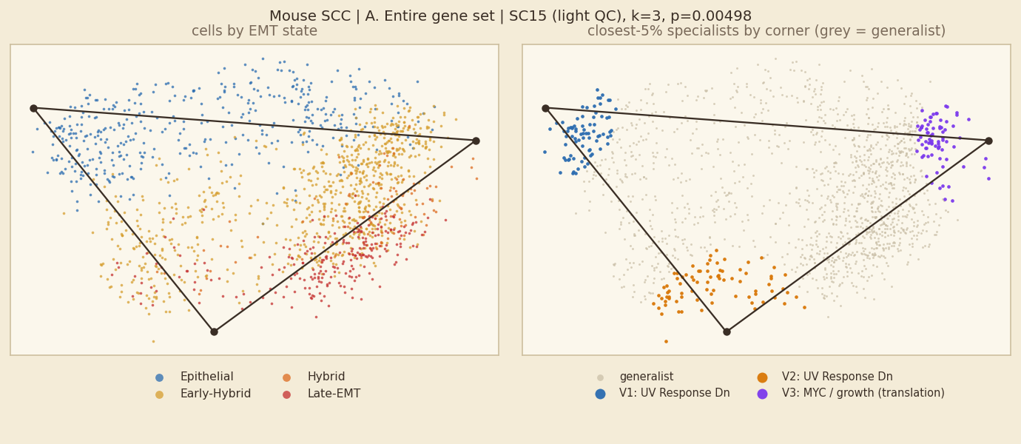
Mouse SCC: A. Entire gene set, unit SC15
Fit shown: light QC · k = 3 · p = 0.00498 · 1,576 cells · 200 shuffles
SIGNIFICANT permutation test, p ≤ 0.05
In plain words
Inside SC15 alone, cells fill a 3-corner simplex (p=0.00498). 4 of 8 units of this dataset have a significant simplex for this gene set.
Corners are programmes: UV Response Dn; MYC / growth (translation).
Hybrid vs other cells: 53% of hybrid cells and 56% of other cells are generalists (rule 1; rule 2: 87% vs 83%), so hybrids are less often generalists (they sit at corners).
Corners and their tasks
V1 UV Response Dn — UV Response Dn +1.35 SD; 22% S/G2M; 100% Epithelial; 100% SC15; Trps1 Frmd4b Adgrl2
V2 UV Response Dn — UV Response Dn +0.99 SD; 38% S/G2M; 54% Early-Hybrid; 100% SC15; Col5a2 Fn1 Col1a1
V3 MYC / growth (translation) — Myc Targets V1 +1.5 SD; 62% S/G2M; 78% Early-Hybrid; 100% SC15; S100a4 Lgals1 Ly6a
Left: cells coloured by EMT state (blue epithelial → red mesenchymal; hybrids are the two middle colours). Right: the 5% of cells nearest each corner coloured by corner, all other cells grey = generalists.
rule | % of hybrid cells that are generalists | % of other cells that are generalists
1 gap (top weight − second ≥ 0.35) | 53% | 56%
2 closest 5% of cells to each corner | 87% | 83%
3 weight > 0.95 on one corner | 100% | 100%
Hybrids are 58% of all cells here; 54% of cells lie inside the simplex.

Slide 11
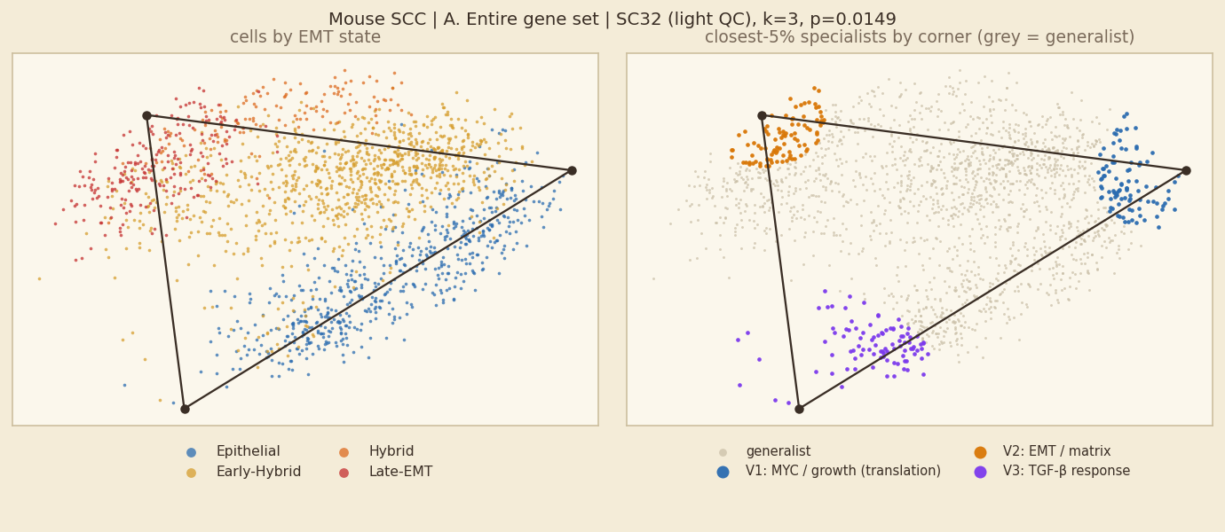
Mouse SCC: A. Entire gene set, unit SC32
Fit shown: light QC · k = 3 · p = 0.0149 · 1,910 cells · 200 shuffles
SIGNIFICANT permutation test, p ≤ 0.05
In plain words
Inside SC32 alone, cells fill a 3-corner simplex (p=0.0149). 4 of 8 units of this dataset have a significant simplex for this gene set.
Corners are programmes: MYC / growth (translation); EMT / matrix; TGF-β response.
Hybrid vs other cells: 66% of hybrid cells and 41% of other cells are generalists (rule 1; rule 2: 93% vs 75%), so hybrids are clearly more often generalists.
Corners and their tasks
V1 MYC / growth (translation) — Myc Targets V2 +1.76 SD; 98% S/G2M; 66% Epithelial; 100% SC32; Fabp5 Krt6a Krt14
V2 EMT / matrix — Epithelial Mesenchymal Transition +1.49 SD; 1% S/G2M; 73% Late-EMT; 100% SC32; Spp1 Vim Fn1
V3 TGF-β response — TGF-beta Signaling +1.03 SD; 24% S/G2M; 76% Epithelial; 100% SC32; Thbs1 Tmem176b Krt42
Left: cells coloured by EMT state (blue epithelial → red mesenchymal; hybrids are the two middle colours). Right: the 5% of cells nearest each corner coloured by corner, all other cells grey = generalists.
rule | % of hybrid cells that are generalists | % of other cells that are generalists
1 gap (top weight − second ≥ 0.35) | 66% | 41%
2 closest 5% of cells to each corner | 93% | 75%
3 weight > 0.95 on one corner | 100% | 99%
Hybrids are 57% of all cells here; 61% of cells lie inside the simplex.

Slide 12
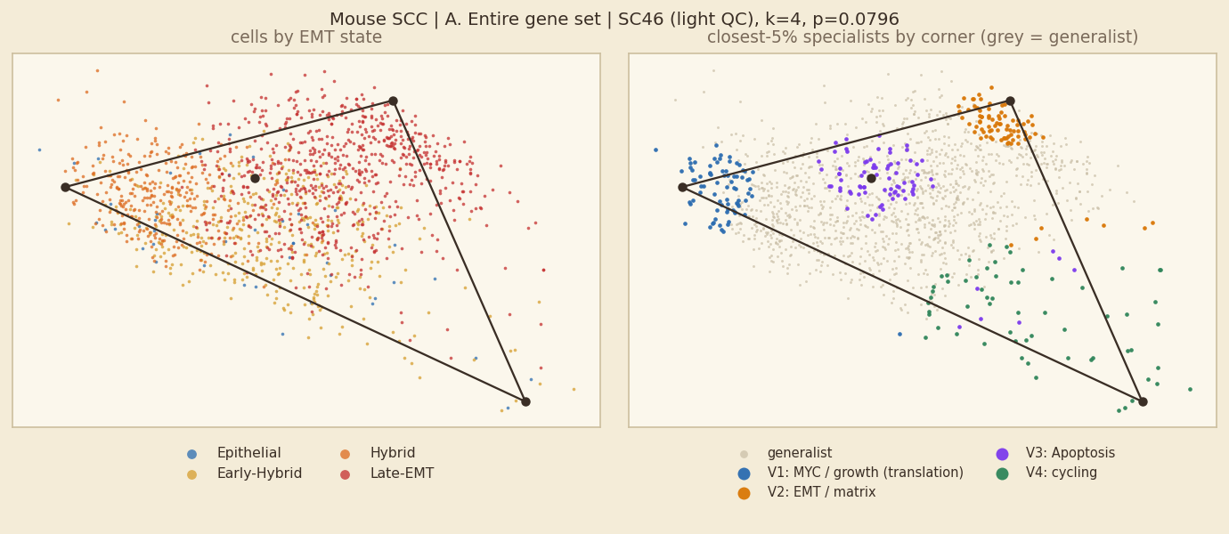
Mouse SCC: A. Entire gene set, unit SC46
Fit shown: light QC · k = 4 · p = 0.0796 · 1,519 cells · 200 shuffles
NOT SIGNIFICANT p > 0.05
In plain words
No simplex inside SC46: the fit (k=4, p=0.0796) is no more triangular than shuffled data, so its corners should not be read as tasks. 4 of 8 units of this dataset have a significant simplex for this gene set.
Hybrid vs other cells: 61% of hybrid cells and 33% of other cells are generalists (rule 1; rule 2: 84% vs 76%), so hybrids are clearly more often generalists. (No significant simplex, so this is descriptive only.)
Corners and their tasks (shown for completeness only)
V1 MYC / growth (translation) — Myc Targets V2 +1.98 SD; 95% S/G2M; 76% Hybrid; 100% SC46; Ccnd1 H2afz Birc5
V2 EMT / matrix — Epithelial Mesenchymal Transition +1.85 SD; 25% S/G2M; 100% Late-EMT; 100% SC46; Col3a1 Eln Bgn
V3 Apoptosis — Apoptosis +1.11 SD; 12% S/G2M; 95% Late-EMT; 100% SC46; Chil4 Gsn Nupr1
V4 cycling — Mitotic Spindle +1.15 SD; 51% S/G2M; 62% Early-Hybrid; 100% SC46; Neat1 Pcdh7 Hivep2
Left: cells coloured by EMT state (blue epithelial → red mesenchymal; hybrids are the two middle colours). Right: the 5% of cells nearest each corner coloured by corner, all other cells grey = generalists.
rule | % of hybrid cells that are generalists | % of other cells that are generalists
1 gap (top weight − second ≥ 0.35) | 61% | 33%
2 closest 5% of cells to each corner | 84% | 76%
3 weight > 0.95 on one corner | 100% | 100%
Hybrids are 50% of all cells here; 28% of cells lie inside the simplex.

Slide 13
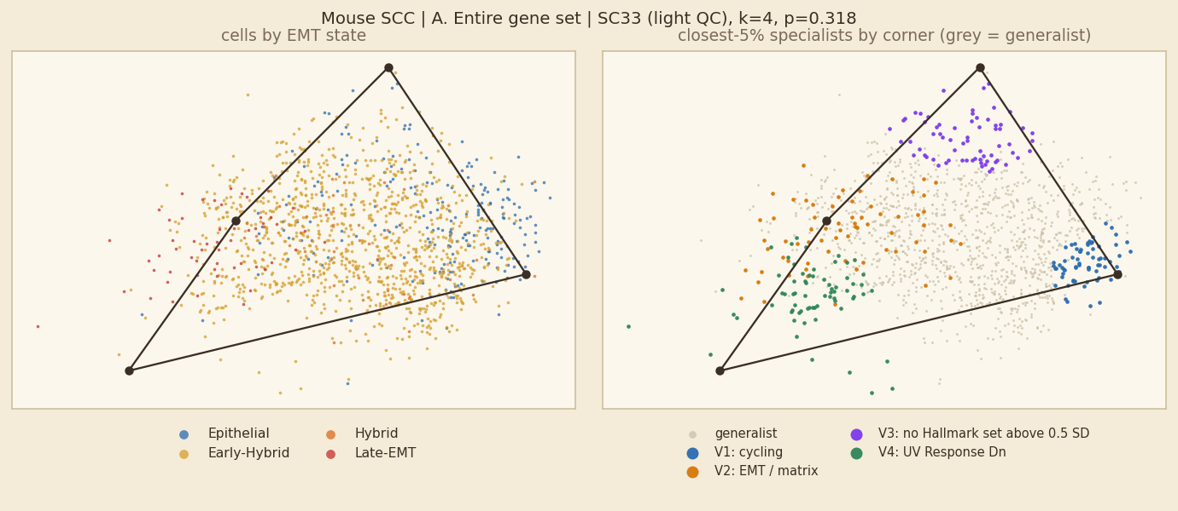
Mouse SCC: A. Entire gene set, unit SC33
Fit shown: light QC · k = 4 · p = 0.318 · 1,379 cells · 200 shuffles
NOT SIGNIFICANT p > 0.05
In plain words
No simplex inside SC33: the fit (k=4, p=0.318) is no more triangular than shuffled data, so its corners should not be read as tasks. 4 of 8 units of this dataset have a significant simplex for this gene set.
Hybrid vs other cells: 70% of hybrid cells and 47% of other cells are generalists (rule 1; rule 2: 83% vs 68%), so hybrids are clearly more often generalists. (No significant simplex, so this is descriptive only.)
Corners and their tasks (shown for completeness only)
V1 cycling — E2F Targets +1.72 SD; 100% S/G2M; 57% Early-Hybrid; 100% SC33; Hmgb2 Rrm2 Hist1h1b
V2 EMT / matrix — Epithelial Mesenchymal Transition +1.66 SD; 9% S/G2M; 54% Late-EMT; 100% SC33; Spp1 Fn1 Dcn
V3 no Hallmark set above 0.5 SD — no Hallmark set above 0.5 SD; 7% S/G2M; 68% Early-Hybrid; 100% SC33; Fabp5 Krtdap Ndufa4l2
V4 UV Response Dn — UV Response Dn +1.91 SD; 14% S/G2M; 96% Early-Hybrid; 100% SC33; Thbs1 Nr4a1 Fosb
Left: cells coloured by EMT state (blue epithelial → red mesenchymal; hybrids are the two middle colours). Right: the 5% of cells nearest each corner coloured by corner, all other cells grey = generalists.
rule | % of hybrid cells that are generalists | % of other cells that are generalists
1 gap (top weight − second ≥ 0.35) | 70% | 47%
2 closest 5% of cells to each corner | 83% | 68%
3 weight > 0.95 on one corner | 100% | 99%
Hybrids are 79% of all cells here; 44% of cells lie inside the simplex.

Slide 14
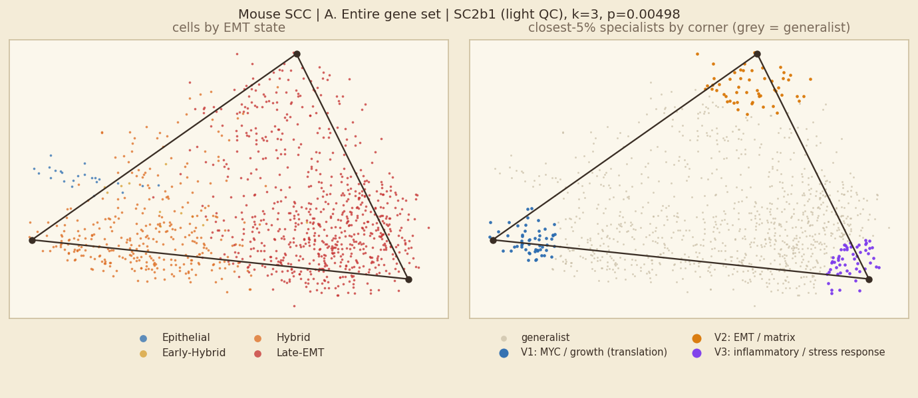
Mouse SCC: A. Entire gene set, unit SC2b1
Fit shown: light QC · k = 3 · p = 0.00498 · 1,099 cells · 200 shuffles
SIGNIFICANT permutation test, p ≤ 0.05
In plain words
Inside SC2b1 alone, cells fill a 3-corner simplex (p=0.00498). 4 of 8 units of this dataset have a significant simplex for this gene set.
Corners are programmes: MYC / growth (translation); EMT / matrix; inflammatory / stress response.
Hybrid vs other cells: 51% of hybrid cells and 41% of other cells are generalists (rule 1; rule 2: 83% vs 86%), so hybrids are clearly more often generalists.
Corners and their tasks
V1 MYC / growth (translation) — Myc Targets V2 +2.1 SD; 96% S/G2M; 100% Hybrid; 100% SC2b1; Hmgb2 Hist1h2ap Tuba1b
V2 EMT / matrix — Epithelial Mesenchymal Transition +1.53 SD; 5% S/G2M; 98% Late-EMT; 100% SC2b1; Mmp13 Col6a3 Mmp3
V3 inflammatory / stress response — TNF-alpha Signaling via NF-kB +1.31 SD; 31% S/G2M; 100% Late-EMT; 100% SC2b1; Cebpd Id3 Cst3
Left: cells coloured by EMT state (blue epithelial → red mesenchymal; hybrids are the two middle colours). Right: the 5% of cells nearest each corner coloured by corner, all other cells grey = generalists.
rule | % of hybrid cells that are generalists | % of other cells that are generalists
1 gap (top weight − second ≥ 0.35) | 51% | 41%
2 closest 5% of cells to each corner | 83% | 86%
3 weight > 0.95 on one corner | 99% | 99%
Hybrids are 31% of all cells here; 66% of cells lie inside the simplex.

Slide 15
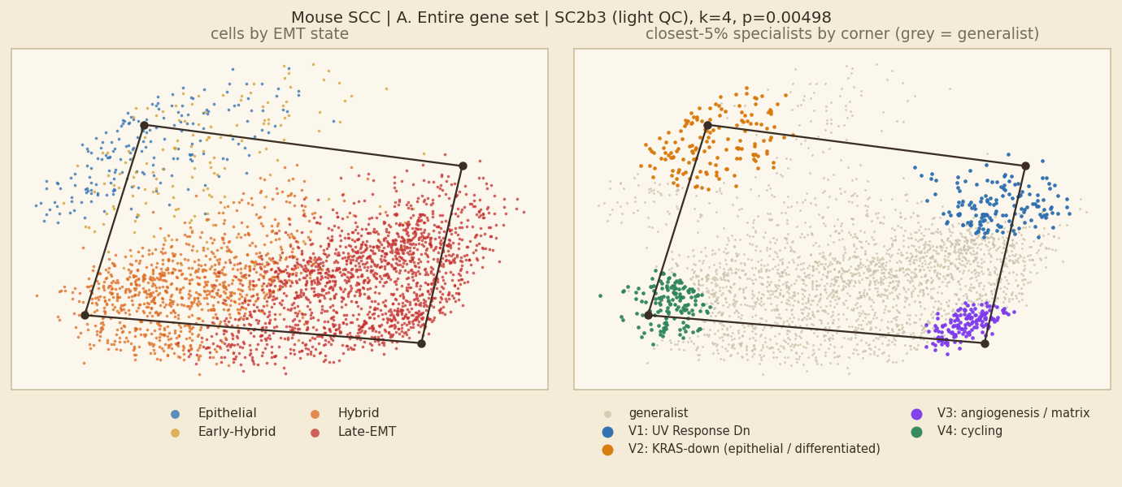
Mouse SCC: A. Entire gene set, unit SC2b3
Fit shown: light QC · k = 4 · p = 0.00498 · 2,961 cells · 200 shuffles
SIGNIFICANT permutation test, p ≤ 0.05
In plain words
Inside SC2b3 alone, cells fill a 4-corner simplex (p=0.00498). 4 of 8 units of this dataset have a significant simplex for this gene set.
Corners are programmes: UV Response Dn; KRAS-down (epithelial / differentiated); angiogenesis / matrix; cycling.
Hybrid vs other cells: 42% of hybrid cells and 62% of other cells are generalists (rule 1; rule 2: 82% vs 79%), so hybrids are less often generalists (they sit at corners).
Corners and their tasks
V1 UV Response Dn — UV Response Dn +1.37 SD; 19% S/G2M; 97% Late-EMT; 100% SC2b3; Malat1 Col5a2 Ahnak
V2 KRAS-down (epithelial / differentiated) — KRAS Signaling Dn +1.5 SD; 62% S/G2M; 68% Epithelial; 100% SC2b3; Krt14 Krt5 Krt17
V3 angiogenesis / matrix — Angiogenesis +1.62 SD; 4% S/G2M; 100% Late-EMT; 100% SC2b3; Mmp3 Col3a1 Spp1
V4 cycling — E2F Targets +2.05 SD; 97% S/G2M; 100% Hybrid; 100% SC2b3; Hmgb2 H2afz Ran
Left: cells coloured by EMT state (blue epithelial → red mesenchymal; hybrids are the two middle colours). Right: the 5% of cells nearest each corner coloured by corner, all other cells grey = generalists.
rule | % of hybrid cells that are generalists | % of other cells that are generalists
1 gap (top weight − second ≥ 0.35) | 42% | 62%
2 closest 5% of cells to each corner | 82% | 79%
3 weight > 0.95 on one corner | 100% | 100%
Hybrids are 38% of all cells here; 20% of cells lie inside the simplex.

Slide 16
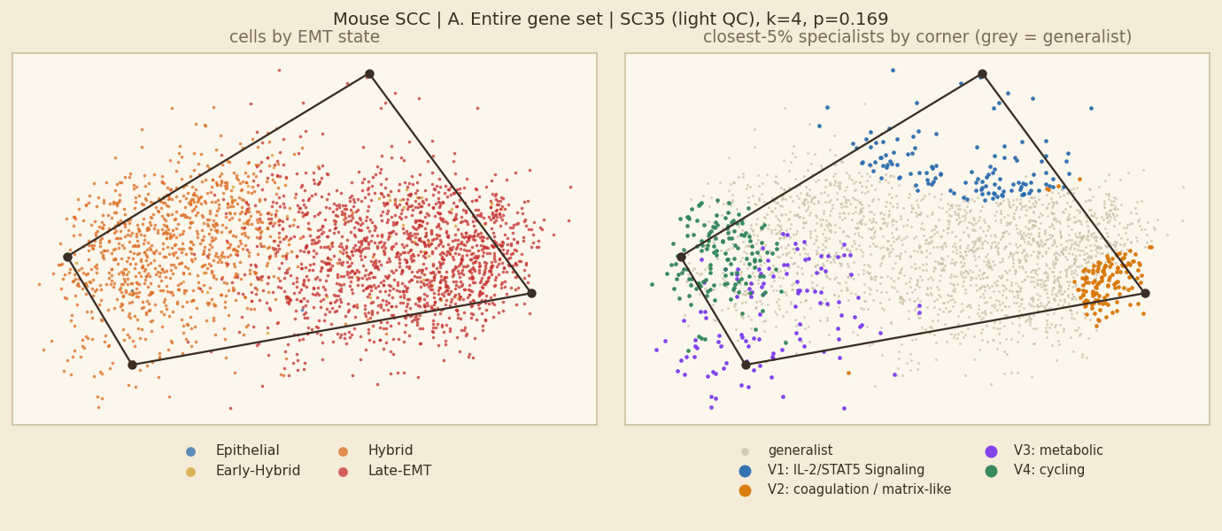
Mouse SCC: A. Entire gene set, unit SC35
Fit shown: light QC · k = 4 · p = 0.169 · 2,574 cells · 200 shuffles
NOT SIGNIFICANT p > 0.05
In plain words
No simplex inside SC35: the fit (k=4, p=0.169) is no more triangular than shuffled data, so its corners should not be read as tasks. 4 of 8 units of this dataset have a significant simplex for this gene set.
Hybrid vs other cells: 67% of hybrid cells and 58% of other cells are generalists (rule 1; rule 2: 73% vs 84%), so hybrids are clearly more often generalists. (No significant simplex, so this is descriptive only.)
Corners and their tasks (shown for completeness only)
V1 IL-2/STAT5 Signaling — IL-2/STAT5 Signaling +0.86 SD; 5% S/G2M; 82% Late-EMT; 100% SC35; Ereg Ptgs2 Neat1
V2 coagulation / matrix-like — Coagulation +1.26 SD; 1% S/G2M; 100% Late-EMT; 100% SC35; Postn Mmp13 Col3a1
V3 metabolic — Oxidative Phosphorylation +1.51 SD; 41% S/G2M; 91% Hybrid; 100% SC35; Akr1b3 S100a4 Upp1
V4 cycling — E2F Targets +2.24 SD; 100% S/G2M; 100% Hybrid; 100% SC35; Hmgb2 Ccnd1 H2afz
Left: cells coloured by EMT state (blue epithelial → red mesenchymal; hybrids are the two middle colours). Right: the 5% of cells nearest each corner coloured by corner, all other cells grey = generalists.
rule | % of hybrid cells that are generalists | % of other cells that are generalists
1 gap (top weight − second ≥ 0.35) | 67% | 58%
2 closest 5% of cells to each corner | 73% | 84%
3 weight > 0.95 on one corner | 100% | 100%
Hybrids are 40% of all cells here; 33% of cells lie inside the simplex.

Slide 17
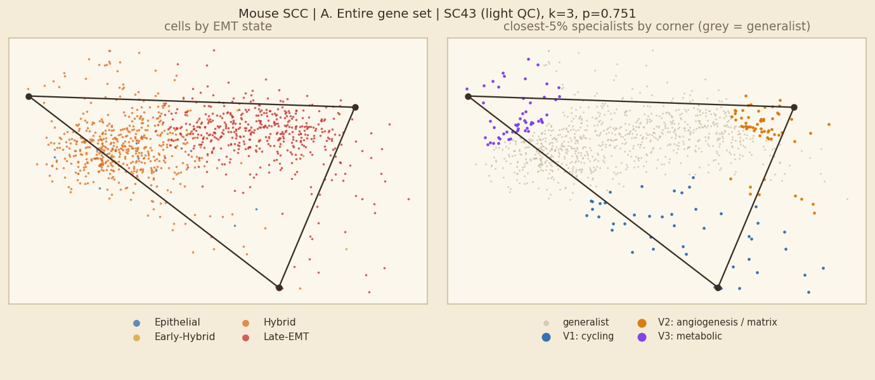
Mouse SCC: A. Entire gene set, unit SC43
Fit shown: light QC · k = 3 · p = 0.751 · 1,041 cells · 200 shuffles
NOT SIGNIFICANT p > 0.05
In plain words
No simplex inside SC43: the fit (k=3, p=0.751) is no more triangular than shuffled data, so its corners should not be read as tasks. 4 of 8 units of this dataset have a significant simplex for this gene set.
Hybrid vs other cells: 50% of hybrid cells and 57% of other cells are generalists (rule 1; rule 2: 86% vs 83%), so hybrids are less often generalists (they sit at corners). (No significant simplex, so this is descriptive only.)
Corners and their tasks (shown for completeness only)
V1 cycling — Mitotic Spindle +0.79 SD; 79% S/G2M; 51% Late-EMT; 100% SC43; Malat1 AY036118 Colec12
V2 angiogenesis / matrix — Angiogenesis +1.56 SD; 0% S/G2M; 100% Late-EMT; 100% SC43; Postn Spp1 Igfbp7
V3 metabolic — Oxidative Phosphorylation +1.19 SD; 98% S/G2M; 100% Hybrid; 100% SC43; Selenoh Crisp1 H2afz
Left: cells coloured by EMT state (blue epithelial → red mesenchymal; hybrids are the two middle colours). Right: the 5% of cells nearest each corner coloured by corner, all other cells grey = generalists.
rule | % of hybrid cells that are generalists | % of other cells that are generalists
1 gap (top weight − second ≥ 0.35) | 50% | 57%
2 closest 5% of cells to each corner | 86% | 83%
3 weight > 0.95 on one corner | 100% | 100%
Hybrids are 53% of all cells here; 74% of cells lie inside the simplex.

Slide 18
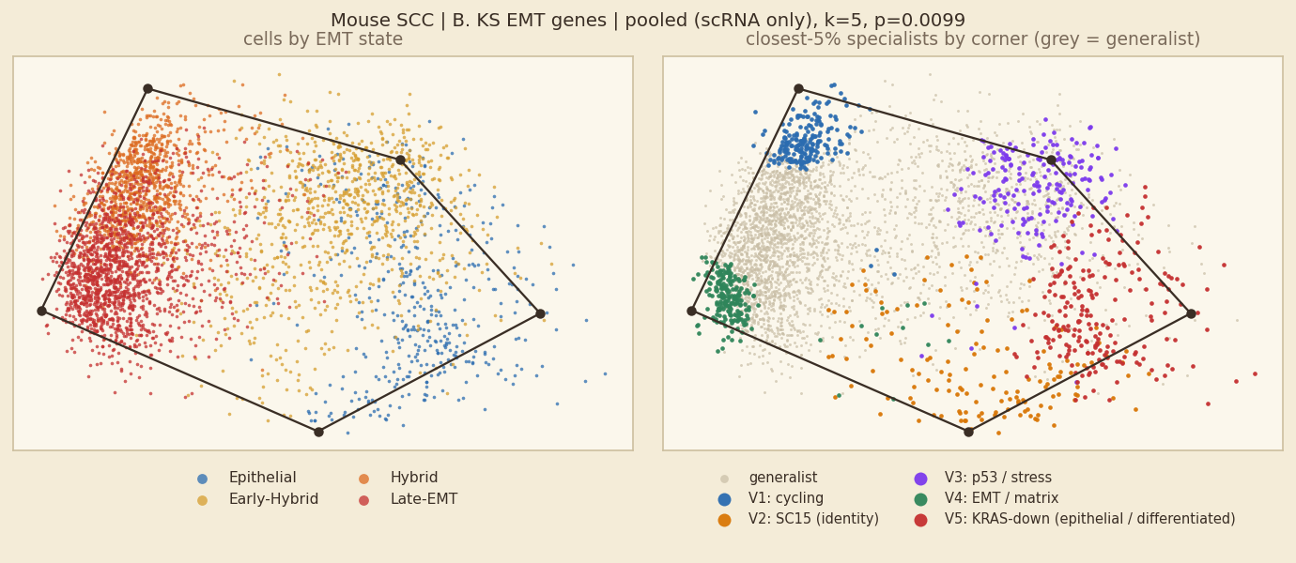
Mouse SCC: B. KS EMT genes, pooled fit
Fit shown: scRNA only · k = 5 · p = 0.0099 · 14,059 cells · 100 shuffles | comparison, light QC: k=5, p=0.0945
SIGNIFICANT permutation test, p ≤ 0.05
In plain words
A significant simplex (k=5, p=0.0099) whose corners mix samples (no corner is 70% or more one sample), so it is not a pure sample-identity simplex.
Corners are programmes: cycling; p53 / stress; EMT / matrix; KRAS-down (epithelial / differentiated).
Hybrid vs other cells: 68% of hybrid cells and 56% of other cells are generalists (rule 1; rule 2: 75% vs 75%), so hybrids are clearly more often generalists.
Corners and their tasks
V1 cycling — E2F Targets +1.02 SD; 72% S/G2M; 95% Hybrid; Krt8 Lgals1 Vim
V2 identity corner: SC15 (programme: cycling) — Mitotic Spindle +1.38 SD; 33% S/G2M; 51% Epithelial; 74% SC15; Dsp Rabgap1l Ank3
V3 p53 / stress — p53 Pathway +1.38 SD; 34% S/G2M; 96% Early-Hybrid; Slpi Sfn Aqp3
V4 EMT / matrix — Epithelial Mesenchymal Transition +1.66 SD; 10% S/G2M; 98% Late-EMT; Col5a2 Sparc Fstl1
V5 KRAS-down (epithelial / differentiated) — KRAS Signaling Dn +1.15 SD; 44% S/G2M; 84% Epithelial; 68% SC32; Fxyd3 Sfn Epcam
KS genes overlap the EMT set: an 'EMT / matrix' label is partly expected.
Left: cells coloured by EMT state (blue epithelial → red mesenchymal; hybrids are the two middle colours). Right: the 5% of cells nearest each corner coloured by corner, all other cells grey = generalists.
rule | % of hybrid cells that are generalists | % of other cells that are generalists
1 gap (top weight − second ≥ 0.35) | 68% | 56%
2 closest 5% of cells to each corner | 75% | 75%
3 weight > 0.95 on one corner | 100% | 100%
Hybrids are 49% of all cells here; 8% of cells lie inside the simplex.

Slide 19
Mouse SCC: B. KS EMT genes, all units at a glance
Main fit of each unit: 3 of 8 units have a significant simplex
unit | fit shown | k | p | light-QC p | hybrid % of cells | hybrids→generalist (1/2/3) | generalists→hybrid (1/2/3)
SC15 | light QC | 3 | 0.184 | – | 58% | 73 / 89 / 100% | 77 / 61 / 58%
SC32 | light QC | 3 | 0.00498 * | – | 57% | 61 / 86 / 100% | 72 / 58 / 57%
SC46 | light QC | 3 | 0.164 | – | 50% | 65 / 82 / 100% | 59 / 48 / 50%
SC33 | light QC | 3 | 0.0746 | – | 79% | 67 / 88 / 100% | 80 / 82 / 79%
SC2b1 | light QC | 4 | 0.0547 | – | 31% | 42 / 76 / 99% | 24 / 29 / 30%
SC2b3 | light QC | 3 | 0.00498 * | – | 38% | 43 / 82 / 100% | 39 / 37 / 38%
SC35 | light QC | 4 | 0.00995 * | – | 40% | 75 / 78 / 100% | 43 / 39 / 40%
SC43 | light QC | 3 | 0.109 | – | 53% | 45 / 88 / 99% | 45 / 55 / 53%
* p ≤ 0.05 for the fit shown. Rules: 1 = gap, 2 = closest 5%, 3 = weight > 0.95. One slide per unit follows; non-significant units are included for completeness and their corners should not be read as tasks.

Slide 20
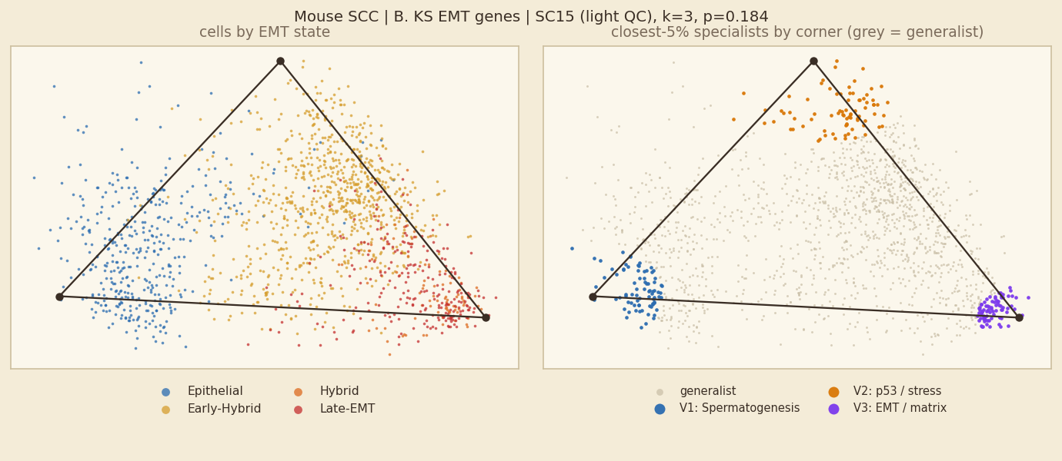
Mouse SCC: B. KS EMT genes, unit SC15
Fit shown: light QC · k = 3 · p = 0.184 · 1,576 cells · 200 shuffles
NOT SIGNIFICANT p > 0.05
In plain words
No simplex inside SC15: the fit (k=3, p=0.184) is no more triangular than shuffled data, so its corners should not be read as tasks. 3 of 8 units of this dataset have a significant simplex for this gene set.
Hybrid vs other cells: 73% of hybrid cells and 30% of other cells are generalists (rule 1; rule 2: 89% vs 80%), so hybrids are clearly more often generalists. (No significant simplex, so this is descriptive only.)
Corners and their tasks (shown for completeness only)
V1 Spermatogenesis — Spermatogenesis +1.15 SD; 19% S/G2M; 100% Epithelial; 100% SC15; Ank3 Arap2 Epcam
V2 p53 / stress — p53 Pathway +1.15 SD; 23% S/G2M; 97% Early-Hybrid; 100% SC15; Slpi Aqp3 Areg
V3 EMT / matrix — Epithelial Mesenchymal Transition +2.03 SD; 59% S/G2M; 66% Late-EMT; 100% SC15; Lgals1 Vim Col5a2
KS genes overlap the EMT set: an 'EMT / matrix' label is partly expected.
Left: cells coloured by EMT state (blue epithelial → red mesenchymal; hybrids are the two middle colours). Right: the 5% of cells nearest each corner coloured by corner, all other cells grey = generalists.
rule | % of hybrid cells that are generalists | % of other cells that are generalists
1 gap (top weight − second ≥ 0.35) | 73% | 30%
2 closest 5% of cells to each corner | 89% | 80%
3 weight > 0.95 on one corner | 100% | 99%
Hybrids are 58% of all cells here; 71% of cells lie inside the simplex.

Slide 21
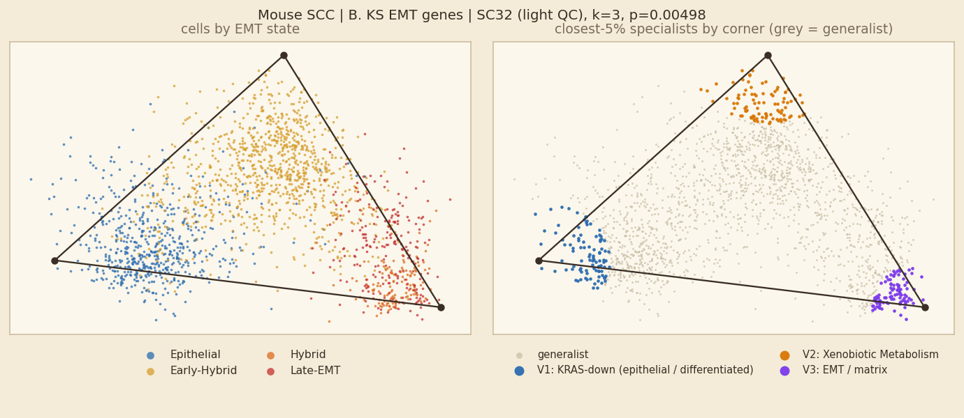
Mouse SCC: B. KS EMT genes, unit SC32
Fit shown: light QC · k = 3 · p = 0.00498 · 1,910 cells · 200 shuffles
SIGNIFICANT permutation test, p ≤ 0.05
In plain words
Inside SC32 alone, cells fill a 3-corner simplex (p=0.00498). 3 of 8 units of this dataset have a significant simplex for this gene set.
Corners are programmes: KRAS-down (epithelial / differentiated); Xenobiotic Metabolism; EMT / matrix.
Hybrid vs other cells: 61% of hybrid cells and 31% of other cells are generalists (rule 1; rule 2: 86% vs 83%), so hybrids are clearly more often generalists.
Corners and their tasks
V1 KRAS-down (epithelial / differentiated) — KRAS Signaling Dn +0.64 SD; 48% S/G2M; 98% Epithelial; 100% SC32; S100a14 Gpx2 Epcam
V2 Xenobiotic Metabolism — Xenobiotic Metabolism +0.92 SD; 19% S/G2M; 100% Early-Hybrid; 100% SC32; Slpi Areg Aqp3
V3 EMT / matrix — Epithelial Mesenchymal Transition +1.18 SD; 32% S/G2M; 56% Hybrid; 100% SC32; Vim Lgals1 Krt8
KS genes overlap the EMT set: an 'EMT / matrix' label is partly expected.
Left: cells coloured by EMT state (blue epithelial → red mesenchymal; hybrids are the two middle colours). Right: the 5% of cells nearest each corner coloured by corner, all other cells grey = generalists.
rule | % of hybrid cells that are generalists | % of other cells that are generalists
1 gap (top weight − second ≥ 0.35) | 61% | 31%
2 closest 5% of cells to each corner | 86% | 83%
3 weight > 0.95 on one corner | 100% | 100%
Hybrids are 57% of all cells here; 82% of cells lie inside the simplex.

Slide 22
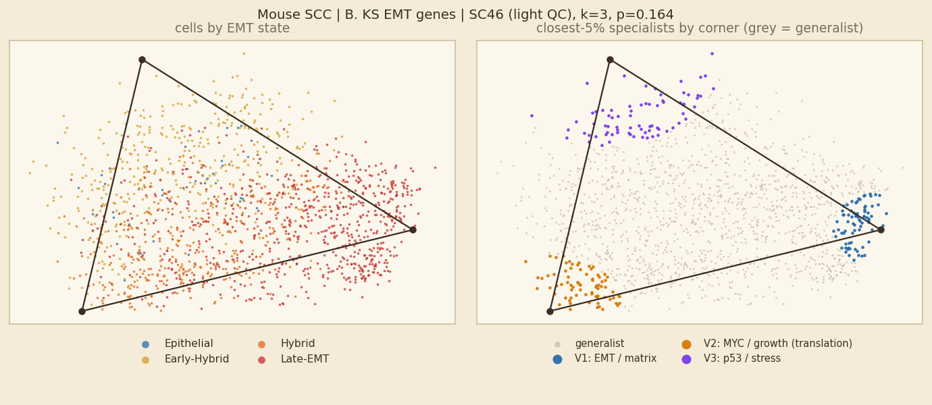
Mouse SCC: B. KS EMT genes, unit SC46
Fit shown: light QC · k = 3 · p = 0.164 · 1,519 cells · 200 shuffles
NOT SIGNIFICANT p > 0.05
In plain words
No simplex inside SC46: the fit (k=3, p=0.164) is no more triangular than shuffled data, so its corners should not be read as tasks. 3 of 8 units of this dataset have a significant simplex for this gene set.
Hybrid vs other cells: 65% of hybrid cells and 44% of other cells are generalists (rule 1; rule 2: 82% vs 88%), so hybrids are clearly more often generalists. (No significant simplex, so this is descriptive only.)
Corners and their tasks (shown for completeness only)
V1 EMT / matrix — Epithelial Mesenchymal Transition +1.82 SD; 20% S/G2M; 100% Late-EMT; 100% SC46; Col5a2 Fstl1 Sparc
V2 MYC / growth (translation) — Myc Targets V2 +1.25 SD; 68% S/G2M; 61% Hybrid; 100% SC46; Krt18 Areg Krt8
V3 p53 / stress — p53 Pathway +1.04 SD; 25% S/G2M; 93% Early-Hybrid; 100% SC46; Fxyd3 Slpi Sfn
KS genes overlap the EMT set: an 'EMT / matrix' label is partly expected.
Left: cells coloured by EMT state (blue epithelial → red mesenchymal; hybrids are the two middle colours). Right: the 5% of cells nearest each corner coloured by corner, all other cells grey = generalists.
rule | % of hybrid cells that are generalists | % of other cells that are generalists
1 gap (top weight − second ≥ 0.35) | 65% | 44%
2 closest 5% of cells to each corner | 82% | 88%
3 weight > 0.95 on one corner | 100% | 100%
Hybrids are 50% of all cells here; 66% of cells lie inside the simplex.

Slide 23
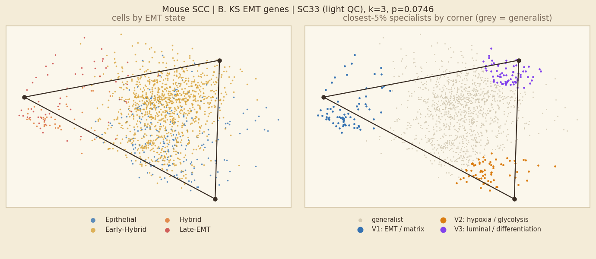
Mouse SCC: B. KS EMT genes, unit SC33
Fit shown: light QC · k = 3 · p = 0.0746 · 1,379 cells · 200 shuffles
NOT SIGNIFICANT p > 0.05
In plain words
No simplex inside SC33: the fit (k=3, p=0.0746) is no more triangular than shuffled data, so its corners should not be read as tasks. 3 of 8 units of this dataset have a significant simplex for this gene set.
Hybrid vs other cells: 67% of hybrid cells and 65% of other cells are generalists (rule 1; rule 2: 88% vs 74%), so no real difference. (No significant simplex, so this is descriptive only.)
Corners and their tasks (shown for completeness only)
V1 EMT / matrix — Epithelial Mesenchymal Transition +1.66 SD; 30% S/G2M; 51% Hybrid; 100% SC33; Col5a2 Vim Krt8
V2 hypoxia / glycolysis — Glycolysis +0.57 SD; 46% S/G2M; 58% Epithelial; 100% SC33; S100a14 Aqp3 Sfn
V3 luminal / differentiation — Estrogen Response Early +0.73 SD; 14% S/G2M; 96% Early-Hybrid; 100% SC33; Slpi Krt18 Aqp3
KS genes overlap the EMT set: an 'EMT / matrix' label is partly expected.
Left: cells coloured by EMT state (blue epithelial → red mesenchymal; hybrids are the two middle colours). Right: the 5% of cells nearest each corner coloured by corner, all other cells grey = generalists.
rule | % of hybrid cells that are generalists | % of other cells that are generalists
1 gap (top weight − second ≥ 0.35) | 67% | 65%
2 closest 5% of cells to each corner | 88% | 74%
3 weight > 0.95 on one corner | 100% | 100%
Hybrids are 79% of all cells here; 83% of cells lie inside the simplex.

Slide 24
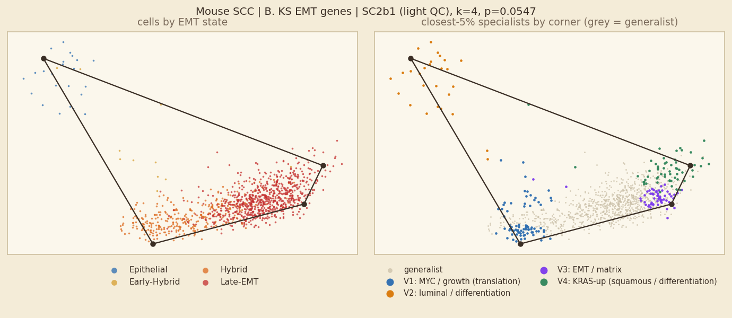
Mouse SCC: B. KS EMT genes, unit SC2b1
Fit shown: light QC · k = 4 · p = 0.0547 · 1,099 cells · 200 shuffles
NOT SIGNIFICANT p > 0.05
In plain words
No simplex inside SC2b1: the fit (k=4, p=0.0547) is no more triangular than shuffled data, so its corners should not be read as tasks. 3 of 8 units of this dataset have a significant simplex for this gene set.
Hybrid vs other cells: 42% of hybrid cells and 59% of other cells are generalists (rule 1; rule 2: 76% vs 82%), so hybrids are less often generalists (they sit at corners). (No significant simplex, so this is descriptive only.)
Corners and their tasks (shown for completeness only)
V1 MYC / growth (translation) — Myc Targets V1 +1.55 SD; 75% S/G2M; 96% Hybrid; 100% SC2b1; Krt8 Map1b Emp3
V2 luminal / differentiation — Estrogen Response Late +1.66 SD; 47% S/G2M; 42% Epithelial; 100% SC2b1; Sfn Areg Perp
V3 EMT / matrix — Epithelial Mesenchymal Transition +1.05 SD; 16% S/G2M; 98% Late-EMT; 100% SC2b1; Col5a2 Sparc Hes1
V4 KRAS-up (squamous / differentiation) — KRAS Signaling Up +0.89 SD; 15% S/G2M; 98% Late-EMT; 100% SC2b1; Slpi Col5a2 Fstl1
KS genes overlap the EMT set: an 'EMT / matrix' label is partly expected.
Left: cells coloured by EMT state (blue epithelial → red mesenchymal; hybrids are the two middle colours). Right: the 5% of cells nearest each corner coloured by corner, all other cells grey = generalists.
rule | % of hybrid cells that are generalists | % of other cells that are generalists
1 gap (top weight − second ≥ 0.35) | 42% | 59%
2 closest 5% of cells to each corner | 76% | 82%
3 weight > 0.95 on one corner | 99% | 100%
Hybrids are 31% of all cells here; 50% of cells lie inside the simplex.

Slide 25
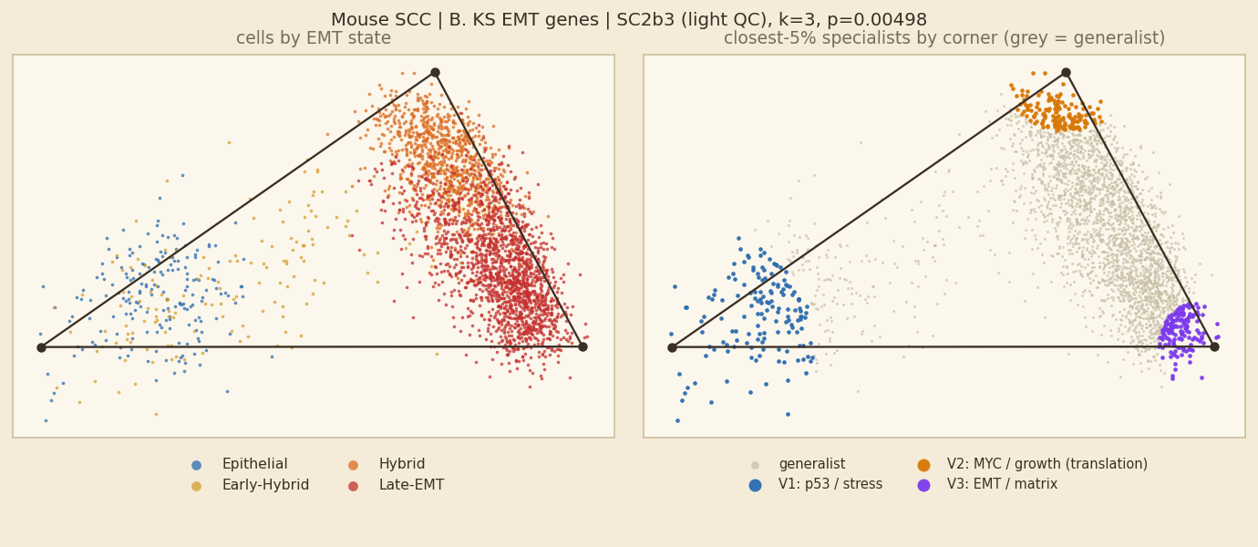
Mouse SCC: B. KS EMT genes, unit SC2b3
Fit shown: light QC · k = 3 · p = 0.00498 · 2,961 cells · 200 shuffles
SIGNIFICANT permutation test, p ≤ 0.05
In plain words
Inside SC2b3 alone, cells fill a 3-corner simplex (p=0.00498). 3 of 8 units of this dataset have a significant simplex for this gene set.
Corners are programmes: p53 / stress; MYC / growth (translation); EMT / matrix.
Hybrid vs other cells: 43% of hybrid cells and 42% of other cells are generalists (rule 1; rule 2: 82% vs 87%), so no real difference.
Corners and their tasks
V1 p53 / stress — p53 Pathway +1.78 SD; 46% S/G2M; 65% Epithelial; 100% SC2b3; Sfn Perp Sdc1
V2 MYC / growth (translation) — Myc Targets V1 +1.47 SD; 81% S/G2M; 99% Hybrid; 100% SC2b3; Krt8 Krt18 Lgals1
V3 EMT / matrix — Epithelial Mesenchymal Transition +1.59 SD; 11% S/G2M; 100% Late-EMT; 100% SC2b3; Col5a2 Sparc Fstl1
KS genes overlap the EMT set: an 'EMT / matrix' label is partly expected.
Left: cells coloured by EMT state (blue epithelial → red mesenchymal; hybrids are the two middle colours). Right: the 5% of cells nearest each corner coloured by corner, all other cells grey = generalists.
rule | % of hybrid cells that are generalists | % of other cells that are generalists
1 gap (top weight − second ≥ 0.35) | 43% | 42%
2 closest 5% of cells to each corner | 82% | 87%
3 weight > 0.95 on one corner | 100% | 99%
Hybrids are 38% of all cells here; 86% of cells lie inside the simplex.

Slide 26
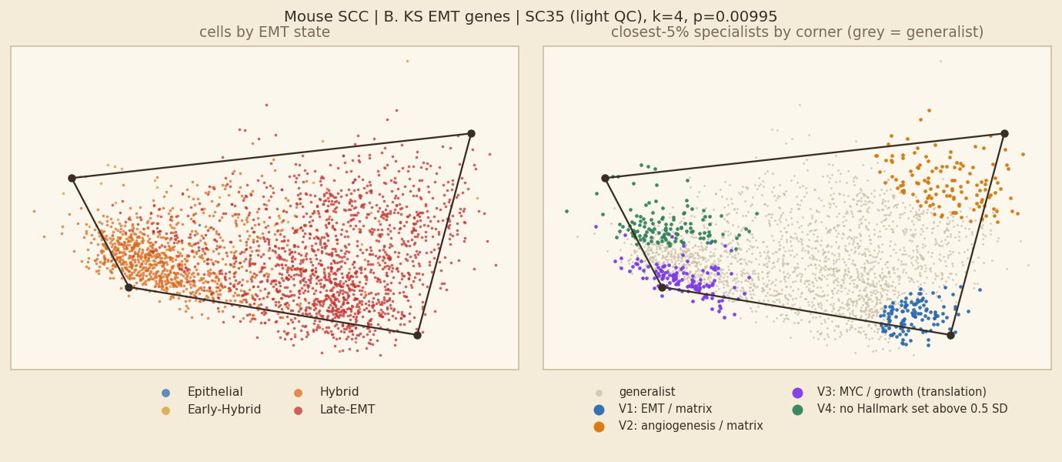
Mouse SCC: B. KS EMT genes, unit SC35
Fit shown: light QC · k = 4 · p = 0.00995 · 2,574 cells · 200 shuffles
SIGNIFICANT permutation test, p ≤ 0.05
In plain words
Inside SC35 alone, cells fill a 4-corner simplex (p=0.00995). 3 of 8 units of this dataset have a significant simplex for this gene set.
Corners are programmes: EMT / matrix; angiogenesis / matrix; MYC / growth (translation); no Hallmark set above 0.5 SD.
Hybrid vs other cells: 75% of hybrid cells and 66% of other cells are generalists (rule 1; rule 2: 78% vs 81%), so hybrids are clearly more often generalists.
Corners and their tasks
V1 EMT / matrix — Epithelial Mesenchymal Transition +1.37 SD; 2% S/G2M; 99% Late-EMT; 100% SC35; Col5a2 Sparc Fstl1
V2 angiogenesis / matrix — Angiogenesis +1.04 SD; 2% S/G2M; 98% Late-EMT; 100% SC35; Slpi Col5a2 Sparc
V3 MYC / growth (translation) — Myc Targets V1 +1.29 SD; 67% S/G2M; 96% Hybrid; 100% SC35; Tuba1a Map1b Krt8
V4 no Hallmark set above 0.5 SD — no Hallmark set above 0.5 SD; 29% S/G2M; 64% Hybrid; 100% SC35; Areg Cd9 Krt18
KS genes overlap the EMT set: an 'EMT / matrix' label is partly expected.
Left: cells coloured by EMT state (blue epithelial → red mesenchymal; hybrids are the two middle colours). Right: the 5% of cells nearest each corner coloured by corner, all other cells grey = generalists.
rule | % of hybrid cells that are generalists | % of other cells that are generalists
1 gap (top weight − second ≥ 0.35) | 75% | 66%
2 closest 5% of cells to each corner | 78% | 81%
3 weight > 0.95 on one corner | 100% | 100%
Hybrids are 40% of all cells here; 42% of cells lie inside the simplex.

Slide 27
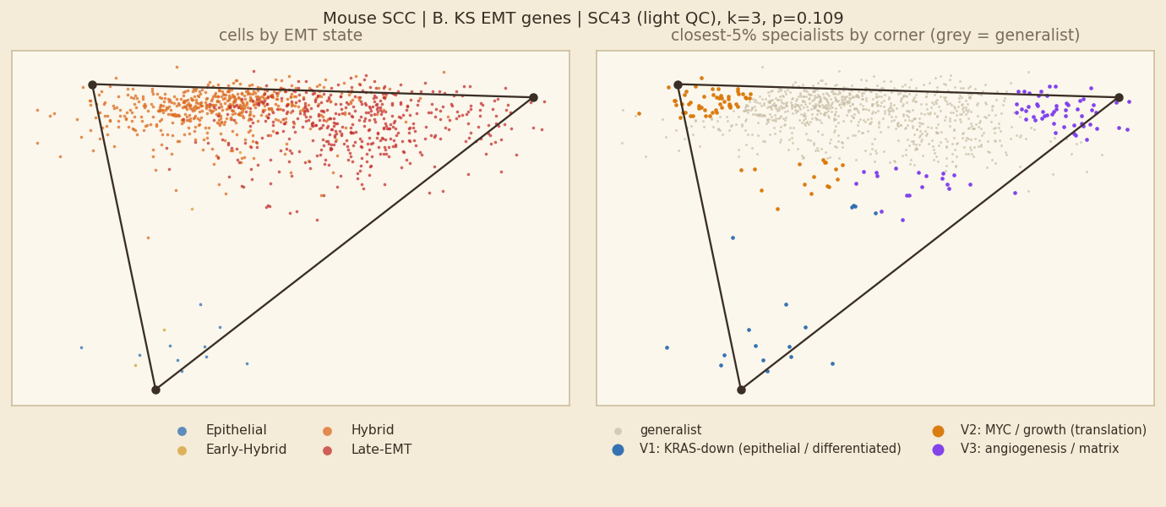
Mouse SCC: B. KS EMT genes, unit SC43
Fit shown: light QC · k = 3 · p = 0.109 · 1,041 cells · 200 shuffles
NOT SIGNIFICANT p > 0.05
In plain words
No simplex inside SC43: the fit (k=3, p=0.109) is no more triangular than shuffled data, so its corners should not be read as tasks. 3 of 8 units of this dataset have a significant simplex for this gene set.
Hybrid vs other cells: 45% of hybrid cells and 62% of other cells are generalists (rule 1; rule 2: 88% vs 81%), so hybrids are less often generalists (they sit at corners). (No significant simplex, so this is descriptive only.)
Corners and their tasks (shown for completeness only)
V1 KRAS-down (epithelial / differentiated) — KRAS Signaling Dn +0.79 SD; 49% S/G2M; 55% Late-EMT; 100% SC43; Areg Perp Epcam
V2 MYC / growth (translation) — Myc Targets V1 +0.88 SD; 85% S/G2M; 100% Hybrid; 100% SC43; Krt8 Krt18 Lgals1
V3 angiogenesis / matrix — Angiogenesis +2.09 SD; 11% S/G2M; 98% Late-EMT; 100% SC43; Col5a2 Sparc Loxl2
KS genes overlap the EMT set: an 'EMT / matrix' label is partly expected.
Left: cells coloured by EMT state (blue epithelial → red mesenchymal; hybrids are the two middle colours). Right: the 5% of cells nearest each corner coloured by corner, all other cells grey = generalists.
rule | % of hybrid cells that are generalists | % of other cells that are generalists
1 gap (top weight − second ≥ 0.35) | 45% | 62%
2 closest 5% of cells to each corner | 88% | 81%
3 weight > 0.95 on one corner | 99% | 99%
Hybrids are 53% of all cells here; 89% of cells lie inside the simplex.

Slide 28
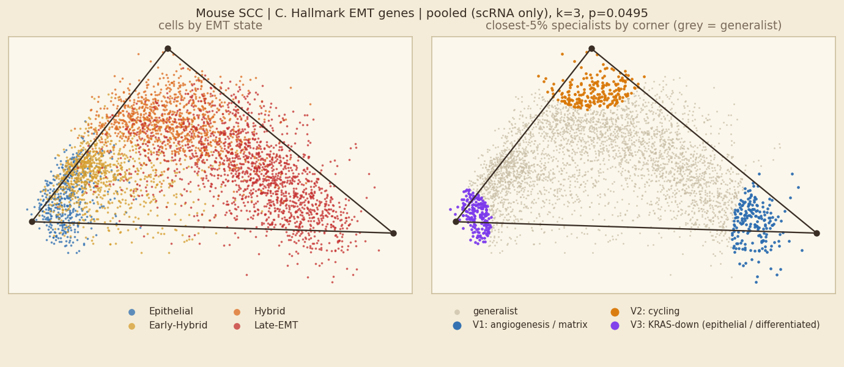
Mouse SCC: C. Hallmark EMT genes, pooled fit
Fit shown: scRNA only · k = 3 · p = 0.0495 · 14,059 cells · 100 shuffles | comparison, light QC: k=5, p=0.277
SIGNIFICANT permutation test, p ≤ 0.05
In plain words
A significant simplex (k=3, p=0.0495) whose corners mix samples (no corner is 70% or more one sample), so it is not a pure sample-identity simplex.
Corners are programmes: angiogenesis / matrix; cycling; KRAS-down (epithelial / differentiated).
Hybrid vs other cells: 57% of hybrid cells and 52% of other cells are generalists (rule 1; rule 2: 89% vs 81%), so hybrids are slightly more often generalists.
Corners and their tasks
V1 angiogenesis / matrix — Angiogenesis +1.76 SD; 7% S/G2M; 99% Late-EMT; Col3a1 Postn Col1a1
V2 cycling — E2F Targets +0.94 SD; 67% S/G2M; 86% Hybrid; Mgp Timp1 Lgals1
V3 KRAS-down (epithelial / differentiated) — KRAS Signaling Dn +1.22 SD; 41% S/G2M; 79% Epithelial; Lama3 Sfrp1 Lamc2
Hallmark EMT set left out when naming (circular: fitted on those genes).
Left: cells coloured by EMT state (blue epithelial → red mesenchymal; hybrids are the two middle colours). Right: the 5% of cells nearest each corner coloured by corner, all other cells grey = generalists.
rule | % of hybrid cells that are generalists | % of other cells that are generalists
1 gap (top weight − second ≥ 0.35) | 57% | 52%
2 closest 5% of cells to each corner | 89% | 81%
3 weight > 0.95 on one corner | 100% | 99%
Hybrids are 49% of all cells here; 83% of cells lie inside the simplex.

Slide 29
Mouse SCC: C. Hallmark EMT genes, all units at a glance
Main fit of each unit: 3 of 8 units have a significant simplex
unit | fit shown | k | p | light-QC p | hybrid % of cells | hybrids→generalist (1/2/3) | generalists→hybrid (1/2/3)
SC15 | light QC | 4 | 0.0249 * | – | 58% | 58 / 82 / 100% | 64 / 60 / 58%
SC32 | light QC | 3 | 0.0299 * | – | 57% | 61 / 89 / 100% | 70 / 60 / 58%
SC46 | light QC | 4 | 0.348 | – | 50% | 54 / 82 / 100% | 47 / 52 / 50%
SC33 | light QC | 4 | 0.692 | – | 79% | 64 / 82 / 100% | 75 / 81 / 79%
SC2b1 | light QC | 3 | 0.00995 * | – | 31% | 54 / 85 / 100% | 33 / 31 / 31%
SC2b3 | light QC | 3 | 0.154 | – | 38% | 62 / 88 / 100% | 37 / 39 / 38%
SC35 | light QC | 4 | 0.522 | – | 40% | 75 / 78 / 100% | 41 / 39 / 40%
SC43 | light QC | 3 | 0.219 | – | 53% | 59 / 91 / 100% | 57 / 57 / 53%
* p ≤ 0.05 for the fit shown. Rules: 1 = gap, 2 = closest 5%, 3 = weight > 0.95. One slide per unit follows; non-significant units are included for completeness and their corners should not be read as tasks.

Slide 30
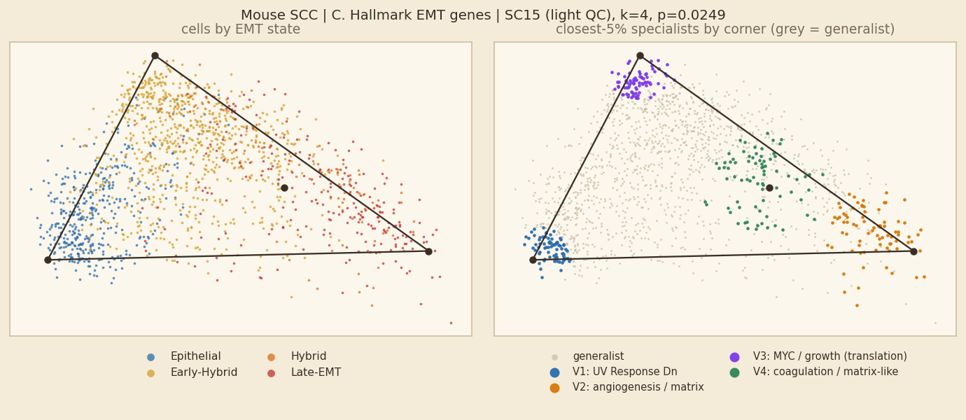
Mouse SCC: C. Hallmark EMT genes, unit SC15
Fit shown: light QC · k = 4 · p = 0.0249 · 1,576 cells · 200 shuffles
SIGNIFICANT permutation test, p ≤ 0.05
In plain words
Inside SC15 alone, cells fill a 4-corner simplex (p=0.0249). 3 of 8 units of this dataset have a significant simplex for this gene set.
Corners are programmes: UV Response Dn; angiogenesis / matrix; MYC / growth (translation); coagulation / matrix-like.
Hybrid vs other cells: 58% of hybrid cells and 46% of other cells are generalists (rule 1; rule 2: 82% vs 77%), so hybrids are clearly more often generalists.
Corners and their tasks
V1 UV Response Dn — UV Response Dn +1.25 SD; 25% S/G2M; 100% Epithelial; 100% SC15; Cadm1 Edil3 Sntb1
V2 angiogenesis / matrix — Angiogenesis +1.89 SD; 56% S/G2M; 68% Late-EMT; 100% SC15; Col1a1 Col1a2 Col3a1
V3 MYC / growth (translation) — Myc Targets V2 +1.57 SD; 65% S/G2M; 99% Early-Hybrid; 100% SC15; Lgals1 Areg Cxcl1
V4 coagulation / matrix-like — Coagulation +1.14 SD; 6% S/G2M; 78% Early-Hybrid; 100% SC15; Fn1 Col5a2 Fbln2
Hallmark EMT set left out when naming (circular: fitted on those genes).
Left: cells coloured by EMT state (blue epithelial → red mesenchymal; hybrids are the two middle colours). Right: the 5% of cells nearest each corner coloured by corner, all other cells grey = generalists.
rule | % of hybrid cells that are generalists | % of other cells that are generalists
1 gap (top weight − second ≥ 0.35) | 58% | 46%
2 closest 5% of cells to each corner | 82% | 77%
3 weight > 0.95 on one corner | 100% | 100%
Hybrids are 58% of all cells here; 28% of cells lie inside the simplex.

Slide 31
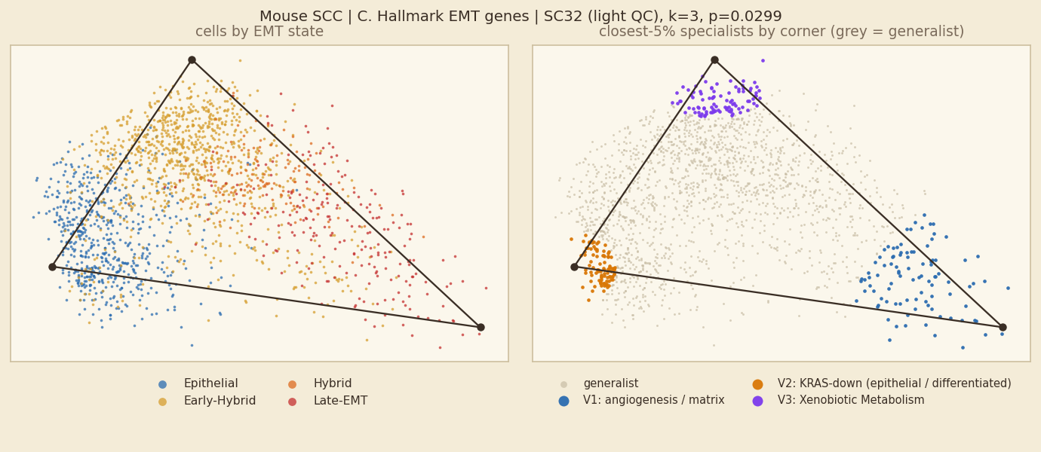
Mouse SCC: C. Hallmark EMT genes, unit SC32
Fit shown: light QC · k = 3 · p = 0.0299 · 1,910 cells · 200 shuffles
SIGNIFICANT permutation test, p ≤ 0.05
In plain words
Inside SC32 alone, cells fill a 3-corner simplex (p=0.0299). 3 of 8 units of this dataset have a significant simplex for this gene set.
Corners are programmes: angiogenesis / matrix; KRAS-down (epithelial / differentiated); Xenobiotic Metabolism.
Hybrid vs other cells: 61% of hybrid cells and 35% of other cells are generalists (rule 1; rule 2: 89% vs 80%), so hybrids are clearly more often generalists.
Corners and their tasks
V1 angiogenesis / matrix — Angiogenesis +2.35 SD; 5% S/G2M; 79% Late-EMT; 100% SC32; Bgn Col5a2 Spp1
V2 KRAS-down (epithelial / differentiated) — KRAS Signaling Dn +0.64 SD; 34% S/G2M; 91% Epithelial; 100% SC32; Sfrp1 Thbs1 Igfbp3
V3 Xenobiotic Metabolism — Xenobiotic Metabolism +0.98 SD; 26% S/G2M; 98% Early-Hybrid; 100% SC32; Areg Ecm1 Vim
Hallmark EMT set left out when naming (circular: fitted on those genes).
Left: cells coloured by EMT state (blue epithelial → red mesenchymal; hybrids are the two middle colours). Right: the 5% of cells nearest each corner coloured by corner, all other cells grey = generalists.
rule | % of hybrid cells that are generalists | % of other cells that are generalists
1 gap (top weight − second ≥ 0.35) | 61% | 35%
2 closest 5% of cells to each corner | 89% | 80%
3 weight > 0.95 on one corner | 100% | 99%
Hybrids are 57% of all cells here; 73% of cells lie inside the simplex.

Slide 32
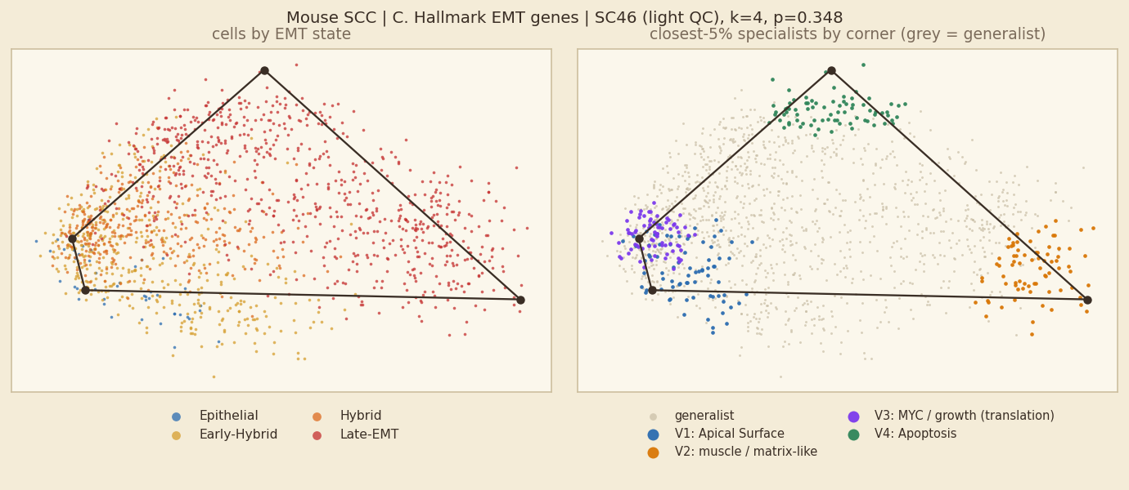
Mouse SCC: C. Hallmark EMT genes, unit SC46
Fit shown: light QC · k = 4 · p = 0.348 · 1,519 cells · 200 shuffles
NOT SIGNIFICANT p > 0.05
In plain words
No simplex inside SC46: the fit (k=4, p=0.348) is no more triangular than shuffled data, so its corners should not be read as tasks. 3 of 8 units of this dataset have a significant simplex for this gene set.
Hybrid vs other cells: 54% of hybrid cells and 62% of other cells are generalists (rule 1; rule 2: 82% vs 78%), so hybrids are less often generalists (they sit at corners). (No significant simplex, so this is descriptive only.)
Corners and their tasks (shown for completeness only)
V1 Apical Surface — Apical Surface +1.0 SD; 28% S/G2M; 79% Early-Hybrid; 100% SC46; Cadm1 Sfrp1 Tgfbi
V2 muscle / matrix-like — Myogenesis +1.74 SD; 26% S/G2M; 100% Late-EMT; 100% SC46; Col3a1 Eln Bgn
V3 MYC / growth (translation) — Myc Targets V2 +1.57 SD; 79% S/G2M; 72% Hybrid; 100% SC46; Areg Lgals1 Pthlh
V4 Apoptosis — Apoptosis +1.18 SD; 13% S/G2M; 100% Late-EMT; 100% SC46; Spp1 Dcn Fn1
Hallmark EMT set left out when naming (circular: fitted on those genes).
Left: cells coloured by EMT state (blue epithelial → red mesenchymal; hybrids are the two middle colours). Right: the 5% of cells nearest each corner coloured by corner, all other cells grey = generalists.
rule | % of hybrid cells that are generalists | % of other cells that are generalists
1 gap (top weight − second ≥ 0.35) | 54% | 62%
2 closest 5% of cells to each corner | 82% | 78%
3 weight > 0.95 on one corner | 100% | 100%
Hybrids are 50% of all cells here; 25% of cells lie inside the simplex.

Slide 33
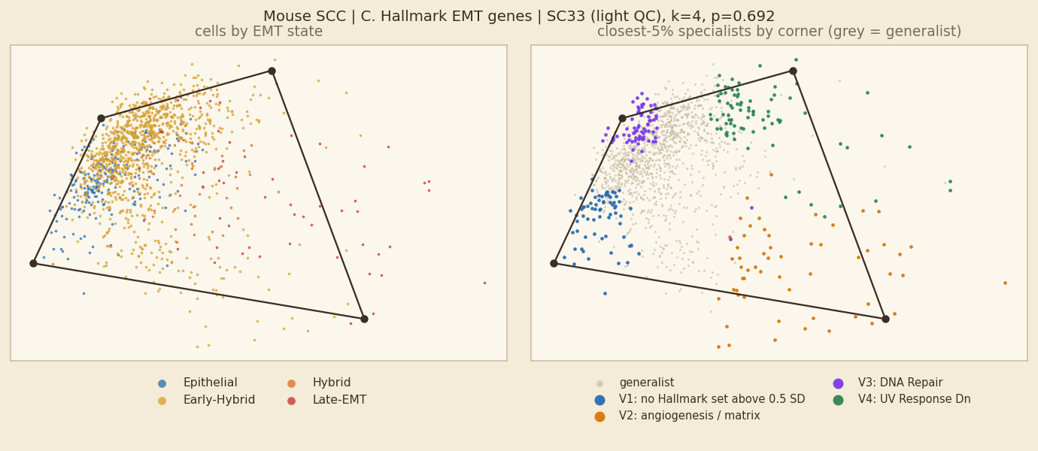
Mouse SCC: C. Hallmark EMT genes, unit SC33
Fit shown: light QC · k = 4 · p = 0.692 · 1,379 cells · 200 shuffles
NOT SIGNIFICANT p > 0.05
In plain words
No simplex inside SC33: the fit (k=4, p=0.692) is no more triangular than shuffled data, so its corners should not be read as tasks. 3 of 8 units of this dataset have a significant simplex for this gene set.
Hybrid vs other cells: 64% of hybrid cells and 79% of other cells are generalists (rule 1; rule 2: 82% vs 73%), so hybrids are less often generalists (they sit at corners). (No significant simplex, so this is descriptive only.)
Corners and their tasks (shown for completeness only)
V1 no Hallmark set above 0.5 SD — no Hallmark set above 0.5 SD; 38% S/G2M; 65% Epithelial; 100% SC33; Lama3 Lamc2 Gja1
V2 angiogenesis / matrix — Angiogenesis +2.27 SD; 7% S/G2M; 51% Early-Hybrid; 100% SC33; Fn1 Spp1 Col6a2
V3 DNA Repair — DNA Repair +0.65 SD; 61% S/G2M; 99% Early-Hybrid; 100% SC33; Areg Cxcl1 Mmp3
V4 UV Response Dn — UV Response Dn +1.59 SD; 16% S/G2M; 94% Early-Hybrid; 100% SC33; Thbs1 Col12a1 Acta2
Hallmark EMT set left out when naming (circular: fitted on those genes).
Left: cells coloured by EMT state (blue epithelial → red mesenchymal; hybrids are the two middle colours). Right: the 5% of cells nearest each corner coloured by corner, all other cells grey = generalists.
rule | % of hybrid cells that are generalists | % of other cells that are generalists
1 gap (top weight − second ≥ 0.35) | 64% | 79%
2 closest 5% of cells to each corner | 82% | 73%
3 weight > 0.95 on one corner | 100% | 100%
Hybrids are 79% of all cells here; 50% of cells lie inside the simplex.

Slide 34
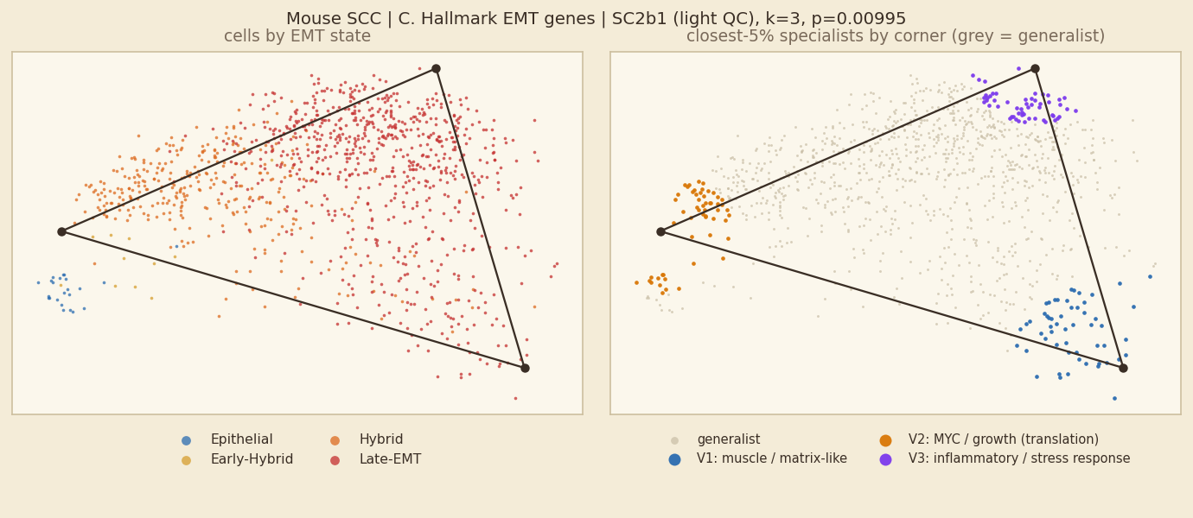
Mouse SCC: C. Hallmark EMT genes, unit SC2b1
Fit shown: light QC · k = 3 · p = 0.00995 · 1,099 cells · 200 shuffles
SIGNIFICANT permutation test, p ≤ 0.05
In plain words
Inside SC2b1 alone, cells fill a 3-corner simplex (p=0.00995). 3 of 8 units of this dataset have a significant simplex for this gene set.
Corners are programmes: muscle / matrix-like; MYC / growth (translation); inflammatory / stress response.
Hybrid vs other cells: 54% of hybrid cells and 48% of other cells are generalists (rule 1; rule 2: 85% vs 85%), so hybrids are slightly more often generalists.
Corners and their tasks
V1 muscle / matrix-like — Myogenesis +1.41 SD; 15% S/G2M; 91% Late-EMT; 100% SC2b1; Col6a3 Mmp3 Col1a1
V2 MYC / growth (translation) — Myc Targets V1 +1.71 SD; 73% S/G2M; 71% Hybrid; 100% SC2b1; Areg Tnfrsf12a Basp1
V3 inflammatory / stress response — TNF-alpha Signaling via NF-kB +1.27 SD; 15% S/G2M; 100% Late-EMT; 100% SC2b1; Postn Col3a1 Lox
Hallmark EMT set left out when naming (circular: fitted on those genes).
Left: cells coloured by EMT state (blue epithelial → red mesenchymal; hybrids are the two middle colours). Right: the 5% of cells nearest each corner coloured by corner, all other cells grey = generalists.
rule | % of hybrid cells that are generalists | % of other cells that are generalists
1 gap (top weight − second ≥ 0.35) | 54% | 48%
2 closest 5% of cells to each corner | 85% | 85%
3 weight > 0.95 on one corner | 100% | 99%
Hybrids are 31% of all cells here; 67% of cells lie inside the simplex.

Slide 35
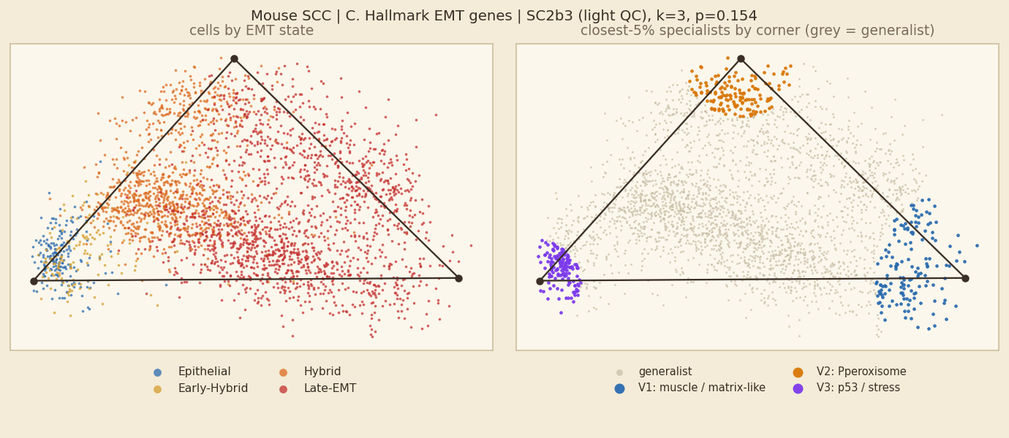
Mouse SCC: C. Hallmark EMT genes, unit SC2b3
Fit shown: light QC · k = 3 · p = 0.154 · 2,961 cells · 200 shuffles
NOT SIGNIFICANT p > 0.05
In plain words
No simplex inside SC2b3: the fit (k=3, p=0.154) is no more triangular than shuffled data, so its corners should not be read as tasks. 3 of 8 units of this dataset have a significant simplex for this gene set.
Hybrid vs other cells: 62% of hybrid cells and 63% of other cells are generalists (rule 1; rule 2: 88% vs 83%), so no real difference. (No significant simplex, so this is descriptive only.)
Corners and their tasks (shown for completeness only)
V1 muscle / matrix-like — Myogenesis +1.53 SD; 10% S/G2M; 100% Late-EMT; 100% SC2b3; Col3a1 Postn Bgn
V2 Pperoxisome — Pperoxisome +0.84 SD; 51% S/G2M; 57% Hybrid; 100% SC2b3; Tagln Acta2 Spp1
V3 p53 / stress — p53 Pathway +1.55 SD; 54% S/G2M; 68% Epithelial; 100% SC2b3; Sdc1 Areg Lamc2
Hallmark EMT set left out when naming (circular: fitted on those genes).
Left: cells coloured by EMT state (blue epithelial → red mesenchymal; hybrids are the two middle colours). Right: the 5% of cells nearest each corner coloured by corner, all other cells grey = generalists.
rule | % of hybrid cells that are generalists | % of other cells that are generalists
1 gap (top weight − second ≥ 0.35) | 62% | 63%
2 closest 5% of cells to each corner | 88% | 83%
3 weight > 0.95 on one corner | 100% | 100%
Hybrids are 38% of all cells here; 72% of cells lie inside the simplex.

Slide 36
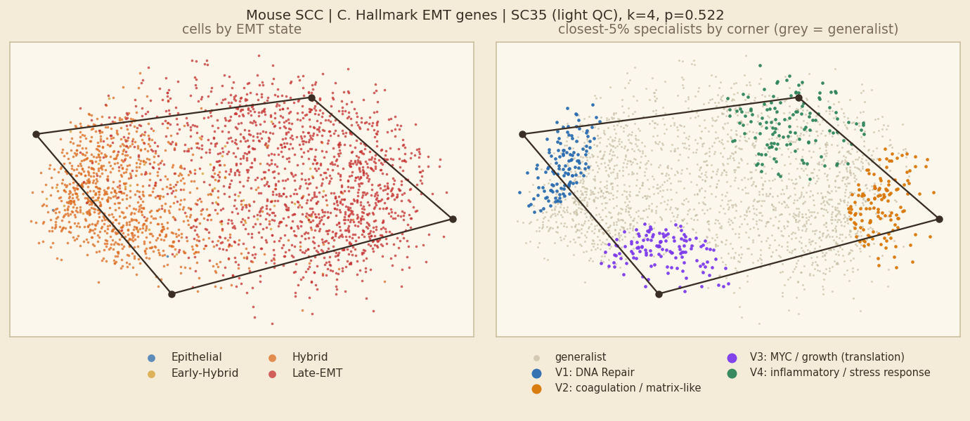
Mouse SCC: C. Hallmark EMT genes, unit SC35
Fit shown: light QC · k = 4 · p = 0.522 · 2,574 cells · 200 shuffles
NOT SIGNIFICANT p > 0.05
In plain words
No simplex inside SC35: the fit (k=4, p=0.522) is no more triangular than shuffled data, so its corners should not be read as tasks. 3 of 8 units of this dataset have a significant simplex for this gene set.
Hybrid vs other cells: 75% of hybrid cells and 70% of other cells are generalists (rule 1; rule 2: 78% vs 81%), so hybrids are slightly more often generalists. (No significant simplex, so this is descriptive only.)
Corners and their tasks (shown for completeness only)
V1 DNA Repair — DNA Repair +0.76 SD; 41% S/G2M; 86% Hybrid; 100% SC35; Spp1 Areg Sat1
V2 coagulation / matrix-like — Coagulation +1.42 SD; 0% S/G2M; 100% Late-EMT; 100% SC35; Postn Col3a1 Mmp3
V3 MYC / growth (translation) — Myc Targets V1 +1.01 SD; 61% S/G2M; 81% Hybrid; 100% SC35; Timp3 Acta2 Dpysl3
V4 inflammatory / stress response — Inflammatory Response +0.93 SD; 2% S/G2M; 99% Late-EMT; 100% SC35; Timp1 Col3a1 Fn1
Hallmark EMT set left out when naming (circular: fitted on those genes).
Left: cells coloured by EMT state (blue epithelial → red mesenchymal; hybrids are the two middle colours). Right: the 5% of cells nearest each corner coloured by corner, all other cells grey = generalists.
rule | % of hybrid cells that are generalists | % of other cells that are generalists
1 gap (top weight − second ≥ 0.35) | 75% | 70%
2 closest 5% of cells to each corner | 78% | 81%
3 weight > 0.95 on one corner | 100% | 100%
Hybrids are 40% of all cells here; 28% of cells lie inside the simplex.

Slide 37
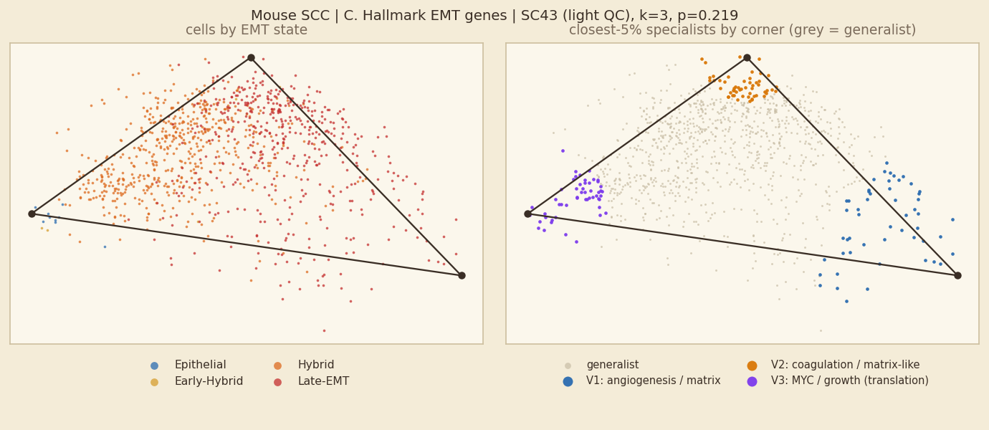
Mouse SCC: C. Hallmark EMT genes, unit SC43
Fit shown: light QC · k = 3 · p = 0.219 · 1,041 cells · 200 shuffles
NOT SIGNIFICANT p > 0.05
In plain words
No simplex inside SC43: the fit (k=3, p=0.219) is no more triangular than shuffled data, so its corners should not be read as tasks. 3 of 8 units of this dataset have a significant simplex for this gene set.
Hybrid vs other cells: 59% of hybrid cells and 50% of other cells are generalists (rule 1; rule 2: 91% vs 78%), so hybrids are clearly more often generalists. (No significant simplex, so this is descriptive only.)
Corners and their tasks (shown for completeness only)
V1 angiogenesis / matrix — Angiogenesis +2.16 SD; 11% S/G2M; 100% Late-EMT; 100% SC43; Postn Col3a1 Col5a2
V2 coagulation / matrix-like — Coagulation +0.62 SD; 17% S/G2M; 85% Late-EMT; 100% SC43; Mgp Bgn Fbln2
V3 MYC / growth (translation) — Myc Targets V1 +1.13 SD; 83% S/G2M; 77% Hybrid; 100% SC43; Areg Pthlh Mcm7
Hallmark EMT set left out when naming (circular: fitted on those genes).
Left: cells coloured by EMT state (blue epithelial → red mesenchymal; hybrids are the two middle colours). Right: the 5% of cells nearest each corner coloured by corner, all other cells grey = generalists.
rule | % of hybrid cells that are generalists | % of other cells that are generalists
1 gap (top weight − second ≥ 0.35) | 59% | 50%
2 closest 5% of cells to each corner | 91% | 78%
3 weight > 0.95 on one corner | 100% | 98%
Hybrids are 53% of all cells here; 79% of cells lie inside the simplex.

Slide 38
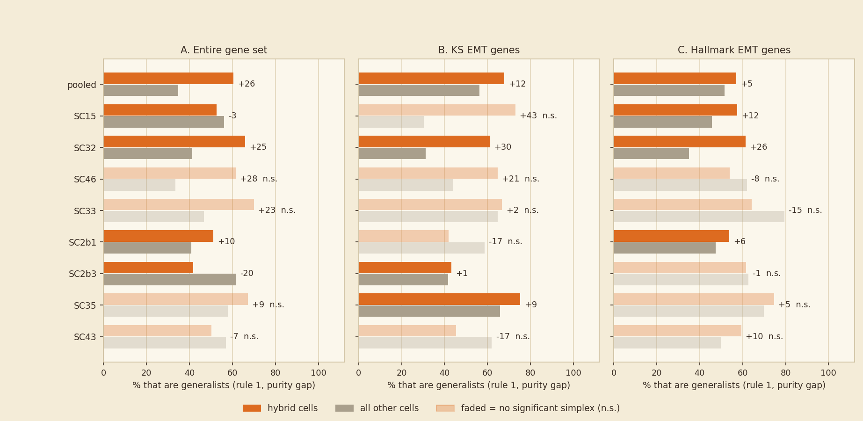
Question 2 · Mouse SCC: are hybrid cells more often generalists than other cells?
Orange = hybrid cells, grey = all other cells; one pair of bars per unit; the number = orange minus grey (percentage points)
Reading
• A. Entire gene set (5 significant): hybrids 53% vs others 41% generalist under rule 1 (rule 2: 87% vs 81%) → hybrids are clearly more often generalists.
• B. KS EMT genes (4 significant): hybrids 64% vs others 49% generalist under rule 1 (rule 2: 80% vs 82%) → hybrids are clearly more often generalists.
• C. Hallmark EMT genes (4 significant): hybrids 57% vs others 47% generalist under rule 1 (rule 2: 87% vs 81%) → hybrids are clearly more often generalists.
Rule 3 (weight > 0.95) is not drawn: it calls about 100% of every group generalist, so it cannot show a difference.

Slide 39
Cook
What the dataset is, and what to keep in mind when reading its slides
What the dataset means
Four human cancer cell lines given TGF-β and sampled over time. Time is an EMT coordinate independent of our score, but each line has its own identity.
Units in the main analysis
A549, DU145, MCF7, OVCA420
Gene sets
A. all genes (11,000 to 14,500); B. KS EMT genes (Tan 2014; about 160 to 190 present); C. Hallmark Epithelial-Mesenchymal-Transition set (200 genes, those present in the data).
Keep in mind
• Cook has no state labels, so hybrids are defined from the KS EMT score (middle two quartiles).
• The cut-offs are pooled over the four lines, so a line's hybrid share mostly reflects the line (A549 about 71%, MCF7 about 11%).
• The removal arm (TGF-β withdrawn) is projected as guests and left out of the cells analysed.
This dataset in numbers (main fits)
• Entire gene set: 2 of 5 fits significant; hybrids 38% / 86% / 100% generalist (median, rules 1/2/3).
• KS EMT genes: 2 of 5 fits significant; hybrids 33% / 84% / 100% generalist (median, rules 1/2/3).
• Hallmark EMT genes: 4 of 5 fits significant; hybrids 59% / 86% / 100% generalist (median, rules 1/2/3).
Question 1 slides come first, then the Question 2 slides for this dataset.

Slide 40
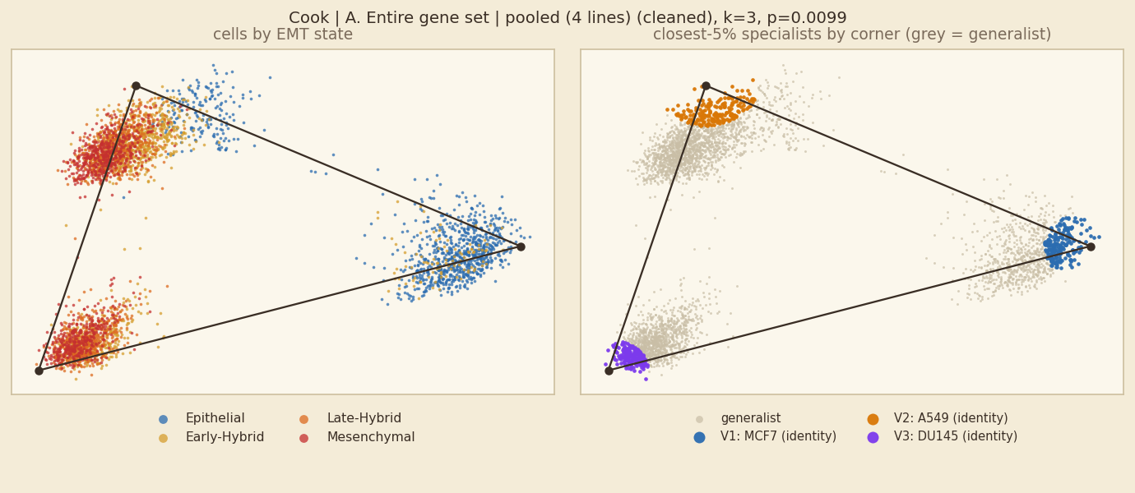
Cook: A. Entire gene set, pooled fit
Fit shown: cleaned · k = 3 · p = 0.0099 · 6,218 cells · 100 shuffles | comparison, light QC: k=3, p=0.00498
SIGNIFICANT permutation test, p ≤ 0.05
In plain words
A significant simplex (k=3, p=0.0099), but 3 of 3 corners are almost entirely one sample (MCF7, A549, DU145). It separates samples; it is not a shared EMT trade-off.
Each corner is essentially one cell line. The programme names (Hallmark) only describe what distinguishes that line, and the EMT-state colours follow the lines (MCF7 scores epithelial, A549 mesenchymal). These corners are not tasks.
Hybrid vs other cells: 2% of hybrid cells and 3% of other cells are generalists (rule 1; rule 2: 87% vs 83%), so no real difference.
Corners and their tasks
V1 identity corner: MCF7 (programme: luminal / differentiation) — Estrogen Response Early +1.96 SD; 21% S/G2M; 94% Epithelial; 100% MCF7; TFF1 DSCAM-AS1 BCAS3
V2 identity corner: A549 (programme: angiogenesis / matrix) — Angiogenesis +1.32 SD; 15% S/G2M; 49% Early-Hybrid; 85% A549; KRT81 S100A4 ALDH1A1
V3 identity corner: DU145 (programme: Allograft Rejection) — Allograft Rejection +1.47 SD; 69% S/G2M; 42% Late-Hybrid; 100% DU145; MT1E CDKN2A MYL9
Left: cells coloured by EMT state (blue epithelial → red mesenchymal; hybrids are the two middle colours). Right: the 5% of cells nearest each corner coloured by corner, all other cells grey = generalists.
rule | % of hybrid cells that are generalists | % of other cells that are generalists
1 gap (top weight − second ≥ 0.35) | 2% | 3%
2 closest 5% of cells to each corner | 87% | 83%
3 weight > 0.95 on one corner | 99% | 98%
Hybrids are 54% of all cells here; 65% of cells lie inside the simplex.

Slide 41
Cook: A. Entire gene set, all units at a glance
Main fit of each unit: 1 of 4 units have a significant simplex
unit | fit shown | k | p | light-QC p | hybrid % of cells | hybrids→generalist (1/2/3) | generalists→hybrid (1/2/3)
A549 | cleaned | 3 | 0.00995 * | 0.0647 | 71% | 75 / 86 / 100% | 73 / 72 / 71%
DU145 | cleaned | 3 | 0.254 | 0.0995 | 69% | 69 / 85 / 100% | 68 / 69 / 69%
MCF7 | cleaned | 3 | 0.463 | 0.0896 | 11% | 54 / 82 / 99% | 10 / 11 / 11%
OVCA420 | cleaned | 3 | 0.756 | 0.453 | 14% | 71 / 84 / 100% | 15 / 14 / 14%
* p ≤ 0.05 for the fit shown. Rules: 1 = gap, 2 = closest 5%, 3 = weight > 0.95. One slide per unit follows; non-significant units are included for completeness and their corners should not be read as tasks.

Slide 42
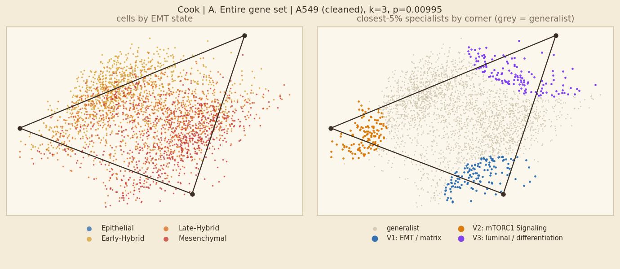
Cook: A. Entire gene set, unit A549
Fit shown: cleaned · k = 3 · p = 0.00995 · 2,646 cells · 200 shuffles | comparison, light QC: k=4, p=0.0647
SIGNIFICANT permutation test, p ≤ 0.05
In plain words
Inside A549 alone, cells fill a 3-corner simplex (p=0.00995). 1 of 4 units of this dataset have a significant simplex for this gene set.
Corners are programmes: EMT / matrix; mTORC1 Signaling; luminal / differentiation.
Hybrid vs other cells: 75% of hybrid cells and 69% of other cells are generalists (rule 1; rule 2: 86% vs 83%), so hybrids are slightly more often generalists.
Corners and their tasks
V1 EMT / matrix — Epithelial Mesenchymal Transition +1.49 SD; 70% S/G2M; 77% Mesenchymal; 100% A549; SERPINE2 IGFBP7 CCDC80
V2 mTORC1 Signaling — mTORC1 Signaling +1.82 SD; 92% S/G2M; 55% Early-Hybrid; 100% A549; AKR1B10 HSP90AA1 CCNB1
V3 luminal / differentiation — Estrogen Response Early +0.71 SD; 12% S/G2M; 66% Early-Hybrid; 100% A549; GPX2 NEAT1 SAT1
Left: cells coloured by EMT state (blue epithelial → red mesenchymal; hybrids are the two middle colours). Right: the 5% of cells nearest each corner coloured by corner, all other cells grey = generalists.
rule | % of hybrid cells that are generalists | % of other cells that are generalists
1 gap (top weight − second ≥ 0.35) | 75% | 69%
2 closest 5% of cells to each corner | 86% | 83%
3 weight > 0.95 on one corner | 100% | 100%
Hybrids are 71% of all cells here; 70% of cells lie inside the simplex.

Slide 43
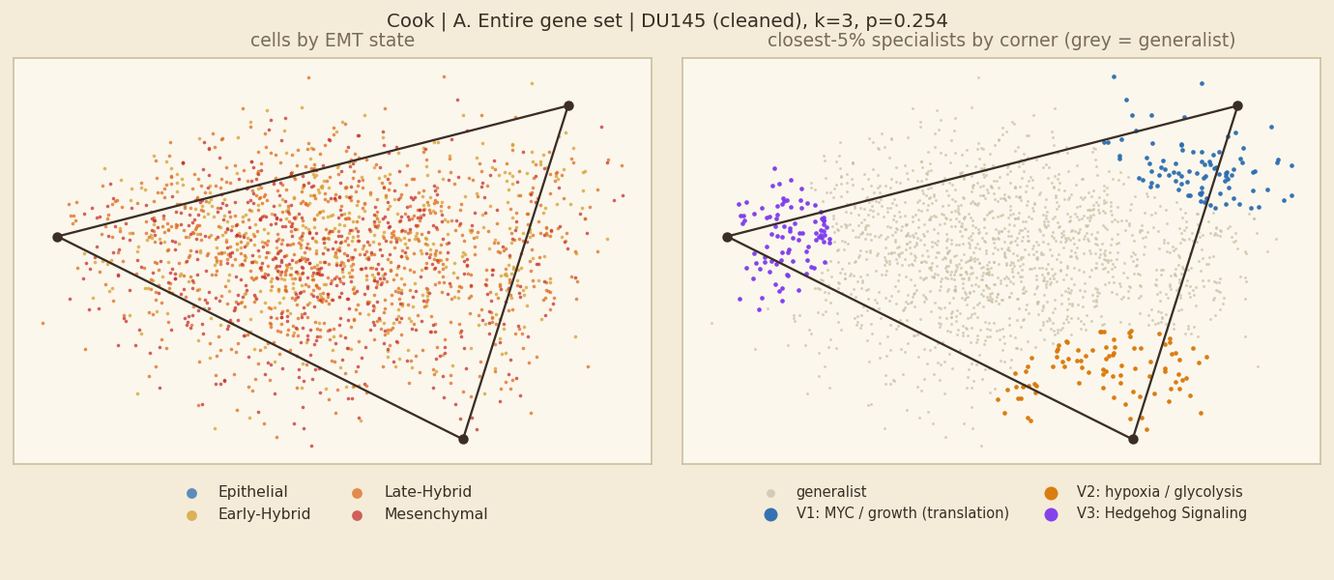
Cook: A. Entire gene set, unit DU145
Fit shown: cleaned · k = 3 · p = 0.254 · 1,839 cells · 200 shuffles | comparison, light QC: k=3, p=0.0995
NOT SIGNIFICANT p > 0.05
In plain words
No simplex inside DU145: the fit (k=3, p=0.254) is no more triangular than shuffled data, so its corners should not be read as tasks. 1 of 4 units of this dataset have a significant simplex for this gene set.
Hybrid vs other cells: 69% of hybrid cells and 71% of other cells are generalists (rule 1; rule 2: 85% vs 85%), so no real difference. (No significant simplex, so this is descriptive only.)
Corners and their tasks (shown for completeness only)
V1 MYC / growth (translation) — Myc Targets V1 +1.72 SD; 90% S/G2M; 42% Early-Hybrid; 100% DU145; CCNB1 CDC20 KPNA2
V2 hypoxia / glycolysis — Hypoxia +1.19 SD; 2% S/G2M; 43% Late-Hybrid; 100% DU145; ANGPTL4 TGFBI KRT19
V3 Hedgehog Signaling — Hedgehog Signaling +0.9 SD; 21% S/G2M; 39% Mesenchymal; 100% DU145; HIST1H4C ATP5E MT2A
Left: cells coloured by EMT state (blue epithelial → red mesenchymal; hybrids are the two middle colours). Right: the 5% of cells nearest each corner coloured by corner, all other cells grey = generalists.
rule | % of hybrid cells that are generalists | % of other cells that are generalists
1 gap (top weight − second ≥ 0.35) | 69% | 71%
2 closest 5% of cells to each corner | 85% | 85%
3 weight > 0.95 on one corner | 100% | 100%
Hybrids are 69% of all cells here; 75% of cells lie inside the simplex.

Slide 44
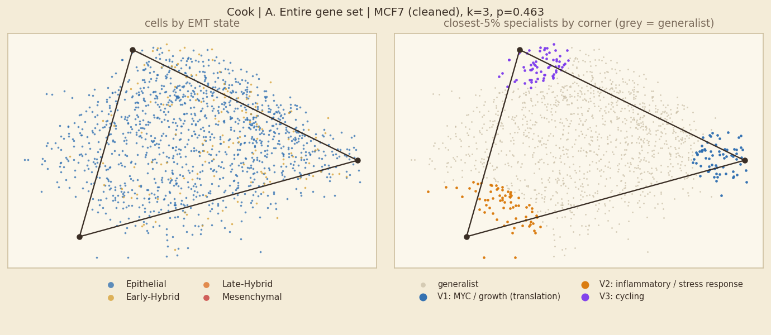
Cook: A. Entire gene set, unit MCF7
Fit shown: cleaned · k = 3 · p = 0.463 · 1,378 cells · 200 shuffles | comparison, light QC: k=5, p=0.0896
NOT SIGNIFICANT p > 0.05
In plain words
No simplex inside MCF7: the fit (k=3, p=0.463) is no more triangular than shuffled data, so its corners should not be read as tasks. 1 of 4 units of this dataset have a significant simplex for this gene set.
Hybrid vs other cells: 54% of hybrid cells and 59% of other cells are generalists (rule 1; rule 2: 82% vs 85%), so hybrids are less often generalists (they sit at corners). (No significant simplex, so this is descriptive only.)
Corners and their tasks (shown for completeness only)
V1 MYC / growth (translation) — Myc Targets V1 +2.09 SD; 99% S/G2M; 86% Epithelial; 100% MCF7; TUBB4B TUBA1B HMGB2
V2 inflammatory / stress response — TNF-alpha Signaling via NF-kB +1.52 SD; 0% S/G2M; 93% Epithelial; 100% MCF7; NEAT1 BTG1 ANXA2
V3 cycling — Mitotic Spindle +0.61 SD; 57% S/G2M; 83% Epithelial; 100% MCF7; HIST1H4C KIAA0101 DSCAM-AS1
Left: cells coloured by EMT state (blue epithelial → red mesenchymal; hybrids are the two middle colours). Right: the 5% of cells nearest each corner coloured by corner, all other cells grey = generalists.
rule | % of hybrid cells that are generalists | % of other cells that are generalists
1 gap (top weight − second ≥ 0.35) | 54% | 59%
2 closest 5% of cells to each corner | 82% | 85%
3 weight > 0.95 on one corner | 99% | 99%
Hybrids are 11% of all cells here; 66% of cells lie inside the simplex.

Slide 45
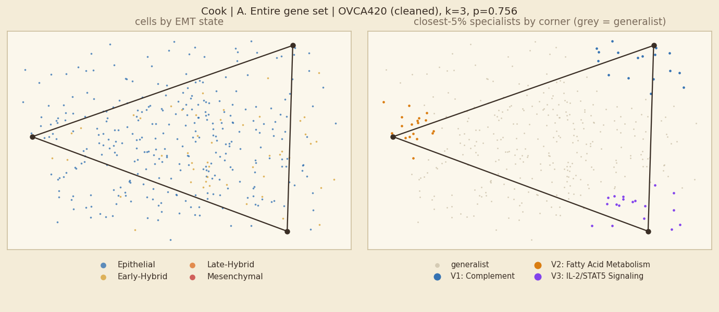
Cook: A. Entire gene set, unit OVCA420
Fit shown: cleaned · k = 3 · p = 0.756 · 355 cells · 200 shuffles | comparison, light QC: k=5, p=0.453
NOT SIGNIFICANT p > 0.05
In plain words
No simplex inside OVCA420: the fit (k=3, p=0.756) is no more triangular than shuffled data, so its corners should not be read as tasks. 1 of 4 units of this dataset have a significant simplex for this gene set.
Hybrid vs other cells: 71% of hybrid cells and 63% of other cells are generalists (rule 1; rule 2: 84% vs 85%), so hybrids are clearly more often generalists. (No significant simplex, so this is descriptive only.)
Corners and their tasks (shown for completeness only)
V1 Complement — Complement +1.57 SD; 6% S/G2M; 89% Epithelial; 100% OVCA420; C15orf48 KRT17 SERPINE2
V2 Fatty Acid Metabolism — Fatty Acid Metabolism +1.51 SD; 89% S/G2M; 89% Epithelial; 100% OVCA420; CBR1 AKR1B10 GSTA1
V3 IL-2/STAT5 Signaling — IL-2/STAT5 Signaling +1.45 SD; 11% S/G2M; 78% Epithelial; 100% OVCA420; MT2A LAMC2 TGM2
Left: cells coloured by EMT state (blue epithelial → red mesenchymal; hybrids are the two middle colours). Right: the 5% of cells nearest each corner coloured by corner, all other cells grey = generalists.
rule | % of hybrid cells that are generalists | % of other cells that are generalists
1 gap (top weight − second ≥ 0.35) | 71% | 63%
2 closest 5% of cells to each corner | 84% | 85%
3 weight > 0.95 on one corner | 100% | 99%
Hybrids are 14% of all cells here; 62% of cells lie inside the simplex.

Slide 46
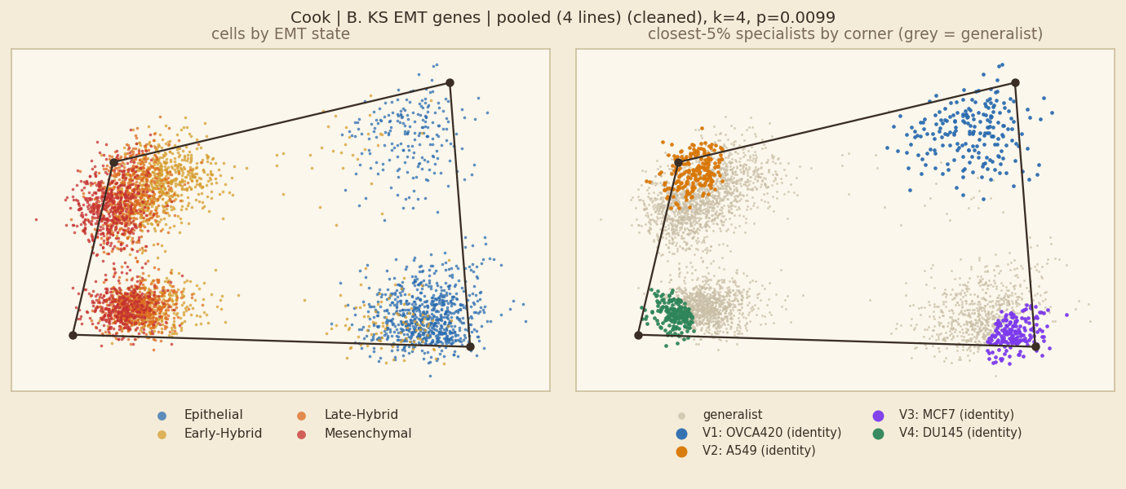
Cook: B. KS EMT genes, pooled fit
Fit shown: cleaned · k = 4 · p = 0.0099 · 6,218 cells · 100 shuffles | comparison, light QC: k=3, p=0.00498
SIGNIFICANT permutation test, p ≤ 0.05
In plain words
A significant simplex (k=4, p=0.0099), but 4 of 4 corners are almost entirely one sample (OVCA420, A549, MCF7, DU145). It separates samples; it is not a shared EMT trade-off.
Each corner is essentially one cell line. The programme names (Hallmark) only describe what distinguishes that line, and the EMT-state colours follow the lines (MCF7 scores epithelial, A549 mesenchymal). These corners are not tasks.
Hybrid vs other cells: 7% of hybrid cells and 13% of other cells are generalists (rule 1; rule 2: 88% vs 71%), so hybrids are less often generalists (they sit at corners).
Corners and their tasks
V1 identity corner: OVCA420 (programme: p53 / stress) — p53 Pathway +2.11 SD; 51% S/G2M; 90% Epithelial; 99% OVCA420; S100A14 KRT19 FXYD3
V2 identity corner: A549 (programme: angiogenesis / matrix) — Angiogenesis +1.19 SD; 49% S/G2M; 48% Late-Hybrid; 100% A549; TPM2 KRT7 VIM
V3 identity corner: MCF7 (programme: luminal / differentiation) — Estrogen Response Late +2.08 SD; 53% S/G2M; 97% Epithelial; 100% MCF7; KRT19 XBP1 FXYD3
V4 identity corner: DU145 (programme: Allograft Rejection) — Allograft Rejection +1.19 SD; 50% S/G2M; 64% Mesenchymal; 100% DU145; MYL9 AXL LGALS1
KS genes overlap the EMT set: an 'EMT / matrix' label is partly expected.
Left: cells coloured by EMT state (blue epithelial → red mesenchymal; hybrids are the two middle colours). Right: the 5% of cells nearest each corner coloured by corner, all other cells grey = generalists.
rule | % of hybrid cells that are generalists | % of other cells that are generalists
1 gap (top weight − second ≥ 0.35) | 7% | 13%
2 closest 5% of cells to each corner | 88% | 71%
3 weight > 0.95 on one corner | 100% | 100%
Hybrids are 54% of all cells here; 47% of cells lie inside the simplex.

Slide 47
Cook: B. KS EMT genes, all units at a glance
Main fit of each unit: 1 of 4 units have a significant simplex
unit | fit shown | k | p | light-QC p | hybrid % of cells | hybrids→generalist (1/2/3) | generalists→hybrid (1/2/3)
A549 | cleaned | 4 | 0.716 | 0.169 | 71% | 83 / 84 / 100% | 72 / 74 / 71%
DU145 | cleaned | 3 | 0.95 | 0.9 | 69% | 78 / 84 / 100% | 70 / 67 / 69%
MCF7 | cleaned | 3 | 0.0299 * | 0.0149 | 11% | 59 / 81 / 99% | 10 / 10 / 11%
OVCA420 | cleaned | 4 | 0.448 | 0.418 | 14% | 49 / 65 / 98% | 11 / 11 / 14%
* p ≤ 0.05 for the fit shown. Rules: 1 = gap, 2 = closest 5%, 3 = weight > 0.95. One slide per unit follows; non-significant units are included for completeness and their corners should not be read as tasks.

Slide 48
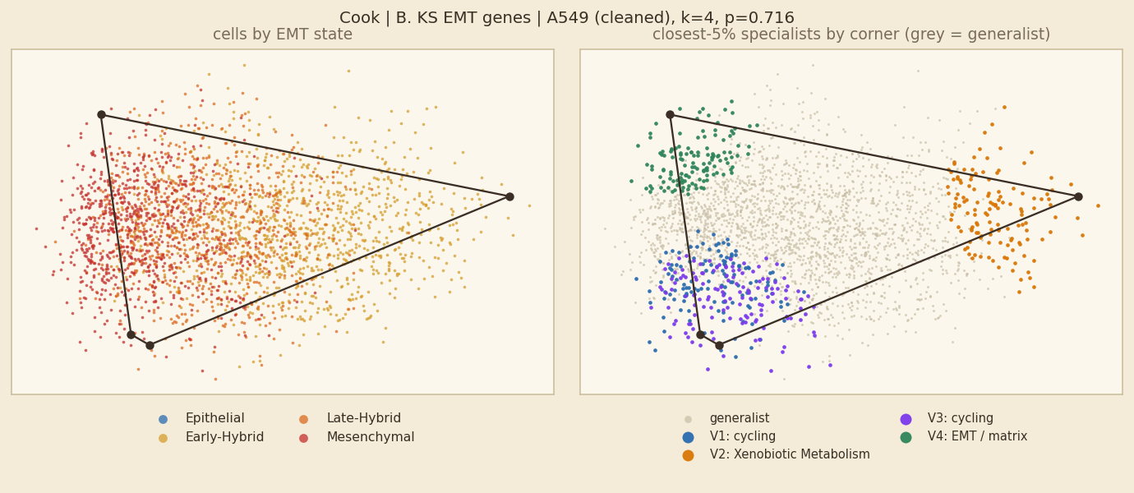
Cook: B. KS EMT genes, unit A549
Fit shown: cleaned · k = 4 · p = 0.716 · 2,646 cells · 200 shuffles | comparison, light QC: k=5, p=0.169
NOT SIGNIFICANT p > 0.05
In plain words
No simplex inside A549: the fit (k=4, p=0.716) is no more triangular than shuffled data, so its corners should not be read as tasks. 1 of 4 units of this dataset have a significant simplex for this gene set.
Hybrid vs other cells: 83% of hybrid cells and 77% of other cells are generalists (rule 1; rule 2: 84% vs 71%), so hybrids are slightly more often generalists. (No significant simplex, so this is descriptive only.)
Corners and their tasks (shown for completeness only)
V1 cycling — no Hallmark set above 0.5 SD; 64% S/G2M; 47% Late-Hybrid; 100% A549; AKAP12 FHL1 SDC1
V2 Xenobiotic Metabolism — Xenobiotic Metabolism +0.78 SD; 38% S/G2M; 99% Early-Hybrid; 100% A549; GPX2 AGR2 ELF3
V3 cycling — Mitotic Spindle +0.6 SD; 55% S/G2M; 59% Mesenchymal; 100% A549; AXL MAP1B PTRF
V4 EMT / matrix — Epithelial Mesenchymal Transition +1.27 SD; 60% S/G2M; 68% Mesenchymal; 100% A549; KRT7 SERPINE1 TPM2
KS genes overlap the EMT set: an 'EMT / matrix' label is partly expected.
Left: cells coloured by EMT state (blue epithelial → red mesenchymal; hybrids are the two middle colours). Right: the 5% of cells nearest each corner coloured by corner, all other cells grey = generalists.
rule | % of hybrid cells that are generalists | % of other cells that are generalists
1 gap (top weight − second ≥ 0.35) | 83% | 77%
2 closest 5% of cells to each corner | 84% | 71%
3 weight > 0.95 on one corner | 100% | 100%
Hybrids are 71% of all cells here; 42% of cells lie inside the simplex.

Slide 49
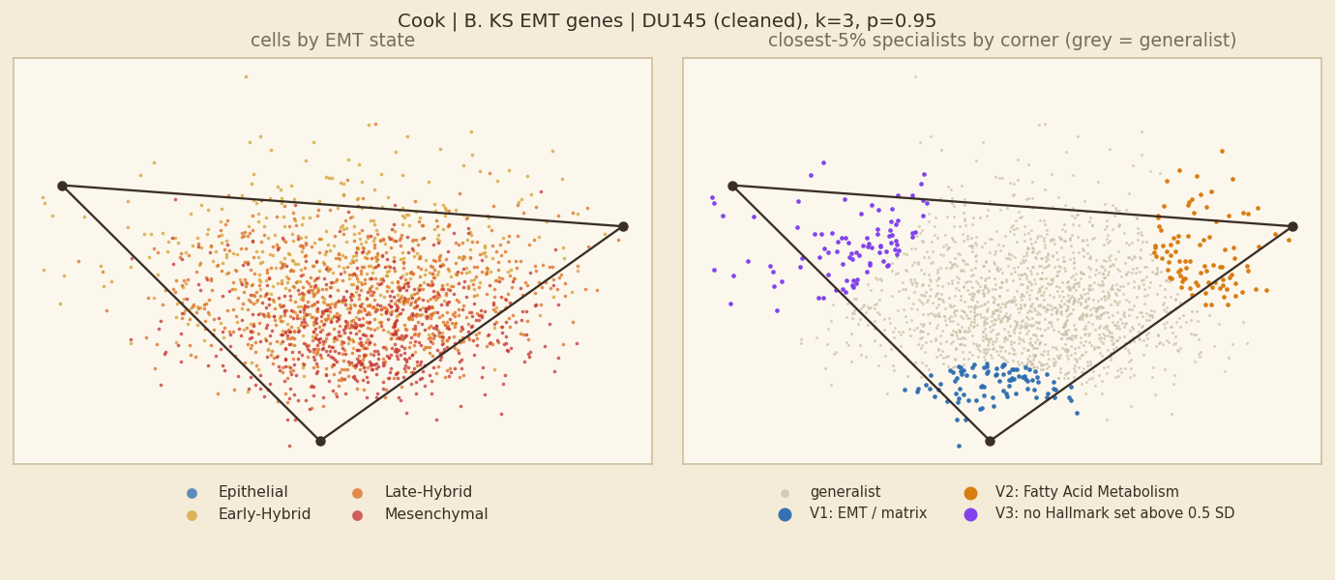
Cook: B. KS EMT genes, unit DU145
Fit shown: cleaned · k = 3 · p = 0.95 · 1,839 cells · 200 shuffles | comparison, light QC: k=4, p=0.9
NOT SIGNIFICANT p > 0.05
In plain words
No simplex inside DU145: the fit (k=3, p=0.95) is no more triangular than shuffled data, so its corners should not be read as tasks. 1 of 4 units of this dataset have a significant simplex for this gene set.
Hybrid vs other cells: 78% of hybrid cells and 72% of other cells are generalists (rule 1; rule 2: 84% vs 88%), so hybrids are slightly more often generalists. (No significant simplex, so this is descriptive only.)
Corners and their tasks (shown for completeness only)
V1 EMT / matrix — Epithelial Mesenchymal Transition +0.69 SD; 32% S/G2M; 58% Mesenchymal; 100% DU145; MYL9 MSN LGALS1
V2 Fatty Acid Metabolism — Fatty Acid Metabolism +1.26 SD; 43% S/G2M; 60% Late-Hybrid; 100% DU145; KRT19 KRT8 KRT18
V3 no Hallmark set above 0.5 SD — no Hallmark set above 0.5 SD; 39% S/G2M; 57% Early-Hybrid; 100% DU145; AREG TOB1 ELF3
KS genes overlap the EMT set: an 'EMT / matrix' label is partly expected.
Left: cells coloured by EMT state (blue epithelial → red mesenchymal; hybrids are the two middle colours). Right: the 5% of cells nearest each corner coloured by corner, all other cells grey = generalists.
rule | % of hybrid cells that are generalists | % of other cells that are generalists
1 gap (top weight − second ≥ 0.35) | 78% | 72%
2 closest 5% of cells to each corner | 84% | 88%
3 weight > 0.95 on one corner | 100% | 100%
Hybrids are 69% of all cells here; 85% of cells lie inside the simplex.

Slide 50
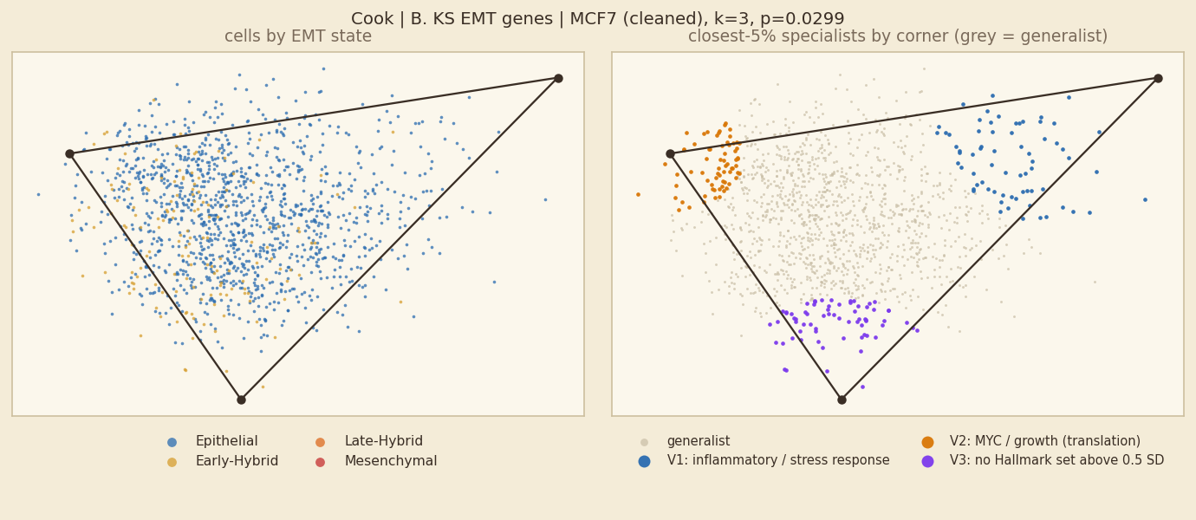
Cook: B. KS EMT genes, unit MCF7
Fit shown: cleaned · k = 3 · p = 0.0299 · 1,378 cells · 200 shuffles | comparison, light QC: k=3, p=0.0149
SIGNIFICANT permutation test, p ≤ 0.05
In plain words
Inside MCF7 alone, cells fill a 3-corner simplex (p=0.0299). 1 of 4 units of this dataset have a significant simplex for this gene set.
Corners are programmes: inflammatory / stress response; MYC / growth (translation); no Hallmark set above 0.5 SD.
Hybrid vs other cells: 59% of hybrid cells and 68% of other cells are generalists (rule 1; rule 2: 81% vs 85%), so hybrids are less often generalists (they sit at corners).
Corners and their tasks
V1 inflammatory / stress response — TNF-alpha Signaling via NF-kB +1.8 SD; 6% S/G2M; 99% Epithelial; 100% MCF7; AQP3 S100A14 AREG
V2 MYC / growth (translation) — Myc Targets V1 +1.22 SD; 74% S/G2M; 86% Epithelial; 100% MCF7; AGR2 KRT18 KRT8
V3 no Hallmark set above 0.5 SD — no Hallmark set above 0.5 SD; 58% S/G2M; 74% Epithelial; 100% MCF7; LGALS1 CYB561 SLC9A3R1
KS genes overlap the EMT set: an 'EMT / matrix' label is partly expected.
Left: cells coloured by EMT state (blue epithelial → red mesenchymal; hybrids are the two middle colours). Right: the 5% of cells nearest each corner coloured by corner, all other cells grey = generalists.
rule | % of hybrid cells that are generalists | % of other cells that are generalists
1 gap (top weight − second ≥ 0.35) | 59% | 68%
2 closest 5% of cells to each corner | 81% | 85%
3 weight > 0.95 on one corner | 99% | 100%
Hybrids are 11% of all cells here; 86% of cells lie inside the simplex.

Slide 51
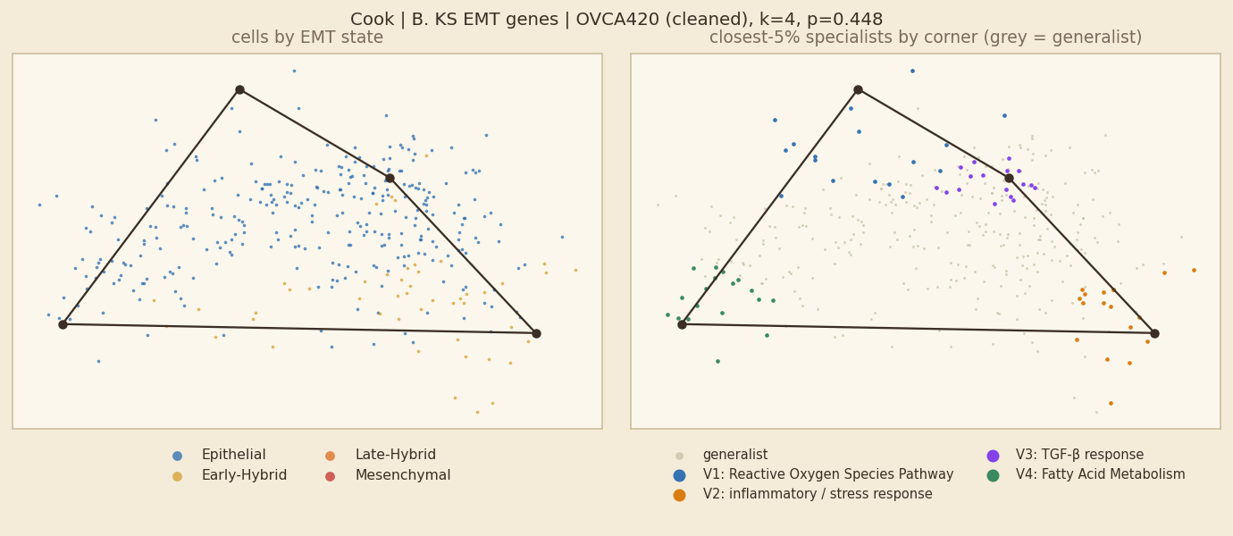
Cook: B. KS EMT genes, unit OVCA420
Fit shown: cleaned · k = 4 · p = 0.448 · 355 cells · 200 shuffles | comparison, light QC: k=3, p=0.418
NOT SIGNIFICANT p > 0.05
In plain words
No simplex inside OVCA420: the fit (k=4, p=0.448) is no more triangular than shuffled data, so its corners should not be read as tasks. 1 of 4 units of this dataset have a significant simplex for this gene set.
Hybrid vs other cells: 49% of hybrid cells and 64% of other cells are generalists (rule 1; rule 2: 65% vs 82%), so hybrids are less often generalists (they sit at corners). (No significant simplex, so this is descriptive only.)
Corners and their tasks (shown for completeness only)
V1 Reactive Oxygen Species Pathway — Reactive Oxygen Species Pathway +0.86 SD; 28% S/G2M; 100% Epithelial; 100% OVCA420; AGR2 KRT19 FXYD3
V2 inflammatory / stress response — Inflammatory Response +1.86 SD; 28% S/G2M; 67% Early-Hybrid; 100% OVCA420; TACSTD2 PTRF SERPINE1
V3 TGF-β response — TGF-beta Signaling +0.54 SD; 50% S/G2M; 78% Epithelial; 100% OVCA420; SERPINE1 CTSH ITGB4
V4 Fatty Acid Metabolism — Fatty Acid Metabolism +0.82 SD; 72% S/G2M; 94% Epithelial; 100% OVCA420; ELF3 ANXA4 ABCC3
KS genes overlap the EMT set: an 'EMT / matrix' label is partly expected.
Left: cells coloured by EMT state (blue epithelial → red mesenchymal; hybrids are the two middle colours). Right: the 5% of cells nearest each corner coloured by corner, all other cells grey = generalists.
rule | % of hybrid cells that are generalists | % of other cells that are generalists
1 gap (top weight − second ≥ 0.35) | 49% | 64%
2 closest 5% of cells to each corner | 65% | 82%
3 weight > 0.95 on one corner | 98% | 100%
Hybrids are 14% of all cells here; 34% of cells lie inside the simplex.

Slide 52
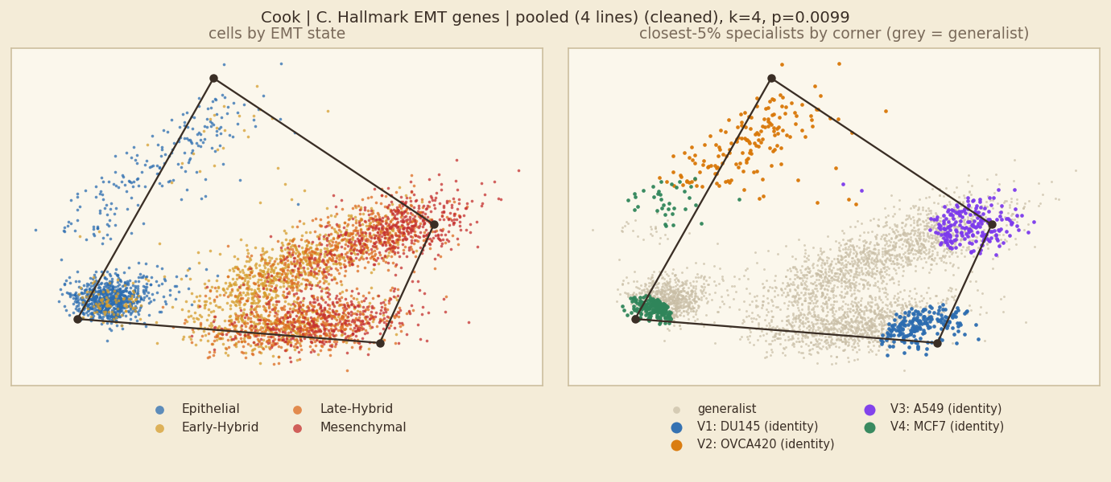
Cook: C. Hallmark EMT genes, pooled fit
Fit shown: cleaned · k = 4 · p = 0.0099 · 6,218 cells · 100 shuffles | comparison, light QC: k=4, p=0.0099
SIGNIFICANT permutation test, p ≤ 0.05
In plain words
A significant simplex (k=4, p=0.0099), but 4 of 4 corners are almost entirely one sample (DU145, OVCA420, A549, MCF7). It separates samples; it is not a shared EMT trade-off.
Each corner is essentially one cell line. The programme names (Hallmark) only describe what distinguishes that line, and the EMT-state colours follow the lines (MCF7 scores epithelial, A549 mesenchymal). These corners are not tasks.
Hybrid vs other cells: 53% of hybrid cells and 18% of other cells are generalists (rule 1; rule 2: 89% vs 70%), so hybrids are clearly more often generalists.
Corners and their tasks
V1 identity corner: DU145 (programme: epithelial junction) — Apical Junction +1.41 SD; 46% S/G2M; 48% Mesenchymal; 100% DU145; TAGLN MYL9 LGALS1
V2 identity corner: OVCA420 (programme: p53 / stress) — p53 Pathway +2.15 SD; 50% S/G2M; 86% Epithelial; 100% OVCA420; SPP1 SERPINE1 SERPINE2
V3 identity corner: A549 (programme: angiogenesis / matrix) — Angiogenesis +1.24 SD; 56% S/G2M; 56% Mesenchymal; 100% A549; TGFBI TPM2 SERPINE2
V4 identity corner: MCF7 (programme: luminal / differentiation) — Estrogen Response Late +1.78 SD; 64% S/G2M; 89% Epithelial; 100% MCF7; MGP ID2 AREG
Hallmark EMT set left out when naming (circular: fitted on those genes).
Left: cells coloured by EMT state (blue epithelial → red mesenchymal; hybrids are the two middle colours). Right: the 5% of cells nearest each corner coloured by corner, all other cells grey = generalists.
rule | % of hybrid cells that are generalists | % of other cells that are generalists
1 gap (top weight − second ≥ 0.35) | 53% | 18%
2 closest 5% of cells to each corner | 89% | 70%
3 weight > 0.95 on one corner | 100% | 99%
Hybrids are 54% of all cells here; 33% of cells lie inside the simplex.

Slide 53
Cook: C. Hallmark EMT genes, all units at a glance
Main fit of each unit: 3 of 4 units have a significant simplex
unit | fit shown | k | p | light-QC p | hybrid % of cells | hybrids→generalist (1/2/3) | generalists→hybrid (1/2/3)
A549 | cleaned | 3 | 0.0448 * | 0.259 | 71% | 65 / 86 / 100% | 71 / 72 / 71%
DU145 | cleaned | 3 | 0.0249 * | 0.0199 | 69% | 77 / 86 / 100% | 67 / 69 / 69%
MCF7 | cleaned | 4 | 0.368 | 0.891 | 11% | 68 / 83 / 100% | 10 / 11 / 11%
OVCA420 | cleaned | 3 | 0.00995 * | 0.00498 | 14% | 47 / 80 / 100% | 14 / 13 / 14%
* p ≤ 0.05 for the fit shown. Rules: 1 = gap, 2 = closest 5%, 3 = weight > 0.95. One slide per unit follows; non-significant units are included for completeness and their corners should not be read as tasks.

Slide 54
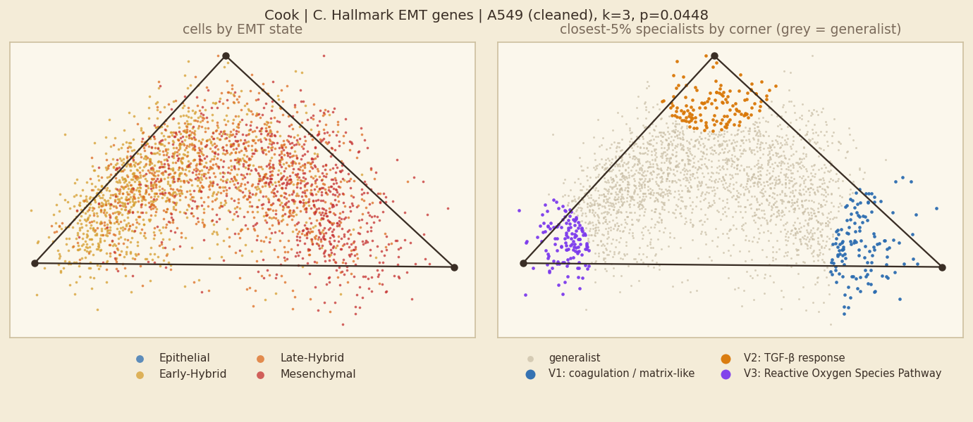
Cook: C. Hallmark EMT genes, unit A549
Fit shown: cleaned · k = 3 · p = 0.0448 · 2,646 cells · 200 shuffles | comparison, light QC: k=3, p=0.259
SIGNIFICANT permutation test, p ≤ 0.05
In plain words
Inside A549 alone, cells fill a 3-corner simplex (p=0.0448). 3 of 4 units of this dataset have a significant simplex for this gene set.
Corners are programmes: coagulation / matrix-like; TGF-β response; Reactive Oxygen Species Pathway.
Hybrid vs other cells: 65% of hybrid cells and 65% of other cells are generalists (rule 1; rule 2: 86% vs 83%), so no real difference.
Corners and their tasks
V1 coagulation / matrix-like — Coagulation +1.37 SD; 62% S/G2M; 81% Mesenchymal; 100% A549; TAGLN SERPINE2 TGFBI
V2 TGF-β response — TGF-beta Signaling +0.85 SD; 44% S/G2M; 43% Late-Hybrid; 100% A549; IGFBP4 SERPINE1 PMEPA1
V3 Reactive Oxygen Species Pathway — Reactive Oxygen Species Pathway +0.71 SD; 51% S/G2M; 89% Early-Hybrid; 100% A549; AREG BASP1 DKK1
Hallmark EMT set left out when naming (circular: fitted on those genes).
Left: cells coloured by EMT state (blue epithelial → red mesenchymal; hybrids are the two middle colours). Right: the 5% of cells nearest each corner coloured by corner, all other cells grey = generalists.
rule | % of hybrid cells that are generalists | % of other cells that are generalists
1 gap (top weight − second ≥ 0.35) | 65% | 65%
2 closest 5% of cells to each corner | 86% | 83%
3 weight > 0.95 on one corner | 100% | 100%
Hybrids are 71% of all cells here; 85% of cells lie inside the simplex.

Slide 55
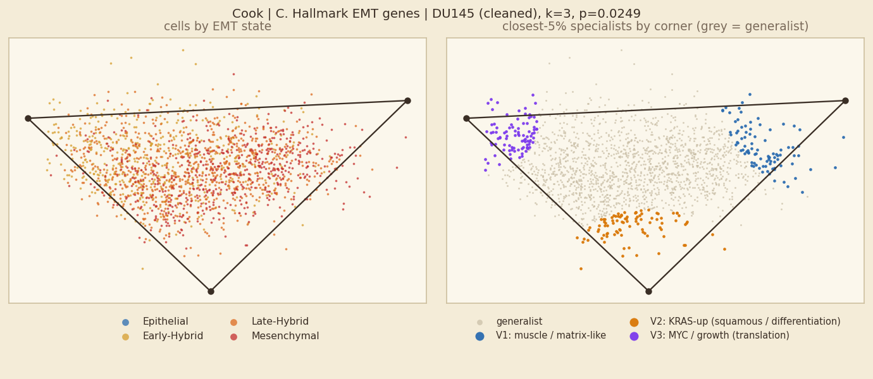
Cook: C. Hallmark EMT genes, unit DU145
Fit shown: cleaned · k = 3 · p = 0.0249 · 1,839 cells · 200 shuffles | comparison, light QC: k=3, p=0.0199
SIGNIFICANT permutation test, p ≤ 0.05
In plain words
Inside DU145 alone, cells fill a 3-corner simplex (p=0.0249). 3 of 4 units of this dataset have a significant simplex for this gene set.
Corners are programmes: muscle / matrix-like; KRAS-up (squamous / differentiation); MYC / growth (translation).
Hybrid vs other cells: 77% of hybrid cells and 83% of other cells are generalists (rule 1; rule 2: 86% vs 82%), so hybrids are less often generalists (they sit at corners).
Corners and their tasks
V1 muscle / matrix-like — Myogenesis +1.37 SD; 37% S/G2M; 60% Mesenchymal; 100% DU145; TAGLN MYL9 TPM1
V2 KRAS-up (squamous / differentiation) — KRAS Signaling Up +1.07 SD; 30% S/G2M; 45% Mesenchymal; 100% DU145; TIMP1 TGFBI VIM
V3 MYC / growth (translation) — Myc Targets V2 +0.55 SD; 39% S/G2M; 63% Early-Hybrid; 100% DU145; AREG SAT1 GPC1
Hallmark EMT set left out when naming (circular: fitted on those genes).
Left: cells coloured by EMT state (blue epithelial → red mesenchymal; hybrids are the two middle colours). Right: the 5% of cells nearest each corner coloured by corner, all other cells grey = generalists.
rule | % of hybrid cells that are generalists | % of other cells that are generalists
1 gap (top weight − second ≥ 0.35) | 77% | 83%
2 closest 5% of cells to each corner | 86% | 82%
3 weight > 0.95 on one corner | 100% | 100%
Hybrids are 69% of all cells here; 92% of cells lie inside the simplex.

Slide 56
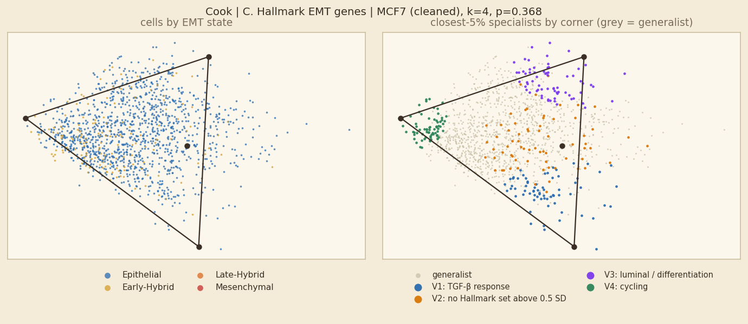
Cook: C. Hallmark EMT genes, unit MCF7
Fit shown: cleaned · k = 4 · p = 0.368 · 1,378 cells · 200 shuffles | comparison, light QC: k=4, p=0.891
NOT SIGNIFICANT p > 0.05
In plain words
No simplex inside MCF7: the fit (k=4, p=0.368) is no more triangular than shuffled data, so its corners should not be read as tasks. 3 of 4 units of this dataset have a significant simplex for this gene set.
Hybrid vs other cells: 68% of hybrid cells and 74% of other cells are generalists (rule 1; rule 2: 83% vs 80%), so hybrids are less often generalists (they sit at corners). (No significant simplex, so this is descriptive only.)
Corners and their tasks (shown for completeness only)
V1 TGF-β response — TGF-beta Signaling +1.31 SD; 13% S/G2M; 94% Epithelial; 100% MCF7; PMEPA1 CD59 LGALS1
V2 no Hallmark set above 0.5 SD — no Hallmark set above 0.5 SD; 45% S/G2M; 93% Epithelial; 100% MCF7; MGP PMEPA1 DKK1
V3 luminal / differentiation — Estrogen Response Late +0.61 SD; 52% S/G2M; 96% Epithelial; 100% MCF7; AREG BASP1 DKK1
V4 cycling — no Hallmark set above 0.5 SD; 71% S/G2M; 81% Epithelial; 100% MCF7; WIPF1 PMP22 LGALS1
Hallmark EMT set left out when naming (circular: fitted on those genes).
Left: cells coloured by EMT state (blue epithelial → red mesenchymal; hybrids are the two middle colours). Right: the 5% of cells nearest each corner coloured by corner, all other cells grey = generalists.
rule | % of hybrid cells that are generalists | % of other cells that are generalists
1 gap (top weight − second ≥ 0.35) | 68% | 74%
2 closest 5% of cells to each corner | 83% | 80%
3 weight > 0.95 on one corner | 100% | 100%
Hybrids are 11% of all cells here; 45% of cells lie inside the simplex.

Slide 57
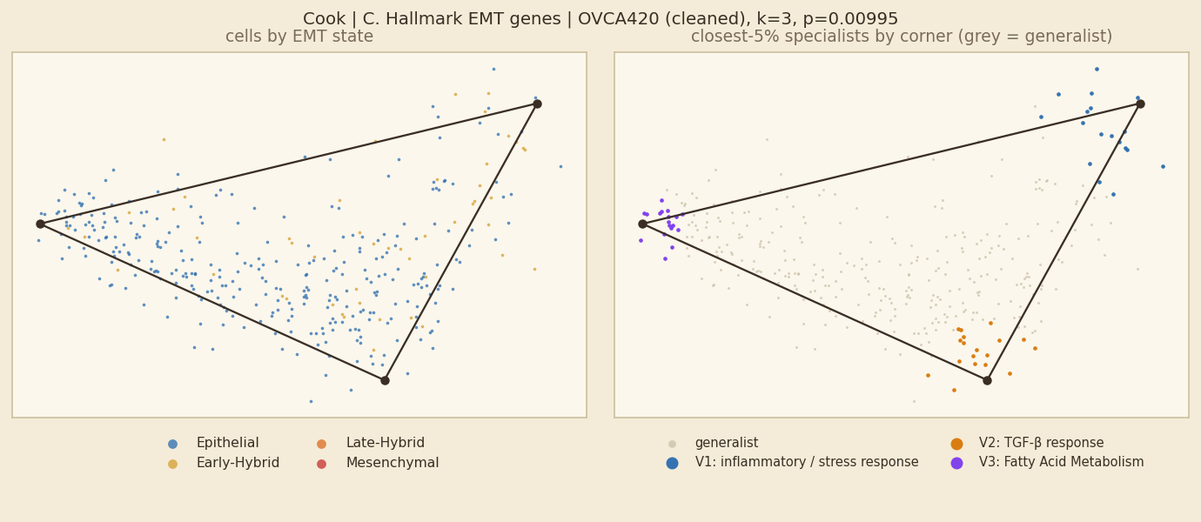
Cook: C. Hallmark EMT genes, unit OVCA420
Fit shown: cleaned · k = 3 · p = 0.00995 · 355 cells · 200 shuffles | comparison, light QC: k=3, p=0.00498
SIGNIFICANT permutation test, p ≤ 0.05
In plain words
Inside OVCA420 alone, cells fill a 3-corner simplex (p=0.00995). 3 of 4 units of this dataset have a significant simplex for this gene set.
Corners are programmes: inflammatory / stress response; TGF-β response; Fatty Acid Metabolism.
Hybrid vs other cells: 47% of hybrid cells and 45% of other cells are generalists (rule 1; rule 2: 80% vs 86%), so no real difference.
Corners and their tasks
V1 inflammatory / stress response — Inflammatory Response +2.2 SD; 0% S/G2M; 56% Epithelial; 100% OVCA420; TFPI2 LAMC2 IL32
V2 TGF-β response — TGF-beta Signaling +1.07 SD; 44% S/G2M; 94% Epithelial; 100% OVCA420; SERPINE1 TGM2 SERPINE2
V3 Fatty Acid Metabolism — Fatty Acid Metabolism +1.39 SD; 78% S/G2M; 94% Epithelial; 100% OVCA420; SPP1 ID2 LRP1
Hallmark EMT set left out when naming (circular: fitted on those genes).
Left: cells coloured by EMT state (blue epithelial → red mesenchymal; hybrids are the two middle colours). Right: the 5% of cells nearest each corner coloured by corner, all other cells grey = generalists.
rule | % of hybrid cells that are generalists | % of other cells that are generalists
1 gap (top weight − second ≥ 0.35) | 47% | 45%
2 closest 5% of cells to each corner | 80% | 86%
3 weight > 0.95 on one corner | 100% | 99%
Hybrids are 14% of all cells here; 74% of cells lie inside the simplex.

Slide 58
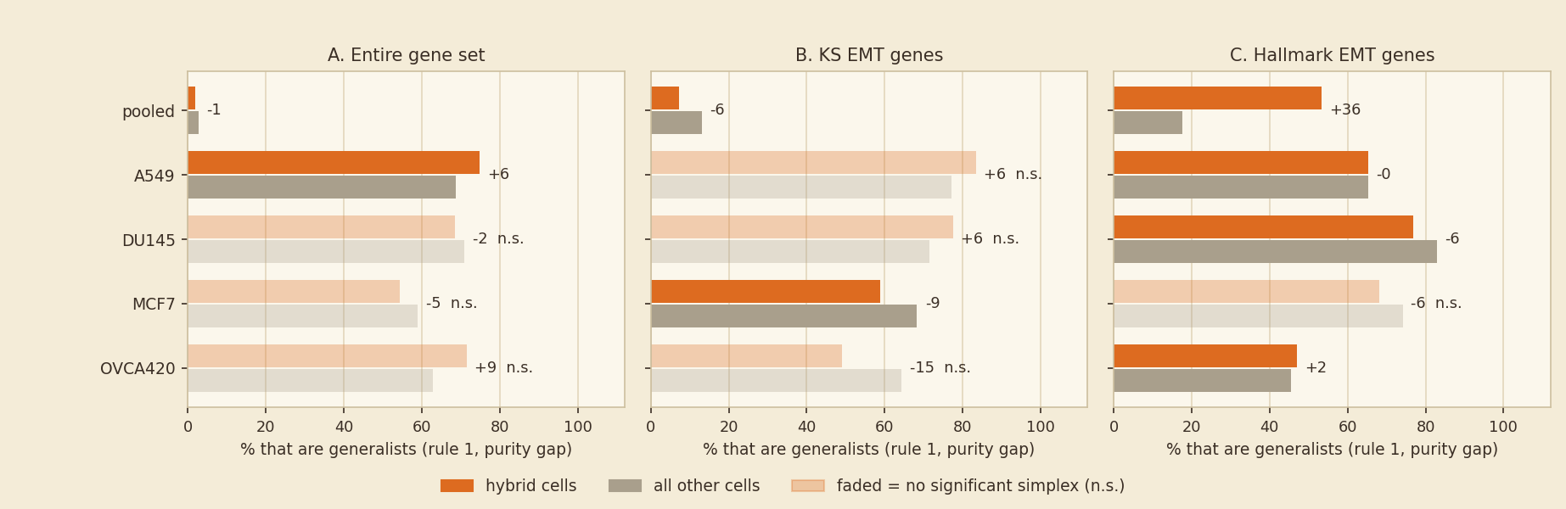
Question 2 · Cook: are hybrid cells more often generalists than other cells?
Orange = hybrid cells, grey = all other cells; one pair of bars per unit; the number = orange minus grey (percentage points)
Reading
• A. Entire gene set (2 significant): hybrids 38% vs others 36% generalist under rule 1 (rule 2: 86% vs 83%) → no real difference.
• B. KS EMT genes (2 significant): hybrids 33% vs others 41% generalist under rule 1 (rule 2: 84% vs 78%) → hybrids are less often generalists (they sit at corners).
• C. Hallmark EMT genes (4 significant): hybrids 59% vs others 55% generalist under rule 1 (rule 2: 86% vs 83%) → no real difference.
Rule 3 (weight > 0.95) is not drawn: it calls about 100% of every group generalist, so it cannot show a difference.

Slide 59
Mouse PDAC
What the dataset is, and what to keep in mind when reading its slides
What the dataset means
Mouse pancreatic tumour cells from two mice at several body sites (primary, liver, metastasis). EMT states are ours (KS-score bins), so partly circular.
Units in the main analysis
M1, M1-PT, M1-SS, M1-Liver, M1-Met, M2, M2-PT, M2-Liver, M2-Met
Gene sets
A. all genes (11,000 to 14,500); B. KS EMT genes (Tan 2014; about 160 to 190 present); C. Hallmark Epithelial-Mesenchymal-Transition set (200 genes, those present in the data).
Keep in mind
• EMT states are ours (KS-score bins), so they are partly circular with the KS-gene fits.
• Units: seven libraries, mouse 1, mouse 2. 'Cleaned' keeps cells with at least 10,000 UMI and drops liver ambient-RNA genes.
• Pooled fit = in vivo tumour cells; mouse and site are confounded.
This dataset in numbers (main fits)
• Entire gene set: 10 of 10 fits significant; hybrids 61% / 84% / 100% generalist (median, rules 1/2/3).
• KS EMT genes: 3 of 10 fits significant; hybrids 75% / 80% / 100% generalist (median, rules 1/2/3).
• Hallmark EMT genes: 4 of 10 fits significant; hybrids 78% / 80% / 100% generalist (median, rules 1/2/3).
Question 1 slides come first, then the Question 2 slides for this dataset.

Slide 60
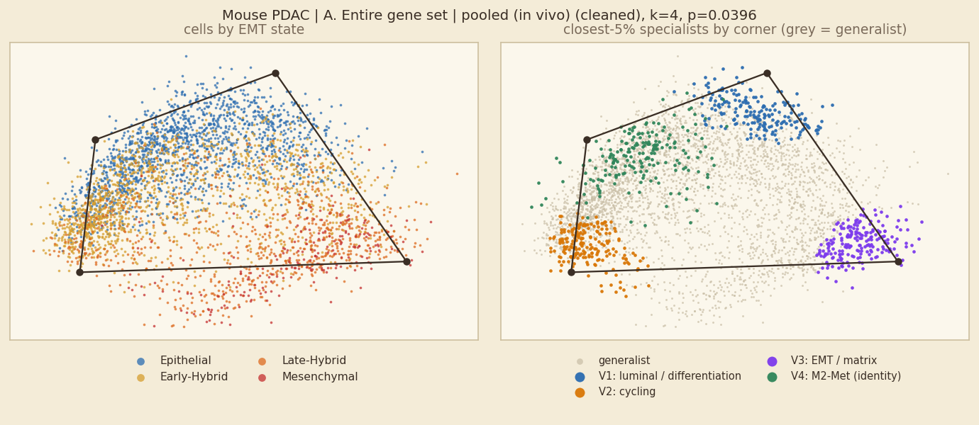
Mouse PDAC: A. Entire gene set, pooled fit
Fit shown: cleaned · k = 4 · p = 0.0396 · 37,387 cells · 100 shuffles | comparison, light QC: k=5, p=0.0796
SIGNIFICANT permutation test, p ≤ 0.05
In plain words
A significant simplex (k=4, p=0.0396) whose corners mix samples (no corner is 70% or more one sample), so it is not a pure sample-identity simplex.
Corners are programmes: luminal / differentiation; cycling; EMT / matrix; no Hallmark set above 0.5 SD.
Hybrid vs other cells: 61% of hybrid cells and 69% of other cells are generalists (rule 1; rule 2: 80% vs 80%), so hybrids are less often generalists (they sit at corners).
Corners and their tasks
V1 luminal / differentiation — Estrogen Response Early +1.69 SD; 0% S/G2M; 98% Epithelial; Ttr Atp1b1 Lgals4
V2 cycling — E2F Targets +1.91 SD; 100% S/G2M; 59% Early-Hybrid; Hmgb2 H2afz Birc5
V3 EMT / matrix — Epithelial Mesenchymal Transition +1.88 SD; 1% S/G2M; 60% Late-Hybrid; Trf Gm26870 Fn1
V4 identity corner: M2-Met (programme: no Hallmark set above 0.5 SD) — no Hallmark set above 0.5 SD; 12% S/G2M; 51% Early-Hybrid; 70% M2-Met; Sprr1a S100a4 Ly6a
Left: cells coloured by EMT state (blue epithelial → red mesenchymal; hybrids are the two middle colours). Right: the 5% of cells nearest each corner coloured by corner, all other cells grey = generalists.
rule | % of hybrid cells that are generalists | % of other cells that are generalists
1 gap (top weight − second ≥ 0.35) | 61% | 69%
2 closest 5% of cells to each corner | 80% | 80%
3 weight > 0.95 on one corner | 100% | 100%
Hybrids are 56% of all cells here; 43% of cells lie inside the simplex.

Slide 61
Mouse PDAC: A. Entire gene set, all units at a glance
Main fit of each unit: 9 of 9 units have a significant simplex
unit | fit shown | k | p | light-QC p | hybrid % of cells | hybrids→generalist (1/2/3) | generalists→hybrid (1/2/3)
M1 | cleaned | 4 | 0.00498 * | 0.00498 | 61% | 70 / 81 / 100% | 69 / 62 / 61%
M1-PT | cleaned | 3 | 0.0199 * | 0.00498 | 49% | 61 / 86 / 100% | 58 / 50 / 49%
M1-SS | cleaned | 3 | 0.00498 * | 0.00498 | 51% | 66 / 86 / 100% | 58 / 52 / 51%
M1-Liver | cleaned | 4 | 0.00498 * | 0.00498 | 67% | 62 / 83 / 100% | 67 / 69 / 67%
M1-Met | cleaned | 4 | 0.00995 * | 0.0249 | 66% | 62 / 84 / 100% | 73 / 69 / 66%
M2 | cleaned | 3 | 0.00498 * | 0.0498 | 50% | 49 / 84 / 99% | 44 / 49 / 49%
M2-PT | cleaned | 3 | 0.00498 * | 0.00498 | 39% | 68 / 82 / 100% | 41 / 37 / 39%
M2-Liver | cleaned | 3 | 0.00498 * | 0.00498 | 53% | 59 / 88 / 100% | 56 / 55 / 53%
M2-Met | cleaned | 3 | 0.00498 * | 0.0647 | 56% | 53 / 85 / 100% | 49 / 56 / 56%
* p ≤ 0.05 for the fit shown. Rules: 1 = gap, 2 = closest 5%, 3 = weight > 0.95. One slide per unit follows; non-significant units are included for completeness and their corners should not be read as tasks.

Slide 62
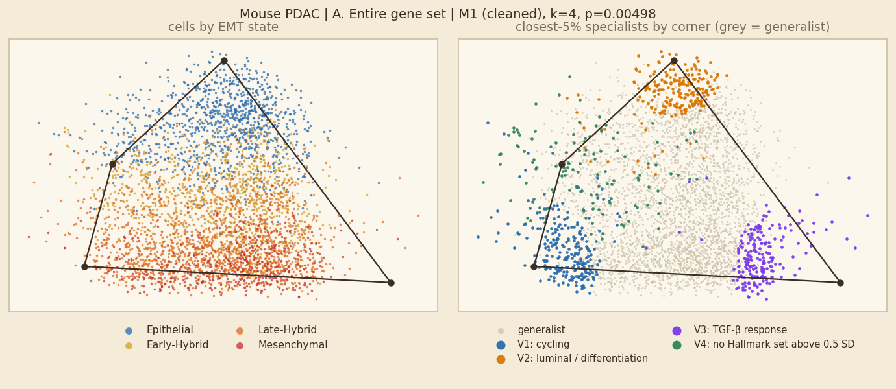
Mouse PDAC: A. Entire gene set, unit M1
Fit shown: cleaned · k = 4 · p = 0.00498 · 4,000 cells · 200 shuffles | comparison, light QC: k=4, p=0.00498
SIGNIFICANT permutation test, p ≤ 0.05
In plain words
Inside M1 alone, cells fill a 4-corner simplex (p=0.00498). 9 of 9 units of this dataset have a significant simplex for this gene set.
Corners are programmes: cycling; luminal / differentiation; TGF-β response; no Hallmark set above 0.5 SD.
Hybrid vs other cells: 70% of hybrid cells and 50% of other cells are generalists (rule 1; rule 2: 81% vs 78%), so hybrids are clearly more often generalists.
Corners and their tasks
V1 cycling — E2F Targets +2.39 SD; 94% S/G2M; 73% Late-Hybrid; Hmgb2 Birc5 H2afz
V2 luminal / differentiation — Estrogen Response Early +1.38 SD; 1% S/G2M; 100% Epithelial; Lgals4 Atp1b1 Dmbt1
V3 TGF-β response — TGF-beta Signaling +1.4 SD; 0% S/G2M; 54% Late-Hybrid; Gm26870 Neat1 Fn1
V4 no Hallmark set above 0.5 SD — no Hallmark set above 0.5 SD; 30% S/G2M; 40% Late-Hybrid; Lgals1 Tmsb10 Tmsb4x
Left: cells coloured by EMT state (blue epithelial → red mesenchymal; hybrids are the two middle colours). Right: the 5% of cells nearest each corner coloured by corner, all other cells grey = generalists.
rule | % of hybrid cells that are generalists | % of other cells that are generalists
1 gap (top weight − second ≥ 0.35) | 70% | 50%
2 closest 5% of cells to each corner | 81% | 78%
3 weight > 0.95 on one corner | 100% | 100%
Hybrids are 61% of all cells here; 50% of cells lie inside the simplex.

Slide 63
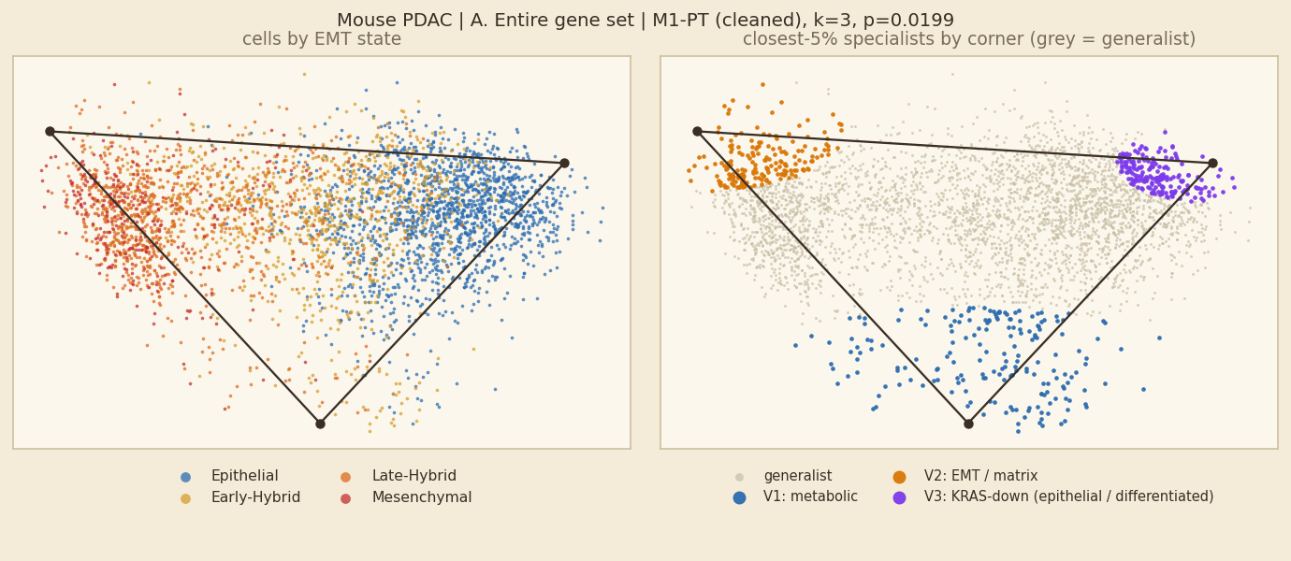
Mouse PDAC: A. Entire gene set, unit M1-PT
Fit shown: cleaned · k = 3 · p = 0.0199 · 3,770 cells · 200 shuffles | comparison, light QC: k=3, p=0.00498
SIGNIFICANT permutation test, p ≤ 0.05
In plain words
Inside M1-PT alone, cells fill a 3-corner simplex (p=0.0199). 9 of 9 units of this dataset have a significant simplex for this gene set.
Corners are programmes: metabolic; EMT / matrix; KRAS-down (epithelial / differentiated).
Hybrid vs other cells: 61% of hybrid cells and 43% of other cells are generalists (rule 1; rule 2: 86% vs 84%), so hybrids are clearly more often generalists.
Corners and their tasks
V1 metabolic — Oxidative Phosphorylation +1.02 SD; 49% S/G2M; 44% Early-Hybrid; 100% M1-PT; Lgals1 S100a6 Lgals2
V2 EMT / matrix — Epithelial Mesenchymal Transition +1.29 SD; 2% S/G2M; 59% Late-Hybrid; 100% M1-PT; Inhba Gm26870 Trf
V3 KRAS-down (epithelial / differentiated) — KRAS Signaling Dn +1.46 SD; 1% S/G2M; 97% Epithelial; 100% M1-PT; Ttr Atp1b1 Dmbt1
Left: cells coloured by EMT state (blue epithelial → red mesenchymal; hybrids are the two middle colours). Right: the 5% of cells nearest each corner coloured by corner, all other cells grey = generalists.
rule | % of hybrid cells that are generalists | % of other cells that are generalists
1 gap (top weight − second ≥ 0.35) | 61% | 43%
2 closest 5% of cells to each corner | 86% | 84%
3 weight > 0.95 on one corner | 100% | 100%
Hybrids are 49% of all cells here; 73% of cells lie inside the simplex.

Slide 64
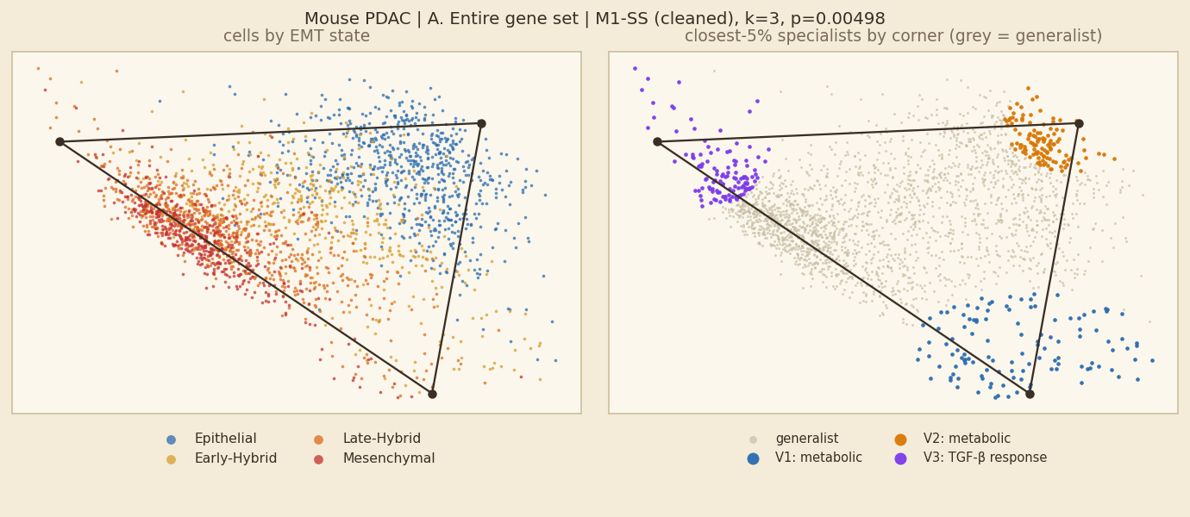
Mouse PDAC: A. Entire gene set, unit M1-SS
Fit shown: cleaned · k = 3 · p = 0.00498 · 2,397 cells · 200 shuffles | comparison, light QC: k=3, p=0.00498
SIGNIFICANT permutation test, p ≤ 0.05
In plain words
Inside M1-SS alone, cells fill a 3-corner simplex (p=0.00498). 9 of 9 units of this dataset have a significant simplex for this gene set.
Corners are programmes: metabolic; TGF-β response.
Hybrid vs other cells: 66% of hybrid cells and 50% of other cells are generalists (rule 1; rule 2: 86% vs 84%), so hybrids are clearly more often generalists.
Corners and their tasks
V1 metabolic — Oxidative Phosphorylation +0.62 SD; 39% S/G2M; 42% Early-Hybrid; 100% M1-SS; Lgals1 S100a6 Rplp1
V2 metabolic — Bile Acid Metabolism +1.57 SD; 0% S/G2M; 99% Epithelial; 100% M1-SS; Atp1b1 Ttr C3
V3 TGF-β response — TGF-beta Signaling +1.43 SD; 1% S/G2M; 52% Late-Hybrid; 100% M1-SS; Gm26870 Neat1 Id3
Left: cells coloured by EMT state (blue epithelial → red mesenchymal; hybrids are the two middle colours). Right: the 5% of cells nearest each corner coloured by corner, all other cells grey = generalists.
rule | % of hybrid cells that are generalists | % of other cells that are generalists
1 gap (top weight − second ≥ 0.35) | 66% | 50%
2 closest 5% of cells to each corner | 86% | 84%
3 weight > 0.95 on one corner | 100% | 100%
Hybrids are 51% of all cells here; 70% of cells lie inside the simplex.

Slide 65
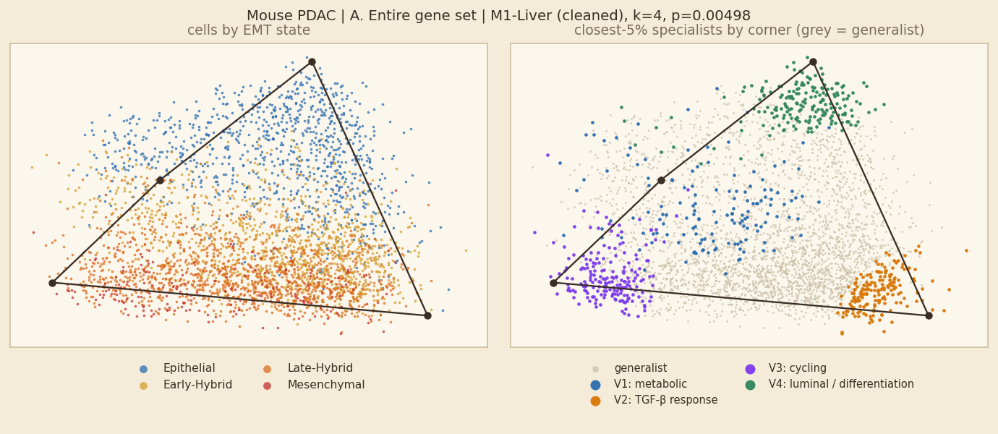
Mouse PDAC: A. Entire gene set, unit M1-Liver
Fit shown: cleaned · k = 4 · p = 0.00498 · 3,521 cells · 200 shuffles | comparison, light QC: k=4, p=0.00498
SIGNIFICANT permutation test, p ≤ 0.05
In plain words
Inside M1-Liver alone, cells fill a 4-corner simplex (p=0.00498). 9 of 9 units of this dataset have a significant simplex for this gene set.
Corners are programmes: metabolic; TGF-β response; cycling; luminal / differentiation.
Hybrid vs other cells: 62% of hybrid cells and 62% of other cells are generalists (rule 1; rule 2: 83% vs 75%), so no real difference.
Corners and their tasks
V1 metabolic — Oxidative Phosphorylation +0.56 SD; 19% S/G2M; 41% Early-Hybrid; 100% M1-Liver; Lgals2 Lgals1 AY036118
V2 TGF-β response — TGF-beta Signaling +1.43 SD; 0% S/G2M; 47% Early-Hybrid; 100% M1-Liver; Gm26870 Fn1 Neat1
V3 cycling — E2F Targets +2.33 SD; 98% S/G2M; 67% Late-Hybrid; 100% M1-Liver; Hmgb2 Birc5 Cenpa
V4 luminal / differentiation — Estrogen Response Early +1.5 SD; 0% S/G2M; 100% Epithelial; 100% M1-Liver; Dmbt1 Lgals4 Atp1b1
Left: cells coloured by EMT state (blue epithelial → red mesenchymal; hybrids are the two middle colours). Right: the 5% of cells nearest each corner coloured by corner, all other cells grey = generalists.
rule | % of hybrid cells that are generalists | % of other cells that are generalists
1 gap (top weight − second ≥ 0.35) | 62% | 62%
2 closest 5% of cells to each corner | 83% | 75%
3 weight > 0.95 on one corner | 100% | 100%
Hybrids are 67% of all cells here; 43% of cells lie inside the simplex.

Slide 66

Mouse PDAC: A. Entire gene set, unit M1-Met
Fit shown: cleaned · k = 4 · p = 0.00995 · 4,000 cells · 200 shuffles | comparison, light QC: k=4, p=0.0249
SIGNIFICANT permutation test, p ≤ 0.05
In plain words
Inside M1-Met alone, cells fill a 4-corner simplex (p=0.00995). 9 of 9 units of this dataset have a significant simplex for this gene set.
Corners are programmes: cycling; metabolic; no Hallmark set above 0.5 SD; TGF-β response.
Hybrid vs other cells: 62% of hybrid cells and 45% of other cells are generalists (rule 1; rule 2: 84% vs 72%), so hybrids are clearly more often generalists.
Corners and their tasks
V1 cycling — E2F Targets +2.23 SD; 92% S/G2M; 69% Late-Hybrid; 100% M1-Met; Hmgb2 Birc5 Cenpa
V2 metabolic — Bile Acid Metabolism +1.84 SD; 1% S/G2M; 95% Epithelial; 100% M1-Met; Lgals4 Atp1b1 Gsta4
V3 no Hallmark set above 0.5 SD — no Hallmark set above 0.5 SD; 37% S/G2M; 44% Late-Hybrid; 100% M1-Met; Lgals1 S100a6 S100a11
V4 TGF-β response — TGF-beta Signaling +1.48 SD; 0% S/G2M; 55% Late-Hybrid; 100% M1-Met; Gm26870 Col6a1 Fn1
Left: cells coloured by EMT state (blue epithelial → red mesenchymal; hybrids are the two middle colours). Right: the 5% of cells nearest each corner coloured by corner, all other cells grey = generalists.
rule | % of hybrid cells that are generalists | % of other cells that are generalists
1 gap (top weight − second ≥ 0.35) | 62% | 45%
2 closest 5% of cells to each corner | 84% | 72%
3 weight > 0.95 on one corner | 100% | 99%
Hybrids are 66% of all cells here; 42% of cells lie inside the simplex.

Slide 67

Mouse PDAC: A. Entire gene set, unit M2
Fit shown: cleaned · k = 3 · p = 0.00498 · 2,728 cells · 200 shuffles | comparison, light QC: k=4, p=0.0498
SIGNIFICANT permutation test, p ≤ 0.05
In plain words
Inside M2 alone, cells fill a 3-corner simplex (p=0.00498). 9 of 9 units of this dataset have a significant simplex for this gene set.
Corners are programmes: metabolic; MYC / growth (translation); hypoxia / glycolysis.
Hybrid vs other cells: 49% of hybrid cells and 60% of other cells are generalists (rule 1; rule 2: 84% vs 86%), so hybrids are less often generalists (they sit at corners).
Corners and their tasks
V1 metabolic — Bile Acid Metabolism +1.57 SD; 0% S/G2M; 91% Epithelial; 89% M2-PT; 2210407C18Rik Gsta4 Ttr
V2 MYC / growth (translation) — Myc Targets V1 +1.67 SD; 100% S/G2M; 64% Early-Hybrid; Hmgb2 Birc5 Cks1b
V3 hypoxia / glycolysis — Hypoxia +1.52 SD; 1% S/G2M; 46% Early-Hybrid; Mt1 Sprr1a Malat1
Left: cells coloured by EMT state (blue epithelial → red mesenchymal; hybrids are the two middle colours). Right: the 5% of cells nearest each corner coloured by corner, all other cells grey = generalists.
rule | % of hybrid cells that are generalists | % of other cells that are generalists
1 gap (top weight − second ≥ 0.35) | 49% | 60%
2 closest 5% of cells to each corner | 84% | 86%
3 weight > 0.95 on one corner | 99% | 100%
Hybrids are 50% of all cells here; 70% of cells lie inside the simplex.

Slide 68

Mouse PDAC: A. Entire gene set, unit M2-PT
Fit shown: cleaned · k = 3 · p = 0.00498 · 4,000 cells · 200 shuffles | comparison, light QC: k=4, p=0.00498
SIGNIFICANT permutation test, p ≤ 0.05
In plain words
Inside M2-PT alone, cells fill a 3-corner simplex (p=0.00498). 9 of 9 units of this dataset have a significant simplex for this gene set.
Corners are programmes: MYC / growth (translation); metabolic; hypoxia / glycolysis.
Hybrid vs other cells: 68% of hybrid cells and 62% of other cells are generalists (rule 1; rule 2: 82% vs 87%), so hybrids are slightly more often generalists.
Corners and their tasks
V1 MYC / growth (translation) — Myc Targets V1 +1.86 SD; 92% S/G2M; 50% Early-Hybrid; 100% M2-PT; H2afz Hmgb2 Birc5
V2 metabolic — Bile Acid Metabolism +1.73 SD; 0% S/G2M; 100% Epithelial; 100% M2-PT; 2210407C18Rik Ttr Dmbt1
V3 hypoxia / glycolysis — Hypoxia +1.87 SD; 2% S/G2M; 42% Early-Hybrid; 100% M2-PT; Ero1l Vegfa Hilpda
Left: cells coloured by EMT state (blue epithelial → red mesenchymal; hybrids are the two middle colours). Right: the 5% of cells nearest each corner coloured by corner, all other cells grey = generalists.
rule | % of hybrid cells that are generalists | % of other cells that are generalists
1 gap (top weight − second ≥ 0.35) | 68% | 62%
2 closest 5% of cells to each corner | 82% | 87%
3 weight > 0.95 on one corner | 100% | 100%
Hybrids are 39% of all cells here; 86% of cells lie inside the simplex.

Slide 69

Mouse PDAC: A. Entire gene set, unit M2-Liver
Fit shown: cleaned · k = 3 · p = 0.00498 · 4,000 cells · 200 shuffles | comparison, light QC: k=4, p=0.00498
SIGNIFICANT permutation test, p ≤ 0.05
In plain words
Inside M2-Liver alone, cells fill a 3-corner simplex (p=0.00498). 9 of 9 units of this dataset have a significant simplex for this gene set.
Corners are programmes: MYC / growth (translation); angiogenesis / matrix; metabolic.
Hybrid vs other cells: 59% of hybrid cells and 51% of other cells are generalists (rule 1; rule 2: 88% vs 82%), so hybrids are clearly more often generalists.
Corners and their tasks
V1 MYC / growth (translation) — Myc Targets V1 +1.55 SD; 100% S/G2M; 42% Early-Hybrid; 100% M2-Liver; Hmgb2 Birc5 Phgdh
V2 angiogenesis / matrix — Angiogenesis +1.06 SD; 2% S/G2M; 62% Epithelial; 100% M2-Liver; Clu Sprr1a Spp1
V3 metabolic — Bile Acid Metabolism +1.8 SD; 2% S/G2M; 94% Epithelial; 100% M2-Liver; 2210407C18Rik Gsta4 Sptssb
Left: cells coloured by EMT state (blue epithelial → red mesenchymal; hybrids are the two middle colours). Right: the 5% of cells nearest each corner coloured by corner, all other cells grey = generalists.
rule | % of hybrid cells that are generalists | % of other cells that are generalists
1 gap (top weight − second ≥ 0.35) | 59% | 51%
2 closest 5% of cells to each corner | 88% | 82%
3 weight > 0.95 on one corner | 100% | 100%
Hybrids are 53% of all cells here; 56% of cells lie inside the simplex.

Slide 70

Mouse PDAC: A. Entire gene set, unit M2-Met
Fit shown: cleaned · k = 3 · p = 0.00498 · 4,000 cells · 200 shuffles | comparison, light QC: k=3, p=0.0647
SIGNIFICANT permutation test, p ≤ 0.05
In plain words
Inside M2-Met alone, cells fill a 3-corner simplex (p=0.00498). 9 of 9 units of this dataset have a significant simplex for this gene set.
Corners are programmes: MYC / growth (translation); metabolic; hypoxia / glycolysis.
Hybrid vs other cells: 53% of hybrid cells and 72% of other cells are generalists (rule 1; rule 2: 85% vs 85%), so hybrids are less often generalists (they sit at corners).
Corners and their tasks
V1 MYC / growth (translation) — Myc Targets V1 +1.75 SD; 100% S/G2M; 58% Early-Hybrid; 100% M2-Met; Hmgb2 Phgdh Birc5
V2 metabolic — Bile Acid Metabolism +1.42 SD; 5% S/G2M; 94% Epithelial; 100% M2-Met; Ttr Fxyd3 Sptssb
V3 hypoxia / glycolysis — Hypoxia +2.11 SD; 4% S/G2M; 52% Early-Hybrid; 100% M2-Met; Mt1 Ero1l Ndrg1
Left: cells coloured by EMT state (blue epithelial → red mesenchymal; hybrids are the two middle colours). Right: the 5% of cells nearest each corner coloured by corner, all other cells grey = generalists.
rule | % of hybrid cells that are generalists | % of other cells that are generalists
1 gap (top weight − second ≥ 0.35) | 53% | 72%
2 closest 5% of cells to each corner | 85% | 85%
3 weight > 0.95 on one corner | 100% | 100%
Hybrids are 56% of all cells here; 88% of cells lie inside the simplex.

Slide 71

Mouse PDAC: B. KS EMT genes, pooled fit
Fit shown: cleaned · k = 4 · p = 0.931 · 37,387 cells · 100 shuffles | comparison, light QC: k=4, p=0.97
NOT SIGNIFICANT p > 0.05
In plain words
No simplex: the pooled fit (k=4, p=0.931) is no more triangular than shuffled data, so its corners should not be read as tasks.
Hybrid vs other cells: 54% of hybrid cells and 70% of other cells are generalists (rule 1; rule 2: 82% vs 78%), so hybrids are less often generalists (they sit at corners). (No significant simplex, so this is descriptive only.)
Corners and their tasks (shown for completeness only)
V1 no Hallmark set above 0.5 SD — no Hallmark set above 0.5 SD; 54% S/G2M; 59% Early-Hybrid; Krt19 Krt7 Areg
V2 EMT / matrix — Epithelial Mesenchymal Transition +1.76 SD; 9% S/G2M; 66% Late-Hybrid; Cald1 Vim Map1b
V3 luminal / differentiation — Estrogen Response Early +1.49 SD; 8% S/G2M; 100% Epithelial; Fxyd3 Atp1b1 Epcam
V4 EMT / matrix — Epithelial Mesenchymal Transition +0.73 SD; 11% S/G2M; 39% Late-Hybrid; Sparc Cald1 Map1b
KS genes overlap the EMT set: an 'EMT / matrix' label is partly expected.
Left: cells coloured by EMT state (blue epithelial → red mesenchymal; hybrids are the two middle colours). Right: the 5% of cells nearest each corner coloured by corner, all other cells grey = generalists.
rule | % of hybrid cells that are generalists | % of other cells that are generalists
1 gap (top weight − second ≥ 0.35) | 54% | 70%
2 closest 5% of cells to each corner | 82% | 78%
3 weight > 0.95 on one corner | 100% | 100%
Hybrids are 56% of all cells here; 38% of cells lie inside the simplex.

Slide 72
Mouse PDAC: B. KS EMT genes, all units at a glance
Main fit of each unit: 3 of 9 units have a significant simplex
unit | fit shown | k | p | light-QC p | hybrid % of cells | hybrids→generalist (1/2/3) | generalists→hybrid (1/2/3)
M1 | cleaned | 4 | 0.985 | 1 | 61% | 77 / 82 / 100% | 63 / 63 / 61%
M1-PT | cleaned | 4 | 0.154 | 0.00498 | 49% | 74 / 82 / 100% | 45 / 50 / 49%
M1-SS | cleaned | 4 | 0.00498 * | 0.448 | 51% | 75 / 81 / 100% | 58 / 52 / 51%
M1-Liver | cleaned | 4 | 0.97 | 0.945 | 67% | 58 / 87 / 100% | 63 / 73 / 67%
M1-Met | cleaned | 4 | 0.597 | 0.343 | 66% | 76 / 84 / 100% | 66 / 69 / 66%
M2 | cleaned | 4 | 0.0249 * | 0.363 | 50% | 66 / 77 / 100% | 46 / 47 / 50%
M2-PT | cleaned | 3 | 0.622 | 0.99 | 39% | 69 / 84 / 100% | 36 / 38 / 39%
M2-Liver | cleaned | 4 | 0.746 | 0.0796 | 53% | 69 / 81 / 100% | 50 / 53 / 53%
M2-Met | cleaned | 4 | 0.0398 * | 0.925 | 56% | 81 / 80 / 100% | 54 / 56 / 56%
* p ≤ 0.05 for the fit shown. Rules: 1 = gap, 2 = closest 5%, 3 = weight > 0.95. One slide per unit follows; non-significant units are included for completeness and their corners should not be read as tasks.

Slide 73

Mouse PDAC: B. KS EMT genes, unit M1
Fit shown: cleaned · k = 4 · p = 0.985 · 4,000 cells · 200 shuffles | comparison, light QC: k=3, p=1
NOT SIGNIFICANT p > 0.05
In plain words
No simplex inside M1: the fit (k=4, p=0.985) is no more triangular than shuffled data, so its corners should not be read as tasks. 3 of 9 units of this dataset have a significant simplex for this gene set.
Hybrid vs other cells: 77% of hybrid cells and 73% of other cells are generalists (rule 1; rule 2: 82% vs 77%), so hybrids are slightly more often generalists. (No significant simplex, so this is descriptive only.)
Corners and their tasks (shown for completeness only)
V1 TGF-β response — TGF-beta Signaling +1.18 SD; 1% S/G2M; 58% Late-Hybrid; Hes1 Cald1 Sdc1
V2 luminal / differentiation — Estrogen Response Early +1.43 SD; 8% S/G2M; 100% Epithelial; Krt7 Fxyd3 Atp1b1
V3 EMT / matrix — Epithelial Mesenchymal Transition +1.13 SD; 8% S/G2M; 58% Mesenchymal; 66% M1-SS; Sparc Cald1 Serpine1
V4 mTORC1 Signaling — mTORC1 Signaling +1.07 SD; 48% S/G2M; 59% Late-Hybrid; Krt19 Krt8 Lgals1
KS genes overlap the EMT set: an 'EMT / matrix' label is partly expected.
Left: cells coloured by EMT state (blue epithelial → red mesenchymal; hybrids are the two middle colours). Right: the 5% of cells nearest each corner coloured by corner, all other cells grey = generalists.
rule | % of hybrid cells that are generalists | % of other cells that are generalists
1 gap (top weight − second ≥ 0.35) | 77% | 73%
2 closest 5% of cells to each corner | 82% | 77%
3 weight > 0.95 on one corner | 100% | 100%
Hybrids are 61% of all cells here; 42% of cells lie inside the simplex.

Slide 74

Mouse PDAC: B. KS EMT genes, unit M1-PT
Fit shown: cleaned · k = 4 · p = 0.154 · 3,770 cells · 200 shuffles | comparison, light QC: k=4, p=0.00498
NOT SIGNIFICANT p > 0.05
In plain words
No simplex inside M1-PT: the fit (k=4, p=0.154) is no more triangular than shuffled data, so its corners should not be read as tasks. 3 of 9 units of this dataset have a significant simplex for this gene set.
Hybrid vs other cells: 74% of hybrid cells and 87% of other cells are generalists (rule 1; rule 2: 82% vs 78%), so hybrids are less often generalists (they sit at corners). (No significant simplex, so this is descriptive only.)
Corners and their tasks (shown for completeness only)
V1 luminal / differentiation — Estrogen Response Early +1.49 SD; 2% S/G2M; 100% Epithelial; 100% M1-PT; Epcam Fxyd3 Atp1b1
V2 EMT / matrix — Epithelial Mesenchymal Transition +1.16 SD; 2% S/G2M; 46% Late-Hybrid; 100% M1-PT; Cald1 Sparc Sdc1
V3 metabolic — Oxidative Phosphorylation +1.18 SD; 36% S/G2M; 66% Epithelial; 100% M1-PT; Krt7 Fxyd3 Krt19
V4 hypoxia / glycolysis — Glycolysis +1.21 SD; 18% S/G2M; 72% Late-Hybrid; 100% M1-PT; Areg Vim Tuba1a
KS genes overlap the EMT set: an 'EMT / matrix' label is partly expected.
Left: cells coloured by EMT state (blue epithelial → red mesenchymal; hybrids are the two middle colours). Right: the 5% of cells nearest each corner coloured by corner, all other cells grey = generalists.
rule | % of hybrid cells that are generalists | % of other cells that are generalists
1 gap (top weight − second ≥ 0.35) | 74% | 87%
2 closest 5% of cells to each corner | 82% | 78%
3 weight > 0.95 on one corner | 100% | 100%
Hybrids are 49% of all cells here; 42% of cells lie inside the simplex.

Slide 75

Mouse PDAC: B. KS EMT genes, unit M1-SS
Fit shown: cleaned · k = 4 · p = 0.00498 · 2,397 cells · 200 shuffles | comparison, light QC: k=4, p=0.448
SIGNIFICANT permutation test, p ≤ 0.05
In plain words
Inside M1-SS alone, cells fill a 4-corner simplex (p=0.00498). 3 of 9 units of this dataset have a significant simplex for this gene set.
Corners are programmes: Adipogenesis; EMT / matrix; metabolic; TGF-β response.
Hybrid vs other cells: 75% of hybrid cells and 57% of other cells are generalists (rule 1; rule 2: 81% vs 78%), so hybrids are clearly more often generalists.
Corners and their tasks
V1 Adipogenesis — Adipogenesis +1.54 SD; 12% S/G2M; 100% Epithelial; 100% M1-SS; Fxyd3 Krt19 Atp1b1
V2 EMT / matrix — Epithelial Mesenchymal Transition +1.76 SD; 10% S/G2M; 88% Mesenchymal; 100% M1-SS; Sparc Cald1 Lhfp
V3 metabolic — Cholesterol Homeostasis +1.0 SD; 31% S/G2M; 61% Late-Hybrid; 100% M1-SS; Krt8 Krt18 Lgals1
V4 TGF-β response — TGF-beta Signaling +1.3 SD; 1% S/G2M; 63% Late-Hybrid; 100% M1-SS; Hes1 Serpine1 Cald1
KS genes overlap the EMT set: an 'EMT / matrix' label is partly expected.
Left: cells coloured by EMT state (blue epithelial → red mesenchymal; hybrids are the two middle colours). Right: the 5% of cells nearest each corner coloured by corner, all other cells grey = generalists.
rule | % of hybrid cells that are generalists | % of other cells that are generalists
1 gap (top weight − second ≥ 0.35) | 75% | 57%
2 closest 5% of cells to each corner | 81% | 78%
3 weight > 0.95 on one corner | 100% | 100%
Hybrids are 51% of all cells here; 43% of cells lie inside the simplex.

Slide 76

Mouse PDAC: B. KS EMT genes, unit M1-Liver
Fit shown: cleaned · k = 4 · p = 0.97 · 3,521 cells · 200 shuffles | comparison, light QC: k=4, p=0.945
NOT SIGNIFICANT p > 0.05
In plain words
No simplex inside M1-Liver: the fit (k=4, p=0.97) is no more triangular than shuffled data, so its corners should not be read as tasks. 3 of 9 units of this dataset have a significant simplex for this gene set.
Hybrid vs other cells: 58% of hybrid cells and 70% of other cells are generalists (rule 1; rule 2: 87% vs 66%), so hybrids are less often generalists (they sit at corners). (No significant simplex, so this is descriptive only.)
Corners and their tasks (shown for completeness only)
V1 luminal / differentiation — Estrogen Response Early +1.33 SD; 1% S/G2M; 100% Epithelial; 100% M1-Liver; Atp1b1 Fxyd3 Krt7
V2 Hedgehog Signaling — Hedgehog Signaling +0.7 SD; 5% S/G2M; 51% Late-Hybrid; 100% M1-Liver; Sparc Cald1 Lcn2
V3 metabolic — Oxidative Phosphorylation +1.12 SD; 40% S/G2M; 94% Epithelial; 100% M1-Liver; Krt7 Krt19 Fxyd3
V4 hypoxia / glycolysis — Glycolysis +0.65 SD; 36% S/G2M; 73% Late-Hybrid; 100% M1-Liver; Tuba1a Lgals1 Krt19
KS genes overlap the EMT set: an 'EMT / matrix' label is partly expected.
Left: cells coloured by EMT state (blue epithelial → red mesenchymal; hybrids are the two middle colours). Right: the 5% of cells nearest each corner coloured by corner, all other cells grey = generalists.
rule | % of hybrid cells that are generalists | % of other cells that are generalists
1 gap (top weight − second ≥ 0.35) | 58% | 70%
2 closest 5% of cells to each corner | 87% | 66%
3 weight > 0.95 on one corner | 100% | 100%
Hybrids are 67% of all cells here; 28% of cells lie inside the simplex.

Slide 77

Mouse PDAC: B. KS EMT genes, unit M1-Met
Fit shown: cleaned · k = 4 · p = 0.597 · 4,000 cells · 200 shuffles | comparison, light QC: k=4, p=0.343
NOT SIGNIFICANT p > 0.05
In plain words
No simplex inside M1-Met: the fit (k=4, p=0.597) is no more triangular than shuffled data, so its corners should not be read as tasks. 3 of 9 units of this dataset have a significant simplex for this gene set.
Hybrid vs other cells: 76% of hybrid cells and 76% of other cells are generalists (rule 1; rule 2: 84% vs 73%), so no real difference. (No significant simplex, so this is descriptive only.)
Corners and their tasks (shown for completeness only)
V1 EMT / matrix — Epithelial Mesenchymal Transition +1.35 SD; 0% S/G2M; 52% Late-Hybrid; 100% M1-Met; Sparc Sdc1 Hes1
V2 luminal / differentiation — Estrogen Response Early +1.45 SD; 10% S/G2M; 98% Epithelial; 100% M1-Met; Krt7 Krt19 Atp1b1
V3 metabolic — Cholesterol Homeostasis +0.87 SD; 38% S/G2M; 71% Late-Hybrid; 100% M1-Met; Krt19 Krt8 Areg
V4 MYC / growth (translation) — Myc Targets V1 +0.82 SD; 59% S/G2M; 52% Late-Hybrid; 100% M1-Met; Lgals1 Tubb6 Axl
KS genes overlap the EMT set: an 'EMT / matrix' label is partly expected.
Left: cells coloured by EMT state (blue epithelial → red mesenchymal; hybrids are the two middle colours). Right: the 5% of cells nearest each corner coloured by corner, all other cells grey = generalists.
rule | % of hybrid cells that are generalists | % of other cells that are generalists
1 gap (top weight − second ≥ 0.35) | 76% | 76%
2 closest 5% of cells to each corner | 84% | 73%
3 weight > 0.95 on one corner | 100% | 100%
Hybrids are 66% of all cells here; 41% of cells lie inside the simplex.

Slide 78

Mouse PDAC: B. KS EMT genes, unit M2
Fit shown: cleaned · k = 4 · p = 0.0249 · 2,728 cells · 200 shuffles | comparison, light QC: k=4, p=0.363
SIGNIFICANT permutation test, p ≤ 0.05
In plain words
Inside M2 alone, cells fill a 4-corner simplex (p=0.0249). 3 of 9 units of this dataset have a significant simplex for this gene set.
Corners are programmes: luminal / differentiation; no Hallmark set above 0.5 SD; MYC / growth (translation); EMT / matrix.
Hybrid vs other cells: 66% of hybrid cells and 77% of other cells are generalists (rule 1; rule 2: 77% vs 84%), so hybrids are less often generalists (they sit at corners).
Corners and their tasks
V1 luminal / differentiation — Estrogen Response Early +1.47 SD; 13% S/G2M; 100% Epithelial; 69% M2-PT; Fxyd3 Epcam Krt19
V2 no Hallmark set above 0.5 SD — no Hallmark set above 0.5 SD; 35% S/G2M; 47% Early-Hybrid; Cald1 Sparc Lcn2
V3 MYC / growth (translation) — Myc Targets V1 +0.68 SD; 72% S/G2M; 77% Early-Hybrid; Areg Tuba1a Lgals1
V4 EMT / matrix — Epithelial Mesenchymal Transition +1.67 SD; 5% S/G2M; 51% Early-Hybrid; 81% M2-PT; Cald1 Camk2n1 Sparc
KS genes overlap the EMT set: an 'EMT / matrix' label is partly expected.
Left: cells coloured by EMT state (blue epithelial → red mesenchymal; hybrids are the two middle colours). Right: the 5% of cells nearest each corner coloured by corner, all other cells grey = generalists.
rule | % of hybrid cells that are generalists | % of other cells that are generalists
1 gap (top weight − second ≥ 0.35) | 66% | 77%
2 closest 5% of cells to each corner | 77% | 84%
3 weight > 0.95 on one corner | 100% | 100%
Hybrids are 50% of all cells here; 46% of cells lie inside the simplex.

Slide 79

Mouse PDAC: B. KS EMT genes, unit M2-PT
Fit shown: cleaned · k = 3 · p = 0.622 · 4,000 cells · 200 shuffles | comparison, light QC: k=3, p=0.99
NOT SIGNIFICANT p > 0.05
In plain words
No simplex inside M2-PT: the fit (k=3, p=0.622) is no more triangular than shuffled data, so its corners should not be read as tasks. 3 of 9 units of this dataset have a significant simplex for this gene set.
Hybrid vs other cells: 69% of hybrid cells and 78% of other cells are generalists (rule 1; rule 2: 84% vs 85%), so hybrids are less often generalists (they sit at corners). (No significant simplex, so this is descriptive only.)
Corners and their tasks (shown for completeness only)
V1 EMT / matrix — Epithelial Mesenchymal Transition +1.2 SD; 8% S/G2M; 44% Late-Hybrid; 100% M2-PT; Cald1 Tuba1a Sparc
V2 luminal / differentiation — Estrogen Response Early +0.88 SD; 9% S/G2M; 100% Epithelial; 100% M2-PT; Epcam Fxyd3 Atp1b1
V3 MYC / growth (translation) — Myc Targets V1 +0.71 SD; 40% S/G2M; 60% Epithelial; 100% M2-PT; Areg Krt7 Krt19
KS genes overlap the EMT set: an 'EMT / matrix' label is partly expected.
Left: cells coloured by EMT state (blue epithelial → red mesenchymal; hybrids are the two middle colours). Right: the 5% of cells nearest each corner coloured by corner, all other cells grey = generalists.
rule | % of hybrid cells that are generalists | % of other cells that are generalists
1 gap (top weight − second ≥ 0.35) | 69% | 78%
2 closest 5% of cells to each corner | 84% | 85%
3 weight > 0.95 on one corner | 100% | 100%
Hybrids are 39% of all cells here; 87% of cells lie inside the simplex.

Slide 80

Mouse PDAC: B. KS EMT genes, unit M2-Liver
Fit shown: cleaned · k = 4 · p = 0.746 · 4,000 cells · 200 shuffles | comparison, light QC: k=4, p=0.0796
NOT SIGNIFICANT p > 0.05
In plain words
No simplex inside M2-Liver: the fit (k=4, p=0.746) is no more triangular than shuffled data, so its corners should not be read as tasks. 3 of 9 units of this dataset have a significant simplex for this gene set.
Hybrid vs other cells: 69% of hybrid cells and 77% of other cells are generalists (rule 1; rule 2: 81% vs 79%), so hybrids are less often generalists (they sit at corners). (No significant simplex, so this is descriptive only.)
Corners and their tasks (shown for completeness only)
V1 metabolic — Bile Acid Metabolism +1.57 SD; 6% S/G2M; 100% Epithelial; 100% M2-Liver; Fxyd3 Atp1b1 Elf3
V2 EMT / matrix — Epithelial Mesenchymal Transition +1.87 SD; 74% S/G2M; 66% Late-Hybrid; 100% M2-Liver; Cald1 Sparc Tubb6
V3 luminal / differentiation — Estrogen Response Early +0.78 SD; 61% S/G2M; 50% Early-Hybrid; 100% M2-Liver; Krt19 Il1rn Areg
V4 MYC / growth (translation) — Myc Targets V1 +0.81 SD; 89% S/G2M; 65% Early-Hybrid; 100% M2-Liver; Lgals1 Krt7 Areg
KS genes overlap the EMT set: an 'EMT / matrix' label is partly expected.
Left: cells coloured by EMT state (blue epithelial → red mesenchymal; hybrids are the two middle colours). Right: the 5% of cells nearest each corner coloured by corner, all other cells grey = generalists.
rule | % of hybrid cells that are generalists | % of other cells that are generalists
1 gap (top weight − second ≥ 0.35) | 69% | 77%
2 closest 5% of cells to each corner | 81% | 79%
3 weight > 0.95 on one corner | 100% | 100%
Hybrids are 53% of all cells here; 51% of cells lie inside the simplex.

Slide 81

Mouse PDAC: B. KS EMT genes, unit M2-Met
Fit shown: cleaned · k = 4 · p = 0.0398 · 4,000 cells · 200 shuffles | comparison, light QC: k=3, p=0.925
SIGNIFICANT permutation test, p ≤ 0.05
In plain words
Inside M2-Met alone, cells fill a 4-corner simplex (p=0.0398). 3 of 9 units of this dataset have a significant simplex for this gene set.
Corners are programmes: EMT / matrix; metabolic; MYC / growth (translation); luminal / differentiation.
Hybrid vs other cells: 81% of hybrid cells and 88% of other cells are generalists (rule 1; rule 2: 80% vs 80%), so hybrids are less often generalists (they sit at corners).
Corners and their tasks
V1 EMT / matrix — Epithelial Mesenchymal Transition +1.1 SD; 44% S/G2M; 59% Early-Hybrid; 100% M2-Met; Cald1 Sparc Emp3
V2 metabolic — Bile Acid Metabolism +1.11 SD; 10% S/G2M; 96% Epithelial; 100% M2-Met; Fxyd3 Atp1b1 Camk2n1
V3 MYC / growth (translation) — Myc Targets V1 +1.16 SD; 89% S/G2M; 52% Late-Hybrid; 100% M2-Met; Areg Tubb6 Lgals1
V4 luminal / differentiation — Estrogen Response Early +0.62 SD; 34% S/G2M; 63% Epithelial; 100% M2-Met; Krt19 Krt7 Krt8
KS genes overlap the EMT set: an 'EMT / matrix' label is partly expected.
Left: cells coloured by EMT state (blue epithelial → red mesenchymal; hybrids are the two middle colours). Right: the 5% of cells nearest each corner coloured by corner, all other cells grey = generalists.
rule | % of hybrid cells that are generalists | % of other cells that are generalists
1 gap (top weight − second ≥ 0.35) | 81% | 88%
2 closest 5% of cells to each corner | 80% | 80%
3 weight > 0.95 on one corner | 100% | 100%
Hybrids are 56% of all cells here; 59% of cells lie inside the simplex.

Slide 82

Mouse PDAC: C. Hallmark EMT genes, pooled fit
Fit shown: cleaned · k = 3 · p = 0.208 · 37,387 cells · 100 shuffles | comparison, light QC: k=3, p=0.129
NOT SIGNIFICANT p > 0.05
In plain words
No simplex: the pooled fit (k=3, p=0.208) is no more triangular than shuffled data, so its corners should not be read as tasks.
Hybrid vs other cells: 72% of hybrid cells and 71% of other cells are generalists (rule 1; rule 2: 87% vs 82%), so no real difference. (No significant simplex, so this is descriptive only.)
Corners and their tasks (shown for completeness only)
V1 MYC / growth (translation) — Myc Targets V1 +1.04 SD; 82% S/G2M; 54% Early-Hybrid; Areg Lgals1 Mcm7
V2 KRAS-down (epithelial / differentiated) — KRAS Signaling Dn +1.13 SD; 1% S/G2M; 87% Epithelial; Fn1 Spp1 Jun
V3 TGF-β response — TGF-beta Signaling +1.56 SD; 4% S/G2M; 57% Late-Hybrid; Inhba Fn1 Fbln2
Hallmark EMT set left out when naming (circular: fitted on those genes).
Left: cells coloured by EMT state (blue epithelial → red mesenchymal; hybrids are the two middle colours). Right: the 5% of cells nearest each corner coloured by corner, all other cells grey = generalists.
rule | % of hybrid cells that are generalists | % of other cells that are generalists
1 gap (top weight − second ≥ 0.35) | 72% | 71%
2 closest 5% of cells to each corner | 87% | 82%
3 weight > 0.95 on one corner | 100% | 100%
Hybrids are 56% of all cells here; 84% of cells lie inside the simplex.

Slide 83
Mouse PDAC: C. Hallmark EMT genes, all units at a glance
Main fit of each unit: 4 of 9 units have a significant simplex
unit | fit shown | k | p | light-QC p | hybrid % of cells | hybrids→generalist (1/2/3) | generalists→hybrid (1/2/3)
M1 | cleaned | 3 | 0.493 | 0.234 | 61% | 76 / 90 / 100% | 66 / 65 / 61%
M1-PT | cleaned | 4 | 0.642 | 0.726 | 49% | 76 / 78 / 100% | 48 / 48 / 49%
M1-SS | cleaned | 3 | 0.00498 * | 0.00995 | 51% | 79 / 93 / 100% | 61 / 56 / 51%
M1-Liver | cleaned | 4 | 0.443 | 0.204 | 67% | 70 / 80 / 100% | 66 / 68 / 67%
M1-Met | cleaned | 4 | 0.0448 * | 0.204 | 66% | 70 / 83 / 100% | 68 / 69 / 66%
M2 | cleaned | 4 | 0.00995 * | 0.124 | 50% | 84 / 77 / 100% | 49 / 48 / 50%
M2-PT | cleaned | 4 | 0.0299 * | 0.0348 | 39% | 77 / 75 / 100% | 37 / 36 / 39%
M2-Liver | cleaned | 3 | 0.164 | 0.0249 | 53% | 75 / 86 / 100% | 50 / 54 / 53%
M2-Met | cleaned | 3 | 0.537 | 0.0846 | 56% | 73 / 84 / 100% | 52 / 56 / 56%
* p ≤ 0.05 for the fit shown. Rules: 1 = gap, 2 = closest 5%, 3 = weight > 0.95. One slide per unit follows; non-significant units are included for completeness and their corners should not be read as tasks.

Slide 84

Mouse PDAC: C. Hallmark EMT genes, unit M1
Fit shown: cleaned · k = 3 · p = 0.493 · 4,000 cells · 200 shuffles | comparison, light QC: k=3, p=0.234
NOT SIGNIFICANT p > 0.05
In plain words
No simplex inside M1: the fit (k=3, p=0.493) is no more triangular than shuffled data, so its corners should not be read as tasks. 4 of 9 units of this dataset have a significant simplex for this gene set.
Hybrid vs other cells: 76% of hybrid cells and 63% of other cells are generalists (rule 1; rule 2: 90% vs 78%), so hybrids are clearly more often generalists. (No significant simplex, so this is descriptive only.)
Corners and their tasks (shown for completeness only)
V1 KRAS-down (epithelial / differentiated) — KRAS Signaling Dn +1.24 SD; 0% S/G2M; 98% Epithelial; Spp1 Tgm2 Jun
V2 MYC / growth (translation) — Myc Targets V1 +0.75 SD; 52% S/G2M; 49% Late-Hybrid; Lgals1 Tpm4 Dpysl3
V3 angiogenesis / matrix — Angiogenesis +1.38 SD; 3% S/G2M; 50% Late-Hybrid; Inhba Fn1 Fbln2
Hallmark EMT set left out when naming (circular: fitted on those genes).
Left: cells coloured by EMT state (blue epithelial → red mesenchymal; hybrids are the two middle colours). Right: the 5% of cells nearest each corner coloured by corner, all other cells grey = generalists.
rule | % of hybrid cells that are generalists | % of other cells that are generalists
1 gap (top weight − second ≥ 0.35) | 76% | 63%
2 closest 5% of cells to each corner | 90% | 78%
3 weight > 0.95 on one corner | 100% | 100%
Hybrids are 61% of all cells here; 79% of cells lie inside the simplex.

Slide 85

Mouse PDAC: C. Hallmark EMT genes, unit M1-PT
Fit shown: cleaned · k = 4 · p = 0.642 · 3,770 cells · 200 shuffles | comparison, light QC: k=4, p=0.726
NOT SIGNIFICANT p > 0.05
In plain words
No simplex inside M1-PT: the fit (k=4, p=0.642) is no more triangular than shuffled data, so its corners should not be read as tasks. 4 of 9 units of this dataset have a significant simplex for this gene set.
Hybrid vs other cells: 76% of hybrid cells and 80% of other cells are generalists (rule 1; rule 2: 78% vs 81%), so hybrids are less often generalists (they sit at corners). (No significant simplex, so this is descriptive only.)
Corners and their tasks (shown for completeness only)
V1 angiogenesis / matrix — Angiogenesis +1.01 SD; 1% S/G2M; 48% Late-Hybrid; 100% M1-PT; Spp1 Fbln2 Ecm1
V2 KRAS-down (epithelial / differentiated) — KRAS Signaling Dn +1.12 SD; 1% S/G2M; 84% Epithelial; 100% M1-PT; Jun Id2 Tgm2
V3 hypoxia / glycolysis — Glycolysis +1.24 SD; 6% S/G2M; 60% Late-Hybrid; 100% M1-PT; Inhba Igfbp3 Fbln2
V4 metabolic — Oxidative Phosphorylation +1.19 SD; 49% S/G2M; 50% Epithelial; 100% M1-PT; Lgals1 Capg Ppib
Hallmark EMT set left out when naming (circular: fitted on those genes).
Left: cells coloured by EMT state (blue epithelial → red mesenchymal; hybrids are the two middle colours). Right: the 5% of cells nearest each corner coloured by corner, all other cells grey = generalists.
rule | % of hybrid cells that are generalists | % of other cells that are generalists
1 gap (top weight − second ≥ 0.35) | 76% | 80%
2 closest 5% of cells to each corner | 78% | 81%
3 weight > 0.95 on one corner | 100% | 100%
Hybrids are 49% of all cells here; 40% of cells lie inside the simplex.

Slide 86

Mouse PDAC: C. Hallmark EMT genes, unit M1-SS
Fit shown: cleaned · k = 3 · p = 0.00498 · 2,397 cells · 200 shuffles | comparison, light QC: k=3, p=0.00995
SIGNIFICANT permutation test, p ≤ 0.05
In plain words
Inside M1-SS alone, cells fill a 3-corner simplex (p=0.00498). 4 of 9 units of this dataset have a significant simplex for this gene set.
Corners are programmes: MYC / growth (translation); metabolic; angiogenesis / matrix.
Hybrid vs other cells: 79% of hybrid cells and 54% of other cells are generalists (rule 1; rule 2: 93% vs 77%), so hybrids are clearly more often generalists.
Corners and their tasks
V1 MYC / growth (translation) — Myc Targets V1 +1.13 SD; 42% S/G2M; 40% Epithelial; 100% M1-SS; Lgals1 Capg Qsox1
V2 metabolic — Bile Acid Metabolism +1.18 SD; 0% S/G2M; 98% Epithelial; 100% M1-SS; Spp1 Tgm2 Id2
V3 angiogenesis / matrix — Angiogenesis +1.95 SD; 1% S/G2M; 82% Mesenchymal; 100% M1-SS; Col3a1 Inhba Sparc
Hallmark EMT set left out when naming (circular: fitted on those genes).
Left: cells coloured by EMT state (blue epithelial → red mesenchymal; hybrids are the two middle colours). Right: the 5% of cells nearest each corner coloured by corner, all other cells grey = generalists.
rule | % of hybrid cells that are generalists | % of other cells that are generalists
1 gap (top weight − second ≥ 0.35) | 79% | 54%
2 closest 5% of cells to each corner | 93% | 77%
3 weight > 0.95 on one corner | 100% | 99%
Hybrids are 51% of all cells here; 81% of cells lie inside the simplex.

Slide 87

Mouse PDAC: C. Hallmark EMT genes, unit M1-Liver
Fit shown: cleaned · k = 4 · p = 0.443 · 3,521 cells · 200 shuffles | comparison, light QC: k=3, p=0.204
NOT SIGNIFICANT p > 0.05
In plain words
No simplex inside M1-Liver: the fit (k=4, p=0.443) is no more triangular than shuffled data, so its corners should not be read as tasks. 4 of 9 units of this dataset have a significant simplex for this gene set.
Hybrid vs other cells: 70% of hybrid cells and 75% of other cells are generalists (rule 1; rule 2: 80% vs 79%), so hybrids are less often generalists (they sit at corners). (No significant simplex, so this is descriptive only.)
Corners and their tasks (shown for completeness only)
V1 angiogenesis / matrix — Angiogenesis +0.92 SD; 3% S/G2M; 50% Late-Hybrid; 100% M1-Liver; Spp1 Fbln2 Fn1
V2 MYC / growth (translation) — Myc Targets V1 +1.64 SD; 70% S/G2M; 62% Late-Hybrid; 100% M1-Liver; Lgals1 Igfbp3 Dpysl3
V3 Adipogenesis — Adipogenesis +1.19 SD; 6% S/G2M; 97% Epithelial; 100% M1-Liver; Qsox1 Sat1 Plaur
V4 IL-6/JAK/STAT3 Signaling — IL-6/JAK/STAT3 Signaling +1.57 SD; 1% S/G2M; 49% Early-Hybrid; 100% M1-Liver; Cxcl1 Vcam1 Fn1
Hallmark EMT set left out when naming (circular: fitted on those genes).
Left: cells coloured by EMT state (blue epithelial → red mesenchymal; hybrids are the two middle colours). Right: the 5% of cells nearest each corner coloured by corner, all other cells grey = generalists.
rule | % of hybrid cells that are generalists | % of other cells that are generalists
1 gap (top weight − second ≥ 0.35) | 70% | 75%
2 closest 5% of cells to each corner | 80% | 79%
3 weight > 0.95 on one corner | 100% | 100%
Hybrids are 67% of all cells here; 37% of cells lie inside the simplex.

Slide 88

Mouse PDAC: C. Hallmark EMT genes, unit M1-Met
Fit shown: cleaned · k = 4 · p = 0.0448 · 4,000 cells · 200 shuffles | comparison, light QC: k=3, p=0.204
SIGNIFICANT permutation test, p ≤ 0.05
In plain words
Inside M1-Met alone, cells fill a 4-corner simplex (p=0.0448). 4 of 9 units of this dataset have a significant simplex for this gene set.
Corners are programmes: TGF-β response; MYC / growth (translation); angiogenesis / matrix; KRAS-down (epithelial / differentiated).
Hybrid vs other cells: 70% of hybrid cells and 64% of other cells are generalists (rule 1; rule 2: 83% vs 74%), so hybrids are slightly more often generalists.
Corners and their tasks
V1 TGF-β response — TGF-beta Signaling +1.3 SD; 2% S/G2M; 52% Mesenchymal; 100% M1-Met; Inhba Fn1 Col6a2
V2 MYC / growth (translation) — Myc Targets V1 +1.56 SD; 62% S/G2M; 71% Late-Hybrid; 100% M1-Met; Igfbp3 Lgals1 Areg
V3 angiogenesis / matrix — Angiogenesis +1.1 SD; 1% S/G2M; 63% Late-Hybrid; 100% M1-Met; Spp1 Cdh6 Ecm1
V4 KRAS-down (epithelial / differentiated) — KRAS Signaling Dn +1.47 SD; 6% S/G2M; 92% Epithelial; 100% M1-Met; Tgm2 Sat1 Qsox1
Hallmark EMT set left out when naming (circular: fitted on those genes).
Left: cells coloured by EMT state (blue epithelial → red mesenchymal; hybrids are the two middle colours). Right: the 5% of cells nearest each corner coloured by corner, all other cells grey = generalists.
rule | % of hybrid cells that are generalists | % of other cells that are generalists
1 gap (top weight − second ≥ 0.35) | 70% | 64%
2 closest 5% of cells to each corner | 83% | 74%
3 weight > 0.95 on one corner | 100% | 100%
Hybrids are 66% of all cells here; 37% of cells lie inside the simplex.

Slide 89

Mouse PDAC: C. Hallmark EMT genes, unit M2
Fit shown: cleaned · k = 4 · p = 0.00995 · 2,728 cells · 200 shuffles | comparison, light QC: k=3, p=0.124
SIGNIFICANT permutation test, p ≤ 0.05
In plain words
Inside M2 alone, cells fill a 4-corner simplex (p=0.00995). 4 of 9 units of this dataset have a significant simplex for this gene set.
Corners are programmes: metabolic; IL-6/JAK/STAT3 Signaling; PI3K/AKT/mTOR Signaling; muscle / matrix-like.
Hybrid vs other cells: 84% of hybrid cells and 86% of other cells are generalists (rule 1; rule 2: 77% vs 82%), so no real difference.
Corners and their tasks
V1 metabolic — Oxidative Phosphorylation +0.75 SD; 58% S/G2M; 77% Epithelial; Fuca1 Mcm7 Capg
V2 IL-6/JAK/STAT3 Signaling — IL-6/JAK/STAT3 Signaling +1.22 SD; 61% S/G2M; 39% Early-Hybrid; 82% M2-Liver; Cxcl1 Vcam1 Tnfaip3
V3 PI3K/AKT/mTOR Signaling — PI3K/AKT/mTOR Signaling +0.92 SD; 66% S/G2M; 61% Early-Hybrid; Areg Tnfrsf12a Inhba
V4 muscle / matrix-like — Myogenesis +1.47 SD; 2% S/G2M; 49% Early-Hybrid; 93% M2-PT; Fn1 Spp1 Fbln2
Hallmark EMT set left out when naming (circular: fitted on those genes).
Left: cells coloured by EMT state (blue epithelial → red mesenchymal; hybrids are the two middle colours). Right: the 5% of cells nearest each corner coloured by corner, all other cells grey = generalists.
rule | % of hybrid cells that are generalists | % of other cells that are generalists
1 gap (top weight − second ≥ 0.35) | 84% | 86%
2 closest 5% of cells to each corner | 77% | 82%
3 weight > 0.95 on one corner | 100% | 100%
Hybrids are 50% of all cells here; 63% of cells lie inside the simplex.

Slide 90

Mouse PDAC: C. Hallmark EMT genes, unit M2-PT
Fit shown: cleaned · k = 4 · p = 0.0299 · 4,000 cells · 200 shuffles | comparison, light QC: k=4, p=0.0348
SIGNIFICANT permutation test, p ≤ 0.05
In plain words
Inside M2-PT alone, cells fill a 4-corner simplex (p=0.0299). 4 of 9 units of this dataset have a significant simplex for this gene set.
Corners are programmes: metabolic; KRAS-down (epithelial / differentiated); hypoxia / glycolysis; angiogenesis / matrix.
Hybrid vs other cells: 77% of hybrid cells and 82% of other cells are generalists (rule 1; rule 2: 75% vs 83%), so hybrids are less often generalists (they sit at corners).
Corners and their tasks
V1 metabolic — Oxidative Phosphorylation +1.09 SD; 67% S/G2M; 55% Epithelial; 100% M2-PT; Lgals1 Capg Tpm2
V2 KRAS-down (epithelial / differentiated) — KRAS Signaling Dn +1.01 SD; 2% S/G2M; 92% Epithelial; 100% M2-PT; Jun Tgm2 Pdlim4
V3 hypoxia / glycolysis — Hypoxia +1.67 SD; 8% S/G2M; 41% Early-Hybrid; 100% M2-PT; Vegfa Serpine1 Igfbp3
V4 angiogenesis / matrix — Angiogenesis +1.11 SD; 4% S/G2M; 48% Early-Hybrid; 100% M2-PT; Fn1 Spp1 Fbln2
Hallmark EMT set left out when naming (circular: fitted on those genes).
Left: cells coloured by EMT state (blue epithelial → red mesenchymal; hybrids are the two middle colours). Right: the 5% of cells nearest each corner coloured by corner, all other cells grey = generalists.
rule | % of hybrid cells that are generalists | % of other cells that are generalists
1 gap (top weight − second ≥ 0.35) | 77% | 82%
2 closest 5% of cells to each corner | 75% | 83%
3 weight > 0.95 on one corner | 100% | 100%
Hybrids are 39% of all cells here; 52% of cells lie inside the simplex.

Slide 91

Mouse PDAC: C. Hallmark EMT genes, unit M2-Liver
Fit shown: cleaned · k = 3 · p = 0.164 · 4,000 cells · 200 shuffles | comparison, light QC: k=4, p=0.0249
NOT SIGNIFICANT p > 0.05
In plain words
No simplex inside M2-Liver: the fit (k=3, p=0.164) is no more triangular than shuffled data, so its corners should not be read as tasks. 4 of 9 units of this dataset have a significant simplex for this gene set.
Hybrid vs other cells: 75% of hybrid cells and 84% of other cells are generalists (rule 1; rule 2: 86% vs 84%), so hybrids are less often generalists (they sit at corners). (No significant simplex, so this is descriptive only.)
Corners and their tasks (shown for completeness only)
V1 coagulation / matrix-like — Coagulation +1.55 SD; 6% S/G2M; 56% Epithelial; 100% M2-Liver; Fn1 Spp1 Fbln2
V2 IL-6/JAK/STAT3 Signaling — IL-6/JAK/STAT3 Signaling +0.95 SD; 80% S/G2M; 42% Early-Hybrid; 100% M2-Liver; Cxcl1 Areg Timp1
V3 metabolic — Oxidative Phosphorylation +0.58 SD; 59% S/G2M; 76% Epithelial; 100% M2-Liver; Mcm7 Fuca1 Pfn2
Hallmark EMT set left out when naming (circular: fitted on those genes).
Left: cells coloured by EMT state (blue epithelial → red mesenchymal; hybrids are the two middle colours). Right: the 5% of cells nearest each corner coloured by corner, all other cells grey = generalists.
rule | % of hybrid cells that are generalists | % of other cells that are generalists
1 gap (top weight − second ≥ 0.35) | 75% | 84%
2 closest 5% of cells to each corner | 86% | 84%
3 weight > 0.95 on one corner | 100% | 100%
Hybrids are 53% of all cells here; 86% of cells lie inside the simplex.

Slide 92

Mouse PDAC: C. Hallmark EMT genes, unit M2-Met
Fit shown: cleaned · k = 3 · p = 0.537 · 4,000 cells · 200 shuffles | comparison, light QC: k=3, p=0.0846
NOT SIGNIFICANT p > 0.05
In plain words
No simplex inside M2-Met: the fit (k=3, p=0.537) is no more triangular than shuffled data, so its corners should not be read as tasks. 4 of 9 units of this dataset have a significant simplex for this gene set.
Hybrid vs other cells: 73% of hybrid cells and 85% of other cells are generalists (rule 1; rule 2: 84% vs 86%), so hybrids are less often generalists (they sit at corners). (No significant simplex, so this is descriptive only.)
Corners and their tasks (shown for completeness only)
V1 Adipogenesis — Adipogenesis +0.74 SD; 44% S/G2M; 82% Epithelial; 100% M2-Met; Fuca1 Jun Lrp1
V2 MYC / growth (translation) — Myc Targets V1 +1.02 SD; 86% S/G2M; 53% Early-Hybrid; 100% M2-Met; Areg Cxcl1 Tnfrsf12a
V3 coagulation / matrix-like — Coagulation +1.54 SD; 10% S/G2M; 49% Early-Hybrid; 100% M2-Met; Fn1 Fbln2 Ecm1
Hallmark EMT set left out when naming (circular: fitted on those genes).
Left: cells coloured by EMT state (blue epithelial → red mesenchymal; hybrids are the two middle colours). Right: the 5% of cells nearest each corner coloured by corner, all other cells grey = generalists.
rule | % of hybrid cells that are generalists | % of other cells that are generalists
1 gap (top weight − second ≥ 0.35) | 73% | 85%
2 closest 5% of cells to each corner | 84% | 86%
3 weight > 0.95 on one corner | 100% | 100%
Hybrids are 56% of all cells here; 89% of cells lie inside the simplex.

Slide 93

Question 2 · Mouse PDAC: are hybrid cells more often generalists than other cells?
Orange = hybrid cells, grey = all other cells; one pair of bars per unit; the number = orange minus grey (percentage points)
Reading
• A. Entire gene set (10 significant): hybrids 61% vs others 55% generalist under rule 1 (rule 2: 84% vs 83%) → hybrids are slightly more often generalists.
• B. KS EMT genes (3 significant): hybrids 75% vs others 77% generalist under rule 1 (rule 2: 80% vs 80%) → hybrids are less often generalists (they sit at corners).
• C. Hallmark EMT genes (4 significant): hybrids 78% vs others 73% generalist under rule 1 (rule 2: 80% vs 79%) → no real difference.
Rule 3 (weight > 0.95) is not drawn: it calls about 100% of every group generalist, so it cannot show a difference.

Slide 94
4T1 clones
What the dataset is, and what to keep in mind when reading its slides
What the dataset means
Five single-cell clones of mouse 4T1 breast cancer chosen along an epithelial–mesenchymal spectrum, plus the parental line, one tumour each.
Units in the main analysis
E, EM1, EM2, EM3, M, 4T1
Gene sets
A. all genes (11,000 to 14,500); B. KS EMT genes (Tan 2014; about 160 to 190 present); C. Hallmark Epithelial-Mesenchymal-Transition set (200 genes, those present in the data).
Keep in mind
• One tumour per clone: clone, tumour and batch are the same thing.
• Clone E has only 142 cells after cleaning, so its cleaned arm is n/a.
• Only clone E is clearly separate on the EMT score; the 'spectrum' is one epithelial clone plus five similar ones.
This dataset in numbers (main fits)
• Entire gene set: 2 of 7 fits significant; hybrids 62% / 90% / 100% generalist (median, rules 1/2/3).
• KS EMT genes: 2 of 7 fits significant; hybrids 72% / 85% / 100% generalist (median, rules 1/2/3).
• Hallmark EMT genes: 1 of 7 fits significant; hybrids 94% / 94% / 100% generalist (median, rules 1/2/3).
Question 1 slides come first, then the Question 2 slides for this dataset.

Slide 95

4T1 clones: A. Entire gene set, pooled fit
Fit shown: cleaned · k = 3 · p = 0.00995 · 13,256 cells · 200 shuffles | comparison, light QC: k=4, p=0.00498
SIGNIFICANT permutation test, p ≤ 0.05
In plain words
A significant simplex (k=3, p=0.00995) whose corners mix samples (no corner is 70% or more one sample), so it is not a pure sample-identity simplex.
Corners are programmes: cycling; KRAS-up (squamous / differentiation); TGF-β response.
Hybrid vs other cells: 68% of hybrid cells and 66% of other cells are generalists (rule 1; rule 2: 86% vs 84%), so no real difference.
Corners and their tasks
V1 cycling — E2F Targets +2.19 SD; 98% S/G2M; 32% Late-Hybrid; Top2a Hist1h1e Hist1h2ap
V2 KRAS-up (squamous / differentiation) — KRAS Signaling Up +0.73 SD; 1% S/G2M; 34% Epithelial; Csf3 Plet1 Cxcl1
V3 identity corner: M (programme: TGF-β response) — TGF-beta Signaling +1.63 SD; 3% S/G2M; 48% Mesenchymal; 90% M; Ctla2a Fosb Mgp
Left: cells coloured by EMT state (blue epithelial → red mesenchymal; hybrids are the two middle colours). Right: the 5% of cells nearest each corner coloured by corner, all other cells grey = generalists.
rule | % of hybrid cells that are generalists | % of other cells that are generalists
1 gap (top weight − second ≥ 0.35) | 68% | 66%
2 closest 5% of cells to each corner | 86% | 84%
3 weight > 0.95 on one corner | 100% | 100%
Hybrids are 54% of all cells here; 81% of cells lie inside the simplex.

Slide 96
4T1 clones: A. Entire gene set, all units at a glance
Main fit of each unit: 1 of 6 units have a significant simplex
unit | fit shown | k | p | light-QC p | hybrid % of cells | hybrids→generalist (1/2/3) | generalists→hybrid (1/2/3)
E | light QC | 3 | 0.00995 * | – | 2% | 56 / 94 / 100% | 2 / 2 / 2%
EM1 | cleaned | 3 | 0.622 | 1 | 59% | 57 / 84 / 100% | 58 / 58 / 59%
EM2 | cleaned | 3 | 0.627 | 0.642 | 66% | 73 / 86 / 100% | 66 / 67 / 66%
EM3 | cleaned | 4 | 0.403 | 0.95 | 44% | 68 / 80 / 100% | 45 / 44 / 44%
M | cleaned | 3 | 0.498 | 0.00995 | 45% | 59 / 86 / 100% | 46 / 46 / 45%
4T1 | cleaned | 4 | 0.0597 | 0.00995 | 56% | 77 / 81 / 100% | 56 / 57 / 56%
* p ≤ 0.05 for the fit shown. Rules: 1 = gap, 2 = closest 5%, 3 = weight > 0.95. One slide per unit follows; non-significant units are included for completeness and their corners should not be read as tasks.

Slide 97

4T1 clones: A. Entire gene set, unit E
Fit shown: light QC · k = 3 · p = 0.00995 · 794 cells · 200 shuffles
SIGNIFICANT permutation test, p ≤ 0.05
In plain words
Inside E alone, cells fill a 3-corner simplex (p=0.00995). 1 of 6 units of this dataset have a significant simplex for this gene set.
Corners are programmes: no Hallmark set above 0.5 SD; metabolic; cycling.
Hybrid vs other cells: 56% of hybrid cells and 47% of other cells are generalists (rule 1; rule 2: 94% vs 85%), so hybrids are clearly more often generalists.
Corners and their tasks
V1 no Hallmark set above 0.5 SD — no Hallmark set above 0.5 SD; 30% S/G2M; 92% Epithelial; 100% E; S100a8 Fos H2-Aa
V2 metabolic — Oxidative Phosphorylation +1.43 SD; 28% S/G2M; 100% Epithelial; 100% E; Atf3 Fos Fosb
V3 cycling — Mitotic Spindle +0.83 SD; 8% S/G2M; 100% Epithelial; 100% E; Csf3 Itga2 Clcf1
Left: cells coloured by EMT state (blue epithelial → red mesenchymal; hybrids are the two middle colours). Right: the 5% of cells nearest each corner coloured by corner, all other cells grey = generalists.
rule | % of hybrid cells that are generalists | % of other cells that are generalists
1 gap (top weight − second ≥ 0.35) | 56% | 47%
2 closest 5% of cells to each corner | 94% | 85%
3 weight > 0.95 on one corner | 100% | 99%
Hybrids are 2% of all cells here; 68% of cells lie inside the simplex.

Slide 98

4T1 clones: A. Entire gene set, unit EM1
Fit shown: cleaned · k = 3 · p = 0.622 · 1,365 cells · 200 shuffles | comparison, light QC: k=3, p=1
NOT SIGNIFICANT p > 0.05
In plain words
No simplex inside EM1: the fit (k=3, p=0.622) is no more triangular than shuffled data, so its corners should not be read as tasks. 1 of 6 units of this dataset have a significant simplex for this gene set.
Hybrid vs other cells: 57% of hybrid cells and 58% of other cells are generalists (rule 1; rule 2: 84% vs 86%), so no real difference. (No significant simplex, so this is descriptive only.)
Corners and their tasks (shown for completeness only)
V1 stress response — UV Response Up +1.61 SD; 72% S/G2M; 32% Early-Hybrid; 100% EM1; Fos Atf3 Fosb
V2 Complement — Complement +0.85 SD; 0% S/G2M; 38% Early-Hybrid; 100% EM1; Lcn2 Mmp13 Mgp
V3 MYC / growth (translation) — Myc Targets V1 +1.13 SD; 55% S/G2M; 39% Early-Hybrid; 100% EM1; Areg Odc1 Lif
Left: cells coloured by EMT state (blue epithelial → red mesenchymal; hybrids are the two middle colours). Right: the 5% of cells nearest each corner coloured by corner, all other cells grey = generalists.
rule | % of hybrid cells that are generalists | % of other cells that are generalists
1 gap (top weight − second ≥ 0.35) | 57% | 58%
2 closest 5% of cells to each corner | 84% | 86%
3 weight > 0.95 on one corner | 100% | 99%
Hybrids are 59% of all cells here; 69% of cells lie inside the simplex.

Slide 99

4T1 clones: A. Entire gene set, unit EM2
Fit shown: cleaned · k = 3 · p = 0.627 · 2,701 cells · 200 shuffles | comparison, light QC: k=3, p=0.642
NOT SIGNIFICANT p > 0.05
In plain words
No simplex inside EM2: the fit (k=3, p=0.627) is no more triangular than shuffled data, so its corners should not be read as tasks. 1 of 6 units of this dataset have a significant simplex for this gene set.
Hybrid vs other cells: 73% of hybrid cells and 71% of other cells are generalists (rule 1; rule 2: 86% vs 83%), so no real difference. (No significant simplex, so this is descriptive only.)
Corners and their tasks (shown for completeness only)
V1 cycling — G2-M Checkpoint +2.05 SD; 100% S/G2M; 41% Early-Hybrid; 100% EM2; Top2a Hist1h1e Hist1h2ap
V2 coagulation / matrix-like — Coagulation +1.05 SD; 0% S/G2M; 38% Early-Hybrid; 100% EM2; Lcn2 Serpine2 F13a1
V3 p53 / stress — p53 Pathway +1.22 SD; 73% S/G2M; 38% Early-Hybrid; 100% EM2; Fosb Sfn Atf3
Left: cells coloured by EMT state (blue epithelial → red mesenchymal; hybrids are the two middle colours). Right: the 5% of cells nearest each corner coloured by corner, all other cells grey = generalists.
rule | % of hybrid cells that are generalists | % of other cells that are generalists
1 gap (top weight − second ≥ 0.35) | 73% | 71%
2 closest 5% of cells to each corner | 86% | 83%
3 weight > 0.95 on one corner | 100% | 100%
Hybrids are 66% of all cells here; 74% of cells lie inside the simplex.

Slide 100

4T1 clones: A. Entire gene set, unit EM3
Fit shown: cleaned · k = 4 · p = 0.403 · 1,507 cells · 200 shuffles | comparison, light QC: k=4, p=0.95
NOT SIGNIFICANT p > 0.05
In plain words
No simplex inside EM3: the fit (k=4, p=0.403) is no more triangular than shuffled data, so its corners should not be read as tasks. 1 of 6 units of this dataset have a significant simplex for this gene set.
Hybrid vs other cells: 68% of hybrid cells and 66% of other cells are generalists (rule 1; rule 2: 80% vs 79%), so no real difference. (No significant simplex, so this is descriptive only.)
Corners and their tasks (shown for completeness only)
V1 interferon response — Interferon Alpha Response +0.96 SD; 3% S/G2M; 51% Mesenchymal; 100% EM3; Lcn2 Cp Spp1
V2 cycling — E2F Targets +2.28 SD; 93% S/G2M; 57% Mesenchymal; 100% EM3; H1f0 Stmn1 Ccnd1
V3 inflammatory / stress response — Inflammatory Response +0.55 SD; 5% S/G2M; 57% Mesenchymal; 100% EM3; Areg Plet1 Sfn
V4 hypoxia / glycolysis — Hypoxia +1.71 SD; 24% S/G2M; 51% Mesenchymal; 100% EM3; Fos Atf3 Jun
Left: cells coloured by EMT state (blue epithelial → red mesenchymal; hybrids are the two middle colours). Right: the 5% of cells nearest each corner coloured by corner, all other cells grey = generalists.
rule | % of hybrid cells that are generalists | % of other cells that are generalists
1 gap (top weight − second ≥ 0.35) | 68% | 66%
2 closest 5% of cells to each corner | 80% | 79%
3 weight > 0.95 on one corner | 100% | 100%
Hybrids are 44% of all cells here; 23% of cells lie inside the simplex.

Slide 101

4T1 clones: A. Entire gene set, unit M
Fit shown: cleaned · k = 3 · p = 0.498 · 3,324 cells · 200 shuffles | comparison, light QC: k=4, p=0.00995
NOT SIGNIFICANT p > 0.05
In plain words
No simplex inside M: the fit (k=3, p=0.498) is no more triangular than shuffled data, so its corners should not be read as tasks. 1 of 6 units of this dataset have a significant simplex for this gene set.
Hybrid vs other cells: 59% of hybrid cells and 57% of other cells are generalists (rule 1; rule 2: 86% vs 84%), so no real difference. (No significant simplex, so this is descriptive only.)
Corners and their tasks (shown for completeness only)
V1 cycling — E2F Targets +2.2 SD; 99% S/G2M; 57% Mesenchymal; 100% M; S100a4 Top2a Hist1h2ap
V2 inflammatory / stress response — Inflammatory Response +0.76 SD; 0% S/G2M; 63% Mesenchymal; 100% M; Ctla2a Inhba Ptgs2
V3 hypoxia / glycolysis — Hypoxia +1.65 SD; 3% S/G2M; 41% Mesenchymal; 100% M; Fos Jun Fosb
Left: cells coloured by EMT state (blue epithelial → red mesenchymal; hybrids are the two middle colours). Right: the 5% of cells nearest each corner coloured by corner, all other cells grey = generalists.
rule | % of hybrid cells that are generalists | % of other cells that are generalists
1 gap (top weight − second ≥ 0.35) | 59% | 57%
2 closest 5% of cells to each corner | 86% | 84%
3 weight > 0.95 on one corner | 100% | 100%
Hybrids are 45% of all cells here; 71% of cells lie inside the simplex.

Slide 102

4T1 clones: A. Entire gene set, unit 4T1
Fit shown: cleaned · k = 4 · p = 0.0597 · 4,000 cells · 200 shuffles | comparison, light QC: k=4, p=0.00995
NOT SIGNIFICANT p > 0.05
In plain words
No simplex inside 4T1: the fit (k=4, p=0.0597) is no more triangular than shuffled data, so its corners should not be read as tasks. 1 of 6 units of this dataset have a significant simplex for this gene set.
Hybrid vs other cells: 77% of hybrid cells and 78% of other cells are generalists (rule 1; rule 2: 81% vs 79%), so no real difference. (No significant simplex, so this is descriptive only.)
Corners and their tasks (shown for completeness only)
V1 Fatty Acid Metabolism — Fatty Acid Metabolism +1.29 SD; 76% S/G2M; 36% Early-Hybrid; 100% 4T1; Procr S100a4 Odc1
V2 cycling — E2F Targets +1.9 SD; 93% S/G2M; 36% Epithelial; 100% 4T1; Fos Atf3 Top2a
V3 IL-6/JAK/STAT3 Signaling — IL-6/JAK/STAT3 Signaling +0.89 SD; 1% S/G2M; 27% Late-Hybrid; 100% 4T1; Lcn2 Slpi Cp
V4 muscle / matrix-like — Myogenesis +0.86 SD; 2% S/G2M; 46% Epithelial; 100% 4T1; Cldn4 Jup Epcam
Left: cells coloured by EMT state (blue epithelial → red mesenchymal; hybrids are the two middle colours). Right: the 5% of cells nearest each corner coloured by corner, all other cells grey = generalists.
rule | % of hybrid cells that are generalists | % of other cells that are generalists
1 gap (top weight − second ≥ 0.35) | 77% | 78%
2 closest 5% of cells to each corner | 81% | 79%
3 weight > 0.95 on one corner | 100% | 100%
Hybrids are 56% of all cells here; 39% of cells lie inside the simplex.

Slide 103

4T1 clones: B. KS EMT genes, pooled fit
Fit shown: cleaned · k = 4 · p = 0.0299 · 13,256 cells · 200 shuffles | comparison, light QC: k=5, p=0.174
SIGNIFICANT permutation test, p ≤ 0.05
In plain words
A significant simplex (k=4, p=0.0299) whose corners mix samples (no corner is 70% or more one sample), so it is not a pure sample-identity simplex.
Corners are programmes: TGF-β response; epithelial junction; no Hallmark set above 0.5 SD; MYC / growth (translation).
Hybrid vs other cells: 75% of hybrid cells and 75% of other cells are generalists (rule 1; rule 2: 85% vs 74%), so no real difference.
Corners and their tasks
V1 TGF-β response — TGF-beta Signaling +0.92 SD; 10% S/G2M; 40% Mesenchymal; Lcn2 Slpi Atp1b1
V2 epithelial junction — Apical Junction +0.98 SD; 28% S/G2M; 89% Epithelial; 67% 4T1; Cldn4 Epcam Cdh1
V3 no Hallmark set above 0.5 SD — no Hallmark set above 0.5 SD; 34% S/G2M; 36% Late-Hybrid; Areg Slpi Sfn
V4 identity corner: M (programme: MYC / growth (translation)) — Myc Targets V1 +0.74 SD; 60% S/G2M; 64% Mesenchymal; 75% M; Axl Hes1 Vim
KS genes overlap the EMT set: an 'EMT / matrix' label is partly expected.
Left: cells coloured by EMT state (blue epithelial → red mesenchymal; hybrids are the two middle colours). Right: the 5% of cells nearest each corner coloured by corner, all other cells grey = generalists.
rule | % of hybrid cells that are generalists | % of other cells that are generalists
1 gap (top weight − second ≥ 0.35) | 75% | 75%
2 closest 5% of cells to each corner | 85% | 74%
3 weight > 0.95 on one corner | 100% | 100%
Hybrids are 54% of all cells here; 52% of cells lie inside the simplex.

Slide 104
4T1 clones: B. KS EMT genes, all units at a glance
Main fit of each unit: 1 of 6 units have a significant simplex
unit | fit shown | k | p | light-QC p | hybrid % of cells | hybrids→generalist (1/2/3) | generalists→hybrid (1/2/3)
E | light QC | 3 | 0.348 | – | 2% | 75 / 81 / 100% | 3 / 2 / 2%
EM1 | cleaned | 4 | 0.219 | 0.00498 | 59% | 69 / 82 / 100% | 58 / 60 / 59%
EM2 | cleaned | 3 | 0.0149 * | 0.279 | 66% | 69 / 86 / 100% | 65 / 67 / 66%
EM3 | cleaned | 4 | 0.458 | 0.0746 | 44% | 80 / 79 / 100% | 43 / 43 / 44%
M | cleaned | 3 | 0.164 | 0.174 | 45% | 67 / 84 / 100% | 45 / 45 / 45%
4T1 | cleaned | 4 | 0.0597 | 0.199 | 56% | 72 / 82 / 100% | 53 / 57 / 56%
* p ≤ 0.05 for the fit shown. Rules: 1 = gap, 2 = closest 5%, 3 = weight > 0.95. One slide per unit follows; non-significant units are included for completeness and their corners should not be read as tasks.

Slide 105

4T1 clones: B. KS EMT genes, unit E
Fit shown: light QC · k = 3 · p = 0.348 · 794 cells · 200 shuffles
NOT SIGNIFICANT p > 0.05
In plain words
No simplex inside E: the fit (k=3, p=0.348) is no more triangular than shuffled data, so its corners should not be read as tasks. 1 of 6 units of this dataset have a significant simplex for this gene set.
Hybrid vs other cells: 75% of hybrid cells and 52% of other cells are generalists (rule 1; rule 2: 81% vs 85%), so hybrids are clearly more often generalists. (No significant simplex, so this is descriptive only.)
Corners and their tasks (shown for completeness only)
V1 KRAS-down (epithelial / differentiated) — KRAS Signaling Dn +0.81 SD; 5% S/G2M; 100% Epithelial; 100% E; Krt19 Elf3 Krt8
V2 EMT / matrix — Epithelial Mesenchymal Transition +1.03 SD; 30% S/G2M; 100% Epithelial; 100% E; Slpi Vim Gja1
V3 no Hallmark set above 0.5 SD — no Hallmark set above 0.5 SD; 28% S/G2M; 88% Epithelial; 100% E; Sparc Mxra7 Chn1
KS genes overlap the EMT set: an 'EMT / matrix' label is partly expected.
Left: cells coloured by EMT state (blue epithelial → red mesenchymal; hybrids are the two middle colours). Right: the 5% of cells nearest each corner coloured by corner, all other cells grey = generalists.
rule | % of hybrid cells that are generalists | % of other cells that are generalists
1 gap (top weight − second ≥ 0.35) | 75% | 52%
2 closest 5% of cells to each corner | 81% | 85%
3 weight > 0.95 on one corner | 100% | 100%
Hybrids are 2% of all cells here; 83% of cells lie inside the simplex.

Slide 106

4T1 clones: B. KS EMT genes, unit EM1
Fit shown: cleaned · k = 4 · p = 0.219 · 1,365 cells · 200 shuffles | comparison, light QC: k=4, p=0.00498
NOT SIGNIFICANT p > 0.05
In plain words
No simplex inside EM1: the fit (k=4, p=0.219) is no more triangular than shuffled data, so its corners should not be read as tasks. 1 of 6 units of this dataset have a significant simplex for this gene set.
Hybrid vs other cells: 69% of hybrid cells and 70% of other cells are generalists (rule 1; rule 2: 82% vs 76%), so no real difference. (No significant simplex, so this is descriptive only.)
Corners and their tasks (shown for completeness only)
V1 MYC / growth (translation) — Myc Targets V1 +1.6 SD; 65% S/G2M; 42% Mesenchymal; 100% EM1; Areg Tubb6 Sfn
V2 epithelial junction — Apical Junction +0.83 SD; 17% S/G2M; 59% Epithelial; 100% EM1; Cldn4 Epcam Krt7
V3 hypoxia / glycolysis — Hypoxia +0.75 SD; 23% S/G2M; 30% Mesenchymal; 100% EM1; Lcn2 Atp1b1 Sparc
V4 KRAS-up (squamous / differentiation) — KRAS Signaling Up +0.6 SD; 23% S/G2M; 38% Early-Hybrid; 100% EM1; Areg Slpi Sdc1
KS genes overlap the EMT set: an 'EMT / matrix' label is partly expected.
Left: cells coloured by EMT state (blue epithelial → red mesenchymal; hybrids are the two middle colours). Right: the 5% of cells nearest each corner coloured by corner, all other cells grey = generalists.
rule | % of hybrid cells that are generalists | % of other cells that are generalists
1 gap (top weight − second ≥ 0.35) | 69% | 70%
2 closest 5% of cells to each corner | 82% | 76%
3 weight > 0.95 on one corner | 100% | 100%
Hybrids are 59% of all cells here; 47% of cells lie inside the simplex.

Slide 107

4T1 clones: B. KS EMT genes, unit EM2
Fit shown: cleaned · k = 3 · p = 0.0149 · 2,701 cells · 200 shuffles | comparison, light QC: k=3, p=0.279
SIGNIFICANT permutation test, p ≤ 0.05
In plain words
Inside EM2 alone, cells fill a 3-corner simplex (p=0.0149). 1 of 6 units of this dataset have a significant simplex for this gene set.
Corners are programmes: luminal / differentiation; coagulation / matrix-like; Unfolded Protein Response.
Hybrid vs other cells: 69% of hybrid cells and 71% of other cells are generalists (rule 1; rule 2: 86% vs 83%), so no real difference.
Corners and their tasks
V1 luminal / differentiation — Estrogen Response Late +0.9 SD; 74% S/G2M; 38% Early-Hybrid; 100% EM2; Sfn Tubb6 Epcam
V2 coagulation / matrix-like — Coagulation +0.71 SD; 4% S/G2M; 35% Early-Hybrid; 100% EM2; Lcn2 Jup Serpine1
V3 Unfolded Protein Response — Unfolded Protein Response +0.78 SD; 50% S/G2M; 46% Early-Hybrid; 100% EM2; Slpi Areg Rbm47
KS genes overlap the EMT set: an 'EMT / matrix' label is partly expected.
Left: cells coloured by EMT state (blue epithelial → red mesenchymal; hybrids are the two middle colours). Right: the 5% of cells nearest each corner coloured by corner, all other cells grey = generalists.
rule | % of hybrid cells that are generalists | % of other cells that are generalists
1 gap (top weight − second ≥ 0.35) | 69% | 71%
2 closest 5% of cells to each corner | 86% | 83%
3 weight > 0.95 on one corner | 100% | 100%
Hybrids are 66% of all cells here; 90% of cells lie inside the simplex.

Slide 108

4T1 clones: B. KS EMT genes, unit EM3
Fit shown: cleaned · k = 4 · p = 0.458 · 1,507 cells · 200 shuffles | comparison, light QC: k=4, p=0.0746
NOT SIGNIFICANT p > 0.05
In plain words
No simplex inside EM3: the fit (k=4, p=0.458) is no more triangular than shuffled data, so its corners should not be read as tasks. 1 of 6 units of this dataset have a significant simplex for this gene set.
Hybrid vs other cells: 80% of hybrid cells and 83% of other cells are generalists (rule 1; rule 2: 79% vs 81%), so no real difference. (No significant simplex, so this is descriptive only.)
Corners and their tasks (shown for completeness only)
V1 no Hallmark set above 0.5 SD — no Hallmark set above 0.5 SD; 24% S/G2M; 54% Mesenchymal; 100% EM3; Areg Klf5 Sfn
V2 interferon response — Interferon Alpha Response +0.57 SD; 7% S/G2M; 51% Mesenchymal; 100% EM3; Slpi Lcn2 Etv1
V3 PI3K/AKT/mTOR Signaling — PI3K/AKT/mTOR Signaling +0.62 SD; 26% S/G2M; 49% Mesenchymal; 100% EM3; Areg Slpi Sfn
V4 cycling — E2F Targets +1.21 SD; 58% S/G2M; 51% Mesenchymal; 100% EM3; Krt18 Hes1 Krt8
KS genes overlap the EMT set: an 'EMT / matrix' label is partly expected.
Left: cells coloured by EMT state (blue epithelial → red mesenchymal; hybrids are the two middle colours). Right: the 5% of cells nearest each corner coloured by corner, all other cells grey = generalists.
rule | % of hybrid cells that are generalists | % of other cells that are generalists
1 gap (top weight − second ≥ 0.35) | 80% | 83%
2 closest 5% of cells to each corner | 79% | 81%
3 weight > 0.95 on one corner | 100% | 100%
Hybrids are 44% of all cells here; 39% of cells lie inside the simplex.

Slide 109

4T1 clones: B. KS EMT genes, unit M
Fit shown: cleaned · k = 3 · p = 0.164 · 3,324 cells · 200 shuffles | comparison, light QC: k=4, p=0.174
NOT SIGNIFICANT p > 0.05
In plain words
No simplex inside M: the fit (k=3, p=0.164) is no more triangular than shuffled data, so its corners should not be read as tasks. 1 of 6 units of this dataset have a significant simplex for this gene set.
Hybrid vs other cells: 67% of hybrid cells and 69% of other cells are generalists (rule 1; rule 2: 84% vs 85%), so no real difference. (No significant simplex, so this is descriptive only.)
Corners and their tasks (shown for completeness only)
V1 EMT / matrix — Epithelial Mesenchymal Transition +1.1 SD; 2% S/G2M; 61% Mesenchymal; 100% M; Lcn2 Atp1b1 Serpine1
V2 MYC / growth (translation) — Myc Targets V1 +1.3 SD; 80% S/G2M; 50% Mesenchymal; 100% M; Krt8 Krt18 Krt7
V3 no Hallmark set above 0.5 SD — no Hallmark set above 0.5 SD; 29% S/G2M; 38% Mesenchymal; 100% M; Slpi Areg Sdc1
KS genes overlap the EMT set: an 'EMT / matrix' label is partly expected.
Left: cells coloured by EMT state (blue epithelial → red mesenchymal; hybrids are the two middle colours). Right: the 5% of cells nearest each corner coloured by corner, all other cells grey = generalists.
rule | % of hybrid cells that are generalists | % of other cells that are generalists
1 gap (top weight − second ≥ 0.35) | 67% | 69%
2 closest 5% of cells to each corner | 84% | 85%
3 weight > 0.95 on one corner | 100% | 100%
Hybrids are 45% of all cells here; 83% of cells lie inside the simplex.

Slide 110

4T1 clones: B. KS EMT genes, unit 4T1
Fit shown: cleaned · k = 4 · p = 0.0597 · 4,000 cells · 200 shuffles | comparison, light QC: k=4, p=0.199
NOT SIGNIFICANT p > 0.05
In plain words
No simplex inside 4T1: the fit (k=4, p=0.0597) is no more triangular than shuffled data, so its corners should not be read as tasks. 1 of 6 units of this dataset have a significant simplex for this gene set.
Hybrid vs other cells: 72% of hybrid cells and 80% of other cells are generalists (rule 1; rule 2: 82% vs 78%), so hybrids are less often generalists (they sit at corners). (No significant simplex, so this is descriptive only.)
Corners and their tasks (shown for completeness only)
V1 IL-6/JAK/STAT3 Signaling — IL-6/JAK/STAT3 Signaling +0.59 SD; 5% S/G2M; 34% Early-Hybrid; 100% 4T1; Slpi Lcn2 Etv1
V2 epithelial junction — Apical Junction +1.28 SD; 27% S/G2M; 96% Epithelial; 100% 4T1; Cldn4 Epcam Cdh1
V3 cycling — E2F Targets +0.58 SD; 45% S/G2M; 37% Late-Hybrid; 100% 4T1; Hes1 Sh2b3 Tob1
V4 Fatty Acid Metabolism — Fatty Acid Metabolism +0.99 SD; 67% S/G2M; 40% Late-Hybrid; 100% 4T1; Sfn Areg Pmp22
KS genes overlap the EMT set: an 'EMT / matrix' label is partly expected.
Left: cells coloured by EMT state (blue epithelial → red mesenchymal; hybrids are the two middle colours). Right: the 5% of cells nearest each corner coloured by corner, all other cells grey = generalists.
rule | % of hybrid cells that are generalists | % of other cells that are generalists
1 gap (top weight − second ≥ 0.35) | 72% | 80%
2 closest 5% of cells to each corner | 82% | 78%
3 weight > 0.95 on one corner | 100% | 100%
Hybrids are 56% of all cells here; 53% of cells lie inside the simplex.

Slide 111

4T1 clones: C. Hallmark EMT genes, pooled fit
Fit shown: cleaned · k = 4 · p = 0.119 · 13,256 cells · 100 shuffles | comparison, light QC: k=4, p=0.0198
NOT SIGNIFICANT p > 0.05
In plain words
No simplex: the pooled fit (k=4, p=0.119) is no more triangular than shuffled data, so its corners should not be read as tasks.
Hybrid vs other cells: 75% of hybrid cells and 78% of other cells are generalists (rule 1; rule 2: 81% vs 79%), so hybrids are less often generalists (they sit at corners). (No significant simplex, so this is descriptive only.)
Corners and their tasks (shown for completeness only)
V1 cycling — E2F Targets +1.2 SD; 81% S/G2M; 29% Mesenchymal; Jun Mcm7 Rhob
V2 UV Response Dn — UV Response Dn +0.63 SD; 7% S/G2M; 39% Mesenchymal; Serpine2 Mgp Gadd45a
V3 inflammatory / stress response — Inflammatory Response +0.7 SD; 21% S/G2M; 31% Early-Hybrid; 64% 4T1; Areg Cxcl1 Inhba
V4 muscle / matrix-like — Myogenesis +1.31 SD; 15% S/G2M; 35% Mesenchymal; 64% EM1; Ccn1 Mgp Thbs1
Hallmark EMT set left out when naming (circular: fitted on those genes).
Left: cells coloured by EMT state (blue epithelial → red mesenchymal; hybrids are the two middle colours). Right: the 5% of cells nearest each corner coloured by corner, all other cells grey = generalists.
rule | % of hybrid cells that are generalists | % of other cells that are generalists
1 gap (top weight − second ≥ 0.35) | 75% | 78%
2 closest 5% of cells to each corner | 81% | 79%
3 weight > 0.95 on one corner | 100% | 100%
Hybrids are 54% of all cells here; 47% of cells lie inside the simplex.

Slide 112
4T1 clones: C. Hallmark EMT genes, all units at a glance
Main fit of each unit: 1 of 6 units have a significant simplex
unit | fit shown | k | p | light-QC p | hybrid % of cells | hybrids→generalist (1/2/3) | generalists→hybrid (1/2/3)
E | light QC | 3 | 0.0149 * | – | 2% | 94 / 94 / 100% | 3 / 2 / 2%
EM1 | cleaned | 4 | 0.403 | 0.00498 | 59% | 70 / 80 / 100% | 58 / 58 / 59%
EM2 | cleaned | 4 | 0.139 | 0.209 | 66% | 73 / 79 / 100% | 65 / 66 / 66%
EM3 | cleaned | 3 | 0.124 | 0.134 | 44% | 74 / 85 / 100% | 43 / 44 / 44%
M | cleaned | 4 | 0.398 | 0.408 | 45% | 77 / 80 / 100% | 45 / 45 / 45%
4T1 | cleaned | 4 | 0.562 | 0.905 | 56% | 78 / 80 / 100% | 56 / 56 / 56%
* p ≤ 0.05 for the fit shown. Rules: 1 = gap, 2 = closest 5%, 3 = weight > 0.95. One slide per unit follows; non-significant units are included for completeness and their corners should not be read as tasks.

Slide 113

4T1 clones: C. Hallmark EMT genes, unit E
Fit shown: light QC · k = 3 · p = 0.0149 · 794 cells · 200 shuffles
SIGNIFICANT permutation test, p ≤ 0.05
In plain words
Inside E alone, cells fill a 3-corner simplex (p=0.0149). 1 of 6 units of this dataset have a significant simplex for this gene set.
Corners are programmes: KRAS-down (epithelial / differentiated); p53 / stress; angiogenesis / matrix.
Hybrid vs other cells: 94% of hybrid cells and 63% of other cells are generalists (rule 1; rule 2: 94% vs 85%), so hybrids are clearly more often generalists.
Corners and their tasks
V1 KRAS-down (epithelial / differentiated) — no Hallmark set above 0.5 SD; 18% S/G2M; 98% Epithelial; 100% E; Sdc4 Pdlim4 Timp3
V2 p53 / stress — p53 Pathway +1.18 SD; 15% S/G2M; 98% Epithelial; 100% E; Jun Gadd45a Rhob
V3 angiogenesis / matrix — Angiogenesis +1.31 SD; 15% S/G2M; 100% Epithelial; 100% E; Inhba Lama3 Areg
Hallmark EMT set left out when naming (circular: fitted on those genes).
Left: cells coloured by EMT state (blue epithelial → red mesenchymal; hybrids are the two middle colours). Right: the 5% of cells nearest each corner coloured by corner, all other cells grey = generalists.
rule | % of hybrid cells that are generalists | % of other cells that are generalists
1 gap (top weight − second ≥ 0.35) | 94% | 63%
2 closest 5% of cells to each corner | 94% | 85%
3 weight > 0.95 on one corner | 100% | 99%
Hybrids are 2% of all cells here; 80% of cells lie inside the simplex.

Slide 114

4T1 clones: C. Hallmark EMT genes, unit EM1
Fit shown: cleaned · k = 4 · p = 0.403 · 1,365 cells · 200 shuffles | comparison, light QC: k=4, p=0.00498
NOT SIGNIFICANT p > 0.05
In plain words
No simplex inside EM1: the fit (k=4, p=0.403) is no more triangular than shuffled data, so its corners should not be read as tasks. 1 of 6 units of this dataset have a significant simplex for this gene set.
Hybrid vs other cells: 70% of hybrid cells and 71% of other cells are generalists (rule 1; rule 2: 80% vs 80%), so no real difference. (No significant simplex, so this is descriptive only.)
Corners and their tasks (shown for completeness only)
V1 hypoxia / glycolysis — Hypoxia +1.33 SD; 33% S/G2M; 33% Late-Hybrid; 100% EM1; Ccn1 Thbs1 Bgn
V2 angiogenesis / matrix — Angiogenesis +1.03 SD; 23% S/G2M; 36% Early-Hybrid; 100% EM1; Areg Pthlh Cxcl1
V3 Complement — Complement +0.82 SD; 0% S/G2M; 41% Early-Hybrid; 100% EM1; Mgp Crlf1 Serpine2
V4 MYC / growth (translation) — Myc Targets V1 +1.11 SD; 65% S/G2M; 29% Early-Hybrid; 100% EM1; Jun Mcm7 Gadd45b
Hallmark EMT set left out when naming (circular: fitted on those genes).
Left: cells coloured by EMT state (blue epithelial → red mesenchymal; hybrids are the two middle colours). Right: the 5% of cells nearest each corner coloured by corner, all other cells grey = generalists.
rule | % of hybrid cells that are generalists | % of other cells that are generalists
1 gap (top weight − second ≥ 0.35) | 70% | 71%
2 closest 5% of cells to each corner | 80% | 80%
3 weight > 0.95 on one corner | 100% | 100%
Hybrids are 59% of all cells here; 43% of cells lie inside the simplex.

Slide 115

4T1 clones: C. Hallmark EMT genes, unit EM2
Fit shown: cleaned · k = 4 · p = 0.139 · 2,701 cells · 200 shuffles | comparison, light QC: k=3, p=0.209
NOT SIGNIFICANT p > 0.05
In plain words
No simplex inside EM2: the fit (k=4, p=0.139) is no more triangular than shuffled data, so its corners should not be read as tasks. 1 of 6 units of this dataset have a significant simplex for this gene set.
Hybrid vs other cells: 73% of hybrid cells and 77% of other cells are generalists (rule 1; rule 2: 79% vs 81%), so hybrids are less often generalists (they sit at corners). (No significant simplex, so this is descriptive only.)
Corners and their tasks (shown for completeness only)
V1 inflammatory / stress response — Inflammatory Response +0.89 SD; 64% S/G2M; 43% Early-Hybrid; 100% EM2; Cxcl1 Areg Inhba
V2 Apoptosis — Apoptosis +1.66 SD; 74% S/G2M; 35% Early-Hybrid; 100% EM2; Jun Ccn1 Gadd45b
V3 coagulation / matrix-like — Coagulation +1.05 SD; 3% S/G2M; 38% Early-Hybrid; 100% EM2; Serpine2 Crlf1 Spp1
V4 MYC / growth (translation) — Myc Targets V1 +1.03 SD; 77% S/G2M; 36% Early-Hybrid; 100% EM2; Col4a1 Col4a2 Mcm7
Hallmark EMT set left out when naming (circular: fitted on those genes).
Left: cells coloured by EMT state (blue epithelial → red mesenchymal; hybrids are the two middle colours). Right: the 5% of cells nearest each corner coloured by corner, all other cells grey = generalists.
rule | % of hybrid cells that are generalists | % of other cells that are generalists
1 gap (top weight − second ≥ 0.35) | 73% | 77%
2 closest 5% of cells to each corner | 79% | 81%
3 weight > 0.95 on one corner | 100% | 100%
Hybrids are 66% of all cells here; 44% of cells lie inside the simplex.

Slide 116

4T1 clones: C. Hallmark EMT genes, unit EM3
Fit shown: cleaned · k = 3 · p = 0.124 · 1,507 cells · 200 shuffles | comparison, light QC: k=3, p=0.134
NOT SIGNIFICANT p > 0.05
In plain words
No simplex inside EM3: the fit (k=3, p=0.124) is no more triangular than shuffled data, so its corners should not be read as tasks. 1 of 6 units of this dataset have a significant simplex for this gene set.
Hybrid vs other cells: 74% of hybrid cells and 76% of other cells are generalists (rule 1; rule 2: 85% vs 85%), so no real difference. (No significant simplex, so this is descriptive only.)
Corners and their tasks (shown for completeness only)
V1 hypoxia / glycolysis — Hypoxia +1.39 SD; 9% S/G2M; 53% Mesenchymal; 100% EM3; Jun Ccn1 Gadd45a
V2 MYC / growth (translation) — Myc Targets V1 +1.05 SD; 51% S/G2M; 47% Mesenchymal; 100% EM3; Pthlh Lgals1 Vim
V3 KRAS-up (squamous / differentiation) — KRAS Signaling Up +1.23 SD; 7% S/G2M; 55% Mesenchymal; 100% EM3; Inhba Areg Cxcl1
Hallmark EMT set left out when naming (circular: fitted on those genes).
Left: cells coloured by EMT state (blue epithelial → red mesenchymal; hybrids are the two middle colours). Right: the 5% of cells nearest each corner coloured by corner, all other cells grey = generalists.
rule | % of hybrid cells that are generalists | % of other cells that are generalists
1 gap (top weight − second ≥ 0.35) | 74% | 76%
2 closest 5% of cells to each corner | 85% | 85%
3 weight > 0.95 on one corner | 100% | 100%
Hybrids are 44% of all cells here; 85% of cells lie inside the simplex.

Slide 117

4T1 clones: C. Hallmark EMT genes, unit M
Fit shown: cleaned · k = 4 · p = 0.398 · 3,324 cells · 200 shuffles | comparison, light QC: k=3, p=0.408
NOT SIGNIFICANT p > 0.05
In plain words
No simplex inside M: the fit (k=4, p=0.398) is no more triangular than shuffled data, so its corners should not be read as tasks. 1 of 6 units of this dataset have a significant simplex for this gene set.
Hybrid vs other cells: 77% of hybrid cells and 78% of other cells are generalists (rule 1; rule 2: 80% vs 80%), so no real difference. (No significant simplex, so this is descriptive only.)
Corners and their tasks (shown for completeness only)
V1 angiogenesis / matrix — Angiogenesis +0.56 SD; 41% S/G2M; 47% Mesenchymal; 100% M; Areg Inhba Cxcl1
V2 UV Response Dn — UV Response Dn +1.45 SD; 6% S/G2M; 63% Mesenchymal; 100% M; Ccn2 Ccn1 Mgp
V3 MYC / growth (translation) — Myc Targets V1 +1.26 SD; 82% S/G2M; 44% Mesenchymal; 100% M; Jun Lgals1 Vim
V4 hypoxia / glycolysis — Hypoxia +0.82 SD; 7% S/G2M; 49% Mesenchymal; 100% M; Mgp Serpine2 Spp1
Hallmark EMT set left out when naming (circular: fitted on those genes).
Left: cells coloured by EMT state (blue epithelial → red mesenchymal; hybrids are the two middle colours). Right: the 5% of cells nearest each corner coloured by corner, all other cells grey = generalists.
rule | % of hybrid cells that are generalists | % of other cells that are generalists
1 gap (top weight − second ≥ 0.35) | 77% | 78%
2 closest 5% of cells to each corner | 80% | 80%
3 weight > 0.95 on one corner | 100% | 100%
Hybrids are 45% of all cells here; 45% of cells lie inside the simplex.

Slide 118

4T1 clones: C. Hallmark EMT genes, unit 4T1
Fit shown: cleaned · k = 4 · p = 0.562 · 4,000 cells · 200 shuffles | comparison, light QC: k=4, p=0.905
NOT SIGNIFICANT p > 0.05
In plain words
No simplex inside 4T1: the fit (k=4, p=0.562) is no more triangular than shuffled data, so its corners should not be read as tasks. 1 of 6 units of this dataset have a significant simplex for this gene set.
Hybrid vs other cells: 78% of hybrid cells and 78% of other cells are generalists (rule 1; rule 2: 80% vs 80%), so no real difference. (No significant simplex, so this is descriptive only.)
Corners and their tasks (shown for completeness only)
V1 angiogenesis / matrix — Angiogenesis +0.77 SD; 36% S/G2M; 38% Epithelial; 100% 4T1; Inhba Lamc2 Itga5
V2 cycling — E2F Targets +1.28 SD; 74% S/G2M; 30% Late-Hybrid; 100% 4T1; Jun Htra1 Mcm7
V3 inflammatory / stress response — Inflammatory Response +0.93 SD; 6% S/G2M; 36% Early-Hybrid; 100% 4T1; Cxcl1 Serpine2 Spp1
V4 UV Response Dn — UV Response Dn +0.78 SD; 10% S/G2M; 30% Late-Hybrid; 100% 4T1; Fn1 Serpine2 Jun
Hallmark EMT set left out when naming (circular: fitted on those genes).
Left: cells coloured by EMT state (blue epithelial → red mesenchymal; hybrids are the two middle colours). Right: the 5% of cells nearest each corner coloured by corner, all other cells grey = generalists.
rule | % of hybrid cells that are generalists | % of other cells that are generalists
1 gap (top weight − second ≥ 0.35) | 78% | 78%
2 closest 5% of cells to each corner | 80% | 80%
3 weight > 0.95 on one corner | 100% | 100%
Hybrids are 56% of all cells here; 43% of cells lie inside the simplex.

Slide 119

Question 2 · 4T1 clones: are hybrid cells more often generalists than other cells?
Orange = hybrid cells, grey = all other cells; one pair of bars per unit; the number = orange minus grey (percentage points)
Reading
• A. Entire gene set (2 significant): hybrids 62% vs others 56% generalist under rule 1 (rule 2: 90% vs 84%) → hybrids are slightly more often generalists.
• B. KS EMT genes (2 significant): hybrids 72% vs others 73% generalist under rule 1 (rule 2: 85% vs 79%) → no real difference.
• C. Hallmark EMT genes (1 significant): hybrids 94% vs others 63% generalist under rule 1 (rule 2: 94% vs 85%) → hybrids are clearly more often generalists.
Rule 3 (weight > 0.95) is not drawn: it calls about 100% of every group generalist, so it cannot show a difference.

Slide 120
MCF10A/HuMEC
What the dataset is, and what to keep in mind when reading its slides
What the dataset means
Human mammary cells (MCF10A, HuMEC) grown as colonies so EMT rises with distance from the colony edge; Mock vs TGF-β. Induced EMT in culture, no replicates.
Units in the main analysis
MCF10A, MCF10A_Mock, MCF10A_TGFB, HuMEC, HuMEC_Mock, HuMEC_TGFB
Gene sets
A. all genes (11,000 to 14,500); B. KS EMT genes (Tan 2014; about 160 to 190 present); C. Hallmark Epithelial-Mesenchymal-Transition set (200 genes, those present in the data).
Keep in mind
• Colony position (inner vs outer) is an independent EMT coordinate; hybrids = Early- + Late-Hybrid (KS-score quartiles).
• Cleaning keeps only 45% of cells (HuMEC 35 to 40%), so cleaned and light-QC fits differ.
• No replicates: one experiment per line and arm.
This dataset in numbers (main fits)
• Entire gene set: 7 of 7 fits significant; hybrids 61% / 88% / 100% generalist (median, rules 1/2/3).
• KS EMT genes: 5 of 7 fits significant; hybrids 64% / 91% / 100% generalist (median, rules 1/2/3).
• Hallmark EMT genes: 6 of 7 fits significant; hybrids 69% / 90% / 100% generalist (median, rules 1/2/3).
Question 1 slides come first, then the Question 2 slides for this dataset.

Slide 121

MCF10A/HuMEC: A. Entire gene set, pooled fit
Fit shown: cleaned · k = 4 · p = 0.0099 · 13,654 cells · 100 shuffles | comparison, light QC: k=6, p=0.00498
SIGNIFICANT permutation test, p ≤ 0.05
In plain words
A significant simplex (k=4, p=0.0099) whose corners mix samples (no corner is 70% or more one sample), so it is not a pure sample-identity simplex.
Corners are programmes: EMT / matrix; KRAS-down (epithelial / differentiated); p53 / stress; MYC / growth (translation).
Hybrid vs other cells: 14% of hybrid cells and 38% of other cells are generalists (rule 1; rule 2: 84% vs 77%), so hybrids are less often generalists (they sit at corners).
Corners and their tasks
V1 identity corner: MCF10A_TGFB (programme: EMT / matrix) — Epithelial Mesenchymal Transition +1.96 SD; 21% S/G2M; 98% Mesenchymal; 100% MCF10A_TGFB; FN1 KRT81 CXCL3
V2 KRAS-down (epithelial / differentiated) — KRAS Signaling Dn +1.94 SD; 0% S/G2M; 100% Epithelial; SPRR1A SBSN PI3
V3 p53 / stress — p53 Pathway +1.0 SD; 55% S/G2M; 46% Late-Hybrid; CALML3 S100A9 FGFBP1
V4 identity corner: MCF10A_Mock (programme: MYC / growth (translation)) — Myc Targets V1 +1.86 SD; 96% S/G2M; 43% Late-Hybrid; 98% MCF10A_Mock; KRT81 MT1E MT2A
Left: cells coloured by EMT state (blue epithelial → red mesenchymal; hybrids are the two middle colours). Right: the 5% of cells nearest each corner coloured by corner, all other cells grey = generalists.
rule | % of hybrid cells that are generalists | % of other cells that are generalists
1 gap (top weight − second ≥ 0.35) | 14% | 38%
2 closest 5% of cells to each corner | 84% | 77%
3 weight > 0.95 on one corner | 100% | 100%
Hybrids are 45% of all cells here; 16% of cells lie inside the simplex.

Slide 122
MCF10A/HuMEC: A. Entire gene set, all units at a glance
Main fit of each unit: 6 of 6 units have a significant simplex
unit | fit shown | k | p | light-QC p | hybrid % of cells | hybrids→generalist (1/2/3) | generalists→hybrid (1/2/3)
MCF10A | cleaned | 3 | 0.00498 * | 0.00498 | 32% | 47 / 94 / 100% | 40 / 36 / 32%
MCF10A_Mock | cleaned | 3 | 0.00498 * | 0.00498 | 54% | 61 / 90 / 99% | 59 / 57 / 55%
MCF10A_TGFB | cleaned | 3 | 0.00498 * | 0.00498 | 16% | 76 / 90 / 100% | 18 / 17 / 16%
HuMEC | cleaned | 4 | 0.00498 * | 0.00498 | 54% | 67 / 85 / 100% | 55 / 57 / 54%
HuMEC_Mock | cleaned | 3 | 0.00498 * | 0.0896 | 56% | 54 / 88 / 99% | 53 / 58 / 56%
HuMEC_TGFB | cleaned | 4 | 0.00498 * | 0.746 | 52% | 74 / 85 / 100% | 55 / 55 / 52%
* p ≤ 0.05 for the fit shown. Rules: 1 = gap, 2 = closest 5%, 3 = weight > 0.95. One slide per unit follows; non-significant units are included for completeness and their corners should not be read as tasks.

Slide 123

MCF10A/HuMEC: A. Entire gene set, unit MCF10A
Fit shown: cleaned · k = 3 · p = 0.00498 · 4,000 cells · 200 shuffles | comparison, light QC: k=3, p=0.00498
SIGNIFICANT permutation test, p ≤ 0.05
In plain words
Inside MCF10A alone, cells fill a 3-corner simplex (p=0.00498). 6 of 6 units of this dataset have a significant simplex for this gene set.
Corners are programmes: KRAS-down (epithelial / differentiated); EMT / matrix; MYC / growth (translation).
Hybrid vs other cells: 47% of hybrid cells and 34% of other cells are generalists (rule 1; rule 2: 94% vs 81%), so hybrids are clearly more often generalists.
Corners and their tasks
V1 KRAS-down (epithelial / differentiated) — KRAS Signaling Dn +2.86 SD; 0% S/G2M; 100% Epithelial; 100% MCF10A_Mock; PI3 SPRR1A SPRR1B
V2 EMT / matrix — Epithelial Mesenchymal Transition +1.53 SD; 27% S/G2M; 100% Mesenchymal; 100% MCF10A_TGFB; FN1 CXCL3 CXCL1
V3 MYC / growth (translation) — Myc Targets V1 +1.79 SD; 100% S/G2M; 60% Mesenchymal; 98% MCF10A_Mock; PTTG1 HMGB2 CCNB1
Left: cells coloured by EMT state (blue epithelial → red mesenchymal; hybrids are the two middle colours). Right: the 5% of cells nearest each corner coloured by corner, all other cells grey = generalists.
rule | % of hybrid cells that are generalists | % of other cells that are generalists
1 gap (top weight − second ≥ 0.35) | 47% | 34%
2 closest 5% of cells to each corner | 94% | 81%
3 weight > 0.95 on one corner | 100% | 99%
Hybrids are 32% of all cells here; 58% of cells lie inside the simplex.

Slide 124

MCF10A/HuMEC: A. Entire gene set, unit MCF10A_Mock
Fit shown: cleaned · k = 3 · p = 0.00498 · 2,536 cells · 200 shuffles | comparison, light QC: k=3, p=0.00498
SIGNIFICANT permutation test, p ≤ 0.05
In plain words
Inside MCF10A_Mock alone, cells fill a 3-corner simplex (p=0.00498). 6 of 6 units of this dataset have a significant simplex for this gene set.
Corners are programmes: KRAS-down (epithelial / differentiated); inflammatory / stress response; cycling.
Hybrid vs other cells: 61% of hybrid cells and 50% of other cells are generalists (rule 1; rule 2: 90% vs 80%), so hybrids are clearly more often generalists.
Corners and their tasks
V1 KRAS-down (epithelial / differentiated) — KRAS Signaling Dn +2.5 SD; 0% S/G2M; 100% Epithelial; 100% MCF10A_Mock; SPRR1A SBSN PI3
V2 inflammatory / stress response — TNF-alpha Signaling via NF-kB +0.67 SD; 20% S/G2M; 39% Late-Hybrid; 100% MCF10A_Mock; MIR205HG TGFBI NDRG1
V3 cycling — G2-M Checkpoint +1.85 SD; 100% S/G2M; 61% Mesenchymal; 100% MCF10A_Mock; CCNB1 STMN1 HMGB2
Left: cells coloured by EMT state (blue epithelial → red mesenchymal; hybrids are the two middle colours). Right: the 5% of cells nearest each corner coloured by corner, all other cells grey = generalists.
rule | % of hybrid cells that are generalists | % of other cells that are generalists
1 gap (top weight − second ≥ 0.35) | 61% | 50%
2 closest 5% of cells to each corner | 90% | 80%
3 weight > 0.95 on one corner | 99% | 97%
Hybrids are 54% of all cells here; 85% of cells lie inside the simplex.

Slide 125

MCF10A/HuMEC: A. Entire gene set, unit MCF10A_TGFB
Fit shown: cleaned · k = 3 · p = 0.00498 · 3,127 cells · 200 shuffles | comparison, light QC: k=4, p=0.00498
SIGNIFICANT permutation test, p ≤ 0.05
In plain words
Inside MCF10A_TGFB alone, cells fill a 3-corner simplex (p=0.00498). 6 of 6 units of this dataset have a significant simplex for this gene set.
Corners are programmes: MYC / growth (translation); inflammatory / stress response; KRAS-down (epithelial / differentiated).
Hybrid vs other cells: 76% of hybrid cells and 67% of other cells are generalists (rule 1; rule 2: 90% vs 84%), so hybrids are clearly more often generalists.
Corners and their tasks
V1 MYC / growth (translation) — Myc Targets V1 +2.07 SD; 100% S/G2M; 100% Mesenchymal; 100% MCF10A_TGFB; PTTG1 CCNB1 CENPF
V2 inflammatory / stress response — TNF-alpha Signaling via NF-kB +0.96 SD; 5% S/G2M; 99% Mesenchymal; 100% MCF10A_TGFB; CXCL3 FN1 TGM2
V3 KRAS-down (epithelial / differentiated) — KRAS Signaling Dn +2.35 SD; 0% S/G2M; 69% Epithelial; 100% MCF10A_TGFB; FXYD3 SAA1 KRT16
Left: cells coloured by EMT state (blue epithelial → red mesenchymal; hybrids are the two middle colours). Right: the 5% of cells nearest each corner coloured by corner, all other cells grey = generalists.
rule | % of hybrid cells that are generalists | % of other cells that are generalists
1 gap (top weight − second ≥ 0.35) | 76% | 67%
2 closest 5% of cells to each corner | 90% | 84%
3 weight > 0.95 on one corner | 100% | 100%
Hybrids are 16% of all cells here; 87% of cells lie inside the simplex.

Slide 126

MCF10A/HuMEC: A. Entire gene set, unit HuMEC
Fit shown: cleaned · k = 4 · p = 0.00498 · 4,000 cells · 200 shuffles | comparison, light QC: k=4, p=0.00498
SIGNIFICANT permutation test, p ≤ 0.05
In plain words
Inside HuMEC alone, cells fill a 4-corner simplex (p=0.00498). 6 of 6 units of this dataset have a significant simplex for this gene set.
Corners are programmes: EMT / matrix; KRAS-down (epithelial / differentiated); cycling; p53 / stress.
Hybrid vs other cells: 67% of hybrid cells and 63% of other cells are generalists (rule 1; rule 2: 85% vs 74%), so hybrids are slightly more often generalists.
Corners and their tasks
V1 EMT / matrix — Epithelial Mesenchymal Transition +1.72 SD; 16% S/G2M; 70% Mesenchymal; 100% HuMEC_TGFB; FN1 LAMC2 LAMA3
V2 KRAS-down (epithelial / differentiated) — KRAS Signaling Dn +2.25 SD; 0% S/G2M; 100% Epithelial; 70% HuMEC_Mock; SPRR1A SBSN CLIC3
V3 cycling — G2-M Checkpoint +2.19 SD; 100% S/G2M; 51% Late-Hybrid; 60% HuMEC_Mock; HMGB2 UBE2C CCNB1
V4 p53 / stress — p53 Pathway +0.95 SD; 14% S/G2M; 44% Early-Hybrid; 96% HuMEC_Mock; CKB CXCL14 C10orf99
Left: cells coloured by EMT state (blue epithelial → red mesenchymal; hybrids are the two middle colours). Right: the 5% of cells nearest each corner coloured by corner, all other cells grey = generalists.
rule | % of hybrid cells that are generalists | % of other cells that are generalists
1 gap (top weight − second ≥ 0.35) | 67% | 63%
2 closest 5% of cells to each corner | 85% | 74%
3 weight > 0.95 on one corner | 100% | 100%
Hybrids are 54% of all cells here; 48% of cells lie inside the simplex.

Slide 127

MCF10A/HuMEC: A. Entire gene set, unit HuMEC_Mock
Fit shown: cleaned · k = 3 · p = 0.00498 · 3,889 cells · 200 shuffles | comparison, light QC: k=4, p=0.0896
SIGNIFICANT permutation test, p ≤ 0.05
In plain words
Inside HuMEC_Mock alone, cells fill a 3-corner simplex (p=0.00498). 6 of 6 units of this dataset have a significant simplex for this gene set.
Corners are programmes: KRAS-down (epithelial / differentiated); hypoxia / glycolysis; cycling.
Hybrid vs other cells: 54% of hybrid cells and 60% of other cells are generalists (rule 1; rule 2: 88% vs 81%), so hybrids are less often generalists (they sit at corners).
Corners and their tasks
V1 KRAS-down (epithelial / differentiated) — KRAS Signaling Dn +2.25 SD; 0% S/G2M; 100% Epithelial; 100% HuMEC_Mock; SPRR1A SBSN CLIC3
V2 hypoxia / glycolysis — Hypoxia +0.73 SD; 7% S/G2M; 47% Epithelial; 100% HuMEC_Mock; CXCL14 C10orf99 CKB
V3 cycling — G2-M Checkpoint +2.1 SD; 99% S/G2M; 51% Late-Hybrid; 100% HuMEC_Mock; MT2A TUBA1B HMGB2
Left: cells coloured by EMT state (blue epithelial → red mesenchymal; hybrids are the two middle colours). Right: the 5% of cells nearest each corner coloured by corner, all other cells grey = generalists.
rule | % of hybrid cells that are generalists | % of other cells that are generalists
1 gap (top weight − second ≥ 0.35) | 54% | 60%
2 closest 5% of cells to each corner | 88% | 81%
3 weight > 0.95 on one corner | 99% | 99%
Hybrids are 56% of all cells here; 92% of cells lie inside the simplex.

Slide 128

MCF10A/HuMEC: A. Entire gene set, unit HuMEC_TGFB
Fit shown: cleaned · k = 4 · p = 0.00498 · 4,000 cells · 200 shuffles | comparison, light QC: k=4, p=0.746
SIGNIFICANT permutation test, p ≤ 0.05
In plain words
Inside HuMEC_TGFB alone, cells fill a 4-corner simplex (p=0.00498). 6 of 6 units of this dataset have a significant simplex for this gene set.
Corners are programmes: cycling; KRAS-down (epithelial / differentiated); EMT / matrix; p53 / stress.
Hybrid vs other cells: 74% of hybrid cells and 65% of other cells are generalists (rule 1; rule 2: 85% vs 75%), so hybrids are clearly more often generalists.
Corners and their tasks
V1 cycling — G2-M Checkpoint +2.25 SD; 100% S/G2M; 48% Late-Hybrid; 100% HuMEC_TGFB; UBE2C HMGB2 CCNB1
V2 KRAS-down (epithelial / differentiated) — KRAS Signaling Dn +2.12 SD; 0% S/G2M; 96% Epithelial; 100% HuMEC_TGFB; SPRR1A KRT6C PI3
V3 EMT / matrix — Epithelial Mesenchymal Transition +1.6 SD; 19% S/G2M; 80% Mesenchymal; 100% HuMEC_TGFB; FN1 LAMC2 MT2A
V4 p53 / stress — p53 Pathway +0.91 SD; 20% S/G2M; 40% Early-Hybrid; 100% HuMEC_TGFB; KRT15 GLUL NEAT1
Left: cells coloured by EMT state (blue epithelial → red mesenchymal; hybrids are the two middle colours). Right: the 5% of cells nearest each corner coloured by corner, all other cells grey = generalists.
rule | % of hybrid cells that are generalists | % of other cells that are generalists
1 gap (top weight − second ≥ 0.35) | 74% | 65%
2 closest 5% of cells to each corner | 85% | 75%
3 weight > 0.95 on one corner | 100% | 100%
Hybrids are 52% of all cells here; 44% of cells lie inside the simplex.

Slide 129

MCF10A/HuMEC: B. KS EMT genes, pooled fit
Fit shown: cleaned · k = 3 · p = 0.0099 · 13,654 cells · 100 shuffles | comparison, light QC: k=4, p=0.119
SIGNIFICANT permutation test, p ≤ 0.05
In plain words
A significant simplex (k=3, p=0.0099) whose corners mix samples (no corner is 70% or more one sample), so it is not a pure sample-identity simplex.
Corners are programmes: p53 / stress; KRAS-down (epithelial / differentiated); TGF-β response.
Hybrid vs other cells: 34% of hybrid cells and 34% of other cells are generalists (rule 1; rule 2: 91% vs 80%), so no real difference.
Corners and their tasks
V1 p53 / stress — p53 Pathway +1.0 SD; 37% S/G2M; 47% Early-Hybrid; KRT15 PYCARD FXYD3
V2 KRAS-down (epithelial / differentiated) — KRAS Signaling Dn +1.43 SD; 1% S/G2M; 100% Epithelial; SLPI TACSTD2 S100P
V3 identity corner: MCF10A_TGFB (programme: TGF-β response) — TGF-beta Signaling +1.73 SD; 63% S/G2M; 100% Mesenchymal; 97% MCF10A_TGFB; SERPINE1 VIM EMP3
KS genes overlap the EMT set: an 'EMT / matrix' label is partly expected.
Left: cells coloured by EMT state (blue epithelial → red mesenchymal; hybrids are the two middle colours). Right: the 5% of cells nearest each corner coloured by corner, all other cells grey = generalists.
rule | % of hybrid cells that are generalists | % of other cells that are generalists
1 gap (top weight − second ≥ 0.35) | 34% | 34%
2 closest 5% of cells to each corner | 91% | 80%
3 weight > 0.95 on one corner | 100% | 99%
Hybrids are 45% of all cells here; 74% of cells lie inside the simplex.

Slide 130
MCF10A/HuMEC: B. KS EMT genes, all units at a glance
Main fit of each unit: 4 of 6 units have a significant simplex
unit | fit shown | k | p | light-QC p | hybrid % of cells | hybrids→generalist (1/2/3) | generalists→hybrid (1/2/3)
MCF10A | cleaned | 4 | 0.00498 * | 0.0149 | 32% | 44 / 76 / 100% | 28 / 31 / 32%
MCF10A_Mock | cleaned | 3 | 0.00498 * | 0.289 | 54% | 69 / 91 / 100% | 62 / 58 / 54%
MCF10A_TGFB | cleaned | 4 | 0.393 | 0.0448 | 16% | 73 / 82 / 100% | 18 / 16 / 16%
HuMEC | cleaned | 3 | 0.0746 | 0.00498 | 54% | 71 / 91 / 100% | 61 / 57 / 54%
HuMEC_Mock | cleaned | 3 | 0.00498 * | 0.239 | 56% | 64 / 86 / 100% | 57 / 57 / 56%
HuMEC_TGFB | cleaned | 3 | 0.00498 * | 0.00995 | 52% | 69 / 91 / 100% | 54 / 55 / 52%
* p ≤ 0.05 for the fit shown. Rules: 1 = gap, 2 = closest 5%, 3 = weight > 0.95. One slide per unit follows; non-significant units are included for completeness and their corners should not be read as tasks.

Slide 131

MCF10A/HuMEC: B. KS EMT genes, unit MCF10A
Fit shown: cleaned · k = 4 · p = 0.00498 · 4,000 cells · 200 shuffles | comparison, light QC: k=4, p=0.0149
SIGNIFICANT permutation test, p ≤ 0.05
In plain words
Inside MCF10A alone, cells fill a 4-corner simplex (p=0.00498). 4 of 6 units of this dataset have a significant simplex for this gene set.
Corners are programmes: IL-2/STAT5 Signaling; KRAS-down (epithelial / differentiated); metabolic; EMT / matrix.
Hybrid vs other cells: 44% of hybrid cells and 55% of other cells are generalists (rule 1; rule 2: 76% vs 82%), so hybrids are less often generalists (they sit at corners).
Corners and their tasks
V1 IL-2/STAT5 Signaling — IL-2/STAT5 Signaling +1.24 SD; 6% S/G2M; 36% Late-Hybrid; 100% MCF10A_TGFB; TACSTD2 IRF6 CDH3
V2 KRAS-down (epithelial / differentiated) — KRAS Signaling Dn +2.87 SD; 1% S/G2M; 100% Epithelial; 98% MCF10A_Mock; S100P FXYD3 SLPI
V3 metabolic — Oxidative Phosphorylation +0.91 SD; 71% S/G2M; 46% Late-Hybrid; 100% MCF10A_Mock; KRT15 S100A14 HES1
V4 EMT / matrix — Epithelial Mesenchymal Transition +1.25 SD; 68% S/G2M; 100% Mesenchymal; 100% MCF10A_TGFB; SERPINE1 VIM TPM2
KS genes overlap the EMT set: an 'EMT / matrix' label is partly expected.
Left: cells coloured by EMT state (blue epithelial → red mesenchymal; hybrids are the two middle colours). Right: the 5% of cells nearest each corner coloured by corner, all other cells grey = generalists.
rule | % of hybrid cells that are generalists | % of other cells that are generalists
1 gap (top weight − second ≥ 0.35) | 44% | 55%
2 closest 5% of cells to each corner | 76% | 82%
3 weight > 0.95 on one corner | 100% | 100%
Hybrids are 32% of all cells here; 30% of cells lie inside the simplex.

Slide 132

MCF10A/HuMEC: B. KS EMT genes, unit MCF10A_Mock
Fit shown: cleaned · k = 3 · p = 0.00498 · 2,536 cells · 200 shuffles | comparison, light QC: k=4, p=0.289
SIGNIFICANT permutation test, p ≤ 0.05
In plain words
Inside MCF10A_Mock alone, cells fill a 3-corner simplex (p=0.00498). 4 of 6 units of this dataset have a significant simplex for this gene set.
Corners are programmes: KRAS-down (epithelial / differentiated); EMT / matrix; hypoxia / glycolysis.
Hybrid vs other cells: 69% of hybrid cells and 50% of other cells are generalists (rule 1; rule 2: 91% vs 77%), so hybrids are clearly more often generalists.
Corners and their tasks
V1 KRAS-down (epithelial / differentiated) — KRAS Signaling Dn +2.5 SD; 0% S/G2M; 100% Epithelial; 100% MCF10A_Mock; S100P TACSTD2 FXYD3
V2 EMT / matrix — Epithelial Mesenchymal Transition +1.34 SD; 82% S/G2M; 90% Mesenchymal; 100% MCF10A_Mock; VIM EMP3 TPM2
V3 hypoxia / glycolysis — Hypoxia +0.94 SD; 35% S/G2M; 51% Early-Hybrid; 100% MCF10A_Mock; KRT15 FXYD3 SFN
KS genes overlap the EMT set: an 'EMT / matrix' label is partly expected.
Left: cells coloured by EMT state (blue epithelial → red mesenchymal; hybrids are the two middle colours). Right: the 5% of cells nearest each corner coloured by corner, all other cells grey = generalists.
rule | % of hybrid cells that are generalists | % of other cells that are generalists
1 gap (top weight − second ≥ 0.35) | 69% | 50%
2 closest 5% of cells to each corner | 91% | 77%
3 weight > 0.95 on one corner | 100% | 99%
Hybrids are 54% of all cells here; 88% of cells lie inside the simplex.

Slide 133

MCF10A/HuMEC: B. KS EMT genes, unit MCF10A_TGFB
Fit shown: cleaned · k = 4 · p = 0.393 · 3,127 cells · 200 shuffles | comparison, light QC: k=4, p=0.0448
NOT SIGNIFICANT p > 0.05
In plain words
No simplex inside MCF10A_TGFB: the fit (k=4, p=0.393) is no more triangular than shuffled data, so its corners should not be read as tasks. 4 of 6 units of this dataset have a significant simplex for this gene set.
Hybrid vs other cells: 73% of hybrid cells and 64% of other cells are generalists (rule 1; rule 2: 82% vs 79%), so hybrids are clearly more often generalists. (No significant simplex, so this is descriptive only.)
Corners and their tasks (shown for completeness only)
V1 cycling — G2-M Checkpoint +0.84 SD; 75% S/G2M; 100% Mesenchymal; 100% MCF10A_TGFB; SERPINE1 TPM2 MYL9
V2 coagulation / matrix-like — Coagulation +1.28 SD; 13% S/G2M; 94% Mesenchymal; 100% MCF10A_TGFB; S100A14 SFN CD9
V3 MYC / growth (translation) — Myc Targets V2 +0.52 SD; 38% S/G2M; 76% Mesenchymal; 100% MCF10A_TGFB; S100A14 SLPI ITGB4
V4 KRAS-down (epithelial / differentiated) — KRAS Signaling Dn +2.56 SD; 0% S/G2M; 74% Epithelial; 100% MCF10A_TGFB; FXYD3 TACSTD2 SLPI
KS genes overlap the EMT set: an 'EMT / matrix' label is partly expected.
Left: cells coloured by EMT state (blue epithelial → red mesenchymal; hybrids are the two middle colours). Right: the 5% of cells nearest each corner coloured by corner, all other cells grey = generalists.
rule | % of hybrid cells that are generalists | % of other cells that are generalists
1 gap (top weight − second ≥ 0.35) | 73% | 64%
2 closest 5% of cells to each corner | 82% | 79%
3 weight > 0.95 on one corner | 100% | 100%
Hybrids are 16% of all cells here; 51% of cells lie inside the simplex.

Slide 134

MCF10A/HuMEC: B. KS EMT genes, unit HuMEC
Fit shown: cleaned · k = 3 · p = 0.0746 · 4,000 cells · 200 shuffles | comparison, light QC: k=3, p=0.00498
NOT SIGNIFICANT p > 0.05
In plain words
No simplex inside HuMEC: the fit (k=3, p=0.0746) is no more triangular than shuffled data, so its corners should not be read as tasks. 4 of 6 units of this dataset have a significant simplex for this gene set.
Hybrid vs other cells: 71% of hybrid cells and 52% of other cells are generalists (rule 1; rule 2: 91% vs 78%), so hybrids are clearly more often generalists. (No significant simplex, so this is descriptive only.)
Corners and their tasks (shown for completeness only)
V1 EMT / matrix — Epithelial Mesenchymal Transition +1.74 SD; 42% S/G2M; 88% Mesenchymal; 99% HuMEC_TGFB; VIM KRT7 EMP3
V2 p53 / stress — p53 Pathway +0.52 SD; 62% S/G2M; 56% Early-Hybrid; 77% HuMEC_Mock; KRT15 HES1 TPM2
V3 KRAS-down (epithelial / differentiated) — KRAS Signaling Dn +2.13 SD; 0% S/G2M; 100% Epithelial; 74% HuMEC_Mock; SLPI DSC2 RAB25
KS genes overlap the EMT set: an 'EMT / matrix' label is partly expected.
Left: cells coloured by EMT state (blue epithelial → red mesenchymal; hybrids are the two middle colours). Right: the 5% of cells nearest each corner coloured by corner, all other cells grey = generalists.
rule | % of hybrid cells that are generalists | % of other cells that are generalists
1 gap (top weight − second ≥ 0.35) | 71% | 52%
2 closest 5% of cells to each corner | 91% | 78%
3 weight > 0.95 on one corner | 100% | 100%
Hybrids are 54% of all cells here; 87% of cells lie inside the simplex.

Slide 135

MCF10A/HuMEC: B. KS EMT genes, unit HuMEC_Mock
Fit shown: cleaned · k = 3 · p = 0.00498 · 3,889 cells · 200 shuffles | comparison, light QC: k=4, p=0.239
SIGNIFICANT permutation test, p ≤ 0.05
In plain words
Inside HuMEC_Mock alone, cells fill a 3-corner simplex (p=0.00498). 4 of 6 units of this dataset have a significant simplex for this gene set.
Corners are programmes: KRAS-down (epithelial / differentiated); no Hallmark set above 0.5 SD; cycling.
Hybrid vs other cells: 64% of hybrid cells and 59% of other cells are generalists (rule 1; rule 2: 86% vs 83%), so hybrids are slightly more often generalists.
Corners and their tasks
V1 KRAS-down (epithelial / differentiated) — KRAS Signaling Dn +2.1 SD; 0% S/G2M; 100% Epithelial; 100% HuMEC_Mock; SLPI CLDN4 DSC2
V2 no Hallmark set above 0.5 SD — no Hallmark set above 0.5 SD; 46% S/G2M; 55% Early-Hybrid; 100% HuMEC_Mock; KRT15 VIM TPM2
V3 cycling — E2F Targets +1.26 SD; 83% S/G2M; 55% Late-Hybrid; 100% HuMEC_Mock; VIM EMP3 KRT7
KS genes overlap the EMT set: an 'EMT / matrix' label is partly expected.
Left: cells coloured by EMT state (blue epithelial → red mesenchymal; hybrids are the two middle colours). Right: the 5% of cells nearest each corner coloured by corner, all other cells grey = generalists.
rule | % of hybrid cells that are generalists | % of other cells that are generalists
1 gap (top weight − second ≥ 0.35) | 64% | 59%
2 closest 5% of cells to each corner | 86% | 83%
3 weight > 0.95 on one corner | 100% | 100%
Hybrids are 56% of all cells here; 92% of cells lie inside the simplex.

Slide 136

MCF10A/HuMEC: B. KS EMT genes, unit HuMEC_TGFB
Fit shown: cleaned · k = 3 · p = 0.00498 · 4,000 cells · 200 shuffles | comparison, light QC: k=4, p=0.00995
SIGNIFICANT permutation test, p ≤ 0.05
In plain words
Inside HuMEC_TGFB alone, cells fill a 3-corner simplex (p=0.00498). 4 of 6 units of this dataset have a significant simplex for this gene set.
Corners are programmes: KRAS-down (epithelial / differentiated); EMT / matrix.
Hybrid vs other cells: 69% of hybrid cells and 62% of other cells are generalists (rule 1; rule 2: 91% vs 79%), so hybrids are slightly more often generalists.
Corners and their tasks
V1 KRAS-down (epithelial / differentiated) — KRAS Signaling Dn +2.12 SD; 0% S/G2M; 98% Epithelial; 100% HuMEC_TGFB; SLPI DSC2 TACSTD2
V2 KRAS-down (epithelial / differentiated) — KRAS Signaling Dn +0.7 SD; 66% S/G2M; 44% Early-Hybrid; 100% HuMEC_TGFB; KRT15 HES1 TPM2
V3 EMT / matrix — Epithelial Mesenchymal Transition +1.5 SD; 44% S/G2M; 92% Mesenchymal; 100% HuMEC_TGFB; KRT7 TUBA1A SERPINE1
KS genes overlap the EMT set: an 'EMT / matrix' label is partly expected.
Left: cells coloured by EMT state (blue epithelial → red mesenchymal; hybrids are the two middle colours). Right: the 5% of cells nearest each corner coloured by corner, all other cells grey = generalists.
rule | % of hybrid cells that are generalists | % of other cells that are generalists
1 gap (top weight − second ≥ 0.35) | 69% | 62%
2 closest 5% of cells to each corner | 91% | 79%
3 weight > 0.95 on one corner | 100% | 100%
Hybrids are 52% of all cells here; 93% of cells lie inside the simplex.

Slide 137

MCF10A/HuMEC: C. Hallmark EMT genes, pooled fit
Fit shown: cleaned · k = 3 · p = 0.0099 · 13,654 cells · 100 shuffles | comparison, light QC: k=5, p=0.0099
SIGNIFICANT permutation test, p ≤ 0.05
In plain words
A significant simplex (k=3, p=0.0099), but 3 of 3 corners are almost entirely one sample (MCF10A_Mock, MCF10A_TGFB, HuMEC_TGFB). It separates samples; it is not a shared EMT trade-off.
Each corner is essentially one sample. The programme names (Hallmark) only describe what distinguishes that sample, and the EMT-state colours follow the samples. These corners are not tasks.
Hybrid vs other cells: 50% of hybrid cells and 36% of other cells are generalists (rule 1; rule 2: 93% vs 78%), so hybrids are clearly more often generalists.
Corners and their tasks
V1 identity corner: MCF10A_Mock (programme: KRAS-down (epithelial / differentiated)) — KRAS Signaling Dn +0.81 SD; 8% S/G2M; 91% Epithelial; 80% MCF10A_Mock; ID2 QSOX1 MFAP5
V2 identity corner: MCF10A_TGFB (programme: UV Response Dn) — UV Response Dn +1.95 SD; 39% S/G2M; 99% Mesenchymal; 100% MCF10A_TGFB; FN1 CXCL1 TGFBI
V3 identity corner: HuMEC_TGFB (programme: coagulation / matrix-like) — Coagulation +1.19 SD; 47% S/G2M; 45% Mesenchymal; 85% HuMEC_TGFB; TFPI2 SERPINE2 VIM
Hallmark EMT set left out when naming (circular: fitted on those genes).
Left: cells coloured by EMT state (blue epithelial → red mesenchymal; hybrids are the two middle colours). Right: the 5% of cells nearest each corner coloured by corner, all other cells grey = generalists.
rule | % of hybrid cells that are generalists | % of other cells that are generalists
1 gap (top weight − second ≥ 0.35) | 50% | 36%
2 closest 5% of cells to each corner | 93% | 78%
3 weight > 0.95 on one corner | 100% | 99%
Hybrids are 45% of all cells here; 68% of cells lie inside the simplex.

Slide 138
MCF10A/HuMEC: C. Hallmark EMT genes, all units at a glance
Main fit of each unit: 5 of 6 units have a significant simplex
unit | fit shown | k | p | light-QC p | hybrid % of cells | hybrids→generalist (1/2/3) | generalists→hybrid (1/2/3)
MCF10A | cleaned | 3 | 0.00498 * | 0.00498 | 32% | 24 / 95 / 100% | 18 / 36 / 32%
MCF10A_Mock | cleaned | 4 | 0.0249 * | 0.617 | 54% | 67 / 85 / 100% | 57 / 58 / 54%
MCF10A_TGFB | cleaned | 3 | 0.0249 * | 0.0348 | 16% | 72 / 87 / 100% | 17 / 16 / 16%
HuMEC | cleaned | 4 | 0.0647 | 0.284 | 54% | 73 / 86 / 100% | 58 / 58 / 54%
HuMEC_Mock | cleaned | 3 | 0.00498 * | 0.791 | 56% | 74 / 88 / 100% | 62 / 58 / 56%
HuMEC_TGFB | cleaned | 3 | 0.0348 * | 0.00995 | 52% | 77 / 93 / 100% | 60 / 56 / 52%
* p ≤ 0.05 for the fit shown. Rules: 1 = gap, 2 = closest 5%, 3 = weight > 0.95. One slide per unit follows; non-significant units are included for completeness and their corners should not be read as tasks.

Slide 139

MCF10A/HuMEC: C. Hallmark EMT genes, unit MCF10A
Fit shown: cleaned · k = 3 · p = 0.00498 · 4,000 cells · 200 shuffles | comparison, light QC: k=3, p=0.00498
SIGNIFICANT permutation test, p ≤ 0.05
In plain words
Inside MCF10A alone, cells fill a 3-corner simplex (p=0.00498). 5 of 6 units of this dataset have a significant simplex for this gene set.
Corners are programmes: KRAS-down (epithelial / differentiated); muscle / matrix-like; coagulation / matrix-like.
Hybrid vs other cells: 24% of hybrid cells and 50% of other cells are generalists (rule 1; rule 2: 95% vs 80%), so hybrids are less often generalists (they sit at corners).
Corners and their tasks
V1 KRAS-down (epithelial / differentiated) — KRAS Signaling Dn +2.44 SD; 2% S/G2M; 99% Epithelial; 100% MCF10A_Mock; MFAP5 ECM1 CAPG
V2 muscle / matrix-like — Myogenesis +1.29 SD; 61% S/G2M; 100% Mesenchymal; 100% MCF10A_TGFB; TAGLN FN1 CXCL1
V3 coagulation / matrix-like — Coagulation +1.3 SD; 7% S/G2M; 71% Mesenchymal; 100% MCF10A_TGFB; FN1 LAMA3 LAMC2
Hallmark EMT set left out when naming (circular: fitted on those genes).
Left: cells coloured by EMT state (blue epithelial → red mesenchymal; hybrids are the two middle colours). Right: the 5% of cells nearest each corner coloured by corner, all other cells grey = generalists.
rule | % of hybrid cells that are generalists | % of other cells that are generalists
1 gap (top weight − second ≥ 0.35) | 24% | 50%
2 closest 5% of cells to each corner | 95% | 80%
3 weight > 0.95 on one corner | 100% | 99%
Hybrids are 32% of all cells here; 82% of cells lie inside the simplex.

Slide 140

MCF10A/HuMEC: C. Hallmark EMT genes, unit MCF10A_Mock
Fit shown: cleaned · k = 4 · p = 0.0249 · 2,536 cells · 200 shuffles | comparison, light QC: k=3, p=0.617
SIGNIFICANT permutation test, p ≤ 0.05
In plain words
Inside MCF10A_Mock alone, cells fill a 4-corner simplex (p=0.0249). 5 of 6 units of this dataset have a significant simplex for this gene set.
Corners are programmes: UV Response Dn; KRAS-down (epithelial / differentiated); hypoxia / glycolysis; angiogenesis / matrix.
Hybrid vs other cells: 67% of hybrid cells and 60% of other cells are generalists (rule 1; rule 2: 85% vs 73%), so hybrids are slightly more often generalists.
Corners and their tasks
V1 UV Response Dn — UV Response Dn +0.97 SD; 59% S/G2M; 78% Mesenchymal; 100% MCF10A_Mock; DKK1 VIM EMP3
V2 KRAS-down (epithelial / differentiated) — KRAS Signaling Dn +2.21 SD; 1% S/G2M; 100% Epithelial; 100% MCF10A_Mock; CD59 ECM1 MFAP5
V3 hypoxia / glycolysis — Hypoxia +1.13 SD; 57% S/G2M; 48% Late-Hybrid; 100% MCF10A_Mock; TGFBI DST TNFRSF12A
V4 angiogenesis / matrix — Angiogenesis +0.54 SD; 25% S/G2M; 50% Epithelial; 100% MCF10A_Mock; TIMP1 ID2 SDC1
Hallmark EMT set left out when naming (circular: fitted on those genes).
Left: cells coloured by EMT state (blue epithelial → red mesenchymal; hybrids are the two middle colours). Right: the 5% of cells nearest each corner coloured by corner, all other cells grey = generalists.
rule | % of hybrid cells that are generalists | % of other cells that are generalists
1 gap (top weight − second ≥ 0.35) | 67% | 60%
2 closest 5% of cells to each corner | 85% | 73%
3 weight > 0.95 on one corner | 100% | 100%
Hybrids are 54% of all cells here; 50% of cells lie inside the simplex.

Slide 141

MCF10A/HuMEC: C. Hallmark EMT genes, unit MCF10A_TGFB
Fit shown: cleaned · k = 3 · p = 0.0249 · 3,127 cells · 200 shuffles | comparison, light QC: k=4, p=0.0348
SIGNIFICANT permutation test, p ≤ 0.05
In plain words
Inside MCF10A_TGFB alone, cells fill a 3-corner simplex (p=0.0249). 5 of 6 units of this dataset have a significant simplex for this gene set.
Corners are programmes: muscle / matrix-like; angiogenesis / matrix; KRAS-down (epithelial / differentiated).
Hybrid vs other cells: 72% of hybrid cells and 67% of other cells are generalists (rule 1; rule 2: 87% vs 85%), so hybrids are slightly more often generalists.
Corners and their tasks
V1 muscle / matrix-like — Myogenesis +0.94 SD; 62% S/G2M; 100% Mesenchymal; 100% MCF10A_TGFB; TAGLN TPM1 CXCL1
V2 angiogenesis / matrix — Angiogenesis +1.05 SD; 8% S/G2M; 93% Mesenchymal; 100% MCF10A_TGFB; TGM2 FBLN5 LOX
V3 KRAS-down (epithelial / differentiated) — KRAS Signaling Dn +2.13 SD; 11% S/G2M; 59% Epithelial; 100% MCF10A_TGFB; COL1A1 PDLIM4 CAPG
Hallmark EMT set left out when naming (circular: fitted on those genes).
Left: cells coloured by EMT state (blue epithelial → red mesenchymal; hybrids are the two middle colours). Right: the 5% of cells nearest each corner coloured by corner, all other cells grey = generalists.
rule | % of hybrid cells that are generalists | % of other cells that are generalists
1 gap (top weight − second ≥ 0.35) | 72% | 67%
2 closest 5% of cells to each corner | 87% | 85%
3 weight > 0.95 on one corner | 100% | 100%
Hybrids are 16% of all cells here; 83% of cells lie inside the simplex.

Slide 142

MCF10A/HuMEC: C. Hallmark EMT genes, unit HuMEC
Fit shown: cleaned · k = 4 · p = 0.0647 · 4,000 cells · 200 shuffles | comparison, light QC: k=4, p=0.284
NOT SIGNIFICANT p > 0.05
In plain words
No simplex inside HuMEC: the fit (k=4, p=0.0647) is no more triangular than shuffled data, so its corners should not be read as tasks. 5 of 6 units of this dataset have a significant simplex for this gene set.
Hybrid vs other cells: 73% of hybrid cells and 61% of other cells are generalists (rule 1; rule 2: 86% vs 73%), so hybrids are clearly more often generalists. (No significant simplex, so this is descriptive only.)
Corners and their tasks (shown for completeness only)
V1 epithelial junction — Apical Junction +1.7 SD; 24% S/G2M; 76% Mesenchymal; 100% HuMEC_TGFB; FN1 LAMC2 LAMA3
V2 KRAS-down (epithelial / differentiated) — KRAS Signaling Dn +1.86 SD; 0% S/G2M; 99% Epithelial; 87% HuMEC_Mock; QSOX1 ECM1 CAPG
V3 MYC / growth (translation) — Myc Targets V1 +0.89 SD; 72% S/G2M; 52% Late-Hybrid; 80% HuMEC_TGFB; TFPI2 VIM EMP3
V4 p53 / stress — p53 Pathway +0.96 SD; 34% S/G2M; 46% Early-Hybrid; 94% HuMEC_Mock; DST IGFBP2 HTRA1
Hallmark EMT set left out when naming (circular: fitted on those genes).
Left: cells coloured by EMT state (blue epithelial → red mesenchymal; hybrids are the two middle colours). Right: the 5% of cells nearest each corner coloured by corner, all other cells grey = generalists.
rule | % of hybrid cells that are generalists | % of other cells that are generalists
1 gap (top weight − second ≥ 0.35) | 73% | 61%
2 closest 5% of cells to each corner | 86% | 73%
3 weight > 0.95 on one corner | 100% | 100%
Hybrids are 54% of all cells here; 48% of cells lie inside the simplex.

Slide 143

MCF10A/HuMEC: C. Hallmark EMT genes, unit HuMEC_Mock
Fit shown: cleaned · k = 3 · p = 0.00498 · 3,889 cells · 200 shuffles | comparison, light QC: k=4, p=0.791
SIGNIFICANT permutation test, p ≤ 0.05
In plain words
Inside HuMEC_Mock alone, cells fill a 3-corner simplex (p=0.00498). 5 of 6 units of this dataset have a significant simplex for this gene set.
Corners are programmes: KRAS-down (epithelial / differentiated); coagulation / matrix-like; hypoxia / glycolysis.
Hybrid vs other cells: 74% of hybrid cells and 56% of other cells are generalists (rule 1; rule 2: 88% vs 81%), so hybrids are clearly more often generalists.
Corners and their tasks
V1 KRAS-down (epithelial / differentiated) — KRAS Signaling Dn +1.82 SD; 0% S/G2M; 100% Epithelial; 100% HuMEC_Mock; QSOX1 MFAP5 ECM1
V2 coagulation / matrix-like — Coagulation +1.7 SD; 59% S/G2M; 53% Late-Hybrid; 100% HuMEC_Mock; FN1 TFPI2 VIM
V3 hypoxia / glycolysis — Hypoxia +0.92 SD; 24% S/G2M; 43% Early-Hybrid; 100% HuMEC_Mock; DST IGFBP2 HTRA1
Hallmark EMT set left out when naming (circular: fitted on those genes).
Left: cells coloured by EMT state (blue epithelial → red mesenchymal; hybrids are the two middle colours). Right: the 5% of cells nearest each corner coloured by corner, all other cells grey = generalists.
rule | % of hybrid cells that are generalists | % of other cells that are generalists
1 gap (top weight − second ≥ 0.35) | 74% | 56%
2 closest 5% of cells to each corner | 88% | 81%
3 weight > 0.95 on one corner | 100% | 99%
Hybrids are 56% of all cells here; 91% of cells lie inside the simplex.

Slide 144

MCF10A/HuMEC: C. Hallmark EMT genes, unit HuMEC_TGFB
Fit shown: cleaned · k = 3 · p = 0.0348 · 4,000 cells · 200 shuffles | comparison, light QC: k=3, p=0.00995
SIGNIFICANT permutation test, p ≤ 0.05
In plain words
Inside HuMEC_TGFB alone, cells fill a 3-corner simplex (p=0.0348). 5 of 6 units of this dataset have a significant simplex for this gene set.
Corners are programmes: KRAS-down (epithelial / differentiated); epithelial junction; MYC / growth (translation).
Hybrid vs other cells: 77% of hybrid cells and 56% of other cells are generalists (rule 1; rule 2: 93% vs 77%), so hybrids are clearly more often generalists.
Corners and their tasks
V1 KRAS-down (epithelial / differentiated) — KRAS Signaling Dn +1.7 SD; 8% S/G2M; 94% Epithelial; 100% HuMEC_TGFB; MFAP5 ECM1 QSOX1
V2 epithelial junction — Apical Junction +1.56 SD; 22% S/G2M; 80% Mesenchymal; 100% HuMEC_TGFB; FN1 LAMA3 LAMC2
V3 MYC / growth (translation) — Myc Targets V1 +0.71 SD; 74% S/G2M; 48% Mesenchymal; 100% HuMEC_TGFB; TFPI2 VIM TIMP1
Hallmark EMT set left out when naming (circular: fitted on those genes).
Left: cells coloured by EMT state (blue epithelial → red mesenchymal; hybrids are the two middle colours). Right: the 5% of cells nearest each corner coloured by corner, all other cells grey = generalists.
rule | % of hybrid cells that are generalists | % of other cells that are generalists
1 gap (top weight − second ≥ 0.35) | 77% | 56%
2 closest 5% of cells to each corner | 93% | 77%
3 weight > 0.95 on one corner | 100% | 99%
Hybrids are 52% of all cells here; 83% of cells lie inside the simplex.

Slide 145

Question 2 · MCF10A/HuMEC: are hybrid cells more often generalists than other cells?
Orange = hybrid cells, grey = all other cells; one pair of bars per unit; the number = orange minus grey (percentage points)
Reading
• A. Entire gene set (7 significant): hybrids 61% vs others 60% generalist under rule 1 (rule 2: 88% vs 80%) → hybrids are clearly more often generalists.
• B. KS EMT genes (5 significant): hybrids 64% vs others 55% generalist under rule 1 (rule 2: 91% vs 80%) → hybrids are slightly more often generalists.
• C. Hallmark EMT genes (6 significant): hybrids 69% vs others 56% generalist under rule 1 (rule 2: 90% vs 79%) → hybrids are clearly more often generalists.
Rule 3 (weight > 0.95) is not drawn: it calls about 100% of every group generalist, so it cannot show a difference.

Slide 146

What it all says: Question 2
Are hybrid cells more often generalists than other cells? (all five datasets)
Most cells are generalists, hybrid or not. Under rule 1 a median 62% of hybrid cells and 56% of other cells are generalists; under rule 2 86% vs 81%.
Hybrids lean slightly toward the interior. Median difference, hybrids minus other cells (rule 1): Mouse SCC +10, MCF10A/HuMEC +6, Mouse PDAC +5, 4T1 clones +2, Cook +0 points. The tilt is clearest in Mouse SCC and absent in Cook.
No hybrid corner. In no dataset do hybrid cells pile up at a corner of their own: hybrids are mixtures in the interior about as often as, or slightly more often than, other cells.

Slide 147
What it all says: Question 1
Is there a simplex, and are its corners tasks? (main fits)
Significance depends on the gene set and the level. Main fits significant: A. Entire gene set 26 of 38; B. KS EMT genes 16 of 38; C. Hallmark EMT genes 19 of 38. Hallmark behaves like KS rather than like the entire gene set.
Pooled simplices mostly separate samples. 53% of the corners of significant pooled simplices are at least 70% one sample, tumour, line or clone.
Within one unit the corners are programmes, not epithelial / hybrid / mesenchymal states. Most frequent corner names in significant within-unit fits: KRAS-down (epithelial / differentiated) (23); MYC / growth (translation) (20); EMT / matrix (16); metabolic (16); angiogenesis / matrix (11); cycling (10). 14% of corners are hybrid-dominated (≥ 60% of their specialists), mainly cycling or MYC/growth corners; 14 of 19 'EMT / matrix' corners are mesenchymal or late-EMT.
So: a trade-off structure exists inside single units (proliferation, growth, differentiation, EMT / matrix), but EMT states do not form their own corners and no dedicated hybrid corner is seen.

Slide 148
Caveats
What these results do not show
• Many fits per dataset (gene sets, k, arms); no multiplicity correction. p cannot go below about 0.005 (200 shuffles) or 0.01 (100 shuffles).
• Hallmark pooled, cleaned-pooled and SCC scRNA-only KS / Hallmark pooled fits used k = 3 to 5 and 100 shuffles.
• Hybrid labels for PDAC, 4T1, GSE114687 and Cook are cut from the same KS score used for the KS-gene fits (circular); Cook bins are pooled across lines.
• Within-unit fits are capped at 4,000 random cells; corner names are automatic (top Hallmark set) and should be sanity-checked against biology.
• Design limits: one tumour per clone (4T1), two mice (PDAC), no replicates (GSE114687), tumour / assay / state tangled (SCC). Nothing here shows that EMT is or is not a Pareto trade-off in tumours.
• Files: main_fits.csv (the fits shown), best_fits.csv (all arms), corner_annotations.csv; scripts analyze.py, corners.py, build_explainer_ppt.py in docs/emt_single_cell/best_simplex/.

Slide 149
Appendix
A1. Mouse SCC: the all-cells pooled fit (with multiome nuclei) and the four multiome tumours. A2. Light QC versus cleaned arm, per unit, for Cook, PDAC, 4T1 and GSE114687.

Slide 150

Appendix A1: Mouse SCC: A. Entire gene set, pooled fit
Fit shown: light QC · k = 3 · p = 0.00498 · 23,959 cells · 200 shuffles
SIGNIFICANT permutation test, p ≤ 0.05
In plain words
A significant simplex (k=3, p=0.00498) whose corners mix samples (no corner is 70% or more one sample), so it is not a pure sample-identity simplex.
Corners are programmes: UV Response Dn; MYC / growth (translation); coagulation / matrix-like.
Hybrid vs other cells: 74% of hybrid cells and 41% of other cells are generalists (rule 1; rule 2: 89% vs 79%), so hybrids are clearly more often generalists.
Corners and their tasks
V1 UV Response Dn — UV Response Dn +1.34 SD; 24% S/G2M; 57% Early-Hybrid; Frmd4b Adgrl3 Maml2
V2 MYC / growth (translation) — Myc Targets V1 +1.8 SD; 75% S/G2M; 62% Early-Hybrid; Krt14 Krt5 Krt6a
V3 coagulation / matrix-like — Coagulation +1.42 SD; 9% S/G2M; 98% Late-EMT; 60% SC2b1; Col3a1 Col1a1 Col1a2
Left: cells coloured by EMT state (blue epithelial → red mesenchymal; hybrids are the two middle colours). Right: the 5% of cells nearest each corner coloured by corner, all other cells grey = generalists.
rule | % of hybrid cells that are generalists | % of other cells that are generalists
1 gap (top weight − second ≥ 0.35) | 74% | 41%
2 closest 5% of cells to each corner | 89% | 79%
3 weight > 0.95 on one corner | 100% | 99%
Hybrids are 57% of all cells here; 73% of cells lie inside the simplex.

Slide 151

Appendix A1: Mouse SCC: A. Entire gene set, unit MU3
Fit shown: light QC · k = 4 · p = 0.00498 · 852 cells · 200 shuffles
SIGNIFICANT permutation test, p ≤ 0.05
In plain words
Inside MU3 alone, cells fill a 4-corner simplex (p=0.00498). 4 of 8 units of this dataset have a significant simplex for this gene set.
Corners are programmes: DNA Repair; cycling; luminal / differentiation; EMT / matrix.
Hybrid vs other cells: 75% of hybrid cells and 52% of other cells are generalists (rule 1; rule 2: 83% vs 69%), so hybrids are clearly more often generalists.
Corners and their tasks
V1 DNA Repair — DNA Repair +1.67 SD; 88% S/G2M; 65% Epithelial; 100% MU3; H2afz Hmgb2 Ly6c1
V2 cycling — Mitotic Spindle +1.37 SD; 65% S/G2M; 93% Early-Hybrid; 100% MU3; Grip1 Jmjd1c Pkp4
V3 luminal / differentiation — Estrogen Response Early +1.15 SD; 9% S/G2M; 79% Early-Hybrid; 100% MU3; Slpi Krt16 Aqp3
V4 EMT / matrix — Epithelial Mesenchymal Transition +2.64 SD; 7% S/G2M; 53% Early-Hybrid; 100% MU3; Fn1 Col5a2 Col1a1
Left: cells coloured by EMT state (blue epithelial → red mesenchymal; hybrids are the two middle colours). Right: the 5% of cells nearest each corner coloured by corner, all other cells grey = generalists.
rule | % of hybrid cells that are generalists | % of other cells that are generalists
1 gap (top weight − second ≥ 0.35) | 75% | 52%
2 closest 5% of cells to each corner | 83% | 69%
3 weight > 0.95 on one corner | 100% | 99%
Hybrids are 78% of all cells here; 50% of cells lie inside the simplex.

Slide 152

Appendix A1: Mouse SCC: A. Entire gene set, unit MU4
Fit shown: light QC · k = 4 · p = 0.00498 · 939 cells · 200 shuffles
SIGNIFICANT permutation test, p ≤ 0.05
In plain words
Inside MU4 alone, cells fill a 4-corner simplex (p=0.00498). 4 of 8 units of this dataset have a significant simplex for this gene set.
Corners are programmes: Androgen Response; EMT / matrix; TGF-β response; metabolic.
Hybrid vs other cells: 62% of hybrid cells and 52% of other cells are generalists (rule 1; rule 2: 84% vs 75%), so hybrids are clearly more often generalists.
Corners and their tasks
V1 Androgen Response — Androgen Response +1.22 SD; 53% S/G2M; 81% Early-Hybrid; 100% MU4; Cxcl3 Csf3 Areg
V2 EMT / matrix — Epithelial Mesenchymal Transition +2.81 SD; 11% S/G2M; 91% Late-EMT; 100% MU4; Dcn Col1a2 Spp1
V3 TGF-β response — TGF-beta Signaling +0.77 SD; 26% S/G2M; 62% Early-Hybrid; 100% MU4; Kcnq5 Grip1 Adgrl3
V4 metabolic — Oxidative Phosphorylation +1.76 SD; 98% S/G2M; 91% Epithelial; 100% MU4; Hmgb2 Tubb5 H2afz
Left: cells coloured by EMT state (blue epithelial → red mesenchymal; hybrids are the two middle colours). Right: the 5% of cells nearest each corner coloured by corner, all other cells grey = generalists.
rule | % of hybrid cells that are generalists | % of other cells that are generalists
1 gap (top weight − second ≥ 0.35) | 62% | 52%
2 closest 5% of cells to each corner | 84% | 75%
3 weight > 0.95 on one corner | 100% | 100%
Hybrids are 51% of all cells here; 26% of cells lie inside the simplex.

Slide 153

Appendix A1: Mouse SCC: A. Entire gene set, unit MU7
Fit shown: light QC · k = 4 · p = 0.552 · 2,801 cells · 200 shuffles
NOT SIGNIFICANT p > 0.05
In plain words
No simplex inside MU7: the fit (k=4, p=0.552) is no more triangular than shuffled data, so its corners should not be read as tasks. 4 of 8 units of this dataset have a significant simplex for this gene set.
Hybrid vs other cells: 68% of hybrid cells and 73% of other cells are generalists (rule 1; rule 2: 84% vs 73%), so hybrids are less often generalists (they sit at corners). (No significant simplex, so this is descriptive only.)
Corners and their tasks (shown for completeness only)
V1 EMT / matrix — Epithelial Mesenchymal Transition +1.74 SD; 26% S/G2M; 70% Late-EMT; 100% MU7; Brinp3 Col1a1 Col1a2
V2 TGF-β response — TGF-beta Signaling +1.23 SD; 5% S/G2M; 99% Early-Hybrid; 100% MU7; Macrod2 Ccnd2 Thbs1
V3 MYC / growth (translation) — Myc Targets V1 +2.37 SD; 92% S/G2M; 60% Early-Hybrid; 100% MU7; Ly6a H2afz Krt6a
V4 no Hallmark set above 0.5 SD — no Hallmark set above 0.5 SD; 26% S/G2M; 78% Epithelial; 100% MU7; Arap2 2610035D17Rik Grip1
Left: cells coloured by EMT state (blue epithelial → red mesenchymal; hybrids are the two middle colours). Right: the 5% of cells nearest each corner coloured by corner, all other cells grey = generalists.
rule | % of hybrid cells that are generalists | % of other cells that are generalists
1 gap (top weight − second ≥ 0.35) | 68% | 73%
2 closest 5% of cells to each corner | 84% | 73%
3 weight > 0.95 on one corner | 100% | 100%
Hybrids are 66% of all cells here; 40% of cells lie inside the simplex.

Slide 154

Appendix A1: Mouse SCC: A. Entire gene set, unit MU8
Fit shown: light QC · k = 3 · p = 0.0498 · 5,308 cells · 200 shuffles
SIGNIFICANT permutation test, p ≤ 0.05
In plain words
Inside MU8 alone, cells fill a 3-corner simplex (p=0.0498). 4 of 8 units of this dataset have a significant simplex for this gene set.
Corners are programmes: p53 / stress; EMT / matrix; metabolic.
Hybrid vs other cells: 48% of hybrid cells and 58% of other cells are generalists (rule 1; rule 2: 88% vs 77%), so hybrids are less often generalists (they sit at corners).
Corners and their tasks
V1 p53 / stress — p53 Pathway +1.0 SD; 34% S/G2M; 100% Early-Hybrid; 100% MU8; Nrg1 Areg Mmp10
V2 EMT / matrix — Epithelial Mesenchymal Transition +1.64 SD; 9% S/G2M; 60% Early-Hybrid; 100% MU8; Col5a2 Col12a1 Hmcn1
V3 metabolic — Oxidative Phosphorylation +1.32 SD; 79% S/G2M; 99% Epithelial; 100% MU8; Epcam Krt17 S100a14
Left: cells coloured by EMT state (blue epithelial → red mesenchymal; hybrids are the two middle colours). Right: the 5% of cells nearest each corner coloured by corner, all other cells grey = generalists.
rule | % of hybrid cells that are generalists | % of other cells that are generalists
1 gap (top weight − second ≥ 0.35) | 48% | 58%
2 closest 5% of cells to each corner | 88% | 77%
3 weight > 0.95 on one corner | 100% | 100%
Hybrids are 70% of all cells here; 72% of cells lie inside the simplex.

Slide 155

Appendix A1: Mouse SCC: B. KS EMT genes, pooled fit
Fit shown: light QC · k = 5 · p = 0.0945 · 23,959 cells · 200 shuffles
NOT SIGNIFICANT p > 0.05
In plain words
No simplex: the pooled fit (k=5, p=0.0945) is no more triangular than shuffled data, so its corners should not be read as tasks.
Hybrid vs other cells: 84% of hybrid cells and 61% of other cells are generalists (rule 1; rule 2: 77% vs 72%), so hybrids are clearly more often generalists. (No significant simplex, so this is descriptive only.)
Corners and their tasks (shown for completeness only)
V1 UV Response Dn — UV Response Dn +1.16 SD; 29% S/G2M; 53% Early-Hybrid; Rabgap1l Ank3 Myo1d
V2 DNA Repair — DNA Repair +1.17 SD; 68% S/G2M; 90% Hybrid; Lgals1 Krt8 Vim
V3 p53 / stress — p53 Pathway +1.1 SD; 30% S/G2M; 96% Early-Hybrid; Slpi Aqp3 Areg
V4 EMT / matrix — Epithelial Mesenchymal Transition +1.83 SD; 12% S/G2M; 96% Late-EMT; Col5a2 Sparc Fstl1
V5 metabolic — Cholesterol Homeostasis +0.75 SD; 48% S/G2M; 87% Epithelial; Epcam Tacstd2 S100a14
KS genes overlap the EMT set: an 'EMT / matrix' label is partly expected.
Left: cells coloured by EMT state (blue epithelial → red mesenchymal; hybrids are the two middle colours). Right: the 5% of cells nearest each corner coloured by corner, all other cells grey = generalists.
rule | % of hybrid cells that are generalists | % of other cells that are generalists
1 gap (top weight − second ≥ 0.35) | 84% | 61%
2 closest 5% of cells to each corner | 77% | 72%
3 weight > 0.95 on one corner | 100% | 100%
Hybrids are 57% of all cells here; 14% of cells lie inside the simplex.

Slide 156

Appendix A1: Mouse SCC: B. KS EMT genes, unit MU3
Fit shown: light QC · k = 3 · p = 0.264 · 852 cells · 200 shuffles
NOT SIGNIFICANT p > 0.05
In plain words
No simplex inside MU3: the fit (k=3, p=0.264) is no more triangular than shuffled data, so its corners should not be read as tasks. 3 of 8 units of this dataset have a significant simplex for this gene set.
Hybrid vs other cells: 80% of hybrid cells and 58% of other cells are generalists (rule 1; rule 2: 89% vs 70%), so hybrids are clearly more often generalists. (No significant simplex, so this is descriptive only.)
Corners and their tasks (shown for completeness only)
V1 Protein Secretion — Protein Secretion +0.86 SD; 12% S/G2M; 98% Early-Hybrid; 100% MU3; Slpi Aqp3 Sdc1
V2 EMT / matrix — Epithelial Mesenchymal Transition +2.43 SD; 14% S/G2M; 47% Late-EMT; 100% MU3; Col5a2 Fstl1 Cald1
V3 metabolic — Cholesterol Homeostasis +0.9 SD; 65% S/G2M; 79% Epithelial; 100% MU3; Epcam S100a14 Gpx2
KS genes overlap the EMT set: an 'EMT / matrix' label is partly expected.
Left: cells coloured by EMT state (blue epithelial → red mesenchymal; hybrids are the two middle colours). Right: the 5% of cells nearest each corner coloured by corner, all other cells grey = generalists.
rule | % of hybrid cells that are generalists | % of other cells that are generalists
1 gap (top weight − second ≥ 0.35) | 80% | 58%
2 closest 5% of cells to each corner | 89% | 70%
3 weight > 0.95 on one corner | 100% | 98%
Hybrids are 78% of all cells here; 79% of cells lie inside the simplex.

Slide 157

Appendix A1: Mouse SCC: B. KS EMT genes, unit MU4
Fit shown: light QC · k = 4 · p = 0.0448 · 939 cells · 200 shuffles
SIGNIFICANT permutation test, p ≤ 0.05
In plain words
Inside MU4 alone, cells fill a 4-corner simplex (p=0.0448). 3 of 8 units of this dataset have a significant simplex for this gene set.
Corners are programmes: Xenobiotic Metabolism; metabolic; EMT / matrix; no Hallmark set above 0.5 SD.
Hybrid vs other cells: 67% of hybrid cells and 64% of other cells are generalists (rule 1; rule 2: 81% vs 79%), so hybrids are slightly more often generalists.
Corners and their tasks
V1 Xenobiotic Metabolism — Xenobiotic Metabolism +1.15 SD; 38% S/G2M; 100% Early-Hybrid; 100% MU4; Areg Aqp3 Slpi
V2 metabolic — Cholesterol Homeostasis +1.05 SD; 51% S/G2M; 53% Epithelial; 100% MU4; Tacstd2 Dsc2 Epcam
V3 EMT / matrix — Epithelial Mesenchymal Transition +2.48 SD; 26% S/G2M; 72% Late-EMT; 100% MU4; Vim Lgals1 Col5a2
V4 no Hallmark set above 0.5 SD — no Hallmark set above 0.5 SD; 43% S/G2M; 83% Epithelial; 100% MU4; Fxyd3 Map7 Myo1d
KS genes overlap the EMT set: an 'EMT / matrix' label is partly expected.
Left: cells coloured by EMT state (blue epithelial → red mesenchymal; hybrids are the two middle colours). Right: the 5% of cells nearest each corner coloured by corner, all other cells grey = generalists.
rule | % of hybrid cells that are generalists | % of other cells that are generalists
1 gap (top weight − second ≥ 0.35) | 67% | 64%
2 closest 5% of cells to each corner | 81% | 79%
3 weight > 0.95 on one corner | 100% | 99%
Hybrids are 51% of all cells here; 32% of cells lie inside the simplex.

Slide 158

Appendix A1: Mouse SCC: B. KS EMT genes, unit MU7
Fit shown: light QC · k = 3 · p = 0.00498 · 2,801 cells · 200 shuffles
SIGNIFICANT permutation test, p ≤ 0.05
In plain words
Inside MU7 alone, cells fill a 3-corner simplex (p=0.00498). 3 of 8 units of this dataset have a significant simplex for this gene set.
Corners are programmes: metabolic; KRAS-up (squamous / differentiation); EMT / matrix.
Hybrid vs other cells: 72% of hybrid cells and 78% of other cells are generalists (rule 1; rule 2: 90% vs 76%), so hybrids are less often generalists (they sit at corners).
Corners and their tasks
V1 metabolic — Cholesterol Homeostasis +0.79 SD; 37% S/G2M; 94% Epithelial; 100% MU7; Epcam Tacstd2 Cdh1
V2 KRAS-up (squamous / differentiation) — KRAS Signaling Up +0.94 SD; 34% S/G2M; 99% Early-Hybrid; 100% MU7; Areg Aqp3 Itgb4
V3 EMT / matrix — Epithelial Mesenchymal Transition +2.05 SD; 35% S/G2M; 69% Late-EMT; 100% MU7; Col5a2 Fstl1 Vim
KS genes overlap the EMT set: an 'EMT / matrix' label is partly expected.
Left: cells coloured by EMT state (blue epithelial → red mesenchymal; hybrids are the two middle colours). Right: the 5% of cells nearest each corner coloured by corner, all other cells grey = generalists.
rule | % of hybrid cells that are generalists | % of other cells that are generalists
1 gap (top weight − second ≥ 0.35) | 72% | 78%
2 closest 5% of cells to each corner | 90% | 76%
3 weight > 0.95 on one corner | 100% | 100%
Hybrids are 66% of all cells here; 92% of cells lie inside the simplex.

Slide 159

Appendix A1: Mouse SCC: B. KS EMT genes, unit MU8
Fit shown: light QC · k = 3 · p = 0.00498 · 5,308 cells · 200 shuffles
SIGNIFICANT permutation test, p ≤ 0.05
In plain words
Inside MU8 alone, cells fill a 3-corner simplex (p=0.00498). 3 of 8 units of this dataset have a significant simplex for this gene set.
Corners are programmes: metabolic; p53 / stress; EMT / matrix.
Hybrid vs other cells: 61% of hybrid cells and 68% of other cells are generalists (rule 1; rule 2: 90% vs 73%), so hybrids are less often generalists (they sit at corners).
Corners and their tasks
V1 metabolic — Cholesterol Homeostasis +1.19 SD; 45% S/G2M; 98% Epithelial; 100% MU8; Tacstd2 Epcam Cdh1
V2 p53 / stress — p53 Pathway +0.96 SD; 33% S/G2M; 100% Early-Hybrid; 100% MU8; Areg Aqp3 Sfn
V3 EMT / matrix — Epithelial Mesenchymal Transition +2.0 SD; 17% S/G2M; 64% Late-EMT; 100% MU8; Col5a2 Vim Fstl1
KS genes overlap the EMT set: an 'EMT / matrix' label is partly expected.
Left: cells coloured by EMT state (blue epithelial → red mesenchymal; hybrids are the two middle colours). Right: the 5% of cells nearest each corner coloured by corner, all other cells grey = generalists.
rule | % of hybrid cells that are generalists | % of other cells that are generalists
1 gap (top weight − second ≥ 0.35) | 61% | 68%
2 closest 5% of cells to each corner | 90% | 73%
3 weight > 0.95 on one corner | 100% | 99%
Hybrids are 70% of all cells here; 92% of cells lie inside the simplex.

Slide 160

Appendix A1: Mouse SCC: C. Hallmark EMT genes, pooled fit
Fit shown: light QC · k = 5 · p = 0.277 · 23,959 cells · 100 shuffles
NOT SIGNIFICANT p > 0.05
In plain words
No simplex: the pooled fit (k=5, p=0.277) is no more triangular than shuffled data, so its corners should not be read as tasks.
Hybrid vs other cells: 80% of hybrid cells and 66% of other cells are generalists (rule 1; rule 2: 78% vs 71%), so hybrids are clearly more often generalists. (No significant simplex, so this is descriptive only.)
Corners and their tasks (shown for completeness only)
V1 DNA Repair — DNA Repair +1.3 SD; 67% S/G2M; 87% Hybrid; Lgals1 Timp1 Vim
V2 p53 / stress — p53 Pathway +1.12 SD; 46% S/G2M; 92% Early-Hybrid; Areg Cxcl1 Ecm1
V3 angiogenesis / matrix — Angiogenesis +1.22 SD; 13% S/G2M; 50% Early-Hybrid; Fn1 Col5a2 Spp1
V4 KRAS-down (epithelial / differentiated) — KRAS Signaling Dn +0.61 SD; 44% S/G2M; 83% Epithelial; Sfrp1 Lama3 Cadm1
V5 angiogenesis / matrix — Angiogenesis +1.54 SD; 9% S/G2M; 98% Late-EMT; Col3a1 Col1a1 Col1a2
Hallmark EMT set left out when naming (circular: fitted on those genes).
Left: cells coloured by EMT state (blue epithelial → red mesenchymal; hybrids are the two middle colours). Right: the 5% of cells nearest each corner coloured by corner, all other cells grey = generalists.
rule | % of hybrid cells that are generalists | % of other cells that are generalists
1 gap (top weight − second ≥ 0.35) | 80% | 66%
2 closest 5% of cells to each corner | 78% | 71%
3 weight > 0.95 on one corner | 100% | 100%
Hybrids are 57% of all cells here; 13% of cells lie inside the simplex.

Slide 161

Appendix A1: Mouse SCC: C. Hallmark EMT genes, unit MU3
Fit shown: light QC · k = 4 · p = 0.00498 · 852 cells · 200 shuffles
SIGNIFICANT permutation test, p ≤ 0.05
In plain words
Inside MU3 alone, cells fill a 4-corner simplex (p=0.00498). 3 of 8 units of this dataset have a significant simplex for this gene set.
Corners are programmes: cycling; angiogenesis / matrix; inflammatory / stress response; Protein Secretion.
Hybrid vs other cells: 67% of hybrid cells and 52% of other cells are generalists (rule 1; rule 2: 83% vs 69%), so hybrids are clearly more often generalists.
Corners and their tasks
V1 cycling — no Hallmark set above 0.5 SD; 65% S/G2M; 63% Epithelial; 100% MU3; Jun Mcm7 Plod1
V2 angiogenesis / matrix — Angiogenesis +2.54 SD; 9% S/G2M; 51% Late-EMT; 100% MU3; Dcn Col5a2 Col1a1
V3 inflammatory / stress response — Inflammatory Response +1.09 SD; 51% S/G2M; 84% Early-Hybrid; 100% MU3; Areg Cxcl1 Lama3
V4 Protein Secretion — Protein Secretion +1.16 SD; 0% S/G2M; 98% Early-Hybrid; 100% MU3; Spp1 Col6a2 Ecm1
Hallmark EMT set left out when naming (circular: fitted on those genes).
Left: cells coloured by EMT state (blue epithelial → red mesenchymal; hybrids are the two middle colours). Right: the 5% of cells nearest each corner coloured by corner, all other cells grey = generalists.
rule | % of hybrid cells that are generalists | % of other cells that are generalists
1 gap (top weight − second ≥ 0.35) | 67% | 52%
2 closest 5% of cells to each corner | 83% | 69%
3 weight > 0.95 on one corner | 100% | 98%
Hybrids are 78% of all cells here; 50% of cells lie inside the simplex.

Slide 162

Appendix A1: Mouse SCC: C. Hallmark EMT genes, unit MU4
Fit shown: light QC · k = 4 · p = 0.00498 · 939 cells · 200 shuffles
SIGNIFICANT permutation test, p ≤ 0.05
In plain words
Inside MU4 alone, cells fill a 4-corner simplex (p=0.00498). 3 of 8 units of this dataset have a significant simplex for this gene set.
Corners are programmes: inflammatory / stress response; angiogenesis / matrix; cycling; no Hallmark set above 0.5 SD.
Hybrid vs other cells: 65% of hybrid cells and 61% of other cells are generalists (rule 1; rule 2: 86% vs 74%), so hybrids are slightly more often generalists.
Corners and their tasks
V1 inflammatory / stress response — Inflammatory Response +1.37 SD; 36% S/G2M; 85% Early-Hybrid; 100% MU4; Areg Vim Cxcl1
V2 angiogenesis / matrix — Angiogenesis +2.94 SD; 9% S/G2M; 94% Late-EMT; 100% MU4; Col1a2 Dcn Spp1
V3 cycling — no Hallmark set above 0.5 SD; 64% S/G2M; 55% Epithelial; 100% MU4; Igfbp3 Areg Pthlh
V4 no Hallmark set above 0.5 SD — no Hallmark set above 0.5 SD; 49% S/G2M; 89% Epithelial; 100% MU4; Thbs1 Timp3 Tnc
Hallmark EMT set left out when naming (circular: fitted on those genes).
Left: cells coloured by EMT state (blue epithelial → red mesenchymal; hybrids are the two middle colours). Right: the 5% of cells nearest each corner coloured by corner, all other cells grey = generalists.
rule | % of hybrid cells that are generalists | % of other cells that are generalists
1 gap (top weight − second ≥ 0.35) | 65% | 61%
2 closest 5% of cells to each corner | 86% | 74%
3 weight > 0.95 on one corner | 100% | 99%
Hybrids are 51% of all cells here; 36% of cells lie inside the simplex.

Slide 163

Appendix A1: Mouse SCC: C. Hallmark EMT genes, unit MU7
Fit shown: light QC · k = 3 · p = 0.00995 · 2,801 cells · 200 shuffles
SIGNIFICANT permutation test, p ≤ 0.05
In plain words
Inside MU7 alone, cells fill a 3-corner simplex (p=0.00995). 3 of 8 units of this dataset have a significant simplex for this gene set.
Corners are programmes: angiogenesis / matrix; metabolic; epithelial junction.
Hybrid vs other cells: 67% of hybrid cells and 54% of other cells are generalists (rule 1; rule 2: 95% vs 65%), so hybrids are clearly more often generalists.
Corners and their tasks
V1 angiogenesis / matrix — Angiogenesis +2.15 SD; 28% S/G2M; 80% Late-EMT; 100% MU7; Col1a2 Col1a1 Col3a1
V2 metabolic — Cholesterol Homeostasis +0.52 SD; 30% S/G2M; 61% Epithelial; 100% MU7; Spp1 Areg Sdc1
V3 epithelial junction — Apical Junction +0.88 SD; 13% S/G2M; 96% Epithelial; 100% MU7; Lama3 Adam12 Lamc2
Hallmark EMT set left out when naming (circular: fitted on those genes).
Left: cells coloured by EMT state (blue epithelial → red mesenchymal; hybrids are the two middle colours). Right: the 5% of cells nearest each corner coloured by corner, all other cells grey = generalists.
rule | % of hybrid cells that are generalists | % of other cells that are generalists
1 gap (top weight − second ≥ 0.35) | 67% | 54%
2 closest 5% of cells to each corner | 95% | 65%
3 weight > 0.95 on one corner | 100% | 99%
Hybrids are 66% of all cells here; 84% of cells lie inside the simplex.

Slide 164

Appendix A1: Mouse SCC: C. Hallmark EMT genes, unit MU8
Fit shown: light QC · k = 4 · p = 0.682 · 5,308 cells · 200 shuffles
NOT SIGNIFICANT p > 0.05
In plain words
No simplex inside MU8: the fit (k=4, p=0.682) is no more triangular than shuffled data, so its corners should not be read as tasks. 3 of 8 units of this dataset have a significant simplex for this gene set.
Hybrid vs other cells: 65% of hybrid cells and 64% of other cells are generalists (rule 1; rule 2: 84% vs 72%), so no real difference. (No significant simplex, so this is descriptive only.)
Corners and their tasks (shown for completeness only)
V1 no Hallmark set above 0.5 SD — no Hallmark set above 0.5 SD; 52% S/G2M; 93% Epithelial; 100% MU8; Lama3 Lamc2 Sdc1
V2 interferon response — Interferon Alpha Response +1.07 SD; 38% S/G2M; 98% Early-Hybrid; 100% MU8; Timp3 Thbs1 Col12a1
V3 p53 / stress — p53 Pathway +0.94 SD; 43% S/G2M; 100% Early-Hybrid; 100% MU8; Areg Igfbp3 Ecm1
V4 angiogenesis / matrix — Angiogenesis +1.97 SD; 9% S/G2M; 77% Late-EMT; 100% MU8; Col5a2 Dcn Fn1
Hallmark EMT set left out when naming (circular: fitted on those genes).
Left: cells coloured by EMT state (blue epithelial → red mesenchymal; hybrids are the two middle colours). Right: the 5% of cells nearest each corner coloured by corner, all other cells grey = generalists.
rule | % of hybrid cells that are generalists | % of other cells that are generalists
1 gap (top weight − second ≥ 0.35) | 65% | 64%
2 closest 5% of cells to each corner | 84% | 72%
3 weight > 0.95 on one corner | 100% | 100%
Hybrids are 70% of all cells here; 37% of cells lie inside the simplex.

Slide 165
Appendix A2. Cook: light QC vs cleaned
p of each arm (* = p ≤ 0.05); the cleaned arm is the one used in the main slides
unit | A. light QC | A. cleaned | B. light QC | B. cleaned | C. light QC | C. cleaned
pooled (4 lines) | k=3, 0.00498 * | k=3, 0.0099 * | k=3, 0.00498 * | k=4, 0.0099 * | k=4, 0.0099 * | k=4, 0.0099 *
A549 | k=4, 0.0647 | k=3, 0.00995 * | k=5, 0.169 | k=4, 0.716 | k=3, 0.259 | k=3, 0.0448 *
DU145 | k=3, 0.0995 | k=3, 0.254 | k=4, 0.9 | k=3, 0.95 | k=3, 0.0199 * | k=3, 0.0249 *
MCF7 | k=5, 0.0896 | k=3, 0.463 | k=3, 0.0149 * | k=3, 0.0299 * | k=4, 0.891 | k=4, 0.368
OVCA420 | k=5, 0.453 | k=3, 0.756 | k=3, 0.418 | k=4, 0.448 | k=3, 0.00498 * | k=3, 0.00995 *

Slide 166
Appendix A2. Mouse PDAC: light QC vs cleaned
p of each arm (* = p ≤ 0.05); the cleaned arm is the one used in the main slides
unit | A. light QC | A. cleaned | B. light QC | B. cleaned | C. light QC | C. cleaned
pooled (in vivo) | k=5, 0.0796 | k=4, 0.0396 * | k=4, 0.97 | k=4, 0.931 | k=3, 0.129 | k=3, 0.208
M1 | k=4, 0.00498 * | k=4, 0.00498 * | k=3, 1 | k=4, 0.985 | k=3, 0.234 | k=3, 0.493
M1-PT | k=3, 0.00498 * | k=3, 0.0199 * | k=4, 0.00498 * | k=4, 0.154 | k=4, 0.726 | k=4, 0.642
M1-SS | k=3, 0.00498 * | k=3, 0.00498 * | k=4, 0.448 | k=4, 0.00498 * | k=3, 0.00995 * | k=3, 0.00498 *
M1-Liver | k=4, 0.00498 * | k=4, 0.00498 * | k=4, 0.945 | k=4, 0.97 | k=3, 0.204 | k=4, 0.443
M1-Met | k=4, 0.0249 * | k=4, 0.00995 * | k=4, 0.343 | k=4, 0.597 | k=3, 0.204 | k=4, 0.0448 *
M2 | k=4, 0.0498 * | k=3, 0.00498 * | k=4, 0.363 | k=4, 0.0249 * | k=3, 0.124 | k=4, 0.00995 *
M2-PT | k=4, 0.00498 * | k=3, 0.00498 * | k=3, 0.99 | k=3, 0.622 | k=4, 0.0348 * | k=4, 0.0299 *
M2-Liver | k=4, 0.00498 * | k=3, 0.00498 * | k=4, 0.0796 | k=4, 0.746 | k=4, 0.0249 * | k=3, 0.164
M2-Met | k=3, 0.0647 | k=3, 0.00498 * | k=3, 0.925 | k=4, 0.0398 * | k=3, 0.0846 | k=3, 0.537

Slide 167
Appendix A2. 4T1 clones: light QC vs cleaned
p of each arm (* = p ≤ 0.05); the cleaned arm is the one used in the main slides
unit | A. light QC | A. cleaned | B. light QC | B. cleaned | C. light QC | C. cleaned
pooled (6 clones) | k=4, 0.00498 * | k=3, 0.00995 * | k=5, 0.174 | k=4, 0.0299 * | k=4, 0.0198 * | k=4, 0.119
E | k=3, 0.00995 * | – | k=3, 0.348 | – | k=3, 0.0149 * | –
EM1 | k=3, 1 | k=3, 0.622 | k=4, 0.00498 * | k=4, 0.219 | k=4, 0.00498 * | k=4, 0.403
EM2 | k=3, 0.642 | k=3, 0.627 | k=3, 0.279 | k=3, 0.0149 * | k=3, 0.209 | k=4, 0.139
EM3 | k=4, 0.95 | k=4, 0.403 | k=4, 0.0746 | k=4, 0.458 | k=3, 0.134 | k=3, 0.124
M | k=4, 0.00995 * | k=3, 0.498 | k=4, 0.174 | k=3, 0.164 | k=3, 0.408 | k=4, 0.398
4T1 | k=4, 0.00995 * | k=4, 0.0597 | k=4, 0.199 | k=4, 0.0597 | k=4, 0.905 | k=4, 0.562

Slide 168
Appendix A2. MCF10A/HuMEC: light QC vs cleaned
p of each arm (* = p ≤ 0.05); the cleaned arm is the one used in the main slides
unit | A. light QC | A. cleaned | B. light QC | B. cleaned | C. light QC | C. cleaned
pooled (4 samples) | k=6, 0.00498 * | k=4, 0.0099 * | k=4, 0.119 | k=3, 0.0099 * | k=5, 0.0099 * | k=3, 0.0099 *
MCF10A | k=3, 0.00498 * | k=3, 0.00498 * | k=4, 0.0149 * | k=4, 0.00498 * | k=3, 0.00498 * | k=3, 0.00498 *
MCF10A_Mock | k=3, 0.00498 * | k=3, 0.00498 * | k=4, 0.289 | k=3, 0.00498 * | k=3, 0.617 | k=4, 0.0249 *
MCF10A_TGFB | k=4, 0.00498 * | k=3, 0.00498 * | k=4, 0.0448 * | k=4, 0.393 | k=4, 0.0348 * | k=3, 0.0249 *
HuMEC | k=4, 0.00498 * | k=4, 0.00498 * | k=3, 0.00498 * | k=3, 0.0746 | k=4, 0.284 | k=4, 0.0647
HuMEC_Mock | k=4, 0.0896 | k=3, 0.00498 * | k=4, 0.239 | k=3, 0.00498 * | k=4, 0.791 | k=3, 0.00498 *
HuMEC_TGFB | k=4, 0.746 | k=4, 0.00498 * | k=4, 0.00995 * | k=3, 0.00498 * | k=3, 0.00995 * | k=3, 0.0348 *

