Slide 1
EMT is a trade-off between programmes, not between states
Archetype (Pareto-simplex) analysis of five single-cell EMT datasets, and what it means for intrinsic dimension
The story in five messages
1. Pooled simplices separate samples, not EMT states
2. Within a tumour or cell line, cells trade off three programmes
3. EMT is the edge between the epithelial and the mesenchymal / matrix corner
4. Hybrid cells are interior mixtures and the proliferating cells
5. This predicts how intrinsic dimension should vary, and gives a test

Slide 2
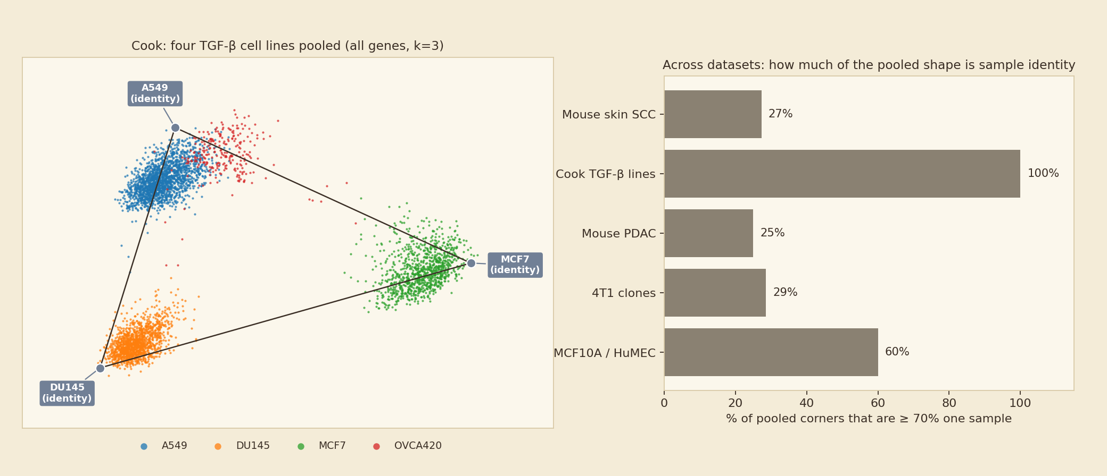
1. Pooled simplices separate samples, not EMT states
A pooled fit finds whatever differs most between cells; across samples, that is the sample
• In the Cook lines every pooled corner is one cell line, in all three gene sets.
• Across datasets, 53% of the corners of significant pooled simplices are ≥ 70% one sample.
So what
Questions about EMT tasks must be asked inside one tumour or line.

Slide 3
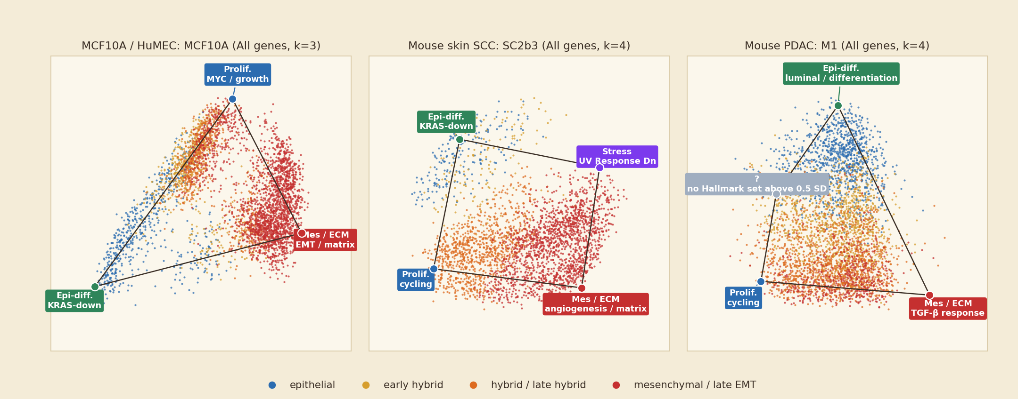
2. Within a tumour or cell line, cells trade off three programmes
Most significant within-unit simplex of three datasets; corners named by the Hallmark programme enriched at each
• 39 of 49 significant within-unit simplices have at least two of: proliferation, epithelial differentiation, mesenchymal / matrix.
• A fourth corner depends on context: metabolism (PDAC), stress / immune signalling (SCC).
So what
There is a shared, low-dimensional trade-off, and it is about programmes.

Slide 4
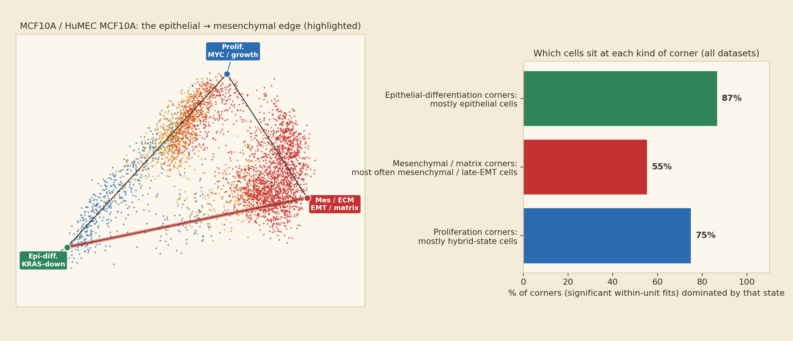
3. EMT is the edge between epithelial and matrix corners
Cells coloured by EMT state run from one corner to the other; hybrids sit along the edge
• Epithelial and mesenchymal / matrix corners appear together in 25 of 49 simplices.
• Epithelial corners hold epithelial cells (87%); matrix corners most often hold mesenchymal / late-EMT cells (55%); no corner is defined by a hybrid state.
So what
EMT behaves as a continuum along one edge of a broader trade-off.

Slide 5
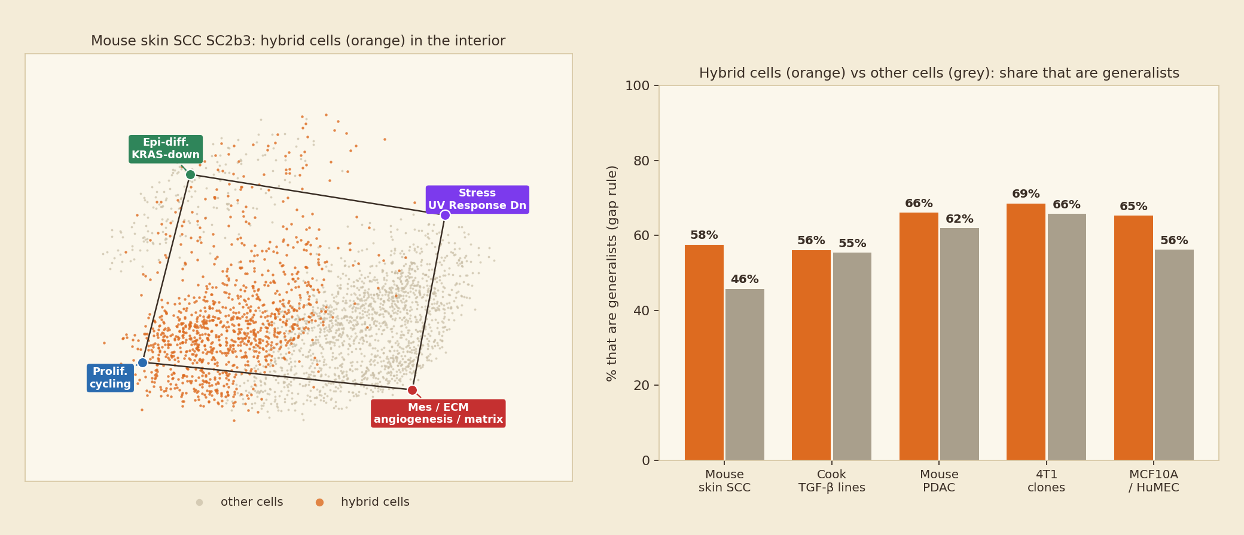
4. Hybrid cells are interior mixtures and the proliferating cells
Left: one tumour with hybrid cells highlighted. Right: hybrid vs other cells as generalists, all five datasets
• 62% of hybrid vs 56% of other cells are generalists; hybrids more often generalists in 40 of 61 fits (clearest in SCC, absent in Cook).
• In 24 of 32 proliferation corners, hybrid-state cells are the largest group.
So what
Hybrids are balanced mixtures that keep dividing, not a separate task.

Slide 6
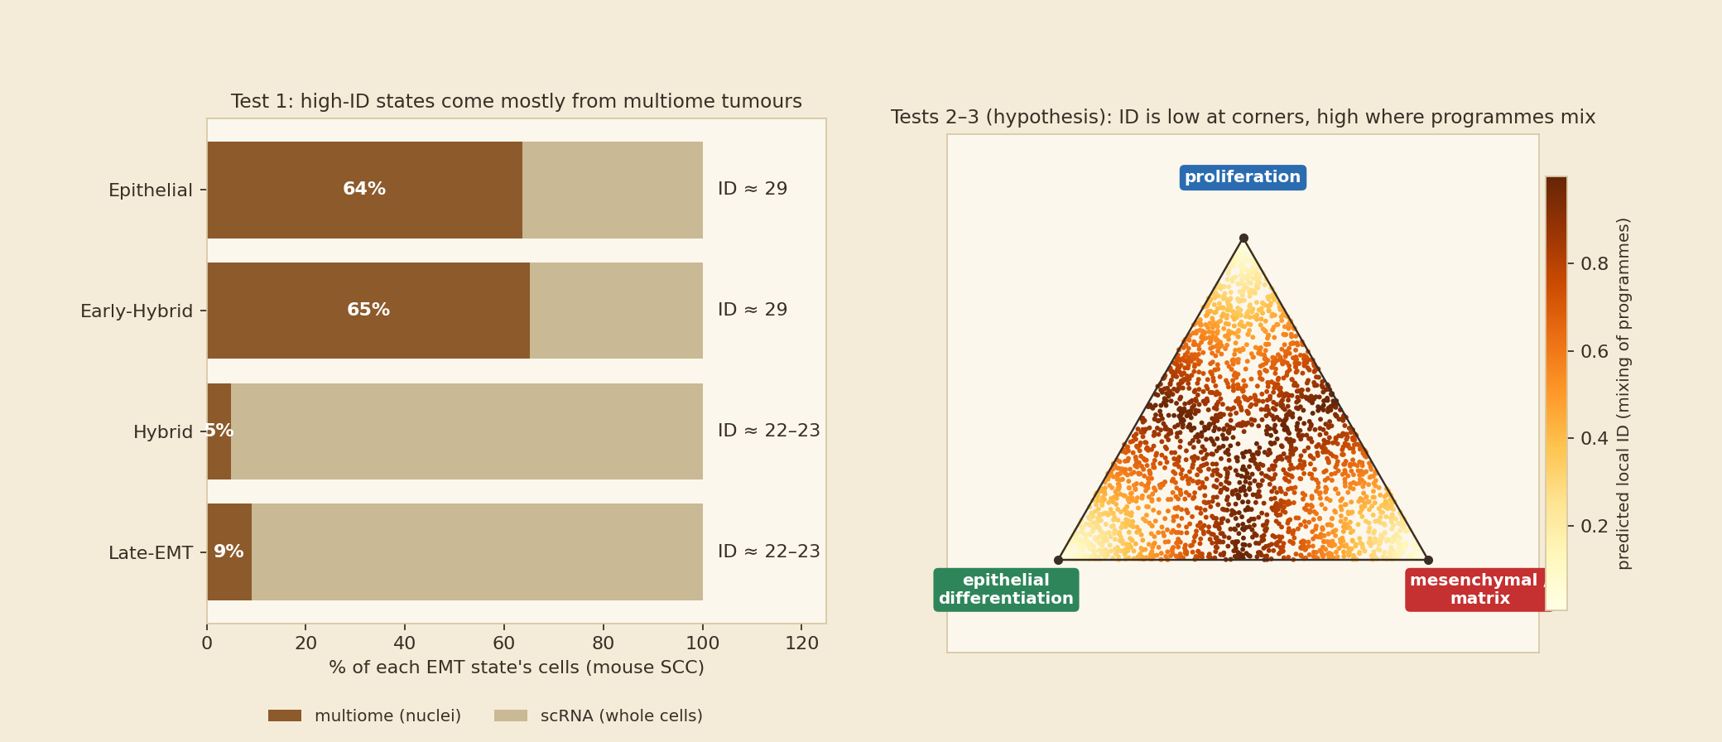
5. This predicts how intrinsic dimension should vary, and gives a test
EMT_ID: ID is higher in Epithelial / Early-Hybrid (≈ 29) than in Hybrid / Late-EMT (≈ 22–23) in mouse SCC
• Test 1 (assay): compare ID between states within scRNA tumours only (SC15, SC32, SC46 have all four states).
• Tests 2–3 (geometry, programmes): model ID against simplex position; predict lower ID near corners, higher in mixed generalists.
So what
First rule out the multiome / scRNA split; then ask whether position in the simplex explains ID.

Slide 7
Next steps
Ordered by how much they change the conclusions, for the least new work
# | Step | Question it answers | Needs
1 | ID within assay and within tumour (SCC) | Is the ID–state effect biology or the multiome / scRNA split? | EMT_ID per-cell table
2 | ID against simplex position (purity, corner distances) | Does position or programme commitment explain ID? | Saved weights + ID table
3 | Hybrid vs generalist by all four states | Is the generalist share highest in hybrids (inverted U)? | Existing fits
4 | Path vs triangle inside units (SCC, PDAC) | Is EMT a one-dimensional path within the simplex? | Existing script
5 | Batch-corrected pooled fits | Is there a shared simplex across samples once identity is removed? | Harmony / scANVI
6 | Time and space vs simplex position (Cook pseudotime, GSE colony position) | Do cells move along the epithelial → matrix edge? | Existing metadata
7 | ID for the other four datasets | Does the ID pattern generalise? | Compute time
Caveats
• Corner names are automatic (top Hallmark programme) and grouped into families by judgement, checked against the cells at each corner.
• Hybrid labels in four datasets come from the KS score; few samples per condition; many fits, no multiplicity correction.
• EMT_ID medians quoted from earlier notes; ID not recomputed here.

