Slide 1
Archetype Analysis of Cancer Cell Line Transcriptomes
Reproducing Groves et al. (Cell Systems, 2022) and extending the analysis to breast cancer, GBM, and EMT gene-restricted archetypes

Slide 2
What are archetypes, and what did Groves et al. try to do?
What is an archetype?
What did Groves et al. (Cell Systems, 2022) do?
Cell lines are points in high-dimensional gene expression space, compressed with PCA into a handful of principal components (PCs)
If cells face trade-offs between conflicting tasks (e.g. proliferate fast vs. migrate fast), the population is predicted to form a polytope (triangle, tetrahedron, etc.) in PC space
The corners ("archetypes") are pure task-specialists; every other cell line is a weighted mixture of the corner strategies
Archetypal analysis (PCHA) fits this polytope and returns each cell line's distance-to-vertex and mixture weights
Applied Pareto Task Inference / archetypal analysis to 120 human SCLC cell lines
Tested whether the fitted polytope is statistically real using a t-ratio permutation test (real polytope volume vs. shuffled-data nulls)
Found a significant 5-archetype polytope, and showed each of the five known SCLC transcriptional subtypes (A, A2, N, P, Y) enriches specifically near one archetype vertex
Established archetypes as task-specialists linked to known cancer subtypes and phenotypic plasticity

Slide 3
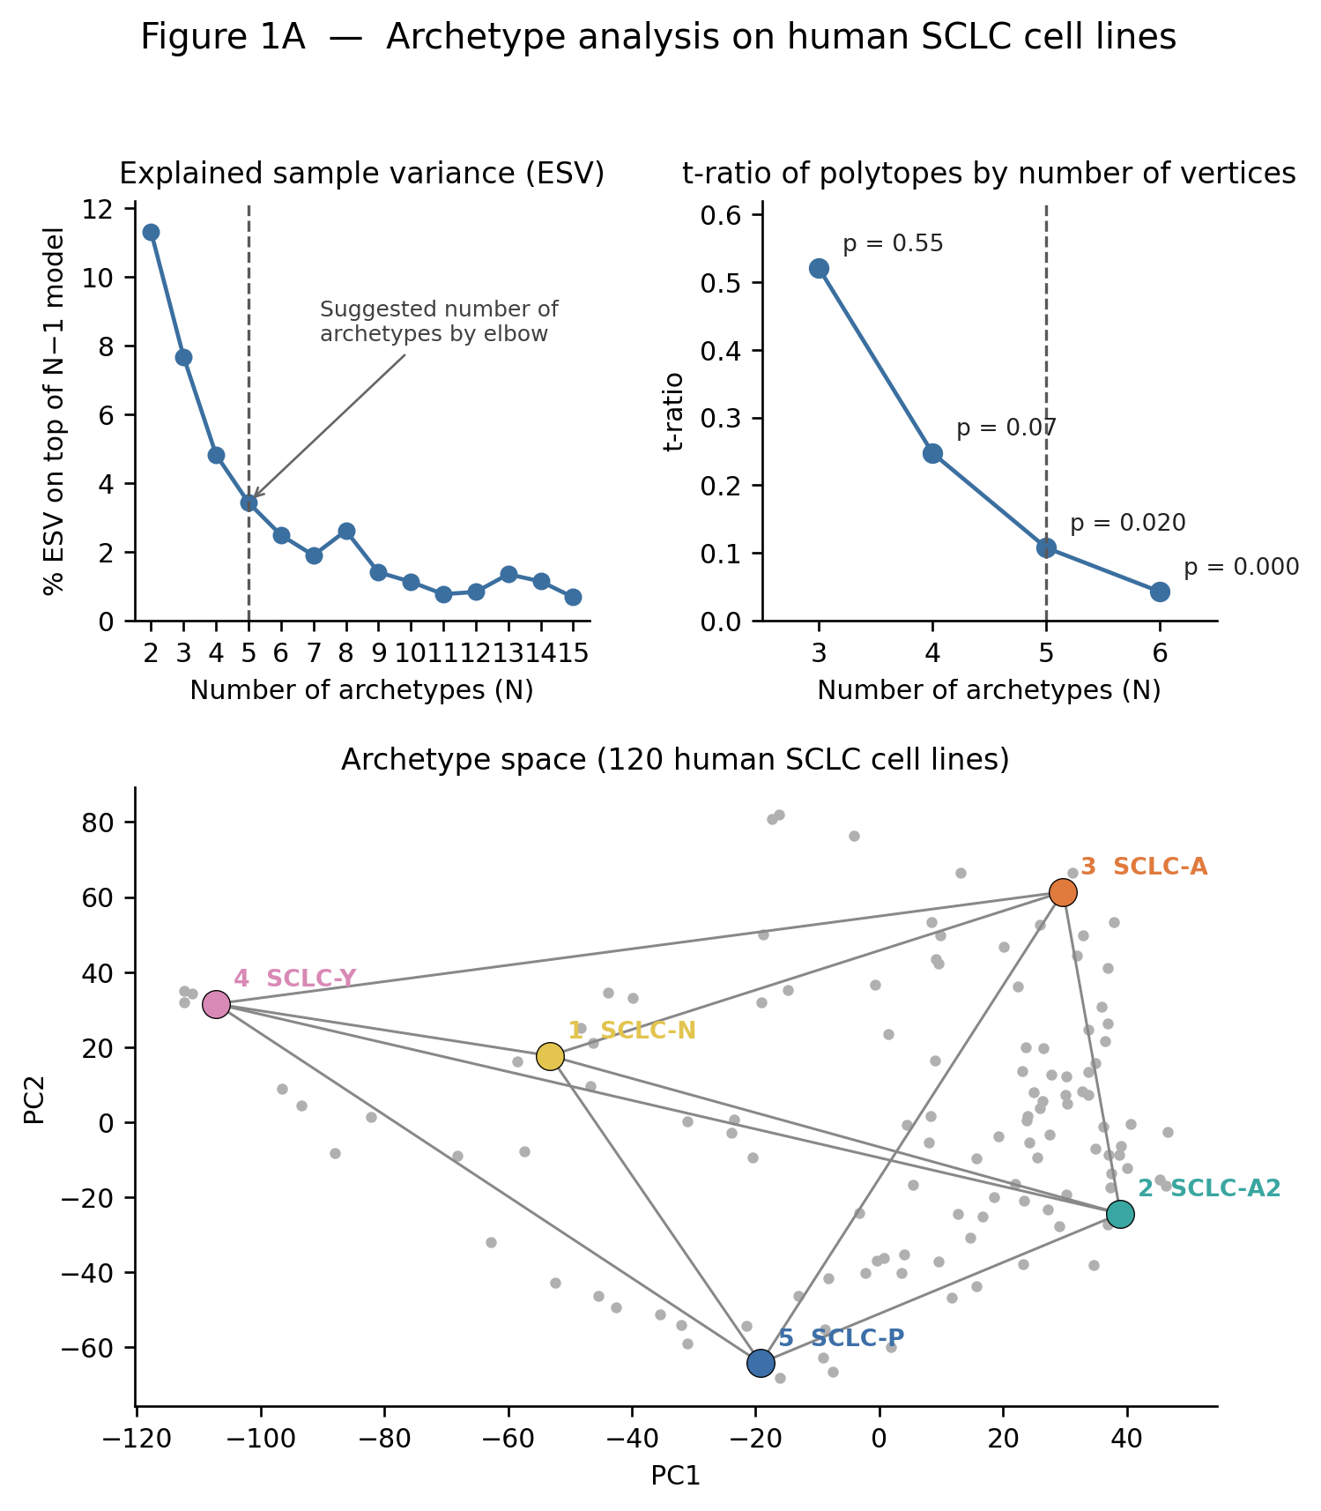
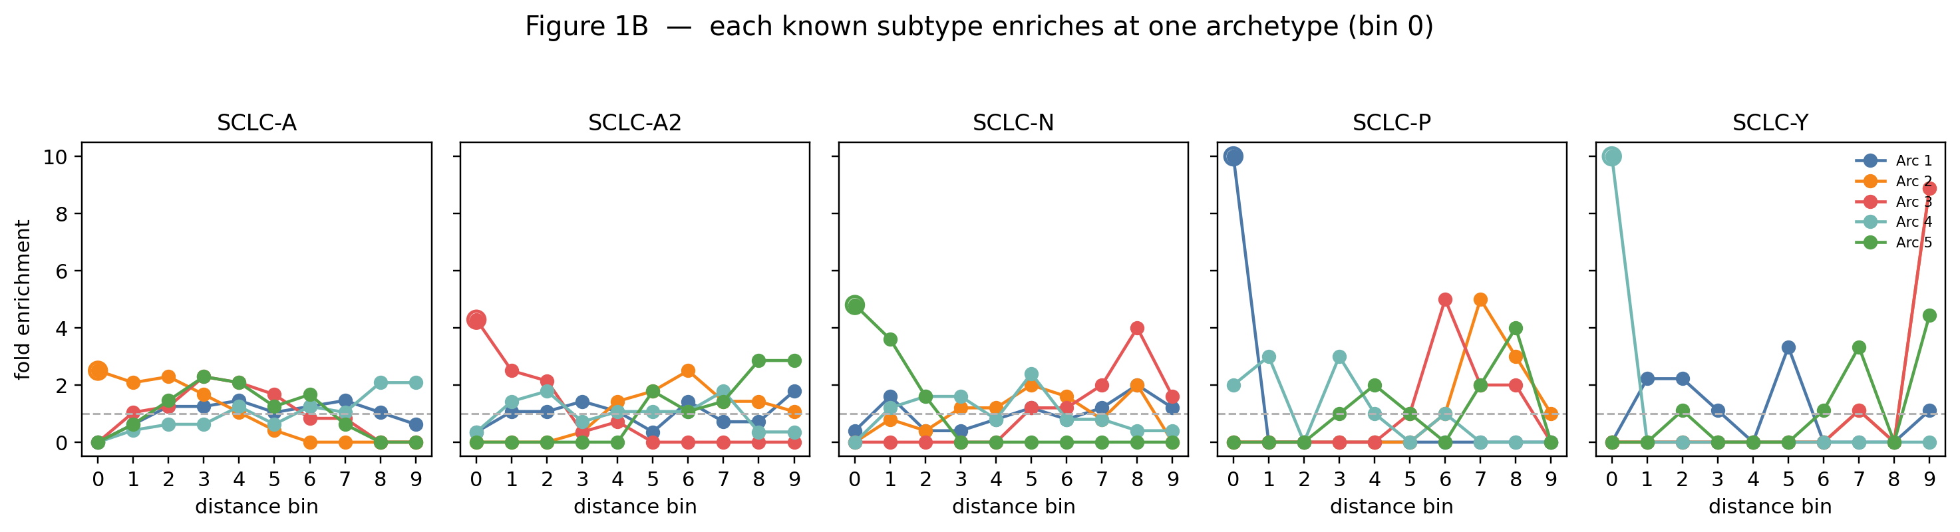
SCLC — archetype fit (Panel A) and subtype enrichment (Panel B)
ESV elbow suggests k=5 archetypes
t-ratio permutation test: polytope is statistically significant at k=5 (p=0.02) and even more so at k=6 (p<0.001)
5 vertices map onto the known SCLC subtypes: SCLC-N, -A2, -A, -Y, -P
Each of the five known SCLC subtypes enriches significantly near one distinct archetype vertex (bin 0)
SCLC-P and SCLC-Y show especially sharp, single-vertex peaks (fold enrichment ~10)
Confirms archetypes correspond to real, independently-labeled transcriptional subtypes, not just a PCA artifact

Slide 4
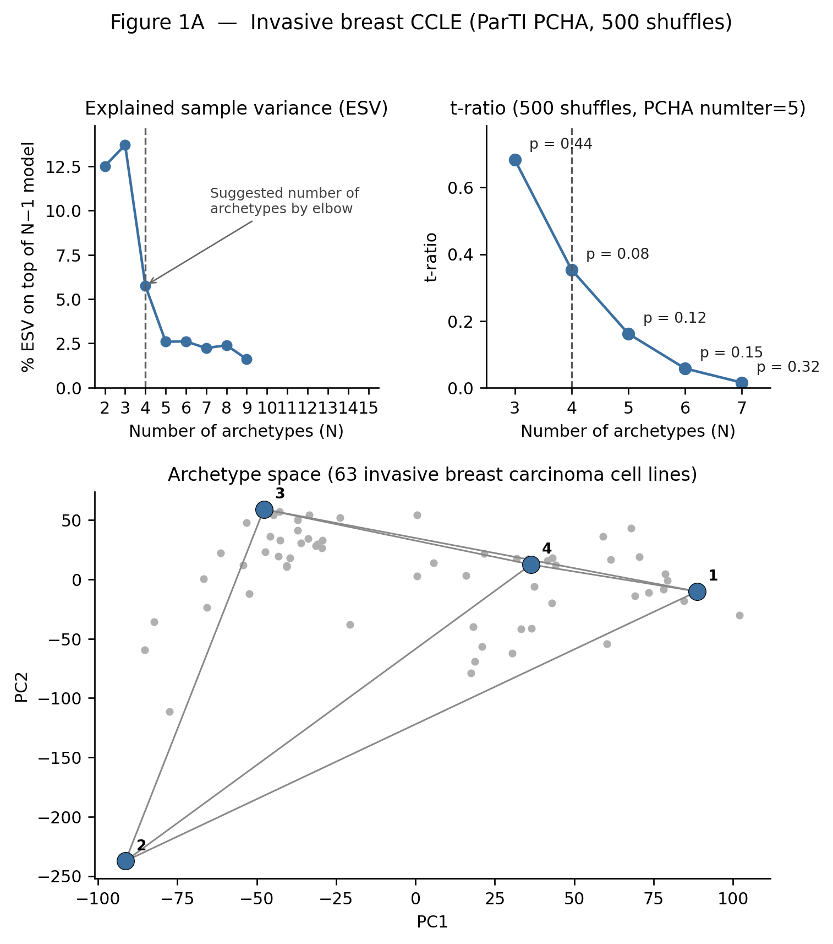
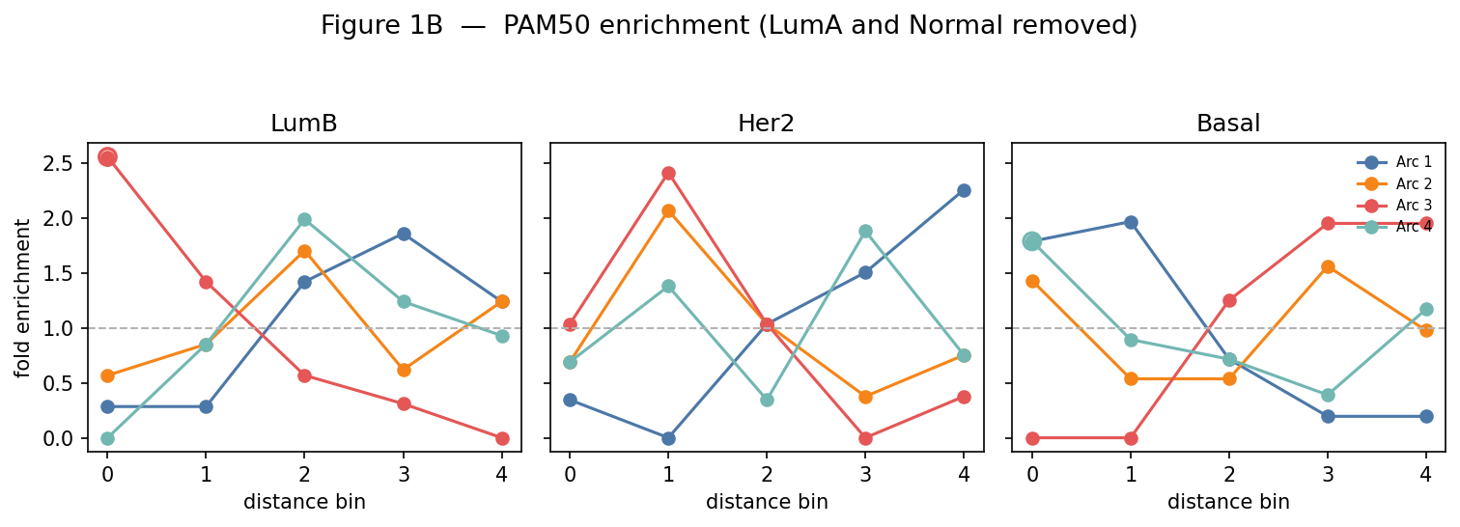
Breast Cancer — archetype fit (Panel A) and PAM50 enrichment (Panel B)
ESV elbow suggests k=4 archetypes
t-ratio permutation test: NOT significant at any k tested (k=3 p=0.44, k=4 p=0.08, k=5 p=0.12, k=6 p=0.15, k=7 p=0.32)
k=4 is only the elbow-selected choice — the polytope itself is not statistically confirmed
PAM50 subtypes (LumA/Normal removed) show partial, not fully clean, enrichment patterns across the 4 archetypes
LumB and Her2 peak near Archetype 3; Basal peaks near Archetypes 1/2
Weaker and less clean than SCLC, consistent with the non-significant Panel A polytope

Slide 5
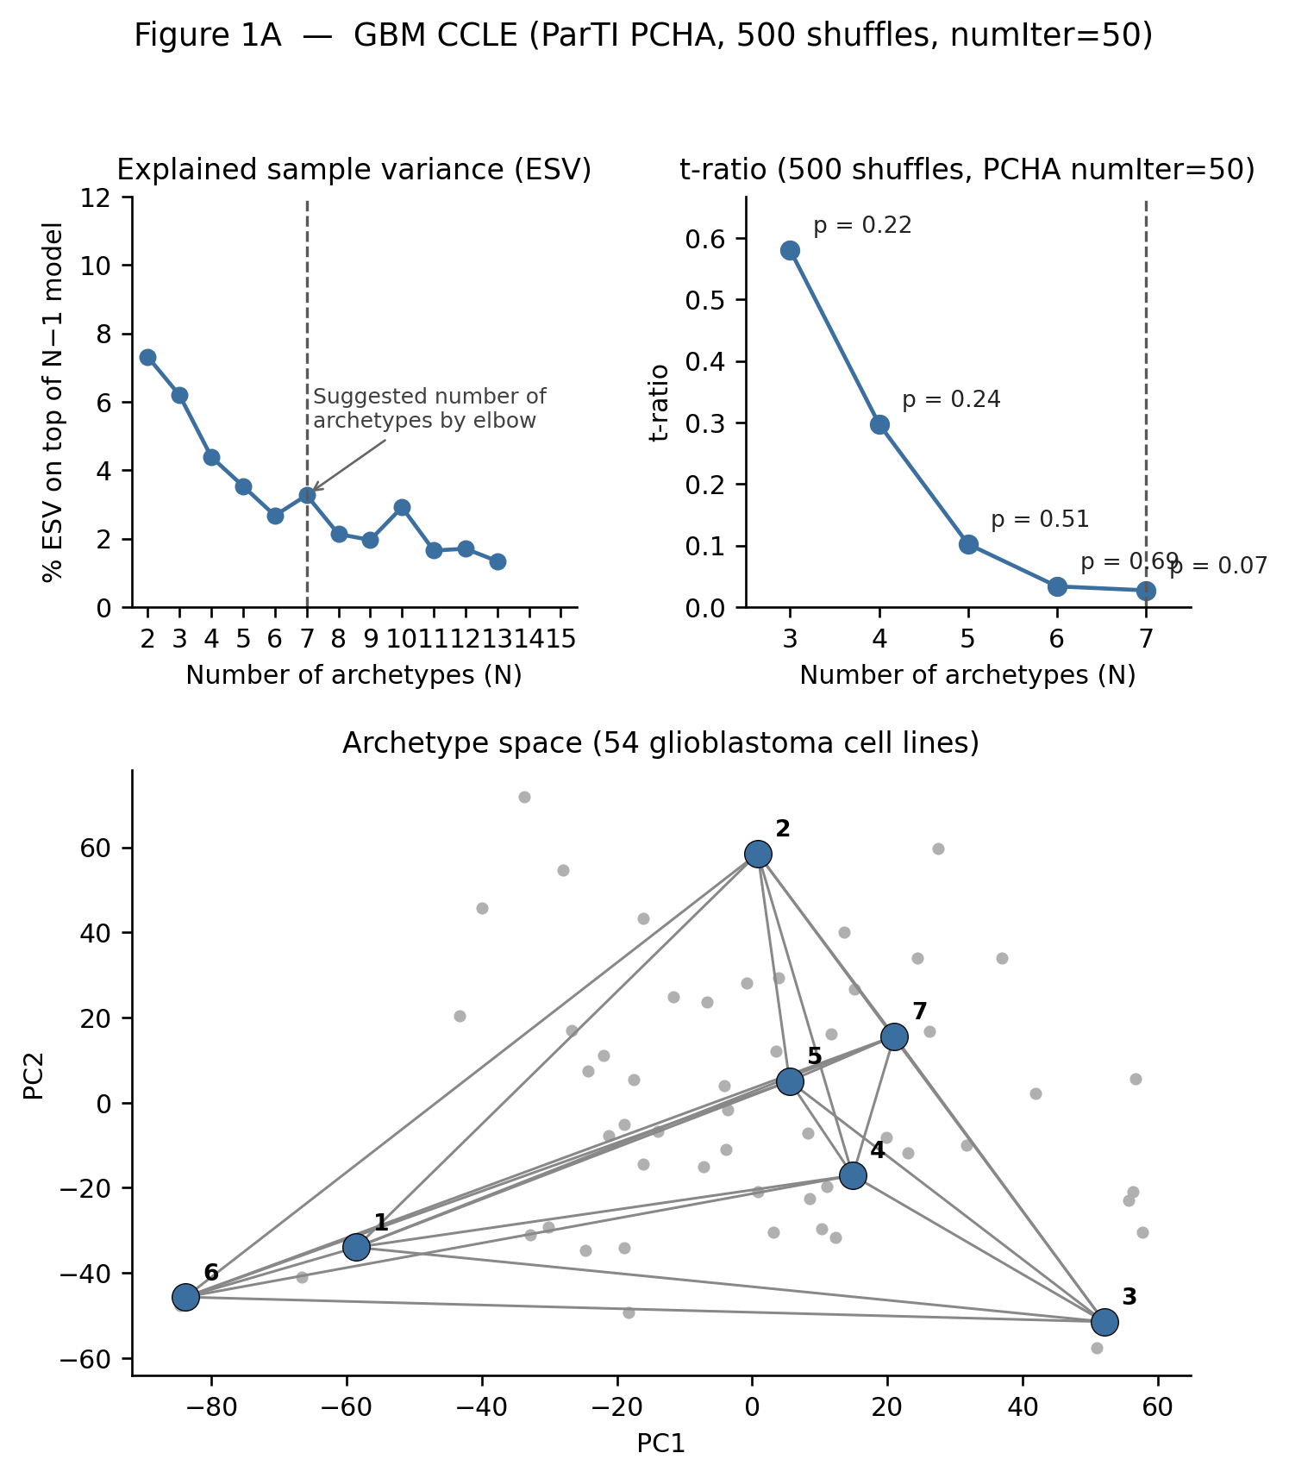
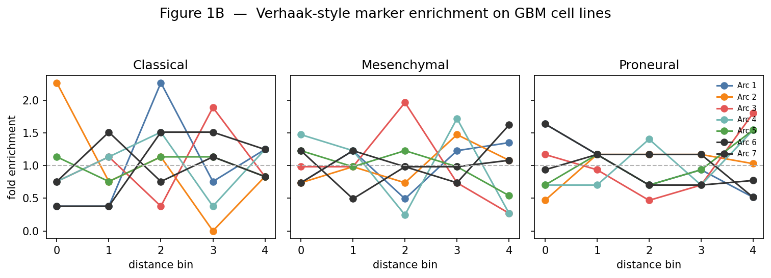
GBM — archetype fit (Panel A) and Verhaak marker enrichment (Panel B)
ESV elbow suggests k=7 archetypes
t-ratio permutation test: NOT significant at any k tested (best p=0.07 at k=7)
Weakest polytope evidence of all three cancer types analyzed
Verhaak-style Classical / Mesenchymal / Proneural marker scores tested across the 7 archetypes
No archetype shows a clean, consistent single-vertex enrichment peak for any of the three programs
Consistent with the non-significant Panel A polytope — no confirmed "Proneural" or "Mesenchymal" vertex

Slide 6
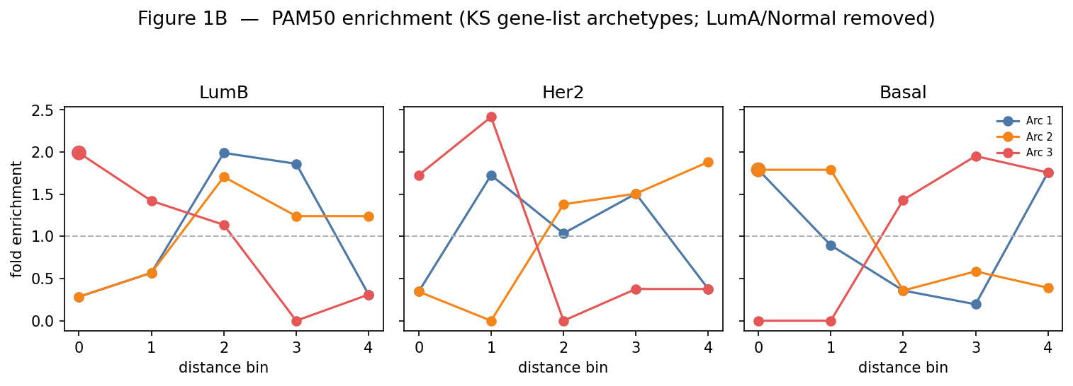
Breast, EMT gene-restricted (Tan et al. 2014 KS signature) — Panel A and B
Panel A image missing —
please re-upload
Figure_1A_breast_ks_genelist_extendedk.png
Panel A image (Figure_1A_breast_ks_genelist_extendedk.png) was not received in this upload — to be added once re-sent
From the run log: ESV elbow at k=3; t-ratio SIGNIFICANT at k=3 (p=0.02), k=4 (p=0.02), and k=5 (p<0.002)
Restricting the matrix to the Tan et al. 2014 EMT gene signature gives a statistically significant polytope — unlike the full-transcriptome breast fit (Slide 4)
PAM50 enrichment on the EMT-restricted, k=3/4 archetypes (LumA/Normal removed)
LumB and Her2 both peak near Archetype 3; Basal peaks near Archetypes 1/2
Cleaner, more significant polytope than the full-transcriptome breast run — EMT genes alone capture real archetype structure in breast cancer

Slide 7
What next?
Path 1 — Follow what Groves et al. did next
Path 2 — Hybrid EMT scoring (Lopez, Tyson & Hong, 2025)
Groves et al. (Cell Systems, 2022) established the 5-archetype SCLC polytope and subtype enrichment shown on Slide 3
Follow-up (Groves et al., Cancers 2023): examined how EMT-related genes specifically relate to the SCLC archetypes/subtypes — the closest direct precedent for our KS-epi/KS-mes question
Most recent follow-up (Lopez, Tyson & Hong, Cell Communication and Signaling 2025): extended archetype analysis of SCLC to single-cell data, added a "Generalist" cell category (cells not close to any archetype vertex), and used cell-cell communication modeling to ask how hybrid/mesenchymal states are actively maintained — a mechanistic follow-up to the statistical question we are asking
Instead of George et al. 2017's 2-gene ordinal logistic model (CLDN7 + VIM/CDH1), this paper scores E/M status per sample using ssGSEA (single-sample Gene Set Enrichment Analysis) against a broader EMT gene set, plus non-negative PCA (nnPCA) as an alternate scoring method
A gene-set-based score, rather than a fixed 2-gene formula — potentially more robust across tissues (e.g. avoids the CDH1-floor problem seen in GBM)
Next step: re-score breast/GBM cell lines with ssGSEA/nnPCA instead of the George et al. model, and re-run the KS-epi/KS-mes generalist-score test to check whether findings are robust to the scoring method

