Slide 1
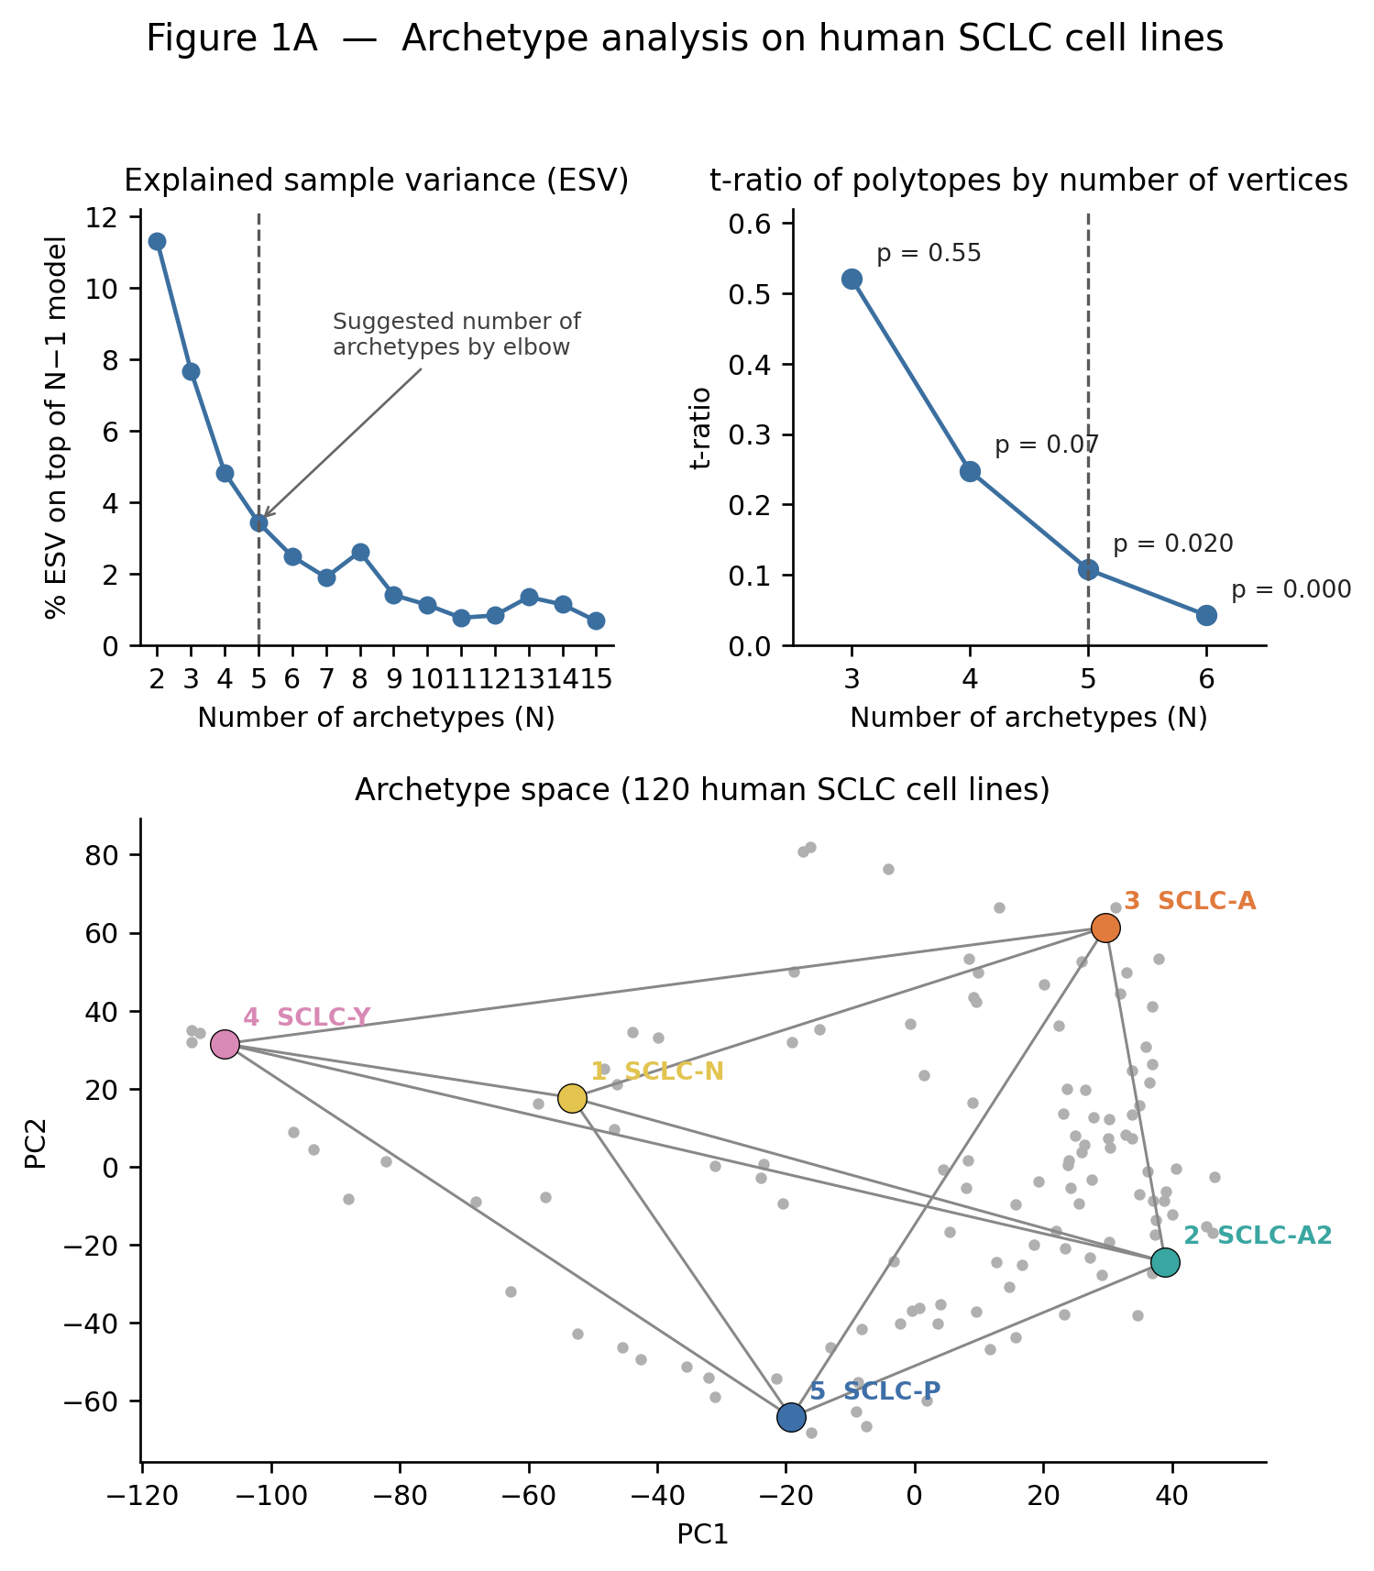
Cancer Archetype Analysis
SCLC reproduction → BRCA → GBM
Pareto Task Inference / PCHA on bulk RNA-seq
VM1235/cancer-archetype-analysis

Slide 2
What the SCLC paper showed
2
A
• 120 SCLC cell lines formed a 5-vertex archetypal polytope.
• The vertices corresponded to the known A, A2, N, P and Y states.
• Tumors could then be projected into the same cell-line geometry.
Main idea: learn the geometry from cell lines, then test whether tumors occupy the same space.
Groves et al., Cell Systems 2022

Slide 3
Analysis pipeline
3
1 PCA
→
2 PCHA
→
3 Shuffle test
→
4 Enrichment
→
5 Projection
retain PCs explaining ≥50% variance
fit k archetypes in first k−1 PCs
compare simplex t-ratio to null
test labels near each vertex
ComBat + project tumors
• Shared implementation: src/archetypes.py, pca.py, enrichment.py, preprocess.py and combat.py.
• Panel C never refits PCHA on tumors; cell-line archetypes are carried into the combined space.
• Disease-specific code changes the input matrix, labels, PC count and PCHA settings.
Same A → B → C logic for SCLC, BRCA and GBM

Slide 4
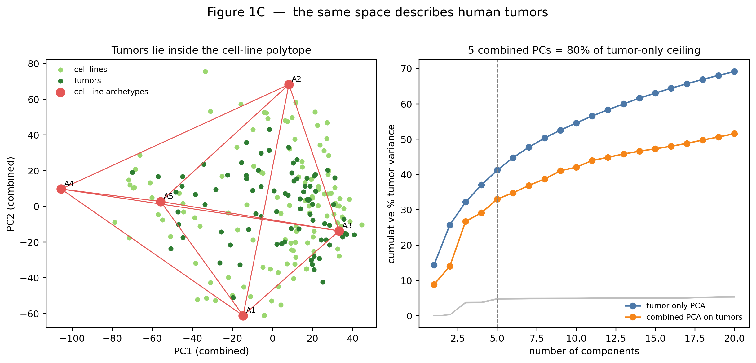
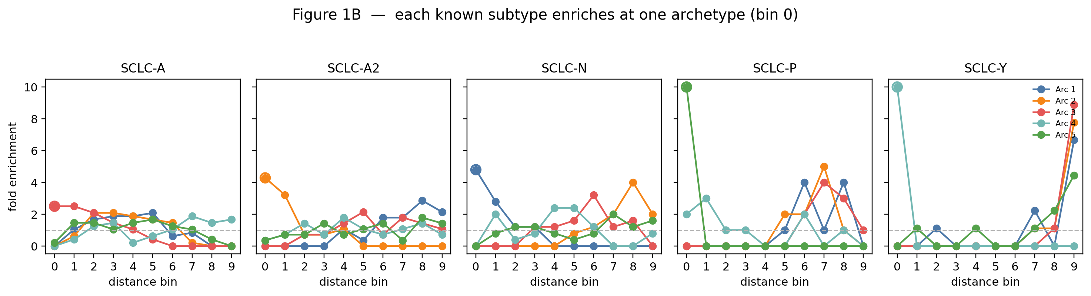
SCLC reproduction
4
A
B
C
• A: the characteristic 5-vertex SCLC geometry is recovered.
• B: subtype labels concentrate near corresponding vertices.
• C: tumors are projected into the cell-line archetype space.
Reproduction shown here used only 100 shuffles, versus 1000 in the paper. The geometry is the focus; permutation p-values are therefore coarser.
SCLC reproduction figures from the repository

Slide 5
BRCA: what changed
5
Input
Panel A
Panel B
63 invasive breast carcinoma cell lines 16,500 genes
8 PCs reach ≥50% variance k = 3–7 500 shuffles numIter = 5
Independent PAM50 labels LumA + Normal excluded from enrichment
Panel C
k selection
Question
TCGA-BRCA primary tumors IHC ER/HER2 labels ComBat before combined PCA
No significant k → use DimensionFinder / elbow fallback Suggested k = 4
Does BRCA show the same discrete archetypal organization as SCLC?
Breast Cancer/codes/

Slide 6
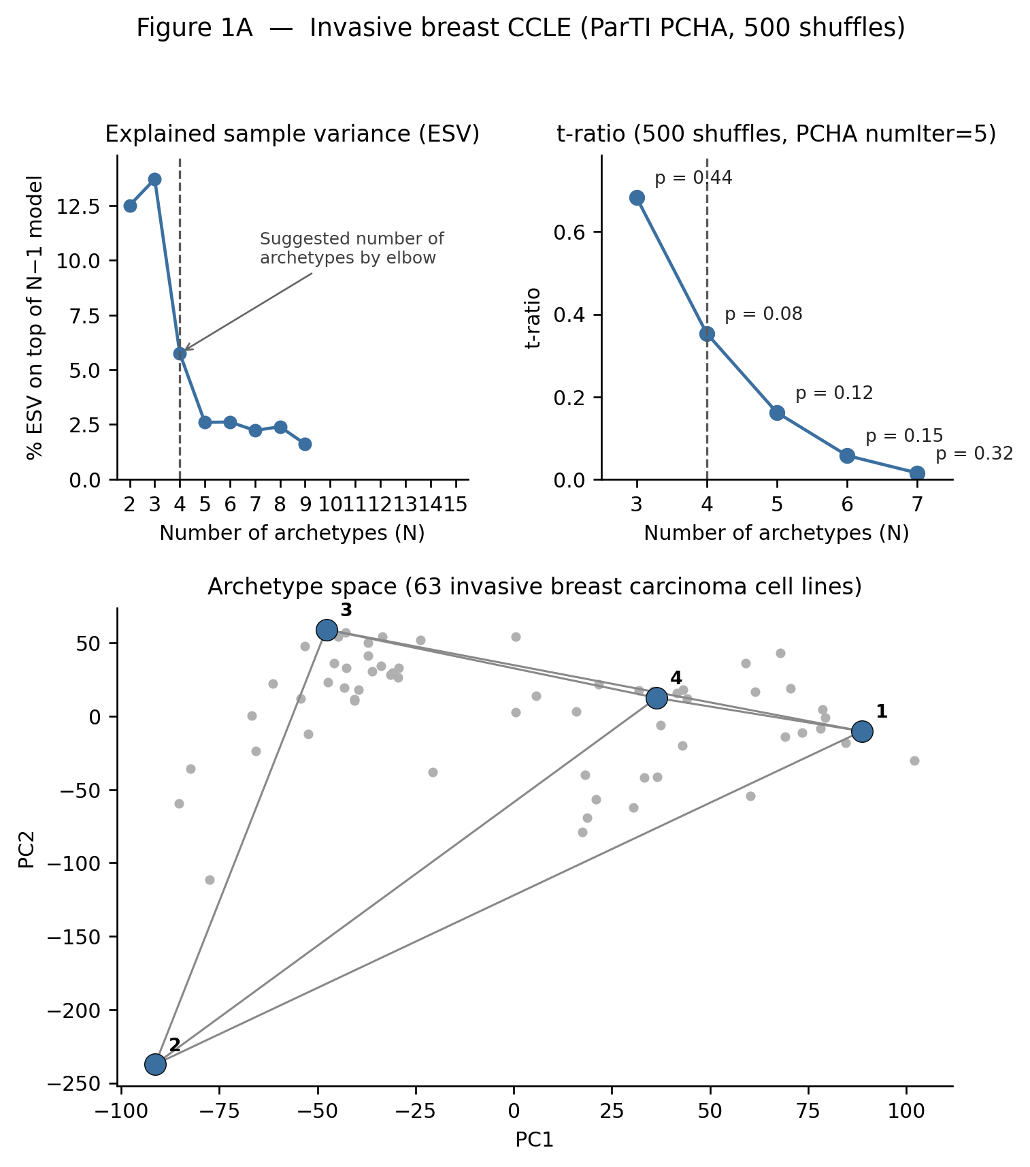
BRCA Panel A: no significant simplex
6
A
63 cell lines | 8 PCs | k = 3–7
Best descriptive choice: k = 4
t = 0.354 p = 0.082
• The elbow suggests k=4.
• But no k passes p<0.05.
• So k=4 is descriptive, not a statistically validated SCLC-like archetype count.
500 shuffles; Panel A results from the repository

Slide 7
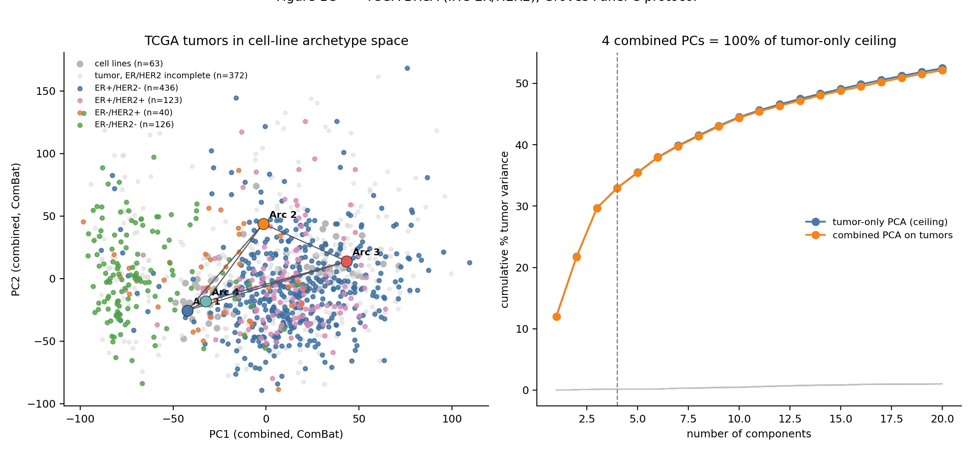
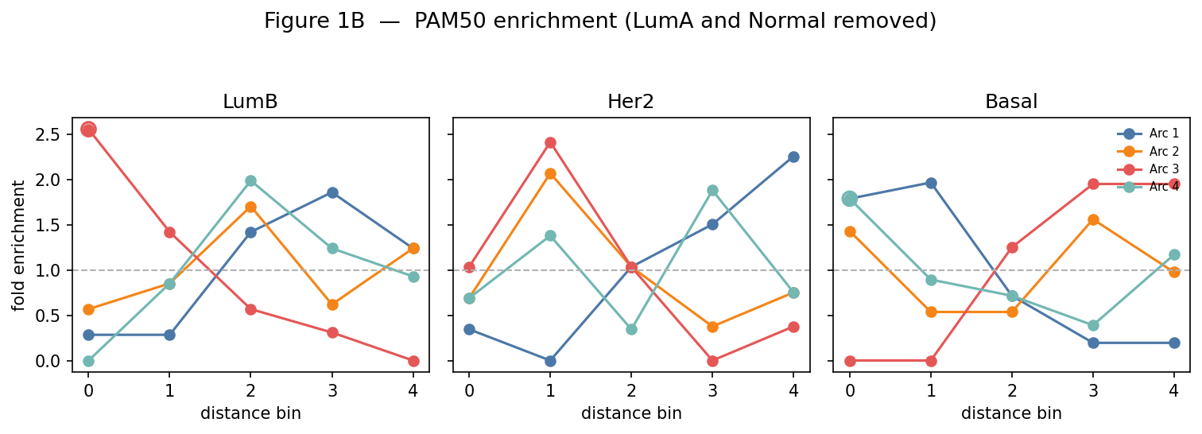
BRCA Panels B and C
7
B
C
Panel B
LumB and Basal show significant bin-0 enrichment; Her2 does not. Two of the three tested PAM50 subtypes map cleanly to vertices.
Panel C
TCGA-BRCA tumors occupy a broad region rather than being tightly confined to the cell-line simplex.
BRCA shows some local subtype structure, but substantially weaker evidence than SCLC.
PAM50 enrichment + TCGA-BRCA tumor projection

Slide 8
GBM: what changed
8
Input
Panel A
Panel B
54 glioblastoma cell lines 15,833 genes
12 PCs reach ≥50% variance k = 3–7 500 shuffles numIter = 50
Marker-based Classical / Mesenchymal / Proneural labels Neural not used
Panel C
PCHA
Question
154 TCGA-GBM primary tumors ComBat with cell lines as reference Combined PCA for projection
Paper-like higher random-start setting 150 observed / 50 null starts per shuffle
Is a stable archetypal geometry present in GBM at all?
Glioblastoma/codes/

Slide 9
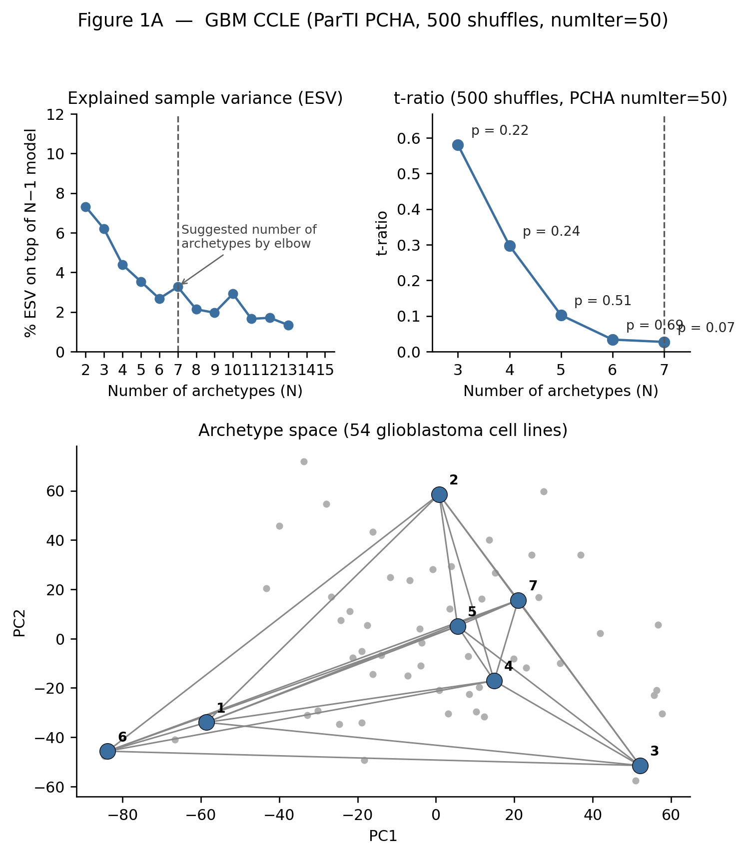
GBM Panel A: k = 3–7 sweep
9
A
Permutation p-values
k=3 0.224 k=4 0.238 k=5 0.510 k=6 0.694 k=7 0.068
Closest: k=7, p=0.068
• No k is significant.
• k=7 is therefore a fallback/elbow choice, not evidence for seven biological archetypes.
• The visible polygon alone is not statistical support.
54 lines; 12 PCs; 500 shuffles; numIter=50

Slide 10
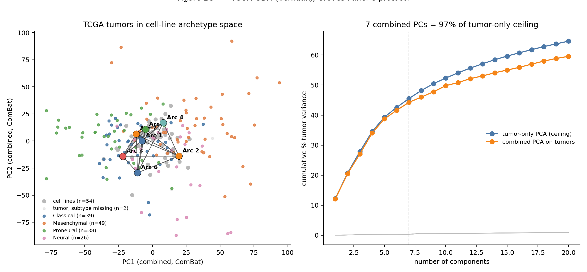
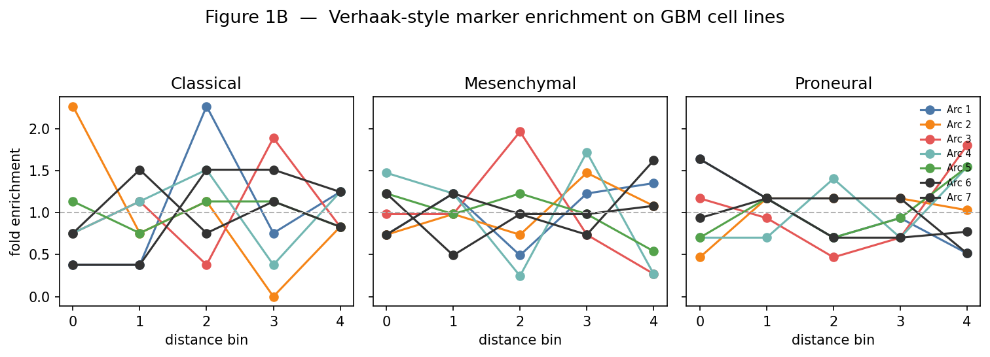
GBM Panels B and C
10
B
C
Panel B
No Classical, Mesenchymal or Proneural subtype gives a significant bin-0 peak.
Panel C
0 / 154 TCGA-GBM tumors fall inside the k=7 cell-line simplex.
GBM fails the independent subtype-mapping and tumor-containment checks as well.
Marker-based subtype enrichment + TCGA-GBM projection

Slide 11
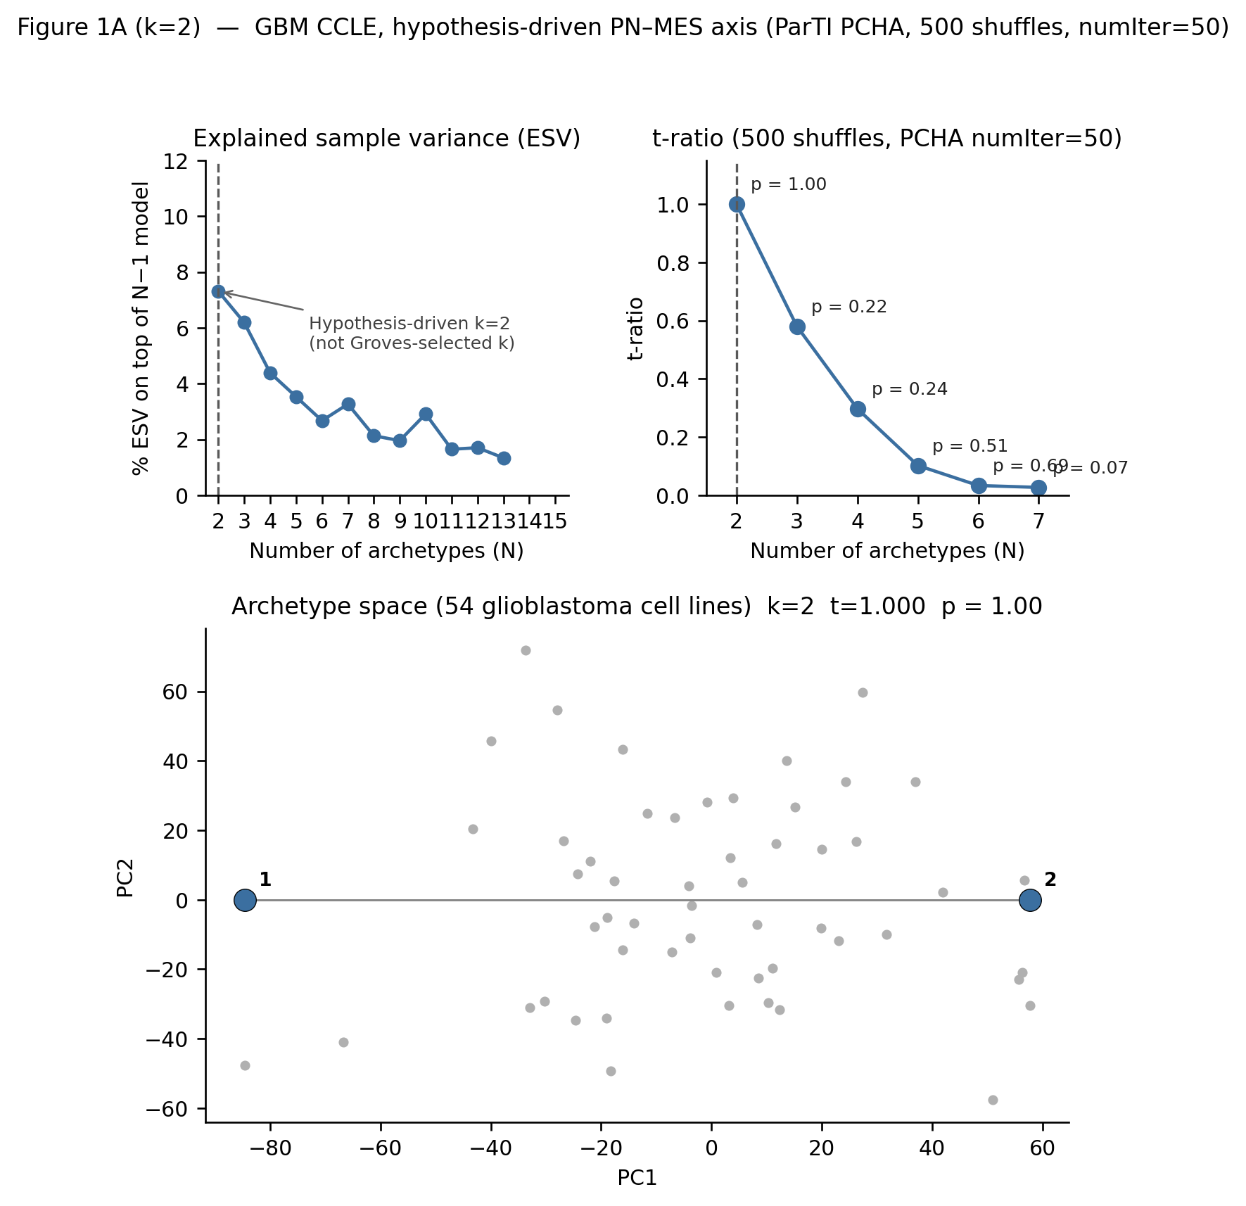
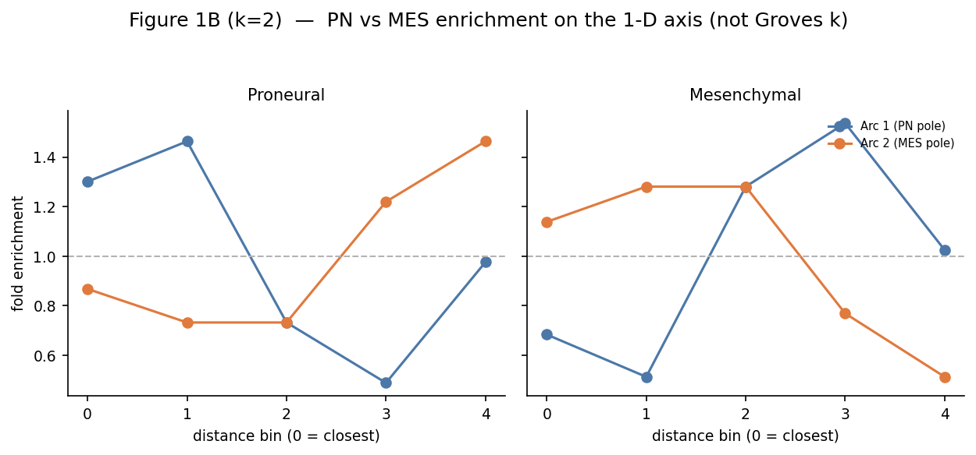
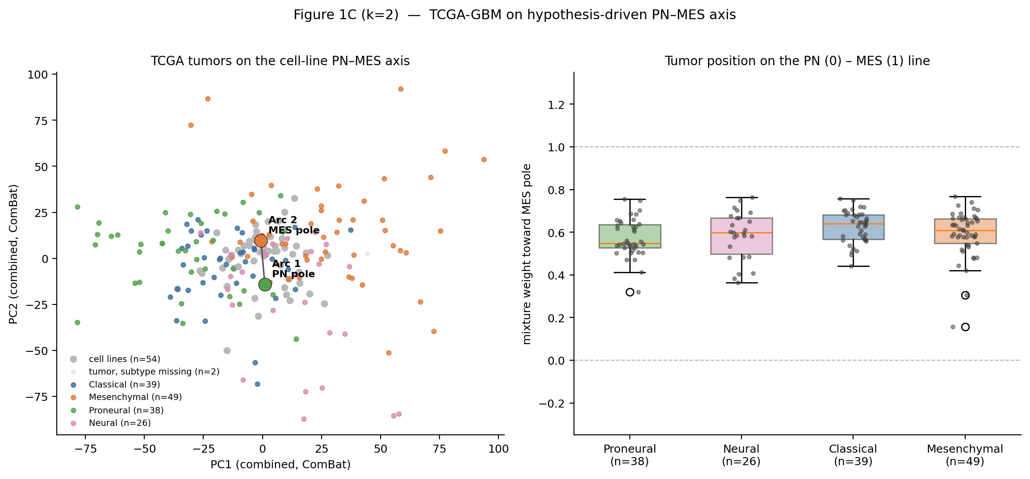
GBM: taking k = 2 does not help
11
A
B
C
• A two-pole PN–MES interpretation is biologically intuitive, but the standard k=2 / 1-PC t-ratio is degenerate.
• The 1-D implementation gives p=1.00; the relaxed 12-PC k=2 test is also non-significant (p=0.49).
• Tumors spread across the axis rather than separating into two clean poles.
Reducing the model to two archetypes does not rescue the GBM hypothesis.
Exploratory k=2 analysis from the repository

Slide 12
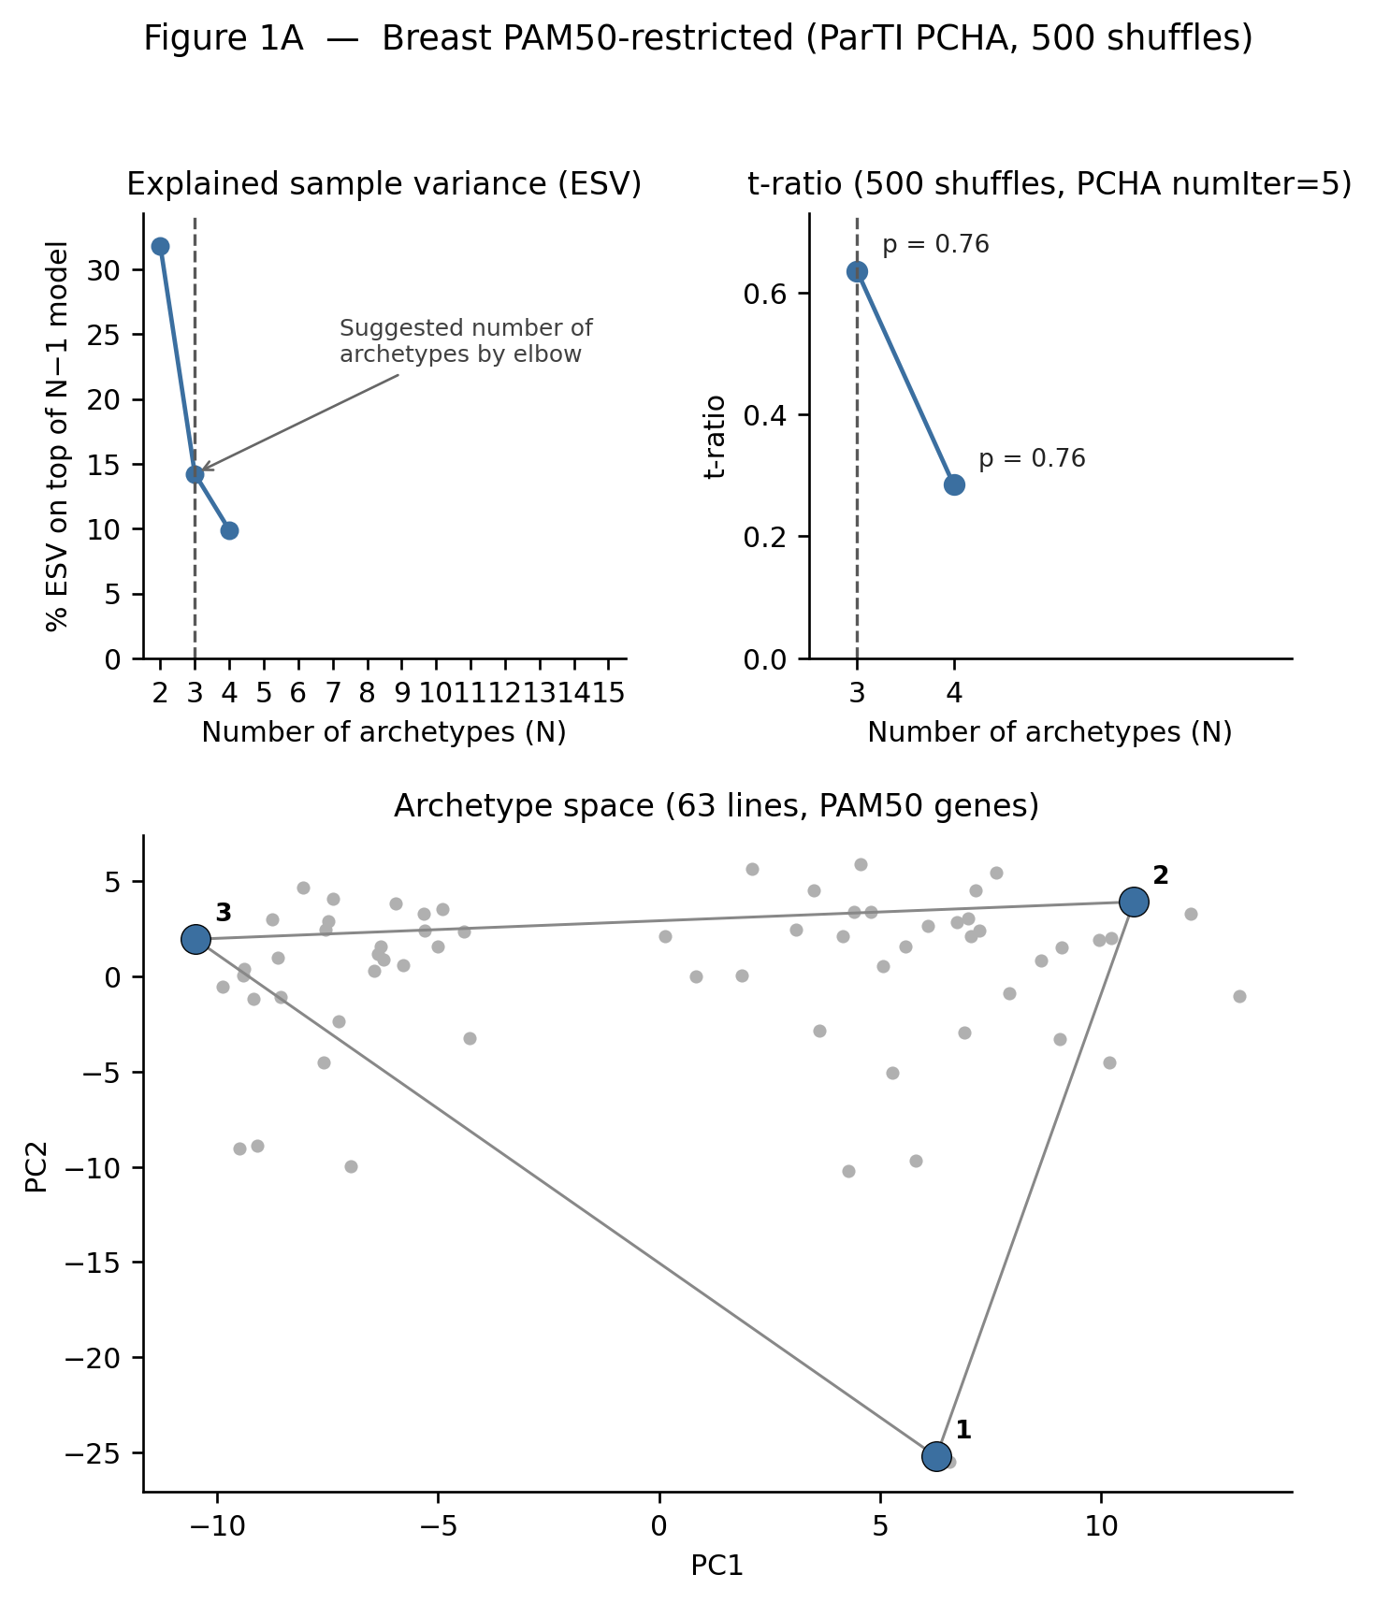
Gene-list restriction: BRCA
12
A
PAM50 genes only
50 genes 3 PCs best p = 0.762
• Full transcriptome best p: 0.082.
• Restricting to subtype genes makes the archetype significance weaker, not stronger.
• LumB and Basal remain the two subtype↔vertex matches.
Gene selection does not explain the BRCA null.
PAM50-restricted analysis

Slide 13
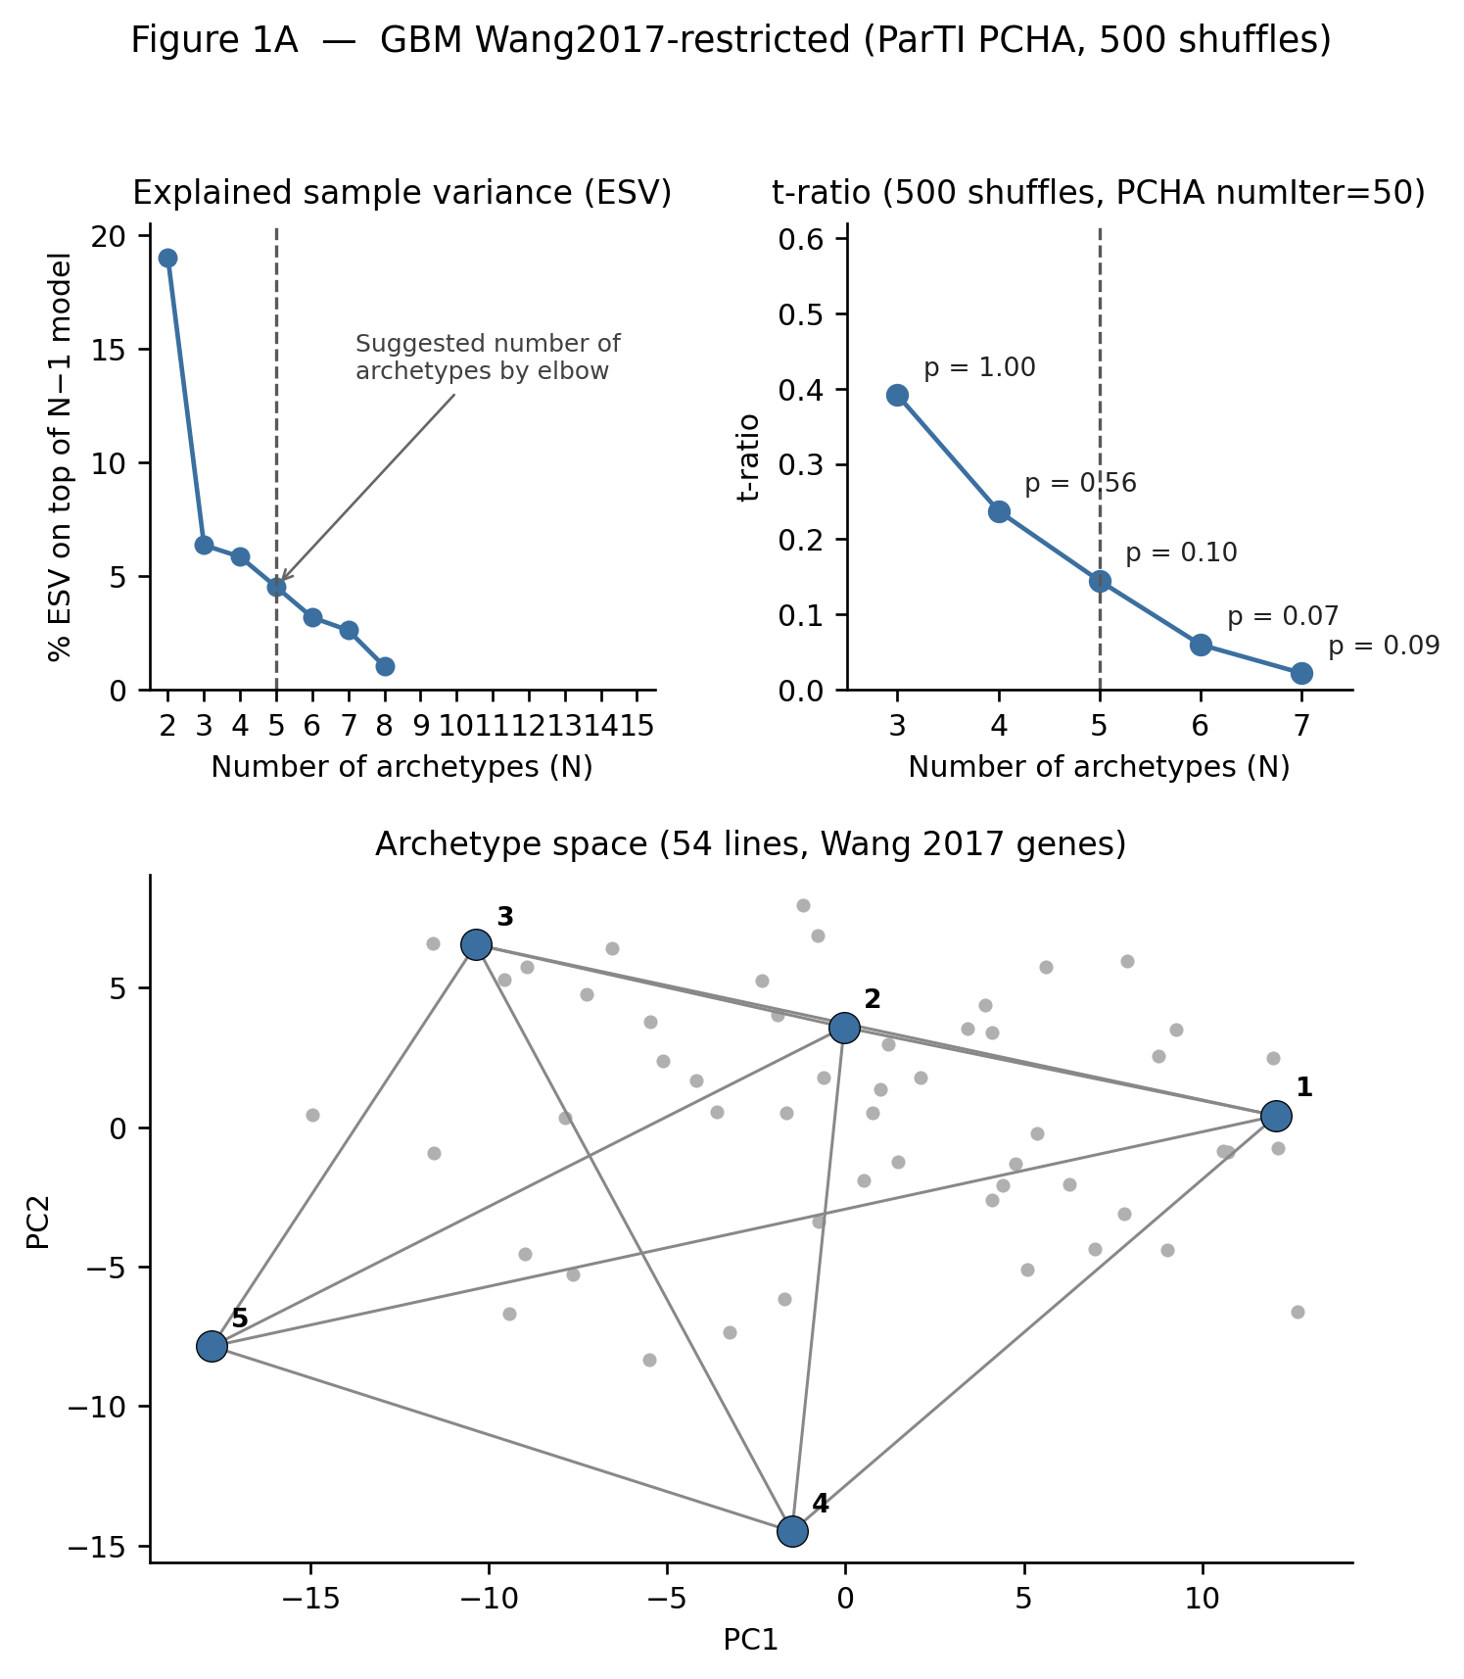
Gene-list restriction: GBM
13
A
Wang 2017 genes only
143 genes 7 PCs best p = 0.066
• Full transcriptome best p: 0.068.
• The restricted run is essentially unchanged and still non-significant.
• Subtype mapping remains 0/3; tumor containment is only 2/154.
Irrelevant genes dominating PCA are not enough to explain the GBM result.
Wang-2017 subtype-gene restricted analysis

Slide 14
Takeaway
14
SCLC
BRCA
GBM
Significant archetypal geometry Subtype↔vertex correspondence Tumors occupy the same geometry
No significant simplex Partial subtype structure Broad tumor projection Gene restriction does not rescue
No significant k=3–7 simplex No subtype↔vertex matches No tumor containment k=2 and gene restriction do not rescue
A visually plausible polytope is not enough.
Significance, independent subtype mapping and tumor containment need to agree.
Same method, different cancer geometries

