Slide 1
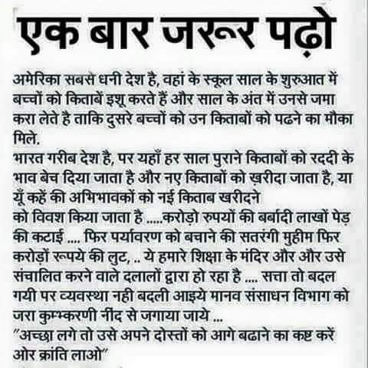
welcome
To world of new era
Notes:
Highly recommended

