Slide 1
KERNEL OPS
An Operating System Hackathon
TEAM DETAILS
PROBLEM STATEMENT
Team Name: VAT
Team Members:
Tanush Keshri – RA2511003011609
Vyom Singh – RA2511003011619
Abhishek Kumar Maurya – RA2511003011623
Theme:
SafeWrite: crash-consistent storage, proven not promised
PS Number: The prototype must demonstrate failure during a write and recover to either the previous valid version or the new valid version, not a corrupted mixture. Teams may use temporary files, logging, copy-on-write or journaling-inspired techniques and must justify the chosen approach.
Title:
“ Crash-Consistent Document Storage “

Slide 2
02
Proposed Solution
CORE IDEA
TARGET USERS
KEY FUNCTIONS
A crash-consistent document store with one API and four interchangeable recovery engines: temp file + rename, undo journal, redo write-ahead log and copy-on-write.
A power-loss simulator proves that every crash recovers the previous or the new version, never a mixture.
Applications that save documents, records and configs
Developers choosing a crash-safety technique, with data
Students and educators: a visual lab for file-system crash semantics
Runs on Linux, macOS, Windows; Python standard library only
Atomic, durable put, delete and multi-document transactions
Recovery on every open: idempotent, crash-safe
Version history and lock-free readers (COW)
Crash Lab: pull the plug at any syscall
Proof: exhaustive explorer, ablations, real kill -9
ONE-LINE SOLUTION
Every crash recovers the previous or the new version. Proven across 63,673 simulated power-loss states and real kill -9 crashes, with every removed safeguard caught.

Slide 3
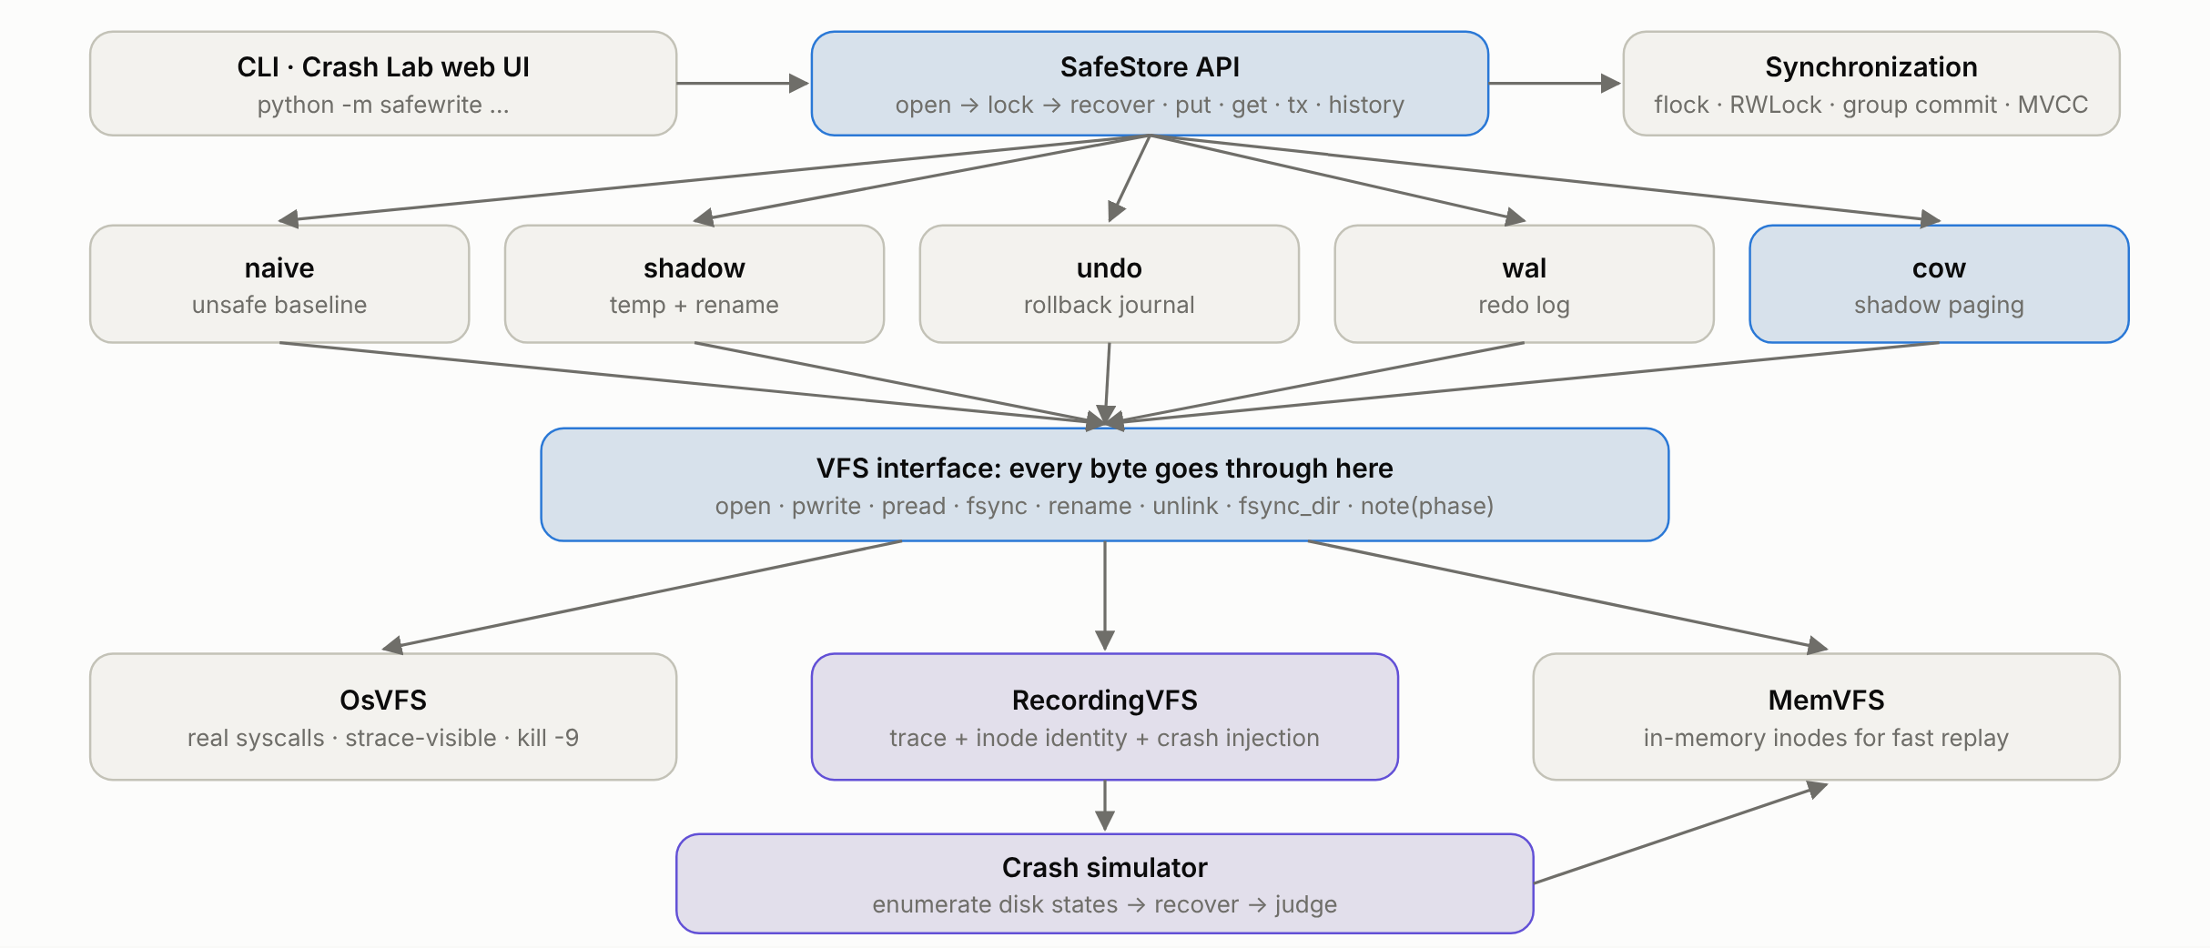
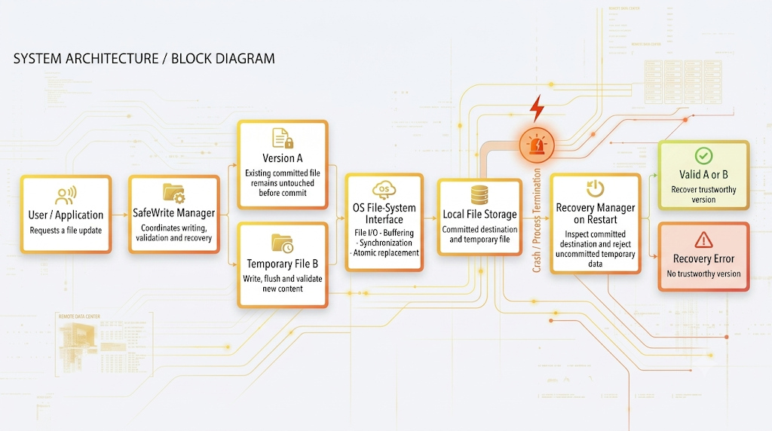
03
System Architecture
Design rule: engines never call os.* directly. The same engine code runs on the real disk, is traced, crash-injected, and replayed against simulated post-crash disks.

Slide 4
04
OS Concepts & Justification (1/2)
1 · FILE SYSTEMS
2 · ATOMICITY
Where: OsVFS (real pwrite / fsync / rename / dir fsync), inode-level crash model, COW volume with superblocks, allocator and GC.
Why: Names are not inodes: fsync(file) persists data, fsync(dir) persists the name. That is the classic “rename landed, data didn’t” bug.
Where: One commit point per engine: rename · journal deactivation · CRC’d COMMIT record · superblock flip.
Why: Before it: previous version; after it: new version. 0 violations in 10,744 crash states.
3 · SYNCHRONIZATION
4 · CRASH RECOVERY
Where: flock process lock · transaction lock · WAL group commit (condition variable) · MVCC snapshot pins · fsync barriers.
Why: Lost-update race: 50/400 without, 400/400 with. 16 threads share ~1 fsync per 6.9 commits.
Where: Engine.recover() on every open: delete temps · roll back · redo · pick a superblock.
Why: Idempotent and crash-safe: 19,318 crashes injected into recovery itself, 0 violations.

Slide 5
05
OS Concepts & Justification (2/2)
5 · COPY-ON-WRITE
6 · UNDO JOURNALING
Where: cow engine: write new blocks and a new catalog elsewhere, barrier, flip one of two checksummed superblocks.
Why: The old version is untouched until the flip. O(1) recovery (~1 ms flat), history for free, readers never block.
Where: undo engine: journal the OLD bytes, fsync, overwrite in place, then deactivate the journal.
Why: An interrupted save rolls BACK: the previous valid version.
7 · REDO JOURNALING (WAL)
8 · CRASH MODEL
Where: wal engine: log the NEW bytes plus a COMMIT record, one shared fsync, checkpoint to home files. CRC + LSN + salt.
Why: A committed save rolls FORWARD: the new valid version, even if home files are torn.
Where: process (kill -9) · power (lost, reordered, torn writes) · paranoid (no sector atomicity).
Why: Every missing-fsync bug passes kill -9 testing. Only the power-loss model catches it.

Slide 6
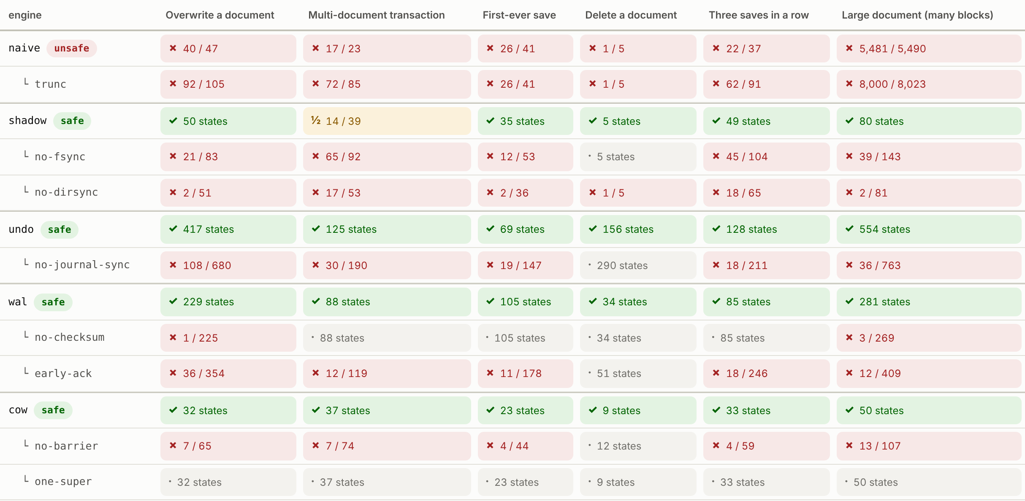
06
Proof: Every Crash State, Not Three Crash Points
CRASH STATES EXPLORED
63,673
3 models × 6 scenarios × 13 engine variants, in 25 s
VIOLATIONS IN THE SAFE ENGINES
0
shadow · undo · wal · cow, incl. crashes during recovery
REMOVED SAFEGUARDS CAUGHT
9 / 9
a checker that cannot catch bugs could not do this
How: crash after every syscall → rebuild every disk the model allows → run the real recovery → check old-or-new, durability, idempotence.
Green all correct · red one safeguard removed, counter-example found · ½ per-document limitation

Slide 7
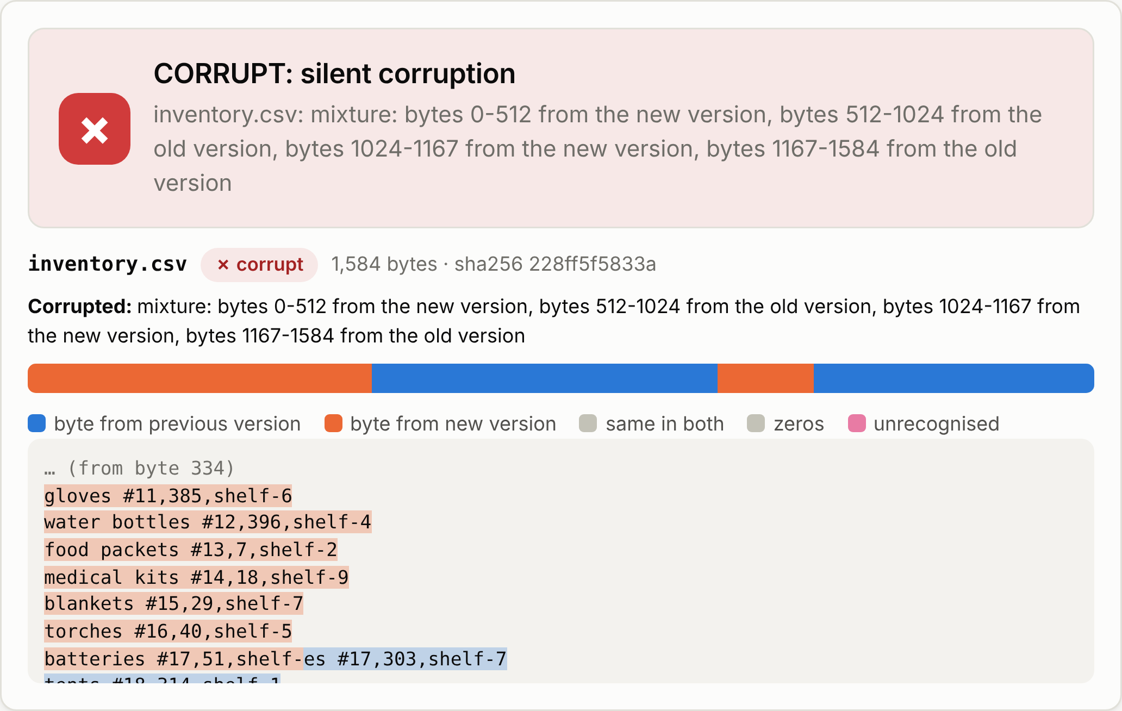
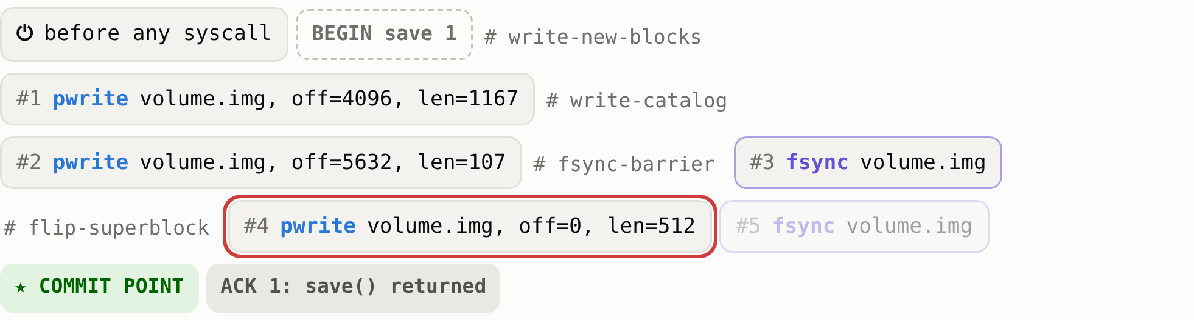

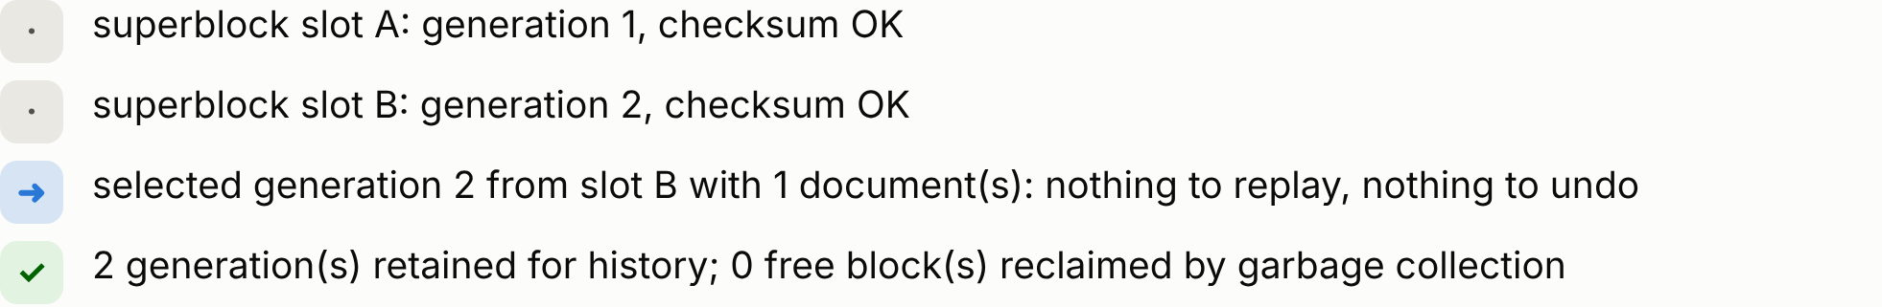
07
Pull the Plug: Corrupted Mixture vs. Recovery
BEFORE: NAIVE IN-PLACE SAVE
AFTER: SAFEWRITE COPY-ON-WRITE
Power cut mid-save: part new, part old, still parses as CSV.
Same save, power cut at the superblock write: the commit point.
Silent: no error is raised; the quantities are just wrong
Real kill -9: naive/trunc corrupts about half of all saves
Before the flip: previous version; after it: new version
Real kill -9 on ext4: 0 corruptions in every safe engine

Slide 8
08
Trade-offs, Measured: Why Copy-on-Write
WHY COW IS THE DEFAULT
O(1) recovery: flat ~1 ms, no replay, no rollback logic to get wrong
Free extras: version history, lock-free MVCC readers
Cost: 2 fsyncs vs WAL’s ~1. For tiny high-rate writes WAL with group commit wins (one-word switch)
Undo: 3 fsyncs, writes every byte twice (2.19×)

Slide 9
09
Implementation & Innovation
PROTOTYPE SCOPE
TECH STACK
INNOVATION
5 engines behind one API: naive (baseline), shadow, undo, wal, cow
Crash simulator: 3 models × 6 scenarios × 13 variants
Crash Lab UI, CLI, kill -9 torture, race demo, benchmarks
53 tests, CI on Linux, macOS, Windows
Language: Python 3.9+, standard library only
UI: stdlib http.server + vanilla JS/SVG, works offline
OS APIs: pwrite, fsync, F_FULLFSYNC, O_DIRECTORY dir fsync, rename, ftruncate, flock / msvcrt
Simulation: own ALICE / CrashMonkey-style persistence model
Proof, not promise: every post-crash disk at every syscall, recovered by the real code
Ablations justify each safeguard with a counter-example
Shows kill -9 tests cannot find missing fsyncs
ALTERNATIVE CONSIDERED
SCOPE / LIMITATIONS
Overwrite in place: mixture (naive)
Temp + rename: not atomic across documents
Undo journal: 3 fsyncs, 2.19× writes
Redo WAL: fastest commit; recovery grows with the log
Chosen: copy-on-write (all four are built and measured)
Assumes the drive honours flush; journaled metadata (ext4, XFS, NTFS, APFS)
One writer process (flock), many threads; COW catalog suits thousands of docs
Future: dm-log-writes block replay, COW B+-tree, COW + WAL hybrid

