Slide 1


Vagrant Up in 5 Easy Steps
Trevor Roberts Jr
@VMTrooper

Slide 2
Introduction
What is Vagrant?
Created by Mitchell Hashimoto
Provisioning Tool for Dev & Test Environments
Why use Vagrant?
Quick
Easily replicate production on a Dev box
How do I get started?

Slide 3
Step 1: Select your Provider
What is a provider?
Oracle VirtualBox (Free)
VMware Fusion or Workstation ($)
Build your own (AWS, Rackspace, etc.)

Slide 4
Step 2: Install Vagrant
http://www.vagrantup.com/downloads.html

Slide 5
Step 3: Select a box
Vagrant Cloud:
https://vagrantcloud.com/discover/featured
Build your own:
http://www.packer.io/docs/post-processors/vagrant.html
Download and Use Others not on Vagrant Cloud:
http://www.vagrantbox.es/
Notes:
We will use hashicorp/precise64 since it is built for Virtualbox and VMware

Slide 6
Step 4: Vagrant Init & Up
Open a Terminal Window in the directory for your test lab:
vagrant init hashicorp/precise64
vagrant up (Virtualbox)
vagrant up --provider=vmware_fusion (VMware)
Notes:
vagrant up --provider=vmware_fusion or vagrant up --provider=vmware_workstation (VMware)

Slide 7
Step 5: Vagrant SSH
Login to the VM using vagrant CLI:
vagrant ssh

Slide 8

Success!

Slide 9
But wait, there’s more…
Version Control
Customize Your VM
Multi-VM Configuration (Static & Dynamic)
VM Provisioners
Squid Proxy

Slide 10
Version Control
Source Code Control for your Vagrantfile
Git, SVN, etc.
Online collaboration
GitHub, BitBucket, etc.
This presentation and example code can be found at: https://github.com/VMTrooper/VagrantBrownBag

Slide 11
Customize Your VM
Hostname
config.vm.hostname = "controller"
IP Address
config.vm.network :private_network, ip: 178.16.172.200
NOTE: For the :public_network option, you will need to do some extra work involving DHCP
Notes:
For :public_network, see http://vmtrooper.com/vagrant-static-external-ip-addresses-with-the-vmware-fusion-provider/

Slide 12
Customize Your VM
IMPORTANT for Virtualbox!
Port forwarding must be used if you want to access a specific port on your VM from your desktop… because, reasons:
config.vm.network "forwarded_port", guest: 80, host: 8080
Notes:
For :public_network, see http://vmtrooper.com/vagrant-static-external-ip-addresses-with-the-vmware-fusion-provider/

Slide 13
Customize Your VM
Memory
# If using Fusion
config.vm.provider :vmware_fusion do |v|
v.vmx["memsize"] = 1024
v.vmx["numvcpus"] = 2
end
# If using VirtualBox
config.vm.provider :virtualbox do |vbox|
vbox.customize ["modifyvm", :id, "--memory", 1024]
vbox.customize ["modifyvm", :id, "--cpus", 2]
end

Slide 14
Multi-VM Configuration
Share files between VMs.
The Vagrantfile’s folder is mounted to /vagrant on each VM
Use Ruby to make multi-VM deployments A LOT simpler (think loops, branching, variables!)
Compare sample code in ./multivmstatic vs ./multivmdynamic
Notes:
NOTE:
vagrant ssh without a VM name will not work since Vagrant is aware you created multiple VMs.
Use the vagrant status command to get your vm names:
bash-3.2$ vagrant status
Current machine states:
controller running (virtualbox)
compute running (virtualbox)
This environment represents multiple VMs. The VMs are all listed
above with their current state. For more information about a specific
VM, run `vagrant status NAME`.
THEN, use the command vagrant ssh <vmname> ex: vagrant ssh compute

Slide 15
Provisioners
Configuration Management
Shell Scripts
Puppet (Standalone & Agent)
Chef (Solo & Client)
Ansible
SaltStack
CFEngine

Slide 16
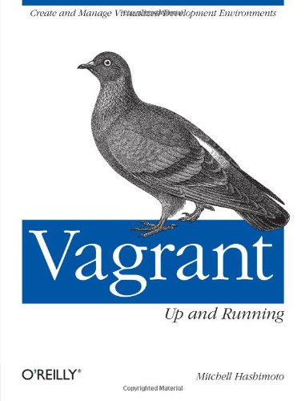
Additional Info
Vagrant Site: http://docs.vagrantup.com/v2/
Google Groups: https://groups.google.com/forum/#!forum/vagrant-up
IRC: #vagrant on Freenode
GitHub (Check out bunchc, bodepd, ody, vmtrooper (me!), etc)
For Fusion-related tips, I post them as I find them:
http://vmtrooper.com/category/automation/vagrant/
Mitchell’s Book

