Slide 1


Vagrant Up in 5 Easy Steps
Trevor Roberts Jr
@VMTrooper
Cody Bunch
@cody_bunch

Slide 2
Step 1: Select your Provider
What is a provider?
Oracle VirtualBox (Free)
VMware Fusion or Workstation ($)
Roll your own (AWS, Rackspace, etc.)

Slide 3
Step 2: Install Vagrant
http://downloads.vagrant.com

Slide 4
Step 3: Download a box
VMware Fusion: http://files.vagrantup.com/precise64_vmware.box
VirtualBox: http://files.vagrantup.com/precise64.box
Roll your own or use others: http://www.vagrantbox.es/

Slide 5
Step 4: Vagrant Init & Up

Slide 6
Step 5: Vagrant SSH

Slide 7

Success!

Slide 8
But wait, there’s more…
Version Control
Custom IP Addresses
Multi-VM Configuration (Static & Dynamic)
Shell, Puppet & Chef Provisioning
Squid Proxy

Slide 9
Chef Integration

Slide 10
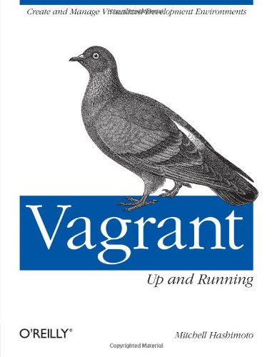
Additional Info
Vagrant Site: http://docs.vagrantup.com/v2/
Google Groups: https://groups.google.com/forum/#!forum/vagrant-up
IRC: #vagrant on Freenode
Mitchell’s Book

