Slide 1


Vagrant Up in 5 Easy Steps
Trevor Roberts Jr
@VMTrooper
Cody Bunch
@cody_bunch

Slide 2
Introduction
What is Vagrant?
Created by Mitchell Hashimoto
Provisioning Tool for Dev & Test Environments
Why use Vagrant?
Quick
Easily replicate production on a Dev box
How do I get started?

Slide 3
Step 1: Select your Provider
What is a provider?
Oracle VirtualBox (Free)
VMware Fusion or Workstation ($)
Build your own (AWS, Rackspace, etc.)

Slide 4
Step 2: Install Vagrant
http://downloads.vagrantup.com

Slide 5
Step 3: Download a box
VirtualBox: http://files.vagrantup.com/precise64.box
VMware Fusion: http://files.vagrantup.com/precise64_vmware.box
Build your own or use others: http://www.vagrantbox.es/

Slide 6
Step 4: Vagrant Init & Up
Open a Terminal Window in the directory for your test lab:
vagrant init
Edit the resulting Vagrantfile
vagrant up
Notes:
Alternatively first line could be…
For Fusion:
vagrant init precise64 http://files.vagrantup.com/precise64_vmware.box
For VirtualBox:
vagrant init precise64 http://files.vagrantup.com/precise64.box
It will automatically configure the name of the Vagrant box that you are using and

Slide 7
Step 5: Vagrant SSH
Login to the VM using vagrant CLI:
vagrant ssh

Slide 8

Success!

Slide 9
But wait, there’s more…
Version Control
Customize Your VM
Multi-VM Configuration (Static & Dynamic)
VM Provisioners
Squid Proxy

Slide 10
Version Control
Source Code Control for your Vagrantfile
Git, SVN, etc.
Online collaboration
GitHub, BitBucket, etc.
This presentation and example code can be found at: https://github.com/VMTrooper/VagrantBrownBag

Slide 11
Customize Your VM
Hostname
config.vm.hostname = "controller"
IP Address
config.vm.network :private_network, ip: 178.16.172.200
NOTE: for NAT addresses (i.e. :public_network), you will need to do some extra work involving DHCP
Notes:
For NAT, see http://vmtrooper.com/vagrant-static-external-ip-addresses-with-the-vmware-fusion-provider/

Slide 12
Customize Your VM
Memory
# If using Fusion
config.vm.provider :vmware_fusion do |v|
v.vmx["memsize"] = 1024
end
# If using VirtualBox
config.vm.provider :virtualbox do |vbox|
vbox.customize ["modifyvm", :id, "--memory", 1024]
end

Slide 13
Multi-VM Configuration
Share files between VMs.
The Vagrantfile’s folder is mounted to /vagrant on each VM
See sample code

Slide 14
Provisioners
Configuration Management
Shell Scripts
Puppet (Standalone & Agent)
Chef (Solo & Client)
Ansible

Slide 15
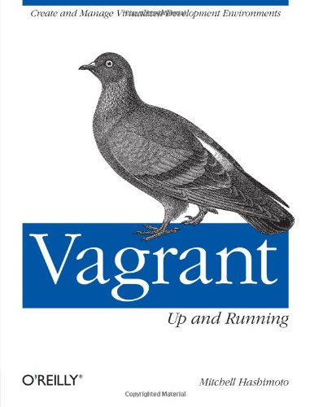
Additional Info
Vagrant Site: http://docs.vagrantup.com/v2/
Google Groups: https://groups.google.com/forum/#!forum/vagrant-up
IRC: #vagrant on Freenode
GitHub (Check out bunchc, bodepd, ody, etc)
For Fusion-related tips, I post them as I find them:
http://vmtrooper.com/category/automation/vagrant/
Mitchell’s Book

