Slide 1
Project By:
MAMATHA.V_ABADS_B12

Slide 2
Introduction
Airbnb, Inc. is an American company operating an online marketplace for short- and long-term homestays and experiences. The company acts as a broker and charges a commission from each booking.
iVision analytics firm has been provided with datasets related to Airbnb listings and reviewer scores worldwide. The objective is to gain a deeper understanding of Airbnb's operations and draw meaningful insights from the data.

Slide 3
Project Goals:
Assessing District Location Scores:
Examining Host Response Time Impact:
Visualizing Airbnb Listing Prices:
Analyzing Composite Scores:
Calculating Listing Age and Host Tenure:
Property Type Price Analysis:
Crafting a Comprehensive City Insights Report:

Slide 4
Assessing District Location Scores: The aim is to pinpoint the location in the district with the least favorable location scores

Slide 5
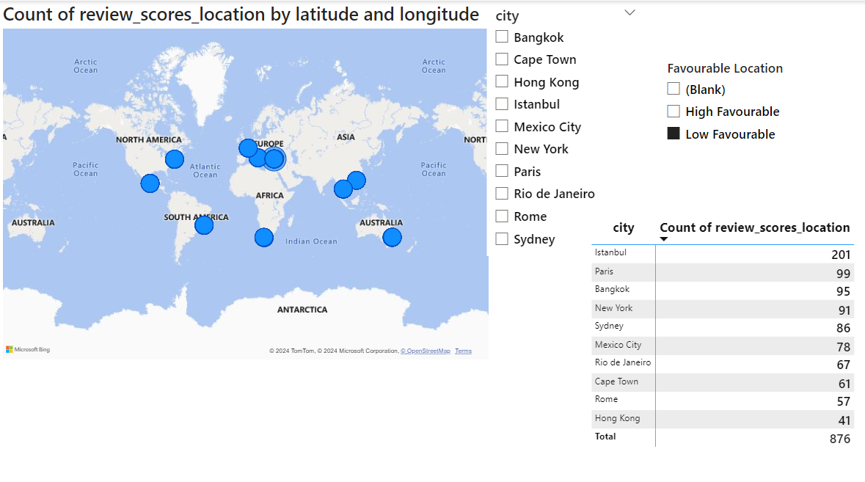

Slide 6
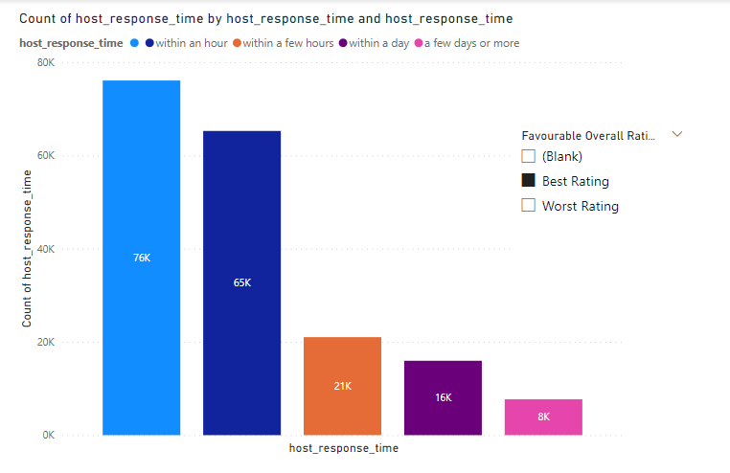
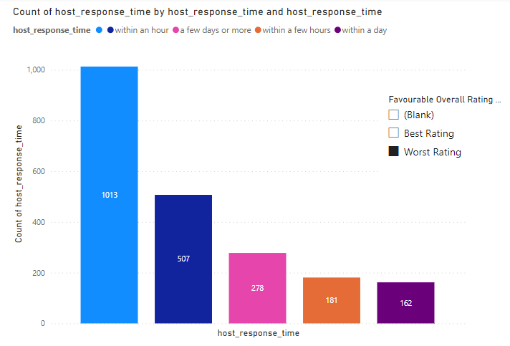
Examining Host Response Time Impact: The goal is to delve into the relationship between host response times and the overall ratings of Airbnb listings providing valuable insights

Slide 7
Visualizing Airbnb Listing Prices: The objective is to create visual representations of Airbnb listing prices across different cities and summarize any noteworthy trends or variations

Slide 8
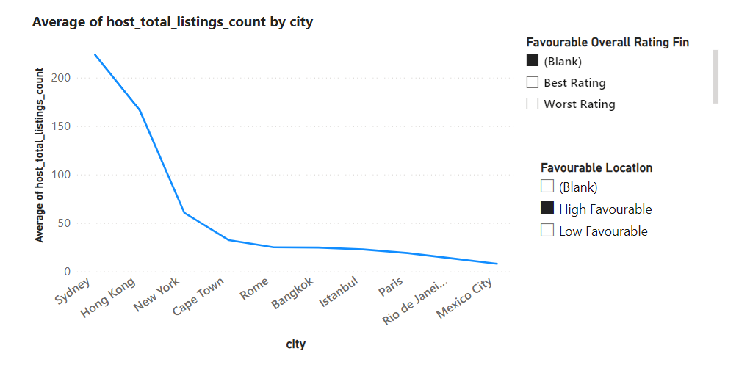

Slide 9
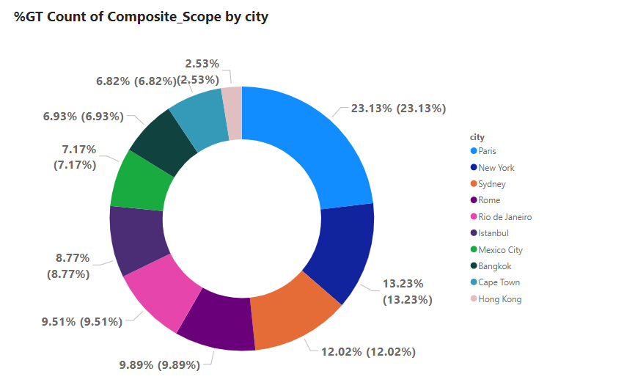
Analyzing Composite Scores: The task involves creating a composite score that integrates check-in experience and host communication for various districts with subsequent analysis and insights.

Slide 10
Calculating Listing Age and Host Tenure: This objective entails computing the age of Airbnb listings and identifying hosts who have accumulated more than ten years of hosting expertise.

Slide 11
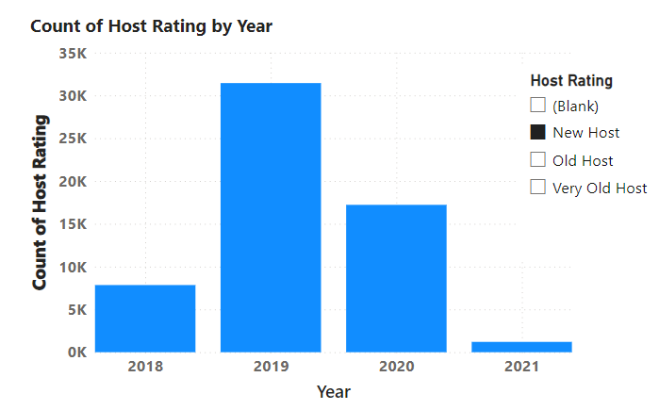
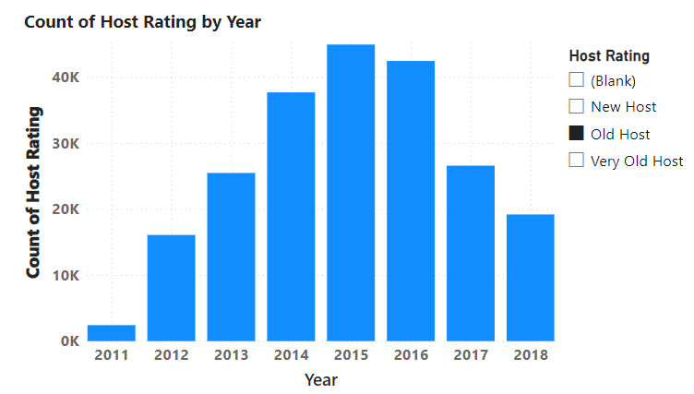
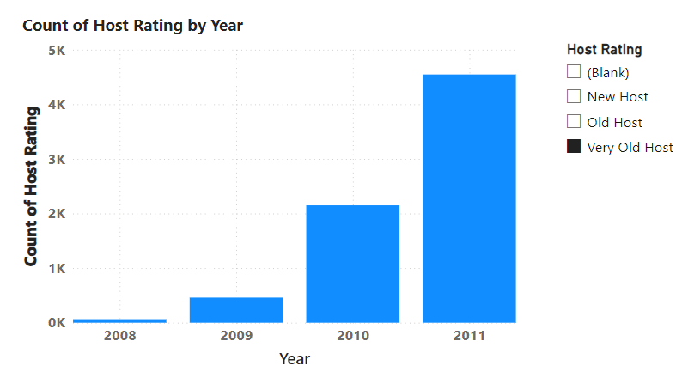

Slide 12
Property Type Price Analysis: The task involves the creation of a visual tree map that displays average prices for various room and property types with specific attention given to the property type associated with the highest prices for entire places.

Slide 13
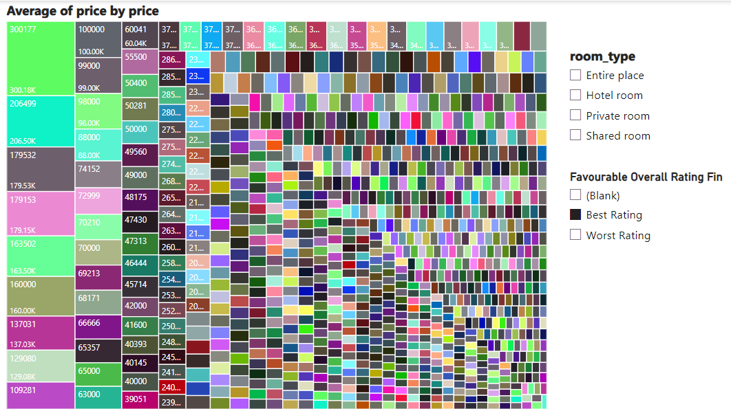

Slide 14
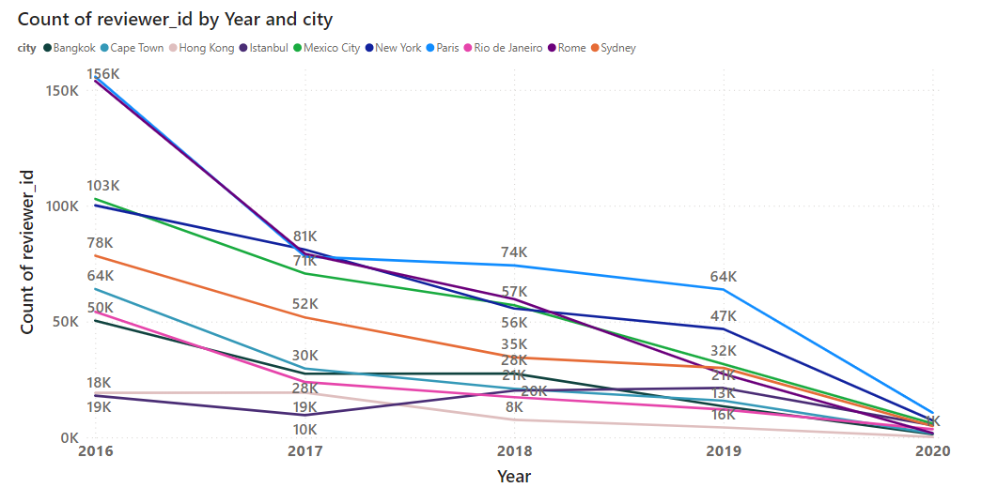
Crafting a Comprehensive City Insights Report: This objective entails the creation of a comprehensive report that presents listing prices, guest ratings, and visitor trends for multiple cities, with a particular focus on assessing changes in visitor trends in 2020 in contrast to earlier years.

Slide 15
Overview

Slide 16
THANK YOU

