Slide 1


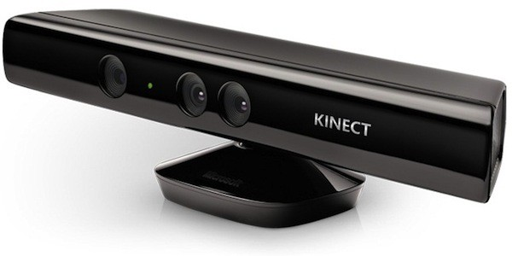
Kinect v1 + ZigFu + Unity 3d
Vladislavs Marisevs
Bsc (Hons) in Software Development
Year 4

Slide 2
What you can do with it?
Avataring a person in Unity 3d
Create sessions on specific body parts
Use gestures for user menu interfaces
Avatare multiple objects at the same time

Slide 3
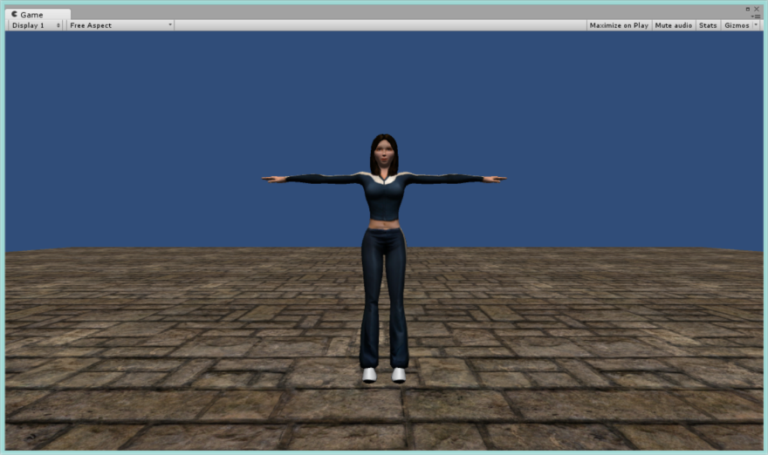
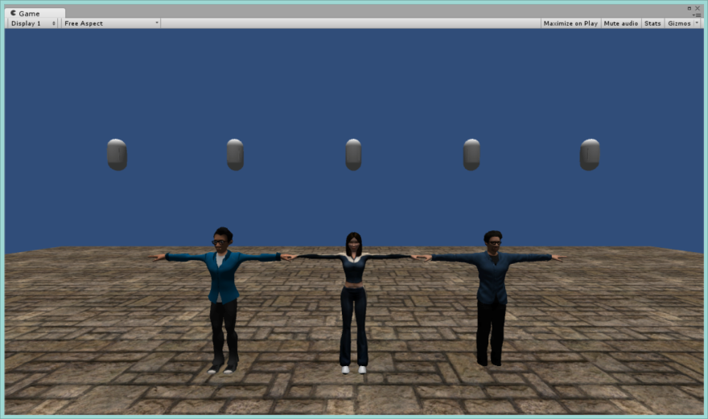
Avataring a person

Slide 4
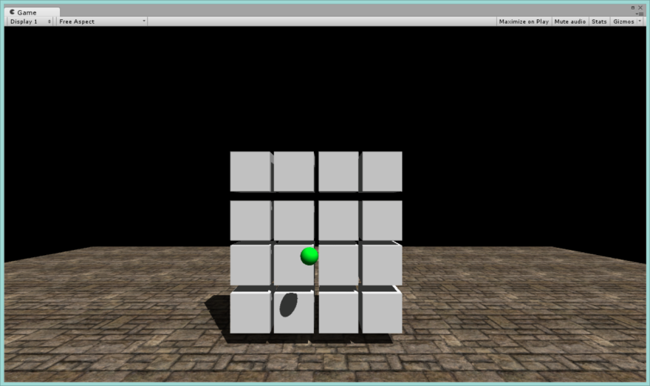
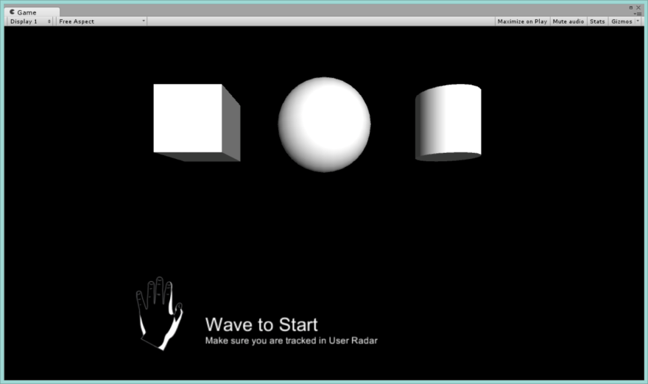
Sessions

Slide 5
ZigFu & Unity
version 1.1 packaged on January 1, 2013
Unity 4.0.0 13 Nov, 2012
My Project:
Unity 3d 5.3.2

Slide 6
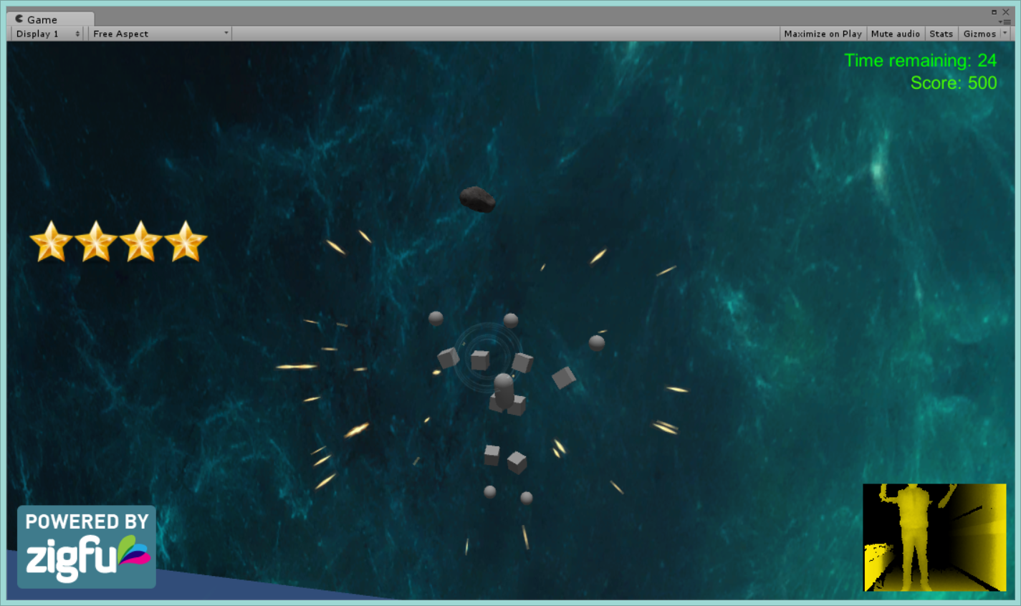
Space walk Game
Break the asteroids to get score and time
If asteroid hits head or chest, lose life

Slide 7
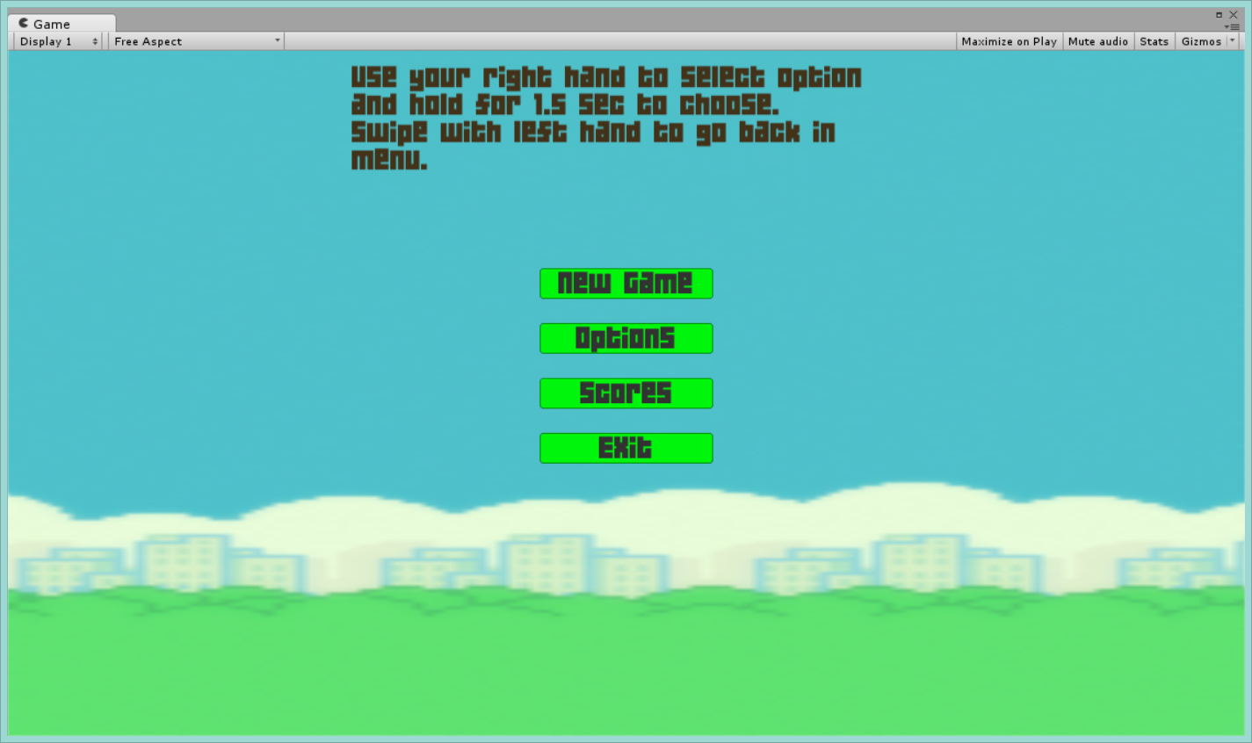
Flappy Bird 3d
Use your right hand to point at the menu button
Hold it for 1.5 sec to select
Use your left hand swipe to go back in the menu

Slide 8
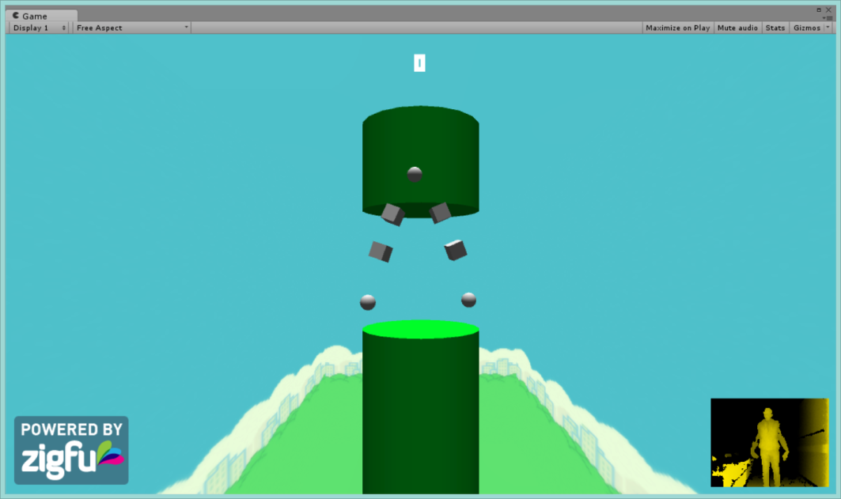
Flappy Bird 3d
Flap to fly!!!

Slide 9
Links
Youtube Video
Online Game – You can play in browser, with unity player and zigfu kinect player installed
GitHub Link

