Slide 1
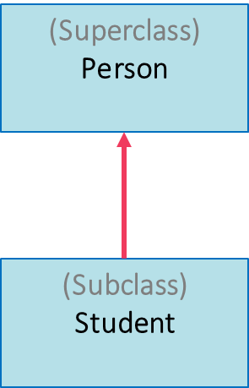
Java Inheritance
Inheritance allows a class (known as the subclass or derived class) to acquire properties and behaviors from another class (known as the superclass or base class).
Inheritance establishes an "is-a" relationship between classes, where the subclass is a specialized version of the superclass.
is-a

Slide 2





The College
Case
Student
Person
Course
Grad Student
Faculty

Slide 3
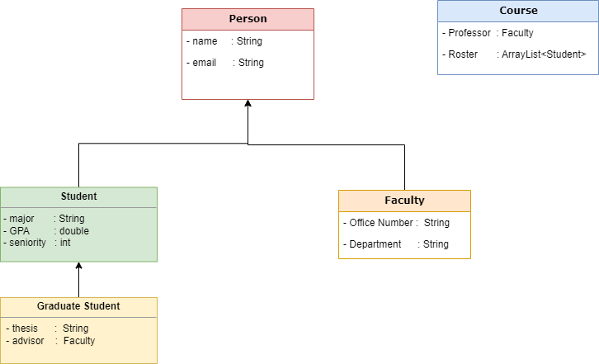
The Person Hierarchy Case
Using Java classes (inheritance & aggregation) to model a typical University environment.
Aggregation
Inheritance Hierarchy

Slide 4
Person Class
Person Class
- name : String - email : String
+ Mutators + Accessors + Constructors + User-Defined Methods (toString titleCaps,...)

Slide 5
Student Class
Student : Person
- major : String - GPA : double
+ Mutators + Accessors + Constructors + User-Defined Methods (toString)

Slide 6
Graduate Student Class
GradStudent : Student
- thesis : String - advisor : String
+ Mutators + Accessors + Constructors + User-Defined Methods (toString)

Slide 7
Faculty Class
Faculty : Person
- office# : String - department : String
+ Mutators + Accessors + Constructors + User-Defined Methods (toString)

Slide 8
Course Class
Course (Aggregation)
- faculty : Faculty - roster : ArrayList<Student>
+ Mutators + Accessors + Constructors + User-Defined Methods (toString)

Slide 9
Java Code
class Person {
//Data members (Good practice: provide default values)
private String name = "na";
private String email = "none";
//Constructor (all-arguments, zero-args uses the default values)
public Person(String nameVal, String emailVal) {
setName(nameVal);
setEmail(emailVal);
}
//Mutators (Put validation logic, business-rules here)
public void setName(String nameVal) { this.name = nameVal; }
public void setEmail(String emailVal) { this.email = emailVal; }
//Accessors
public String getName() { return name; }
public String getEmail() { return email; }
//User-defined methods
@Override
public String toString() {
return "Pers. Name: " + name + "\nPers. Email: " + email;
}
}
class Student extends Person {
private String major = "undeclared";
private int seniorityLevel = 1;
private double gpa = 0;
public Student(String name, String email,
String major, int seniorityLevel, double gpa) {
super(name, email);
setMajor(major);
setSeniorityLevel(seniorityLevel);
setGpa(gpa);
}
public void setMajor(String major) { this.major = major; }
public void setGpa(double gpa) { this.gpa = gpa; } public void setSeniorityLevel(int seniorityLevel) {
this.seniorityLevel = seniorityLevel;
}
public String getMajor() { return major; }
public int getSeniorityLevel() { return seniorityLevel; } public double getGpa() { return gpa; }
@Override
public String toString() {
return super.toString() + "\nStud. Major: " + major
+ "\nStud. Seniority Level: " + seniorityLevel
+ "\nStud. GPA: " + gpa;
}
}

Slide 10
Java Code
class GradStudent extends Student {
private String thesis = "na";
private String advisor = null;
public GradStudent(String name, String email,
String major, int seniorityLevel, double gpa,
String thesis, String advisor) {
super(name, email, major, seniorityLevel, gpa);
setThesis(thesis);
setAdvisor(advisor);
}
public void setThesis(String thesis) { this.thesis = thesis; }
public void setAdvisor(String advisor) { this.advisor = advisor; }
public String getThesis() { return thesis; }
public String getAdvisor() { return advisor; }
@Override
public String toString() {
return super.toString() + "\nGrad. Thesis: " + thesis
+ "\nGrad. Advisor: " + advisor;
}
}
class Faculty extends Person {
private String officeNumber;
private String department;
public Faculty(String name, String email,
String officeNumber, String department) {
super(name, email);
setOfficeNumber(officeNumber);
setDepartment(department);
}
public void setOfficeNumber(String officeNumber) { this.officeNumber = officeNumber; }
public String getDepartment() { return department; }
public String getOfficeNumber() { return officeNumber; }
public void setDepartment(String department) { this.department = department; }
@Override
public String toString() {
return super.toString() + "\nFac. Office Number: " + officeNumber
+ "\nFac. Department: " + department;
}
}

Slide 11
Java Code
class Course {
private Faculty faculty;
private ArrayList<Student> roster;
public Course(Faculty faculty, ArrayList<Student> roster) {
setFaculty(faculty);
setRoster(roster);
}
public void setFaculty(Faculty faculty) {
this.faculty = faculty; }
public void setRoster(ArrayList<Student> roster) {
this.roster = roster; }
public Faculty getFaculty() { return faculty; }
public ArrayList<Student> getRoster() { return roster; }
@Override
public String toString() {
StringBuilder sb = new StringBuilder();
sb.append("Course-Faculty Information:\n")
.append(faculty)
.append("\n\n");
sb.append("Course-Student Roster:\n");
for (Student student : roster) {
sb.append(student).append("\n\n");
}
return sb.toString();
}
}
public class Driver {
public static void main(String[] args) {
Person person = new Person("Juan Valdez", "greatCoffee@gmail.com");
System.out.println("\n" + person);
Student student = new Student("Harry Potter", "magic@gmail.com",
"Magical Science", 4, 3.79);
System.out.println("\n" + student);
GradStudent gradStudent = new GradStudent("Sheldon Cooper", "sheldon@gmail.com",
"Astrophysics", 6, 3.99,
"Big-Bang Theory", "Dr. Xavier");
System.out.println("\n" + gradStudent);
Faculty faculty = new Faculty("Dr. Charles Xavier", "xman@gmail.com",
"A123", "Physics");
System.out.println("\n" + faculty);
ArrayList<Student> courseRoster = new ArrayList<>();
courseRoster.add(student);
courseRoster.add(gradStudent);
courseRoster.add(new Student("Hermione Granger", "her@gmail.com",
"Mathematics", 4, 4.0));
Course course = new Course(faculty, courseRoster); System.out.println("\n\nCourse Information-----------------");
System.out.println(course);
}//main
}//Driver class

Slide 12
Output
Pers. Name: Juan Valdez
Pers. Email: greatCoffee@gmail.com
Pers. Name: Harry Potter
Pers. Email: magic@gmail.com
Stud. Major: Magical Science
Stud. Seniority Level: 4
Stud. GPA: 3.79
Pers. Name: Sheldon Cooper
Pers. Email: sheldon@gmail.com
Stud. Major: Astrophysics
Stud. Seniority Level: 6
Stud. GPA: 3.99
Grad. Thesis: Big-Bang Theory
Grad. Advisor: Dr. Xavier
Pers. Name: Dr. Charles Xavier
Pers. Email: xman@gmail.com
Fac. Office Number: A123
Fac. Department: Physics
Course Information-----------------
Course-Faculty Information:
Pers. Name: Dr. Charles Xavier
Pers. Email: xman@gmail.com
Fac. Office Number: A123
Fac. Department: Physics
Course-Student Roster:
Pers. Name: Harry Potter
Pers. Email: magic@gmail.com
Stud. Major: Magical Science
Stud. Seniority Level: 4
Stud. GPA: 3.79
Pers. Name: Sheldon Cooper
Pers. Email: sheldon@gmail.com
Stud. Major: Astrophysics
Stud. Seniority Level: 6
Stud. GPA: 3.99
Grad. Thesis: Big-Bang Theory
Grad. Advisor: Dr. Xavier
Pers. Name: Hermione Granger
Pers. Email: her@gmail.com
Stud. Major: Mathematics
Stud. Seniority Level: 4
Stud. GPA: 4.0

