Slide 1


Android API - Open GL
Vincent Morsaint
Ben Mannell

Slide 2
Overview
What is Open GL
Building an Open GL ES environment
Defining Shapes
Drawing Shapes
Projections & Views
Motion
Touch events

Slide 3
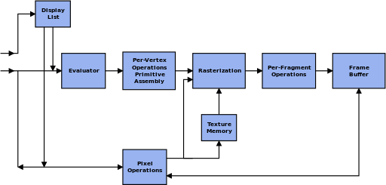
What is Open GL?
Open Graphics Library(2D and 3D)
  Cross Language
  Multi-platform
  Hardware Accelerated rendering(GPU)
  Maintained by Khronos Group

Slide 4
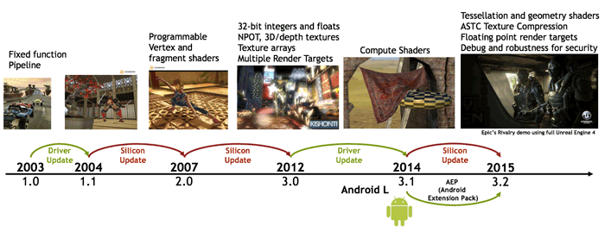
OPEN GL ES
OpenGL for Embedded Systems(smart phones/tablets)
  Open GL ES 1.0
  Removed need for OpenGL library calls with glBegin and glEnd
  Primitive rendering functions changed to vertex arrays
  Fixed-point data types introduced for vertex coordinates
  Open GL ES 2.0
    Not backwards compatible with 1.x
  Open GL ES 3.0
    Backwards compatible with 2.x
  Open GL ES 3.1
  Backwards compatible with 2.x and 3.0

Slide 5
Building the environment
Manifest
Open GL ES 2.0 API - Android 2.2 (API level 8)
Open GL ES 3.0 API - Android 4.3 (API level 18)
Open GL ES 3.1 API - Android 5.0 (API level 21)
Texture Compression
Notes:
ES 3.X backwards compatible with 2.0

Slide 6
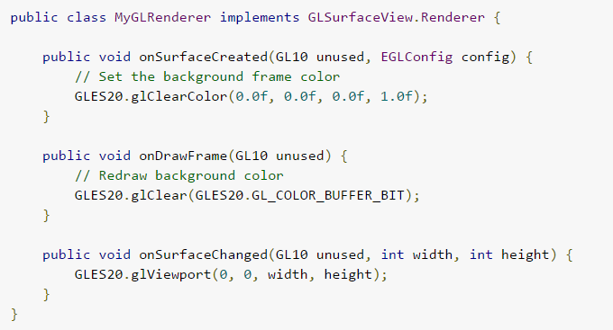
Building the environment
Renderer

Slide 7
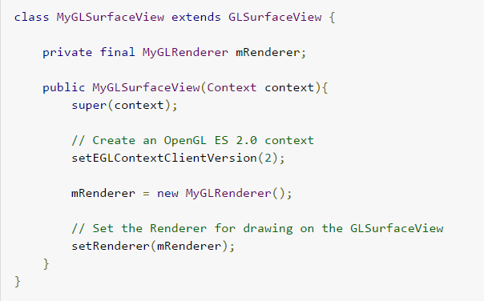
Building the environment
Surface View

Slide 8
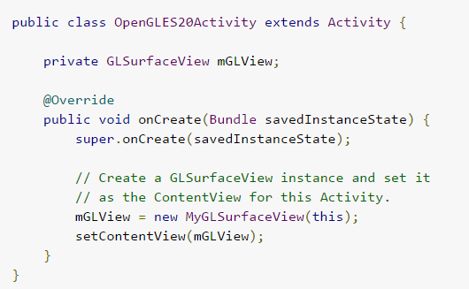
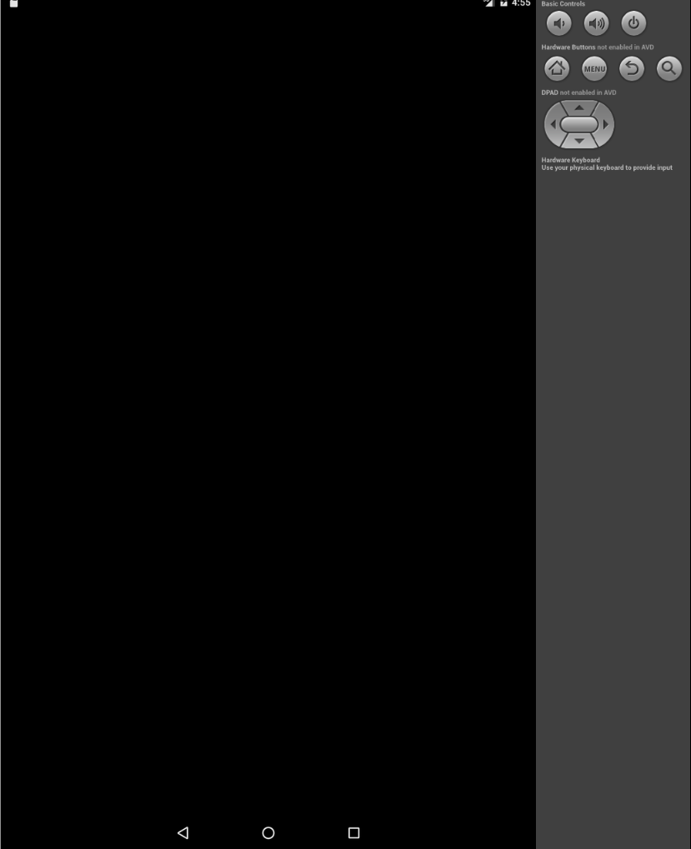
Building the environment
Activity

Slide 9
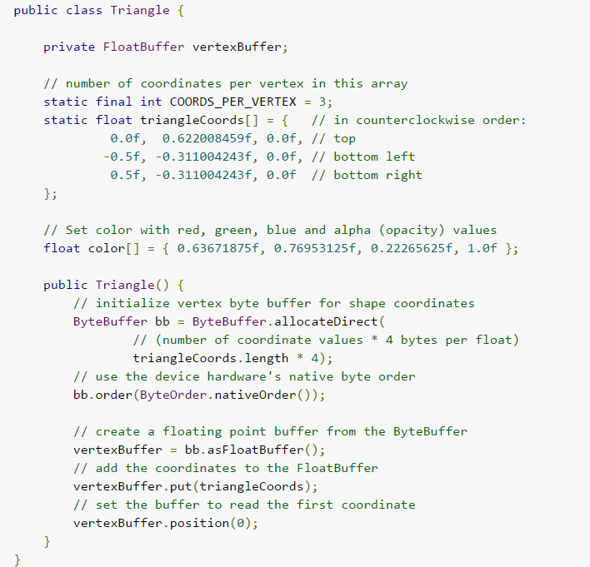
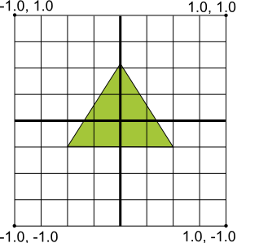
Defining Shapes
Example:
Triangle
  Vertex array of floating points (X,Y,Z) between -1 and 1
  Passed using Byte Buffer
Notes:
In OpenGL, the typical way to define shames is to define a vertex array of floating point numbers for the coordinates. For maximum efficiency, you write these coordinates into a ByteBuffer, that is passed into the OpenGL ES graphics pipeline for processing.

Slide 10
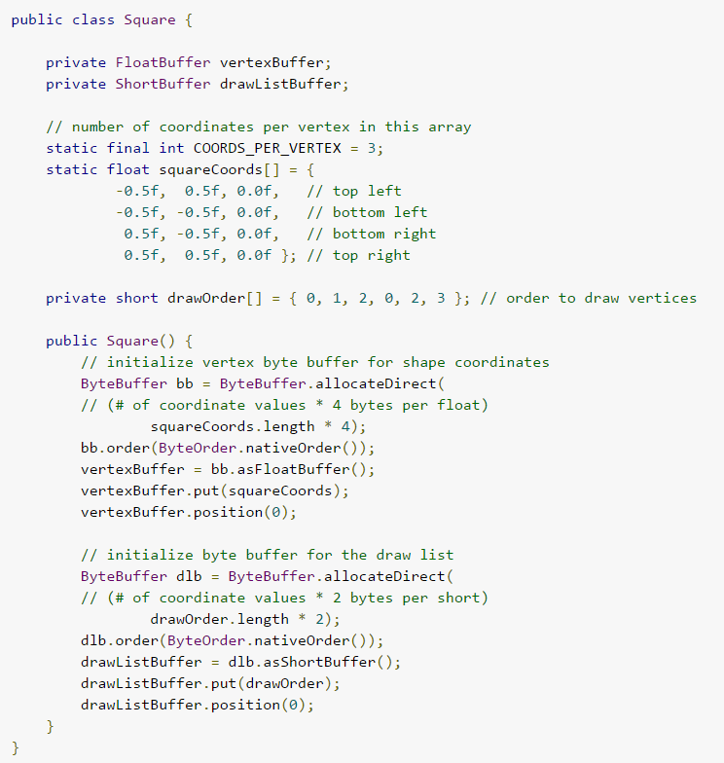
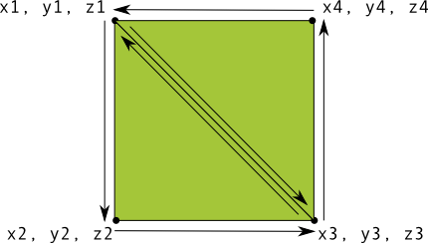
Defining Shapes
Example:
Square
  Four vertices
  Drawn using triangles
  Specify order to increase efficiency

Slide 11
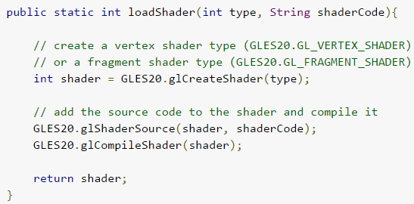
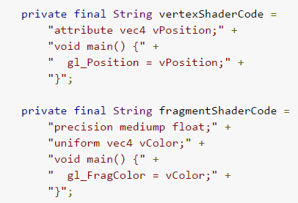
Drawing Shapes
Shaders
  Vertex Shader – code for rendering vertices of a shape
  Fragment Shader – code for rendering the face of a shape with colors or textures
  Program – object that contains the shaders used for drawing one or more shapes
add to renderer class:
add to triangle class:

Slide 12
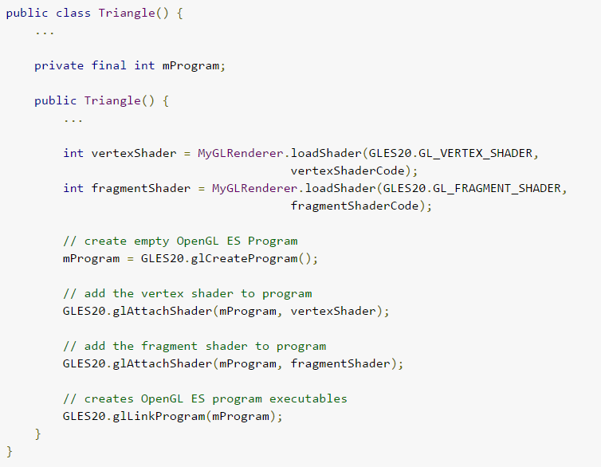
Drawing Shapes
Loading Shaders
  CPU Expensive and should only be loaded once per shader

Slide 13
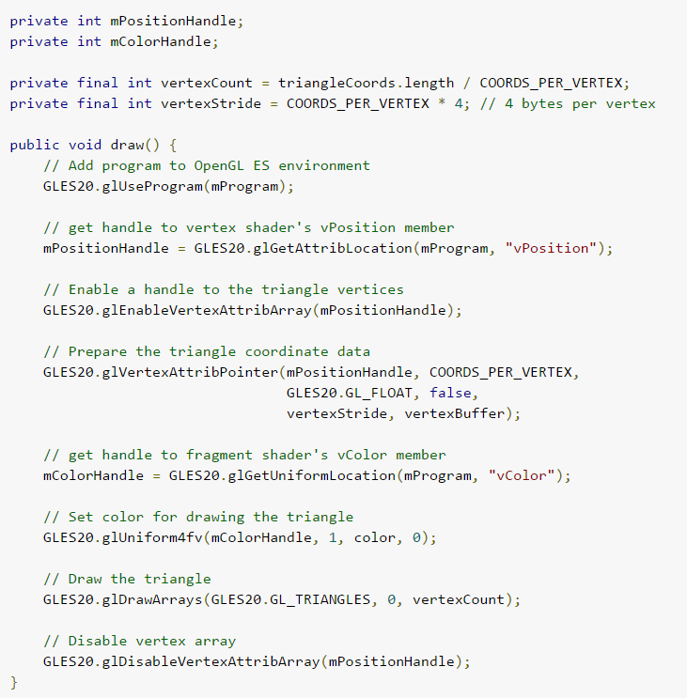
Drawing Shapes
Drawing options
  Typically varies by shape
  Each shape should have its own draw function

Slide 14
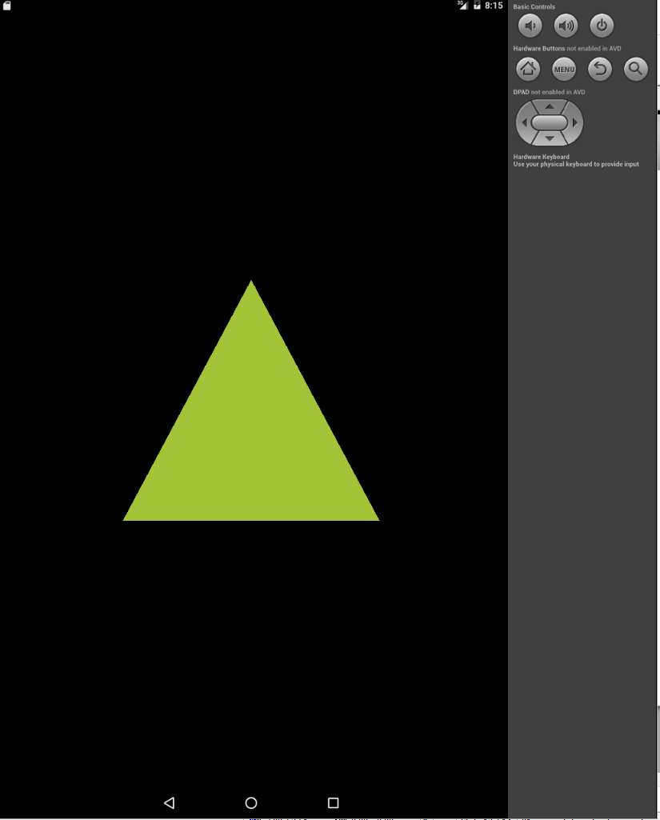

Drawing Shapes
Drawing shape
add to renderer's class onDrawFrame:

Slide 15
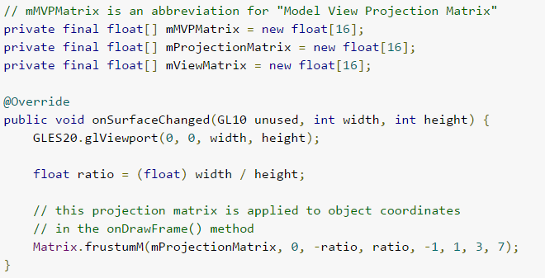
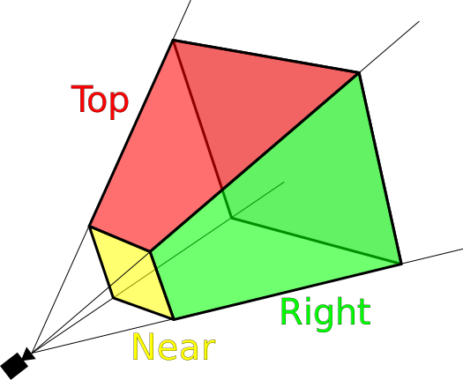
Projection & Views
Projection transformation calculated in Renderer's onSurfaceChange
  Create a projection matrix using Matrix.frustrumM
  (a view frustrum is defined by a field of view, and the distances in depth between the front and back plane)

Slide 16
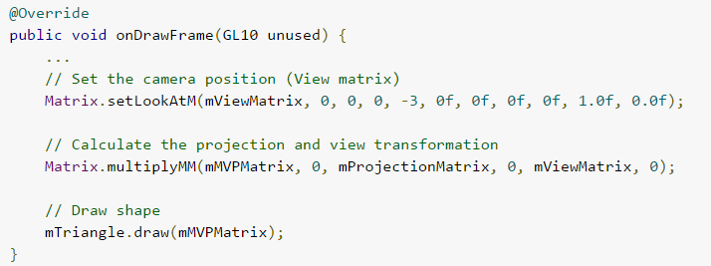
Projection & Views
Camera View transformation in Renderer's onDrawFrame
Note: applying Matrix to Shape's draw method

Slide 17
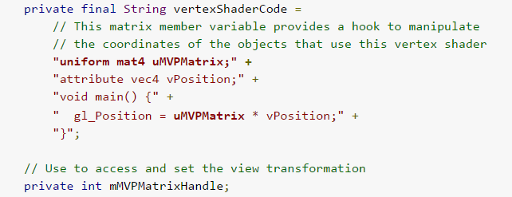
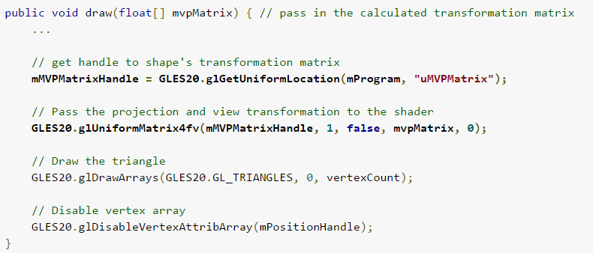
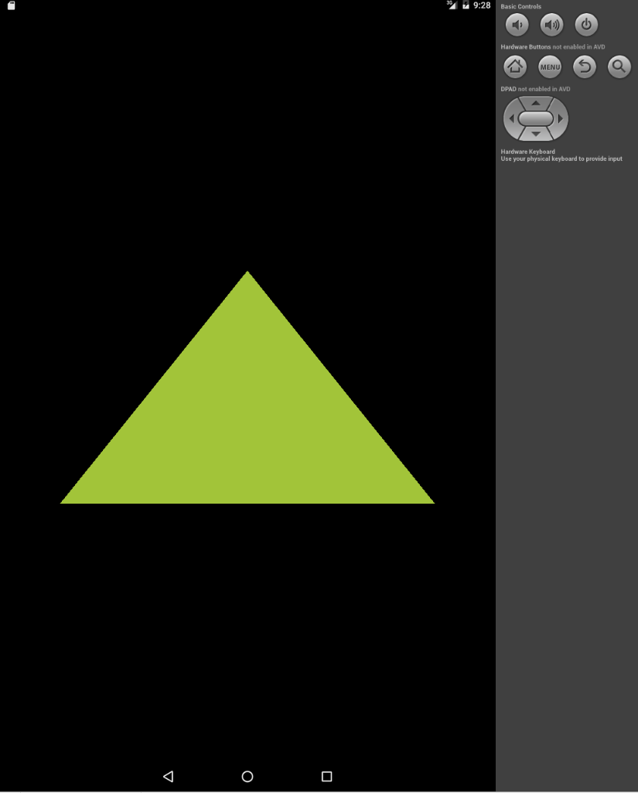
Projection & Views
Updating Shape for 3D projection/view
Notes:
the matrix must be included as a modifier of gl_Position
Note that the uMVPMatrix factor *must be first* in order for the matrix multiplication product to be correct.

Slide 18
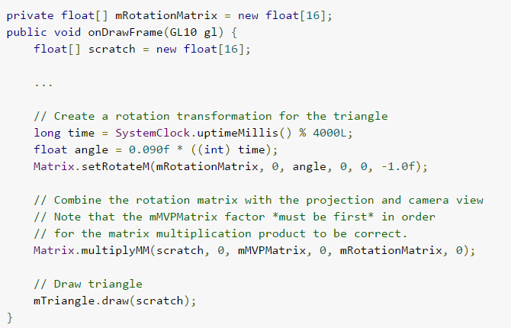
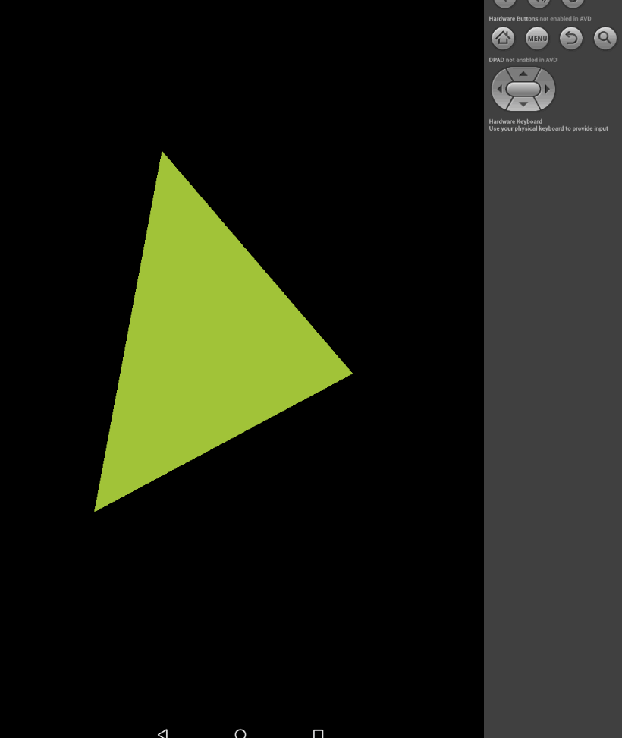
Motion
Rotation Matrix
  Example: Updating the triangle's draw method to calculate rotation matrix(using SystemSlock to drive rotation)

Slide 19
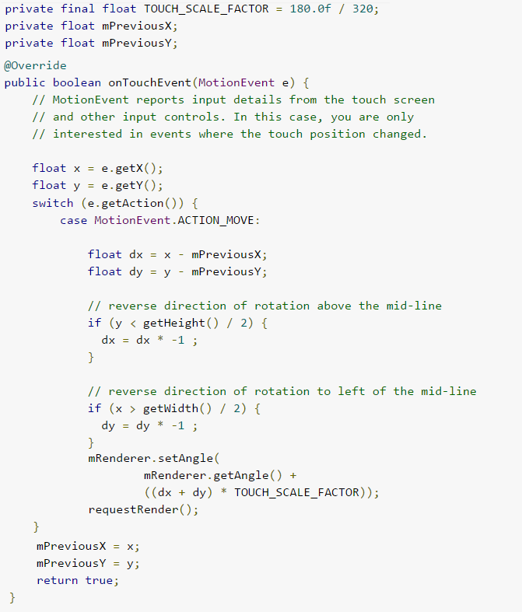
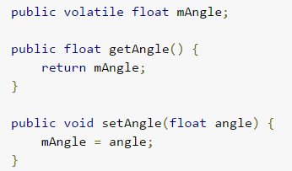
Touch Events
Add OnTouchEvent to SurfaceView
Pass new position/angle and call requestRender (only redraw when shape is moved)
Add 'angle' float value to Renderer class and update onDrawFrame
Notes:
Other options for touch capture action_pointer_2_down and action_down

Slide 20
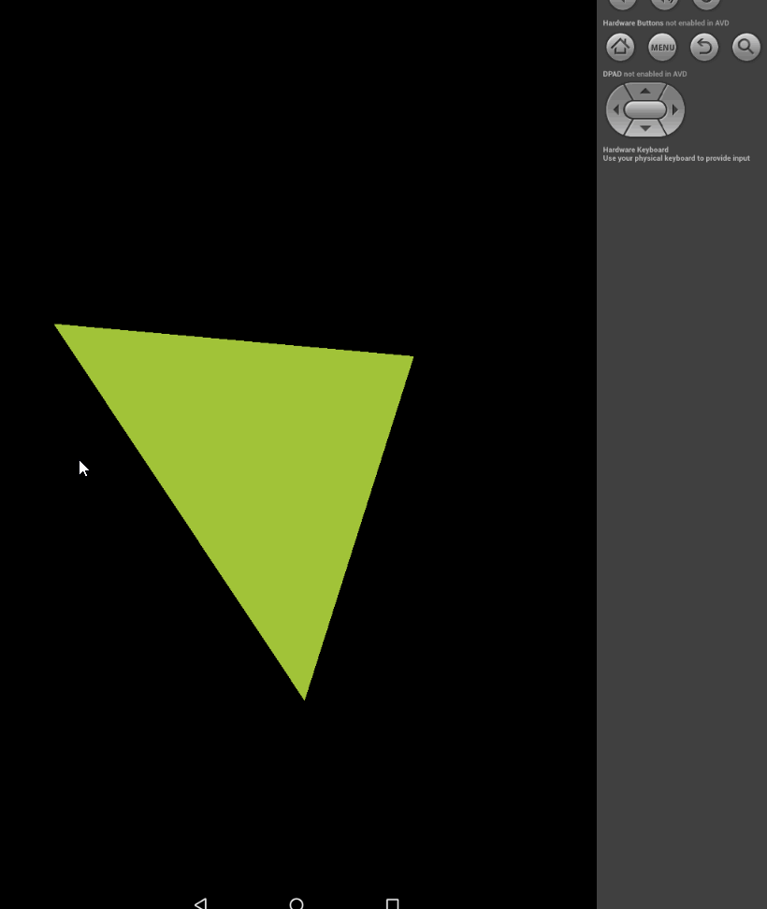

Touch Events
Use the new angle float value to calculate the rotation matrix instead of the SystemClock

Slide 21
Resources
http://developer.android.com/guide/topics/graphics/opengl.html
http://developer.android.com/training/graphics/opengl/index.html
https://www.khronos.org/opengles/
https://en.wikipedia.org/wiki/Viewing_frustum

