Slide 1
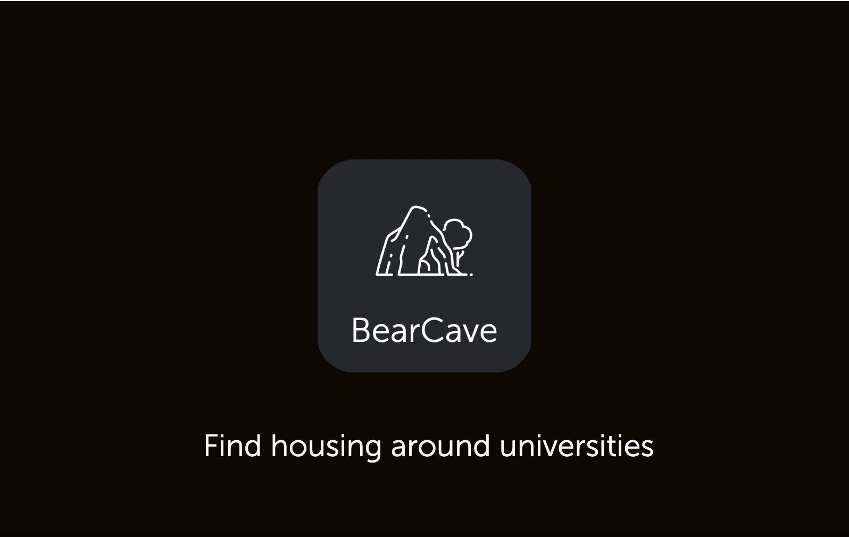

Slide 2
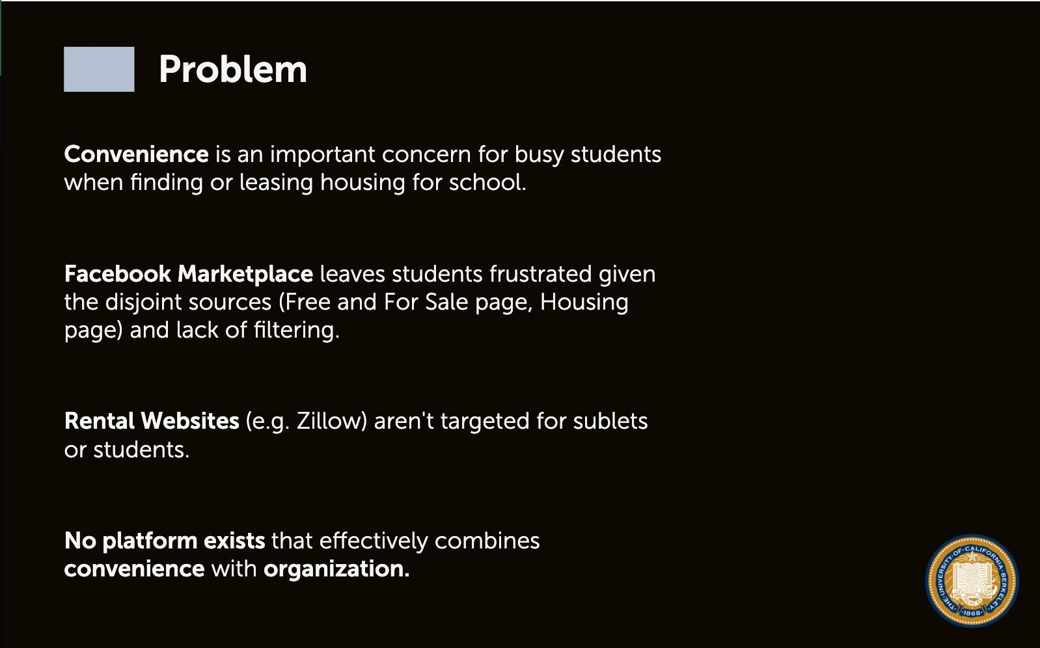

Slide 3
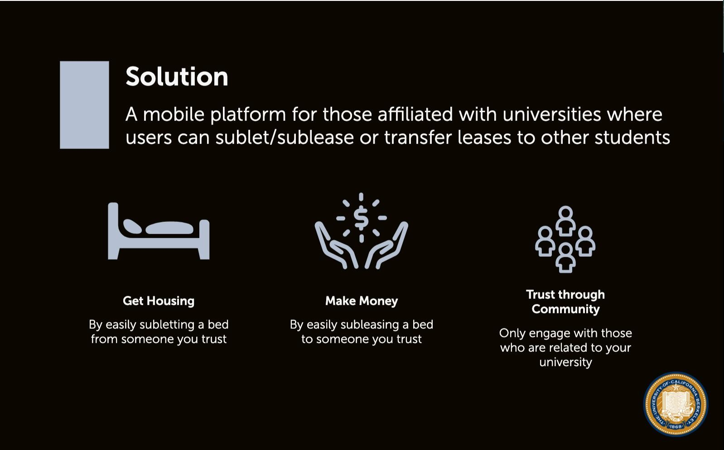

Slide 4


Slide 5
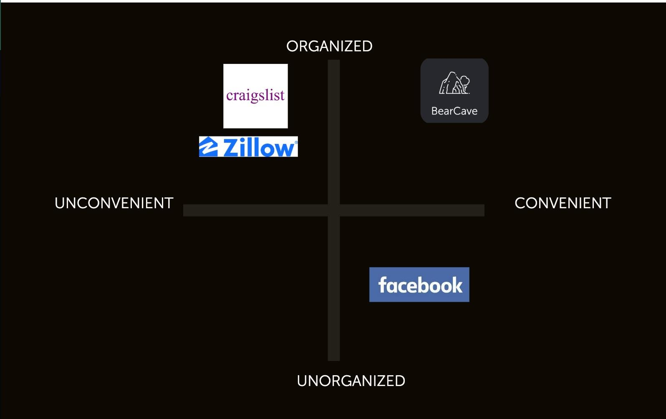
Notes:
facebook housing and free and for sale are convenient because you are more likely to trust the people on their since they are affiliated with Berkeley, but it is unorganized since you can’t easily filter by beds or price range
craigslist and zillow are organized in that you can filter, but they are inconvenient since you have to more carefully vet the people on there, and only property owners can post leases for sale on Zillow.
You also see people posting every single day on FB and Craigslist to get more traction

Slide 6
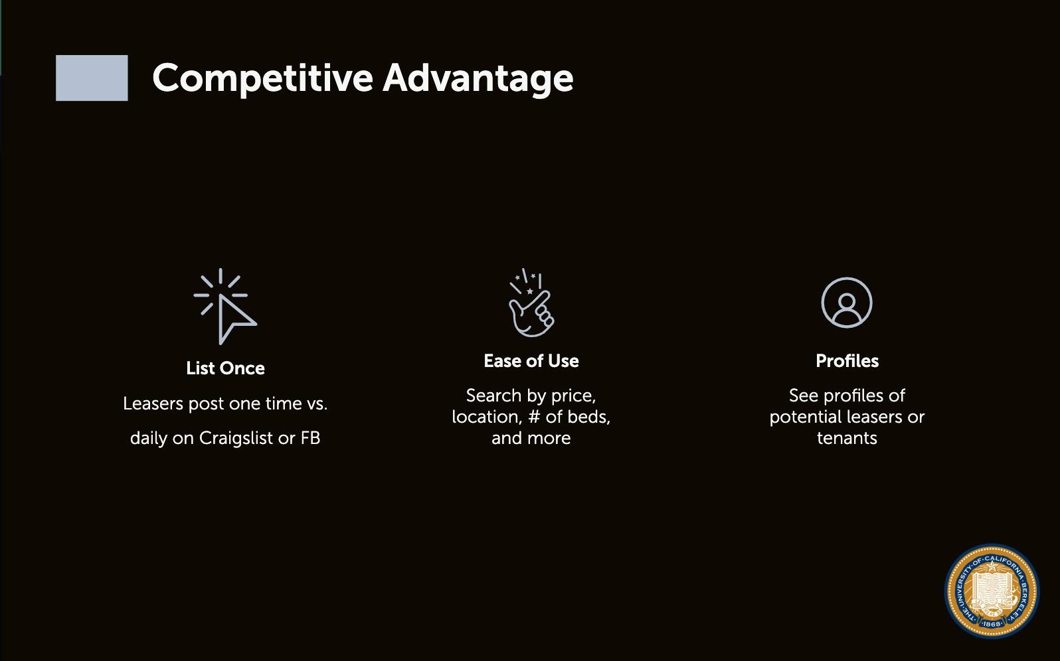

Slide 7
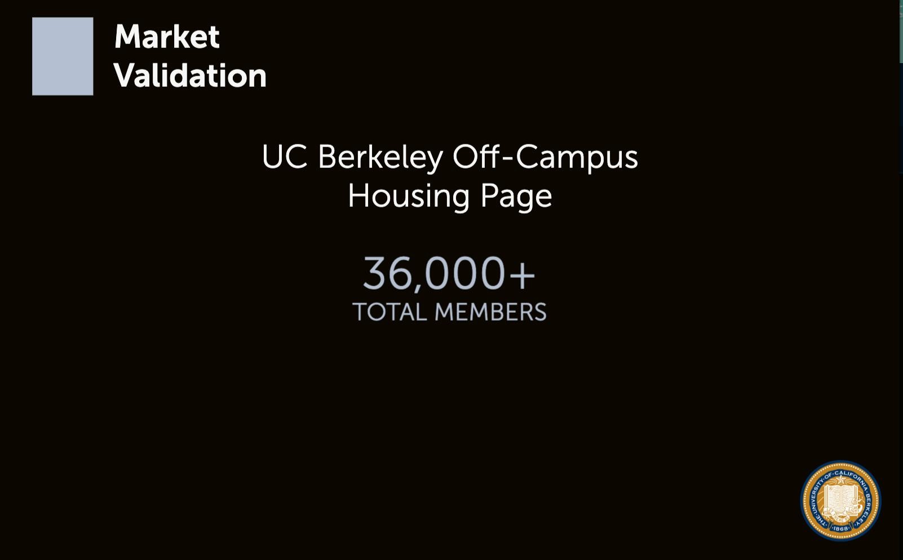

Slide 8

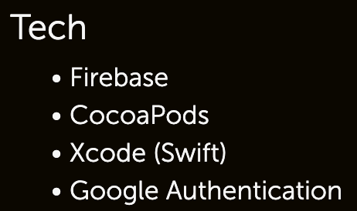

Notes:
video link?

Slide 9



