Slide 1
True Visibility Suite
VMware Aria Operations for Integrations
vmware

Slide 2



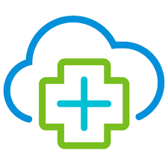



vRealize True Visibility Suite
Attain data depth & context in a single view, with relationship-aware monitoring integrations
Collaborative Management
Applications
Database
With the ability to aggregate operations data from the leading server, storage, compute and database applications, vRealize becomes single source of truth for multiple IT teams.
Connectors
Compute
vRealize Operations
End-to-end visibility
Relationship-Aware Monitoring
Provide value through a unified view, integrating data from your datacenter infrastructure and applications to create a cohesive monitoring strategy.
Quickly assess the state-of-affairs and gain a deeper understanding of how one piece of the stack might be affecting another.
Converged & Hyper-Converged
Network
Virtualization, Container & Cloud
Storage
Notes:
Bringing all of these technologies into vRealize Operations. vROps takes care of all the “core” SDDC elements – your vSphere, vSAN, TKG, and so-on, but we know that there are times when the health of those pieces depends on the environment that it’s running on.
The main things that we want to explore today are how end-to-end visibility of your stack can create a collaborative management environment, with relationship-aware data that multiple teams can trust can drastically reduce your troubleshooting time, and change the behavior of your team to a proactive approach to management.

Slide 3
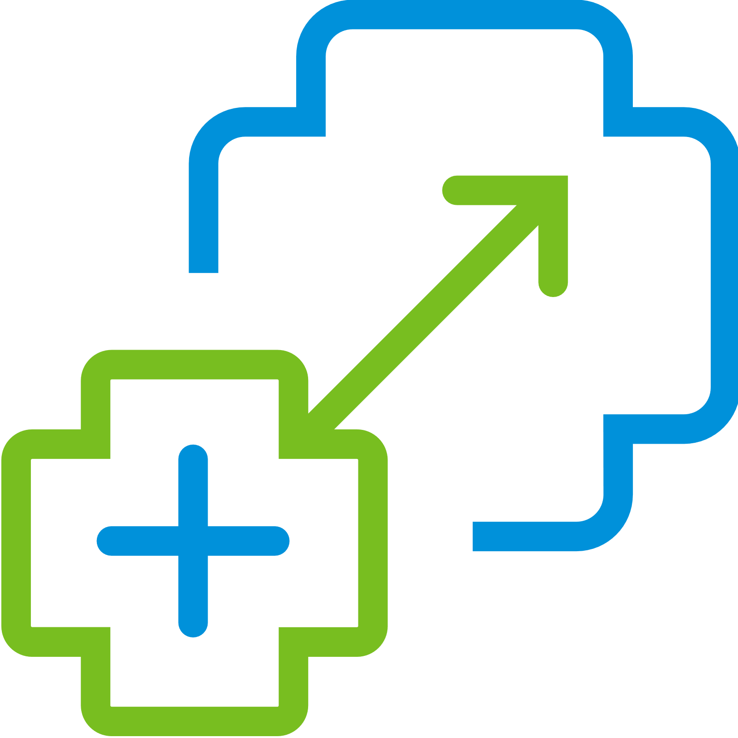
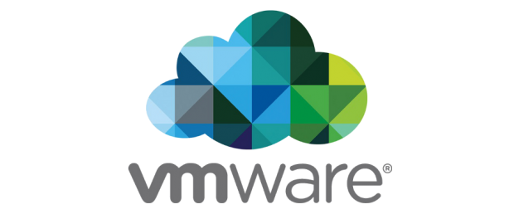

Adding extensibility through management packs
vRealize True Visibility Suite
Applications
Compute
Network
True Visibility Suite
Management Packs
Remote Connections
No Agents Required
RestAPI, JDBC, SNMP
Storage
Databases
VMware Aria
Operations
Notes:
Here I have a quick illustration that explains kind of the logistics of how this works. We have all of the physical infrastructure, apps and databases, and then we have the vRTVS management pack, which is a remote connection, no agents required, and that brings the information into vRealize Operations.

Slide 4
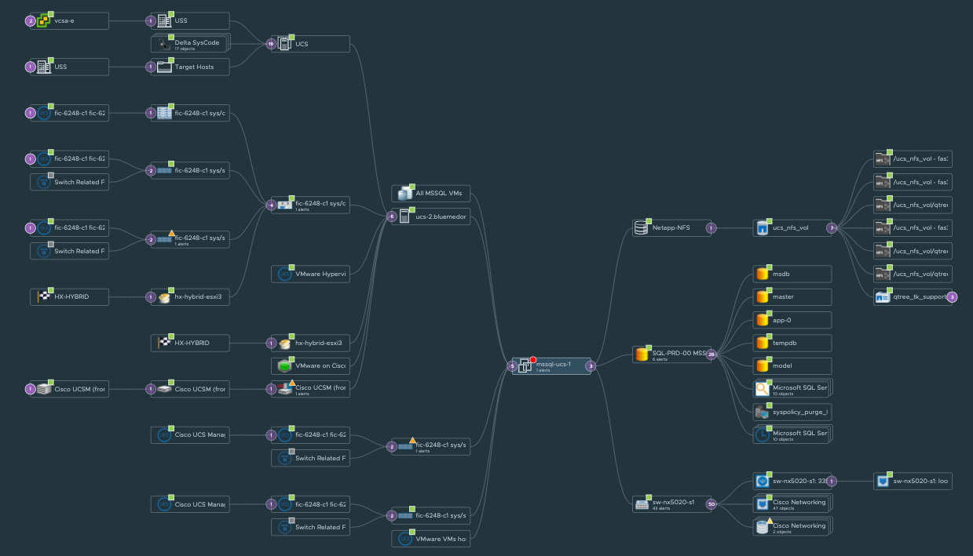


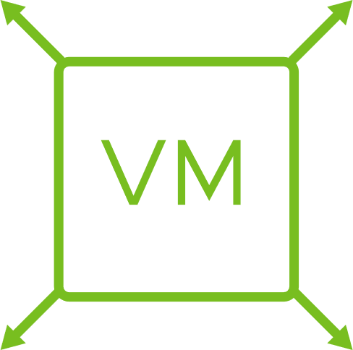

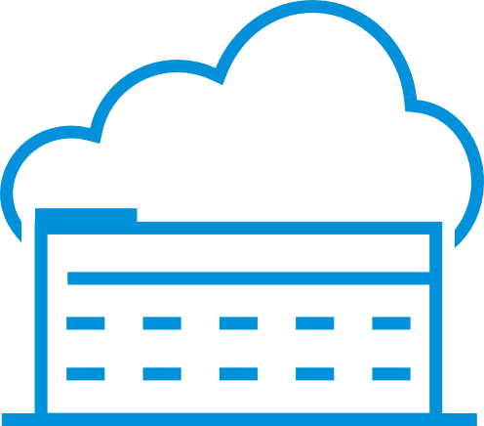
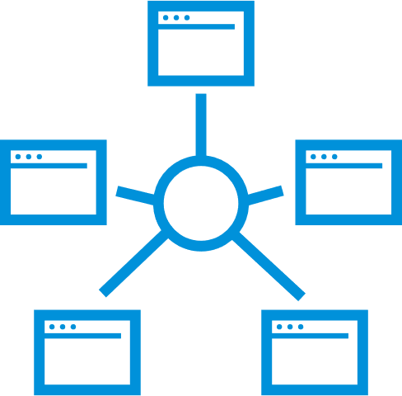
Extending Operations
Adding the vRealize True Visibility Suite
Aria Operations
Application-aware monitoring across SDDC and multiple clouds
Compute Chassis
Cloud planning, capacity optimization and compliance
Compute Blade
Storage Volume
Datastore
Automated and proactive workloads management
Compute Network
vRealize True Visibility Suite
ESXi Host
VM
Database Instance
Deeper root cause analysis
Database
Wider collaboration for hybrid cloud management
Database Queries
Network Switch
Full stack resource dependency mapping
Network Ports
Notes:
Now I want to show you specifically what these management packs bring to vRealize Operations. You can see in the green, the VM, host and datastore, which is what you get with vROps. Next, everything you see in blue is what you can add in. Again, I want to hit home, that you’re not just monitoring these technologies in the same tool, side by side. You’re seeing the layout of the datacenter, which makes it infinitely easier to correlate problems.

Slide 5

Management Pack Alignment
Entitled through Aria Operations ☺
HPE 3PAR StoreServ
IBM SVC & Storwize
NetApp E-Series
NetApp FAS/AFF
NetApp SolidFire
Pure Storage FlashArray
HPE Nimble
Cohesity
Dell EMC Isilon
Dell EMC PowerMax & VMAX
Dell EMC VNX
Dell EMC XtremIO
Dell EMC Unity
Cisco UCS
Dell EMC PowerEdge
Dell EMC OpenManage Ent
HPE ProLiant
HPE OneView
Lenovo Compute
Compute
Storage
TVS ADV
Arista EOS
Cisco Catalyst
Cisco MDS
Cisco Nexus
Citrix ADC
F5 BIG-IP
Palo Alto Networks
Networking Devices
Citrix Virtual Apps & Desktops
Docker
IBM PowerVC
IBM HMC
Microsoft Hyper-V
VMware Tanzu
Application Service
Nutanix
Microsoft SCOM
Nagios XI
Oracle Enterprise Manager
ServiceNow
SolarWinds NPM
Connectors
Network
Virtualization
& Container
TVS ENT (includes TVS ADV)
Apache Hadoop
Microsoft Azure SQL
Microsoft SQL Server
MongoDB
MySQL
Oracle Database
PostgreSQL
SAP HANA
Apache Tomcat
Microsoft IIS Server
Red Hat JBoss EAP
SAP
Database
Applications

