Slide 1
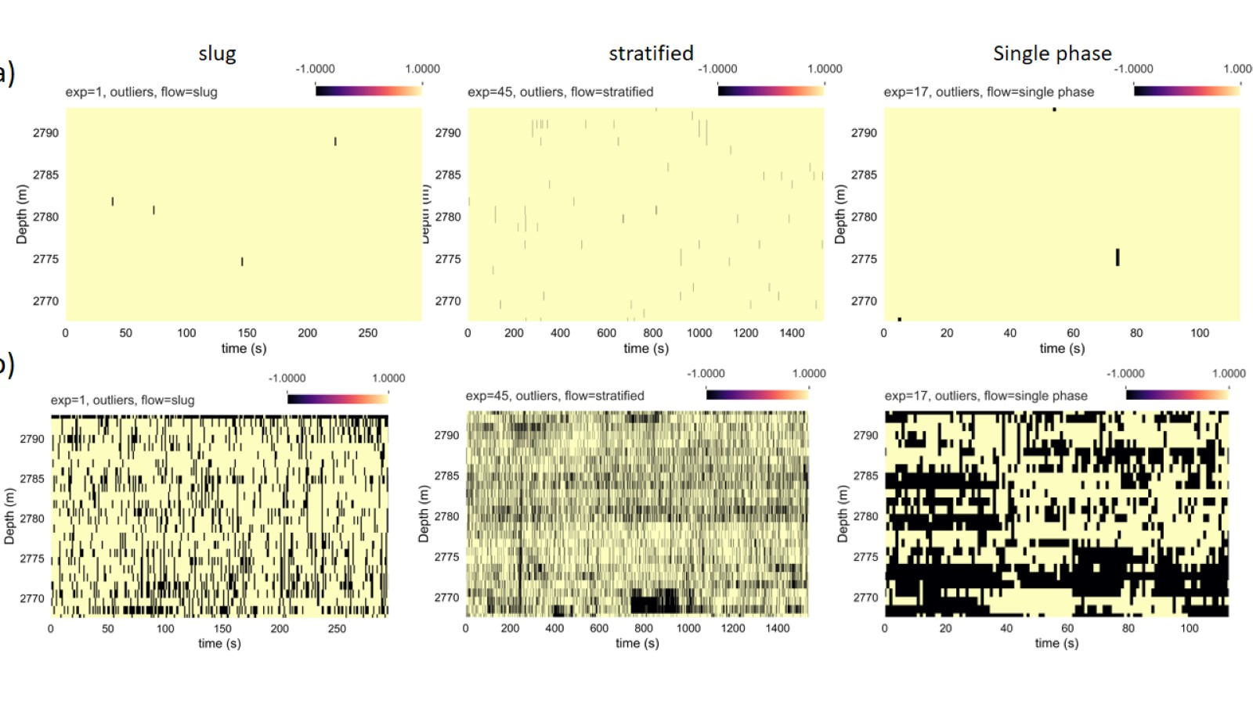

Slide 2
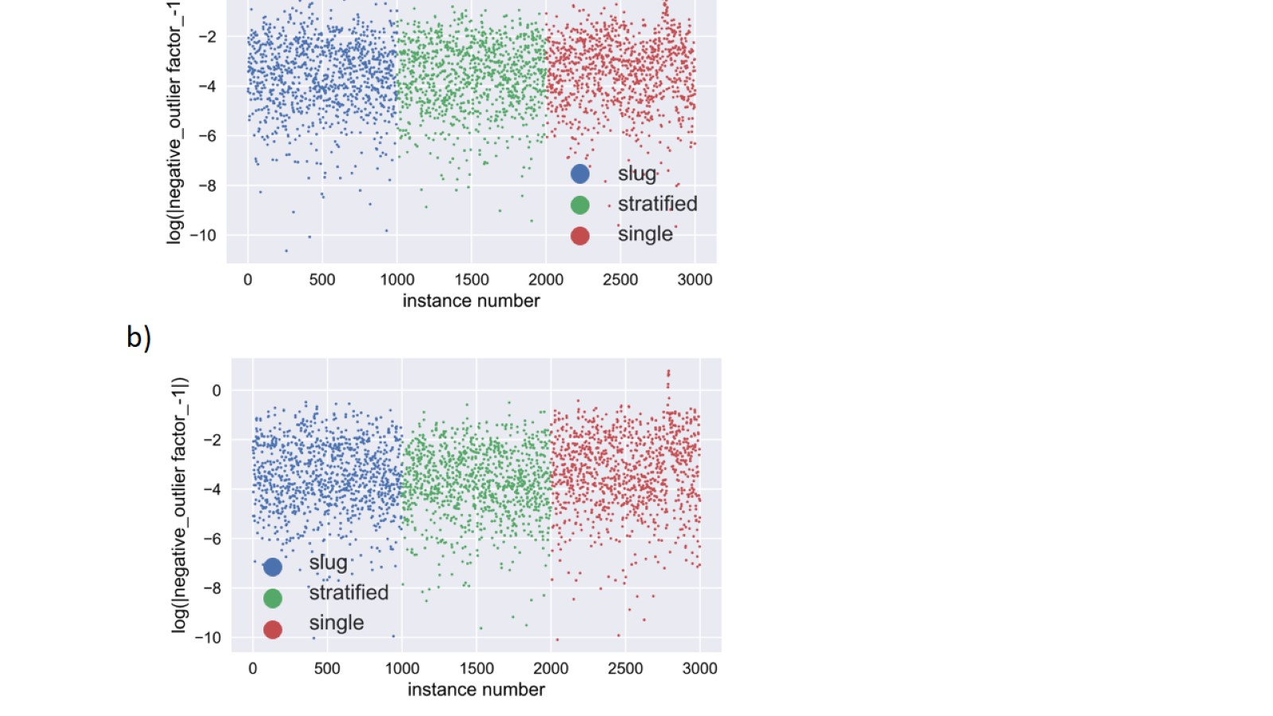

Slide 3
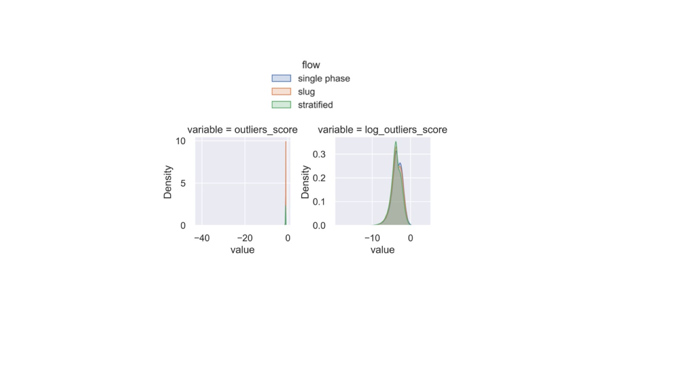

Slide 4
Inputs: 7dimensions
Dense layer with n_units
Dense layer 2 units
codings
Dense layer with n_units
reconstructions
outputs: 7dimensions

