Slide 1
Suggesting best venues for
stay in Toronto for Tourism
By
Navaneeth Krishna Vadapalli

Slide 2
Introduction
Tourism is a social, cultural and economic phenomenon which entails the movement of people to countries or places outside their usual environment for personal or business/professional purposes.
Tourism generates about Half a Billion Dollar revenue worldwide.
Problem Statement
Rate of exploitation by the local neighborhoods when a tourist comes to an unknown place.
Tourists end up staying in places where the venues are very fat apart causing a lot of inconvenience.

Slide 3
Data acquisition
Data Sources:
The source of the data is Wikipedia and the links are attached below:
https://en.wikipedia.org/wiki/List_of_postal_codes_of_Canada:_M
The link contains data about the neighborhoods in Toronto.
https://foursquare.com/
To get the venues around a location.
http://cocl.us/Geospatial_data
To get the co-ordinates of various neighborhoods of Toronto.

Slide 4
Data Cleaning
The final data was obtained by combining data from multiple sources into one.
The data from Wikipedia has to be scrapped cleaned and obtain the columns PostalCode, Borough, and Neighborhood.
Later these had to be integrated with the co-ordinates (Latitudes and Longitudes).
The processing involved working with the cells that have an assigned borough.
Ignore cells with a borough that is Not assigned.
More than one neighborhood can exist in one postal code area.
If a cell has a borough but a Not assigned neighborhood, then the neighborhood will be the same as the borough.

Slide 5
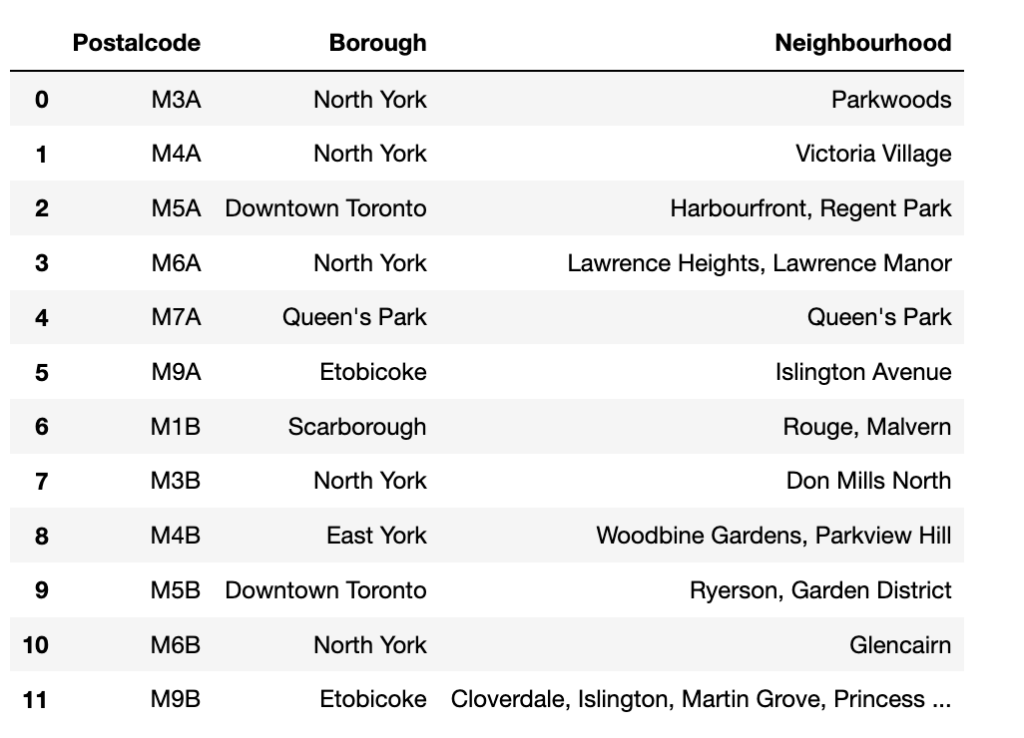
Exploratory Data Analysis
Part 1

Slide 6
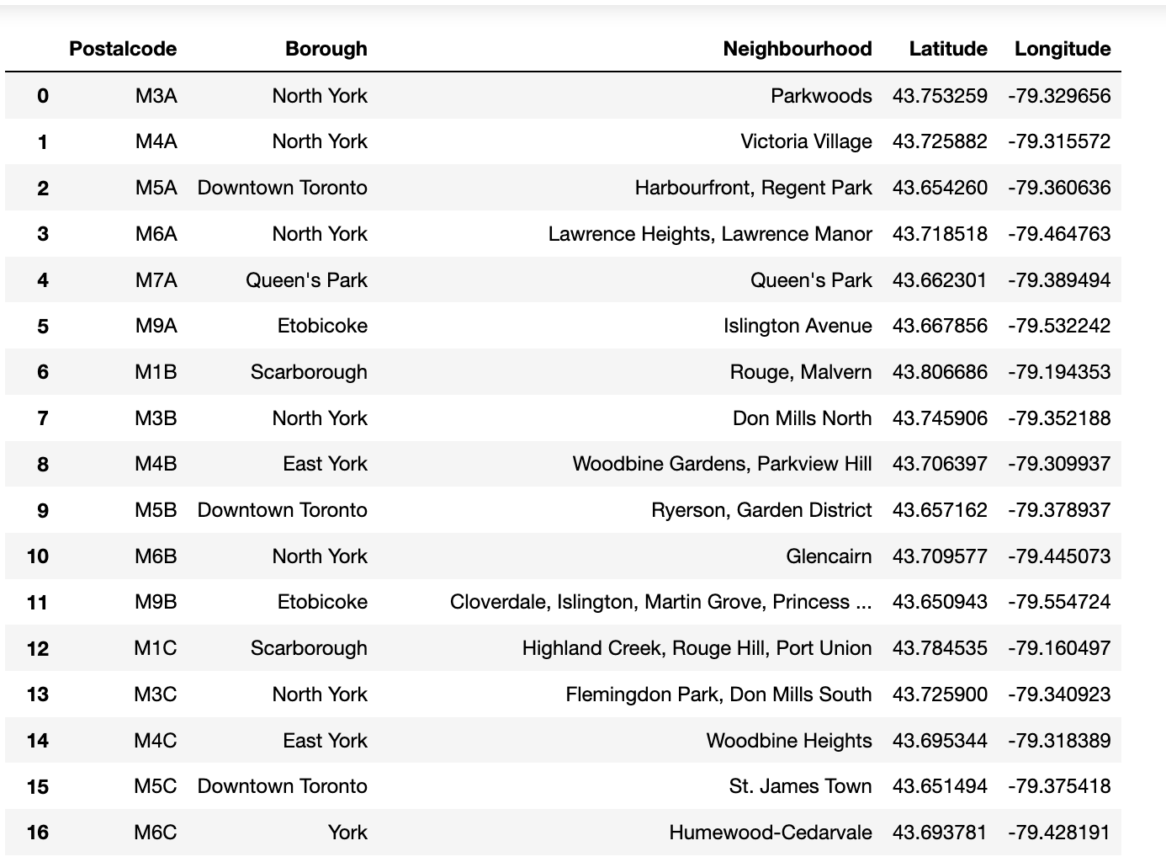
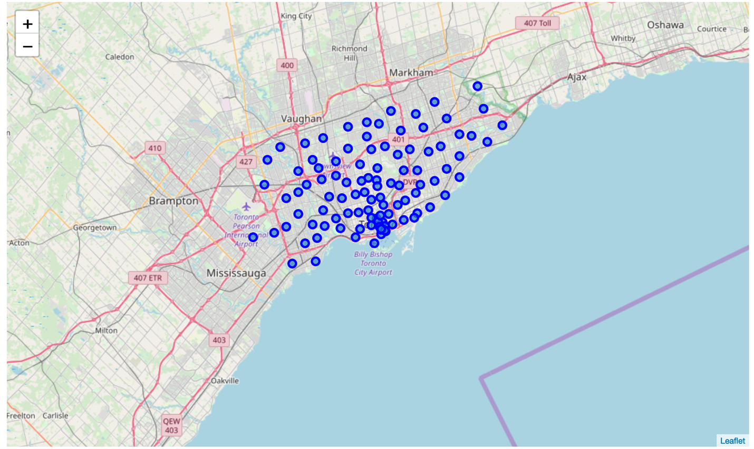
Part 2

Slide 7
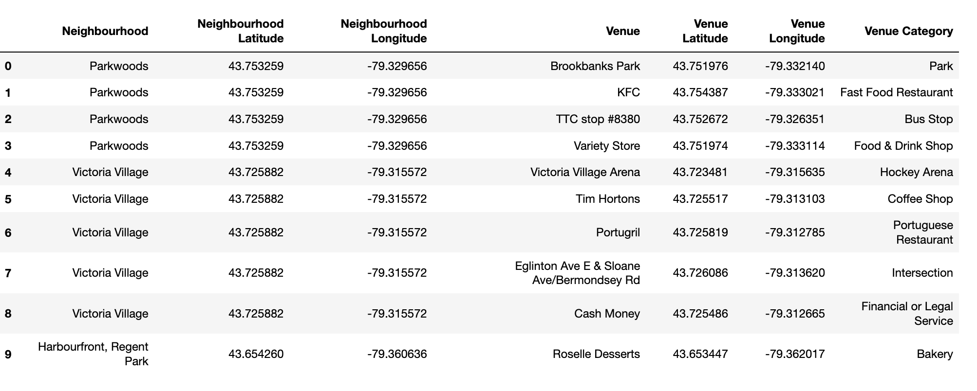
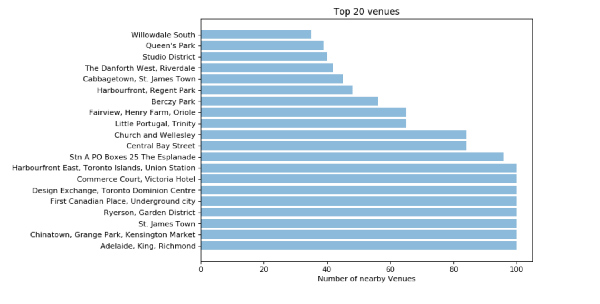
Part 3
Using Foursquare API to get nearby venues
Top 20 neighborhoods which have highest number of venues located within 500 meters of the location

Slide 8
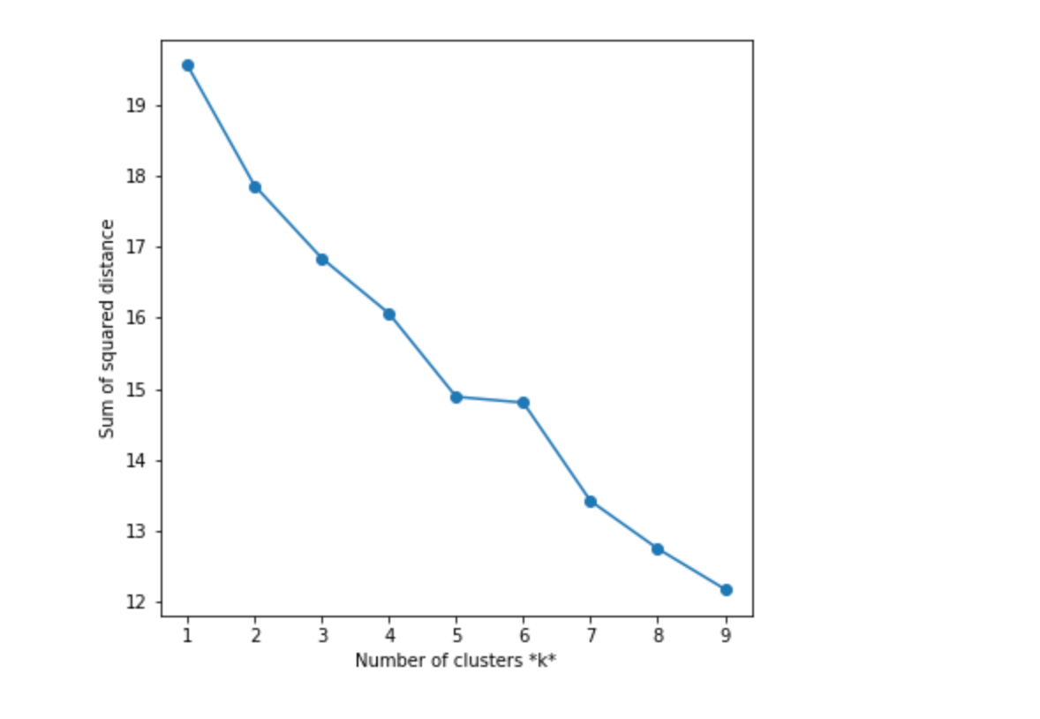
Results
Analyzing the sum of squared distances of the centroids of the cluster.
The optimal value of k = 5. The reason being the elbow joint occurring at k = 5.

Slide 9
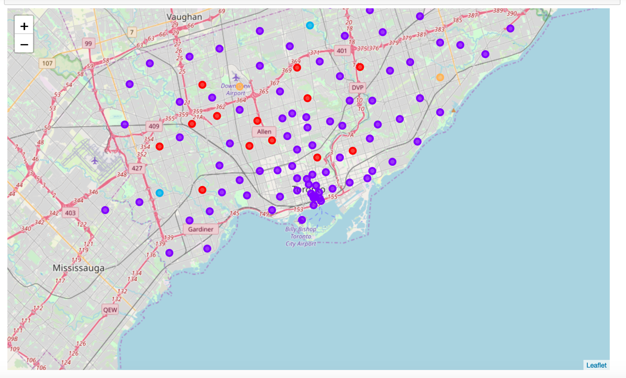
The Cluster 2 is very highly concentrated having 81 Burrows in the group.
This implies that the 81 neighborhoods in that area have very high similarity and is the best cluster to live in.
The reasons being high availability of the venues around the neighborhood and having a variety of options to explore.
The Cluster 1 stands second as there are 13 Burrows in the group.

Slide 10
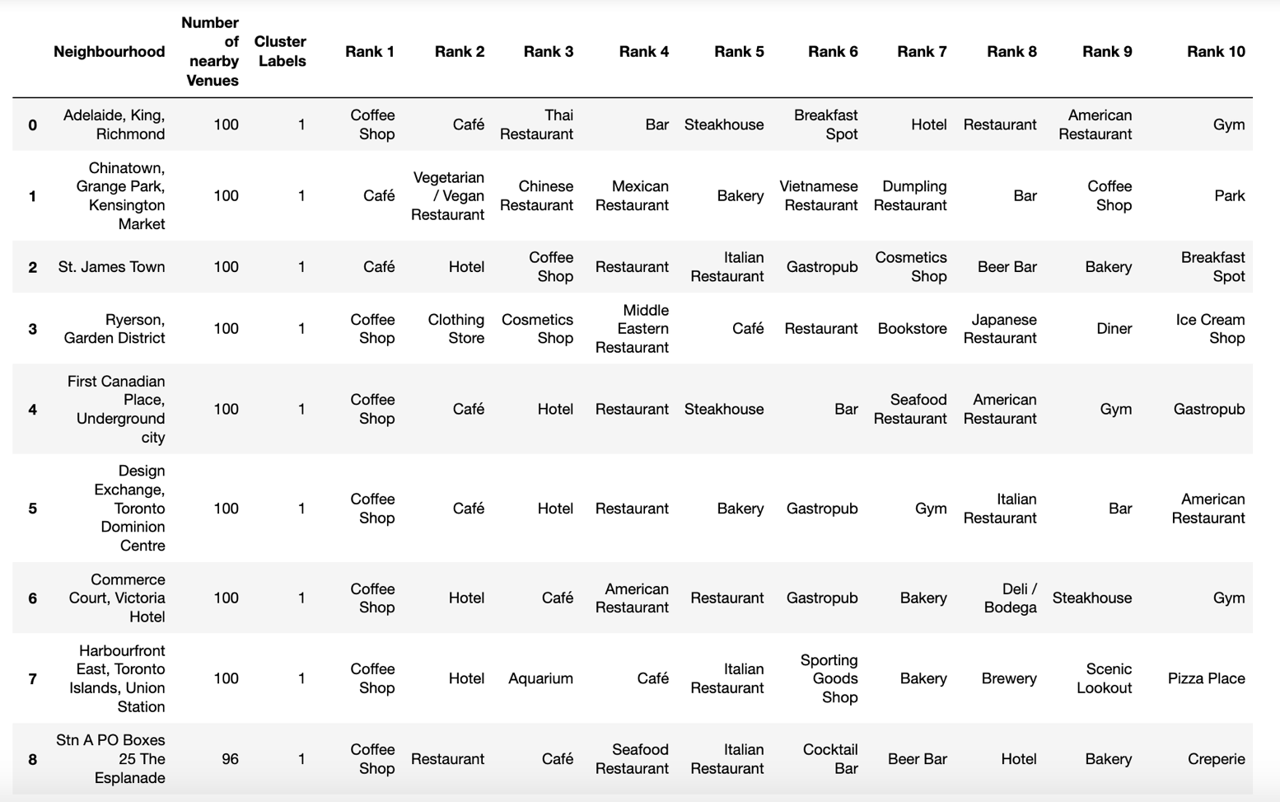
Discussion

Slide 11
Conclusion
Based on the use case of Suggesting best venues for stay in Toronto for Tourism:
The best neighbourhood could be any one from the top 8 entries. But based on the variety and of-course the case provided, the best Neighborhood would be 'Harbourfront East, Toronto Islands, Union Station’.
The data in the scope of the project cannot be decisively state or claim the best neighborhood as the factors such as reviews, number of visits made by people, costs, menu, sanitation and other vital factors are not taken into consideration.
For future scenarios if these factors are tapped into and a model is prescribed on it, then the analysis would be more rigid and accurate.

