Slide 1

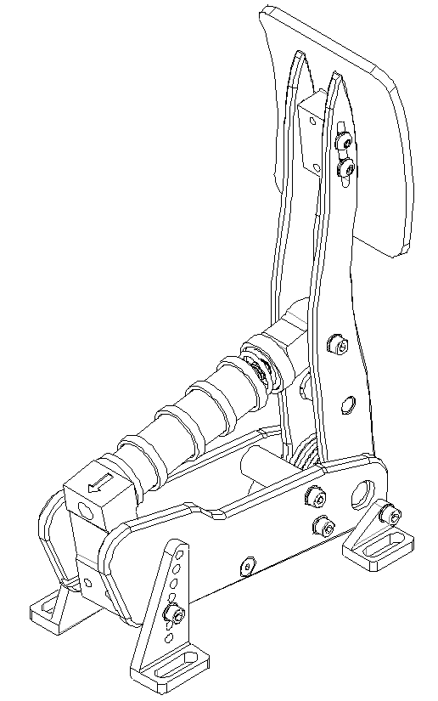
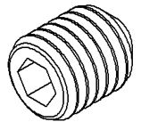
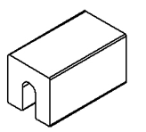
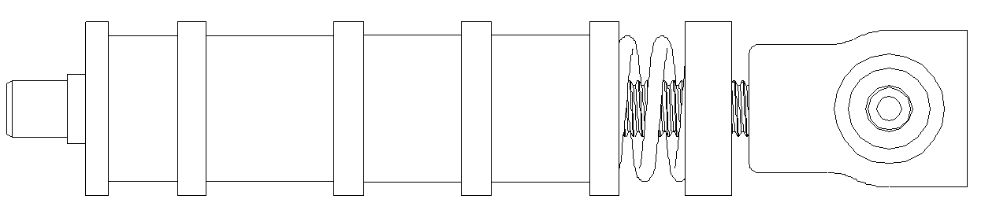
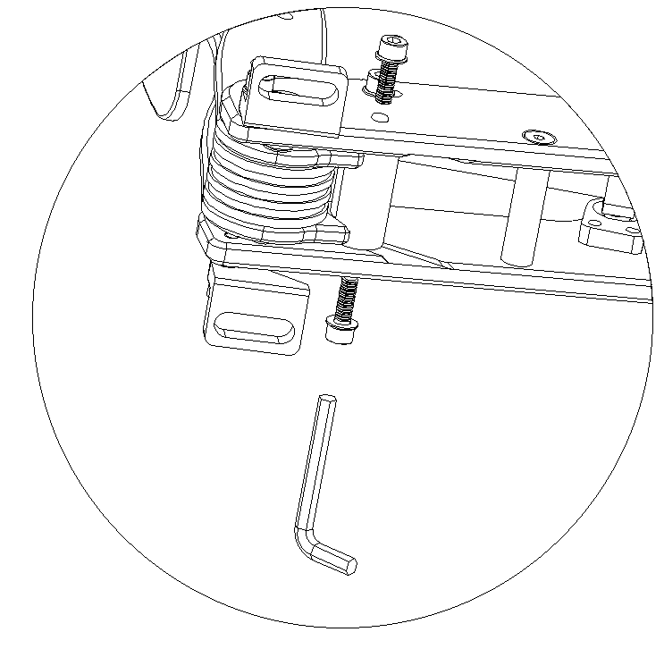
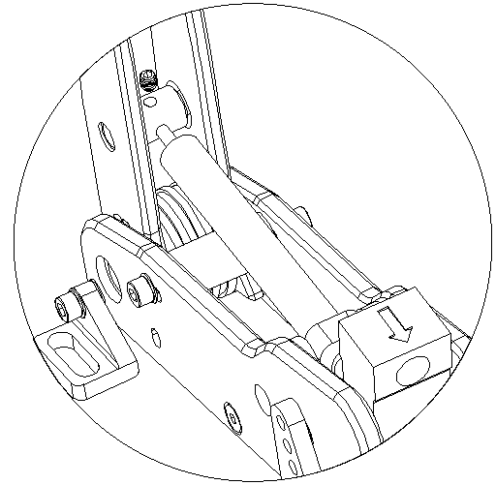
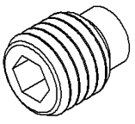

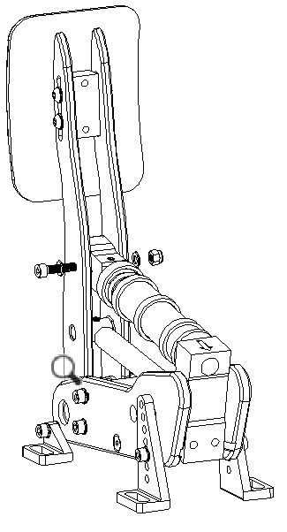
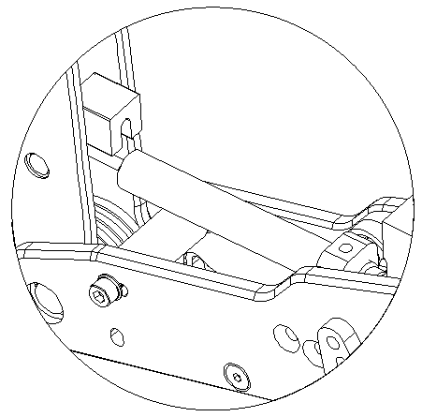
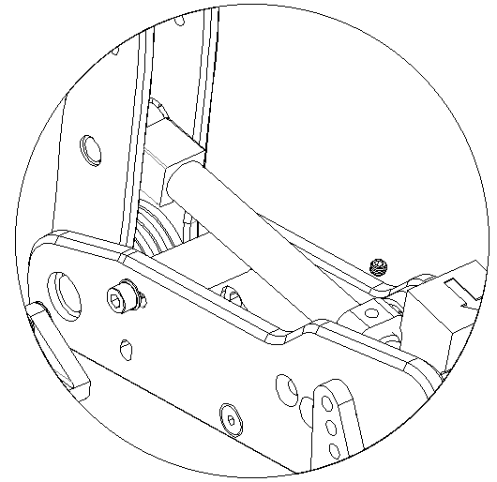
Content
Step 1: Remove the elastomer stack
Step 2: Remove the bumpstop
Step 3: Install the damper
Damper
Remove the 2 hex bolts on the sides, push the pedal arm backwards and slide the blue bumpstop downwards
Insert the piston shaft into the hole and tighten with the grub screw
Twist the damper into the large threaded hole
3D printed spacer
M5x4 plastic-headed grub screw
M5x6 flat-headed grub screw
Step 4: Adjust the damper
Step 5: Tighten the damper and remove the spacer
Step 6: Re-install the bumpstop.
Step 7: Re-install the elastomer stack
Step 5.2: Tighten the whole damper until it touches the spacer
Step 6.1: Fix the damper in place by screwing in the plastic- headed grub screw
Reinstall the stack and adjust the preload to your liking.
Step 5.1: Insert the 3D printed spacer.
Step 6.2: Remove the spacer.

