Slide 1

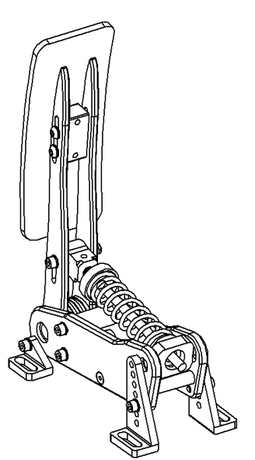

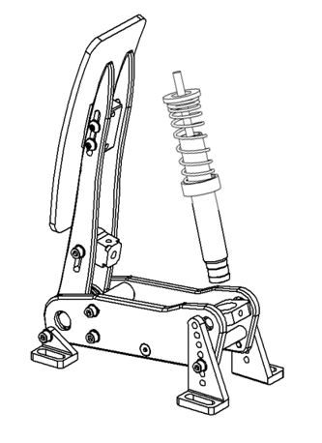
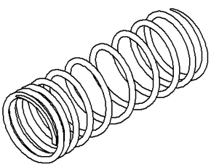
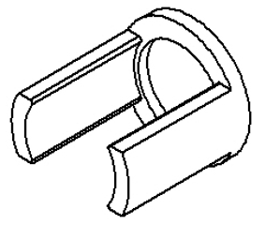

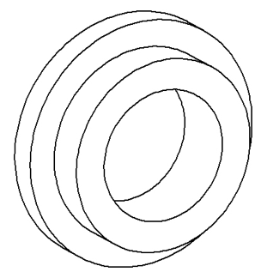
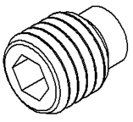
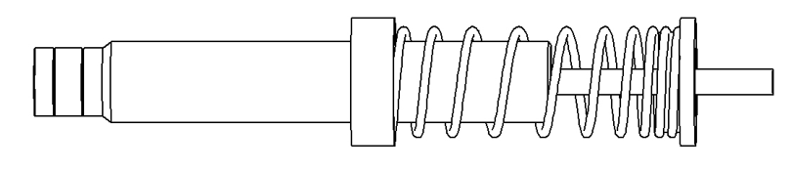
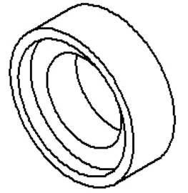
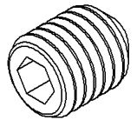
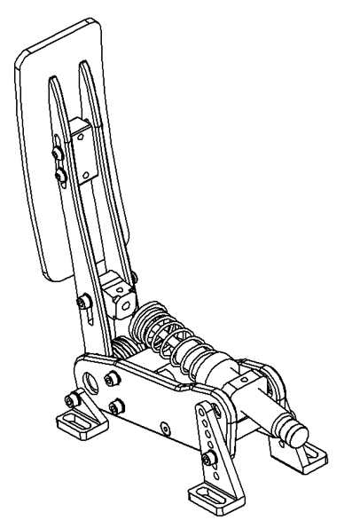
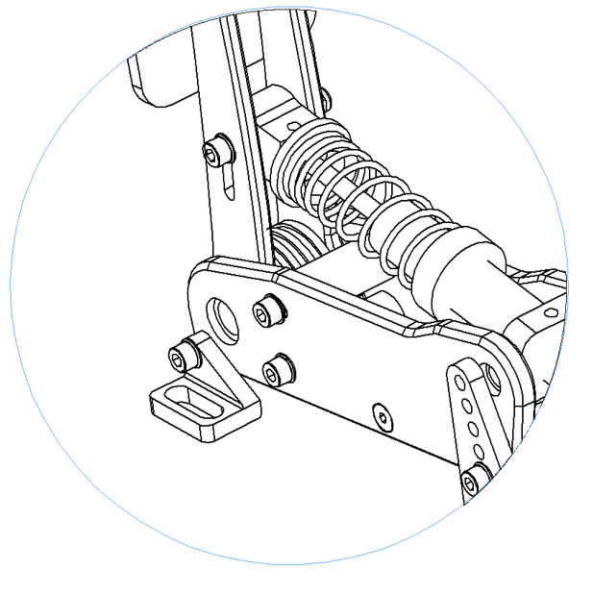
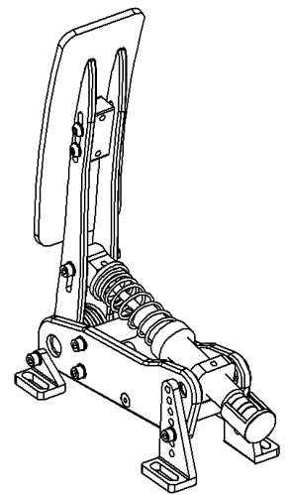
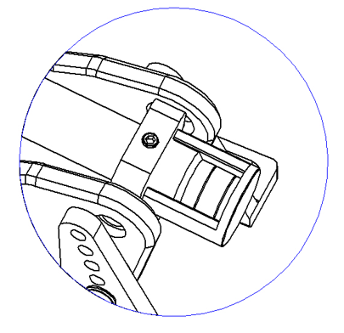
Content
Step 1: Remove the spring
Step 2: Replace the spring assembly with the damper cylinder
Step 3: Install the damper
Damper
Step 1.3: Remove the spring assembly from the throttle unit
Twist the damper into the large threaded hole
Damper Springs
3D printed spacer
Step 1.2: Loosen the spring preload
Install the included spring to the damper to replace the basic spring assembly.
Pads Springs
M5x4 plastic-headed grub screw
Rotate the damper bracket so that it faces upwards
Adjust Springs
M5x4 flat-headed grub screw
Step 1.1: Remove the grub screw
Step 4: Fix the damper rod’s end to the pedal arm
Step 5: Adjust the damper
Insert the damper rod’s end into the hole and tighten with the grub screw
Push the 3D printed adjuster into the cylinder and twist until it touches the damper bracket. Tighten using the grub screw and remove the adjuster.

