Slide 1

The Golden Rats

Slide 2
Time table
Our Team
Our Idea
Technologies used

Slide 3
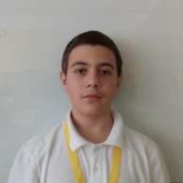
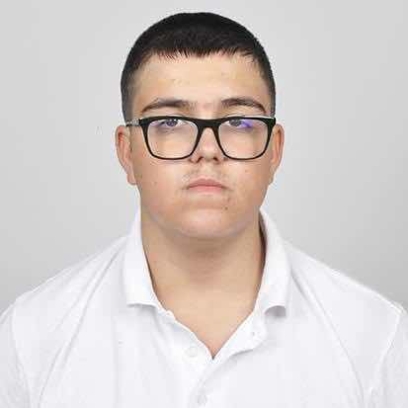
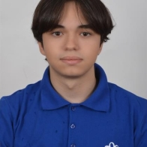
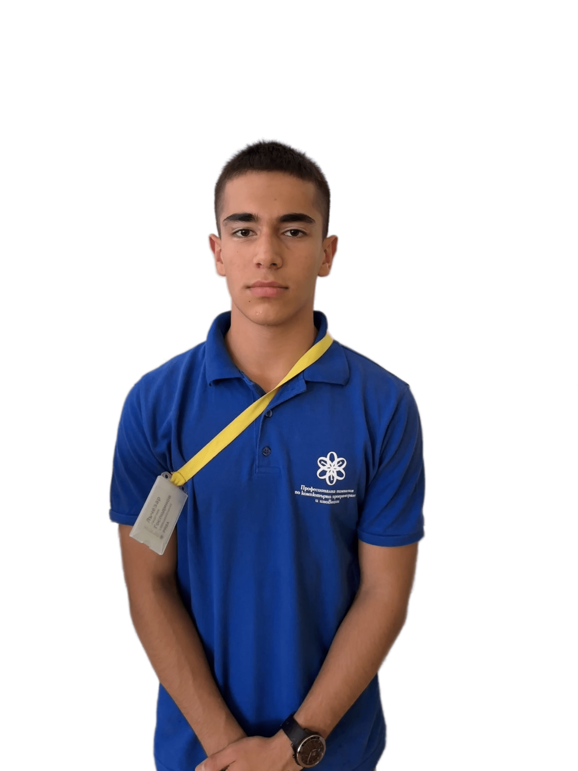
Our Team
Велизар Николаев Михайлов
9 "а" клас
Scrum trainer
Виктор Борисов
Кънев
9 "а" клас
Front-end developer
Михаил Атанасов Николов
9 "а" клас
Front-end developer
Георги Николаев Субашев
9 "а" клас
Designer

Slide 4
Our Idea
Our Idea was to create an eco-friendly store where the customer can purchase things that will benefit towards a greener world

Slide 5






Technologies used

Slide 6
Lets continue with the site

