Slide 1


Thêm dấu cho tiếng Việt ứng dụng cho báo cáo y tế
Project:
VNOpenAI.org

Slide 2
Table of Contents
01
02
03
Overall
Dataset and Models
Results

Slide 3

01
Overall

Slide 4

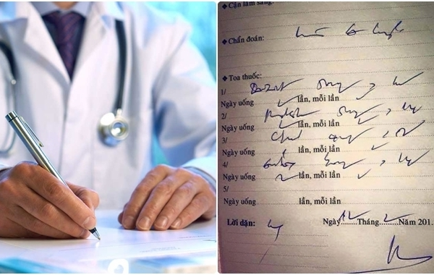
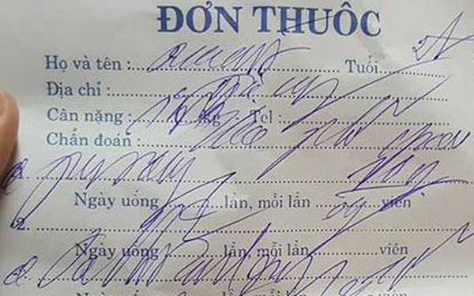


Problem

Slide 5
Solution
Tự động thêm dấu cho báo cáo y tế
Viêm phổi cấp
Viem phoi cap

Slide 6
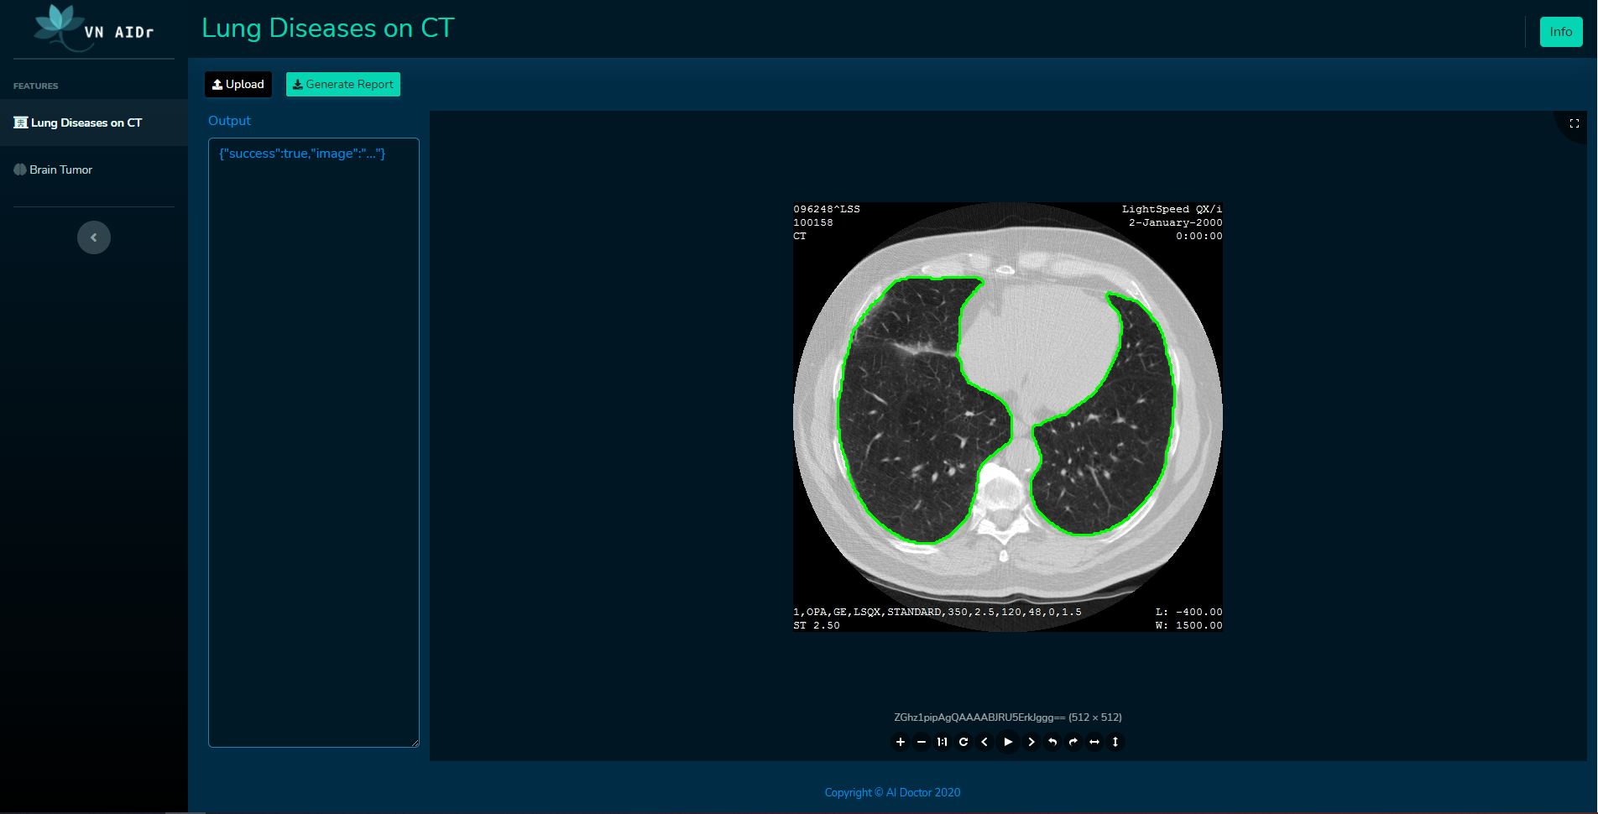
Ecosystem
VAD Learning:
Learning resources for medical image processing and NLP
VAD Vision:
Medical image processing models and algorithms
VAD NLP:
Medical report autocomplete
VAD Platform:
Open source code base for medical image processing projects

Slide 7
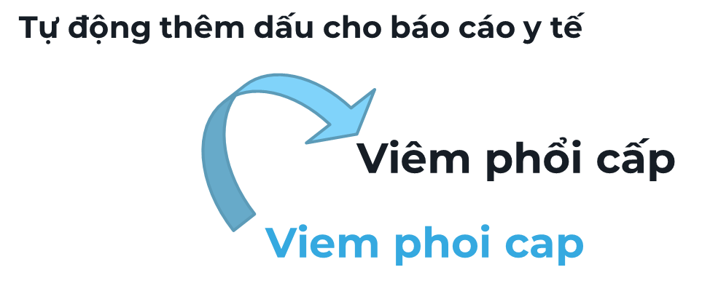
What will be done in NLP course?
VAD NLP
1
VAD Platform
2
Web UI Deployment

Slide 8

02
Dataset and Models
Models and Datasets for NLP task

Slide 9
1
Dataset
Wiki
Raw text
4315334 sentences
Wiki extractor
Preprocess
19.5k posts
from yhocvn.net
1.4k posts
from benhvien108.vn
Raw text
455549 sentences
Crawler
Preprocess

Slide 10
1
Dataset
Train
4750883 sentences
Data
Shuffled
Data
Validation
10000 sentences
Shuffle
Test
10000 sentences

Slide 11
1
Dataset
Tiền xử lý
Bỏ số, các dấu chấm câu và đưa về chữ thường.
Bỏ các câu có dưới 10 từ và lớn hơn 200 từ.
Chuẩn hoá vị trí bỏ dấu câu.
Tạo dữ liệu không dấu bằng cách loại bỏ dấu câu.

Slide 12
2
Models and pipeline
Word-level model
Character-level model
tri
trí
t
t
r
model
r
tue
model
tuệ
Text prediction models
i
í
nhan
nhân
␣
␣
tao
tạo
. . .
. . .
o
o
t
null
tri
/
r
model
null
tue
model
^.
Tone prediction models
i
/
nhan
^
␣
null
tao
.
. . .
. . .
o
null

Slide 13
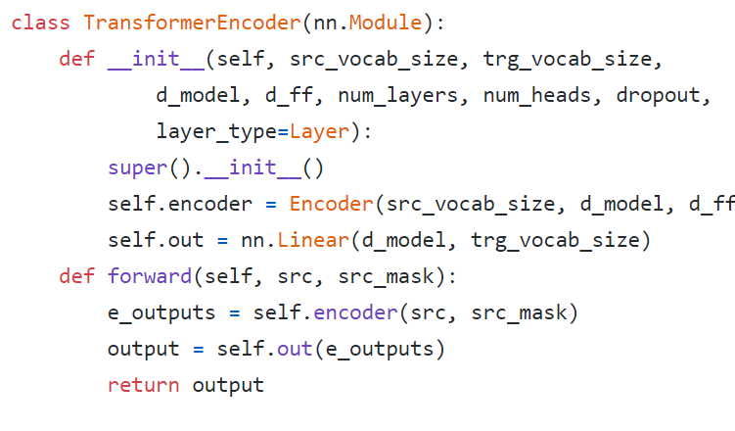
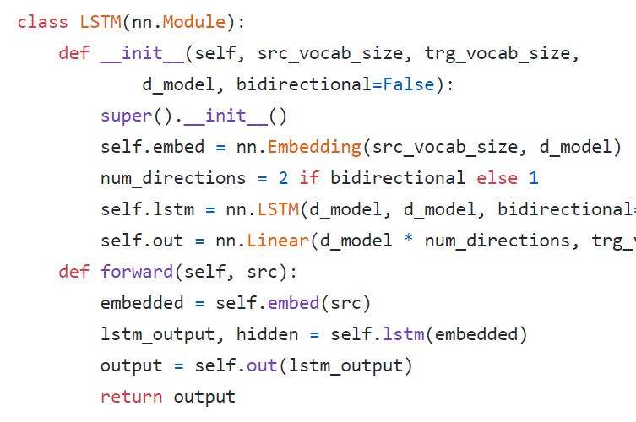
2
Models and pipeline
Transformer model
LSTM Model

Slide 14









2
Models and pipeline
LSTM Model
Output words
Linear
$$y_{0}$$
$$y_{1}$$
$$y_{2}$$
$$y_{i}$$
$$…$$
LSTM
$$x_{0}$$
$$x_{1}$$
$$x_{2}$$
$$x_{i}$$
Embedding
Input words

Slide 15








2
Models and pipeline
BiLSTM Model
Output words
Linear
$$y_{0}$$
$$y_{1}$$
$$y_{2}$$
$$y_{i}$$
$$…$$
BiLSTM
$$…$$
$$x_{0}$$
$$x_{1}$$
$$x_{2}$$
$$x_{i}$$
Embedding
Input words

Slide 16
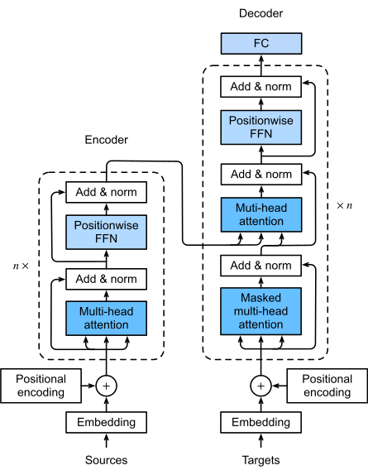
2
Models and pipeline
Transformer Model
Transformer model
Hình ảnh từ cuốn Dive into Deep learning
https://d2l.ai/chapter_attention-mechanisms/transformer.html

Slide 17
2
Models and pipeline
Transformer Model
Output words
Linear
Transformer Encoder
Embedding
Input words
Transformer Encoder + Linear in our project

Slide 18
2
Models and pipeline
Evolved Transformer Model
Output words
Linear
Evolved Transformer Encoder
Embedding
Input words
Transformer Encoder + Linear in our project

Slide 19
03
Results

Slide 20
Thank You
Do you have any questions?
Please keep this slide for attribution

