Slide 1


Thêm dấu cho tiếng Việt ứng dụng cho báo cáo y tế
Project:
VNOpenAI.org

Slide 2
Table of Contents
01
02
03
Overall
Dataset and Models
Plan

Slide 3

01
Overall

Slide 4

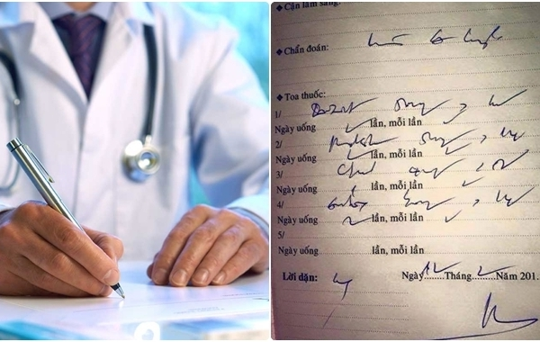
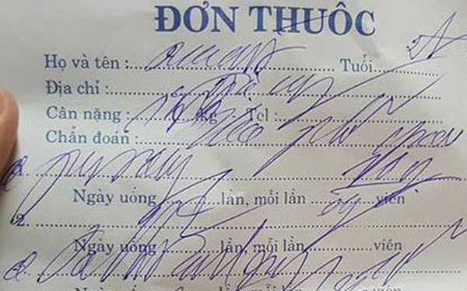

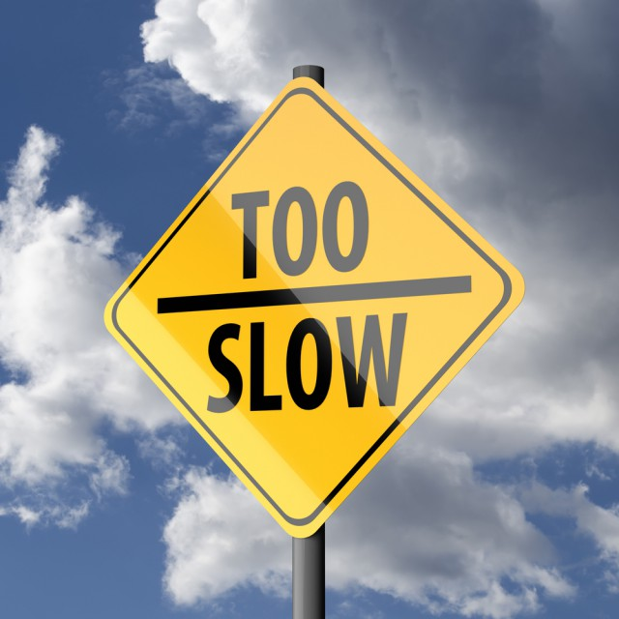
Problem

Slide 5
Solution
Tự động thêm dấu cho báo cáo y tế
Viêm phổi cấp
Viem phoi cap

Slide 6
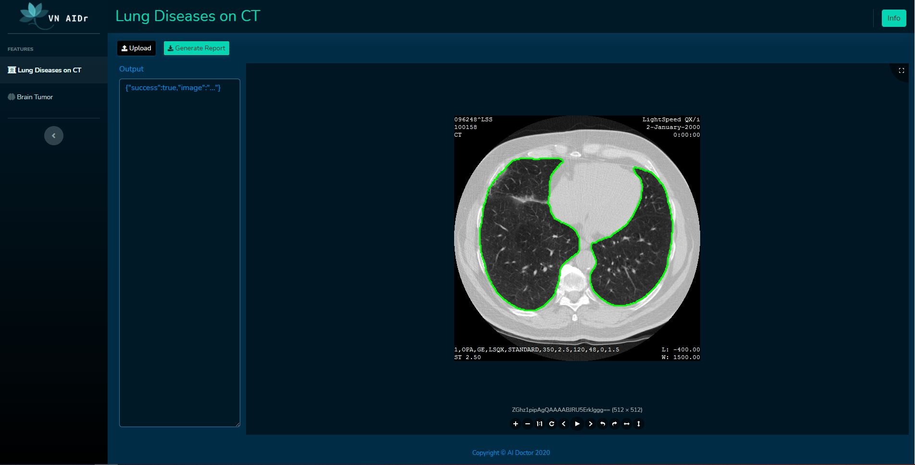
Ecosystem
VAD Learning:
Learning resources for medical image processing and NLP
VAD Vision:
Medical image processing models and algorithms
VAD NLP:
Medical report autocomplete
VAD Platform:
Open source code base for medical image processing projects

Slide 7
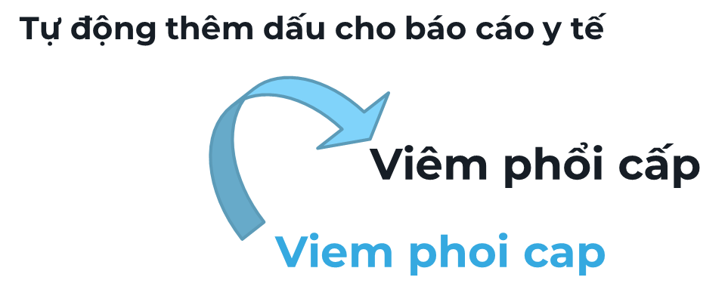
What will be done in NLP course?
VAD NLP
1
VAD Platform
2
Web UI Deployment

Slide 8

02
Dataset and Models
Models and Datasets for NLP task

Slide 9
1
Dataset
Wiki
Raw text
4118950 sentences
Wiki extractor
Preprocess
19.5k posts
from yhocvn.net
1.4k posts
from benhvien108.vn
Raw text
448744 sentences
Crawler
Preprocess

Slide 10
1
Dataset
Train
3699831 sentences
Data
Shuffled
Data
Validation
411093 sentences
Shuffle
Test
456770 sentences

Slide 11
1
Dataset
Tiền xử lý
Bỏ số, các dấu chấm câu và đưa về chữ thường.
Bỏ các câu có dưới 10 từ và lớn hơn 200 từ.
Tạo dữ liệu không dấu bằng cách loại bỏ dấu câu.

Slide 12
2
Models and pipeline
Word-level model
Character-level model
tri
trí
t
t
r
model
r
tue
model
tuệ
Text prediction models
i
í
nhan
nhân
␣
␣
tao
tạo
. . .
. . .
o
o
t
null
tri
/
r
model
null
tue
model
^.
Tone prediction models
i
/
nhan
^
␣
null
tao
.
. . .
. . .
o
null

Slide 13
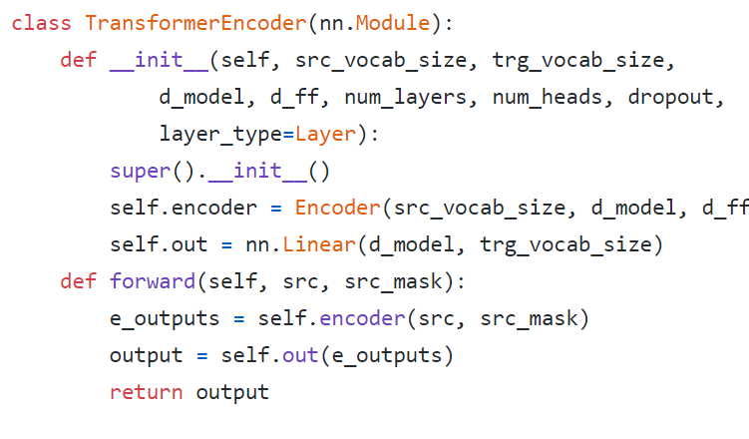
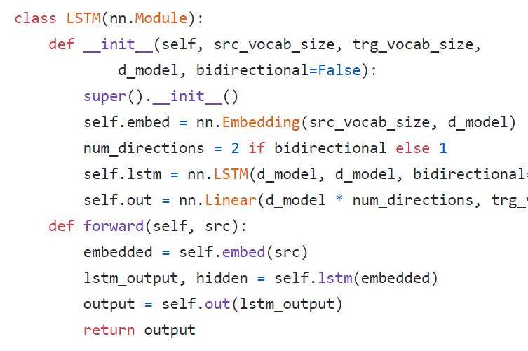
2
Models and pipeline
Transformer model
LSTM Model

Slide 14
03
Plan
Project plan and work assignment

Slide 15
*
Plan and work assignment
Stage 1: 24/12 – 30/12/2020
Define problems and datasets.
Stage 2: 01/01/2021 – 20/01/2021
Implement and training models.
Stage 3: 21/01/2021 – 25/01/2021
WebUI
Refine and deploy models, write report.

Slide 16
Thank You
Do you have any questions?
Please keep this slide for attribution

