Slide 1





Slide 2
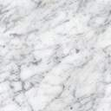
Team
Title
Machine Vision Based Adaptive control of Robotic from obstacles
Team
T. Rahul kumar, Under Graduate, Mechanical Engineering
B. Manisha Reddy, Graduate, Mechanical Engineering
K. Ramesh, Research scholar, Mechanical engineering (Automation)

Slide 3
Content
Objectives
Literature review
Introduction
Methodology
Data collection / Data Analysis
Results
Conclusion

Slide 4
Objectives
To develop a machine vision based model to avoid the obstacles for robot while cleaning the floor.
Proof of concept of the above mentioned system with the use of a developed model.
Step 1: Data collection, preprocessing of images
Step 2: Development of algorithm (YOLO)
Step 3: Training and Testing of the model

Slide 5
Literature Review
After doing a literature review on object detection, we came to the following conclusions:
Researchers have worked on the use of machine vision for object recognition,
Machine vision was used by a few researchers to enhance the perfection of robots in visualization,
Various vision based techniques of precise measurement were also been reported,
Various machine learning techniques were investigated by researchers to train the vision based object recognition.

Slide 6
Introduction
YOLO v5 is a single-stage object detector, it has three important parts like any other single-stage object detector.
1. Model Backbone
2. Model Neck
3. Model Head
Model Backbone is mainly used to extract important features from the given input image. In YOLO v5 the CSP (Cross Stage Partial Networks) are used as a backbone to extract rich in informative features from an input image. CSPNet has shown significant improvement in processing time with deeper networks.
Model Neck is mainly used to generate feature pyramids. Feature pyramids help models to generalized well on object scaling. It helps to identify the same object with different sizes and scales. Feature pyramids are very useful and help models to perform well on unseen data. In YOLO v5 PANet is used as neck to get feature pyramids.
The model Head is mainly used to perform the final detection part. It applied anchor boxes on features and generates final output vectors with class probabilities, objectness scores, and bounding boxes.

Slide 7
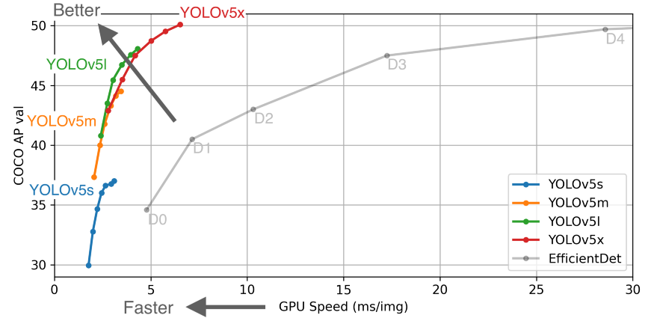
Introduction
YOLOv5 is the latest object detection model developed by ultralytics. YOLOv5 is available in four models, namely s, m, l, and x, each one of them offering different detection accuracy and performance as shown below.
Version wise performance of YOLO

Slide 8
Methodology
Data collection
Pre-processing of images
Development of algorithm
Training the algorithm
Deployment of model
Performance testing of model on new data
Bad
Good

Slide 9
Methodology
Parameter used in YOLOv5:
1. Activation Function:
YOLO v5 authors decided to go with the Leaky ReLU and Sigmoid activation function.
In YOLO v5 the Leaky ReLU activation function is used in middle/hidden layers and the sigmoid activation function is used in the final detection layer.
2. Optimization Function:
For optimization function in YOLO v5, we have two options
1. SGD
2. Adam
In YOLO v5, the default optimization function for training is SGD.
However, you can change it to Adam by using the “ --adam” command-line argument.
3. Cost Function or Loss Function:
In the YOLO family, there is a compound loss is calculated based on objectness score, class probability score, and bounding box regression score.
Ultralytics have used Binary Cross-Entropy with Logits Loss function from PyTorch for loss calculation of class probability and object score.
4. Yolov5s Model Summary: 191 layers, 7.46816e+06 parameters, 7.46816e+06 gradients

Slide 10
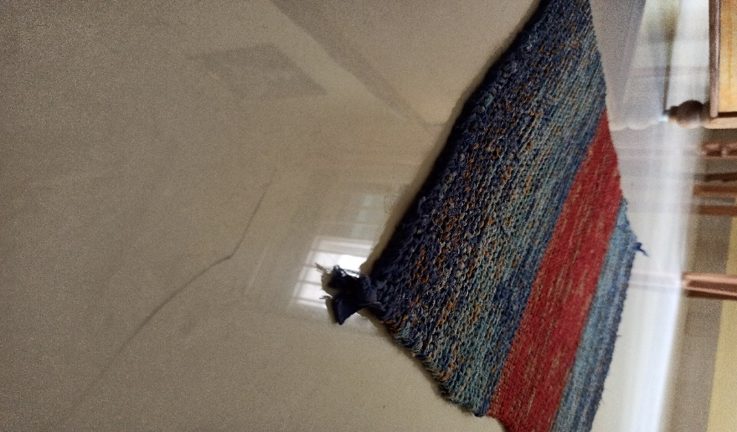
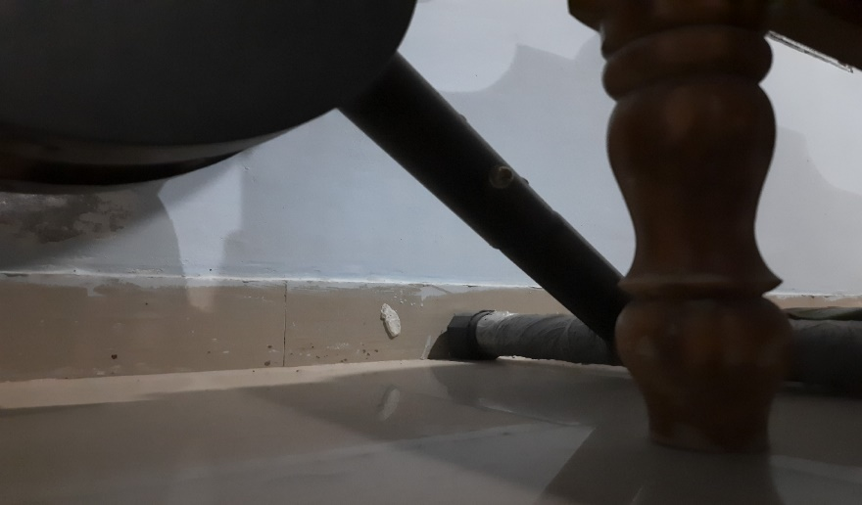
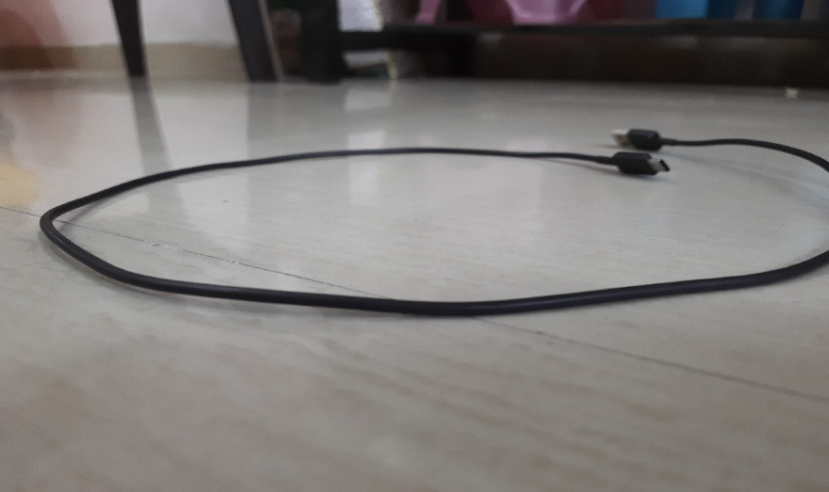
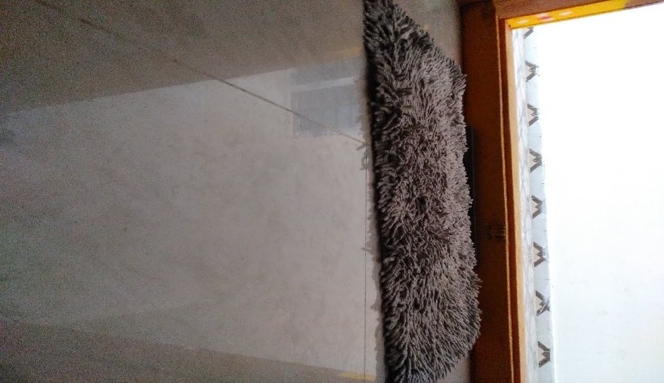
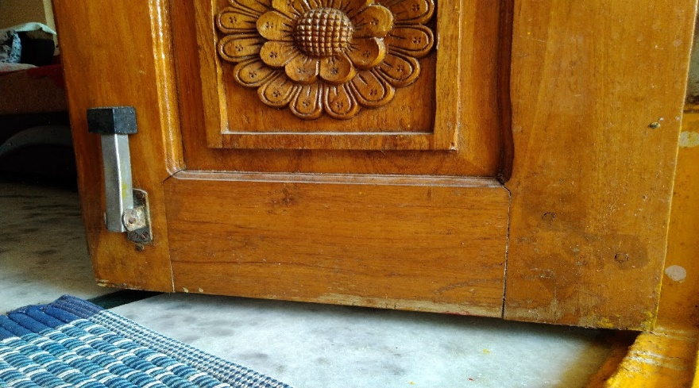
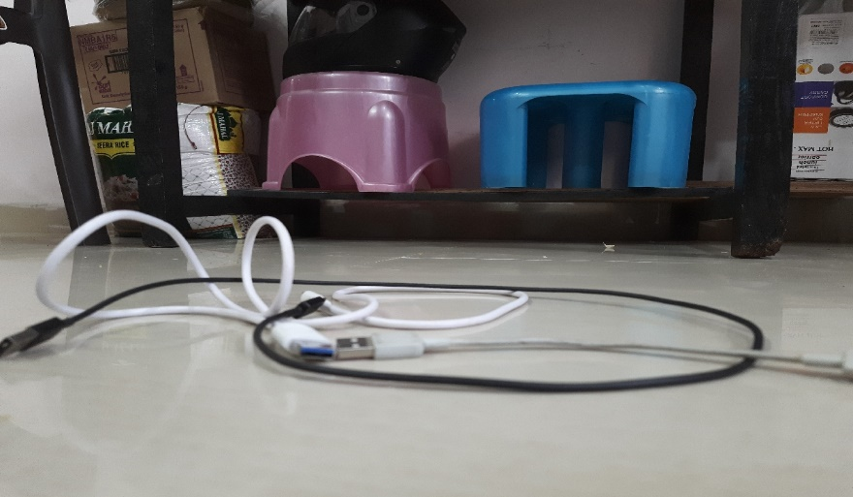
Data Collection / Data Analysis
We have collected the dataset as per the requirements (size: 1200X720, placement of camera: 10cm above from the ground). Some sample images of the collected dataset are shown in below figures:
(a) Furniture & Doors
(b) Garments
(c) Cables

Slide 11
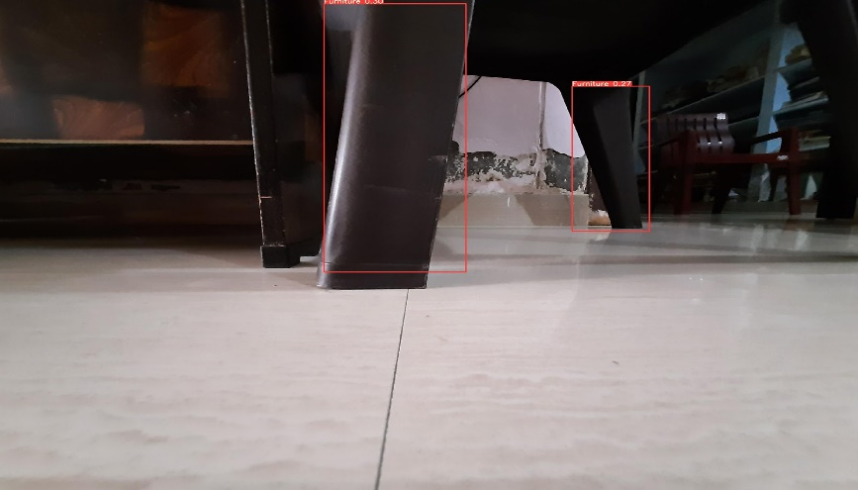
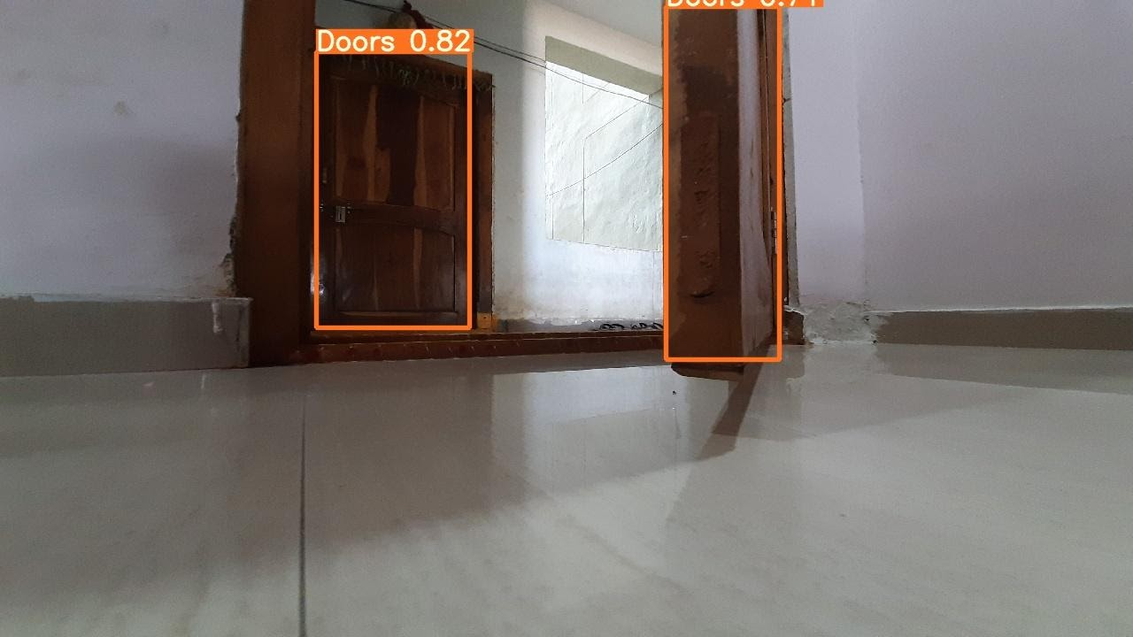
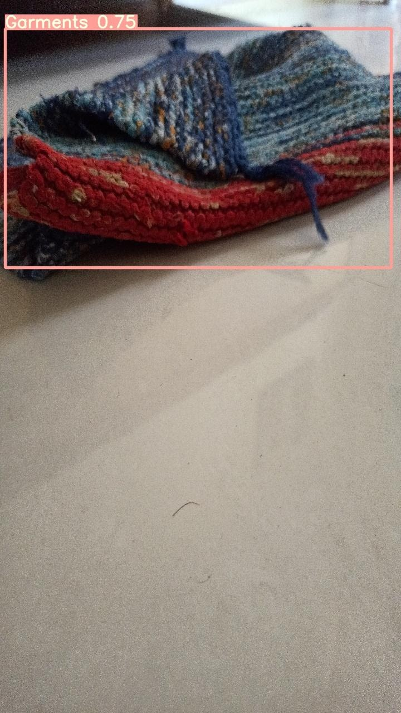
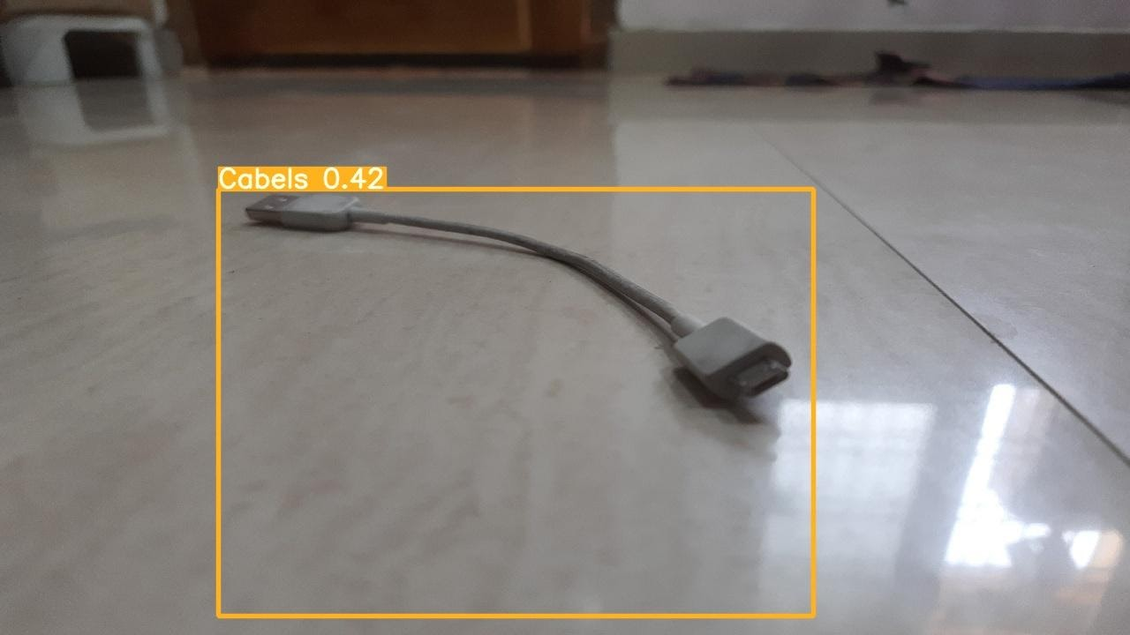
Results
We have achieved the following results from the trained model.
Furniture
Doors
Garments
Cables

Slide 12
Conclusion
Have achieved a better results with yolov5, our model is predicting the objects (Furniture, Doors, Cables and Garments) with a better accuracy.

Slide 13
References
Redmon, Joseph, Santosh Divvala, Ross Girshick, and Ali Farhadi. "You only look once: Unified, real-time object detection." In Proceedings of the IEEE conference on computer vision and pattern recognition, pp. 779-788. 2016.
Kuznetsova, Anna, Tatiana Maleva, and Vladimir Soloviev. "Detecting Apples in Orchards Using YOLOv3 and YOLOv5 in General and Close-Up Images." In International Symposium on Neural Networks, pp. 233-243. Springer, Cham, 2020.
Laroca, Rayson, Evair Severo, Luiz A. Zanlorensi, Luiz S. Oliveira, Gabriel Resende Gonçalves, William Robson Schwartz, and David Menotti. "A robust real-time automatic license plate recognition based on the YOLO detector." In 2018 International Joint Conference on Neural Networks (IJCNN), pp. 1-10. IEEE, 2018.
Chen, Yuwen, Chao Zhang, Tengfei Qiao, Jianlin Xiong, and Bin Liu. "Ship detection in optical sensing images based on YOLOv5." In Twelfth International Conference on Graphics and Image Processing (ICGIP 2020), vol. 11720, p. 117200E. International Society for Optics and Photonics, 2021.
Wang, Xiaolong, Abhinav Shrivastava, and Abhinav Gupta. "A-fast-rcnn: Hard positive generation via adversary for object detection." In Proceedings of the IEEE conference on computer vision and pattern recognition, pp. 2606-2615. 2017.
Yu, Yang, Kailiang Zhang, Li Yang, and Dongxing Zhang. "Fruit detection for strawberry harvesting robot in non-structural environment based on Mask-RCNN." Computers and Electronics in Agriculture 163 (2019): 104846.
https://github.com/ultralytics/yolov5

