Slide 1
Camping Gear Tracker App
Name: Viraat Naidoo
Student Number:ST10509365

Slide 2
Project Overview
The Camping Gear Tracker App allows users to add, view, and manage camping gear items. It demonstrates Kotlin fundamentals, ArrayLists, Intents, and user interaction.

Slide 3
Purpose of the App
• Track camping equipment
• Organize gear by category
• Monitor quantities
• Improve packing efficiency

Slide 4
Key Features
• Add new gear items
• View all stored items
• Display detailed gear information
• Easy navigation between screens

Slide 5
Technologies Used
• Kotlin
• Android Studio
• ArrayLists
• Intents
• XML Layouts

Slide 6
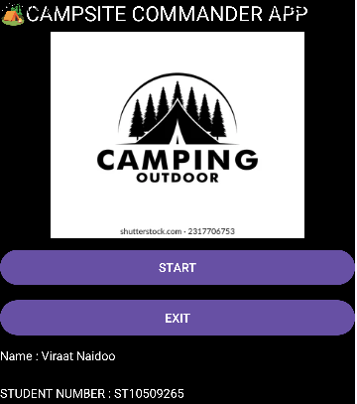
Screen 1: Splash Screen
Users start the app by clicking the Start button and they are greeted by a title and image

Slide 7
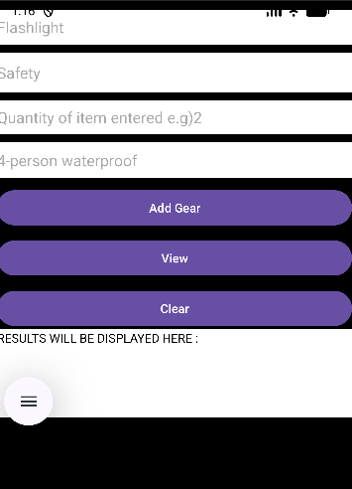
Screen 2: Gear List
Displays all camping gear items stored in the ArrayLists. Users can review the information entered.

Slide 8
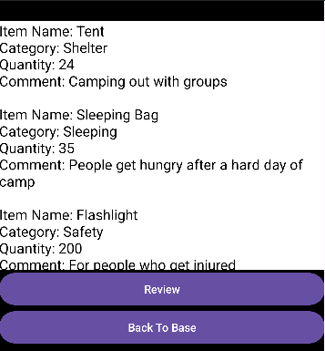
Screen 3: Detailed View
Shows detailed information about the selected camping gear item and provides a clearer overview of stored data.

Slide 9
Learning Outcomes
• Working with ArrayLists
• Passing data using Intents
• Input validation
• Android UI design
• Event handling

Slide 10
Conclusion
The Camping Gear Tracker App is a practical project that demonstrates core Android development concepts while solving a real-world camping organization problem.

