Slide 1
Customer Churn Reduction Strategy
Executive Board Summary

Slide 2
Current State
Overall churn rate: 26% (Retention 74%)
Higher churn among month-to-month customers
High-paying customers (> $70) churn 2x more
Lack of technical support raises churn by 40%
Gender has no measurable impact

Slide 4
Key Insights
1. Contract Length: Month-to-month churn 3x more
2. Price Sensitivity: High-paying customers churn 2x more
3. Customer Support: Lack of tech support drives 40% higher churn

Slide 5
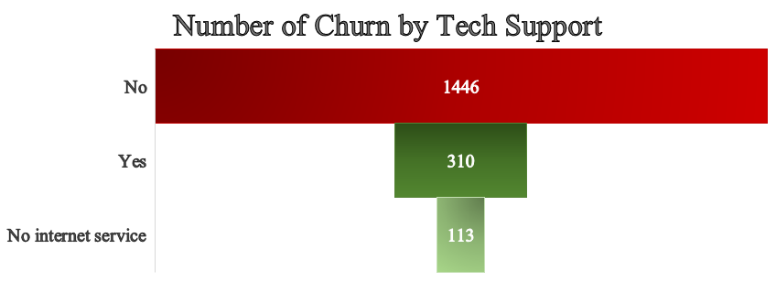

Slide 6
Strategic Priorities
1. Contract Strategy – Incentivize long-term commitments
2. Pricing & Value Optimization – Tiered plans & added value
3. Customer Support Transformation – Strengthen tech support
4. Retention & Loyalty Programs – Rewards & personalization
5. Data-Driven Retention – Predictive churn modeling

Slide 7
Expected Impact
Reduce churn by 5–8% in 12 months
Stabilize high-value customer base
Increase customer satisfaction and loyalty
Protect revenue and lifetime customer value

Slide 8
Board Recommendation
Approve investment in:
Contract incentives
Technical support expansion
Advanced analytics for churn prediction
→ Strengthen competitive positioning & reduce revenue leakage

Slide 9
Churn Reduction Storyboard – Executive Summary
Who is Leaving?
• Month-to-month customers churn 3x more • High-paying customers (> $70) churn 2x more • Customers without tech support are 40% more likely to leave
Why They Leave?
• Low switching barriers from flexible contracts • Perceived poor value for high costs • Frustration due to lack of technical support
What Can We Do?
• Promote 1–2year contracts with incentives • Offer tiered pricing & value bundles • Transform customer support with 24/7 channels • Launch loyalty & rewards programs
Managing Retained Customers
• Use predictive churn modeling • Personalize engagement & offers • Enhance self-service tools • Regular feedback integration

