Slide 1

Jeff the virtual assistant
Cosc-2083: Intro to Information Technology
Semester: 10/2021 – 1/2022
Lecturer: Nguyen Minh Long
Group 6: Skynet
Trinh Viet Quy
Nguyen Thi Ha Giang
Nguyen Toan Thang
Tran Khanh Duc

Slide 2


1. Description– what is “jeff”?
AI Definition:
Artificial Intelligence
Solving problems which requires human intelligence
Some application: Automatic systems, Robot, Virtual Assistants,…
How we apply AI in our project? Overview of our product.
Small virtual assistant applications
Use speech recognition
Interaction between application and users
Perform some interesting and helpful functions: play music, video, weather report,…

Slide 3
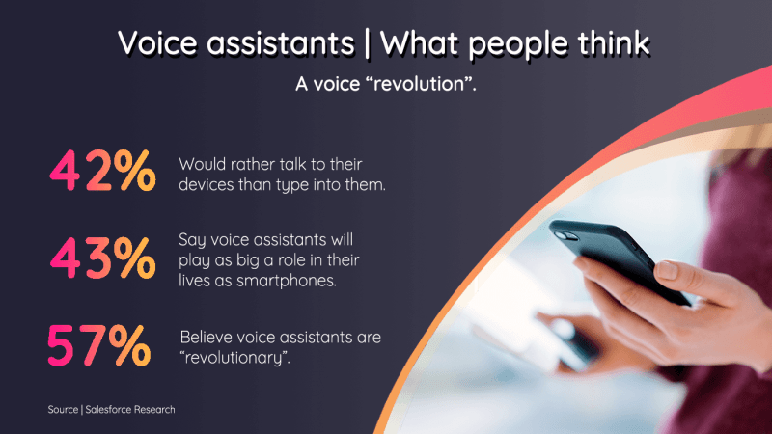
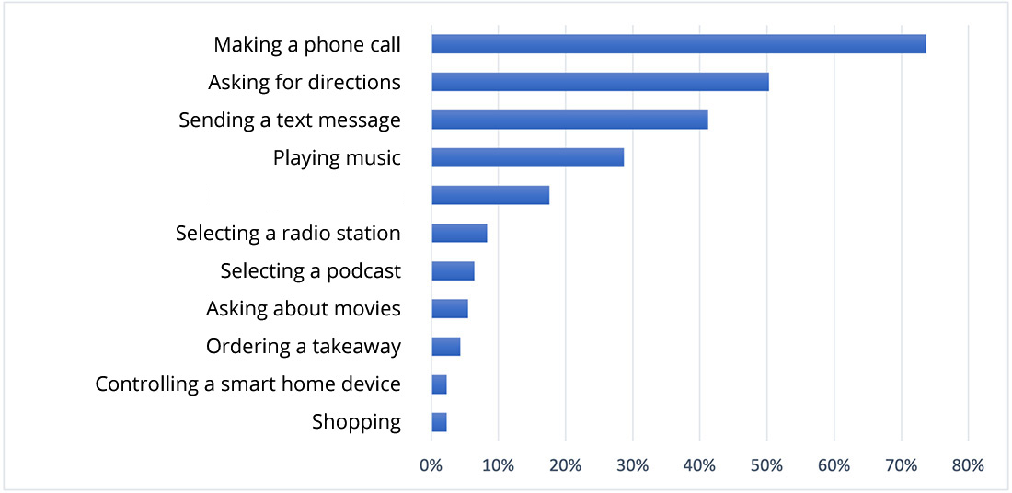
2. Background
How would users use virtual assistants?
- Helps solving basic tasks when they are busy
- Reminds important information
Why virtual assistant is not popular in Vietnam?
- Unsupported language
- The technology is rather new to some people
What distinguish Jeff from others?
-Jeff solves these problems by being minimalistic:
+ Friendly UI/UX
+ Basic functions
+ Support Vietnamese language
+ Act as a tutorial on the concept of virtual assistant
Searching

Slide 4
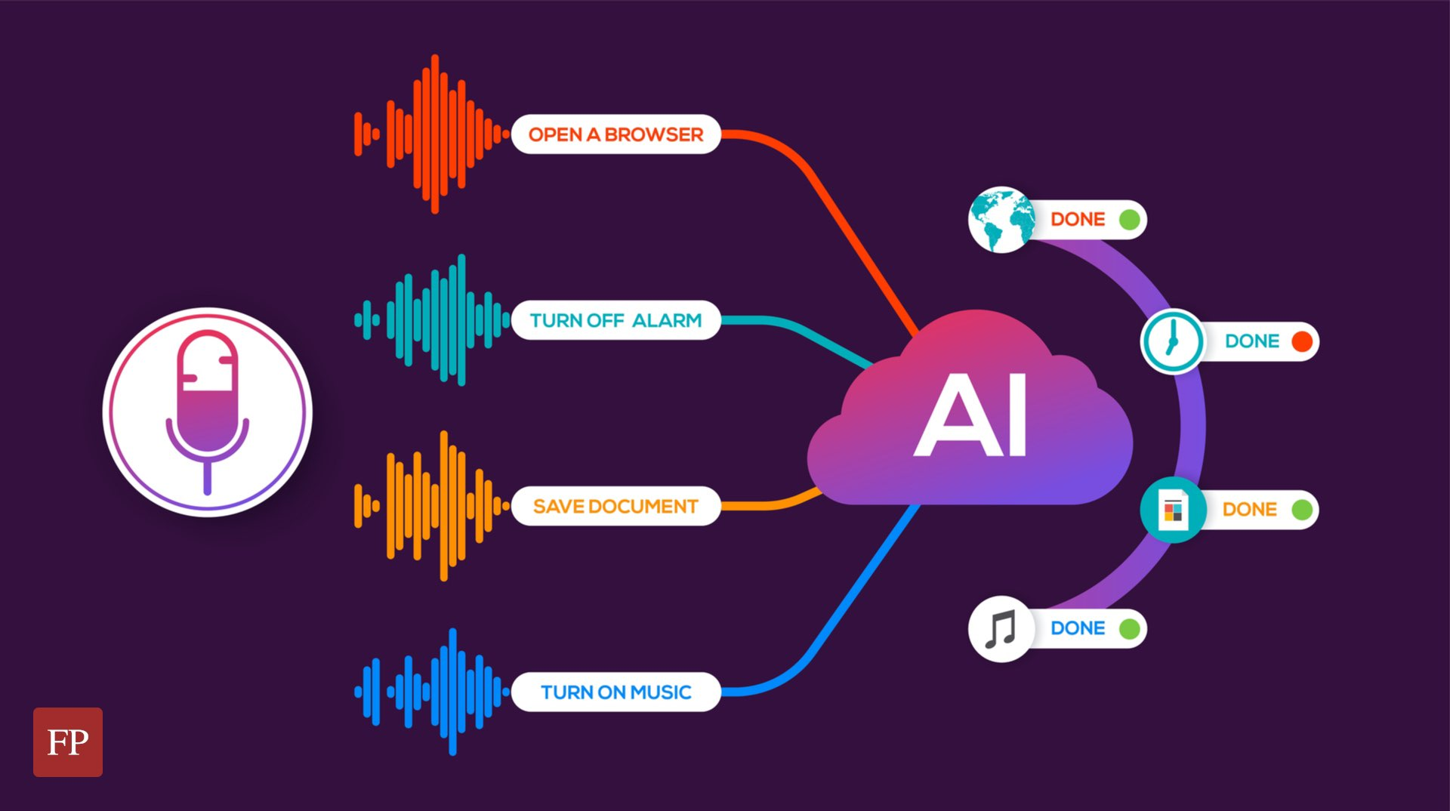
3. solutions – Mechanics
How VAs work, step by step:
- Determine users needs:
+ Speech recognition
+ Natural language processing
- Execute tasks:
+ Mining data
- Report:
+ Dialogue management
+ Texts to speeches

Slide 5
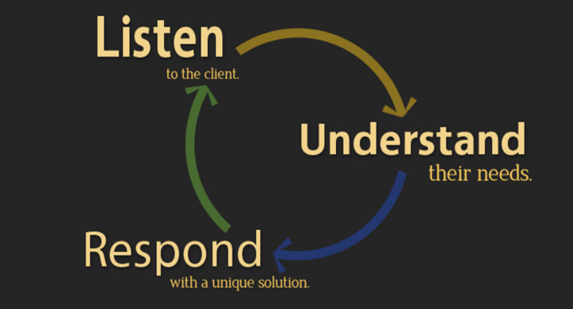
4. design
How is the interface designed?
- Python
- Tkinter
- Pillow(PIL)
What does it have(include)?
- Robot
- Texts
- Button
How does it work?
- Button-click
- Text-write

Slide 6
Conclusion
To summarize, Jeff is:
- Users friendly design
- Easy to get familiar
- Basic functions
- A tutorial on the concept of virtual assistant

Slide 7


Thank you for your attention!

