Slide 1

Jeff the virtual assistant
Cosc-2083: Intro to Information Technology
Semester: 10/2021 – 1/2022
Lecturer: Nguyen Minh Long
Group 6: Skynet
Trinh Viet Quy
Nguyen Thi Ha Giang
Nguyen Toan Thang
Tran Khanh Duc

Slide 2

1. Description– what is “jeff”?
AI Definition:
- Artificial Intelligence
- Solving problems which requires human intelligence
- Some application: Automatic systems, Robot, Virtual Assistants,…

Slide 3
1. Description– what is “jeff”?
AI Definition:
How we apply AI in our project? Overview of our product.
- Small virtual assistant applications
- Use speech recognition
- Interaction between application and users
- Perform some interesting and helpful functions: play music, video, weather report,…

Slide 4
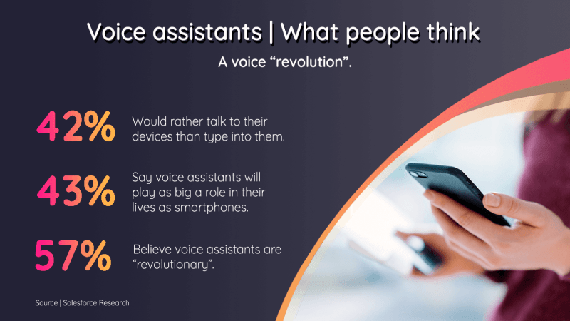
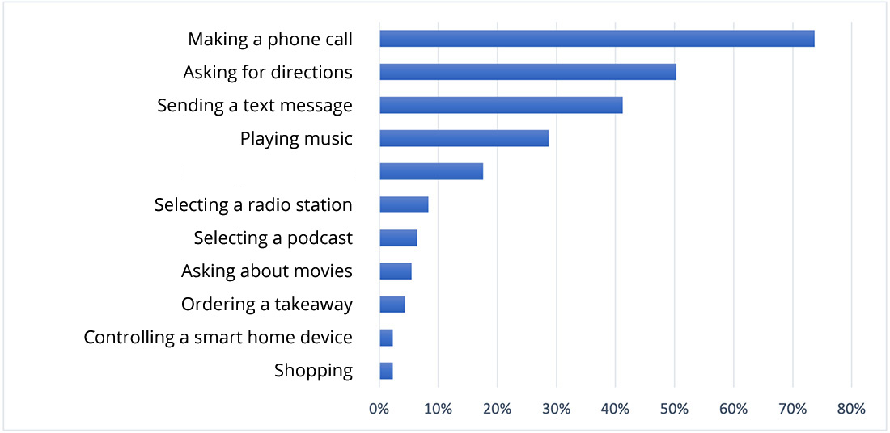
2. Background
How would users use virtual assistants?
- Helps solving basic tasks when they are busy
- Reminds important information
Searching

Slide 5
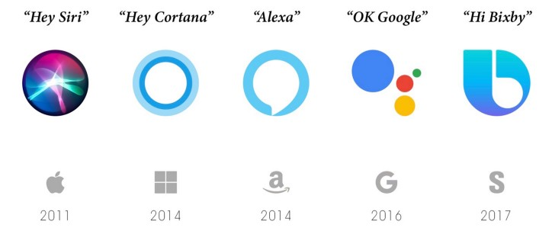
2. Background
How would users use virtual assistants?
Why virtual assistant is not popular in Vietnam?
- Unsupported language
- The technology is rather new to some people

Slide 6
2. Background
How would users use virtual assistants?
Why virtual assistant is not popular in Vietnam?
What distinguishes Jeff from others?
-Jeff solves the problems above by being minimalistic:
+ Friendly UI/UX
+ Basic functions
+ Support Vietnamese language
+ Act as a tutorial on the concept of virtual assistant

Slide 7
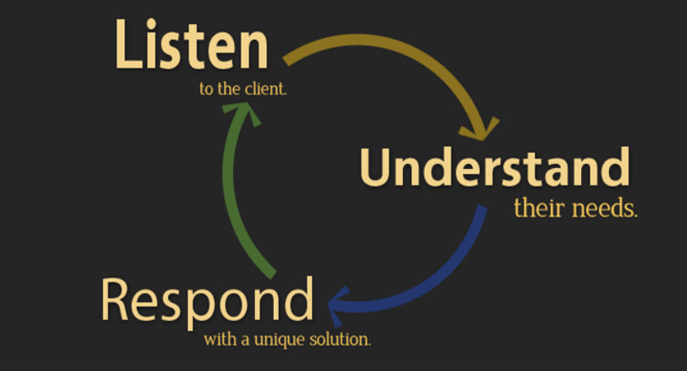
3. solutions – Mechanics

Slide 8
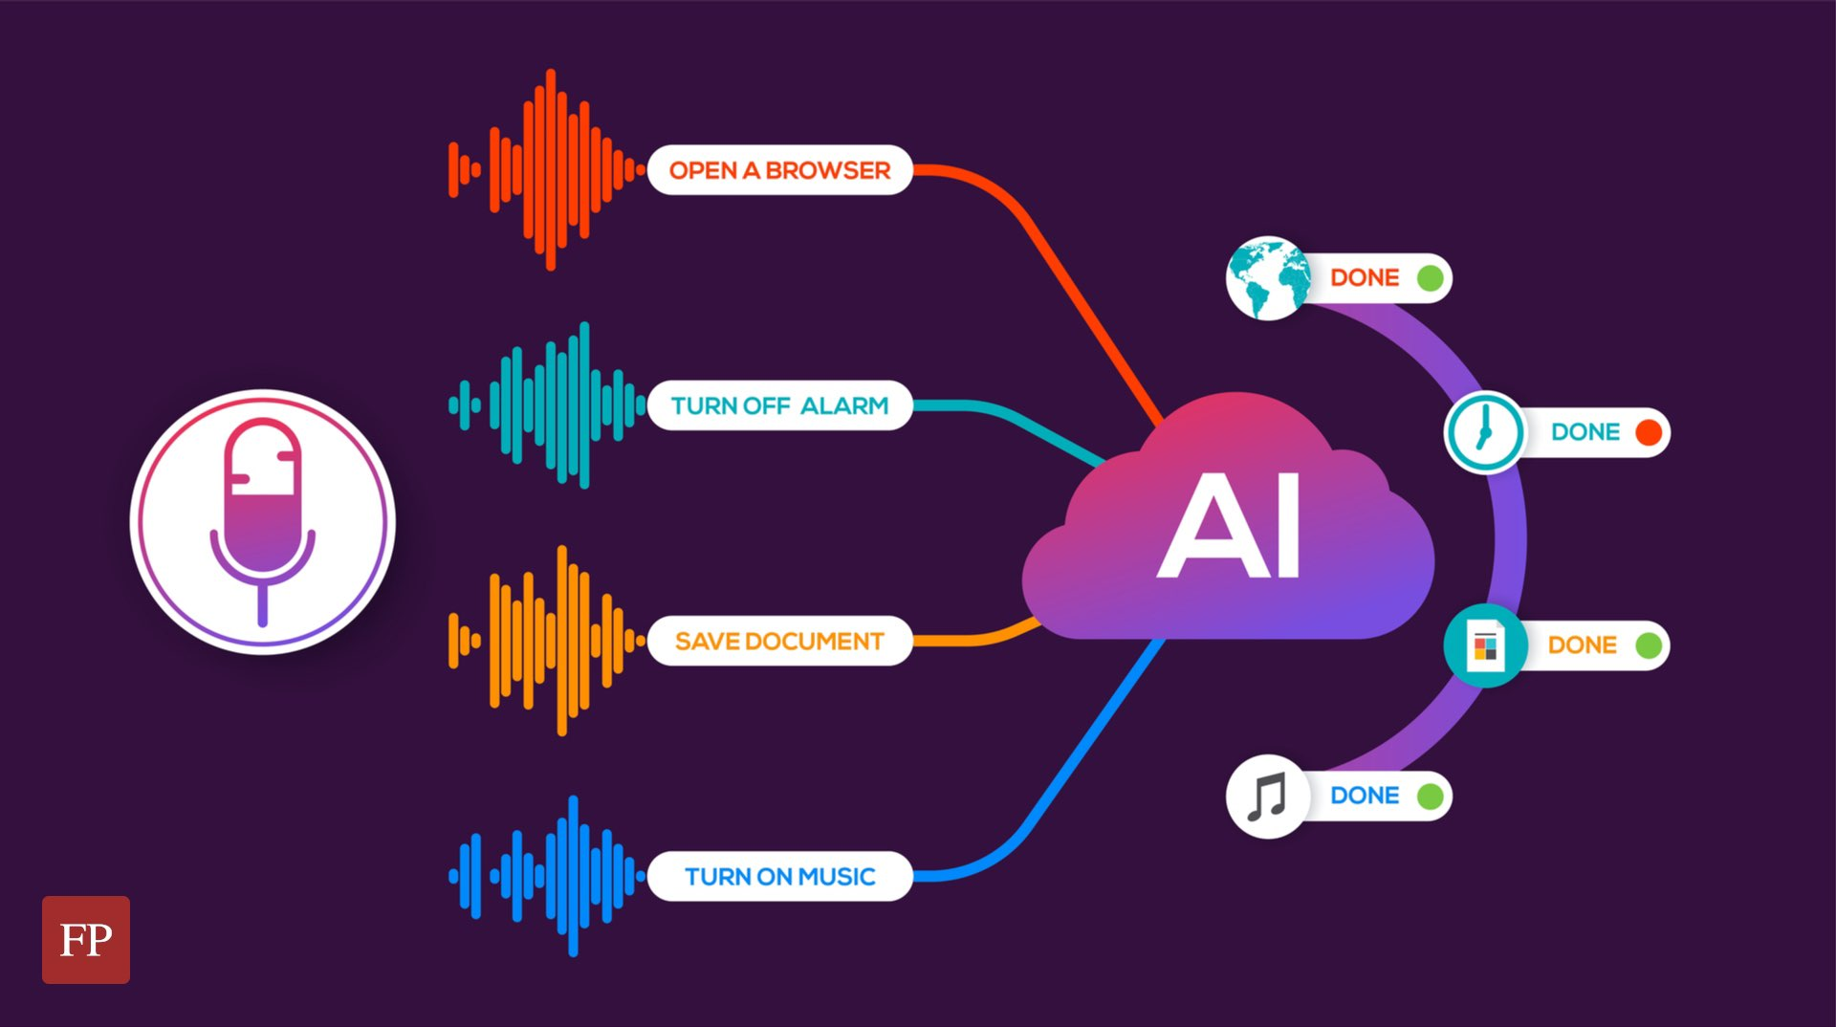
3. solutions – Mechanics
How VAs work, step by step:
- Determine users needs:
+ Speech recognition
+ Natural language processing

Slide 9

3. solutions – Mechanics
How VAs work, step by step:
- Determine users needs:
- Execute tasks:
+ Determine command and find solutions

Slide 10

3. solutions – Mechanics
How VAs work, step by step:
- Determine users needs:
- Execute tasks:
- Report:
+ Dialogue management
+ Texts to speeches

Slide 11
4. design
How is the interface designed?
- Python
- Tkinter
- Pillow(PIL)
What does it have(include)?
- Robot
- Texts
- Button
How does it work?
- Button-click
- Text-write

Slide 12
Conclusion
To summarize, Jeff is:
- Users friendly design
- Easy to get familiar
- Basic functions
- A tutorial on the concept of virtual assistant

Slide 13


Thank you for your attention!

