Slide 1
Meta-analysis of Diagnostic Test Accuracy studies with CopulaDTA
Victoria N Nyaga, PhD
Sciensano, Belgium
ESMARConf2023

Slide 2
Why Copuladta?
Common scenarios in meta-analysis of DTA studies
Few studies
Sparse data i.e. Zero/low counts
Common problems
Non-identifiability of the model
Convergence with missing/large standard errors

Slide 3
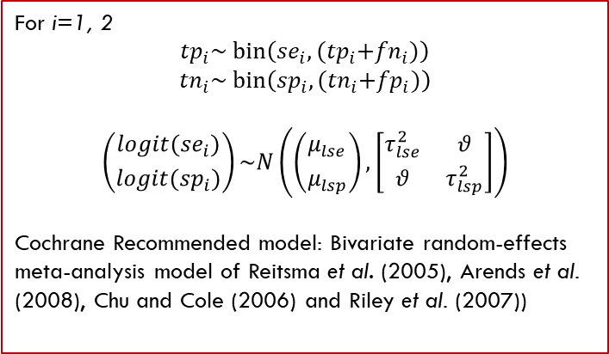
Example 1 – Frequentist Framework
author | tp | fn | fp | tn
Unemo_2018 | 15 | 0 | 0 | 222
Francis_2008 | 17 | 0 | 8 | 41
Interest: Estimation and inference about the overall sensitivity and specificity
ying1 <- read.csv('https://…/Ying1.csv', sep=',')
For i=1, 2
$${tp}_{i}\sim bin\left({se}_{i}, {(tp}_{i}+{fn}_{i})\right)$$
$${tn}_{i}\sim bin\left({sp}_{i}, {(tn}_{i}+{fp}_{i})\right)$$
$$\left({{logit(se}_{i}) \atop logit({sp}_{i})}\right)\sim N\left(\left({μ_{lse} \atop μ_{lsp}}\right),\left[\begin{matrix}τ_{lse}^{2} & θ \\ θ & τ_{lsp}^{2}\end{matrix}\right]\right)$$
Cochrane Recommended model: Bivariate random-effects meta-analysis model of Reitsma et al. (2005), Arends et al. (2008), Chu and Cole (2006) and Riley et al. (2007))
No dedicated package!

Slide 4
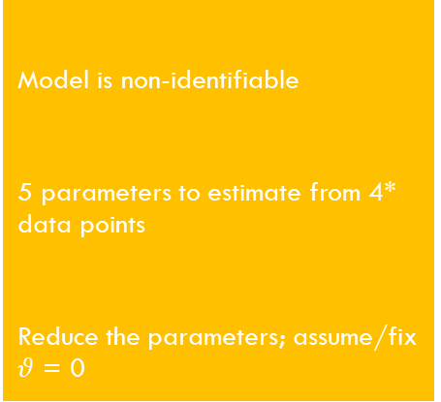
Example 1 – Frequentist Framework
author | tp | fn | fp | tn
Unemo_2018 | 15 | 0 | 0 | 222
Francis_2008 | 17 | 0 | 8 | 41
If there were a dedicated package…
ying1 <- read.csv('https://…/Ying1.csv', sep=',')
Model is non-identifiable
5 parameters to estimate from 4* data points
Reduce the parameters; assume/fix $θ$ = 0
Challenge
For i=1, 2
$${tp}_{i}\sim bin\left({se}_{i}, {(tp}_{i}+{fn}_{i})\right)$$
$${tn}_{i}\sim bin\left({sp}_{i}, {(tn}_{i}+{fp}_{i})\right)$$
$$\left({{logit(se}_{i}) \atop logit({sp}_{i})}\right)\sim N\left(\left({μ_{lse} \atop μ_{lsp}}\right),\left[\begin{matrix}τ_{lse}^{2} & θ \\ θ & τ_{lsp}^{2}\end{matrix}\right]\right)$$
Cochrane Recommended model: Bivariate random-effects meta-analysis model of Reitsma et al. (2005), Arends et al. (2008), Chu and Cole (2006) and Riley et al. (2007))
Cause
Solution I
No dedicated package!

Slide 5
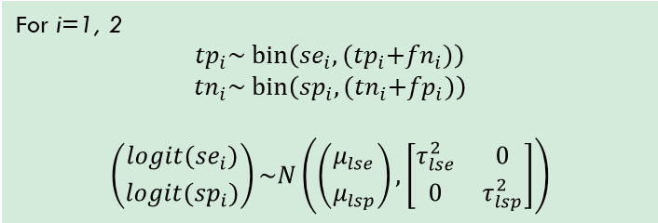
Example 1 – Frequentist framework
author | tp | fn | fp | tn
Unemo_2018 | 15 | 0 | 0 | 222
Francis_2008 | 17 | 0 | 8 | 41
Solution 1 - Metafor
For i=1, 2
$${tp}_{i}\sim bin\left({se}_{i}, {(tp}_{i}+{fn}_{i})\right)$$
$${tn}_{i}\sim bin\left({sp}_{i}, {(tn}_{i}+{fp}_{i})\right)$$
$$\left({{logit(se}_{i}) \atop logit({sp}_{i})}\right)\sim N\left(\left({μ_{lse} \atop μ_{lsp}}\right),\left[\begin{matrix}τ_{lse}^{2} & 0 \\ 0 & τ_{lsp}^{2}\end{matrix}\right]\right)$$
se = rma.glmm(xi=tp, ni=dis, data=ying1, measure ="PLO")
sp = rma.glmm(xi=tn, ni=ndis, data=ying1, measure ="PLO")

Slide 6
Example 1 – Frequentist framework
forest.rma(sp)
Corrected CI
Med:0.99 [0.23, 1.00]

Slide 7
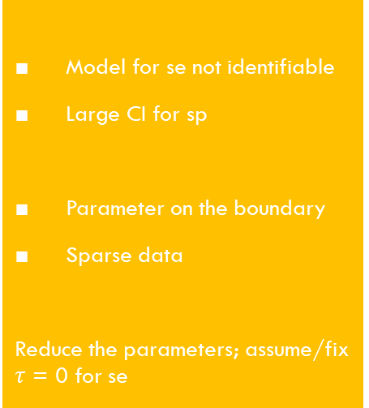
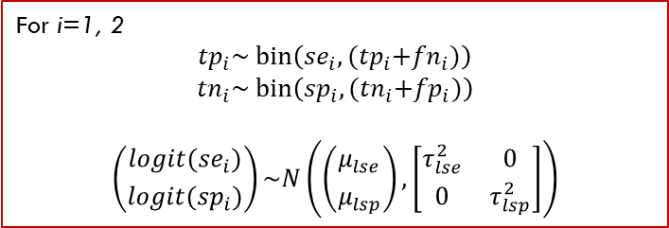
Example 1 – Frequentist framework
author | tp | fn | fp | tn
Unemo_2018 | 15 | 0 | 0 | 222
Francis_2008 | 17 | 0 | 8 | 41
Solution 1 - Metafor
For i=1, 2
$${tp}_{i}\sim bin\left({se}_{i}, {(tp}_{i}+{fn}_{i})\right)$$
$${tn}_{i}\sim bin\left({sp}_{i}, {(tn}_{i}+{fp}_{i})\right)$$
$$\left({{logit(se}_{i}) \atop logit({sp}_{i})}\right)\sim N\left(\left({μ_{lse} \atop μ_{lsp}}\right),\left[\begin{matrix}τ_{lse}^{2} & 0 \\ 0 & τ_{lsp}^{2}\end{matrix}\right]\right)$$
Model for se not identifiable
Large CI for sp
Parameter on the boundary
Sparse data
Reduce the parameters; assume/fix $τ$ = 0 for se
Challenge
Cause
se = rma.glmm(xi=tp, ni=dis, data=ying1, measure ="PLO“)
sp = rma.glmm(xi=tn, ni=ndis, data=ying1, measure ="PLO")
Solution 1.1

Slide 8
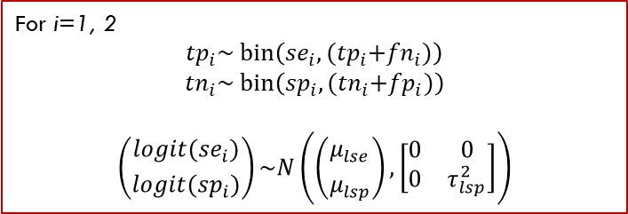
Example 1 – Frequentist framework
author | tp | fn | fp | tn
Unemo_2018 | 15 | 0 | 0 | 222
Francis_2008 | 17 | 0 | 8 | 41
Solution 1.1 - Metafor
For i=1, 2
$${tp}_{i}\sim bin\left({se}_{i}, {(tp}_{i}+{fn}_{i})\right)$$
$${tn}_{i}\sim bin\left({sp}_{i}, {(tn}_{i}+{fp}_{i})\right)$$
$$\left({{logit(se}_{i}) \atop logit({sp}_{i})}\right)\sim N\left(\left({μ_{lse} \atop μ_{lsp}}\right),\left[\begin{matrix}0 & 0 \\ 0 & τ_{lsp}^{2}\end{matrix}\right]\right)$$
se = rma.glmm(xi=tp, ni=dis, data=ying1, measure ="PLO“, method=‘EE’)
sp = rma.glmm(xi=tn, ni=ndis, data=ying1, measure ="PLO")

Slide 9
Example 1 – Frequentist framework
forest.rma(se)
Corrected CI
Med:1.00 [0, NA]

Slide 10
Example 1 – Frequentist framework
author | tp | fn | fp | tn
Unemo_2018 | 15 | 0 | 0 | 222
Francis_2008 | 17 | 0 | 8 | 41
Solution 1.1 - Metafor
For i=1, 2
$${tp}_{i}\sim bin\left({se}_{i}, {(tp}_{i}+{fn}_{i})\right)$$
$${tn}_{i}\sim bin\left({sp}_{i}, {(tn}_{i}+{fp}_{i})\right)$$
$$\left({{logit(se}_{i}) \atop logit({sp}_{i})}\right)\sim N\left(\left({μ_{lse} \atop μ_{lsp}}\right),\left[\begin{matrix}0 & 0 \\ 0 & τ_{lsp}^{2}\end{matrix}\right]\right)$$
Extremely large CI for se
Large CI for sp
Parameter on the boundary
Sparse data
End of the road
Challenge
Cause
se = rma.glmm(xi=tp, ni=dis, data=ying1, measure ="PLO“, method=‘EE’)
sp = rma.glmm(xi=tn, ni=ndis, data=ying1, measure ="PLO")
Solution 1.2

Slide 11
Example 1 – Frequentist Framework
author | tp | fn | fp | tn
Unemo_2018 | 15 | 0 | 0 | 222
Francis_2008 | 17 | 0 | 8 | 41
ying1 <- read.csv('https://…/Ying1.csv', sep=',')
For i=1, 2
$${tp}_{i}\sim bin\left({se}_{i}, {(tp}_{i}+{fn}_{i})\right)$$
$${tn}_{i}\sim bin\left({sp}_{i}, {(tn}_{i}+{fp}_{i})\right)$$
$$\left({{logit(se}_{i}) \atop logit({sp}_{i})}\right)\sim N\left(\left({μ_{lse} \atop μ_{lsp}}\right),\left[\begin{matrix}τ_{lse}^{2} & θ \\ θ & τ_{lsp}^{2}\end{matrix}\right]\right)$$
Cochrane Recommended model: Bivariate random-effects meta-analysis model of Reitsma et al. (2005), Arends et al. (2008), Chu and Cole (2006) and Riley et al. (2007))
There is a ‘dedicated’ package!

Slide 12
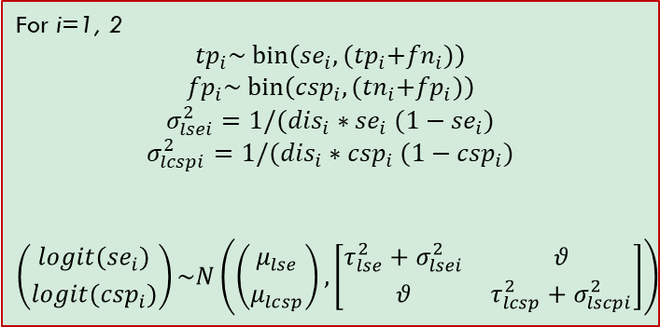
Example 1 – Frequentist framework
author | tp | fn | fp | tn
Unemo_2018 | 15 | 0 | 0 | 222
Francis_2008 | 17 | 0 | 8 | 41
Solution 2 - Mada
For i=1, 2
$${tp}_{i}\sim bin\left({se}_{i}, {(tp}_{i}+{fn}_{i})\right)$$
$${fp}_{i}\sim bin\left({csp}_{i}, {(tn}_{i}+{fp}_{i})\right)$$
$$σ_{lsei}^{2}=1/({dis}_{i}∗{se}_{i} (1−{se}_{i})$$
$$σ_{lcspi}^{2}=1/({dis}_{i}∗{csp}_{i} (1−{csp}_{i})$$
$$\left({{logit(se}_{i}) \atop logit({csp}_{i})}\right)\sim N\left(\left({μ_{lse} \atop μ_{lcsp}}\right),\left[\begin{matrix}τ_{lse}^{2}+σ_{lsei}^{2} & θ \\ θ & τ_{lcsp}^{2}+σ_{lscpi}^{2}\end{matrix}\right]\right)$$
Undefined data points
Sparse data
Enable continuity correction (0.5)
Challenge
Cause
Solution 2.1
fit = reitsma(ying1, correction = 0)

Slide 13
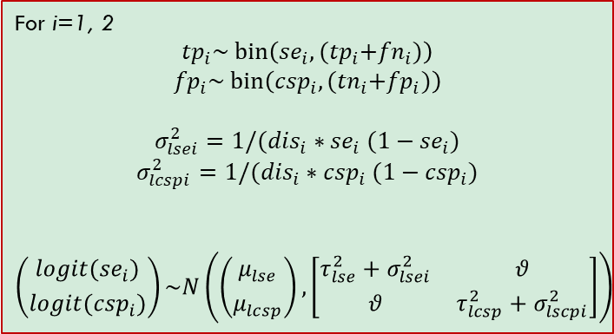
Example 1 – Frequentist framework
author | tp | fn | fp | tn
Unemo_2018 | 15 | 0 | 0 | 222
Francis_2008 | 17 | 0 | 8 | 41
Solution 2 - Mada
For i=1, 2
$${tp}_{i}\sim bin\left({se}_{i}, {(tp}_{i}+{fn}_{i})\right)$$
$${fp}_{i}\sim bin\left({csp}_{i}, {(tn}_{i}+{fp}_{i})\right)$$
$$σ_{lsei}^{2}=1/({dis}_{i}∗{se}_{i} (1−{se}_{i})$$
$$σ_{lcspi}^{2}=1/({dis}_{i}∗{csp}_{i} (1−{csp}_{i})$$
$$\left({{logit(se}_{i}) \atop logit({csp}_{i})}\right)\sim N\left(\left({μ_{lse} \atop μ_{lcsp}}\right),\left[\begin{matrix}τ_{lse}^{2}+σ_{lsei}^{2} & θ \\ θ & τ_{lcsp}^{2}+σ_{lscpi}^{2}\end{matrix}\right]\right)$$
Large CI for sp
Different conclusion
Sparse data
Continuity correction (0.5)
Challenge
Cause
fit = reitsma(ying1)

Slide 14
Example 1 – Frequentist framework
Corrected CIs
Med:0.97 [0.82, 1.00]
Med:0.97 [0.31, 1.00]

Slide 15
Example 1 – Bayesian Framework
author | tp | fn | fp | tn
Unemo_2018 | 15 | 0 | 0 | 222
Francis_2008 | 17 | 0 | 8 | 41
Interest: Estimation and inference about the overall sensitivity and specificity
CopulaDTA
Gaussian Copula with logit link
Assume that the se and sp of the test is 0.5 (useless).
Assume correlation is 0.
Update opinion given the data.
Principle
For i=1, 2
$${tp}_{i}\sim bin\left({se}_{i}, {(tp}_{i}+{fn}_{i})\right)$$
$${tn}_{i}\sim bin\left({sp}_{i}, {(tn}_{i}+{fp}_{i})\right)$$
$$\left({{logit(se}_{i}) \atop logit({sp}_{i})}\right)\sim N\left(\left({μ_{lse} \atop μ_{lsp}}\right),\left[\begin{matrix}τ_{lse}^{2} & θ \\ θ & τ_{lsp}^{2}\end{matrix}\right]\right)$$
Cochrane Recommended model: Bivariate random-effects meta-analysis model of Reitsma et al. (2005), Arends et al. (2008), Chu and Cole (2006) and Riley et al. (2007))

Slide 16
Example 1 – Bayesian Framework
author | tp | fn | fp | tn
Unemo_2018 | 15 | 0 | 0 | 222
Francis_2008 | 17 | 0 | 8 | 41
Interest: Estimation and inference about the overall sensitivity and specificity
CopulaDTA
Gaussian Copula with logit link
gauss <- cdtamodel(copula = 'gauss’)
fit2 <- fit(gauss,
SID='author',
data=ying1,
iter=2000,
warmup=1000,
thin=1,
seed=3)
traceplot(fit1)
print(fit1)
plot(fit1)

Slide 17
Example 1 – Bayesian Framework

Slide 18
Example 1 – Bayesian Framework
author | tp | fn | fp | tn
Unemo_2018 | 15 | 0 | 0 | 222
Francis_2008 | 17 | 0 | 8 | 41
Interest: Estimation and inference about the overall sensitivity and specificity
CopulaDTA
FGM Copula (weak correlation)
fgm <- cdtamodel(copula = ‘fgm’)
fit2 <- fit(fgm,
SID='author',
data=ying1,
iter=2000,
warmup=1000,
thin=1,
seed=3)
plot(fit2)

Slide 19
Example 1 – Bayesian Framework

Slide 20
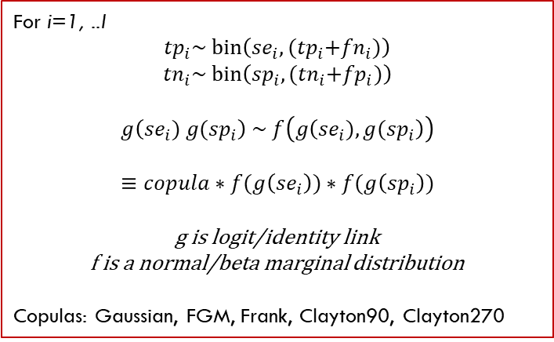
Copuladta
Assume that the se and sp of the test is 0.5 (useless).
Assume correlation is 0.
Update opinion given the data.
Principle
Principle - Sklar’s Theorem
For i=1, ..I
$${tp}_{i}\sim bin\left({se}_{i}, {(tp}_{i}+{fn}_{i})\right)$$
$${tn}_{i}\sim bin\left({sp}_{i}, {(tn}_{i}+{fp}_{i})\right)$$
$$g\left({se}_{i}) {g(sp}_{i}\right) \sim f\left(g\left({se}_{i}), {g(sp}_{i}\right)\right)$$
$$≡copula∗f(g\left({se}_{i}\right))∗f(g\left({sp}_{i}\right))$$
g is logit/identity link
f is a normal/beta marginal distribution
Copulas: Gaussian, FGM, Frank, Clayton90, Clayton270
Flexibility
Binomial-normal models
Beta-binomial models
Include covariates
More meaningful parameters (mean, not median)
Benefits

Slide 21
Materials
https://github.com/VNyaga/ESMARConf2023
Code
Data
Jstatsoft publication on CopulaDTA
https://cran.rstudio.com/web/packages/CopulaDTA/vignettes/CopulaDTA_Vignette.html

