Slide 1
Meta-analysis of Diagnostic Test Accuracy studies with CopulaDTA
Victoria N Nyaga, PhD
Sciensano, Belgium
ESMARConf2023

Slide 2
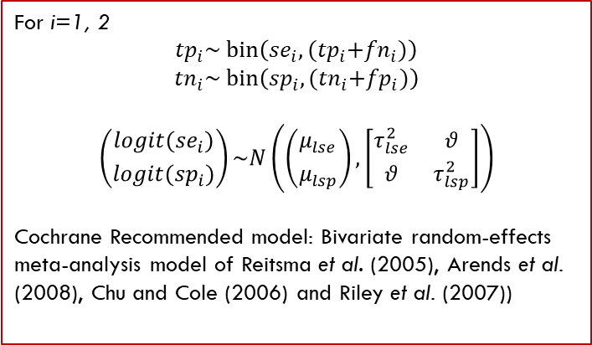
Example 1 – Frequentist Framework
author | tp | fn | fp | tn
Unemo_2018 | 15 | 0 | 0 | 222
Francis_2008 | 17 | 0 | 8 | 41
Interest: Estimation and inference about the overall sensitivity and specificity
ying1 <- read.csv('https://…/Ying1.csv', sep=',')
For i=1, 2
$${tp}_{i}\sim bin\left({se}_{i}, {(tp}_{i}+{fn}_{i})\right)$$
$${tn}_{i}\sim bin\left({sp}_{i}, {(tn}_{i}+{fp}_{i})\right)$$
$$\left({{logit(se}_{i}) \atop logit({sp}_{i})}\right)\sim N\left(\left({μ_{lse} \atop μ_{lsp}}\right),\left[\begin{matrix}τ_{lse}^{2} & θ \\ θ & τ_{lsp}^{2}\end{matrix}\right]\right)$$
Cochrane Recommended model: Bivariate random-effects meta-analysis model of Reitsma et al. (2005), Arends et al. (2008), Chu and Cole (2006) and Riley et al. (2007))
No dedicated package!

Slide 3
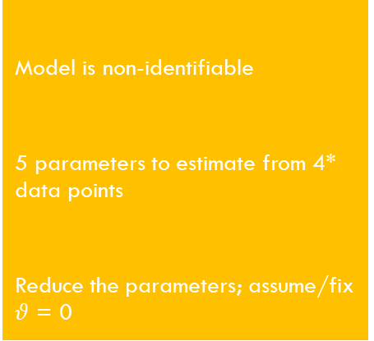
Example 1 – Frequentist Framework
author | tp | fn | fp | tn
Unemo_2018 | 15 | 0 | 0 | 222
Francis_2008 | 17 | 0 | 8 | 41
Interest: Estimation and inference about the overall sensitivity and specificity
If there were a dedicated package…
ying1 <- read.csv('https://…/Ying1.csv', sep=',')
Model is non-identifiable
5 parameters to estimate from 4* data points
Reduce the parameters; assume/fix $θ$ = 0
Challenge
For i=1, 2
$${tp}_{i}\sim bin\left({se}_{i}, {(tp}_{i}+{fn}_{i})\right)$$
$${tn}_{i}\sim bin\left({sp}_{i}, {(tn}_{i}+{fp}_{i})\right)$$
$$\left({{logit(se}_{i}) \atop logit({sp}_{i})}\right)\sim N\left(\left({μ_{lse} \atop μ_{lsp}}\right),\left[\begin{matrix}τ_{lse}^{2} & θ \\ θ & τ_{lsp}^{2}\end{matrix}\right]\right)$$
Cochrane Recommended model: Bivariate random-effects meta-analysis model of Reitsma et al. (2005), Arends et al. (2008), Chu and Cole (2006) and Riley et al. (2007))
Cause
Solution I
No dedicated package!

Slide 4
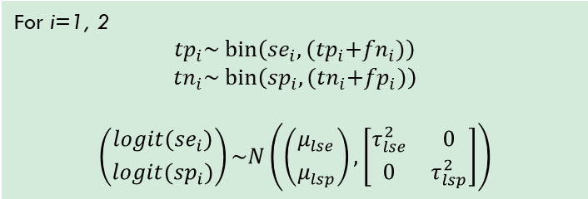
Example 1 – Frequentist framework
author | tp | fn | fp | tn
Unemo_2018 | 15 | 0 | 0 | 222
Francis_2008 | 17 | 0 | 8 | 41
Interest: Estimation and inference about the overall sensitivity and specificity
Solution 1 - Metafor
For i=1, 2
$${tp}_{i}\sim bin\left({se}_{i}, {(tp}_{i}+{fn}_{i})\right)$$
$${tn}_{i}\sim bin\left({sp}_{i}, {(tn}_{i}+{fp}_{i})\right)$$
$$\left({{logit(se}_{i}) \atop logit({sp}_{i})}\right)\sim N\left(\left({μ_{lse} \atop μ_{lsp}}\right),\left[\begin{matrix}τ_{lse}^{2} & 0 \\ 0 & τ_{lsp}^{2}\end{matrix}\right]\right)$$
se = rma.glmm(xi=tp, ni=dis, data=ying1, measure ="PLO")
sp = rma.glmm(xi=tn, ni=ndis, data=ying1, measure ="PLO")

Slide 5
Example 1 – Frequentist framework
forest.rma(sp)
Corrected CI
Med:0.99 [0.23, 1.00]

Slide 6
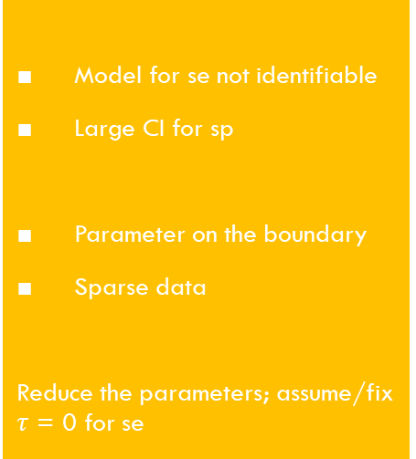
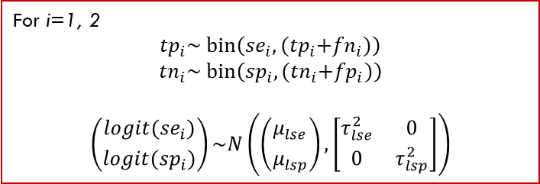
Example 1 – Frequentist framework
author | tp | fn | fp | tn
Unemo_2018 | 15 | 0 | 0 | 222
Francis_2008 | 17 | 0 | 8 | 41
Interest: Estimation and inference about the overall sensitivity and specificity
Solution 1 - Metafor
For i=1, 2
$${tp}_{i}\sim bin\left({se}_{i}, {(tp}_{i}+{fn}_{i})\right)$$
$${tn}_{i}\sim bin\left({sp}_{i}, {(tn}_{i}+{fp}_{i})\right)$$
$$\left({{logit(se}_{i}) \atop logit({sp}_{i})}\right)\sim N\left(\left({μ_{lse} \atop μ_{lsp}}\right),\left[\begin{matrix}τ_{lse}^{2} & 0 \\ 0 & τ_{lsp}^{2}\end{matrix}\right]\right)$$
Model for se not identifiable
Large CI for sp
Parameter on the boundary
Sparse data
Reduce the parameters; assume/fix $τ$ = 0 for se
Challenge
Cause
se = rma.glmm(xi=tp, ni=dis, data=ying1, measure ="PLO“)
sp = rma.glmm(xi=tn, ni=ndis, data=ying1, measure ="PLO")
Solution 1.1

Slide 7
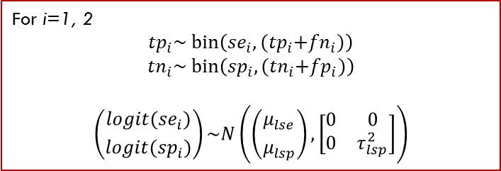
Example 1 – Frequentist framework
author | tp | fn | fp | tn
Unemo_2018 | 15 | 0 | 0 | 222
Francis_2008 | 17 | 0 | 8 | 41
Interest: Estimation and inference about the overall sensitivity and specificity
Solution 1.1 - Metafor
For i=1, 2
$${tp}_{i}\sim bin\left({se}_{i}, {(tp}_{i}+{fn}_{i})\right)$$
$${tn}_{i}\sim bin\left({sp}_{i}, {(tn}_{i}+{fp}_{i})\right)$$
$$\left({{logit(se}_{i}) \atop logit({sp}_{i})}\right)\sim N\left(\left({μ_{lse} \atop μ_{lsp}}\right),\left[\begin{matrix}0 & 0 \\ 0 & τ_{lsp}^{2}\end{matrix}\right]\right)$$
se = rma.glmm(xi=tp, ni=dis, data=ying1, measure ="PLO“, method=‘EE’)
sp = rma.glmm(xi=tn, ni=ndis, data=ying1, measure ="PLO")

Slide 8
Example 1 – Frequentist framework
forest.rma(se)
Corrected CI
Med:1.00 [0, NA]

Slide 9
Example 1 – Frequentist framework
author | tp | fn | fp | tn
Unemo_2018 | 15 | 0 | 0 | 222
Francis_2008 | 17 | 0 | 8 | 41
Interest: Estimation and inference about the overall sensitivity and specificity
Solution 1.1 - Metafor
For i=1, 2
$${tp}_{i}\sim bin\left({se}_{i}, {(tp}_{i}+{fn}_{i})\right)$$
$${tn}_{i}\sim bin\left({sp}_{i}, {(tn}_{i}+{fp}_{i})\right)$$
$$\left({{logit(se}_{i}) \atop logit({sp}_{i})}\right)\sim N\left(\left({μ_{lse} \atop μ_{lsp}}\right),\left[\begin{matrix}0 & 0 \\ 0 & τ_{lsp}^{2}\end{matrix}\right]\right)$$
Extremely large CI for se
Large CI for sp
Parameter on the boundary
Sparse data
End of the road
Challenge
Cause
se = rma.glmm(xi=tp, ni=dis, data=ying1, measure ="PLO“, method=‘EE’)
sp = rma.glmm(xi=tn, ni=ndis, data=ying1, measure ="PLO")
Solution 1.2

Slide 10
Example 1 – Frequentist Framework
author | tp | fn | fp | tn
Unemo_2018 | 15 | 0 | 0 | 222
Francis_2008 | 17 | 0 | 8 | 41
Interest: Estimation and inference about the overall sensitivity and specificity
ying1 <- read.csv('https://…/Ying1.csv', sep=',')
For i=1, 2
$${tp}_{i}\sim bin\left({se}_{i}, {(tp}_{i}+{fn}_{i})\right)$$
$${tn}_{i}\sim bin\left({sp}_{i}, {(tn}_{i}+{fp}_{i})\right)$$
$$\left({{logit(se}_{i}) \atop logit({sp}_{i})}\right)\sim N\left(\left({μ_{lse} \atop μ_{lsp}}\right),\left[\begin{matrix}τ_{lse}^{2} & θ \\ θ & τ_{lsp}^{2}\end{matrix}\right]\right)$$
Cochrane Recommended model: Bivariate random-effects meta-analysis model of Reitsma et al. (2005), Arends et al. (2008), Chu and Cole (2006) and Riley et al. (2007))
There is a ‘dedicated’ package!

Slide 11
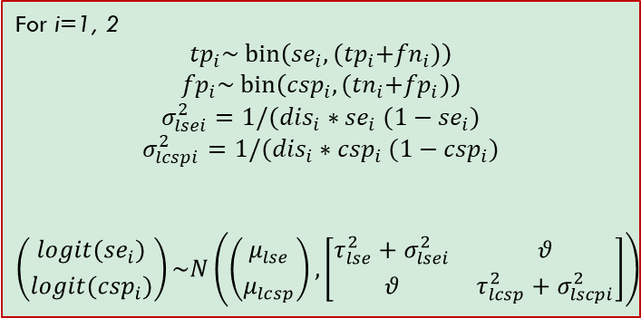
Example 1 – Frequentist framework
author | tp | fn | fp | tn
Unemo_2018 | 15 | 0 | 0 | 222
Francis_2008 | 17 | 0 | 8 | 41
Interest: Estimation and inference about the overall sensitivity and specificity
Solution 2 - Mada
For i=1, 2
$${tp}_{i}\sim bin\left({se}_{i}, {(tp}_{i}+{fn}_{i})\right)$$
$${fp}_{i}\sim bin\left({csp}_{i}, {(tn}_{i}+{fp}_{i})\right)$$
$$σ_{lsei}^{2}=1/({dis}_{i}∗{se}_{i} (1−{se}_{i})$$
$$σ_{lcspi}^{2}=1/({dis}_{i}∗{csp}_{i} (1−{csp}_{i})$$
$$\left({{logit(se}_{i}) \atop logit({csp}_{i})}\right)\sim N\left(\left({μ_{lse} \atop μ_{lcsp}}\right),\left[\begin{matrix}τ_{lse}^{2}+σ_{lsei}^{2} & θ \\ θ & τ_{lcsp}^{2}+σ_{lscpi}^{2}\end{matrix}\right]\right)$$
Undefined data points
Sparse data
Enable continuity correction (0.5)
Challenge
Cause
Solution 2.1
fit = reitsma(ying1, correction = 0)

Slide 12
Example 1 – Frequentist framework
author | tp | fn | fp | tn
Unemo_2018 | 15 | 0 | 0 | 222
Francis_2008 | 17 | 0 | 8 | 41
Interest: Estimation and inference about the overall sensitivity and specificity
Solution 2 - Mada
For i=1, 2
$${tp}_{i}\sim bin\left({se}_{i}, {(tp}_{i}+{fn}_{i})\right)$$
$${fp}_{i}\sim bin\left({csp}_{i}, {(tn}_{i}+{fp}_{i})\right)$$
$$σ_{lsei}^{2}=1/({dis}_{i}∗{se}_{i} (1−{se}_{i})$$
$$σ_{lcspi}^{2}=1/({dis}_{i}∗{csp}_{i} (1−{csp}_{i})$$
$$\left({{logit(se}_{i}) \atop logit({csp}_{i})}\right)\sim N\left(\left({μ_{lse} \atop μ_{lcsp}}\right),\left[\begin{matrix}τ_{lse}^{2}+σ_{lsei}^{2} & θ \\ θ & τ_{lcsp}^{2}+σ_{lscpi}^{2}\end{matrix}\right]\right)$$
Large CI for sp
Different conclusion
Sparse data
Continuity correction (0.5)
Challenge
Cause
fit = reitsma(ying1)

Slide 13
Example 1 – Frequentist framework
Corrected CIs
Med:0.97 [0.82, 1.00]
Med:0.97 [0.31, 1.00]

Slide 14
Example 1 – Bayesian Framework
author | tp | fn | fp | tn
Unemo_2018 | 15 | 0 | 0 | 222
Francis_2008 | 17 | 0 | 8 | 41
Interest: Estimation and inference about the overall sensitivity and specificity
CopulaDTA
Gaussian* Copula
Assume that the se and sp of the test is 0.5 (useless).
Assume correlation is 0.
Update opinion given the data.
Principle
For i=1, 2
$${tp}_{i}\sim bin\left({se}_{i}, {(tp}_{i}+{fn}_{i})\right)$$
$${tn}_{i}\sim bin\left({sp}_{i}, {(tn}_{i}+{fp}_{i})\right)$$
$$\left({{logit(se}_{i}) \atop logit({sp}_{i})}\right)\sim N\left(\left({μ_{lse} \atop μ_{lsp}}\right),\left[\begin{matrix}τ_{lse}^{2} & θ \\ θ & τ_{lsp}^{2}\end{matrix}\right]\right)$$
Cochrane Recommended model: Bivariate random-effects meta-analysis model of Reitsma et al. (2005), Arends et al. (2008), Chu and Cole (2006) and Riley et al. (2007))
ying1 <- read.csv('https://…/Ying1.csv', sep=',')

Slide 15
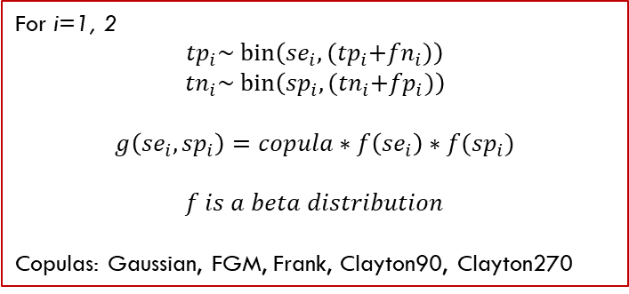
Example 1 – Bayesian Framework
author | tp | fn | fp | tn
Unemo_2018 | 15 | 0 | 0 | 222
Francis_2008 | 17 | 0 | 8 | 41
Interest: Estimation and inference about the overall sensitivity and specificity
CopulaDTA
Principle - Sklar’s Theorem
Flexibility
More meaningful parameters (mean, not median)
Benefits
For i=1, 2
$${tp}_{i}\sim bin\left({se}_{i}, {(tp}_{i}+{fn}_{i})\right)$$
$${tn}_{i}\sim bin\left({sp}_{i}, {(tn}_{i}+{fp}_{i})\right)$$
$$g\left({se}_{i},{sp}_{i}\right)=copula∗f\left({se}_{i}\right)∗f({sp}_{i})$$
$f is a beta distribution$
Copulas: Gaussian, FGM, Frank, Clayton90, Clayton270
Beta-binomial modelling!

