Slide 1

FormForge 2.0
An Information-Aware Adaptive Questionnaire Platform with Privacy-Preserving AI
Ask fewer, better questions
[STUDENT NAME] | [REGISTER NUMBER]
Guide: Prof. / Dr. [Guide Name]
Master of Computer Applications | SCORE, VIT Vellore
Notes:
Introduce the project: FormForge started as a multi-tenant form builder. After Review 1 it was turned into a research-driven adaptive questionnaire platform that chooses the next question for each respondent, runs at zero cost on a free AI model behind a privacy layer, and was experimentally evaluated against conventional forms.

Slide 2
Agenda
01
02
03
Context
Literature
Design
Review 1 feedback, problem, objectives
2024-2026 research and the gap
Architecture, UML, data model, algorithms
04
05
06
Build
Results
Close
Implementation, testing and live demo
Static vs rule-based vs adaptive, cold start, ablation
Cost, conclusion and future scope
Notes:
Walk through the structure of the talk: context and literature, the design of each module, implementation and demo, then the experimental results and cost.

Slide 3


From Review 1 to FormForge 2.0
Review 1: FormForge 1.0
Now: research-driven 2.0
Multi-tenant form builder with RBAC workspaces
Drag-and-drop builder, public form links
Webhooks, e-mail workflows, SSE live counter
Feedback: "nothing new, built many times before"
Adaptive engine picks the next question per respondent
A free LLM generates forms with metadata
Automatic questionnaire quality analysis
Synthetic cold start, PII masking, insights
Measured against static and rule-based forms
Notes:
Review 1 correctly pointed out that a form builder alone is not novel. The existing platform was kept as the foundation, and research components were added on top, with a measurable research question.

Slide 4



The Problem with Static Forms
Same list for everyone
Research question
A student who never met a mentor still answers five mentoring questions
Can a form decide, for each respondent, which question is worth asking next, so that useful information is collected with fewer questions and less effort?
Long forms get abandoned
In our simulation about 30% of respondents left the 16-question static form midway
Badly written questions
46% of 250 items in locally designed surveys were not recommended for use (Reed et al., 2024)
...while running at zero cost and keeping response data on the machine.
AI usually means cloud
Paid APIs fail on quota and send personal data off the machine
Notes:
Four problems motivate the work. The central research question is on the right: selecting the next question by its information value while controlling respondent burden.

Slide 5






Objectives
AI form generation
Quality analyzer
Adaptive engine
Plain-language prompt to a structured form with metadata, via a free LLM
Flag double-barrelled, leading, ambiguous and redundant questions; estimate time
Score every unanswered question and ask the one with the highest utility
Cold start
Privacy and insights
Evaluation
Warm start new forms with synthetic respondents whose weight decays
Mask PII before any model call; summarise answers into topics and sentiment
Compare with static and rule-based forms on seven metrics
Notes:
Six objectives, one per module. The adaptive engine and its evaluation are the core research contribution; the other modules support it.

Slide 6
Literature Survey: Key Recent Work
Work | Focus | Key finding
Bachmann et al., 2024 | Adaptive questionnaires | 74% accuracy vs <40% for fixed short forms
Bachmann et al., 2025 | GPT-4 synthetic cold start | RMSE 0.420 to 0.297; gain fades after ~175 users
Hu et al., 2024 | Information-gain questioning | +38.1% task success with fewer questions
Li et al., 2025 | Adaptive testing (ATLAS) | Up to 90% fewer items at same precision
Adhikari et al., 2025 | LLM questionnaire generation | Generated items clearer and more specific
Reed et al., 2024 | Quality of local surveys | 46% of 250 items not recommended
Lukauskas & Šarkauskaitė, 2026 | Audit of synthetic respondents | +0.84 SD acquiescence; poor transfer
Nayyeri & Rasoolzadegan, 2025 | Local LLM for web forms | Local model avoids cloud data leakage
15 references in the report, 2024-2026, all with verified DOI or arXiv links
Notes:
Highlight Bachmann 2024 and 2025 as the closest precedents for adaptive selection and cold start, Hu 2024 for information gain, and the 2026 audit as the main caution about synthetic respondents.

Slide 7
Research Gap and Our Answer
Gap in existing work
FormForge 2.0
Adaptive questionnaires exist only for fixed instruments
Adaptive selection inside a general-purpose form builder
Generators produce wording, not machine-readable structure
Every generated question carries target, objective, time
Selection optimises information alone
Utility adds burden, redundancy and coverage
Cold start studied with large paid models only
Synthetic warm start with a free model and a decaying weight
AI features send raw responses to the cloud
PII masking before any model call; local model one setting away
Notes:
Each individual idea has been studied. The novelty is the integration into a general form platform plus the burden- and redundancy-aware utility and its evaluation.

Slide 8

Solution Overview
Six intelligence modules added on top of the existing FormForge platform
AI Generator
Quality Analyzer
Adaptive Engine
Cold-start Simulator
PII Redactor
Response Intelligence
Prompt to draft form
Score + issues
Next best question
Synthetic warm start
Mask before AI
Topics, sentiment
Creation
Creation
Answering
Answering
Analysis
Analysis
Foundation (FormForge 1.0)
Workspaces + RBAC | JWT auth | drag-and-drop builder | public forms | webhooks with HMAC + retries | SSE live counter | analytics | CSV export
Notes:
The intelligence modules map to the three stages of a form's life: creation, answering and analysis. The original platform is reused unchanged underneath.

Slide 9


















Tools and Technologies
Frontend
Backend
dnd-kit, Zustand, TanStack Query, Recharts
zod validation, JWT, bcrypt, node-cron
Next.js 14
React 18
Tailwind
Node.js
Express
TypeScript
Data
AI
JSONB fields, migrations, Compose
Free tier, OpenAI-compatible, swappable
PostgreSQL 16
Prisma 6
Docker
Gemini API
flash-lite
Ollama (opt.)
Research
Tooling
Simulation, EM, evaluation
Monorepo, strict TS, 124 tests, CI
Python
NumPy
Matplotlib
Turborepo
Vitest
zod
Notes:
All tools are free and open-source. The Gemini free tier was chosen because a local model was too slow and too large for a laptop without a GPU; Ollama or OpenAI can be selected with one setting behind the same interface.

Slide 10
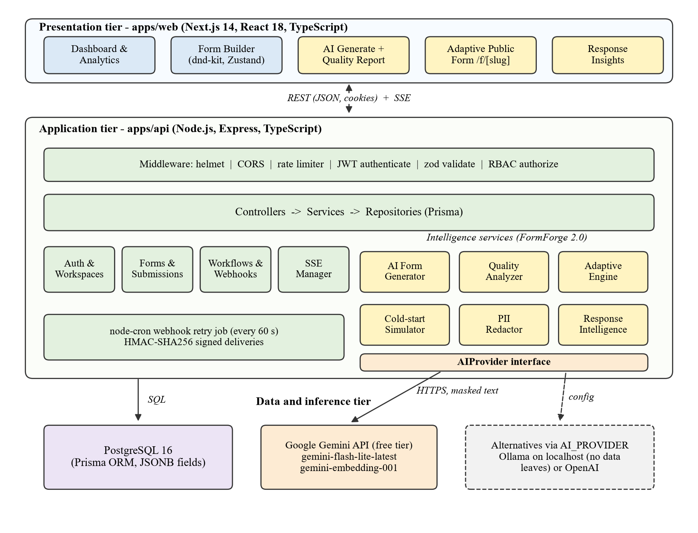
System Architecture
Three tiers
Next.js client, Express API, PostgreSQL + Gemini API
Fixed middleware chain
helmet, CORS, rate limit, JWT, zod, RBAC
Layered API
routes, controllers, services, repositories
One AIProvider interface
Gemini free tier by default, masked text only
Notes:
Yellow boxes are the new FormForge 2.0 services; green are the original platform. All model calls go through the AIProvider interface, which defaults to the Gemini free tier and only ever receives masked text.

Slide 11
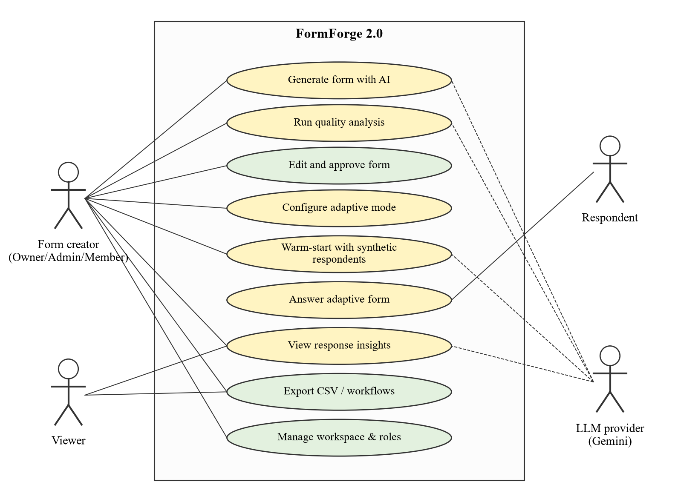
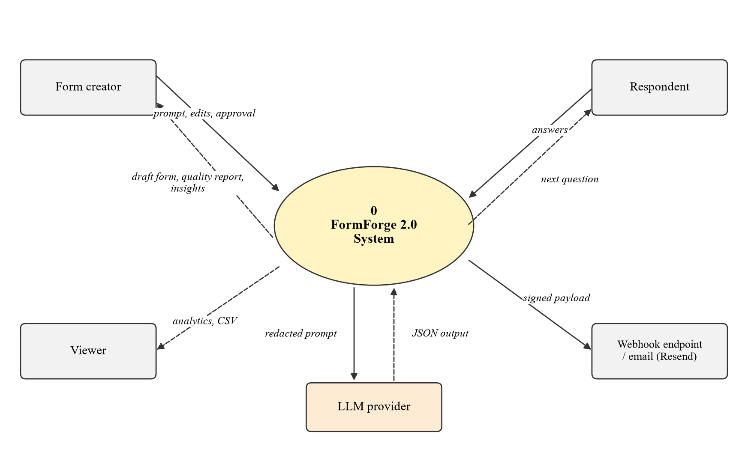
Use Case and Data Flow Diagrams
Use case: creator, viewer, respondent; LLM provider as secondary actor
DFD level 0: only redacted text flows to the model; only JSON returns
Notes:
The respondent never logs in. The language model supports generation, quality review, the simulator and insights but is never used while a respondent answers.

Slide 12
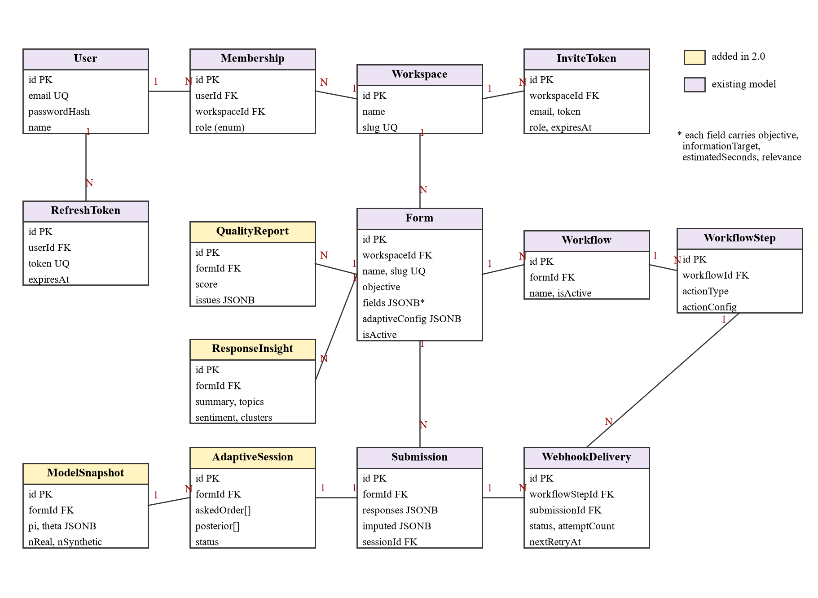
Data Model
9 existing models kept unchanged
Only three columns added: Form.objective, Form.adaptiveConfig, Submission.imputed
QualityReport
score, issues, time
AdaptiveSession
asked order, posterior
ModelSnapshot
pi, theta, nReal, nSynthetic
ResponseInsight
summary, topics, sentiment
Notes:
Question metadata lives inside the existing fields JSON, so older forms stay valid. Predicted values are stored separately from real answers.

Slide 13
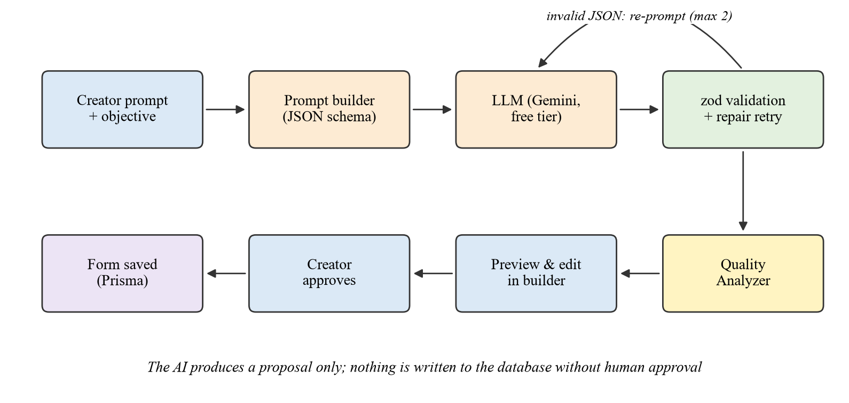
AI Form Generation with a Free LLM
Every question carries metadata
{
"label": "Mentor feedback?",
"type": "RATING",
"required": false,
"objective": "Mentoring",
"informationTarget":
"mentor_quality",
"estimatedSeconds": 12,
"relevance": 0.9
}
Human in the loop: the model returns a proposal only. It opens in the existing builder and nothing is saved until the creator approves.
Used later by the analyzer and the adaptive engine
Notes:
Schema enforced with zod; all properties required and nullable after the structured-output issue we hit with optional fields. Invalid JSON is sent back for repair at most twice. Gemini rejects some JSON Schema keywords, so the model gets a structure-only schema and zod does the full check. A 10-question draft takes about 5 to 7 seconds.

Slide 14
Form Quality Analyzer
Double-barrelled
Leading
Quality score
"How satisfied were you with your mentor and project?"
"How much did you enjoy our excellent service?"
Score = max(0, 100 - Σ w(issue))
12 for double-barrelled or leading
8 for ambiguous or redundant
5 for readability
6 for required ratio or time
Ambiguous
Redundant
"Do you exercise regularly?"
"How happy..." vs "How satisfied..."
Readability
Burden
Rules run instantly in the builder; an optional AI review adds depth
Flesch below 50 (6+ words) or over 25 words
Required ratio over 70%; time over 5 min
Completion time = base time by field type + reading time (3.5 words/s) + 0.6 s per option
Notes:
The categories follow the error types reported by Reed et al. 2024 and the checks used in Adhikari et al. 2025. Findings are suggestions; the creator decides.

Slide 15
Adaptive Engine: Choosing the Next Question
U(q) = α·IG(q) + β·Rel(q) + γ·Cov(q) − δ·Bur(q) − ε·Red(q)
IG
Rel
Cov
Bur
Red
Information gain
Relevance
Coverage
Burden
Redundancy
Expected drop in uncertainty over all unanswered questions
How central the question is to the form objective
1 if its information target is still unknown
Estimated answering time, normalised
Max normalised mutual information with answered questions
α = 0.40
β = 0.15
γ = 0.20
δ = 0.10
ε = 0.30
Respondent model: latent class model (K = 6) fitted with EM. Posterior over classes after each answer gives predictions for every unasked question.
Notes:
Information gain is the only term that reacts to the respondent's own answers, so it has the largest weight. Redundancy is next because asking two questions that measure the same thing is wasted effort.

Slide 16
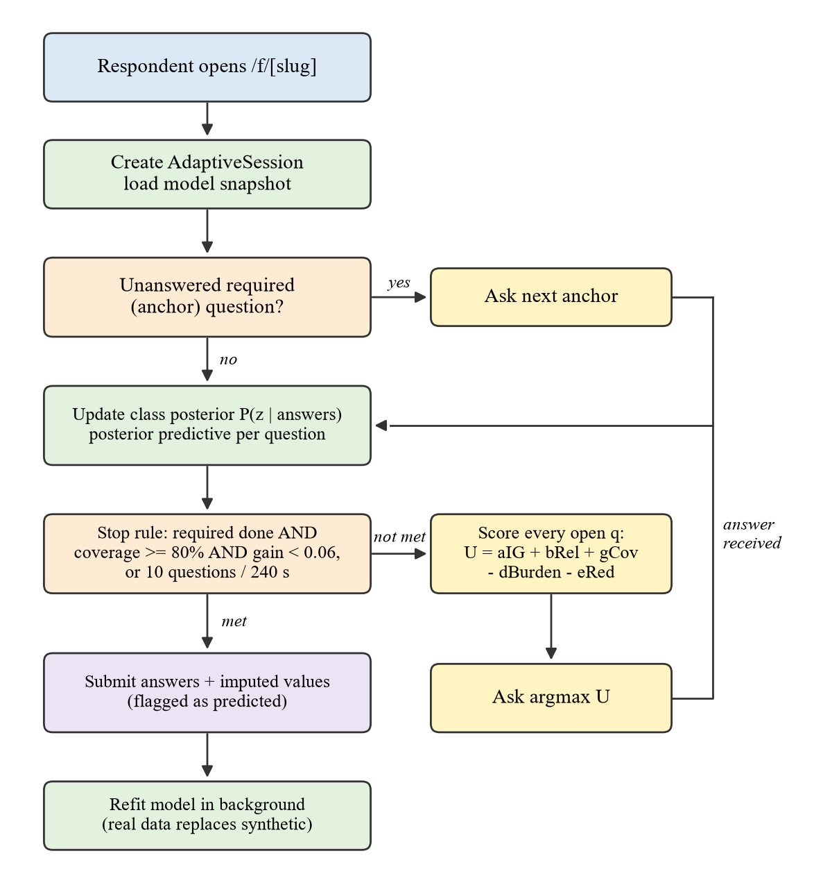




Adaptive Engine: Flow and Safety Rules
Anchors first
Required questions are asked first, in the creator's order
Never repeat
No question asked twice; never more than 10 or 240 s
Stop rule
Coverage ≥ 80% and remaining gain < 10% of maximum
Honest output
Skipped answers predicted, stored and labelled separately
Hidden scores
Respondents never see utilities or predictions
Notes:
Anchors-first came from an early experiment where the engine picked the redundant satisfaction question first and was then forced to ask the required one too. Verified on 7,500 simulated sessions with zero rule violations.

Slide 17




Cold Start with Synthetic Respondents
New form
Personas
Synthetic answers
Weighted fit
Real data takes over
0 real responses
The LLM writes varied respondent profiles
Options shuffled per persona, letter-labelled
EM on synthetic + real data
Synthetic weight decays
Synthetic weight
Used only to initialise, never as data
w(n) = 25 / (25 + n)
LLM respondents show low variance and an acquiescence shift of +0.84 SD (Lukauskas & Šarkauskaitė, 2026; Bisbee et al., 2024). Synthetic rows are kept apart and never appear in responses, exports or insights.
n = real responses. Full weight at 0, half at 25, one fifth at 100.
Notes:
Inspired by Bachmann et al. 2025, who pre-trained an adaptive questionnaire with GPT-4 answers. We follow the same design with a free model, with a decaying weight so real data takes over. In a live check, 40 Gemini personas took 14 seconds and lifted prediction accuracy from 56% to 73% before any real response.

Slide 18
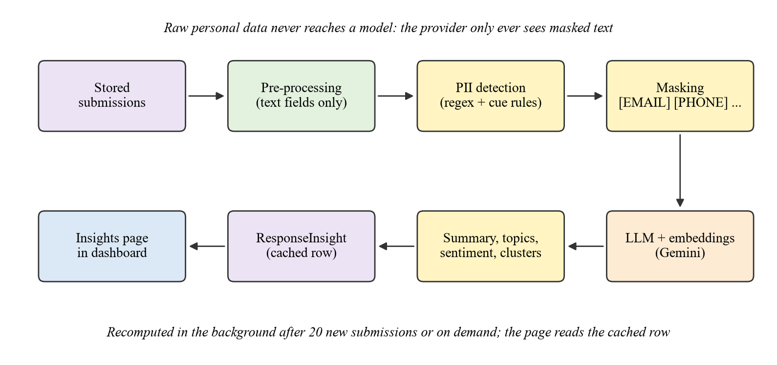
Privacy Layer and Response Intelligence
Insights from open answers
Summary, topics with counts, sentiment, clusters per question
Computed in the background every 20 responses
Detects email, phone, URL, IP, Aadhaar, PAN, register no., names
Prompt-injection safeguards
Answers sent as delimited data, never as instructions
Model returns answer numbers, not quotes
Insights are display-only; never trigger actions
Masking example
IN Reach me on 7012345678 or at a.k@vit.ac.in
OUT Reach me on [PHONE] or at [EMAIL]
Notes:
The provider only ever sees masked text: in the demo, all 8 planted personal details were masked and none reached the model. Results are cached so the page never waits on a model.

Slide 19
Implementation and Testing
95
29 / 29
15
7,500
unit tests, incl. 3 parity tests vs Python
API tests on a real database
new API endpoints
simulated sessions, 0 rule violations
Test case | Result
Duplicate e-mail registration | 409 Conflict
Access another workspace | 403 Forbidden
Missing required field | 400, field named
6th public submit in a minute | 429 Rate limited
Unpublished form by slug | 404
Webhook workflow on submit | Delivery queued, HMAC signed
Adaptive session limits | No repeats, limit kept, anchors first
PII in insights | Masked; nothing personal sent
PII in insights | Masked; nothing personal sent
Issues found and fixed
Optional schema fields rejected: made required + nullable
Gemini schema limits: structure-only schema
Redundant early pick (98%): anchors first, now 0%
CSV labels with commas: RFC 4180 writer
Model change mid-session: snapshot pinned
Notes:
The 29 functional tests run the real Express app against a PostgreSQL test database, with a fake model so the run is repeatable. The engine constraints were also verified on 7,500 simulated sessions.

Slide 20
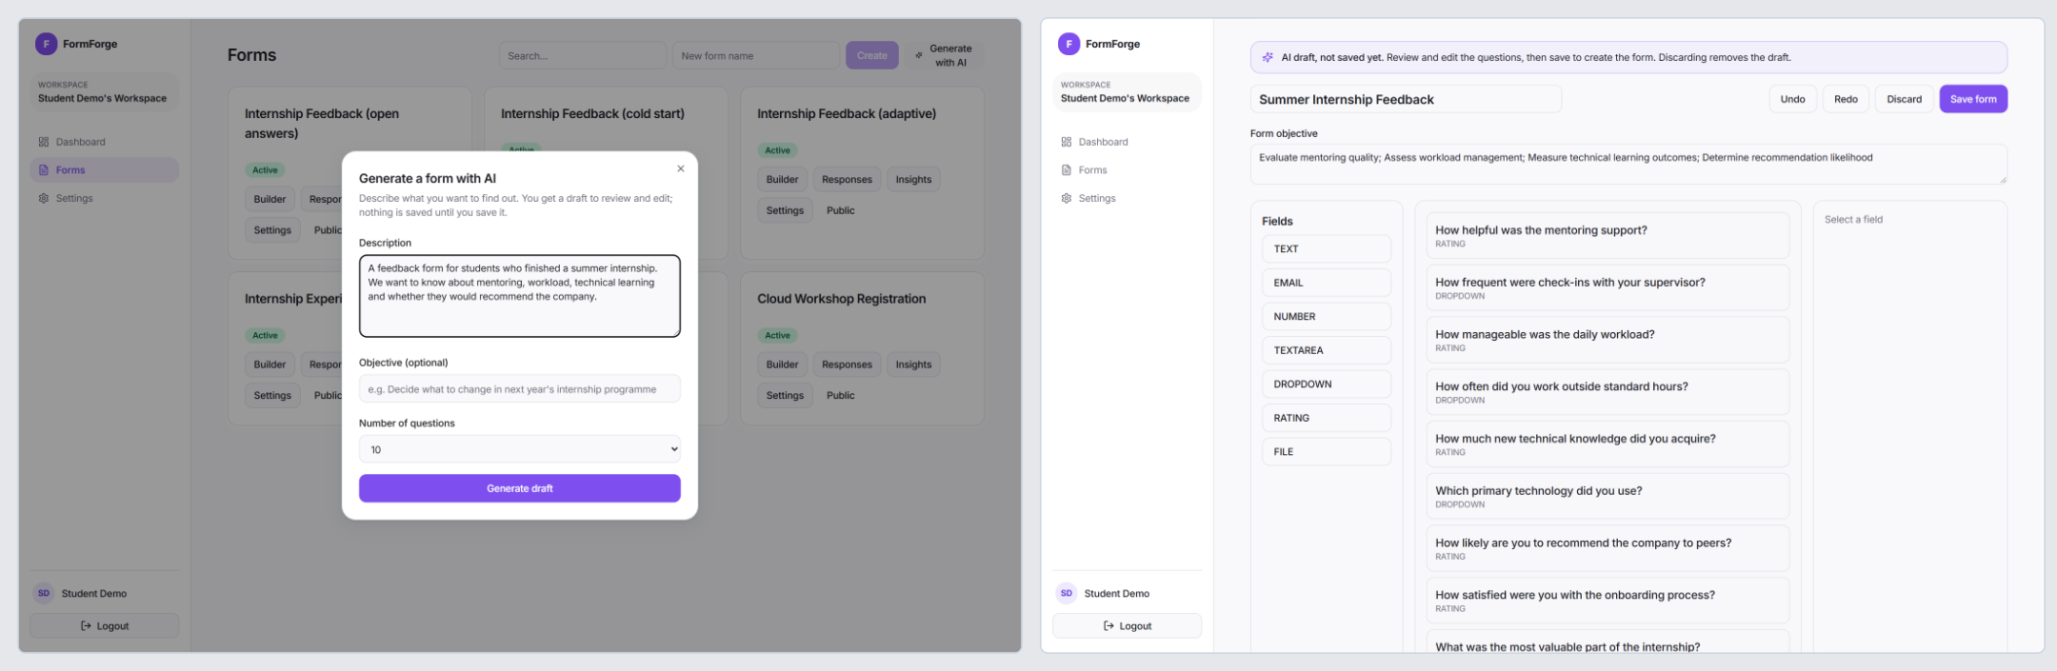
Working System
AI draft in 7 s, opened in the builder
Respondent view | quality report
Insights on masked answers: summary, sentiment, topics
Describe form
AI draft + quality report
Edit and approve
Publish adaptive
Publish adaptive
Insights
Insights
Notes:
Show the live demo here if possible: generate a form, look at its quality report, publish it in adaptive mode, answer it on a phone, and open insights.

Slide 21


Experimental Setup
16-question form
Three systems compared
Internship feedback: 3 required anchors, 1 deliberately redundant question
Static: all 16 questions in order
Rule-based: hand-written skip logic
FormForge adaptive: utility engine, max 10 questions
Simulated respondents
4 latent groups, correlated traits, noise; true answer known for every question
Break-off model
Seven metrics
Quit hazard grows with elapsed time; same patience for all systems (paired)
Questions asked, completion time, completion rate
Information coverage, redundant questions
Prediction accuracy, targets per question
Protocol
Model trained on 3,000; tested on 1,500; repeated with 5 seeds
Notes:
Simulation is the only way to know the true answers to skipped questions. A field study with students is in the future scope.

Slide 22
Adaptive vs Static vs Rule-Based
−35%
questions asked
13.7 → 8.9
−35%
completion time
146 s → 95 s
+14.1 pts
completion rate
70.3% → 84.5%
0
redundant questions
static asked 0.31 per person
Same information, fewer questions: adaptive coverage 82.1% vs 85.4% static, at 1.53 vs 0.93 targets per question
Notes:
Skipped answers are predicted, exactly right 56.6% and within one point 84.5% of the time. They are labelled as predicted, never treated as answers.

Slide 23
Cold Start and Ablation
Simulation: 53% → 85% before any real response. Live check with 40 Gemini personas: 56% → 73% (real data: 82%)
The respondent model matters most: a fixed top-10 order asks 0.33 redundant questions per person vs 0 for the engine
Notes:
Cold start follows Bachmann et al. 2025. Caveat: synthetic data in the simulation shares the model's structure; the live check with real Gemini personas gave a smaller but clear gain (56% to 73% within one point, against 82% with real data). Ablation shows information gain and the respondent model drive the gains.

Slide 24
Quality Analyzer, PII Masking and Cost
F1 0.91
PII detection
20 of 23 entities masked; precision 0.95, recall 0.87
₹0
recurring cost
Free tier, no API bills
Gemini free tier for generation and embeddings
PostgreSQL + Node.js in Docker, all open source
Only masked text leaves the machine; Ollama keeps all local
Accuracy 90% for flagged vs clean questions
Notes:
Double-barrelled recall is lowest because the rule misses pairs separated by an article. Cost is zero by design. The trade-offs are free-tier rate limits, handled with retries and background jobs, and that masked text leaves the machine; Ollama avoids that for sensitive forms.

Slide 25
Conclusion and Future Scope
What we showed
Future scope
35% fewer questions and 35% less time with almost the same information
Field study with students: static vs adaptive
Learn utility weights per form (contextual bandits)
Grow the question bank from open answers
Local NER model for stronger PII masking
Adaptive selection for free-text questions
AI generation and quality checks at zero cost
Synthetic warm start works for brand-new forms
Privacy by design: masking before every model call
Thank you | Questions?
Notes:
Close with the one-line takeaway: a form does not have to be a fixed list. Then invite questions.

