Slide 1
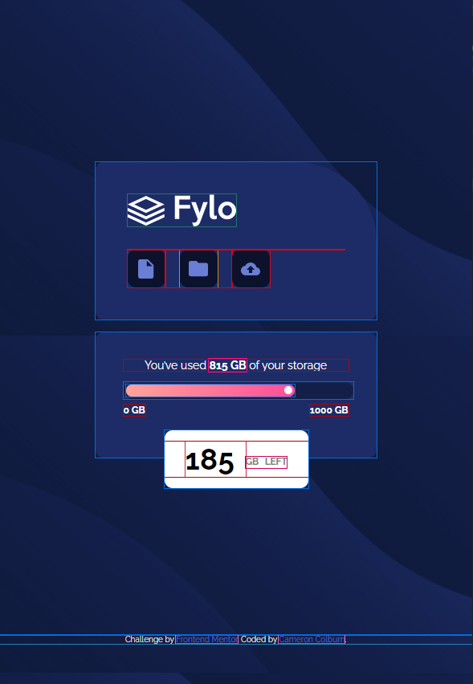
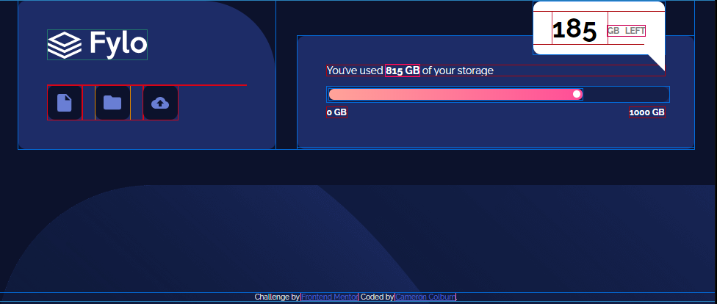
/* ########## Storage Container ########## */
.storage-container {
background-color: hsl(228, 56%, 26%);
border-radius: 10px;
display: inline-block;
position: relative;
width: 100%;
} .storage-header {
color: #fff;
line-height: 1.0em;
margin: 0 0 14px 0;
text-align: center;
} .storage-content {
overflow: auto;
padding: 34px 35px 52px;
} .p-min-value {
color: #fff;
float: left;
font-size: 0.75rem;
margin: 0;
} .p-max-value {
color: #fff;
float: right;
font-size: 0.75rem;
margin: 0;
} .gauge-container {
background: hsla(229, 57%, 11%, 0.5);
border: none;
border-radius: 30px;
height: 15px;
margin-bottom: 7px;
padding: 3px;
position: relative;
width: 100%;
} .gauge-fill {
background: linear-gradient(to left,
hsl(335, 100%, 65%), hsl(6, 100%, 80%));
border-radius: 30px;
height: 100%;
position: relative;
width: 75%;
} .gauge-fill::after {
border-bottom: 5px solid #fff;
border-left: 5px solid #fff;
border-right: 5px solid #fff;
border-top: 5px solid #fff;
border-radius: 50%;
bottom: 3px;
content: '';
height: 0;
position: absolute;
right: 3px;
width: 0;
} #alert {
background: #fff;
border-radius: 10px;
width: 179px;
height: 72px;
left: 50%;
margin-left: -89px;
position: absolute;
top: 122px;
} .alert-text {
color: grey;
font-size: 0.875rem;
font-weight: 700;
text-align: center;
text-transform: uppercase;
word-spacing: 5px;
} .alert-value {
color: #000;
font-size: 2.3125rem;
font-weight: 700;
}
html {
height: 100%;
} body {
background: hsl(229, 57%, 11%) url('images/bg-mobile.png') no-repeat;
font-family: 'Raleway', sans-serif;
font-size: 0.875rem;
margin: 0;
padding: 0;
} .container {
display: flex;
flex-direction: column;
height: 87vh;
justify-content: center;
padding: 25px;
/* border: 1px solid red; */
}
/* ########## Upload Container ########## */
.upload-container {
background-color: hsl(228, 56%, 26%);
border-radius: 10px 100px 10px 10px;
display: inline-block;
font-size: 0;
margin-bottom: 16px;
width: 100%;
} .upload-content {
overflow: auto;
padding: 40px;
} img {
margin: 0 0 29px;
} ul {
margin: 0;
padding: 0;
list-style-type: none;
} li {
float: left;
} .button-style {
background-color: hsl(229, 57%, 11%);
background-repeat: no-repeat;
background-position: center center;
border: none;
border-radius: 10px;
height: 47px;
width: 47px;
} .button1 {
background-image: url('images/icon-document.svg');
} .button2 {
background-image: url('images/icon-folder.svg');
margin: 0 18px;
} .button3 {
background-image: url('images/icon-upload.svg');
}
/* ########## Media Queries ########## */
@media (min-width: 376px), (min-height: 668px) {
body {
background: hsl(229, 57%, 11%) url('images/bg- desktop.png') repeat 25% 0;
}
.container {
min-height: 470px;
} .upload-container, .storage-container {
margin: 0 auto 16px auto;
max-width: 350px;
}
} @media (min-width: 976px) {
body {
background: hsl(229, 57%, 11%)
url('images/bg-desktop.png') no-repeat
left 0 bottom -12px; }
.container {
align-items: flex-end;
display: flex;
flex-direction: row;
height: 100%;
justify-content: space-between;
margin: 20% auto;
max-width: 920px;
min-height: unset;
padding: 0;
}
.upload-container {
margin: 0;
} img {
margin: 0 0 35px;
} .storage-container {
height: 154px;
margin: 0;
max-width: 540px;
} .storage-content {
padding: 40px;
} .storage-header {
margin: 0 0 15px 0;
text-align: left;
} #alert {
bottom: 0;
left: 321px;
margin-left: 0px;
position: absolute;
top: -47px;
}
#alert::before {
border-top: 10px solid #fff;
border-right: 28px solid #fff;
border-bottom: 28px solid transparent;
content: "";
height: 0;
left: 151px;
position: absolute;
top: 57px;
width: 0;
}
}
<!DOCTYPE html>
<html lang="en">
<head>
<meta charset="UTF-8">
<meta name="viewport" content="width=device-width, initial-scale=1.0">
<link rel="icon" type="image/png" sizes="32x32" href="./images/favicon-32x32.png">
<link href="https://fonts.googleapis.com/css2?family=Raleway:wght@400;700&display=swap" rel="stylesheet">
<link rel="stylesheet" href="styles.css">
<title>Frontend Mentor | Fylo data storage component</title>
</head>
<body>
<div class="container">
<!-- Upload Container -->
<div class="upload-container">
<div class="upload-content">
<img src="images/logo.svg" alt="company logo">
<ul>
<li><button class="button-style button1" title="Document Upload Button" type="button"></button></li>
<li><button class="button-style button2" title="Folder Upload Button" type="button"></button></li>
<li><button class="button-style button3" title="Cloud Upload Button" type="button"></button></li>
</ul>
</div>
</div>
<!-- Storage Container -->
<div class="storage-container">
<div class="storage-content">
<p class="storage-header">You’ve used <strong>815 GB</strong> of your storage</p>
<div class="gauge-container">
<div class="gauge-fill"></div>
</div>
<div id="alert">
<p class="alert-text"><span class="alert-value">185 </span> <sup>GB Left</sup></p>
</div>
<p class="p-min-value"><strong>0 GB</strong></p>
<p class="p-max-value"><strong>1000 GB</strong></p>
</div>
</div>
</div>
<!-- Frontend Mentor Attribution -->
<div class="attribution">
Challenge by <a href="https://www.frontendmentor.io?ref=challenge" target="_blank">Frontend Mentor</a>.
Coded by <a href="#">Cameron Colburn</a>.
</div> </body> </html>

