Slide 1

INSTITUTE OF TECHNOLOGY OF CAMBODIA
Department : Génie Informatique et Communication
Topic : Smart Room
Lecturers
1. CHUN Thavarak (Advance Computer Architecture)
2. HENG Sothearith (Internet Programming)
Members:
1. CHIM Sopheaktra 2. VONG Tith
3. BLANG Vibol 4. MICH Mongkul
5. SOK Chamraen 6. KRY Chulsa
7. CHOU Seakny
2017-2018

Slide 2
CONTENT
Introduction ……………….
Problematic .……………………
Objective …..…………………....
Process ………………………....
Work flow
Equipment
Diagram
Coding …………………………….
Technology
Functionality
Demo ……………………………
Conclusion …………………………

Slide 3
I. INTRODUCTION
SmartRoom is an IOT project to create a room which equipped with hardware device(sensor and light) which can control and monitor via website.

Slide 4
II. Problematic
Nowadays, all equipment in side our house can only be controlled manually and directly, and difficult to monitor.

Slide 5
III. Objective
To create the room which equipped with light and sensor that can be controlled and monitor remotely via website

Slide 6
IV. Process 1. Work Flow:
Name | Arduino code | Web+ Arduino connection | Web design | Database | House architecture | Support
CHIM Sopheaktra |  |  |  | 
VONG Tith |  |  |  |  | 
BLAND Vibol |  |  |  |  |  | 
KRY Culsa |  |  |  |  |  | 
MICH Mongkul |  |  |  |  |  | 
SOK Chamrean |  |  |  |  |  | 

Slide 7
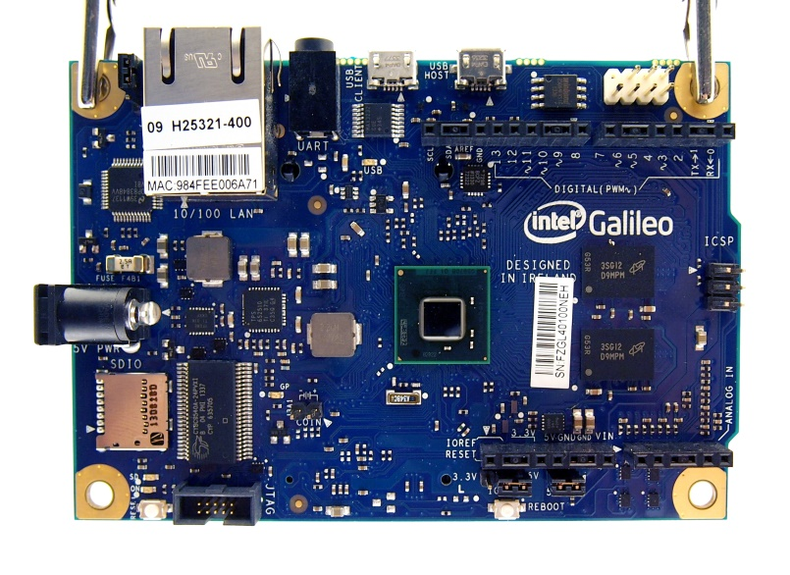
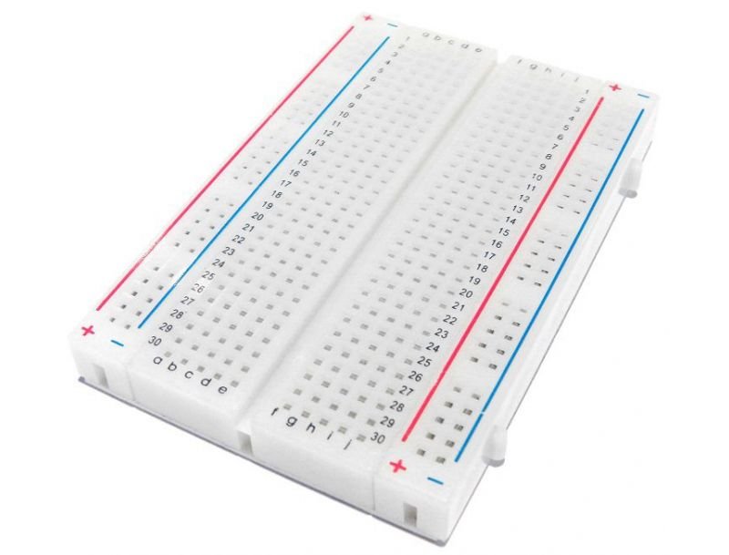
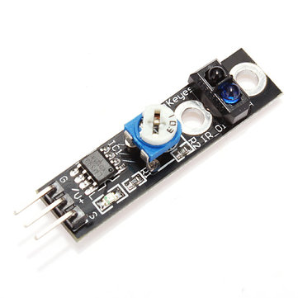

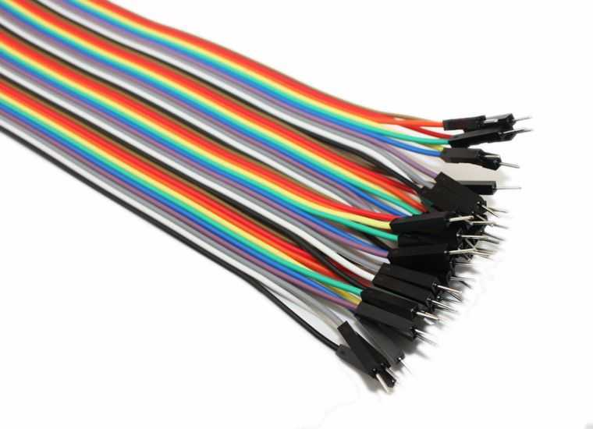
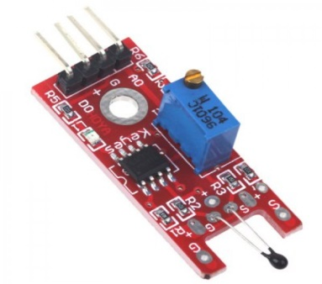
IV. Process 2. Equipment:
Intel@ Galileo GenI
Bread Board
Tracking Sensor
LED Light
Bread Board Wire
Temperature Sensor

Slide 8
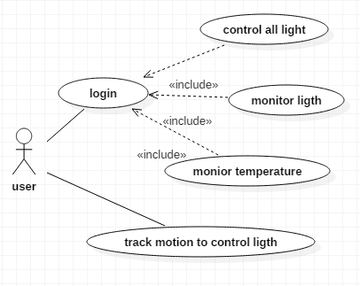
IV. Process 3. Diagram:

Slide 9
V. Coding 1. Functionality:
- Control all the light in the room
- Monitor the status of the light
- Monitor the temperature in the room
- Sensor tracking to turn on/off light

Slide 10




V. Coding 2. Technology:

Slide 11
DEMONSTRATION START!

Slide 12
VII. Conlusion:

