Slide 1
Projet JAVAEE – WARZONE
Guillaume Vouilloz & Nicolas Solioz
Notes:
1
1
1
1

Slide 2
Concept général de l’application
Notes:
2
2
2
2
2

Slide 3
Entités

Slide 4
Technologies implémentées
foreach(techno in techRequired)
{
techno.use = true;
}
System.out.println (“Project done !”);
JSF
Facelets
Stateless EJB
JNDI
dependency injection
@TransactionAttribute
Entities
Mapping associations and relations
Transitive persistence
JPQL
Inheritanc:

Slide 5
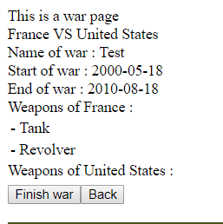
Highlights
<property name="hibernate.enable_lazy_load_no_trans“ value="true" />
<h:dataTable value="#{WarZoneBean.tmpWar.countryTwo.weapons}" var="weapon">
<h:column>- #{weapon.name}</h:column>
</h:dataTable>
public void FinishWar(War war) {
Date today = new Date();
war.setEndDate(today);
em.merge(war);
}

