Slide 1

Unit 2 Part 1 :TCP
23.<number>
Copyright © The McGraw-Hill Companies, Inc. Permission required for reproduction or display.

Slide 2
23-1 PROCESS-TO-PROCESS DELIVERY
The transport layer is responsible for process-to-process delivery—the delivery of a packet, part of a message, from one process to another. Two processes communicate in a client/server relationship, as we will see later.
Topics discussed in this section:
Client/Server Paradigm
Multiplexing and Demultiplexing
Connectionless Versus Connection-Oriented Service
Reliable Versus Unreliable
Three Protocols
23.<number>

Slide 3

Note
The transport layer is responsible for process-to-process delivery.
23.<number>

Slide 4

Figure 23.1 Types of data deliveries
23.<number>

Slide 5

Figure 23.2 Port numbers
23.<number>

Slide 6

Figure 23.3 IP addresses versus port numbers
23.<number>

Slide 7

Figure 23.4 IANA ranges
23.<number>

Slide 8

Figure 23.5 Socket address
23.<number>

Slide 9

Figure 23.6 Multiplexing and demultiplexing
23.<number>

Slide 10

Figure 23.7 Error control
23.<number>

Slide 11

Figure 23.8 Position of UDP, TCP, and SCTP in TCP/IP suite
23.<number>

Slide 12
23-3 TCP
TCP is a connection-oriented protocol
It creates a virtual connection between two TCPs to send data.
In addition, TCP uses flow and error control mechanisms at the transport level.
TCP is called a connection-oriented, reliable transport protocol. It add connection-oriented and reliability features to the services of IP.

Slide 13
TCP Services
Process-to-Process Communication
  Like UDP, TCP provides process-to-process communication using port numbers.
Stream Delivery Service
  TCP is a stream-oriented protocol.
  TCP, on the other hand, allows the sending process to deliver data as a stream of bytes and allows the receiving process to obtain data as a stream of bytes.
  TCP creates an environment in which the two processes seem to be connected by an imaginary "tube“ that carries their data across the Internet.

Slide 14

Table 23.2 Well-known ports used by TCP
23.<number>

Slide 15

Figure 23.13 Stream delivery
23.<number>

Slide 16

Figure 23.14 Sending and receiving buffers
23.<number>

Slide 17

Figure 23.15 TCP segments
23.<number>

Slide 18
Full-Duplex Communication
  TCP offers full-duplex service, in which data can flow in both directions at the same time.
  Each TCP then has a sending and receiving buffer, and segments move in both directions.

Slide 19
Connection-Oriented Service
  TCP, unlike UDP, is a connection-oriented protocol. When a process at site A wants to send and receive data from another process at site B, the following occurs:
    1. The two TCPs establish a connection between them.
    2. Data are exchanged in both directions.
    3. The connection is terminated.

Slide 20
  Note that this is a virtual connection, not a physical connection.
  The TCP segment is encapsulated in an IP datagram and can be sent out of order, or lost, or corrupted, and then resent.
  Each may use a different path to reach the destination. There is no physical connection.
  TCP creates a stream-oriented environment in which it accepts the responsibility of delivering the bytes in order to the other site.
  The situation is similar to creating a bridge that spans multiple islands and passing all the bytes from one island to another in one single connection.

Slide 21
Reliable Service
  TCP is a reliable transport protocol. It uses an acknowledgment mechanism to check the safe and sound arrival of data.

Slide 22
TCP Features
Numbering System
  Sequence Number
  Acknowledgment Number
Flow control
Error control
Congestion control

Slide 23
Note
The bytes of data being transferred in each connection are numbered by TCP.
The numbering starts with a randomly generated number.
23.<number>

Slide 24

Example 23.3
The following shows the sequence number for each segment:
23.<number>

Slide 25
Note
The value in the sequence number field of a segment defines the
number of the first data byte
contained in that segment.
23.<number>

Slide 26
Note
The value of the acknowledgment field in a segment defines
the number of the next byte a party expects to receive.
The acknowledgment number is cumulative.
23.<number>

Slide 27
Flow Control
  TCP, unlike UDP, provides flow control.
  The receiver of the data controls the amount of data that are to be sent by the sender.
  This is done to prevent the receiver from being overwhelmed with data.
  The numbering system allows TCP to use a byte-oriented flow control.

Slide 28
Error Control
  To provide reliable service, TCP implements an error control mechanism.
  Although error control considers a segment as the unit of data for error detection (loss or corrupted segments), error control is byte-oriented

Slide 29
Congestion Control
  TCP, unlike UDP, takes into account congestion in the network.
  The amount of data sent by a sender is not only controlled by the receiver (flow control), but is also determined by the level of congestion in the network.

Slide 30
Segment
A packet in TCP is called a segment

Slide 31

Figure 23.16 TCP segment format
23.<number>

Slide 32
Source port address. This is a 16-bit field that defines the port number of the application program in the host that is sending the segment. This serves the same purpose as the source port address in the UDP header.
Destination port address. This is a 16-bit field that defines the port number of the application program in the host that is receiving the segment. This serves the same purpose as the destination port address in the UDP header.

Slide 33
Sequence number. This 32-bit field defines the number assigned to the first byte of data contained in this segment.
  TCP is a stream transport protocol.
  To ensure connectivity, each byte to be transmitted is numbered.
  The sequence number tells the destination which byte in this sequence comprises the first byte in the segment.
  During connection establishment, each party uses a random number generator to create an initial sequence number (ISN), which is usually different in each direction.

Slide 34
Acknowledgment number.
  This 32-bit field defines the byte number that the receiver of the segment is expecting to receive from the other party. If the receiver of the segment has successfully received byte number x from the other party, it defines x + I as the acknowledgment number. Acknowledgment and data can be piggybacked together.

Slide 35
Header length. This 4-bit field indicates the number of 4-byte words in the TCP header. The length of the header can be between 20 and 60 bytes. Therefore, the value of this field can be between 5 (5 x 4 =20) and 15 (15 x 4 =60).

Slide 36
Reserved. This is a 6-bit field reserved for future use.
Control. This field defines 6 different control bits or flags as shown in Figure 23.17. One or more of these bits can be set at a time.

Slide 37

Figure 23.17 Control field
23.<number>

Slide 38

Table 23.3 Description of flags in the control field
23.<number>

Slide 39
Window size.
  This field defines the size of the window, in bytes, that the other party must maintain. Note that the length of this field is 16 bits, which means that the maximum size of the window is 65,535 bytes. This value is normally referred to as the receiving window (rwnd) and is determined by the receiver. The sender must obey the dictation of the receiver in this case.
Checksum. This 16-bit field contains the checksum.

Slide 40
TCP connection establishment

Slide 41

Figure 23.18 Connection establishment using three-way handshaking
23.<number>

Slide 42
Note
A SYN segment cannot carry data, but it consumes one sequence number.
23.<number>

Slide 43
Note
A SYN + ACK segment cannot
carry data, but does consume one
sequence number.
23.<number>

Slide 44
Note
An ACK segment, if carrying no data, consumes no sequence number.
23.<number>

Slide 45

Figure 23.19 Data transfer
23.<number>

Slide 46

Figure 23.20 Connection termination using three-way handshaking
23.<number>

Slide 47
Note
The FIN segment consumes one sequence number if it does
not carry data.
23.<number>

Slide 48
Note
The FIN + ACK segment consumes
one sequence number if it
does not carry data.
23.<number>

Slide 49

Figure 23.21 Half-close
23.<number>

Slide 50
STATE TRANSITION DIAGRAM
To keep track of all the different events happening during connection establishment, connection termination, and data transfer, TCP is specified as the finite state machine

Slide 51
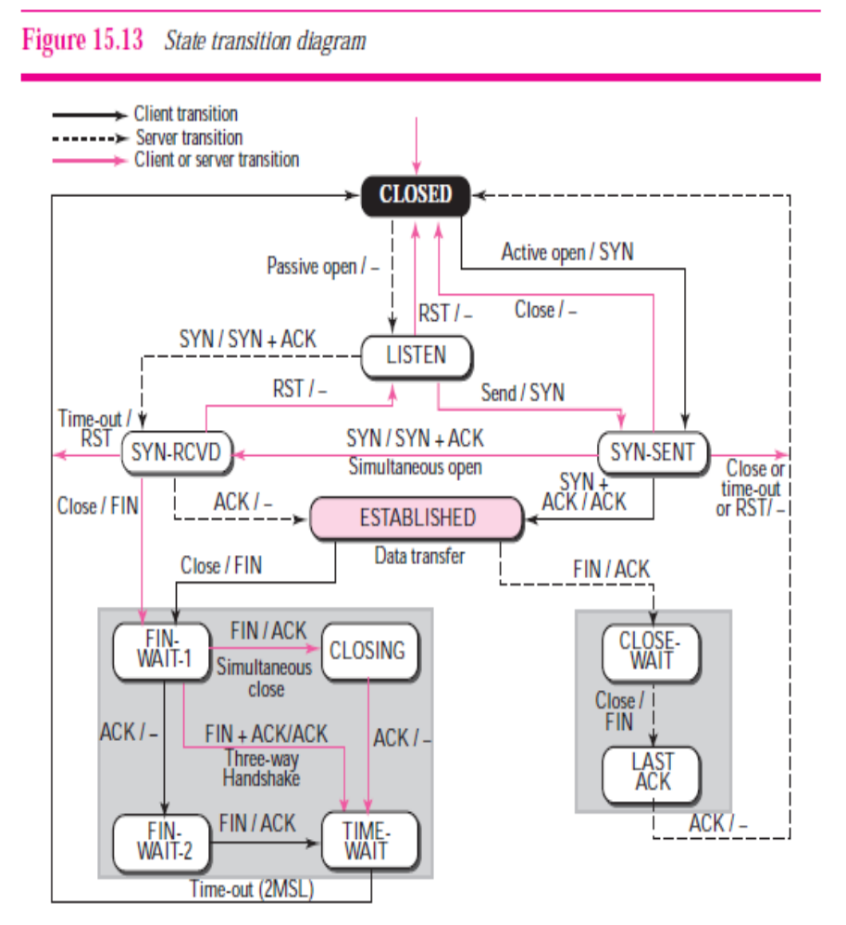

Slide 52
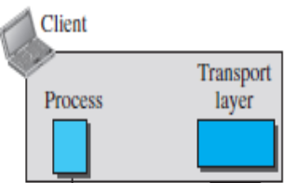
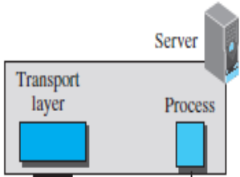









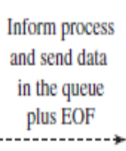



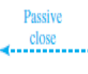
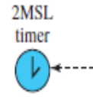


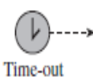





SYN
SYN+ACK
ACK
DATA TRANSFER
FIN
ACK
DATA TRANSFER
ACKNOWLEDGEMENT
FIN
ACK

Slide 53

Figure 23.22 Sliding window
23.<number>

Slide 54
Note
A sliding window is used to make transmission more efficient as well as
to control the flow of data so that the destination does not become
overwhelmed with data.
TCP sliding windows are byte-oriented.
23.<number>

Slide 55
Example 23.4
What is the value of the receiver window (rwnd) for host A if the receiver, host B, has a buffer size of 5000 bytes and 1000 bytes of received and unprocessed data?
Solution
The value of rwnd = 5000 − 1000 = 4000. Host B can receive only 4000 bytes of data before overflowing its buffer. Host B advertises this value in its next segment to A.
23.<number>

Slide 56
Example 23.5
What is the size of the window for host A if the value of rwnd is 3000 bytes and the value of cwnd is 3500 bytes?
Solution
The size of the window is the smaller of rwnd and cwnd, which is 3000 bytes.
23.<number>

Slide 57
Example 23.6
Figure 23.23 shows an unrealistic example of a sliding window. The sender has sent bytes up to 202. We assume that cwnd is 20 (in reality this value is thousands of bytes). The receiver has sent an acknowledgment number of 200 with an rwnd of 9 bytes (in reality this value is thousands of bytes). The size of the sender window is the minimum of rwnd and cwnd, or 9 bytes. Bytes 200 to 202 are sent, but not acknowledged. Bytes 203 to 208 can be sent without worrying about acknowledgment. Bytes 209 and above cannot be sent.
23.<number>

Slide 58

Figure 23.23 Example 23.6
23.<number>

Slide 59
Note
Some points about TCP sliding windows:
❏ The size of the window is the lesser of rwnd and
cwnd.
❏ The source does not have to send a full window’s
worth of data.
❏ The window can be opened or closed by the
receiver, but should not be shrunk.
❏ The destination can send an acknowledgment at
any time as long as it does not result in a shrinking
window.
❏ The receiver can temporarily shut down the
window; the sender, however, can always send a
segment of 1 byte after the window is shut down.
23.<number>

Slide 60
Note
ACK segments do not consume sequence numbers and are not acknowledged.
23.<number>

Slide 61
Note
In modern implementations, a retransmission occurs if the retransmission timer expires or three duplicate ACK segments have arrived.
23.<number>

Slide 62
Note
No retransmission timer is set for an ACK segment.
23.<number>

Slide 63
Note
Data may arrive out of order and be temporarily stored by the receiving TCP,
but TCP guarantees that no out-of-order segment is delivered to the process.
23.<number>

Slide 64

Figure 23.24 Normal operation
23.<number>

Slide 65

Figure 23.25 Lost segment
23.<number>

Slide 66
Note
The receiver TCP delivers only ordered data to the process.
23.<number>

Slide 67

Figure 23.26 Fast retransmission
23.<number>

