Slide 1

Weekly analysis group meeting 31/10/24

Slide 2
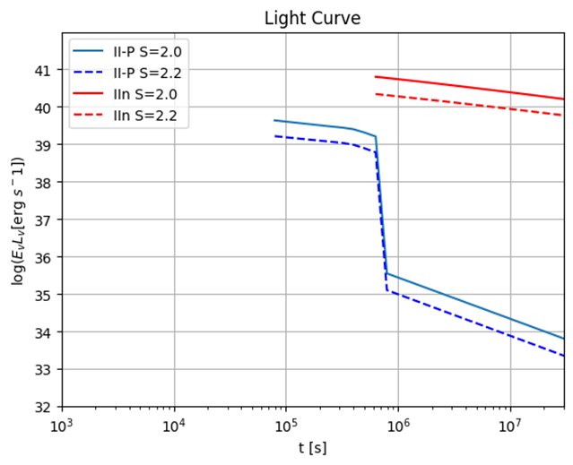
Step 1: Model of the Light Curve
We used the neutrino flux by Murase simulation:
(https://github.com/pegasuskmurase/ModelTemplates/tree/main/SNHEMM)
Firstly, we managed to reproduce the Light Curve (fig 1 from the paper) for IIn and II-P type SN.
Light curves for various type
of SN at Ev = 1TeV

Slide 3
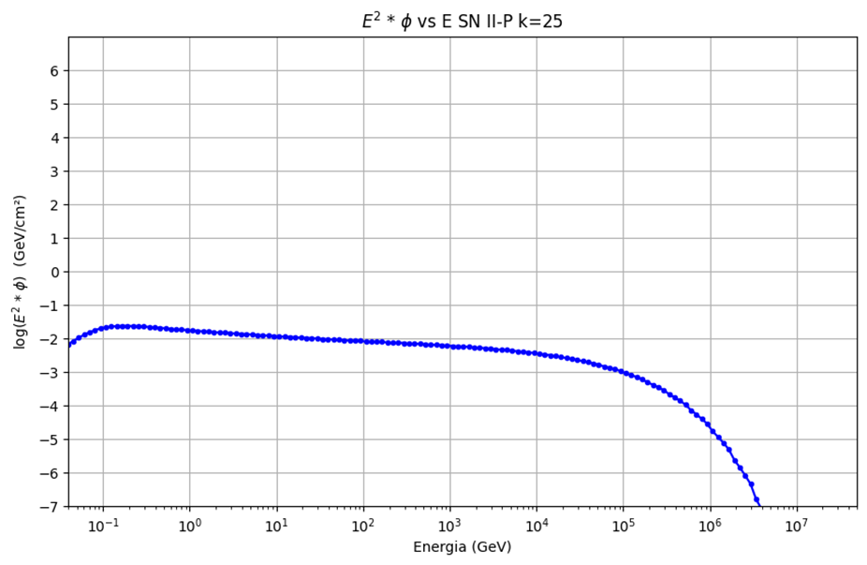
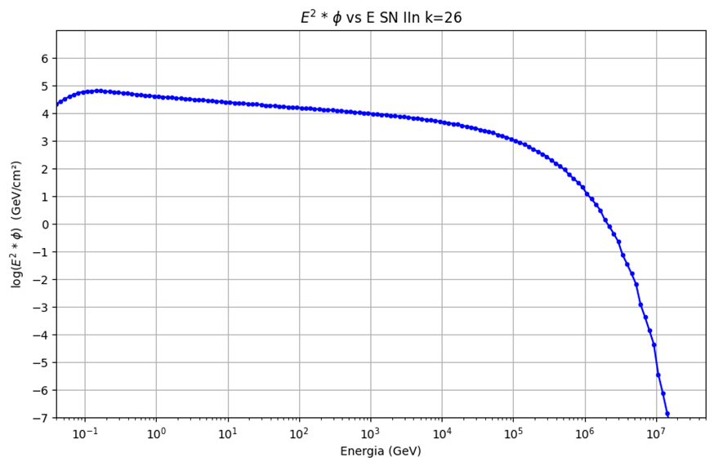
Step 2: Model of the Fluence
We also reproduced the fluences of neutrinos, for both type of SN, considering the time t_νmax, which is the time when the significance of neutrino emission becomes the maximum. (See fig. 2 right from this other Murase’s paper)

Slide 4
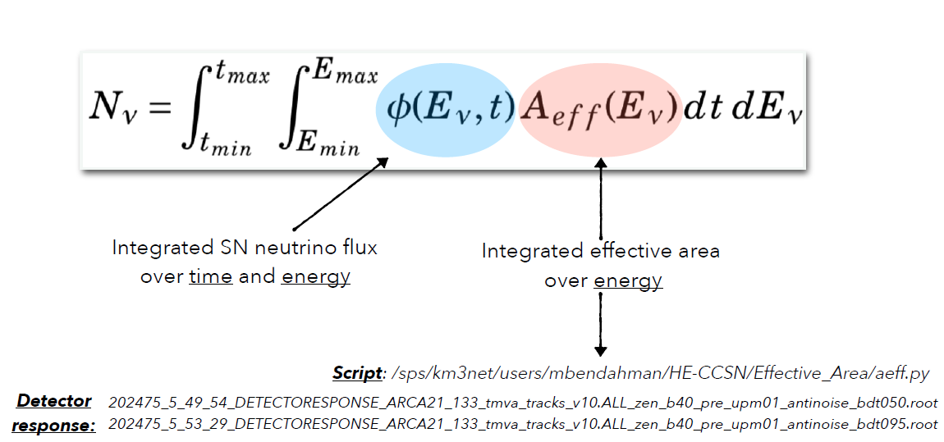
Step 3: Event rate
The fluences will be used as inputs for gSeaGen simulation (we are waiting for Anna Sin.)
The light curves will be used for the time-dependent unbinned likelihood (signal time PDF)
In the meanwhile, we have been focusing on reproducing the expected number of neutrinos, considering time range correspondent to the HE neutrino emission as predicted in the Murase model.

Slide 5
Step 3: Event rate
Duration of the HE neutrino emission
We would like to consider the Aeff at different declinations, according (for example) to the different SNe registered in 2022, 2023.. during ARCA8/ARCA21 period
→ we need to do new catalogue selection (for example within 10 kpc to 10 Mpc)

Slide 6
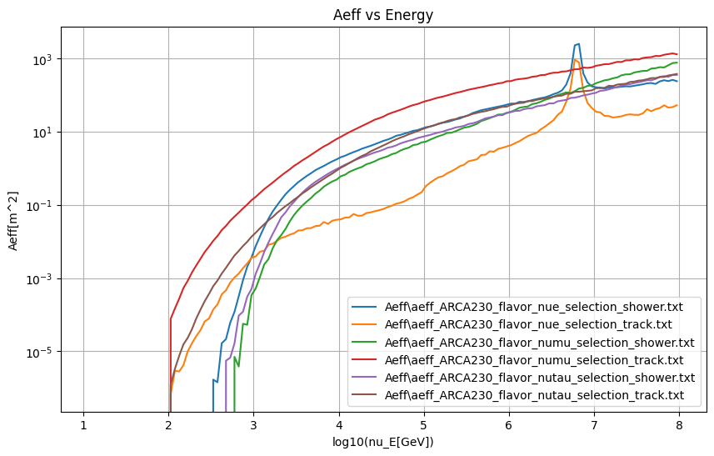
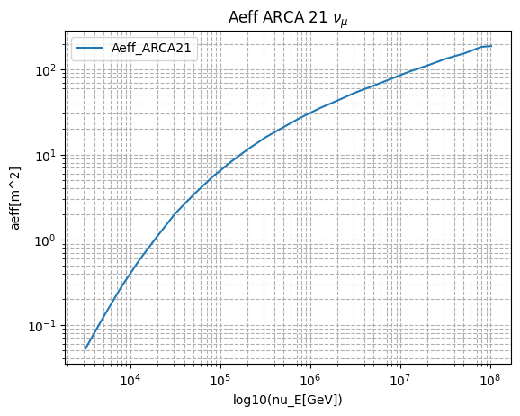
Step 3: Event rate
At the beginning, Thijs kindly helped with the ARCA230 Aeff, and Meriem with ARCA21 Aeff but this is averaged over all declination (we discover that is wrong to use these Aeff when you have a specific declination):

Slide 7
Summary of next steps
Compute Aeff for specific declination
Compute the number of expected events related to certain declinations considering different SN models
New catalogue of SN with different distances (for example from 10 Kpc to 10 Mpc)
Question to the group:
is it correct to consider the discovery time as the time of explosion?
In case not, how it is possible to retrieve this information? —> we need it because the HE emission occurs mostly about 10^5 seconds after the explosion

