Slide 1
CC-SNe high-energy neutrino emission overview & goals

Slide 2
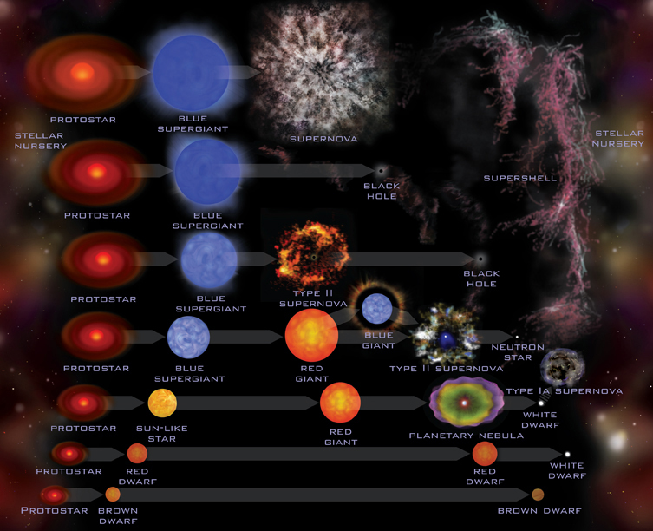
Stellar evolution and neutrinos
The interplay between the gravitational, the electromagnetic and the nuclear forces determines the life evolution of stars. The force field that holds the nuclei in the star core is due to the gravitational pressure of matter present in the outer layers.
A star is a system in equilibrium between pressure due to gravity and pressure due to radiation produced by fusion reactions in the core.
The energy of stars is provided by nuclear fusion reactions in their core, and their evolution strongly depends on their mass.
The stars shine through nuclear fusion reactions. As light elements (starting from hydrogen) are burned, stars slowly evolve.
Their central temperature is adjusted so that the average thermal energy of a nucleus is small compared to the Coulomb repulsion from potential fusion partners. The large Coulomb repulsion, which corresponds to few MeV, slows the nuclear reaction rates to long time scales. Nuclear fusion reactions are possible because of the tunneling effect through a potential barrier.
The Sun, through the Standard Solar Model (SSM), is the only star for which the stellar evolution theory can be deeply tested.
The neutrinos are probes useful to verify the theoretical predictions of the various thermonuclear processes occurring inside the Sun.
The experimental study of solar neutrinos has given a fundamental contribution to astroparticle and elementary particle physics, offering an ideal test of solar models and providing at the same time fundamental indications of the physics of the neutrino sector.

Slide 3
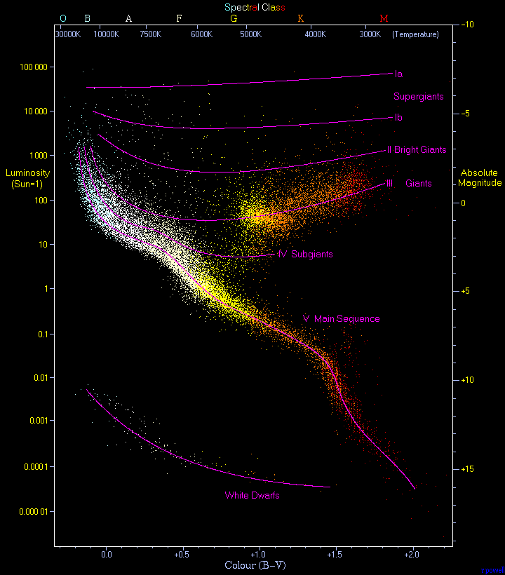
Stellar evolution and neutrinos
Approximately 80% of observed stars (called main sequence stars) lie along a path in the Hertzsprung-Russell diagram characterized by energy generation through proton burning.
Main sequence stars fuse protons to produce energy contrasting the gravitational collapse via the proton–proton (pp) or the carbon-nitrogen-oxygen (CNO) cycles, two distinct reaction chains.

Slide 4
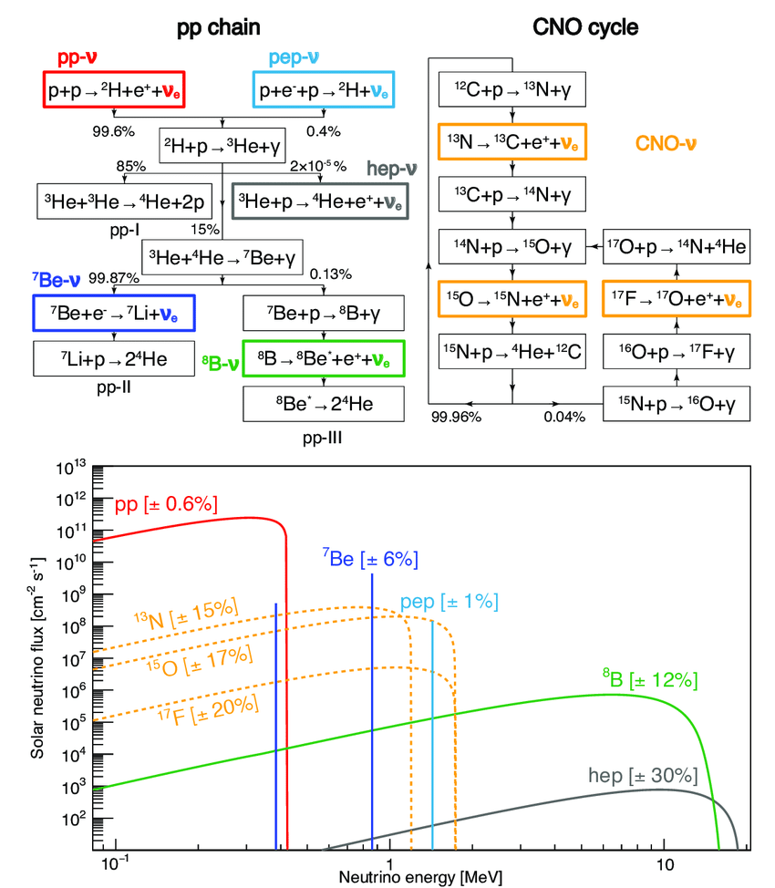
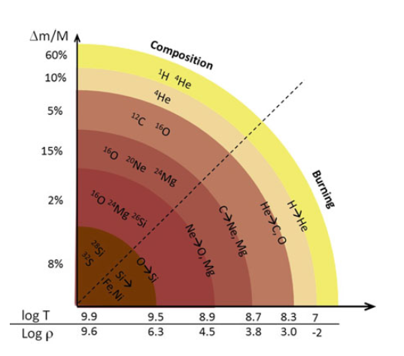
Stellar evolution and neutrinos
The branching ratios are relative to the Sun at its current stage of life
Stellar nucleosynthesis is responsible for the abundance of elements up to iron nuclei.
The first reaction of the proton-proton cycle occurs through weak interactions.
A star with roughly the solar mass, when hydrogen is exhausted, tends to contract,and to increase its density; this happens because the radiation produced by the fusion reactions is no longer able to balance the gravitational pressure.
Nucleosynthesis from nuclear fusion proceeds (according to the mass of the star) until the formation of nuclei with A ≤60. Nuclei with A ∼ 60 (the iron peak) have the highest binding energy.
Due to many other physical processes, the energy produced by fusion propagates to the surface of the star, the photosphere.
The diffusion time of photons from the stellar core to the photosphere (taking into account the γ − p cross section) is 10^5–10^6 years.

Slide 5
Stellar evolution and neutrinos
Neutrinos escape unimpeded from the stellar material and nuclear burning is needed to replace the huge amount of energy carried away.
The time scales for the silicon burning last only about tens of days.
Once the star’s inner region is made primarily of iron, further compression of the core does not ignite nuclear fusion anymore; the star cannot support its outer envelope made of concentric shells thermodynamically.
The rest of the star, without the support of the radiation, collapses, compressing the star nucleus, producing a core-collapse supernova.

Slide 6
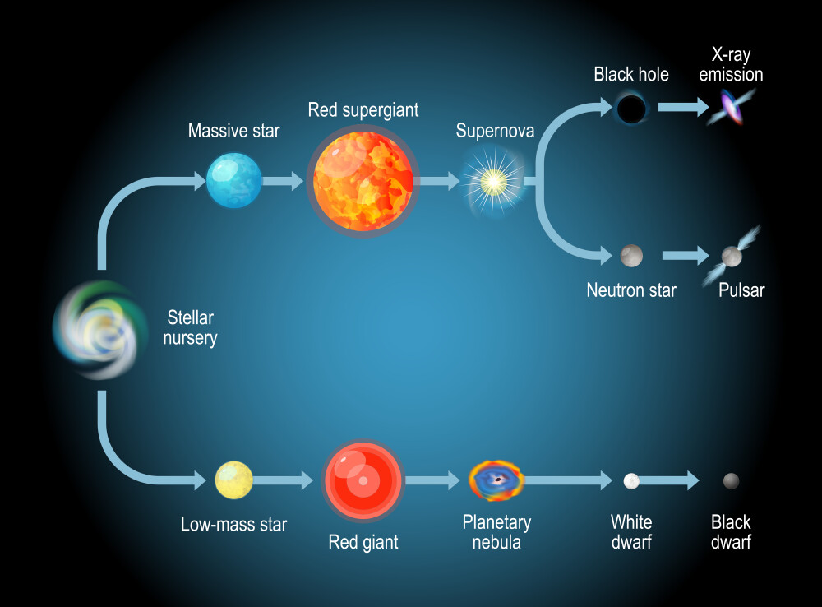
Dying stars
A systematic study of supernovae was started around 1930 with newly developed telescopes, which allowed photographing a large area of the sky.
Since then astronomers have discovered between 10 and 30 SN each year, and for most of them they measured the spectrum and the light curve, i.e., the optical luminosity as a function of time.
Connected with the possibility of measuring the spectra of the discovered SNe, the astronomers found at least two SN topologies:
If the spectrum contains lines of hydrogen, the supernova is classified as core-collapse SN or Type II. Their remnants usually have a neutron star or a black hole at their center.
Supernovae whose spectrum does not contain hydrogen lines are classified as thermonuclear SN or Type I.
The physical processes of the two SN topologies are completely different.
Towards the end of its life, stars like the Sun swells up into a red giant, before losing their outer layers as a planetary nebula and finally shrinking to become a white dwarf.

Slide 7
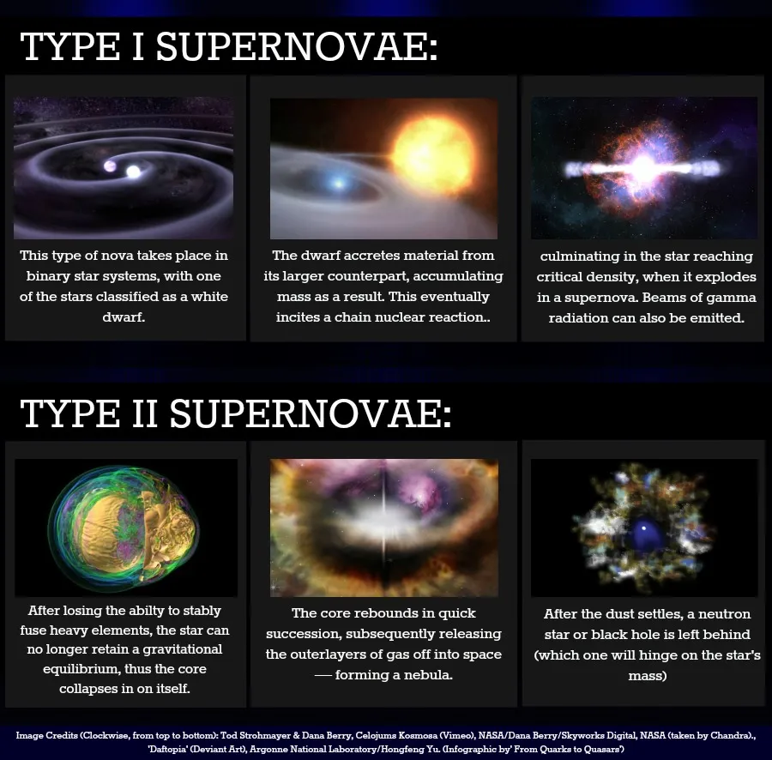
Supernova of Type 1
Type I supernovae play a fundamental role in cosmology: about 80% of Type I SNe (designated as Type Ia) have a characteristic light curve. The SNe of this subset are used as standard candles for determining the absolute magnitudes of galaxies, and hence their distance.
SNe type Ia are due to the thermonuclear disruption of white dwarfs: a WD consists mainly of carbon and oxygen and has a limit mass of 1.44 M⨀; if it accretes material from a companion star, its mass exceeds the limit mass and the star tends to collapse.
Right before the collapse, its nucleus reaches extremely high temperatures needed for the carbon fusion: carbon (or possibly helium) is ignited under highly degenerate conditions.
Within a few seconds, a substantial fraction of the matter in the WD undergoes nuclear fusion, releasing enough energy (1−2 ×10^51 erg) to unbind the star in a supernova explosion.
The end product of this nuclear burn is iron, which is very abundant in the optical spectrum of Type I SNe.

Slide 8
Supernova of Type 2
Type II supernovae (or core-collapse supernova) originate from the internal collapse and subsequent violent explosion of stars with a mass greater than at least 9 times the mass of the Sun.
Once they reach an advanced stage in their life cycle, massive stars do not only fuse helium into carbon but, by their sufficiently high mass, can implement fusion cycles: from carbon, it leads to the production of increasingly heavier elements.
The end product of these nucleosynthesis cycles is Fe-56, an iron isotope, which accumulates inert in the nucleus due to the excessive energy expenditure required to fuse it.
When the ferrous nucleus reaches and exceeds a limiting mass, called the Chandrasekhar limit and equivalent to 1.44 solar masses, it undergoes an implosion.
After collapse, this incompressible core would bounce back the in-falling material. This creates a shock wave that causes the outer layers of the star to be violently ejected into surrounding space.
Since the 1960s, it was generally accepted that the core of a massive star collapses at the end of its lifetime to something like a neutron star.

Slide 9
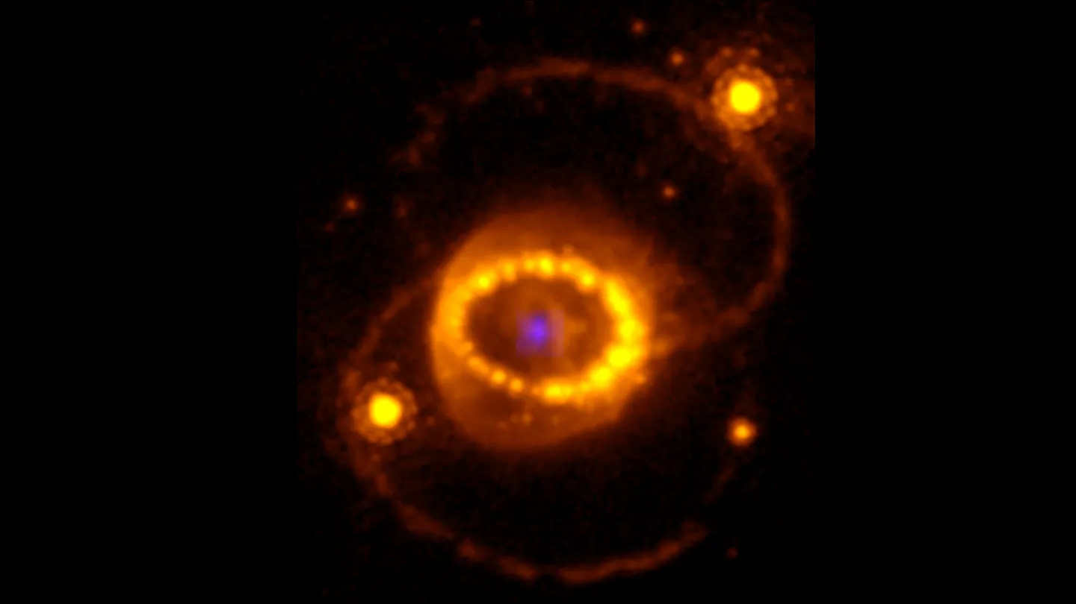
Supernova of Type 2
As for Type I SN, the total energy release observable with astronomical tools is of the order of 10^51 erg for a SN of 10 M⊙ star: this quantity represents in Type II SNe only ∼1% of the total estimated energy balance.
According to energy conservation, and based on the interaction theory among the constituents of the collapsing star, about 99% of the gravitational energy must be converted into kinetic energy of massless particles different from the photons: the neutrinos.
The theoretical relationship between neutrinos and supernovae was experimentally confirmed in February 1987, when at least two underground detectors recorded a burst of neutrinos and a spectacular supernova was later observed by astronomers worldwide. That observation was a breakthrough in the long history of supernovae.

Slide 10
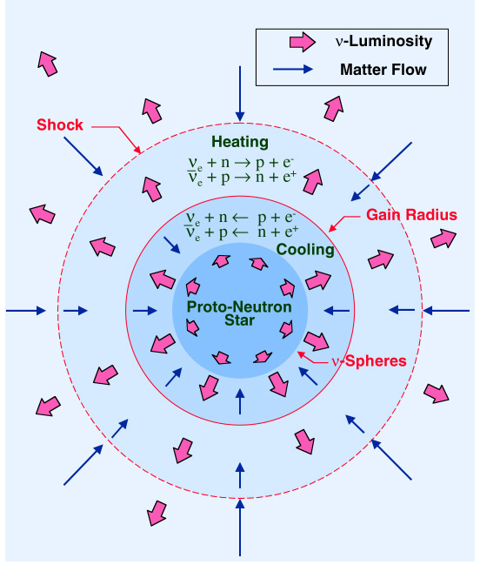
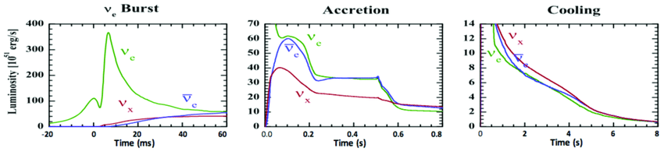
CCSN neutrino emission phases
The collapse leads to an extremely dense region in the star’s core, called proto-neutron star (PNS), which reaches nuclear densities 𝜌 ∼ 10^14 g.cm−3.
The bounce of the collapsing matter on this dense and hard region creates a shock wave. From the onset of the shock wave to the cooling of the proto-neutron star after an explosion, colossal amounts of neutrinos are emitted.
These neutrinos are thermal, with their O(10) MeV energies reflecting the extreme temperatures of the collapsing core. Due to the extremely high densities inside the PNS, these neutrinos can be trapped in the deepest regions of the star.
The surfaces corresponding to neutrino free-streaming regions are called the neutrinospheres and depend on the interaction cross-sections of the different neutrino flavours.
During a CCSN, three phases of neutrino emission, corresponding to specific stages of the supernova process, can be identified: burst, accretion and cooling phase

Slide 11
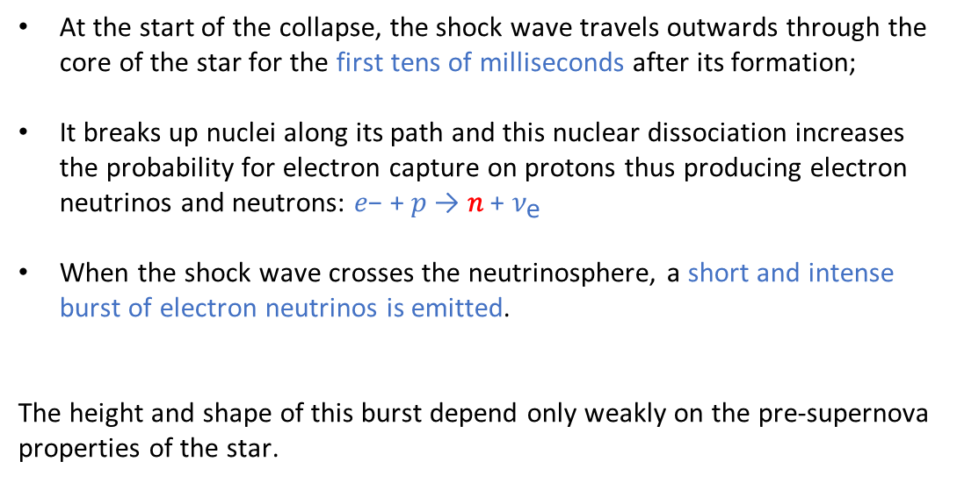
Neutronization burst: intense $ν_{e}$ emission ΔT ̴ O(10ms)
At the start of the collapse, the shock wave travels outwards through the core of the star for the first tens of milliseconds after its formation;
It breaks up nuclei along its path and this nuclear dissociation increases the probability for electron capture on protons thus producing electron neutrinos and neutrons: 𝑒− + 𝑝 → 𝑛 + ${\text{ν}}_{\text{e}}$
When the shock wave crosses the neutrinosphere, a short and intense burst of electron neutrinos is emitted.
The height and shape of this burst depend only weakly on the pre-supernova properties of the star.

Slide 12
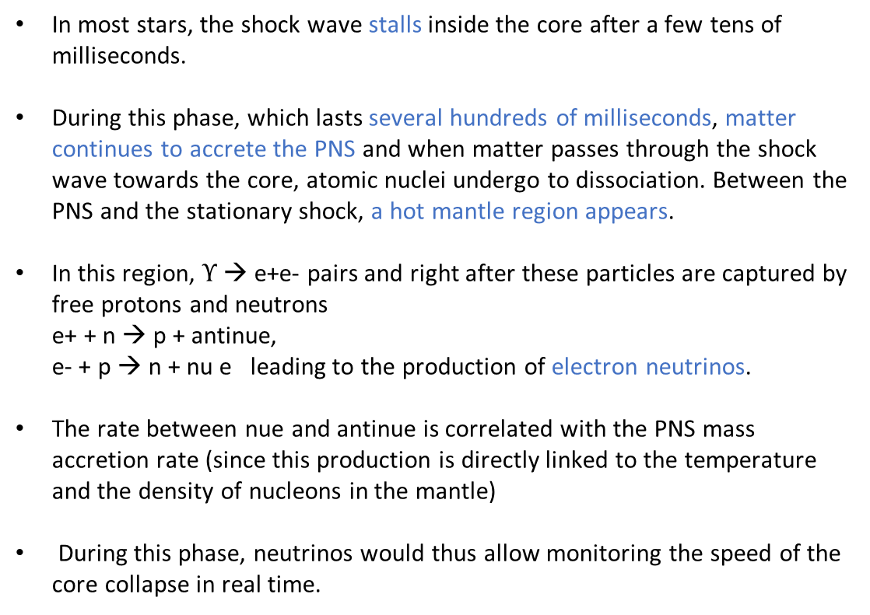
Accretion phase: $ν_{e}$ and $\overline{ν_{e}}$ dominate ΔT ̴ O(100ms)
In most stars, the shock wave stalls inside the core after a few tens of milliseconds.
During this phase, which lasts several hundreds of milliseconds, matter continues to accrete the PNS and when matter passes through the shock wave towards the core, atomic nuclei undergo to dissociation. Between the PNS and the stationary shock, a hot mantle region appears.
In this region, $ϒ$ → e+e- pairs and right after these particles are captured by free protons and neutrons e+ + n → p + antinue, e- + p → n + nu e leading to the production of electron neutrinos.
The rate between nue and antinue is correlated with the PNS mass accretion rate (since this production is directly linked to the temperature and the density of nucleons in the mantle)
During this phase, neutrinos would thus allow monitoring the speed of the core collapse in real time.

Slide 13
Cooling phase: $ν_{x}$ and $\overline{ν_{x}}$ all flavours ΔT ̴ O(10s)
The hot and dense PNS cools down by emitting neutrinos and antineutrinos couples of all flavours through neutral current interactions.
The high density of the innermost region of the star slows down the exit of these neutrinos: their emission is slightly delayed compared to neutrinos from the neutronization and accretion phases.
If a supernova explosion occurs, these cooling neutrinos will be emitted during several tens of seconds, with an exponentially decreasing rate.
Besides carrying information about the collapse, neutrinos could decisively influence it: it has been hypothesized that neutrinos leaving the core of the star could deposit enough energy below the shock wave to restart its propagation to the star, triggering the supernova explosion.

Slide 14
Supernova neutrino energies
About 90% of the energy is released during the cooling phase and, as neutrinos escape, the temperatures gradually decrease.
There may be significant variations in the expected flux from supernova to supernova due to differences in the mass and composition of the progenitor, and possibly asymmetries, rotational effects, or magnetic field effects.
Matter oscillation effects modify the spectra as the neutrinos traverse dense matter, so the neutrino spectra arriving on Earth depend on supernova matter profiles and neutrino oscillation parameters.
Supernova neutrinos have energies around 10–20MeV, intermediate between those of solar (1MeV) and atmospheric neutrinos (>100MeV).
Example of supernova neutrino fluence (the time-integrated neutrino flux) for the different flavor components. The prediction includes collective effects, which are responsible for the structure observed in the νe dashed line

Slide 15
Supernova neutrino energies
The neutrino luminosity is roughly equally divided among the three flavours: however, νμ, ντ are below the threshold for CC interactions. Thus, most of the signal produced by a supernova is provided by νe + p inverse beta decay reaction (as was in the case of SN1987A).
Interaction on electrons and NC interactions of all neutrino flavours can add only a small contribution to the signal, as evident from the cross sections shown in picture.
Although the cross-section is relatively small compared with the interaction on nucleons one (CC), neutrino electron elastic scattering could be important because of its directionality → As supernova neutrinos are more energetic than solar neutrinos, the electron is scattered closer to the direction of the incoming neutrino
ES events can be thus used to point to the supernova direction, although this represents a difficult experimental task.
Cross section for different processes at energies of interest for SN neutrinos

Slide 16
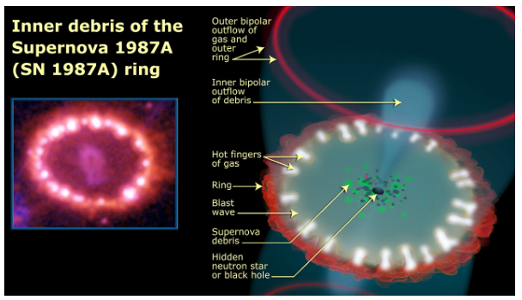
High-energy neutrinos form SNe
The core-collapse supernovae (CCSNe) explosion mechanism is driven by low energy (MeV) neutrinos, which release most of the system's gravitational binding energy.
In addition to MeV neutrinos, some CCSNe are good candidates for the production of high-energy (HE) neutrinos at GeV and higher due to dense circumstellar material (CSM), which provides target material for the ejecta to form shocks and accelerate protons with matter via hadronuclear (pp interaction) or photohadronic (pγ) mechanism. While these neutrinos have yet to be observed, there are recent hints of HE neutrinos in connection with the SN 1987A (Oyama 2022).
Neutrino telescopes such as the IceCube Neutrino Observatory and KM3NeT observe the burst of MeV neutrinos from CCSNe as single-photon hits from interactions that occur near the photomultiplier tubes (PMTs). This makes the measurement quite sensitive to the high level of single photon noise due to, for example, the dark noise in the PMT or radioactivity of the PMT glass → This limits the ability for neutrino telescopes to observe faint signals from CCSNe.
Despite the large size of the detector, at MeV energies IceCube has a detection horizon for CCSNe of ∼ 50 kpc, and KM3NeT has an expected reach of ∼ 50−60 kpc, in contrast to detectors with tighter PMT spacing like Super-K, which has nearly a double reach of ∼ 100 kpc (Ikeda et al. 2007). For next generation detectors like Hyper-K, the detection horizon for low energy neutrinos from CCSNe is expected to reach ∼ 1 Mpc.
Prospects for extending the core-collapse supernova detection horizon using high-energy neutrinos (https://arxiv.org/pdf/2206.00450)

Slide 17
High-energy neutrinos form SNe: the CSM ejecta model and CJ scenario
The potential to extend the detection horizon past the Magellanic Clouds through detecting HE neutrinos has to be explored.
To increase the number of observable supernovae, these neutrinos could give us an insight into the cosmic ray acceleration processes, which are inaccessible with the low-energy neutrinos produced through nuclear processes in supernovae.
We consider two production mechanisms for HE neutrinos in CCSNe: one through the interaction between supernova ejecta with CSM (Murase 2018) and the other through relativistic choked jets (Enberg et al. 2009).
The CSM-ejecta model was first proposed in Murase et al. (2011) and predicted neutrino emission times between 0.1 day to 1-year post-core bounce. This model was recently extended: this HE neutrino flux can contribute to the flux of diffuse neutrinos found by IceCube.
In the choked jet (CJ) scenario, the proposed progenitors are similar to gamma-ray bursts (GRBs), except the jets are slower and never break through the stellar envelope, leading to neutrinos without the counterpart gamma-ray emission.
Prospects for extending the core-collapse supernova detection horizon using high-energy neutrinos (https://arxiv.org/pdf/2206.00450)

Slide 18
High-energy neutrinos form SNe: the CSM ejecta model and CJ scenario
Supernovae that have experienced mass loss before the explosion due to, for example, stellar winds are surrounded by CSM.
The type of supernovae is characterized by optical observations and are associated with different amounts of CSM.
Type IIn and IIp are associated with having a significant amount of CSM in the O(10^−3 − 10^−1 ) M⊙yr−1 making them good candidates for HE neutrino emission via Fermi shocks.
When the supernova explodes, the ejecta compresses the CSM, forming shocks. These shocks propagate in the CSM, creating an environment where charged particles are trapped and scattered. Via inelastic pp collisions, HE neutrinos are produced through processes like pp → π + → µ +νµ → e +νeνµν¯µ
The predicted neutrino flux depends on the CCSNe explosion parameters, including explosion energy, wind velocity, ejecta mass, and mass-loss rate (the reference distance for the model given in Murase (2018) is dref = 10 kpc).
In the CJ scenario, a mildly relativistic jet in the collapsing star becomes trapped behind the optically-thick outer shell.
In contrast to gamma-ray bursts, where gamma rays produced in the jet can escape the star, only neutrinos escape the star in the CJ scenario. To predict the neutrino flux produced in CJ, Enberg et al. (2009) included the decay of charm mesons in addition to pion and kaon decay.
Type Ib/c and IIb are candidates for HE neutrino emission from CJ (Piran et al. 2019).
Prospects for extending the core-collapse supernova detection horizon using high-energy neutrinos (https://arxiv.org/pdf/2206.00450)

Slide 19
Riassunto paper di icecube + Teresa montaruli
Prospects for extending the core-collapse supernova detection horizon using high-energy neutrinos (https://arxiv.org/pdf/2206.00450)

Slide 20
High-energy neutrinos from nearby SNe (Murase)
SN remnants aged ∼ 10^3 − 10^4 yr are established as efficient particle accelerators: they generate GeV-PeV CRs that are accelerated at shocks via the Fermi mechanism.
Optical observations of various types of extragalactic SNe have provided evidence that a SN progenitor commonly experiences a significant mass loss a short time before the explosion. → As a result, shock interactions with a dense circumstellar material (CSM) should occur, leading to efficient production of neutrinos.
A new time-dependent calculations of high-energy neutrino emission from nearby SNe with dense CSM interactions, lead to a detailed high-energy neutrino light curves from different classes of SNe.
∼ 0.1 − 10 days after detections of MeV neutrinos and gravitational waves, a high-statistics TeV neutrino signal in IceCube and KM3Net is expected even for an ordinary Galactic SN.
Multiwavelength observations have revealed that dense, confined circumstellar material (CCSM)
commonly exists in the vicinity of supernova (SN) progenitors, suggesting enhanced mass losses
years to centuries before their core collapse. Interacting SNe, which are powered or aided by interaction with the CCSM, are considered to be promising high-energy multimessenger transient
sources.
New prospects for detecting high-energy neutrinos from nearby supernovae (https://journals.aps.org/prd/abstract/10.1103/PhysRevD.97.081301)
Interacting supernovae as high-energy multimessenger transients (https://journals.aps.org/prd/abstract/10.1103/PhysRevD.109.103020)

Slide 21
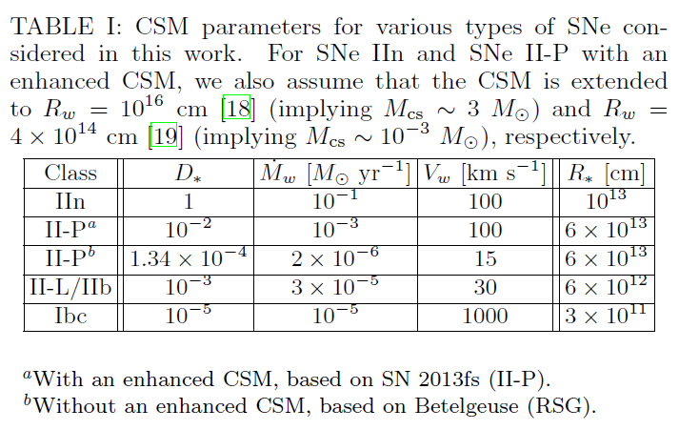
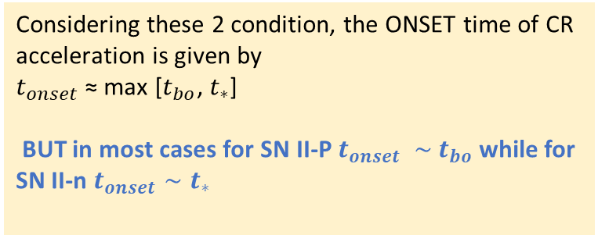
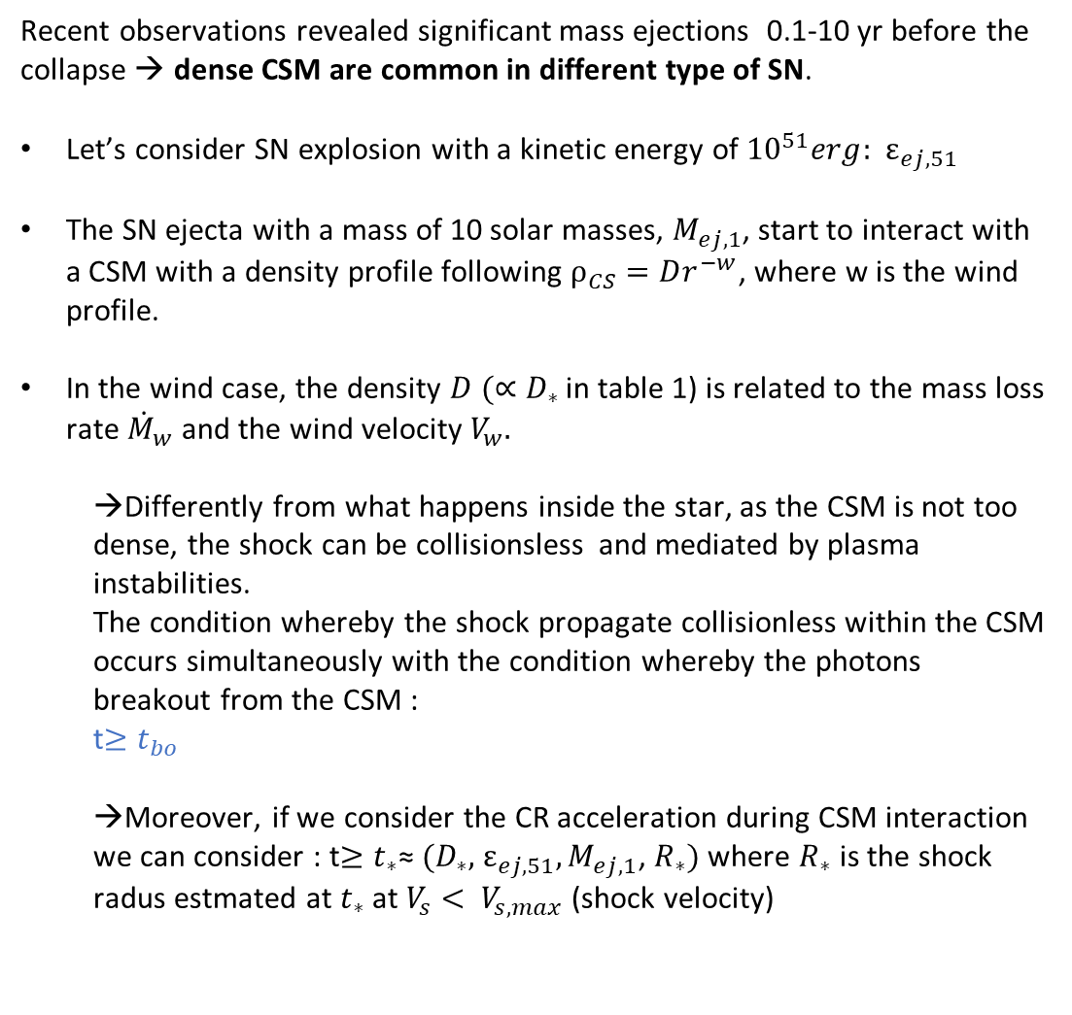
High-energy neutrinos from nearby SNe (Murase)
Recent observations revealed significant mass ejections 0.1-10 yr before the collapse → dense CSM are common in different type of SN.
Let’s consider SN explosion with a kinetic energy of ${10}^{51}erg:{ ε}_{ej,51}$
The SN ejecta with a mass of 10 solar masses, $M_{ej,1}$, start to interact with a CSM with a density profile following $ρ_{CS}=Dr^{−w}$, where w is the wind profile.
In the wind case, the density $D (∝D_{∗}$ in table 1) is related to the mass loss rate ${\dot{M}}_{w}$ and the wind velocity $V_{w}.$
→Differently from what happens inside the star, as the CSM is not too dense, the shock can be collisionsless and mediated by plasma instabilities. The condition whereby the shock propagate collisionless within the CSM occurs simultaneously with the condition whereby the photons breakout from the CSM : t$≥t_{bo}$
→Moreover, if we consider the CR acceleration during CSM interaction we can consider : t$≥t_{∗}$≈ ${(D}_{∗},$ $ε_{ej,51}, M_{ej,1}$, $R_{∗})$ where $R_{∗}$ is the shock radus estmated at $t_{∗}$ at $V_{s}< V_{s,max}$ (shock velocity)
Considering these 2 condition, the ONSET time of CR acceleration is given by $t_{onset}$≈ max [$t_{bo}$, $t_{∗}$]
BUT in most cases for SN II-P $t_{onset} ∼$ $t_{bo}$ while for SN II-n $t_{onset}∼t_{∗}$
New prospects for detecting high-energy neutrinos from nearby supernovae (https://journals.aps.org/prd/abstract/10.1103/PhysRevD.97.081301)

Slide 22
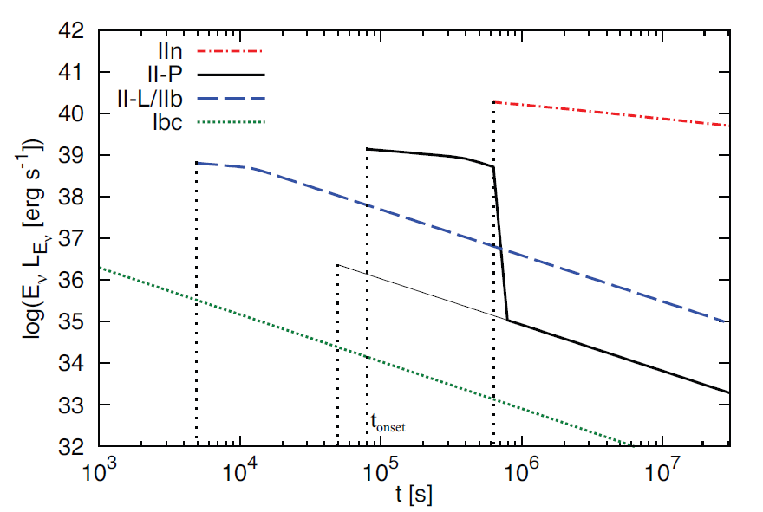
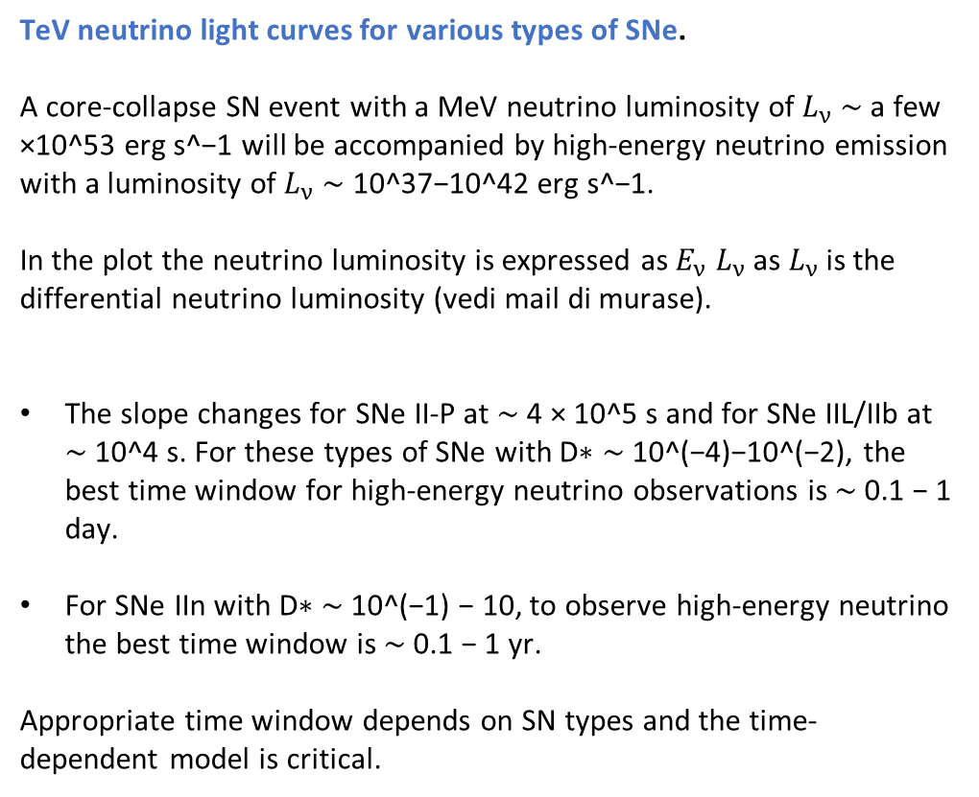
High-energy neutrinos from nearby SNe (Murase)
High-energy CRs interact with CSM nucleons and produce mostly pions via inelastic pp collisions, and high-energy neutrinos are generated via decay processes.
TeV neutrino light curves for various types of SNe. A core-collapse SN event with a MeV neutrino luminosity of $L_{ν}$ ∼ a few ×10^53 erg s^−1 will be accompanied by high-energy neutrino emission with a luminosity of $L_{ν}$∼ 10^37−10^42 erg s^−1.
In the plot the neutrino luminosity is expressed as $E_{ν}$ $L_{ν}$ as $L_{ν}$ is the differential neutrino luminosity (vedi mail di murase).
The slope changes for SNe II-P at ∼ 4 × 10^5 s and for SNe IIL/IIb at ∼ 10^4 s. For these types of SNe with D∗ ∼ 10^(−4)−10^(−2), the best time window for high-energy neutrino observations is ∼ 0.1 − 1 day.
For SNe IIn with D∗ ∼ 10^(−1) − 10, to observe high-energy neutrino the best time window is ∼ 0.1 − 1 yr.
Appropriate time window depends on SN types and the time-dependent model is critical.
Predictions of neutrino “light curves” (at E = 1 TeV) for various types of SNe. The slow decline implies the importance of late-time emissions.
For SNe II-P, the thick (thin) curve represents the case
with (without) an enhanced CSM.
It is assumed that a CR spectrum to be dNcr/dp ∝ p^(−s) with
s ∼ 2.0 − 2.2, where p is the proton momentum. The typical neutrino energy for a CR proton with an energy Ep is E ∼(0.03 − 0.05)Ep.
New prospects for detecting high-energy neutrinos from nearby supernovae (https://journals.aps.org/prd/abstract/10.1103/PhysRevD.97.081301)

Slide 23
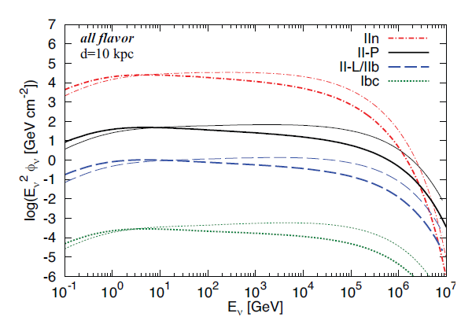
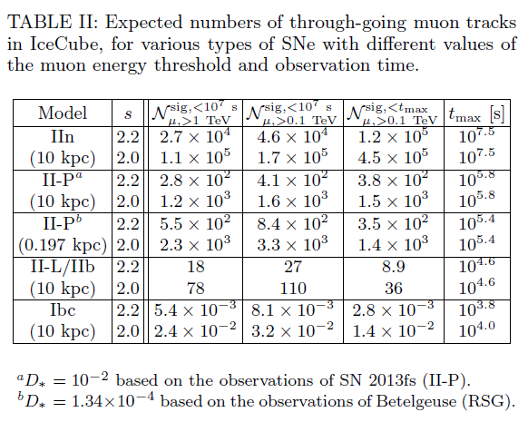
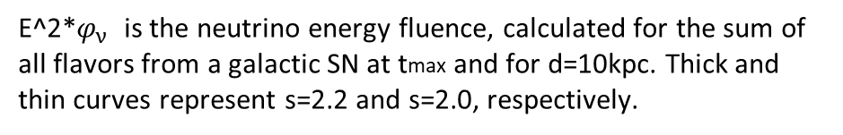
High-energy neutrinos from nearby SNe (Murase)
E^2*$φ_{ν}$ is the neutrino energy fluence, calculated for the sum of all flavors from a galactic SN at tmax and for d=10kpc. Thick and thin curves represent s=2.2 and s=2.0, respectively.
We find that IceCube can detect ∼ 10^3 events for a Type II-P SN at 10 kpc. The core-collapse SN rate in the Milky Way is estimated to be ∼ 3 /century, and the rates of Type II-P are ∼ 50% and II-L/IIb are ∼ 15−20%. The frequency of rare SNe IIn is only ∼ 10%, but they can be detected up to ∼ 10 Mpc. If a SN IIn explodes (assuming that a CSM with w = 2 is erupted), we could have ∼ 3 × 10^6 neutrino events.
New prospects for detecting high-energy neutrinos from nearby supernovae (https://journals.aps.org/prd/abstract/10.1103/PhysRevD.97.081301)

Slide 24
High-energy neutrinos from nearby SNe (Murase)
OUTCOMES:
OUTCOMES:
For the first time, the detectability of high-energy neutrinos from different classes of nearby SNe has been systematically evaluated:
for a Galactic SN, surprisingly, we showed that Gton neutrino detectors like IceCube and KM3NeT can detect ≥ 10 neutrinos from a Type II SNe, which forms a dominant class of core-collapse SNe. Even ∼ 10^3 − 10^6 events are possible for Type II-P and IIn. The targeted time window is ∼ 0.1 − 1 day (∼ 0.1 − 1 yr) after the MeV neutrino detection for SNe II-P/II-L/IIb (SNe IIn).
Exploiting the time-dependent model is crucial for not missing the neutrino signals: in the simplest model, the expected signal can be significantly underestimated, and the detectability is diminished. This is especially critical for detections of a SN with a smaller CSM or in another galaxy.
In this model, CR production relies on the shock acceleration, and target material is not the SN ejecta but the “CSM”. There are various implications: - we can probe mechanisms of the pre-SN mass ejection or envelope inflation. Unlike photons that can be largely attenuated, neutrinos give us direct information on the CSM. - through the observation of ∼ 0.1 − 1 PeV neutrinos, we can test whether nascent SN remnants contribute to the observed CRs around the knee at 3 PeV. This is relevant, since SNe IIn and IIb have been suggested as the origins of such very high-energy CRs. -we can study CR ion acceleration in “real-time”. Neutrino signals earlier than tonset may indicate CR acceleration inside the ejecta.
New prospects for detecting high-energy neutrinos from nearby supernovae (https://journals.aps.org/prd/abstract/10.1103/PhysRevD.97.081301)

Slide 25
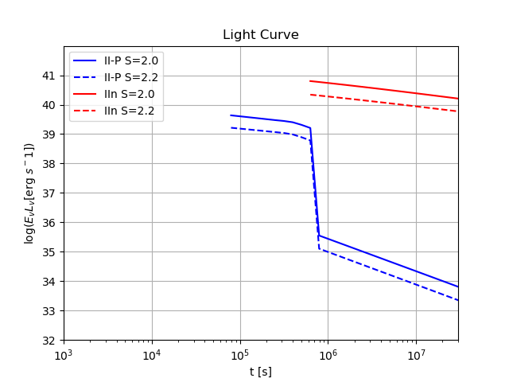
Our goal
Reproduce the neutrino light curves for different supernovae as plotted in Murase’s paper: - to do this we used the Murase git repository
Reproduce the neutrino light curve from Murase’s paper
Reproduce the fluence (that’s what we need for gSeaGen)+
Run the gSeaGen and Aanet according to the neutrino flux as input
Light propagation and detection: KM3Sim, Jsirene… JtriggerEfficiency(BKG)
Reconstruction: JPP

Slide 26
Our goal: step 2
Reproduce the neutrino light curves for different supernovae as plotted in Murase’s paper: - to do this we used the Murase git repository

Slide 27
Our goal: step 1
Reproduce the neutrino light curves for different supernovae as plotted in Murase’s paper: - to do this we used the Murase git repository

Slide 28
Our goal
SN 2024ggi in NGC 3621: Rising Ionization in a Nearby, CSM-Interacting Type II Supernova
W. V. Jacobson-Gal´an,1, 2 K. W. Davis,3 C. D. Kilpatrick,4, 5 L. Dessart,6 R. Margutti,1, 7 R. Chornock,1 R. J. Foley,3

Slide 29
