Slide 1
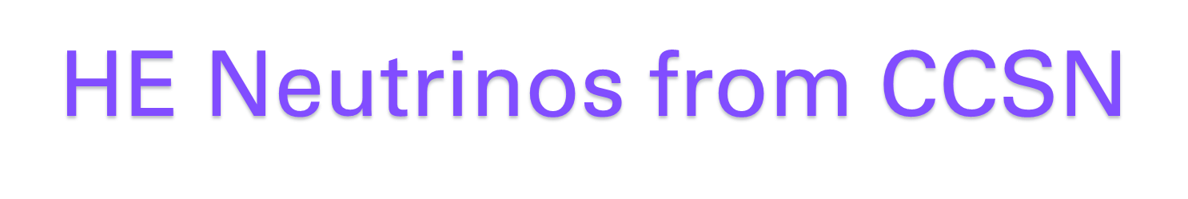
Weekly analysis group meeting 31/10/24

Slide 2
High-energy neutrinos form SNe
The core-collapse supernovae (CCSNe) explosion mechanism is driven by low energy (MeV) neutrinos, which release most of the system's gravitational binding energy.
In addition to MeV neutrinos, some CCSNe are good candidates for the production of high-energy (HE) neutrinos at GeV and higher due to dense circumstellar material (CSM), which provides target material for the ejecta to form shocks and accelerate protons with matter via hadronuclear (pp interaction) or photohadronic (pγ) mechanism. While these neutrinos have yet to be observed, there are recent hints of HE neutrinos in connection with the SN 1987A (Oyama 2022).

Slide 3
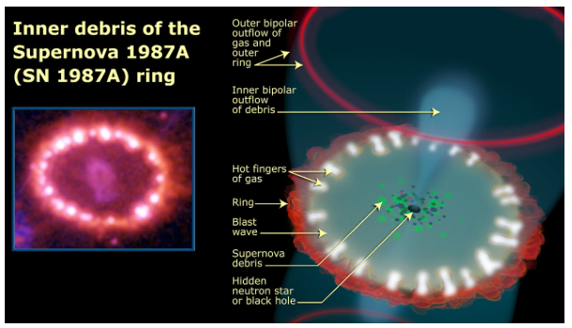
High-energy neutrinos form SNe
The core-collapse supernovae (CCSNe) explosion mechanism is driven by low energy (MeV) neutrinos, which release most of the system's gravitational binding energy.
In addition to MeV neutrinos, some CCSNe are good candidates for the production of high-energy (HE) neutrinos at GeV and higher due to dense circumstellar material (CSM), which provides target material for the ejecta to form shocks and accelerate protons with matter via hadronuclear (pp interaction) or photohadronic (pγ) mechanism. While these neutrinos have yet to be observed, there are recent hints of HE neutrinos in connection with the SN 1987A (Oyama 2022).
Neutrino telescopes such as the IceCube Neutrino Observatory and KM3NeT observe the burst of MeV neutrinos from CCSNe as single-photon hits from interactions that occur near the photomultiplier tubes (PMTs). This makes the measurement quite sensitive to the high level of single photon noise due to, for example, the dark noise in the PMT or radioactivity of the PMT glass → This limits the ability for neutrino telescopes to observe faint signals from CCSNe.
Despite the large size of the detector, at MeV energies IceCube has a detection horizon for CCSNe of ∼ 50 kpc, and KM3NeT has an expected reach of ∼ 50−60 kpc, in contrast to detectors with tighter PMT spacing like Super-K, which has nearly a double reach of ∼ 100 kpc (Ikeda et al. 2007). For next generation detectors like Hyper-K, the detection horizon for low energy neutrinos from CCSNe is expected to reach ∼ 1 Mpc.
Prospects for extending the core-collapse supernova detection horizon using high-energy neutrinos (https://arxiv.org/pdf/2206.00450)

Slide 4
High-energy neutrinos form SNe: the CSM ejecta model and CJ scenario
The potential to extend the detection horizon past the Magellanic Clouds through detecting HE neutrinos has to be explored.
To increase the number of observable supernovae, these neutrinos could give us an insight into the cosmic ray acceleration processes, which are inaccessible with the low-energy neutrinos produced through nuclear processes in supernovae.
We consider two production mechanisms for HE neutrinos in CCSNe: one through the interaction between supernova ejecta with CSM (Murase 2018) and the other through relativistic choked jets (Enberg et al. 2009).
The CSM-ejecta model was first proposed in Murase et al. (2011) and predicted neutrino emission times between 0.1 day to 1-year post-core bounce. This model was recently extended: this HE neutrino flux can contribute to the flux of diffuse neutrinos found by IceCube.
In the choked jet (CJ) scenario, the proposed progenitors are similar to gamma-ray bursts (GRBs), except the jets are slower and never break through the stellar envelope, leading to neutrinos without the counterpart gamma-ray emission.
Prospects for extending the core-collapse supernova detection horizon using high-energy neutrinos (https://arxiv.org/pdf/2206.00450)

Slide 5


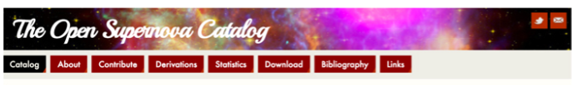

Plan for the analysis
We chose to follow the analysis performed on IceCube data
(Constraining High-Energy Neutrino Emission from Supernovae with IceCube)
Analysis method
Catalogue
Candidates for HE neutrinos
Time dependent point source likelihood method:
Useful reference to free sources catalog
Type IIn and II-P SNs for CSM interaction + Type Ib/c and II b for CJs
Same as ours!
Signal PDF (same for bkg)
Spatial term
(2D Gauss)
Neutrino energy spectrum
Time term (Light Curve)

Slide 6
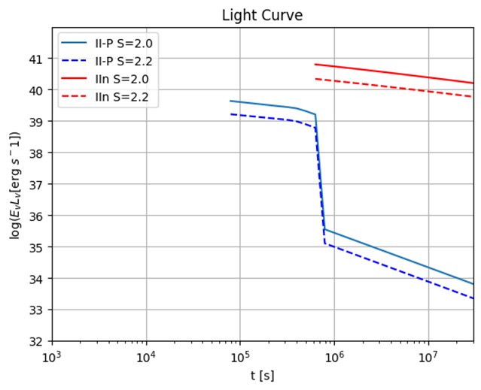
Step 1: Model of the Light Curve
We used the neutrino flux by Murase simulation:
(https://github.com/pegasuskmurase/ModelTemplates/tree/main/SNHEMM)
Firstly, we managed to reproduce the Light Curve (fig 1 from the paper) for IIn and II-P type SN.
Light curves for various type
of SN at Ev = 1TeV

Slide 7
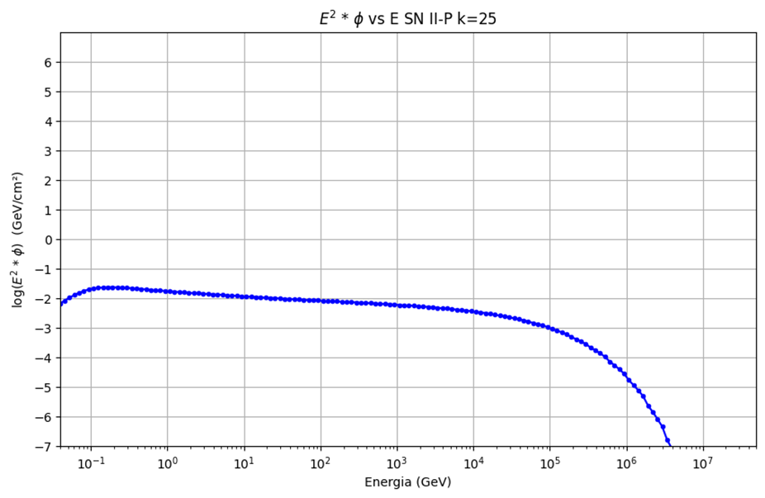
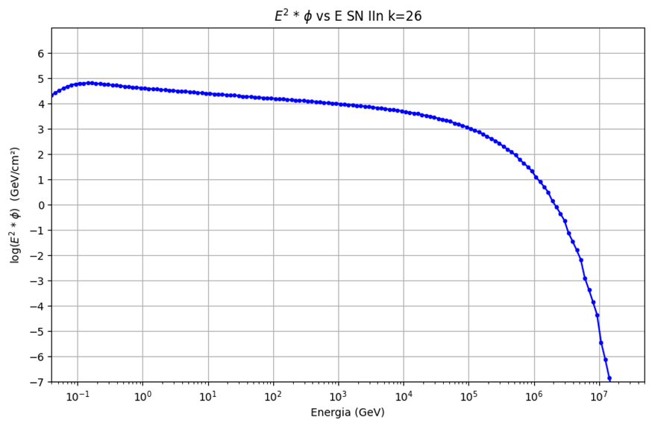
Step 2: Model of the Fluence
We also reproduced the fluences of neutrinos, for both type of SN, considering the time t_νmax, which is the time when the significance of neutrino emission becomes the maximum. (See fig. 2 right from this other Murase’s paper)

Slide 8
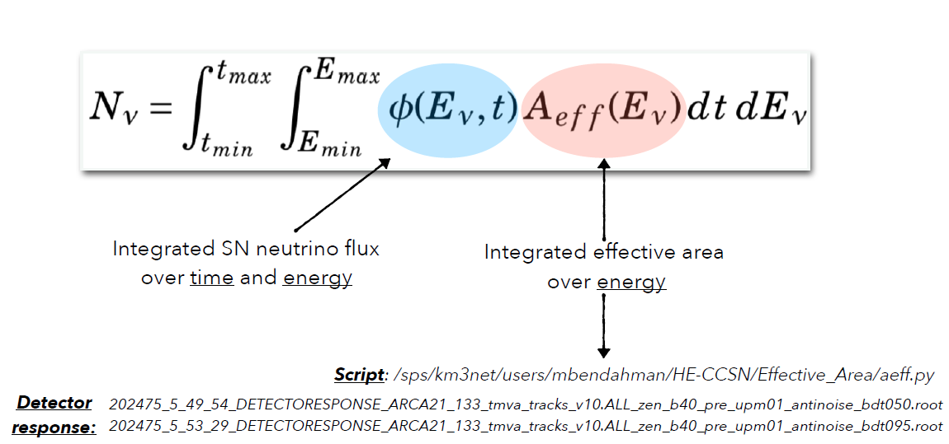
Step 3: Event rate
The light curves will be used for the time-dependent unbinned likelihood (signal time PDF)
In the meanwhile, we have been focusing on reproducing the expected number of neutrinos, considering time range correspondent to the HE neutrino emission as predicted in the Murase model.

Slide 9
Step 3: Event rate
Duration of the HE neutrino emission
We would like to consider the Aeff at different declinations, according (for example) to the different SNe registered in 2022, 2023.. during ARCA8/ARCA21 period
→ we need to do new catalogue selection (for example within 10 kpc to 10 Mpc)

Slide 10
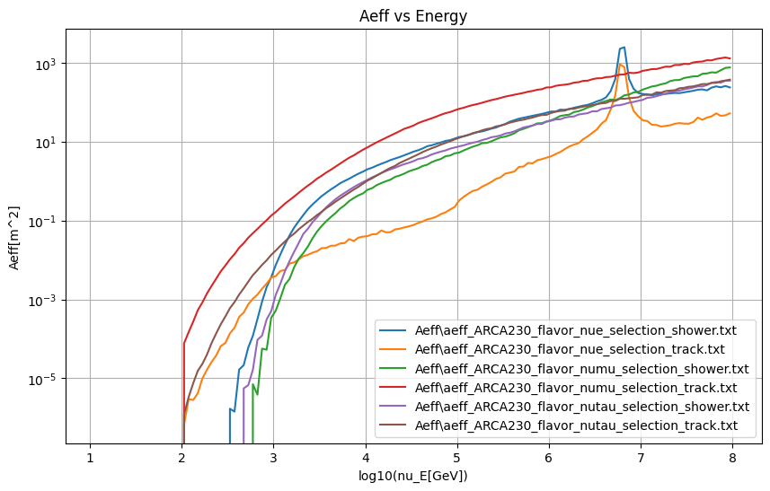
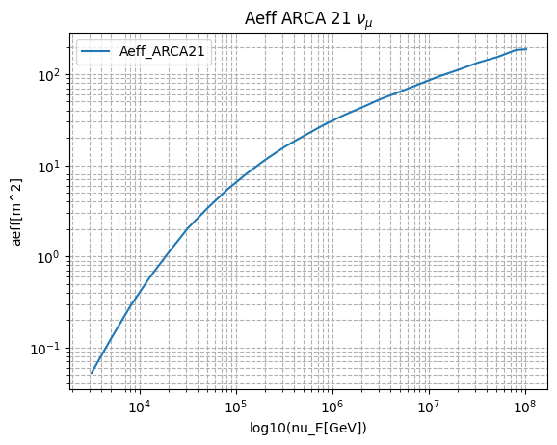
Step 3: Event rate
At the beginning, Thijs kindly helped with the ARCA230 Aeff, and Meriem with ARCA21 Aeff but this is averaged over all declination (we discover that is wrong to use these Aeff when you have a specific declination):

Slide 11
Summary of next steps
Compute Aeff for specific declination
Compute the number of expected events related to certain declinations considering different SN models
New catalogue of SN with different distances (for example from 10 Kpc to 10 Mpc)
Question to the group:
is it correct to consider the discovery time as the time of explosion?
In case not, how it is possible to retrieve this information? —> we need it because the HE emission occurs mostly about 10^5 seconds after the explosion

