Slide 1
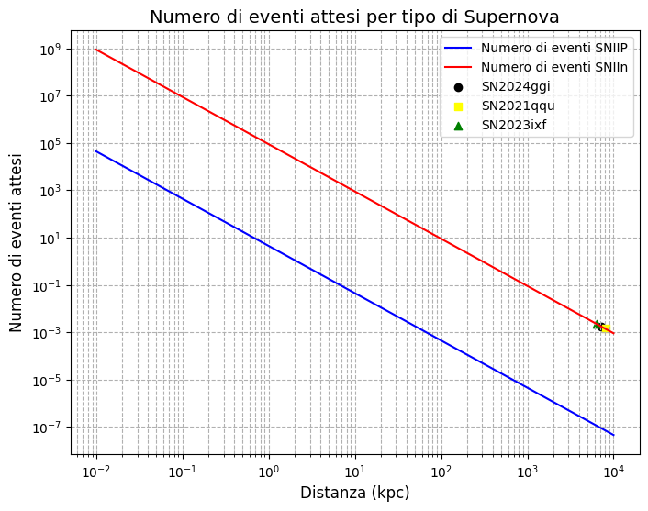
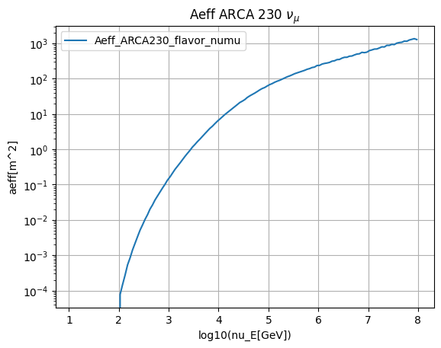
High energy neutrinos from ccsn
SN neutrino flux by Murase data
(https://github.com/pegasuskmurase/ModelTemplates/tree/main/SNHEMM)
Aeff from KM3NeT collaboration
(Thijs Juan van Eeden sent it to me)
Sources selected from our catalogue
(Only the ones with a d ≈ 10 Mpc)

Slide 2
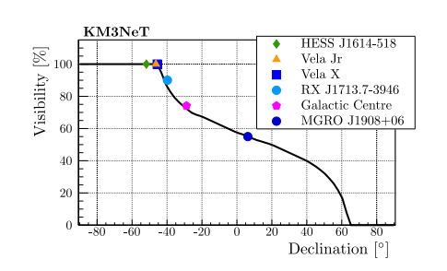

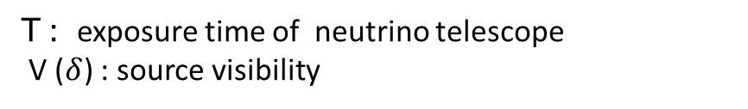
High energy neutrinos from ccsn
Number of expected events from a point-like neutrino source
As a next step I will also implement the declination of sources for the calculation of expected events
https://doi.org/10.3847/1538-4357/ad4960
T : exposure time of neutrino telescope
V ($δ$) : source visibility
https://doi.org/10.1016/j.astropartphys.2019.04.002
Also, Anna from Catania now is working on simulation with gseagen.

