Slide 1

Spotify Groovin’
Mary Vang
Sandra Braun
Trevor Bridges
Veronica Ostapowich

Slide 2
Data Sources
https://www.kaggle.com/datasets/yelexa/spotify200
https://developer.spotify.com/documentation/

Slide 3
Data and Delivery
A Dashboard page with multiple charts that all reference the same data was created
Python was used to initially clean data set and place into a csv
  Limited analysis to North America (Canada, Mexico, United States) and Fiscal Year 2022 (July 1, 2021 – June 30, 2022)
PostgresSQL and Psycopg2 library were used to import csv data
Python Flask API was Set Up
  Used CSVs to connect to Java Script

Slide 4
Back End
Spotify Project Index.html
Jquery Library Utilized

Slide 5
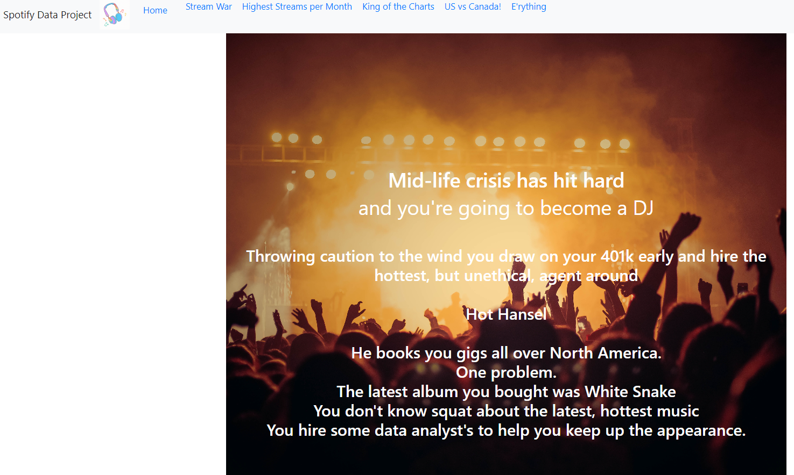
Visualizations

Slide 6
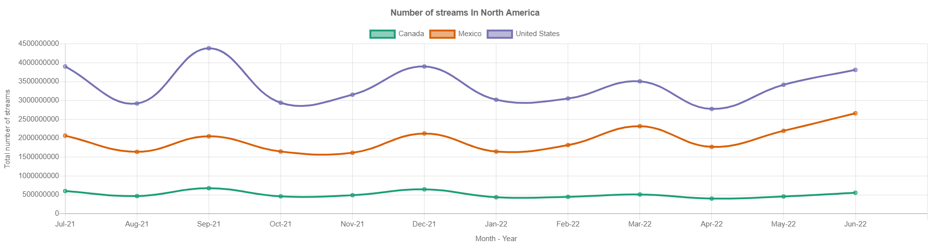
Visualizations

Slide 7
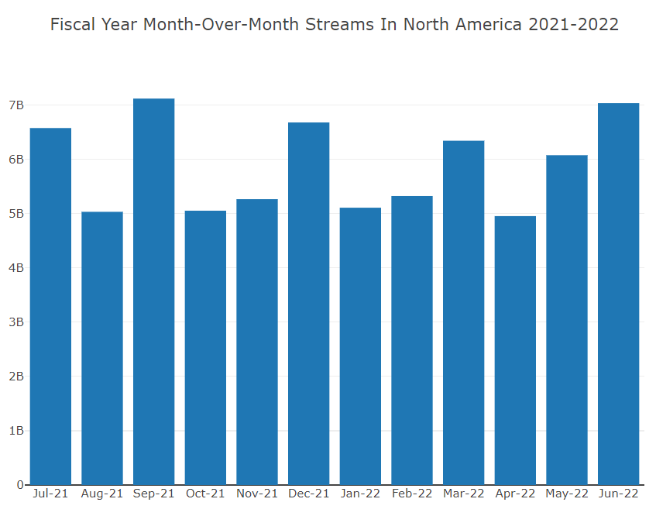
Visualizations

Slide 8
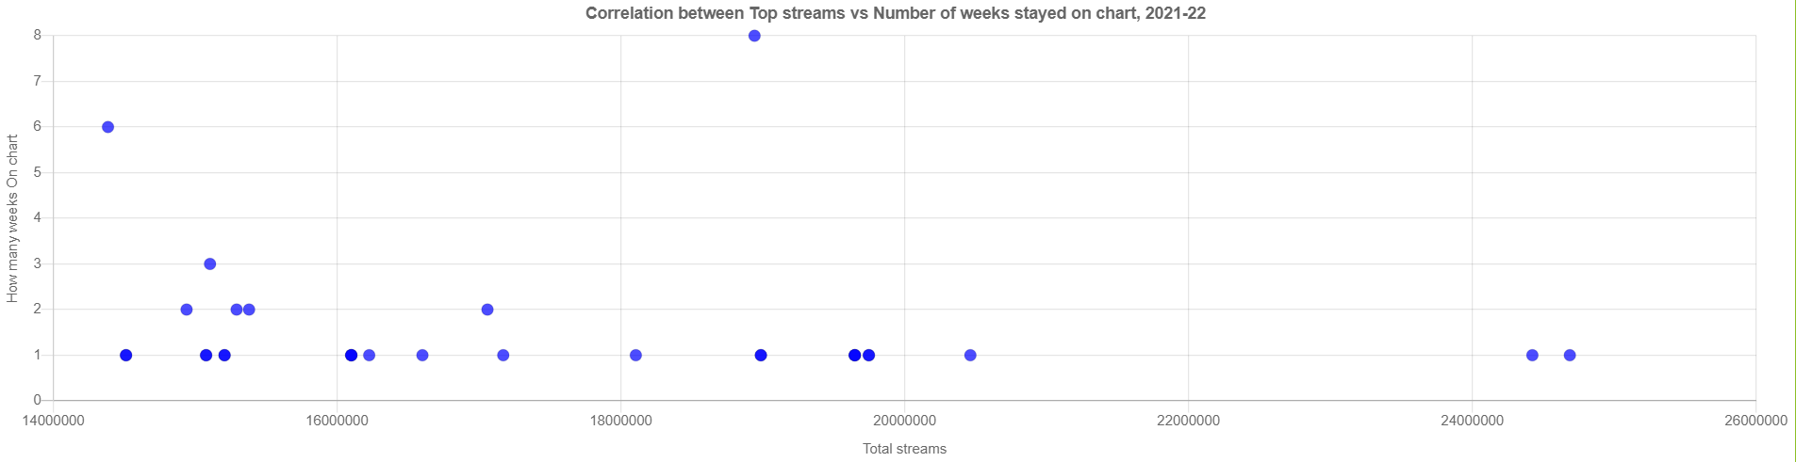
Visualizations

Slide 9
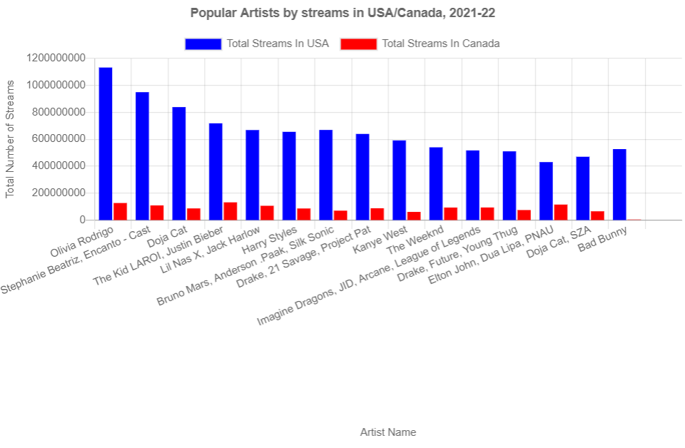
Visualizations

Slide 10
Challenges
Our dataset was very large which made it difficult to load, work with and troubleshoot
We were unable to get groupby functions to work on date fields in postgresSQL
We attempted to convert to json, but double quotes around field names made the data non-readable

Slide 11
Next Steps
Further analysis to look at genre trends by country
Look for any seasonality or temporal patterns in streaming
Final Thoughts:
  Thankful for Tableau and Power BI to make these visualizations so much easier to create!

