Slide 1
End to End Security Automation in CI/CD pipeline with Monitoring Alerts and Patch Management
Submitted By :
Prathamesh Karve : (240344223029)
Vineet Patil : (240344223025)
Shrikant Raut : (240344223030)

Slide 2



Under the Guidance
of
Mr. Sandeep Walvekar
In partial fulfillment of the award of Post Graduate Diploma in IT Infrastructure, Systems and Security (PG-DITISS) Sunbeam Institute of Information Technology, Pune (Maharashtra) PG-DITISS -2024

Slide 3
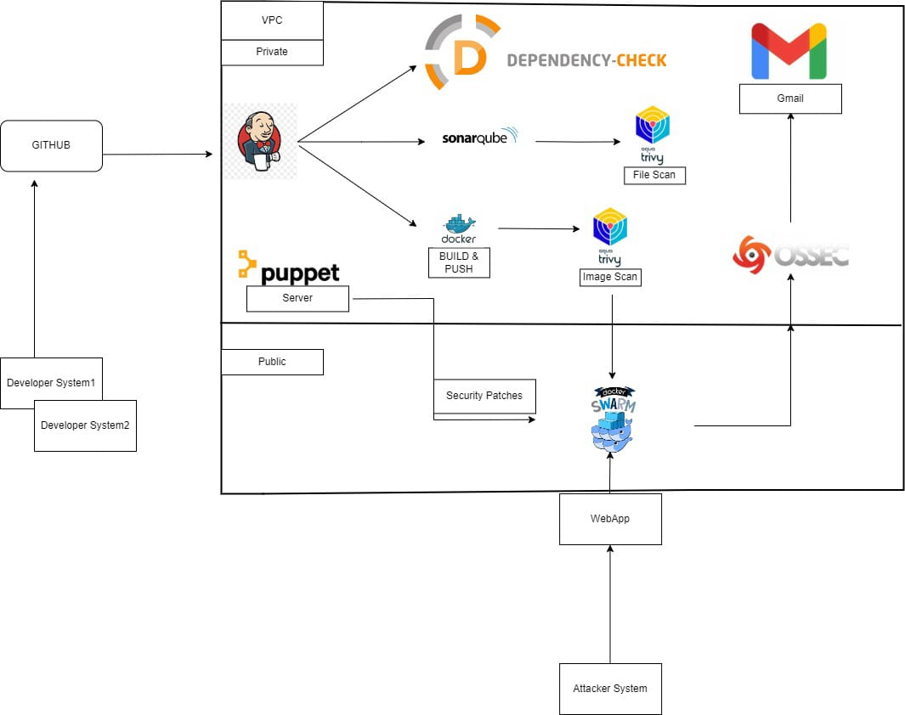
Work Flow of Project

Slide 4


1. Source Code Management and Automation
2. Dependency and Security Checks
- Dependency Check: Analyzes project dependencies for security vulnerabilities.
- Function: Ensure all dependencies are secure and up-to-date.
- Jenkins: The primary automation server.
- Function: Jenkins will automatically pull the source code or Docker images
from Git repositories.
- Workflow: Jenkins is configured to trigger a build process whenever there are
changes in the Git repository

Slide 5


- SonarQube: Static code analysis tool.
- Function: Inspect code for bugs, vulnerabilities, and code smells.
- Workflow: After the dependency check, SonarQube runs to provide a comprehensive analysis report.
- Aqua Trivy: Docker image and file scanner.
- Function: Identify vulnerabilities in Docker images.
- Workflow: Trivy scans the Docker images post dependency check and
SonarQube analysis.

Slide 6
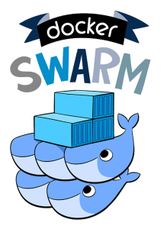

3. Hosting and Deployment​
​
- Docker Swarm: Container orchestration tool.​
​ - Function: Host the web application with load balancing and high availability.
- Workflow: After passing all security checks, Docker Swarm deploys the
​ application.
4. Monitoring and Alerts​
​
- OSSEC: Host-based intrusion detection system (HIDS).​
​
- Function: Monitor the deployed application and send email alerts in case of any
suspicious activity or attacks.
- Workflow: OSSEC is configured to monitor system logs and other indicators of
compromise. It sends email alerts if an attack is detected.

Slide 7
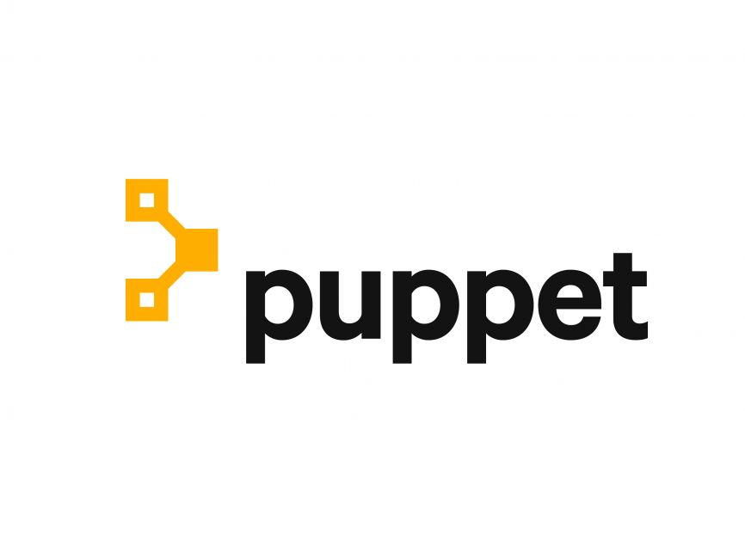
5. Maintenance and Patching
- Puppet: Configuration management tool.
- Function: Apply security patches and maintain system configurations.
- Workflow: Puppet is used to ensure that all systems are up-to-date with
the latest security patches and configurations.

Slide 8
3. Hosting and Deployment
- Docker Swarm: Container orchestration tool.
- Function: Host the web application with load balancing and high availability.
- Workflow: After passing all security checks, Docker Swarm deploys the application.
4. Monitoring and Alerts
- OSSEC: Host-based intrusion detection system (HIDS).
- Function: Monitor the deployed application and send email alerts in case of any suspicious activity or attacks.
- Workflow: OSSEC is configured to monitor system logs and other indicators of compromise. It sends email alerts if an attack is detected.

Slide 9
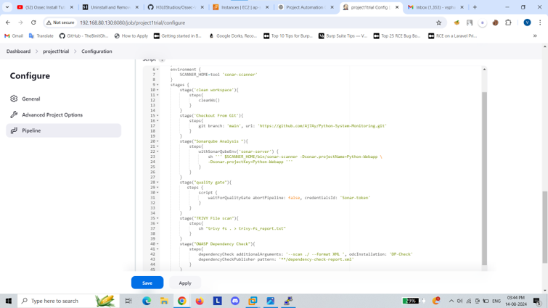

Slide 10
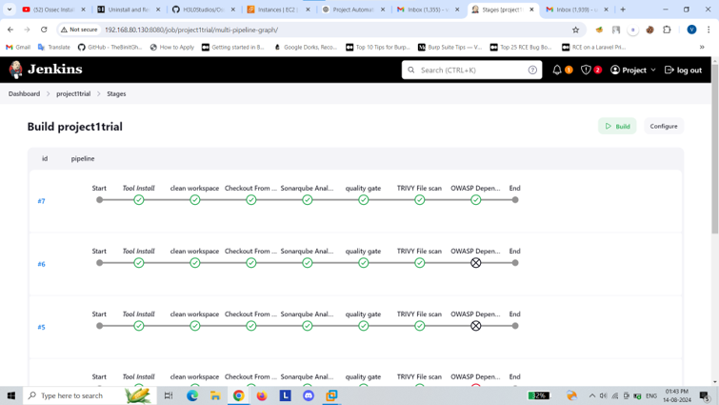
Jenkins stages output

Slide 11
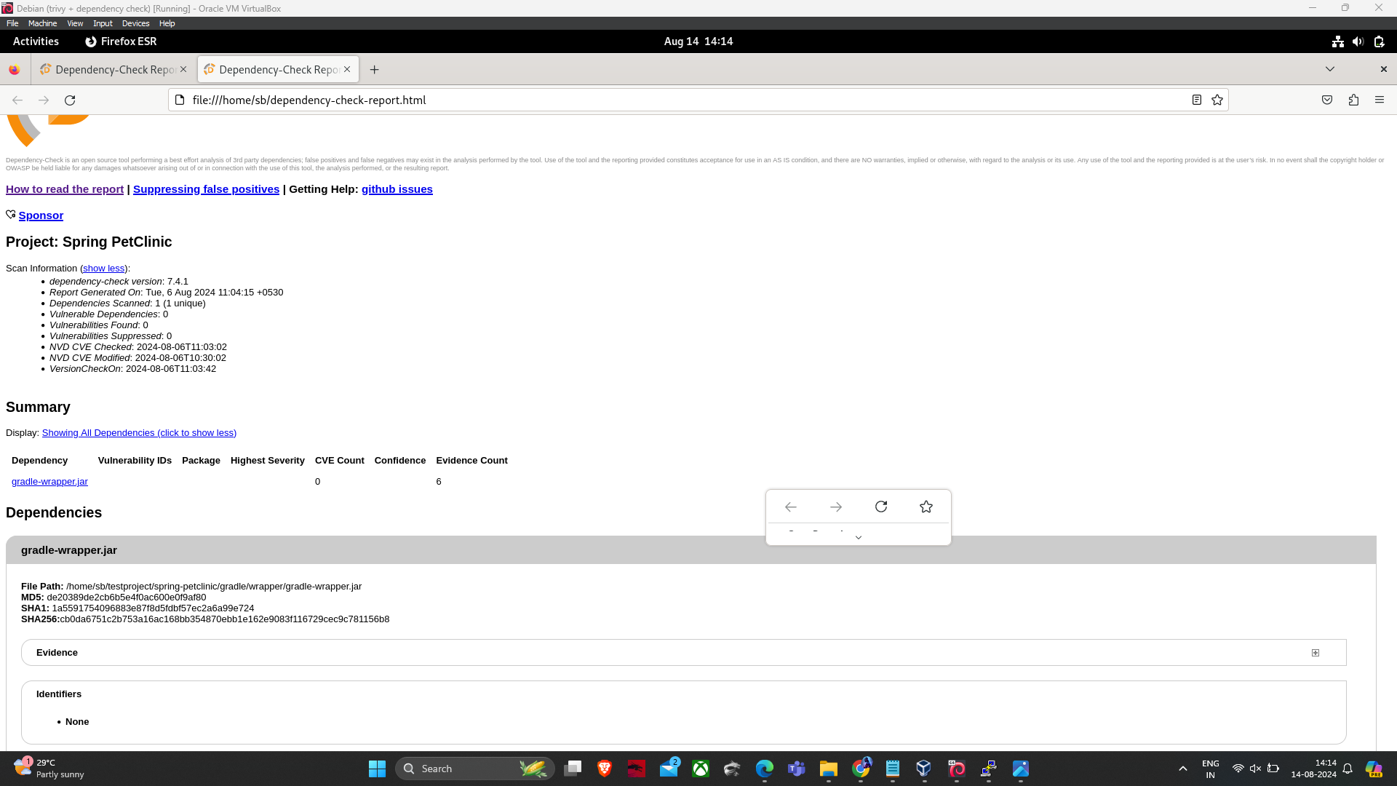
Dependency check report

Slide 12
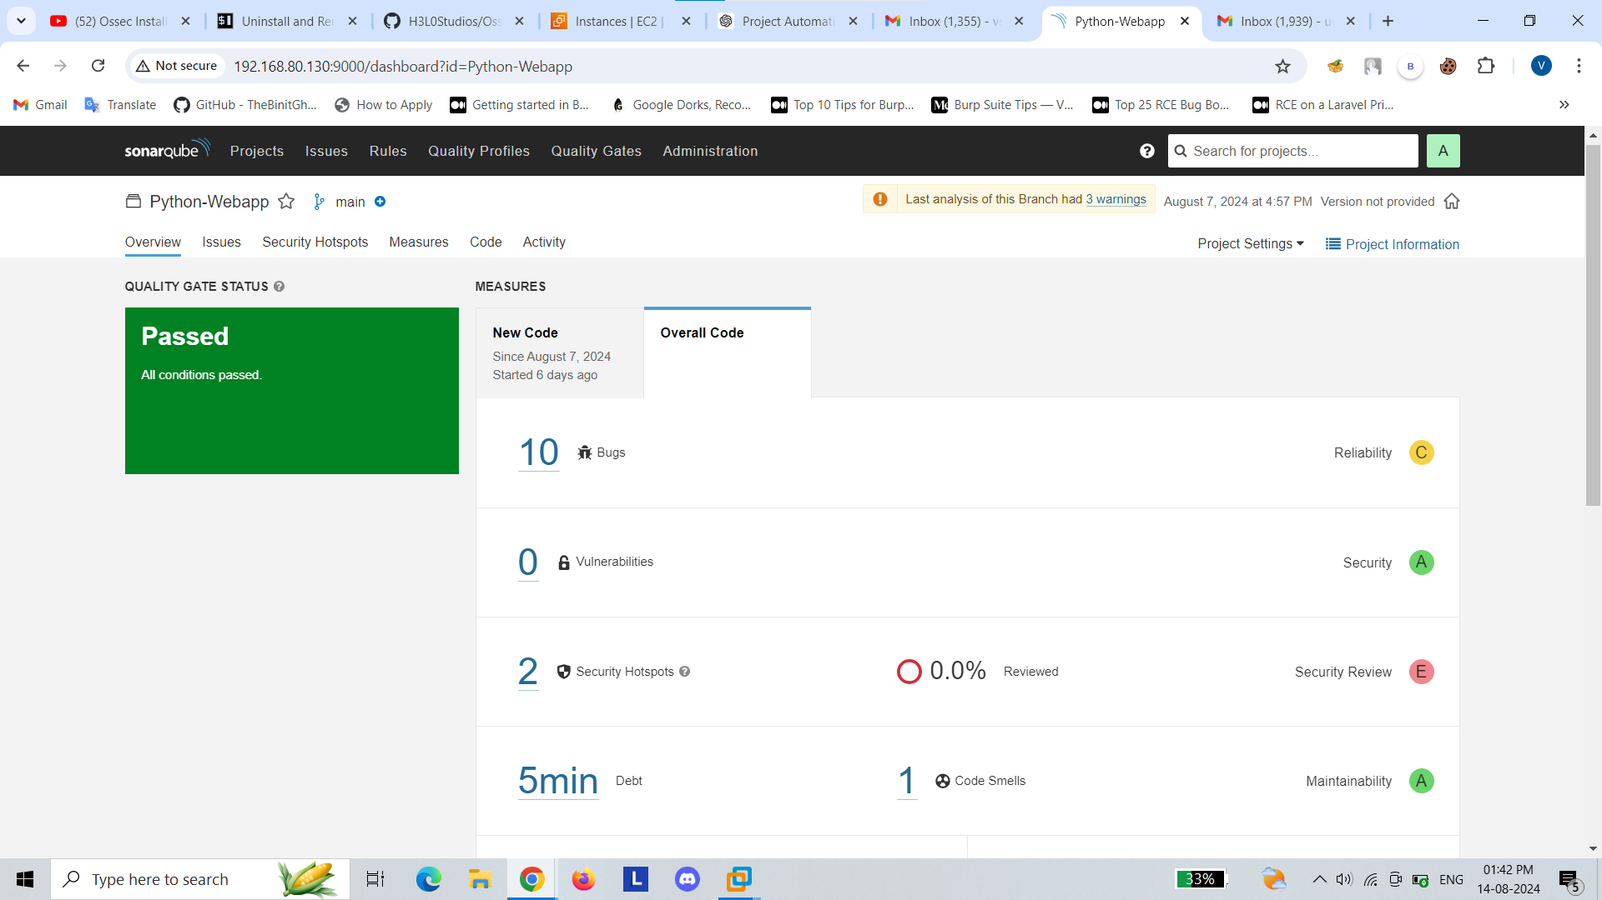
SonarQube Output

Slide 13
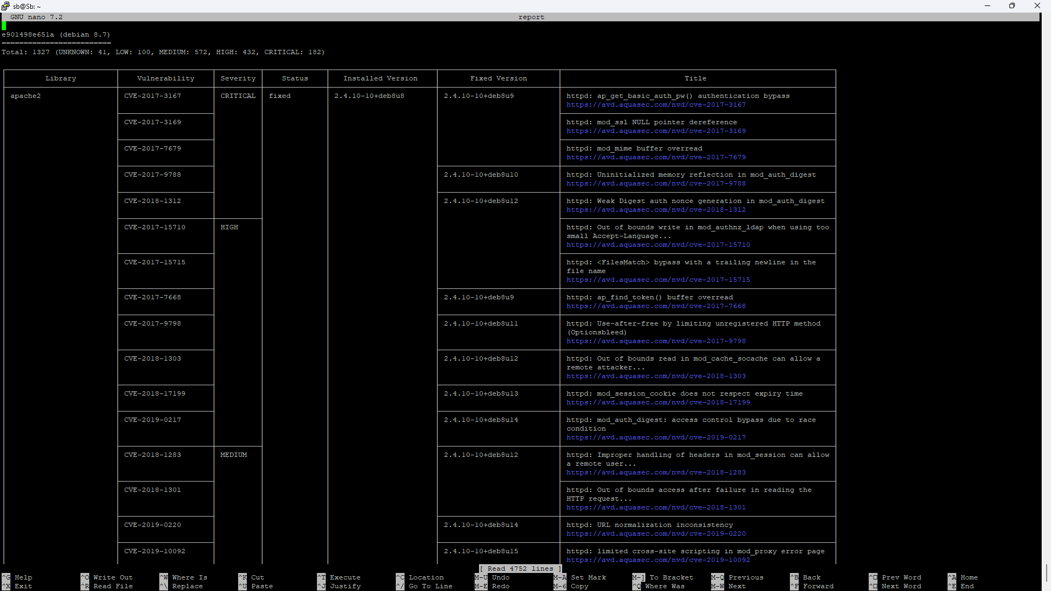
Aqua Trivy report

Slide 14
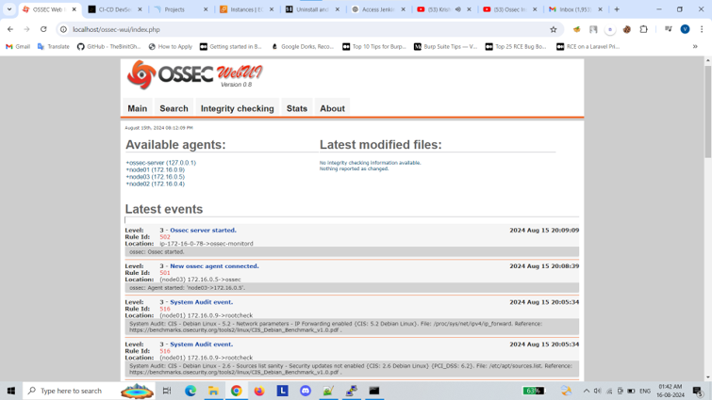
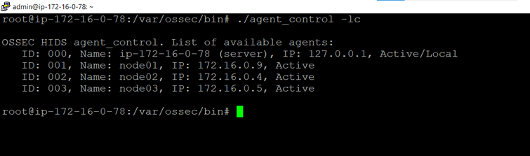

Slide 15
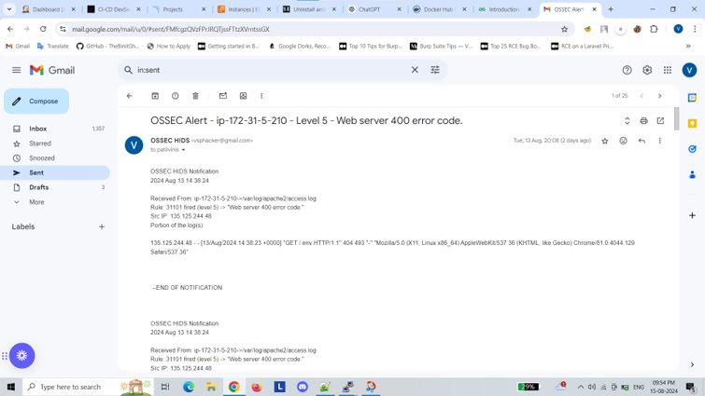

Slide 16
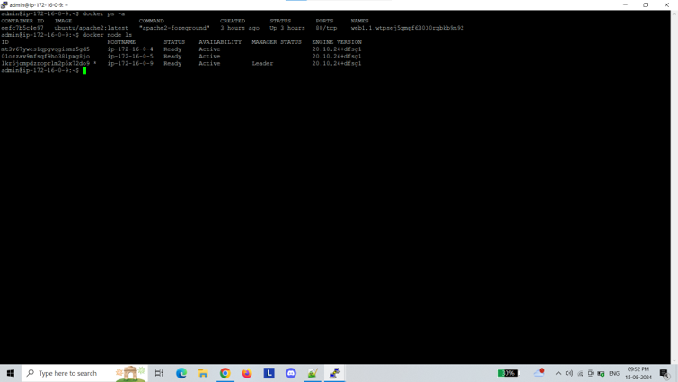

Slide 17
