Slide 1
DIPLOMA PROJECT REPORT · GOVERNMENT GIRLS POLYTECHNIC, SHAMLI
AI-Based Smart Attendance
Management System
Face-recognition attendance automation — with manual correction, supervised self-marking, leave, timetable, reporting and a full audit trail
Submitted by Ankita Pandey · 4th Semester, Computer Science Engineering
Guide Mr. Vivek Kumar
1

Slide 2
AGENDA
What this presentation covers
01
The Problem & Objectives
02
System Architecture & Design
Why paper attendance fails, and what the project set out to fix
Layers, data flow, use cases and the 24-table schema
03
Face Recognition Pipeline
04
Three Attendance Routes
Dual-backend recognition, confidence scoring, dataset capture
Face recognition, manual marking, supervised self-marking
05
Security, Reports & Analytics
06
Interface, Testing & Results
RBAC, audit trail, 11 report types, live dashboards
Representative screens, test outcomes, achievements
2

Slide 3
BACKGROUND
Paper attendance has three failure modes
5-10 min
0%
75%
lost every single class period calling out a roll-number register by hand
of proxy marks are detectable after the fact in a paper register
mandatory attendance threshold — students typically find out they're below it only near the exam-eligibility deadline
Government Girls Polytechnic, Shamli — three diploma branches, paper registers per subject per section, consolidated by hand every month.
3

Slide 4
OBJECTIVES
Six objectives drove every design decision
Automate attendance with face recognition on hardware colleges already own — a webcam, nothing more
Make proxy attendance structurally difficult, not just discouraged
1
2
Keep a manual correction path that never fights the automatic one
Let students self-mark, but never let their own click count without teacher approval
3
4
Model the whole academic structure as data — no hard-coded branches or semesters
Deliver institution-grade security, reporting and a tamper-evident audit trail
5
6
4

Slide 5
LITERATURE REVIEW
Why face recognition, and not the alternatives
Method
Extra hardware
Proxy-resistant
Offline
Paper register
None
No
Yes
RFID card
Reader + cards
No — can be lent
Yes
Barcode / QR
Printer / scanner
No — can be shared
Yes
Fingerprint biometric
Per-room scanner
Partially
Yes
Mobile OTP self-check-in
Student smartphones
No — self-reported
No
Face recognition (this project)
Webcam (built-in)
Yes
Yes
5

Slide 6
PROPOSED SYSTEM
Three complementary routes, one attendance record
Route 1
Route 2
Route 3
Face Recognition
Manual Marking
Self-Marking + Verification
Primary route. Camera recognises enrolled students continuously and marks Present/Late automatically with a confidence score.
One-click P/A/L/LV/ML by the teacher. Overriding a face-mark requires a written, audited reason.
A student's tap only raises a Pending request — a faculty approval is what actually changes the record.
All three write to the same attendance table — a UNIQUE(session, student) database constraint is what actually prevents double-marking.
6

Slide 7
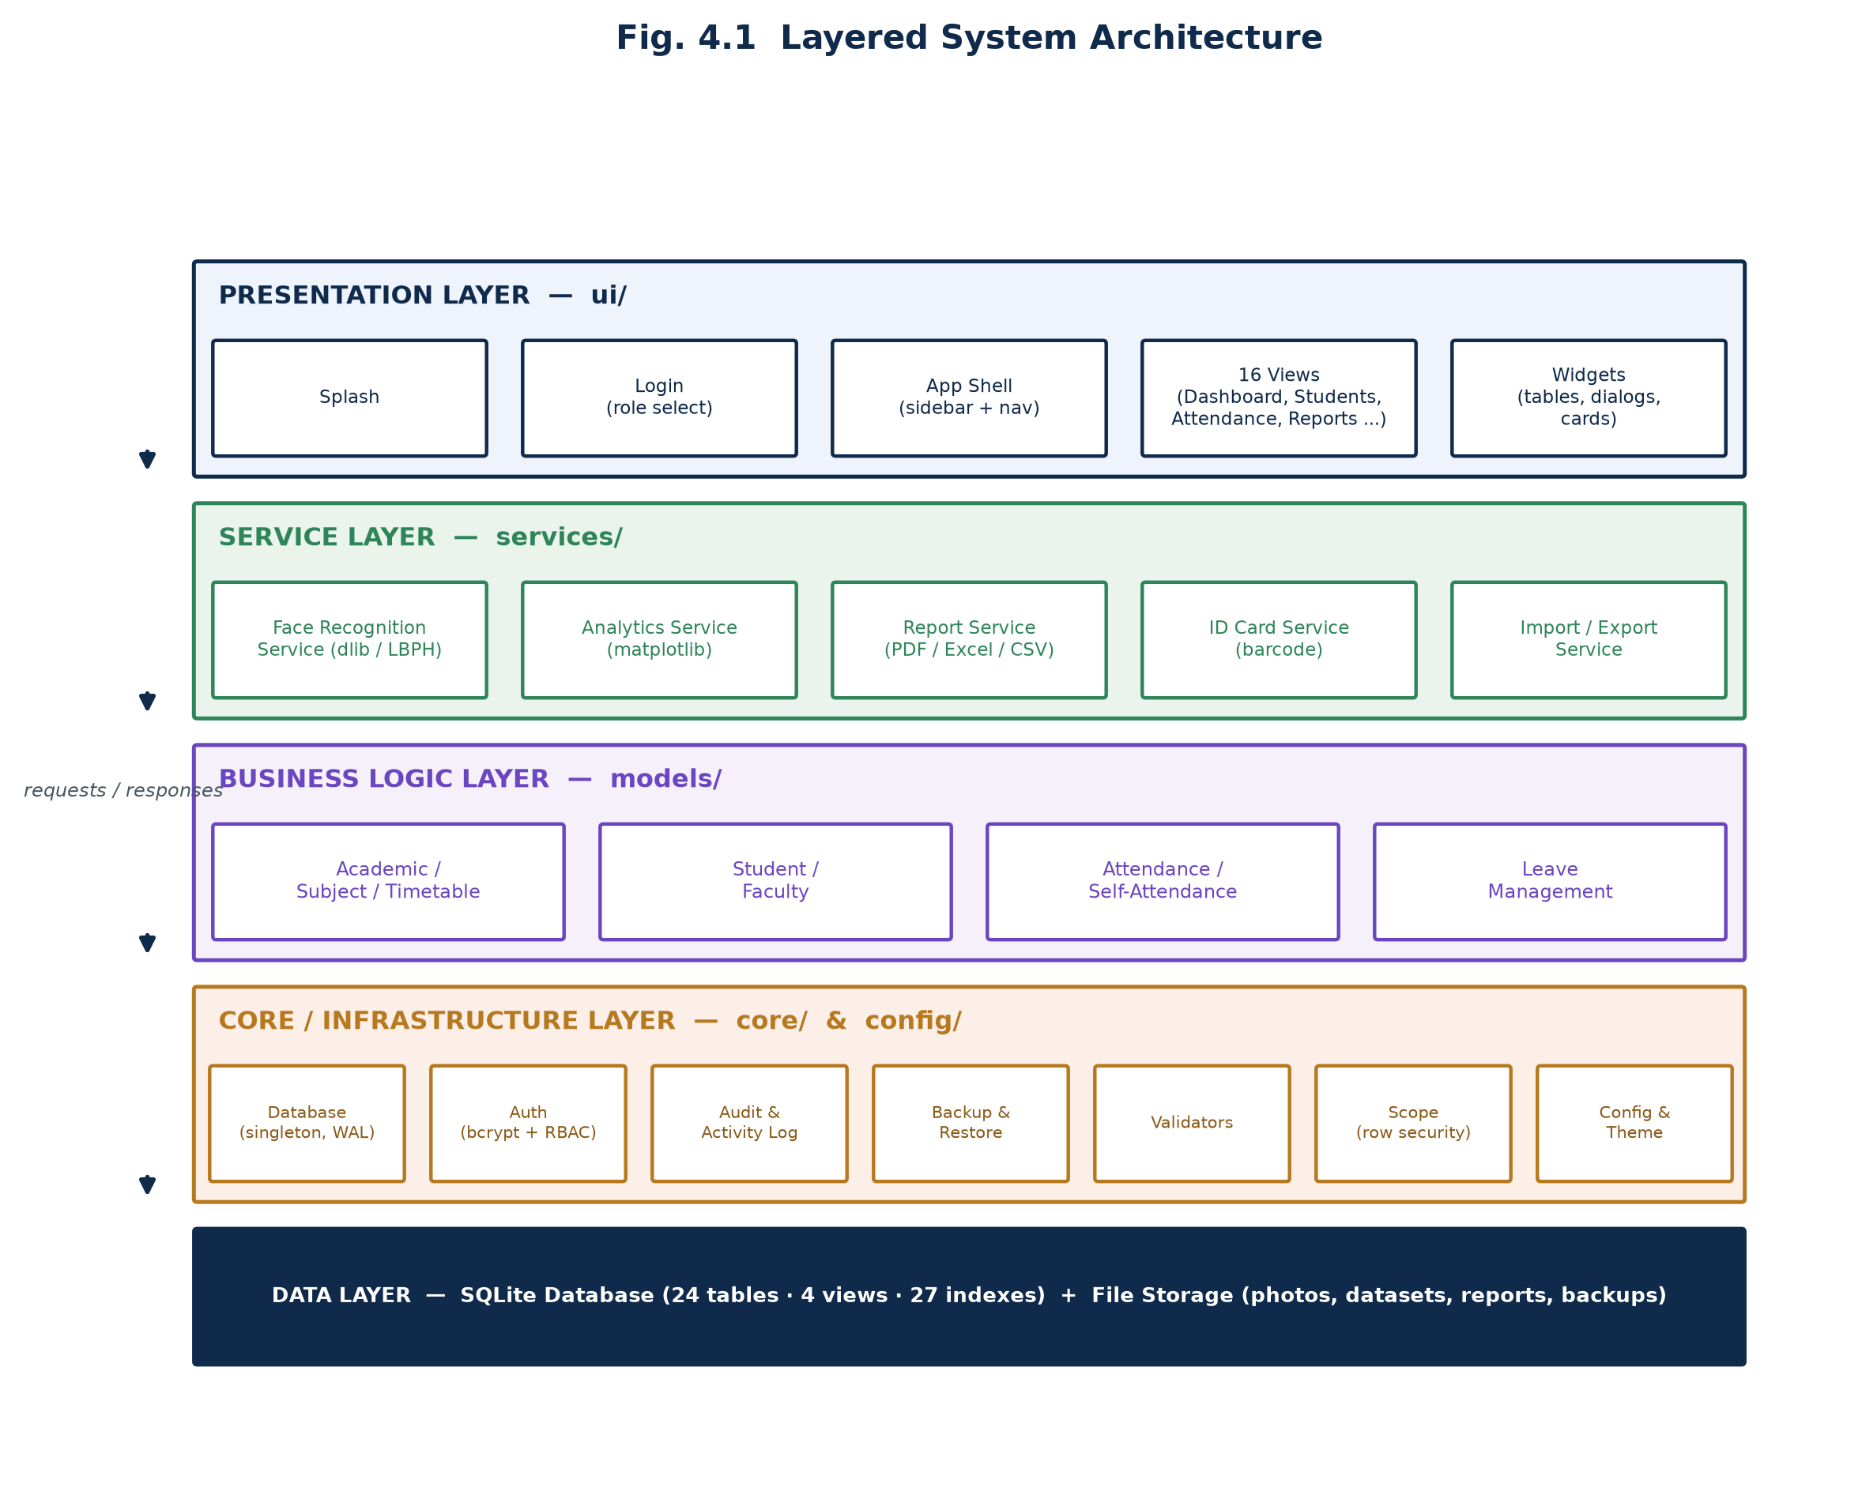
SYSTEM DESIGN
A strictly layered architecture
7

Slide 8
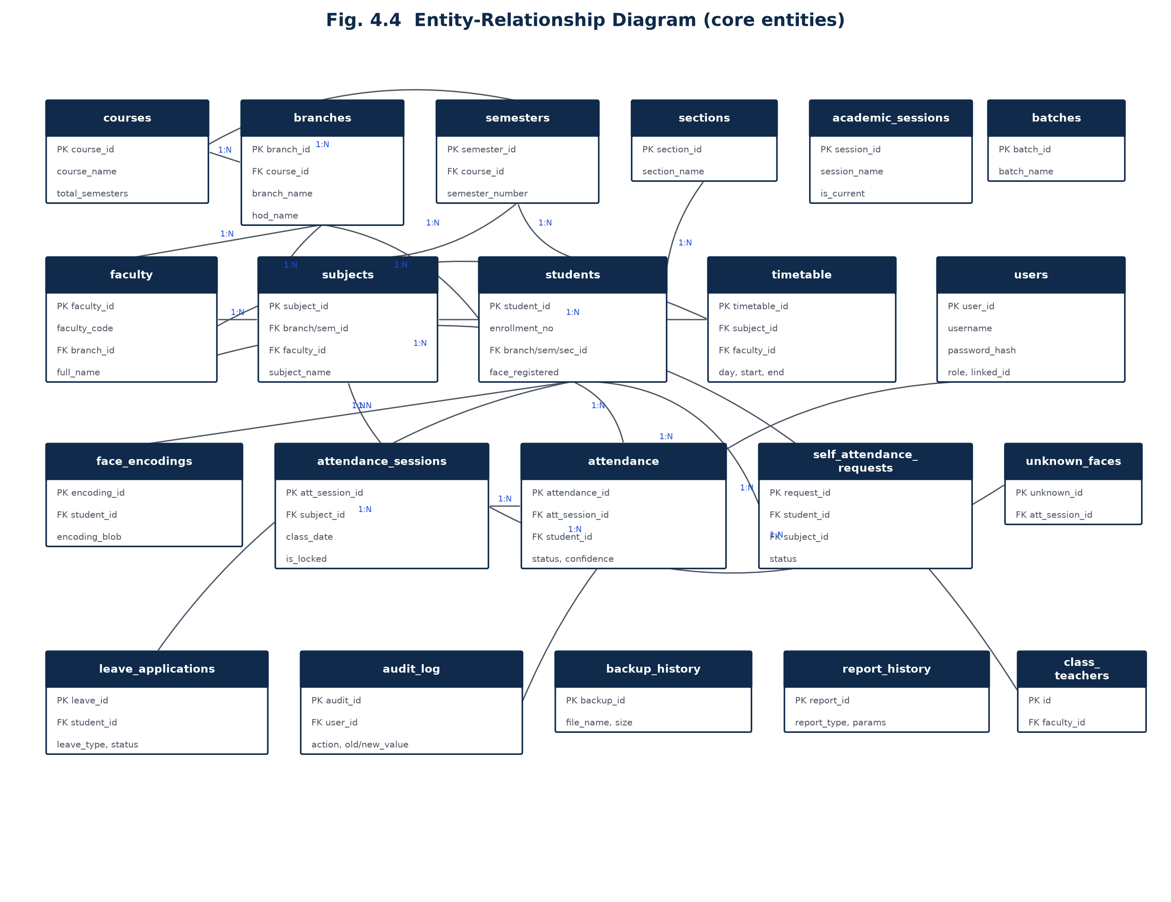
SYSTEM DESIGN
24 tables · 4 views · 27 indexes
8

Slide 9
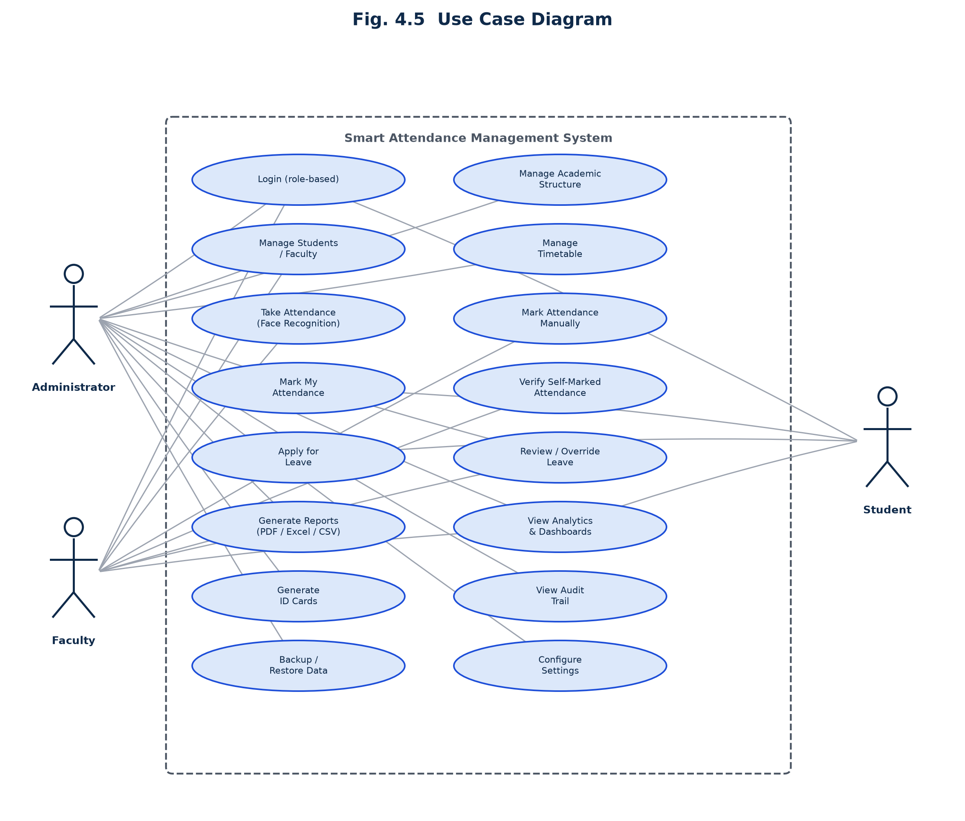
SYSTEM DESIGN
Sixteen use cases across three roles
9

Slide 10
TECHNOLOGY STACK
Built entirely on free, open-source tooling
UI
Interface
FR
Face Recognition
CustomTkinter, tkcalendar
OpenCV LBPH · dlib / face_recognition (optional)
DA
Data & Imaging
RP
Reporting
NumPy, pandas, Pillow
ReportLab (PDF), OpenPyXL (Excel), Matplotlib (charts)
DB
Storage
SEC
Security
SQLite — WAL mode, native backup API
bcrypt (cost factor 12)
10

Slide 11
IMPLEMENTATION
The face recognition pipeline, end to end
1
→
2
→
3
→
4
→
5
Capture
Train
Detect
Recognise
Mark
60 images/student on a worker thread; blurred frames rejected by a sharpness gate
dlib: mean 128-d embedding per student · LBPH: one shared model, retrained per new student
Live frame → Haar cascade (LBPH) or HOG (dlib) locates faces
Distance → confidence normalised to 0-100%, higher is better on both backends
Confidence ≥ threshold → UPDATE the pre-seeded Absent row to Present / Late
Dual-backend design: dlib/face_recognition (128-d embeddings, highest accuracy) is used automatically when installed; the system falls back transparently to OpenCV LBPH — no C++ compiler needed — on any ordinary college PC.
11

Slide 12
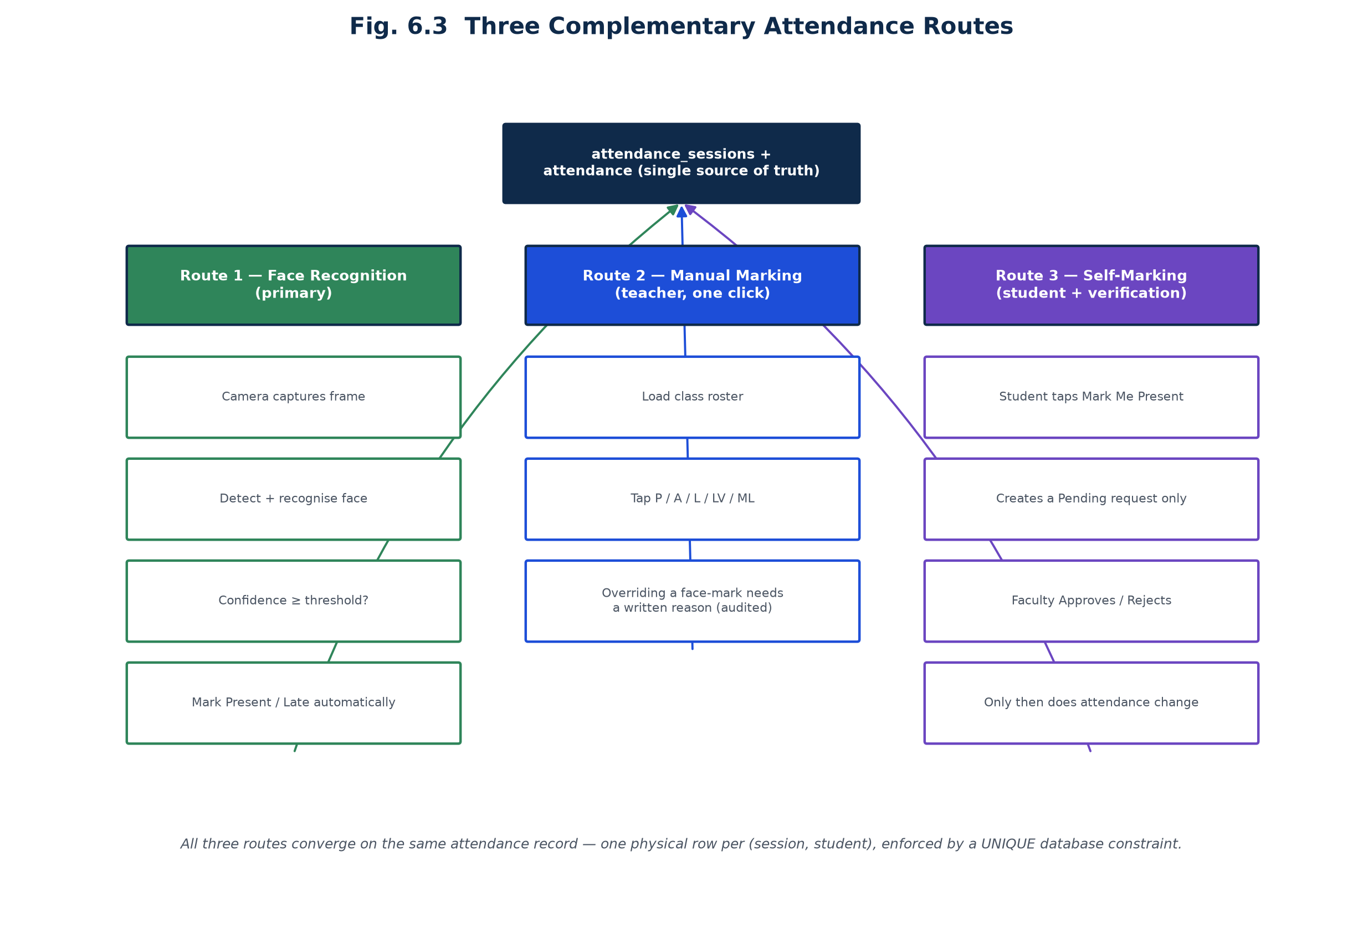
IMPLEMENTATION
One record, three ways to reach it
12

Slide 13
SECURITY
Defence in depth: hashing, RBAC, scope, audit
Permission
Admin
Faculty
Student
Take attendance (face recognition)
✓
✓
—
Unlock a locked attendance session
✓
—
—
Override a leave decision
✓
—
—
Verify self-attendance requests
✓
✓
—
Mark own attendance (self-request)
—
—
✓
Below the navigation layer: core.scope restricts every query to a faculty member's own subjects/classes and a student's own records — enforced in the data layer, not just hidden in the UI.
Every sensitive action is audited: attendance edits, leave overrides, lock/unlock, backup/restore — with before/after values and a mandatory reason where applicable.
13

Slide 14
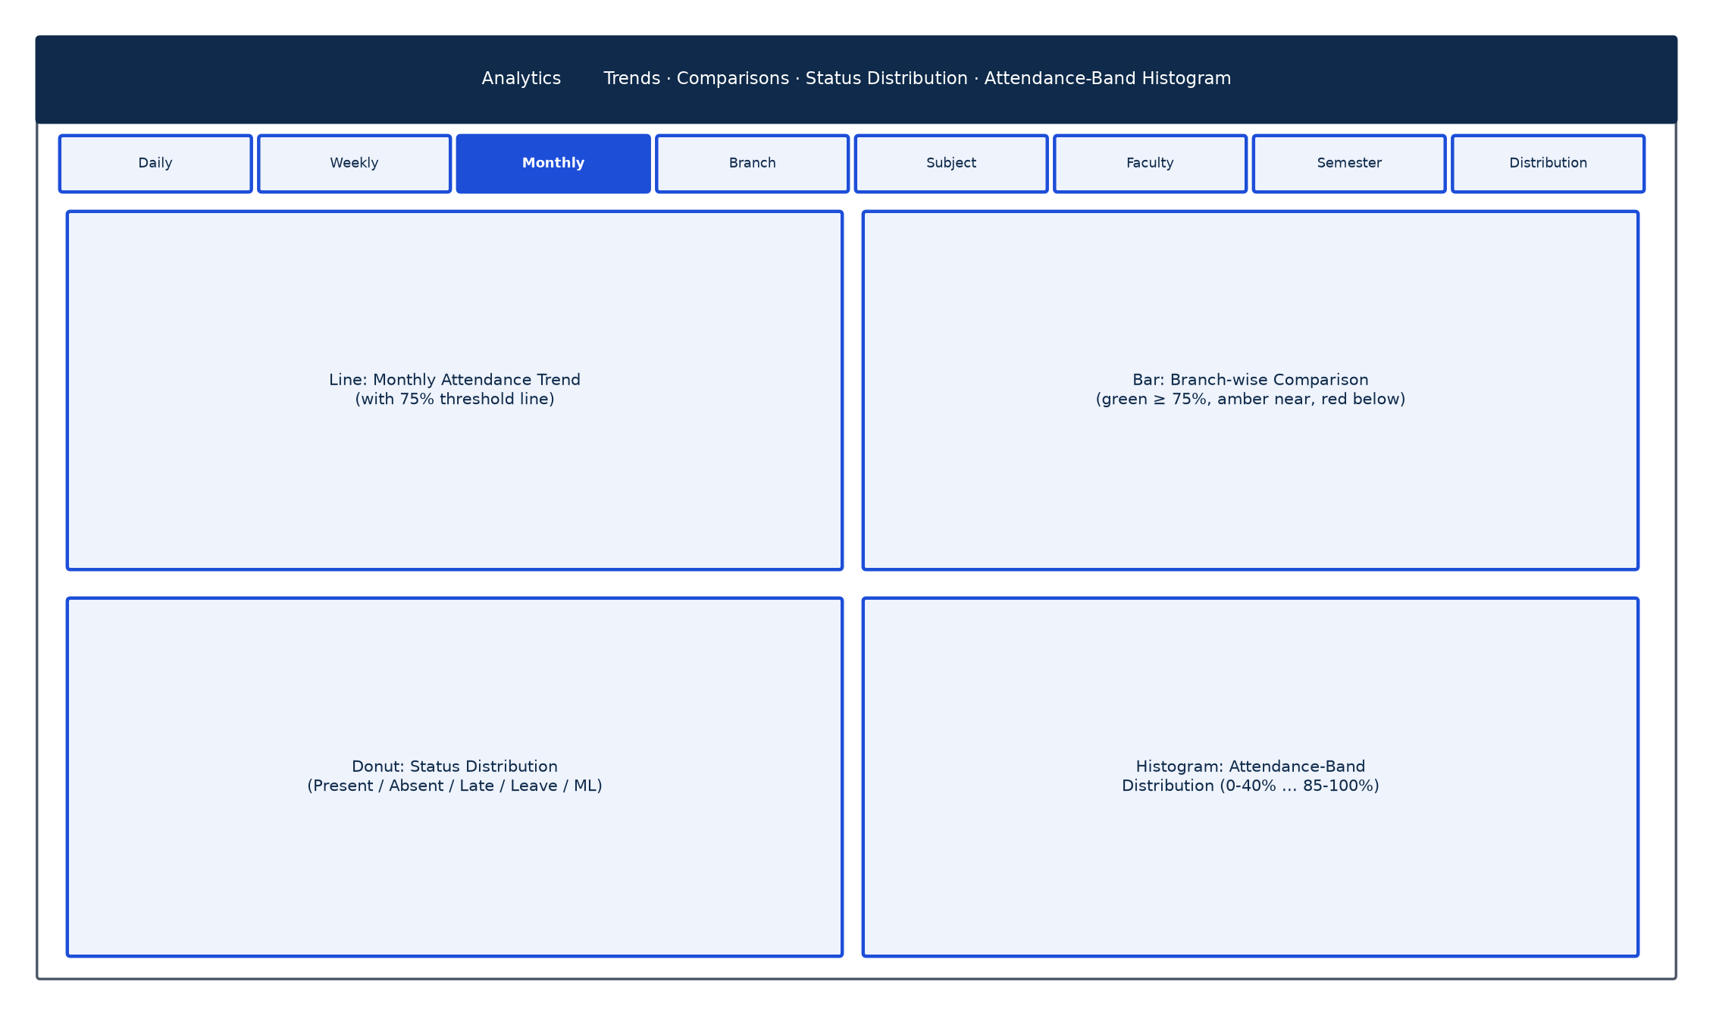
REPORTS & ANALYTICS
Eleven report types, four chart families
Every export in PDF, Excel or CSV — with
college letterhead, applied filters, and the generating user's name.
Daily / Weekly / Monthly / Semester Attendance
Student / Subject / Branch / Faculty Attendance
Defaulter List (below eligibility threshold)
Leave Report · Medical Leave Report
Printable Attendance Sheet (signature register)
14

Slide 15
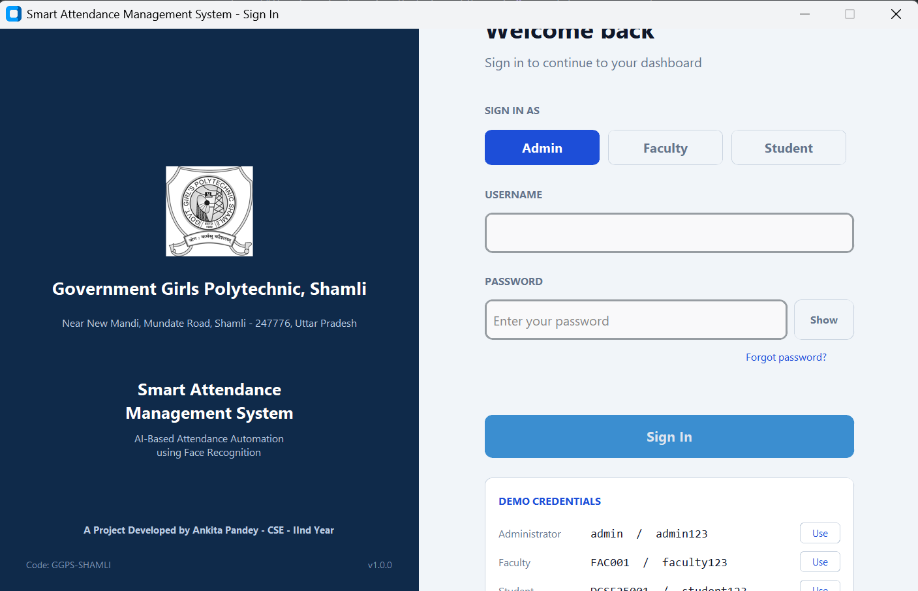
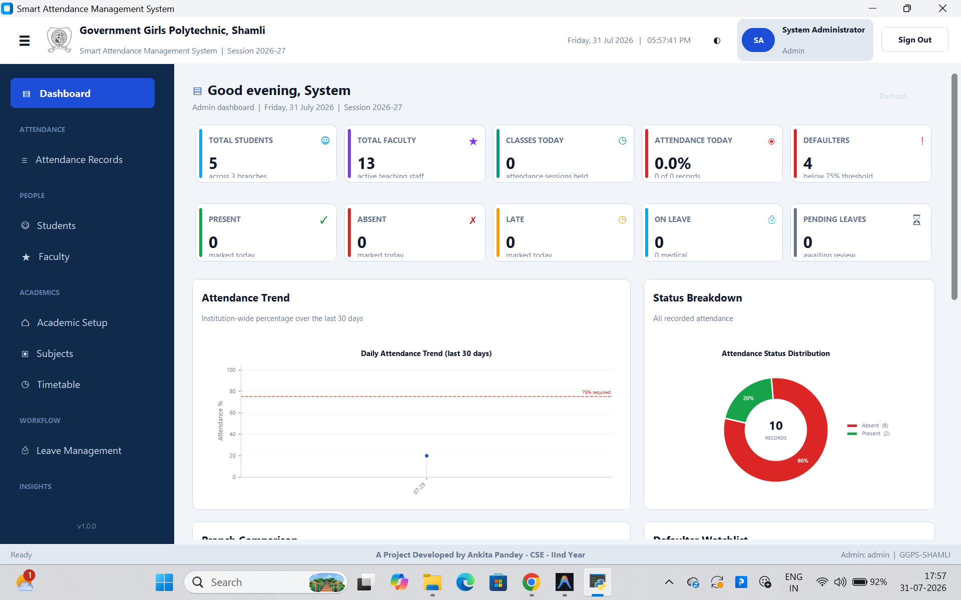
INTERFACE WALKTHROUGH — LIVE SCREENS
Sign-in and the Administrator dashboard
Role selection is a real access control — the wrong role for a valid account is rejected.
15

Slide 16
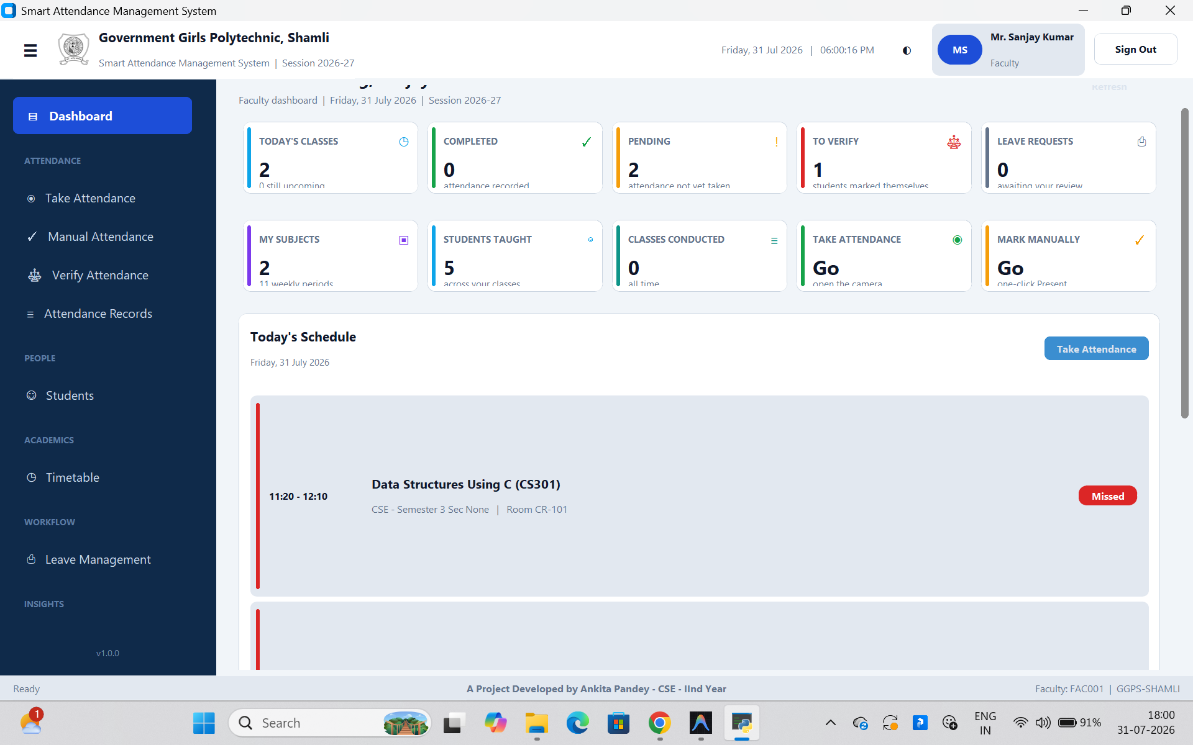
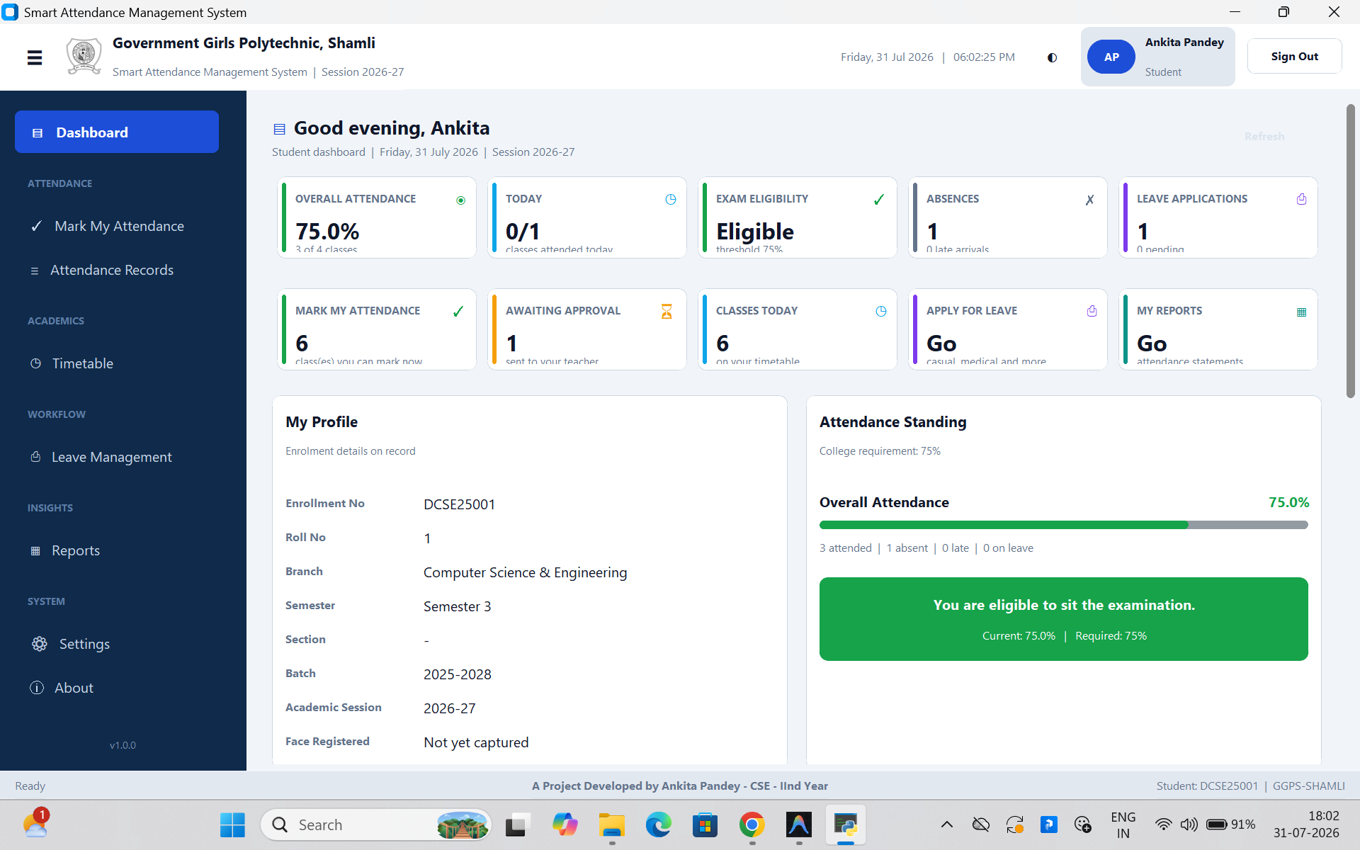
INTERFACE WALKTHROUGH — LIVE SCREENS
Every role sees what matters to them
Faculty: today's classes and pending approvals. Student: attendance % against the 75% threshold.
16

Slide 17
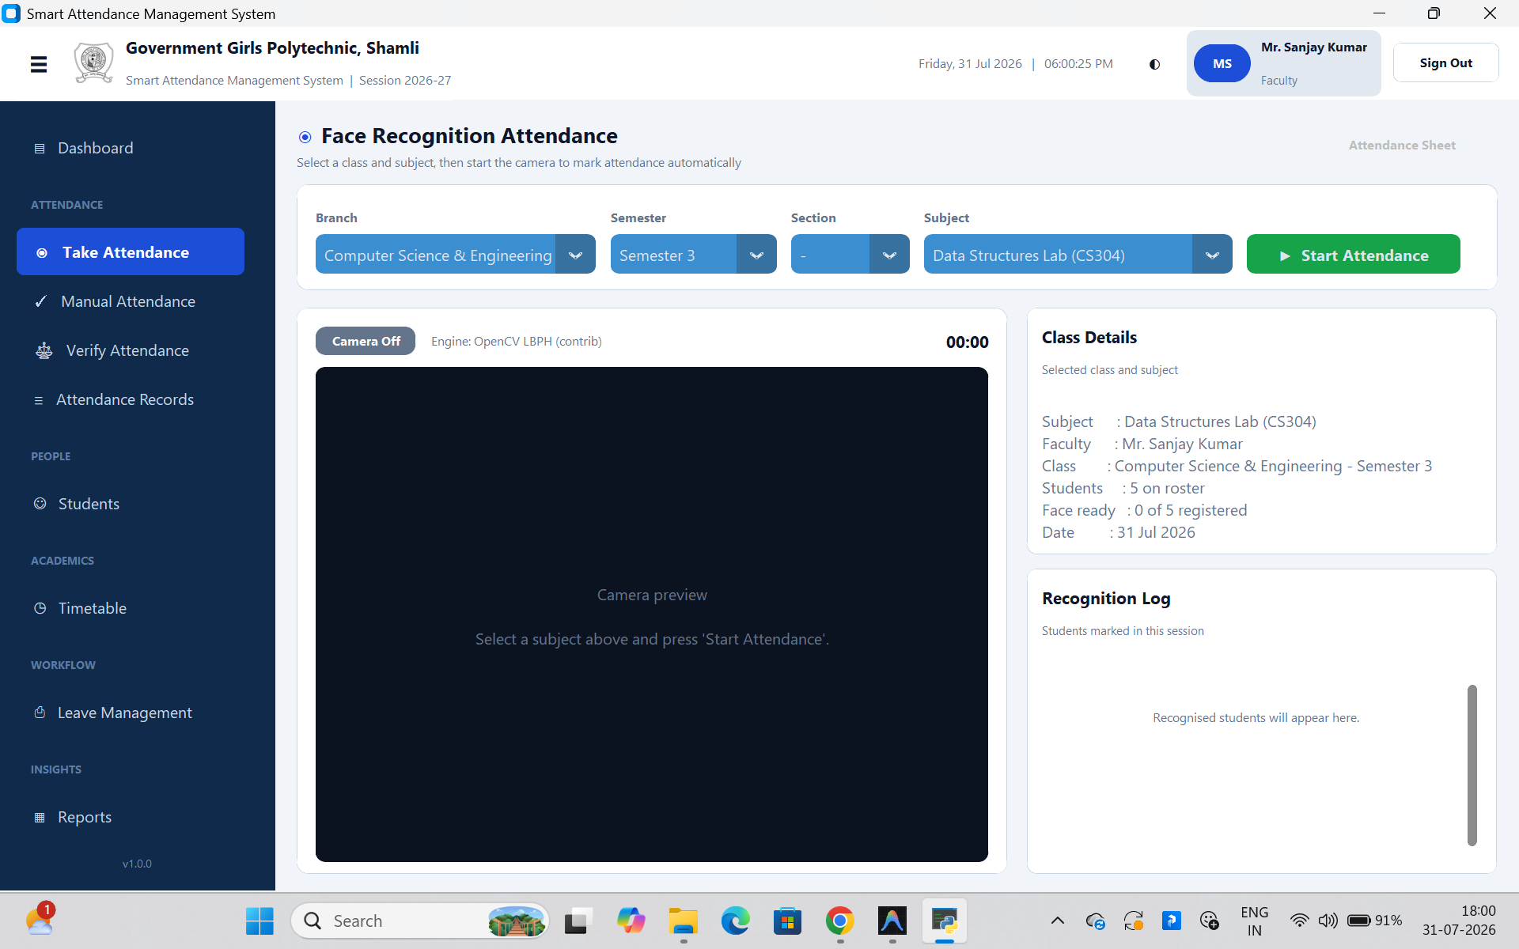
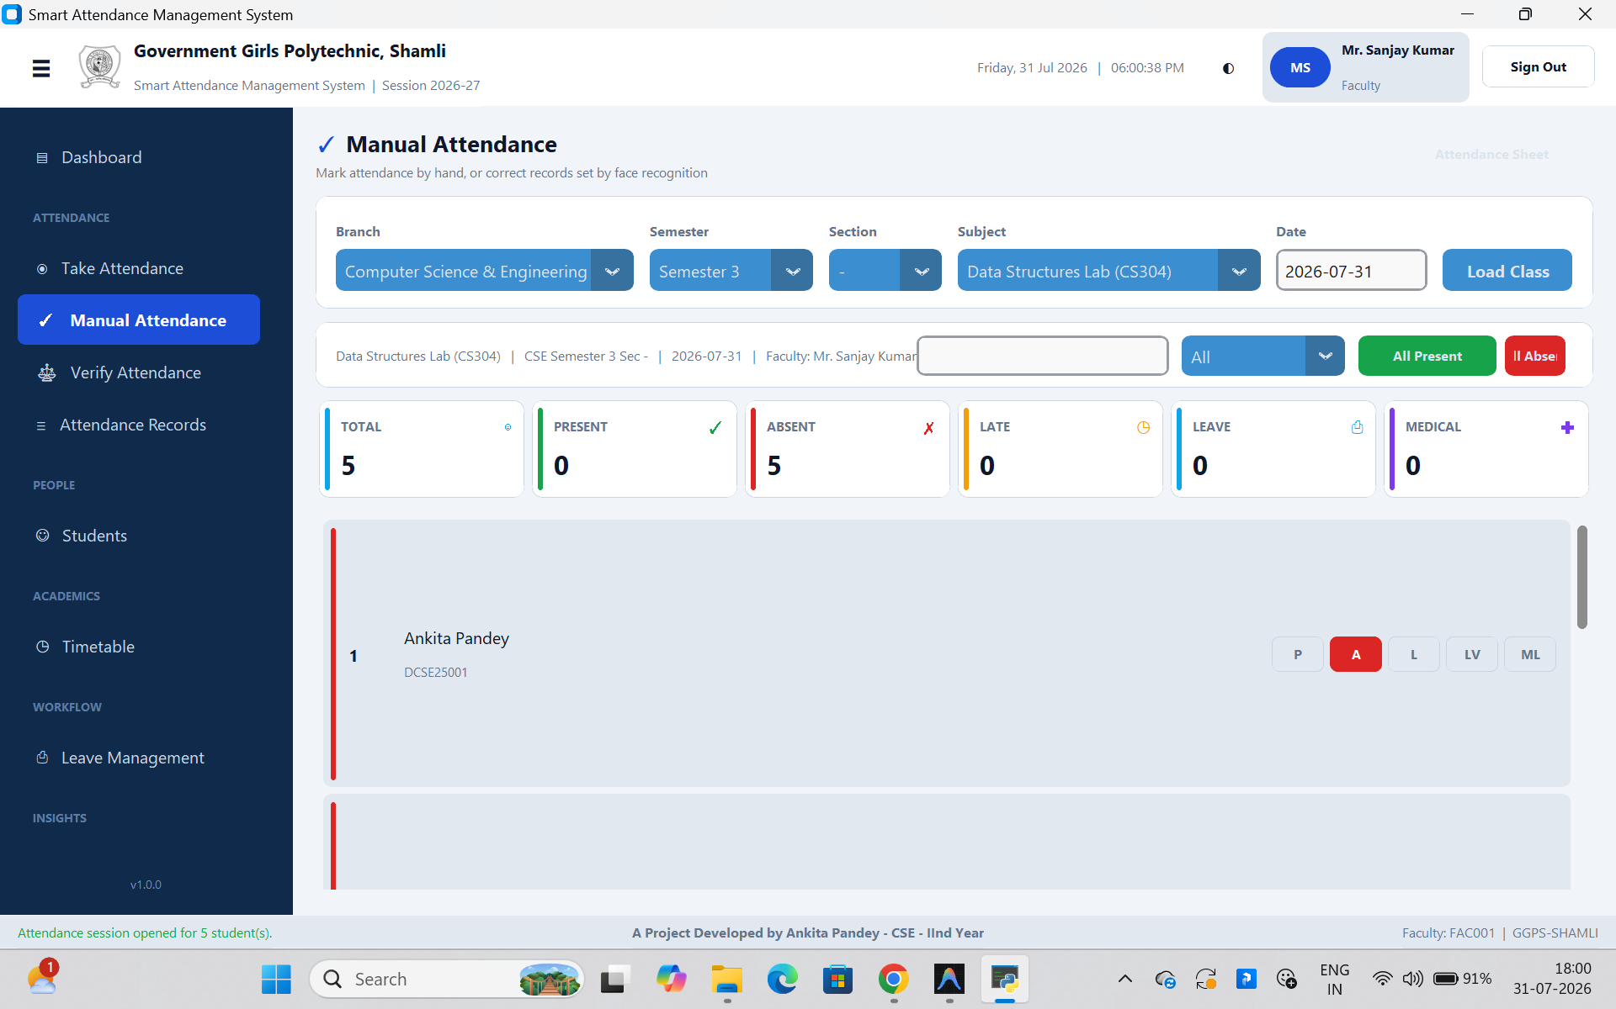
INTERFACE WALKTHROUGH — LIVE SCREENS
Marking attendance: automatic and manual
Live camera recognition (left) and one-click manual marking with a full P/A/L/LV/ML roster (right).
17

Slide 18
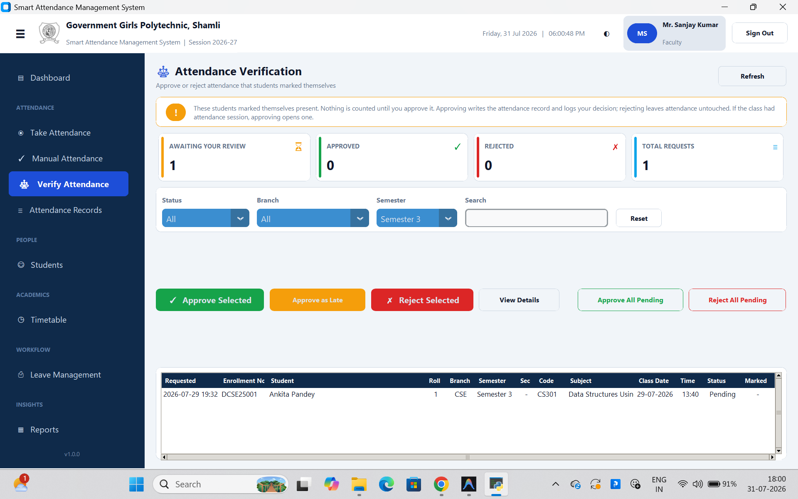
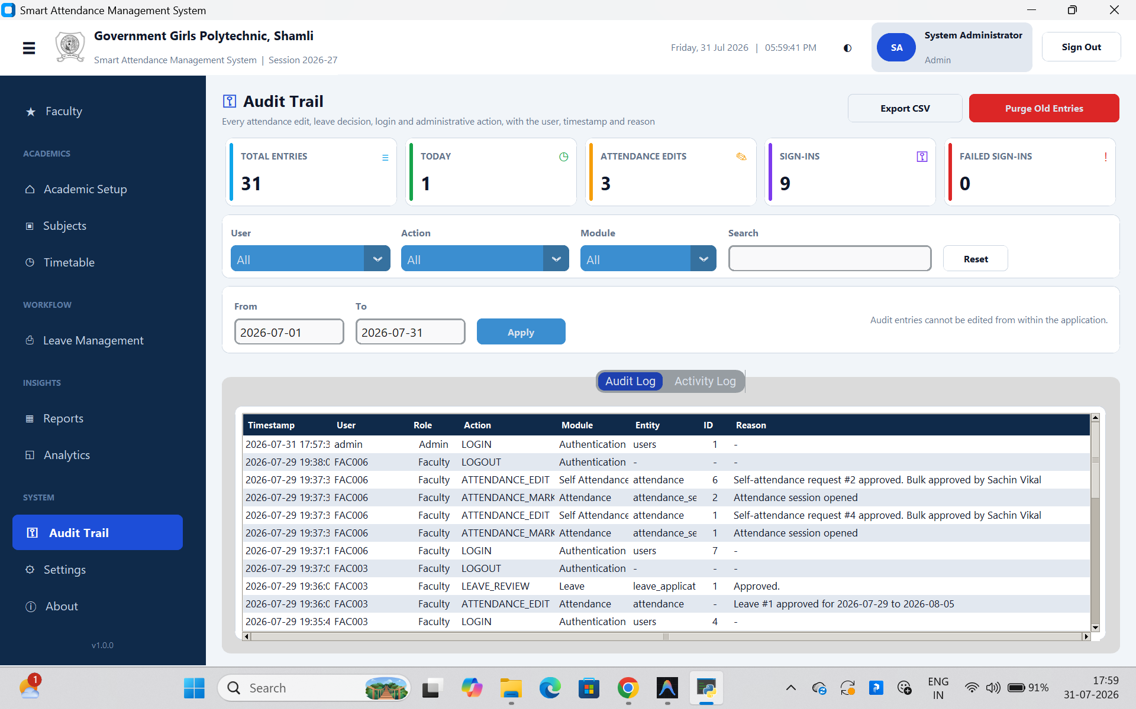
INTERFACE WALKTHROUGH — LIVE SCREENS
Self-marking only counts once approved — and it's all audited
Ankita Pandey's self-marked request awaiting approval (left); the same action logged permanently (right).
18

Slide 19
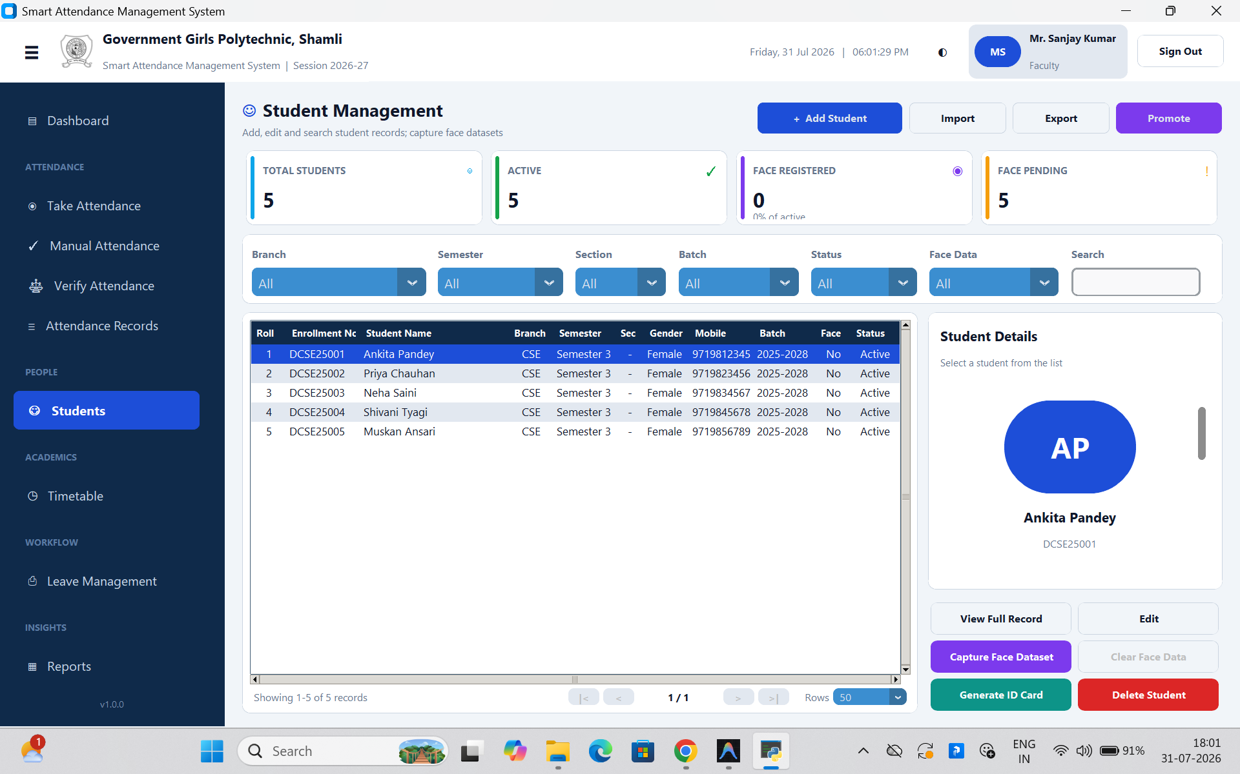
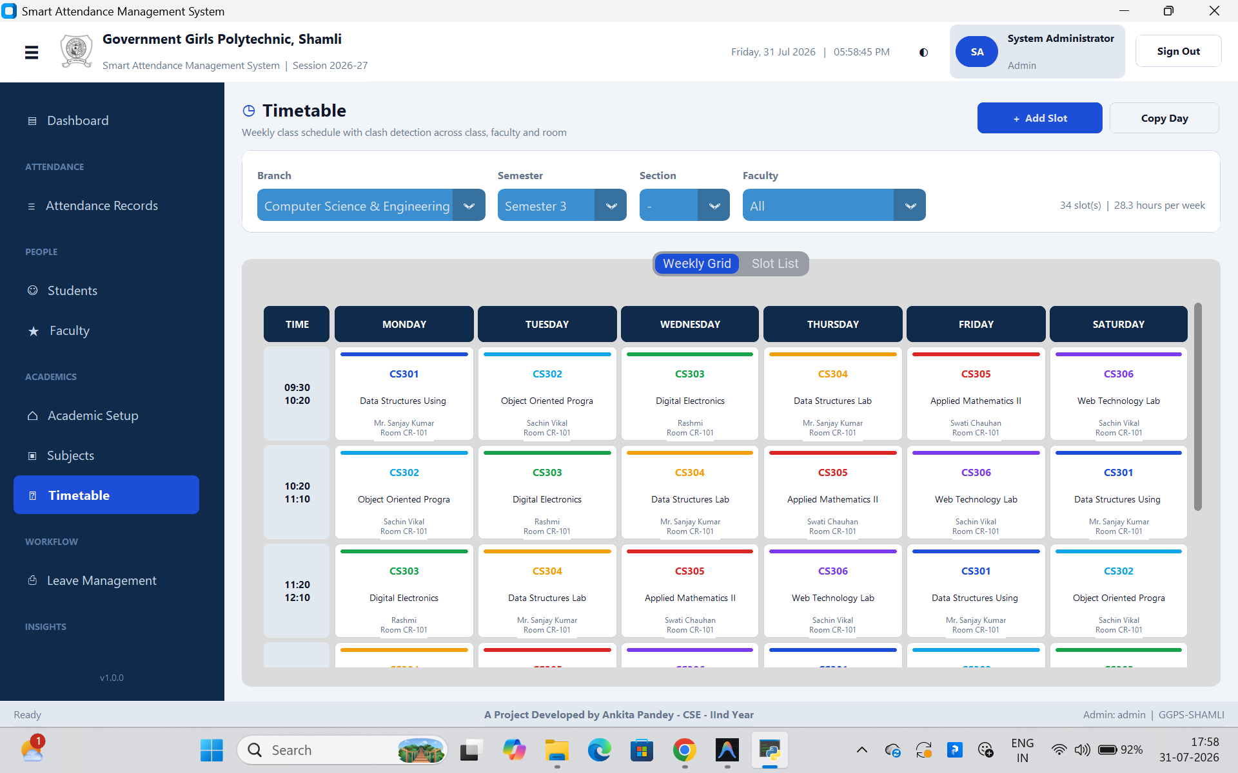
INTERFACE WALKTHROUGH — LIVE SCREENS
Managing students and the weekly timetable
5 seeded CSE students (left) and the real 34-slot, 28.3 hour/week CSE Semester 3 schedule (right).
19

Slide 20
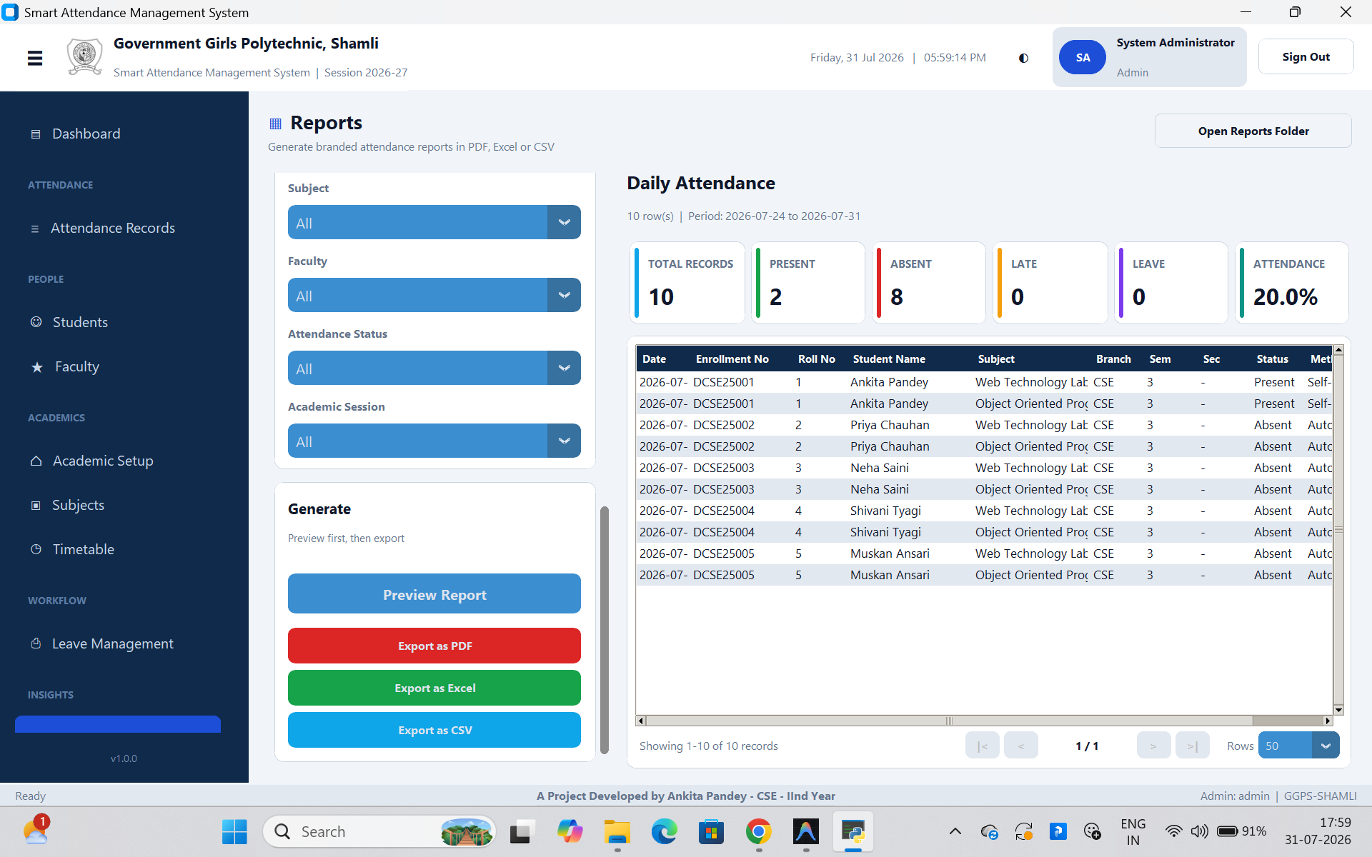
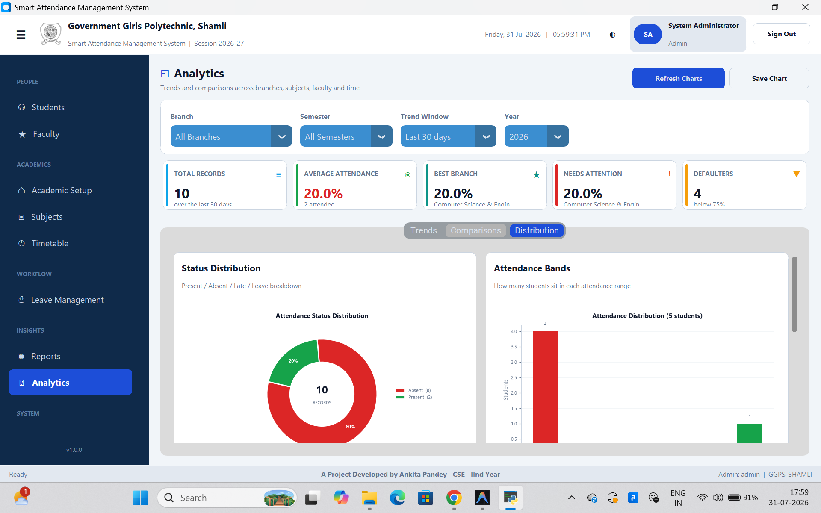
INTERFACE WALKTHROUGH — LIVE SCREENS
Reports and analytics, generated live
The same 10-record window: a Daily Attendance report (left) and its Distribution chart (right).
20

Slide 21
TESTING
16 functional test cases, 3 automated suites — all passing
16 / 16
3 / 3
0
representative test cases passed
automated smoke-test files passed (schema, imports, validators)
known open defects in the tested build
Representative cases
Wrong role selected for a valid password → login rejected
Five failed logins in a row → account locked for the configured period
Face confidence below the minimum threshold → student not marked, logged as unknown
Manual override of a face-marked Present → blocked until a reason is given
Two timetable slots clash for one faculty member → save rejected before commit
Medical leave beyond 3 days without a certificate → submission blocked
21

Slide 22
RESULTS
Every stated objective, achieved
Objective
Achieved as
Face recognition on ordinary hardware
Dual-backend recognizer, auto-selected at start-up
Proxy attendance structurally difficult
Live camera + DB uniqueness constraint on (session, student)
Manual correction that never fights automation
One-click marking; overriding a face-mark requires an audited reason
Self-marking never counts on its own
Pending request until a faculty approval mutates the record
Institution-grade reporting
11 report types + signature sheet, PDF / Excel / CSV
22

Slide 23
HONEST ASSESSMENT
Limitations
Test coverage above the validator layer is manual, not an automated UI harness
No liveness detection yet — a good printed photo could, in principle, fool the camera
!
!
Single-institution, offline by design — no multi-campus sync today
dlib backend needs a C++ toolchain most classroom PCs won't have on Python 3.13+
!
!
23

Slide 24
WHAT'S NEXT
Future scope
M
C
L
Mobile companion app for students to view attendance and apply for leave
Optional cloud sync across branch campuses, alongside the offline mode
Liveness detection / anti-spoofing to close the printed-photo gap
N
T
Q
SMS / email alerts when attendance crosses below the eligibility threshold
Automatic, timetable-driven session opening
An automated UI-level test harness
24

Slide 25
CONCLUSION
A system that succeeds by giving each manual step a narrower, auditable role — not by removing them.
23,000 lines of code · 56 modules · 24-table schema · dual-backend face recognition · role-based security with a tamper-evident audit trail — built to the standard a real institution, not just a classroom assignment, would require.
Government Girls Polytechnic, Shamli · Ankita Pandey · Guide: Mr. Vivek Kumar
25

Slide 26
Thank You
Questions & Discussion
26

