Slide 1

-A few clicks is all it takes
Team Members :
Bhavya, Indrani,
Kavitha, Monika,
Parimala, Ritika
Ritu, Rituja
Teja Pravallika , Vijaya lakshmi
Mentor:
Snehal Pagare

Slide 2
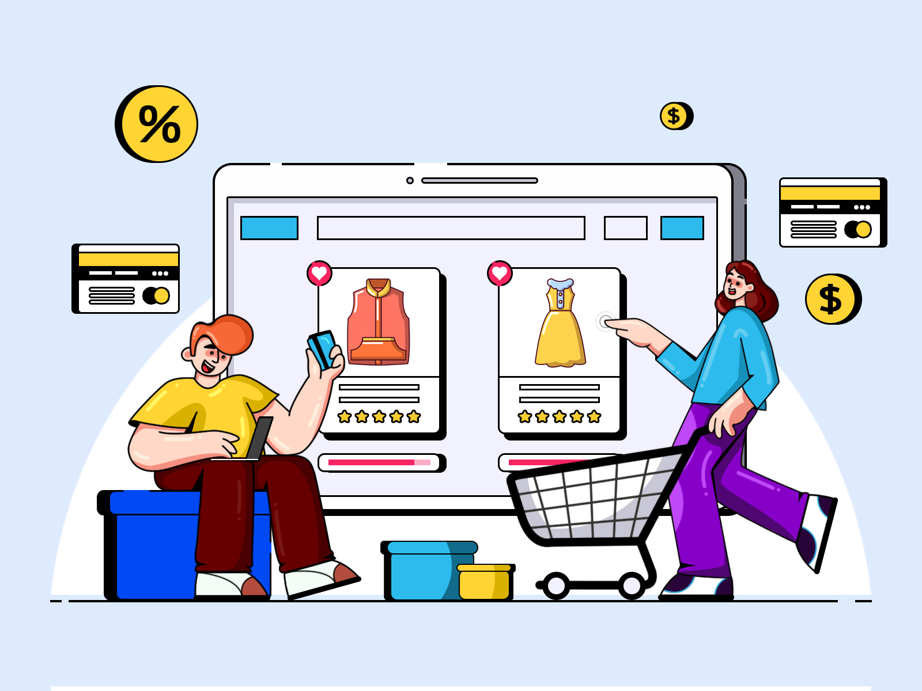
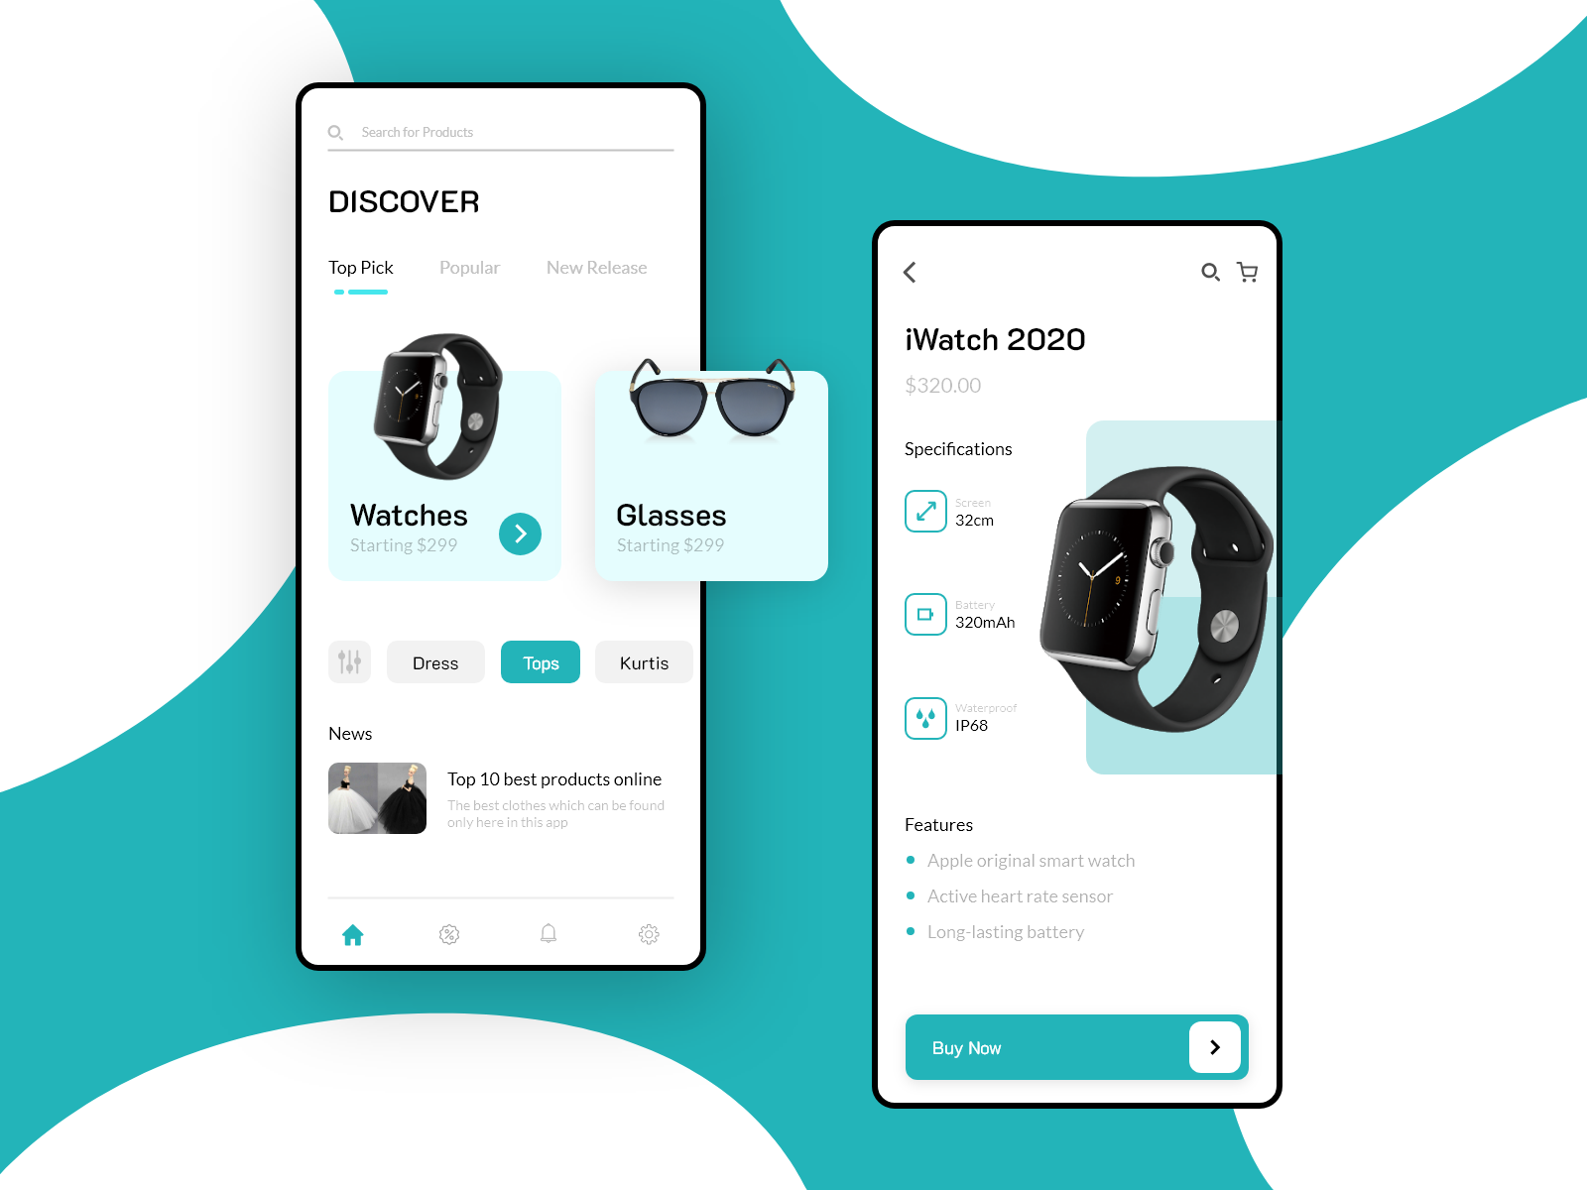
Shopify is an Online shopping cart system which involves buying or selling of products on online services or over the Internet.
About

Slide 3



Issues faced during manual shopping
Less user-friendly.
Exhausting and time-consuming.
Limited variety of products.
Not in reach of distant users.
Limited offers and discounts.
Insufficient product description.

Slide 4





Solution to the above problems
Shopify allows users to buy products at anytime.
Users can easily search for products specific to their needs.
It offers large variety of products.
There is no geographical limitations.
Delivery at doorstep.
Shopify provides frequent offers and discount.

Slide 5
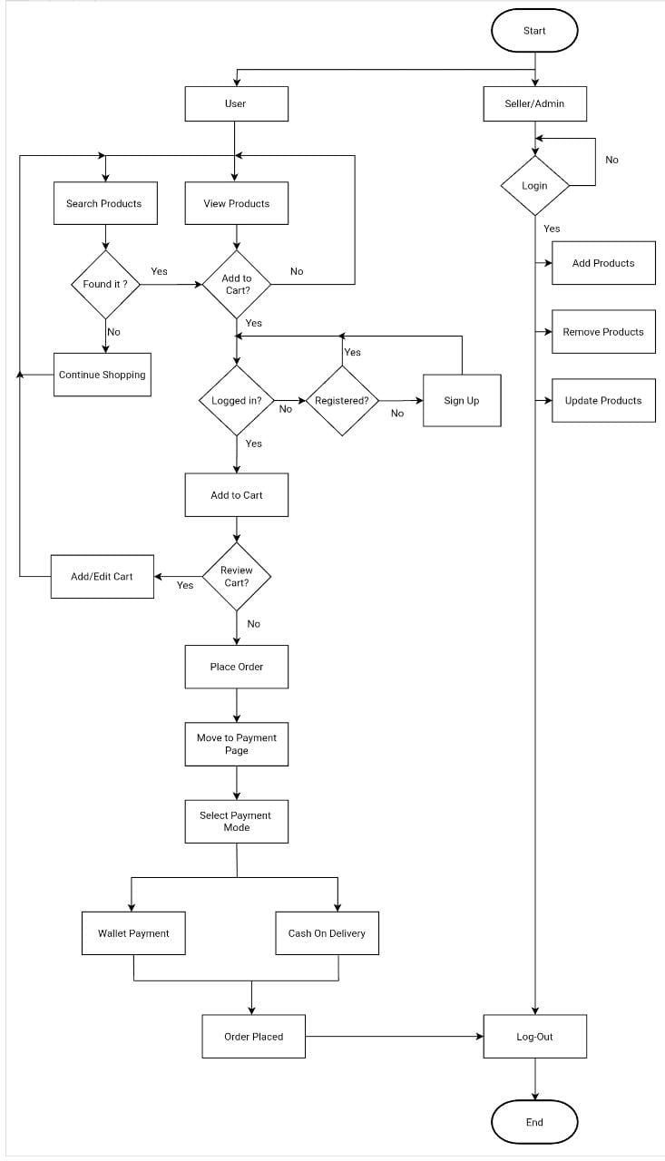
Workflow of our website

Slide 6
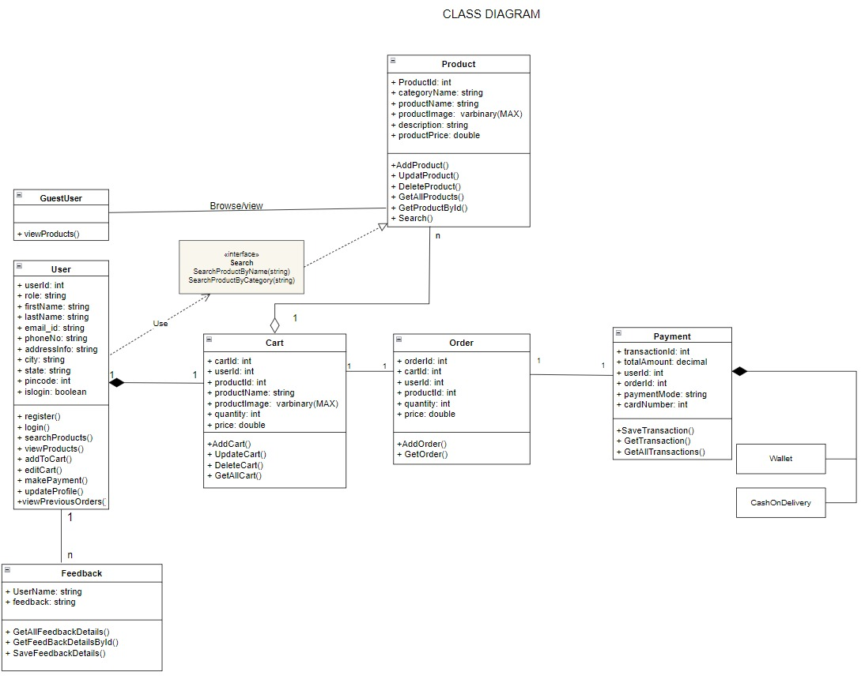
UML Diagrams
Class diagram

Slide 7
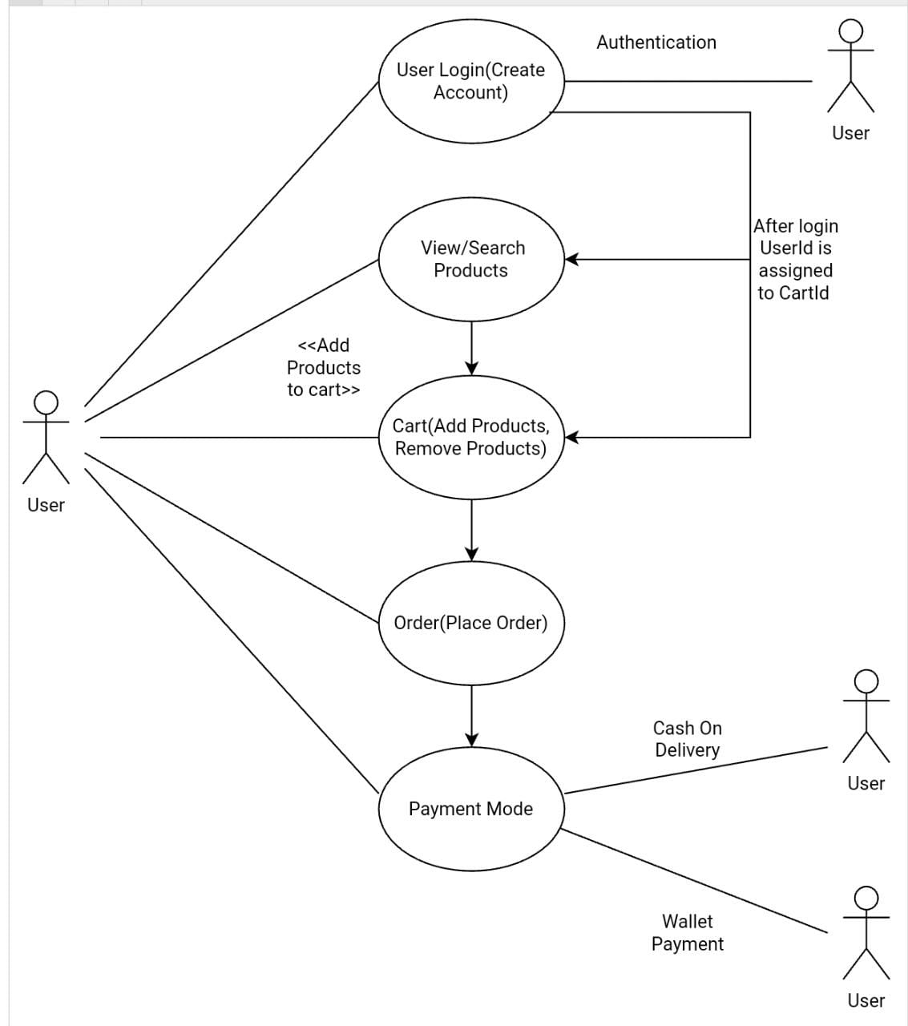
Use case diagram for user

Slide 8
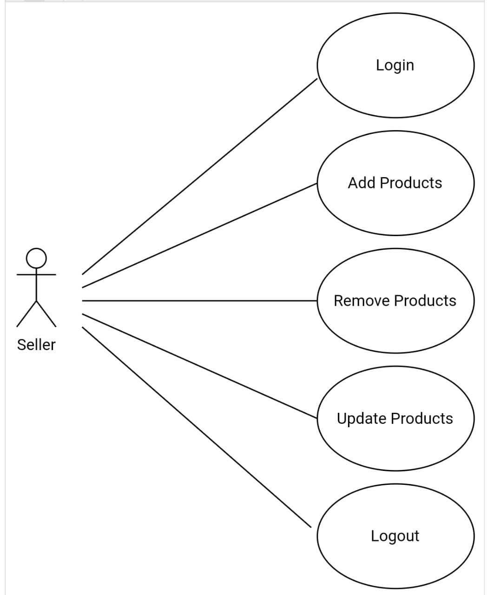
Use case diagram for seller

Slide 9
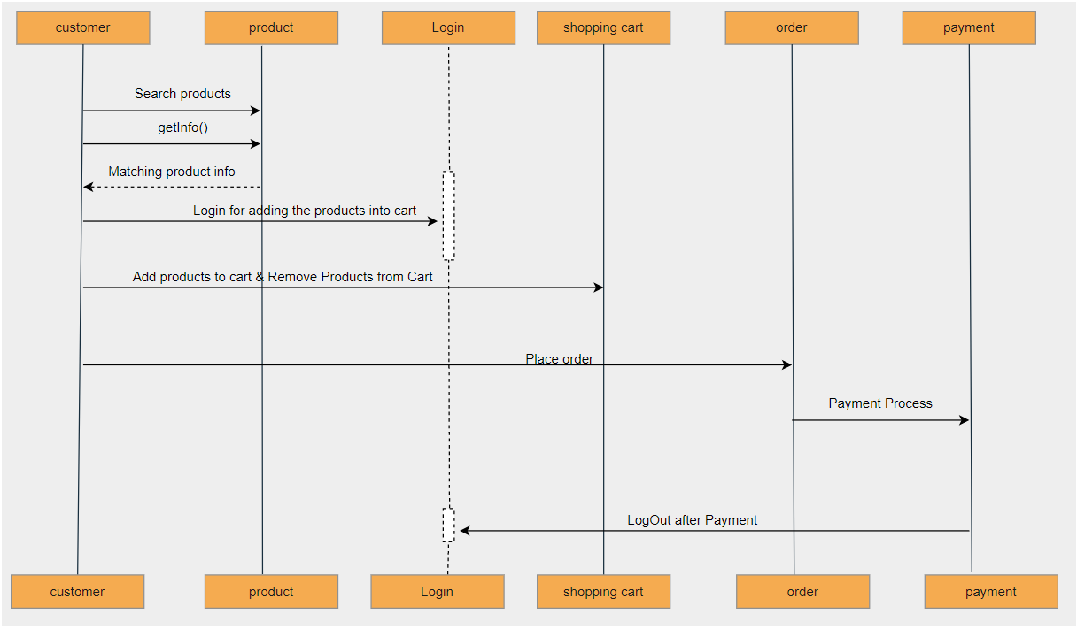
Sequence diagram for user

Slide 10
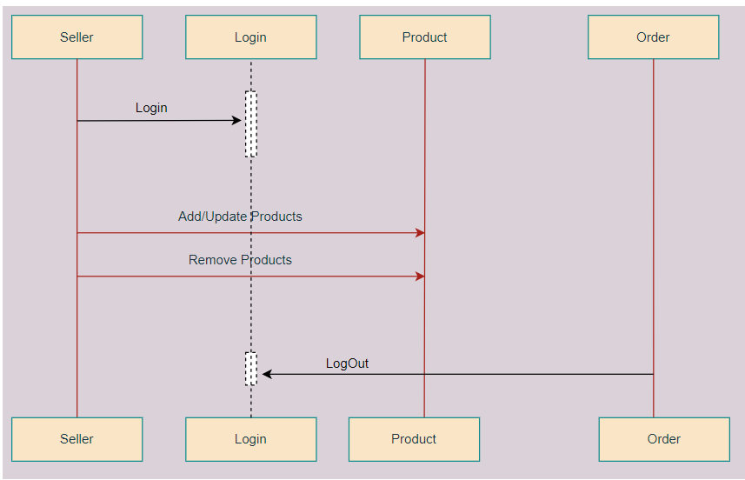
Sequence diagram for seller/admin

Slide 11
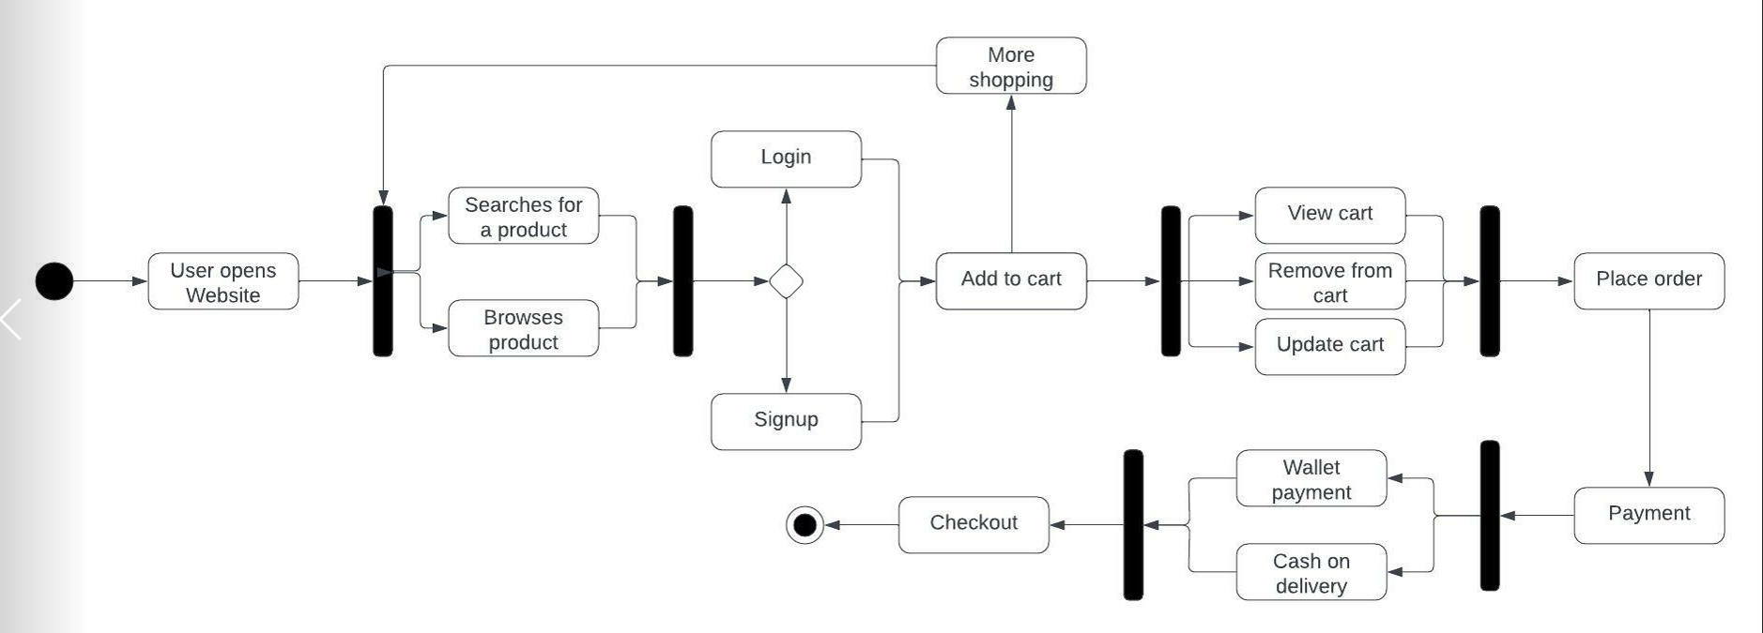
Activity diagram for user

Slide 12
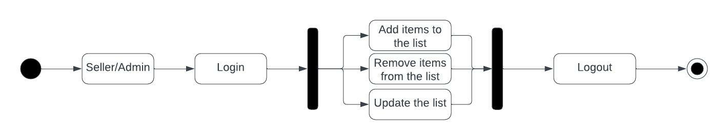
Activity diagram for user

Slide 13

THANK YOU!

