Slide 1

HOTEL MANAGER
Easier way to control your hotel

Slide 2

Why is our application useful?

Slide 3

Our application is useful to the owner of the hotel or the manager.

Slide 4

How our program works?

Slide 5

Imagine you are owner\manager of a big hotel and your work is to employ the new employees in the hotel. It will be easier to have a program who knows all the people you entered in, right?

Slide 6

So our project is to facilitate the Hotel Owner or the manager to enter the new employee’s names and to analyses the main information about them

Slide 7
Our functions

Slide 8
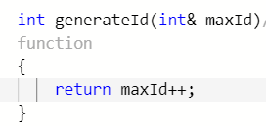
Function for generating ID which we need for the delete function

Slide 9
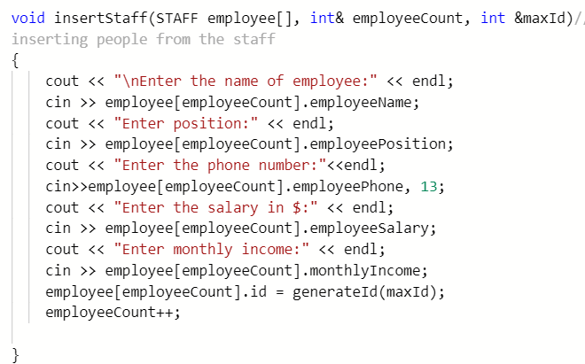
function about inserting people from the staff

Slide 10
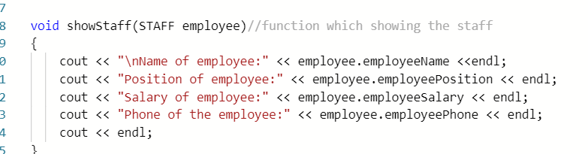
This function is to show the Staff on the screen

Slide 11
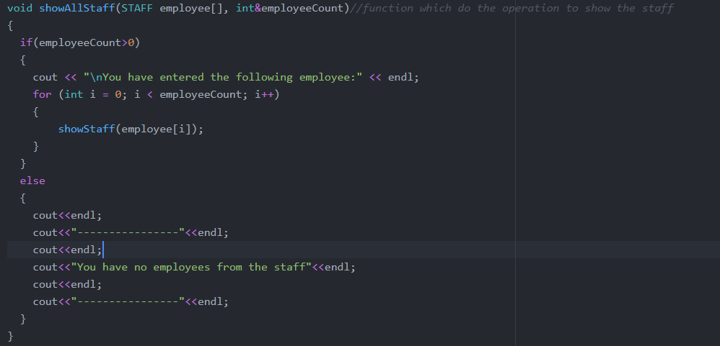
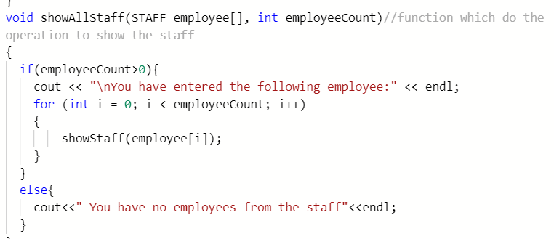

In this function there is an "if statement" where we check if employeeCount>0 and there is a 'for cycle' where we call the "showStaff" function.

Slide 12

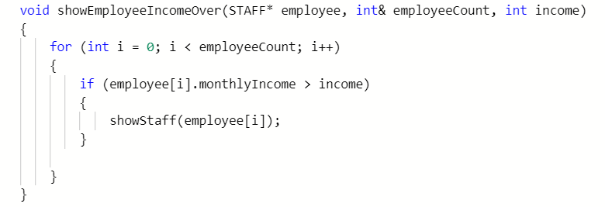
In this function there is operation 'for' to see which employees are with monthly income, also in this 'for cycle' there is 'if statement' which check the monthlyIncome if it is over than our entered income from the user.

Slide 13
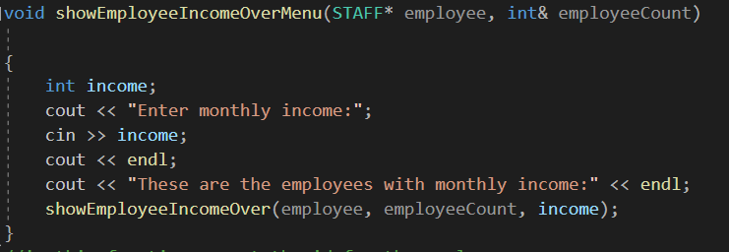
This is the menu of the function with the operation for the monthly income. This function is for the menu which is showing if monthly income is entered. There we call 'showEmployeeIncomeOver' function

Slide 14
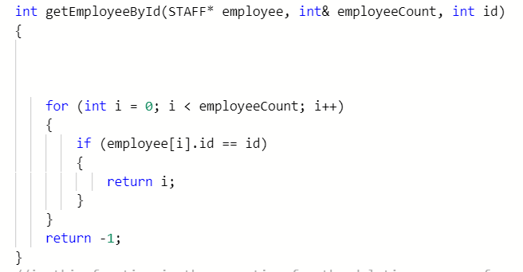
This is function about getting ID from your employees.The ID is the employee number from your staff.
'return I'- to get employee's ID
'return –1' - if the id entered is not found

Slide 15
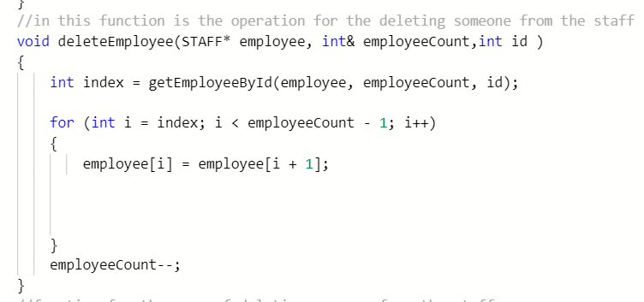
This function is to do the operation 'delete employee'. There we have a cycle 'for'.

Slide 16
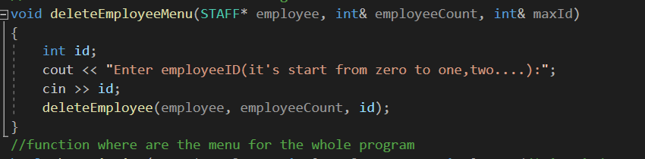
This is function about the menu for the deleting employees from the staff, so here we just entered the id of the employee and then we call the function deleteEmployee.

Slide 17
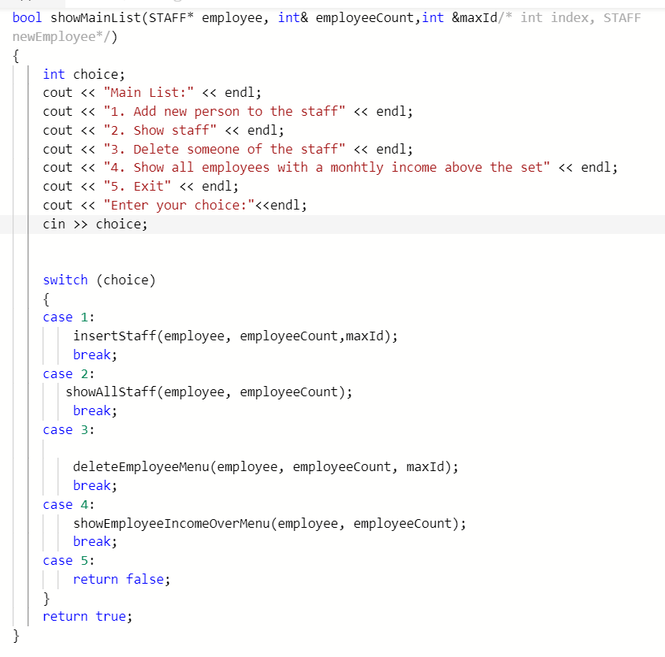
This function show our menu and in this function there is switch case which is to work when I press a number from the keyboard and then the case is call the function we are need to call

Slide 18
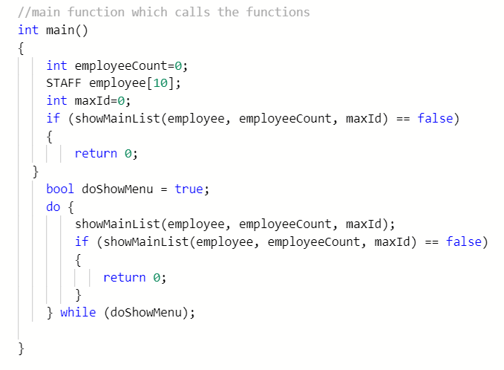
This is the main function where we do all the operations and stuff and intialized the variables.

